Slide 1
Ch. 10: America’s Economic Revolution
Focus Questions:
Identify some of the major cities that developed in the United States during the market revolution.
Identify some of the new immigrants who came to the United States and their characteristics.
Explain the push/pull factors of this new immigration.
Describe nativism and its impact on immigration.
Discuss major changes in transportation and communication during the era.
Explain changes in industry and business (i.e. inventors and inventions as well as the government’s role in business growth).
Identify the role of class, family and women during the era.
Explain the characteristics of Northern and western agriculture.
Notes:
1
The purpose of the focus questions is to help students find larger themes and structures to bring the historical evidence, events, and examples together for a connected thematic purpose.
As we go through each portion of this lecture, you may want to keep in mind how the information relates to this larger thematic question. Here are some suggestions: write the focus question in the left or right margin on your notes and as we go through, either mark areas of your notes for you to come back to later and think about the connection OR as you review your notes later (to fill in anything else you remember from the lecture or your thoughts during the lecture or additional information from the readings), write small phrases from the lecture and readings that connect that information to each focus question AND/OR are examples that work together to answer the focus question.

Slide 2
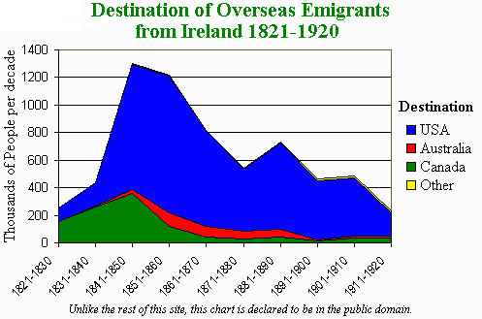
The Changing American Population
The American Population, 1820-1840
*1820: 10m – 1840: 17m
*increasing rapidly
-faster rate than Europe
-mainly from better public health
-higher birth rate
-large amounts of immigrants
*migrating towards cities in Northeast
*migrating to the Northwest

Slide 3
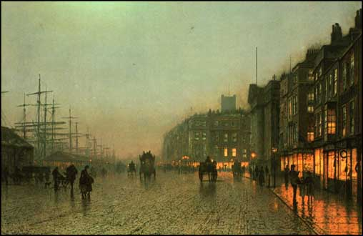
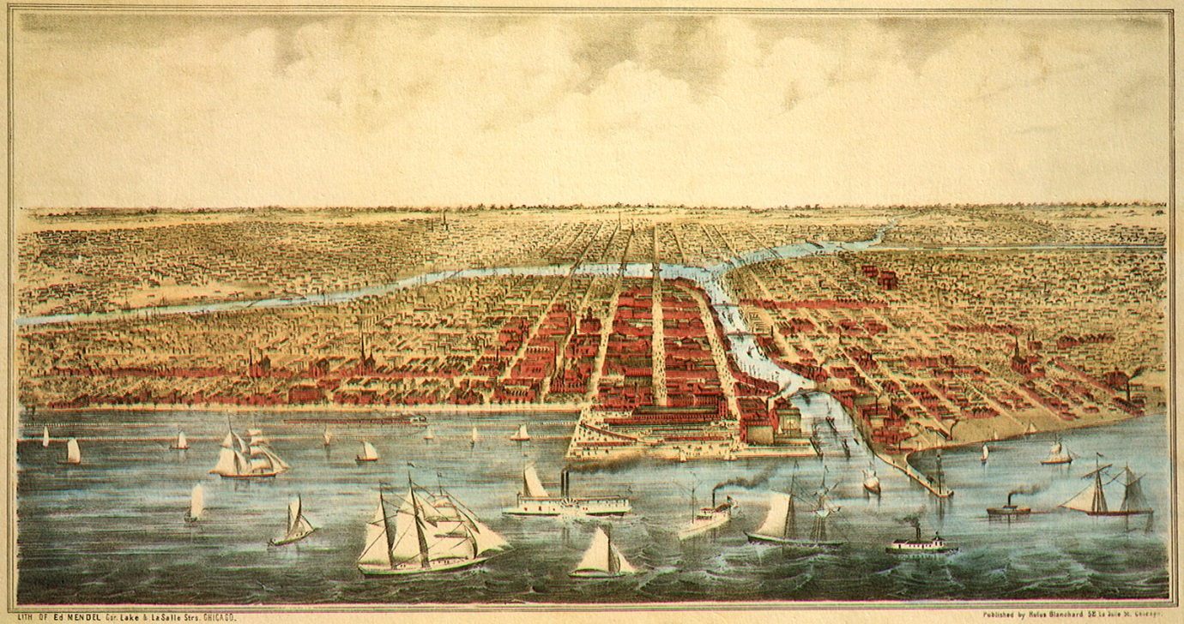
Immigration and Urban Growth
Cities by 1860
*New York, 1.2m
*Philadelphia, 565,000
*Boston, 177,000
*River cities: St. Louis, Pittsburg, Cincinnati, New Orleans
*Great Lakes cities: Buffalo, Detroit, Milwaukee, Cleveland and CHICAGO
*most of population in cities were made up of immigrants
Immigration
*1.5m from 1820-1840
*mostly settled in cities
*only 500,000 in south by 1860
*most came from Europe
-England, France, Italy, Scandinavia, Poland, Holland

Slide 4
Immigration
●Push/Pull factors
Notes:
4
Immigration
*the period after the War of 1812 witness a growth in America never before seen
*most of this was due to immigration restrictions being lifted after the war
*there were also a number of other reasons for immigration into the US
Push and pull factors of immigration
Pull factors
*cheap and abundant land
*an abundance of job opportunities
*a chance to make a better life
Push factors
*usually push factors included economic depression and or famine
*wars (usually unification wars: Germany, Italy)
*negative social movements such as the rise of Marxism (early form of communism) or socialism itself
*religious persecution
Major ethnic groups
*one of the largest groups to head to the United States throughout US history
*Irish (1.6 million) before the turn of the century
*Germans (1.2 million)
*British (600,000)

Slide 5
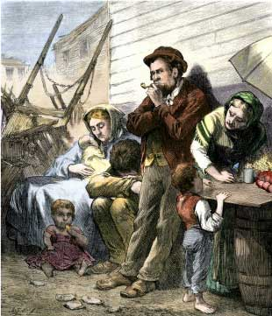
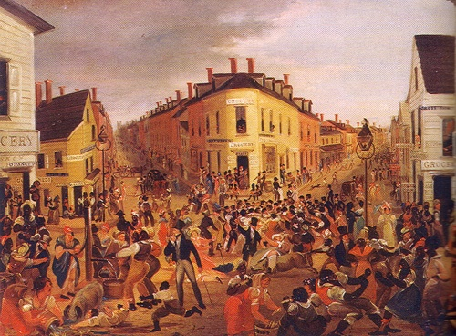
The Irish
Irish
*45% of immigrants were Irish
*tended to be poor and uneducated
*tended to live in eastern cities
*unskilled laborers or domestic workers
*mostly single male or female
*clannish
*Catholic
Push factors
*economic problems
*English oppression
*widespread poverty
*potato famine

Slide 6
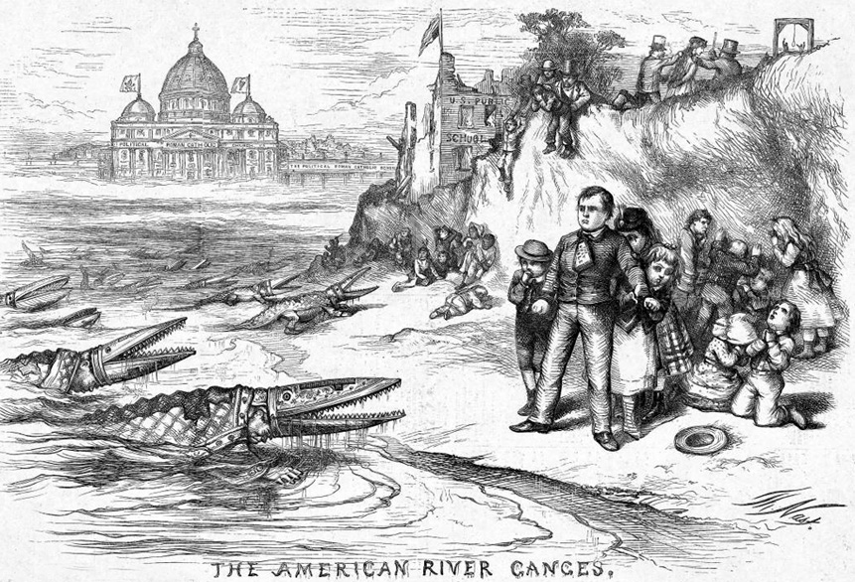
Notes:
6
Reasons for antagonism towards immigrants
Religion
*most anti-immigrant sentiment was geared toward their Catholic religion
*Americans had a mistrust of Catholics because of their loyalty to a Pope thousands of mile away
felt that Catholic immigrants were taking orders from the Vatican and this freaked people out
Uneducated
*the fact that most immigrants had no education also proved a problem for Nativists
*the Irish especially were viewed as stubborn and unwilling to Americanize
*German immigrants were despised because people felt they would bring their education system
threat to American ways of life

Slide 7
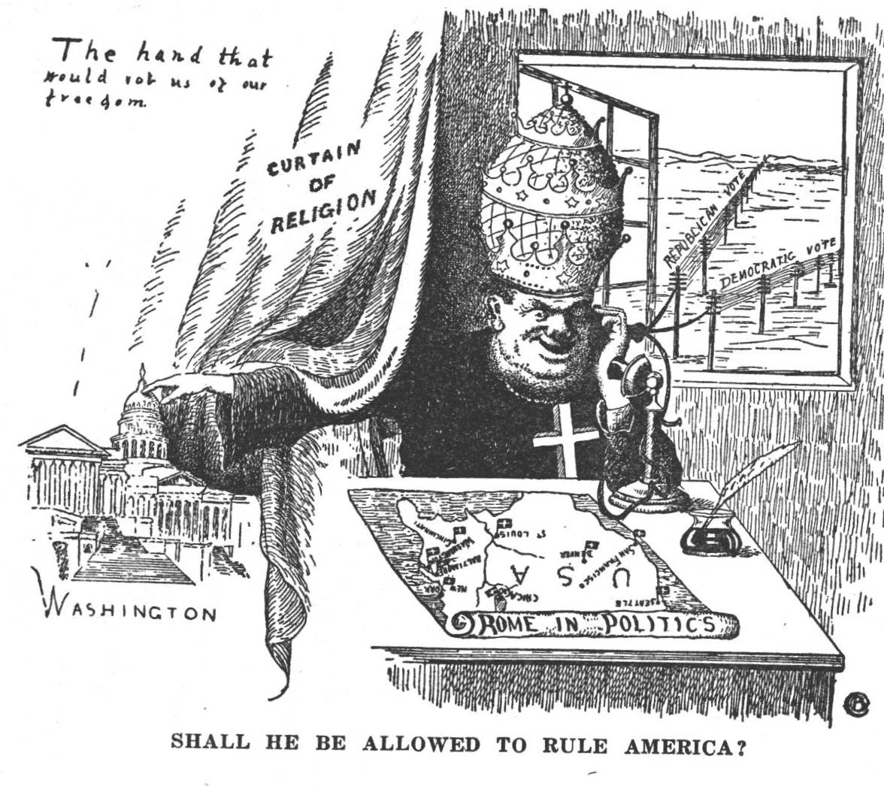

Slide 8
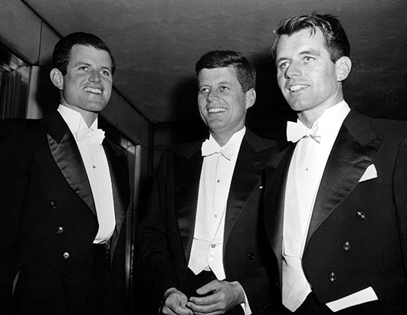
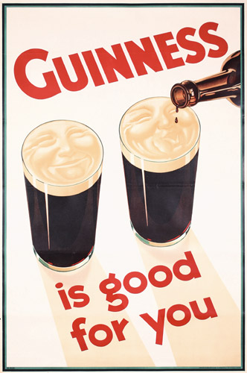
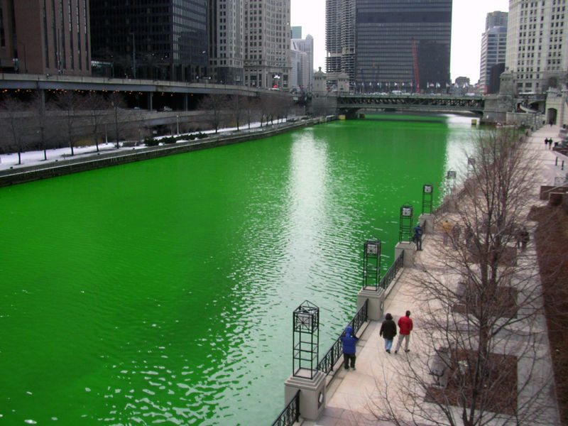
Irish American influence in Popular Culture
Notes:
8

Slide 9
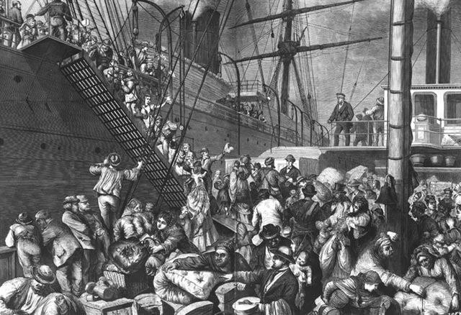
The Germans
Germans
*27% of immigrant population
*more educated and less poor
*2/3rd Protestant and 1/3rd Catholic
*mostly family units or single men
*settled in Northwest
*became farmers
*tended to isolate themselves
Push factors
*economic uncertainty
*political oppression
-unification wars
-failed liberalism (Marxism)

Slide 10
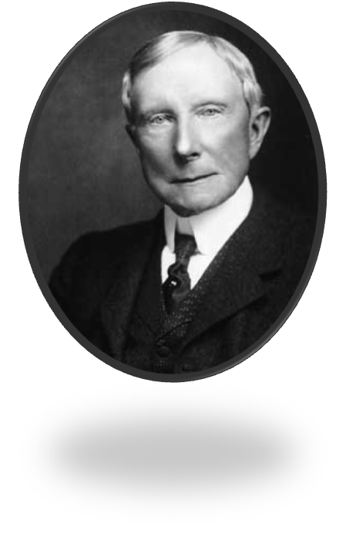
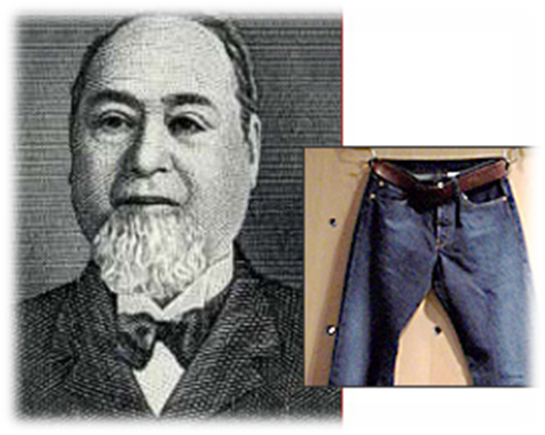
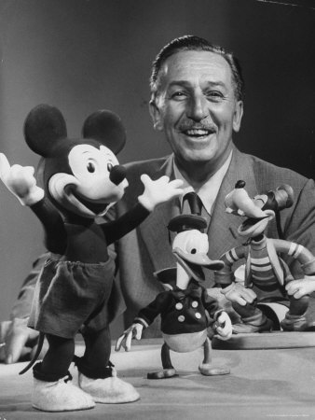
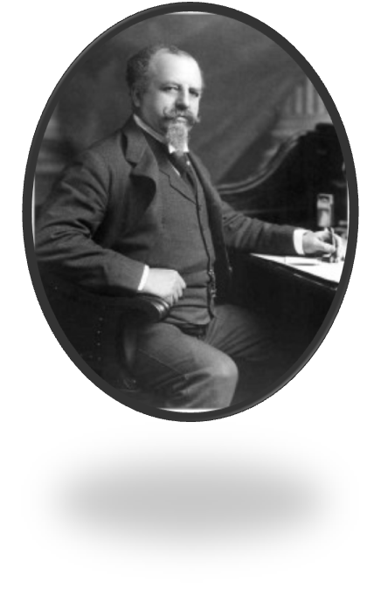
Notable Germans
Notes:
John Steinbeck
L. Frank Baum
Dr. Seuss
William Edward Boeing
Walter Chrysler
Walt Disney
Harvey Firestone
Henry Heinz
Milton Hershey
Barron Hilton
Bernard Kroger
Oscar Mayer
F.L. Maytag
John D. Rockefeller
Levi Strauss
10

Slide 11
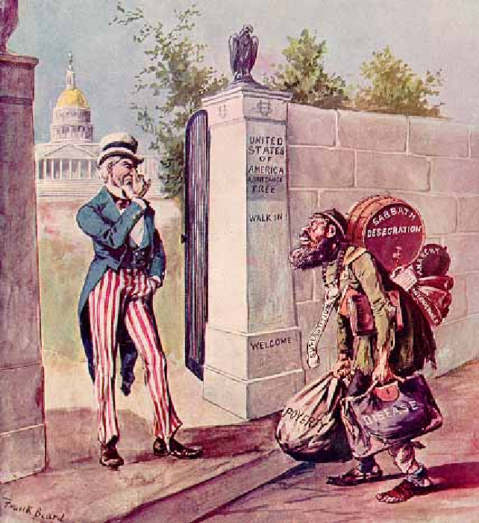
The Rise of Nativism
Nativism
*distrust of foreigners
*favored “Native-born” Americans
Nativist fears
*immigrants would work for lower wages
*immigrants were destroying American culture
*Catholic church and Pope
*poverty
*immigrants voting
In Politics
*Native America Party
*Supreme Order of the Star-Spangled Banner
*Know-Nothing Party
*American Party
*all wanted to restrict immigration
-immigration laws
-Chinese Exclusion Act
*prevent immigrants from voting
-literacy tests
-land requirements

Slide 12
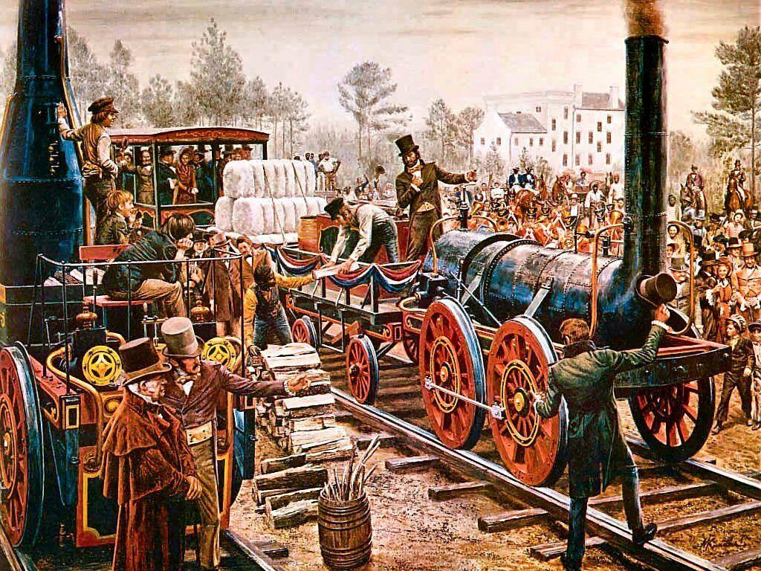
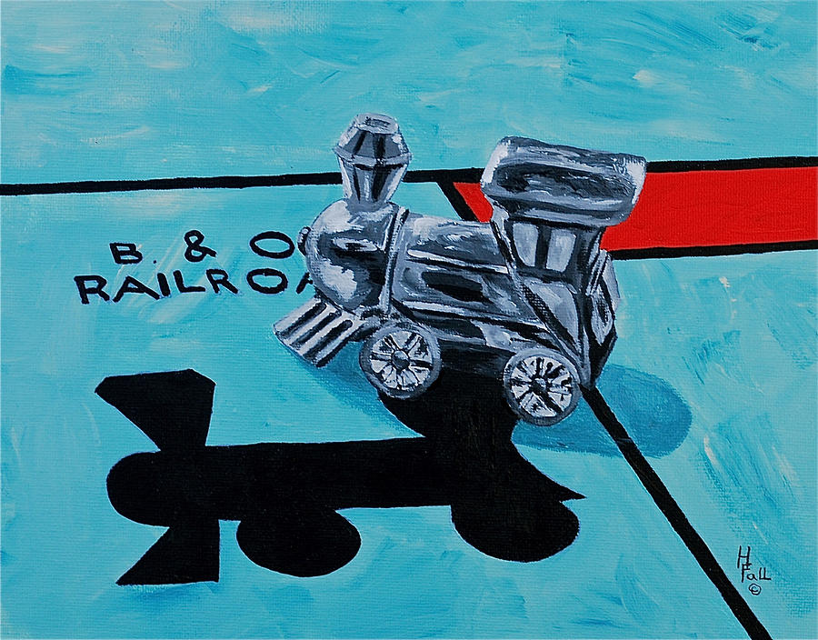
Transportation, Communications, and Technology
The Canal Age
*Erie Canal: 360 miles
*connected Chicago and New York
*built by Irish
*huge success financially
*led to increased settlement and growth of cities
Steamboats
*brought quicker two way traffic to rivers
Railroads
*best form of transportation
*Why?
*Baltimore and Ohio – 1830
Problems
*no organization
*different gauges of tracks
*erratic schedules
*frequent accidents
*competition with canals

Slide 13
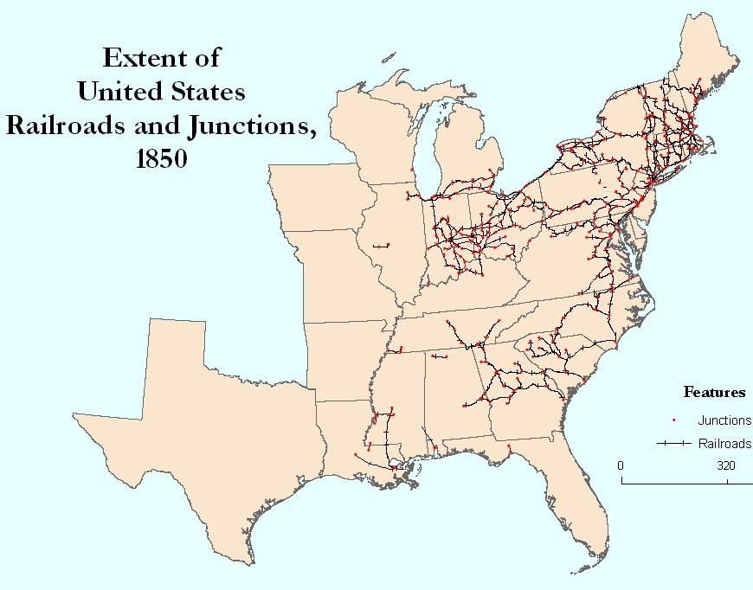
The Triumph of the Rails
Increased development
*”Trunk Lines”
*shorter lines consolidated into longer lines
*decreased importance of canals
Funding
*private companies
*foreign investment
*State, local and Federal governments
-promoted railroad growth
-provided capital
-gave land grants
*most railroads built in Northeast

Slide 14
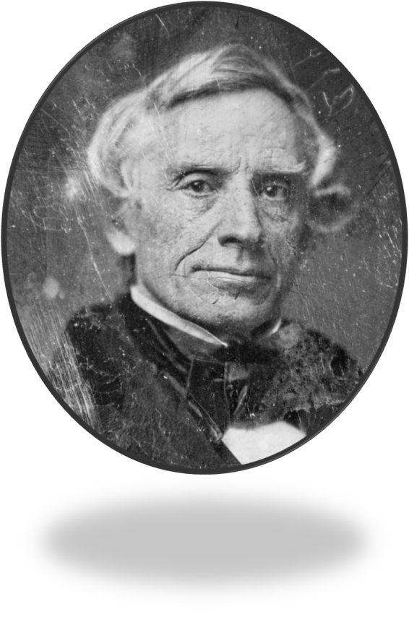
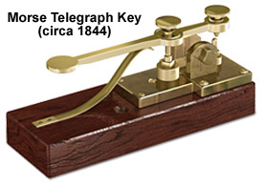
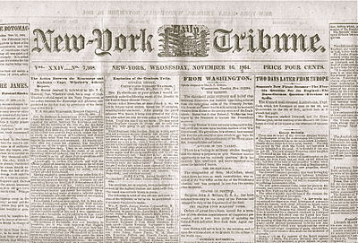
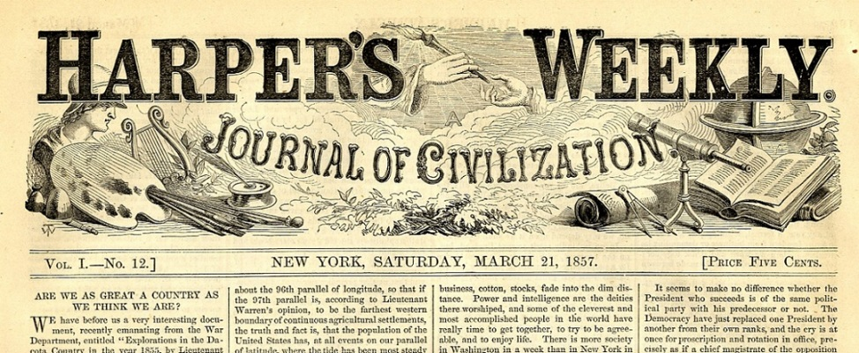
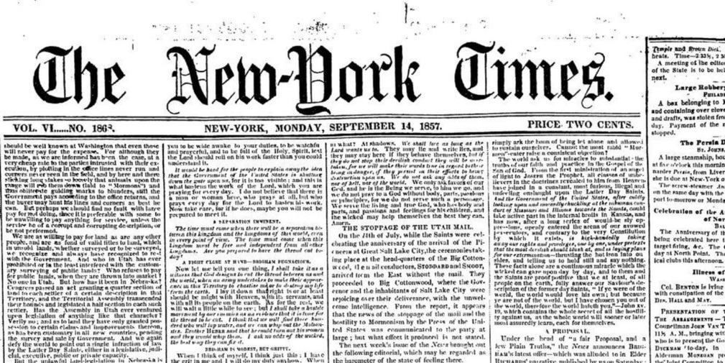
Innovations in Communications and Journalism
Telegraphs
*Samuel Morse, Morse Code 1844
*solved problem of long distance communication
*by 1860 – 50,000 miles of line connecting nation
*Pacific Telegraph: connected NY and San Francisco
The Associated Press
*cooperative news gathering by wire
*large NY newspapers: Herald, Times, Tribune
*sold more papers than entire south combined

Slide 15
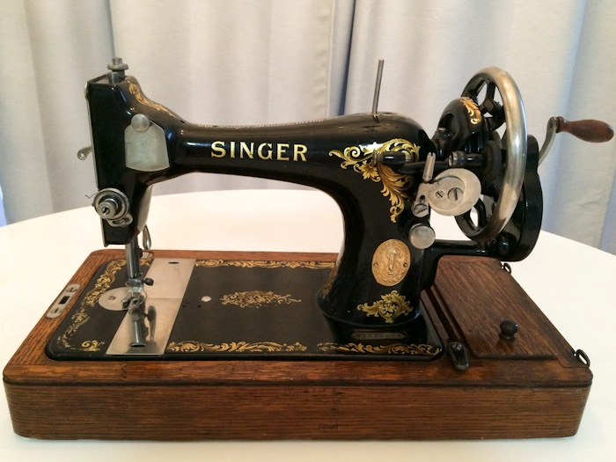
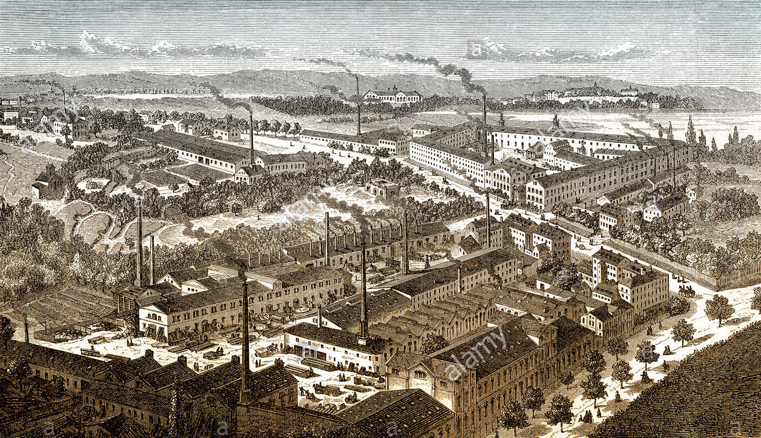
Commerce and Industry
Corporations
*became easier to create large businesses
*restrictions were lifted
*simple fee was the only requirement
*investment for most businesses was inadequate
*limited liability
-stockholders only lost value of stock if business failed
Factory boom
*2/3rd factories were in Northeast
*most were textile and shoe manufacturers
*relied mostly on water power
*many factories shut down in the winter
*began to rely on steam power
*coal allowed cities to not rely on water power
*cities producing coal became important (Pittsburg)
Technological Advances
*Interchangeable parts – Eli Whitney
-made clocks, guns, bikes, sewing machines, type writers
*Charles Goodyear – rubber
*Elias Howe/Isaac Singer – sewing machine

Slide 16
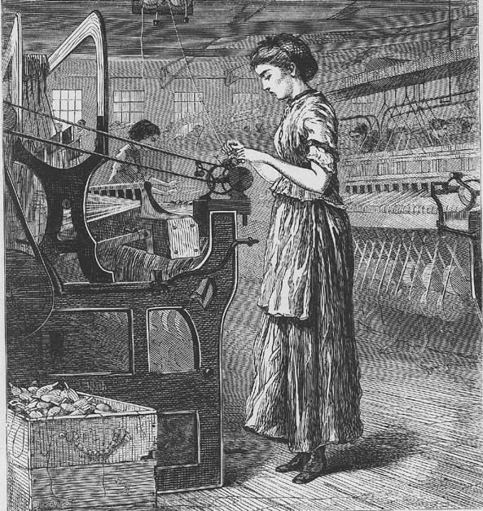
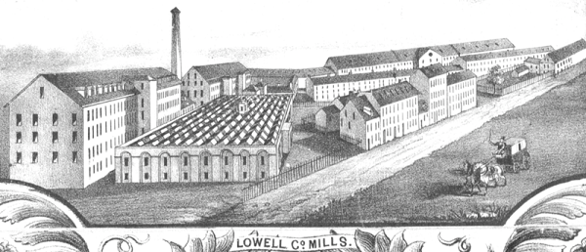
Women at work
Early workers
*two main types of workers
-farmers who were replaced by machines
-young, single women
The Lowell System
*New England factories used women mainly
*lived near factories in dormitories
*well fed and supervised
*strict rules and curfews
*generous wages for the time
*paradise compared to working conditions elsewhere
Problems
*women suffered loneliness
*repetitive tasks
*work from sunrise to sunset
Decline of the Lowell System
*mainly from the panic of 1837
*women began to find work as teachers or servants
*replaced by immigrant workers

Slide 17
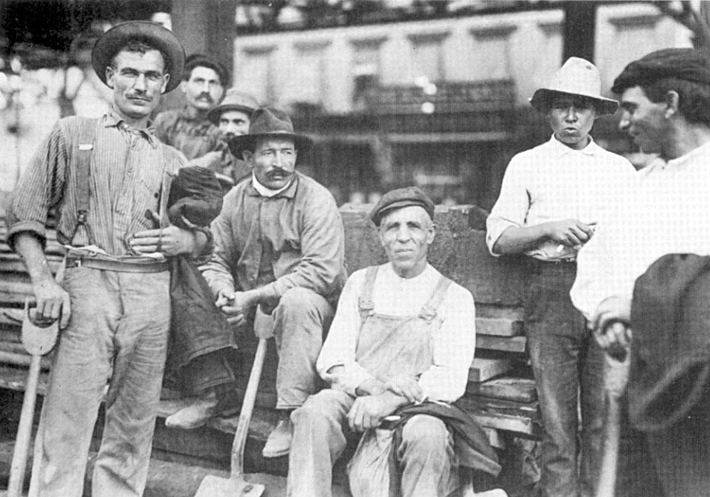
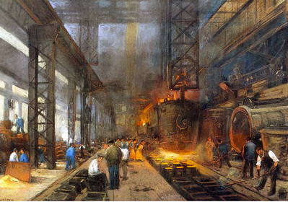
Immigrant Workforce
Harsh Working Conditions
*construction gangs
-build canals, railroads in horrible conditions
-barely made enough money to support families
*Irish workers treated like garbage
*low wages
*women and children paid even less
*were seen as expendable
*factories were loud and dangerous
*12 hour workdays
Early Unions
*advantages to joining forces
*factory owners viewed unions as illegal
*Commonwealth v. Hunt
-Mass. SC ruled unions were legal
-other states agreed
“Free Labor”
*Northern laborers hated slavery
-took away freedom
-took away jobs

Slide 18
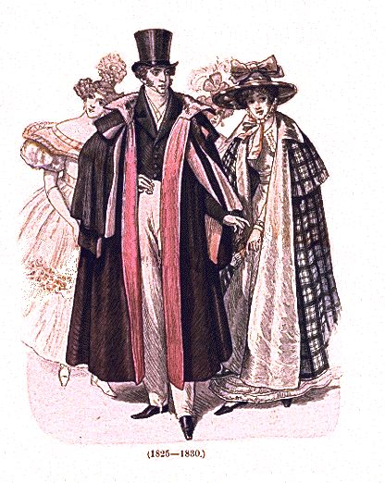
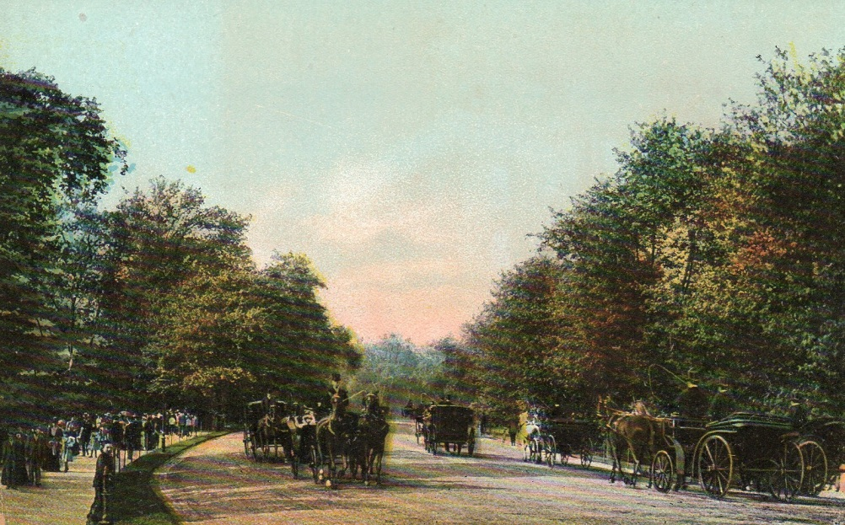
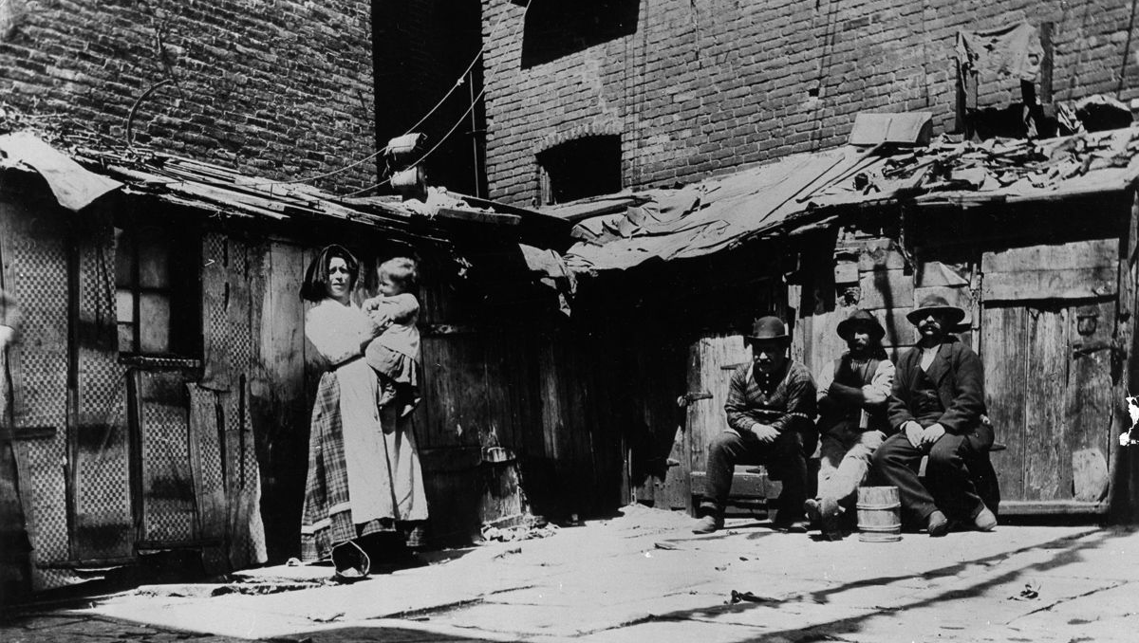
Patterns of Industrial Society
Rich and Poor
*economic growth not shared equally
-rich got richer
-poor got poorer
*high poverty rates in urban areas
Rich
*small percentage owned majority of wealth in America
*founded clubs and social rituals
*advertised their opulence
Central Park
*NY’s attempt to compete with London/Paris
*Frederick Law Olmsted
*840 acres in middle of city with , lakes, hill, forests, bridges
Poor
*cities full of homeless
*many turned to alcoholism
Free Blacks
*most free blacks in North lived a poor life
*could not: find jobs, vote, use public services (schools)

Slide 19
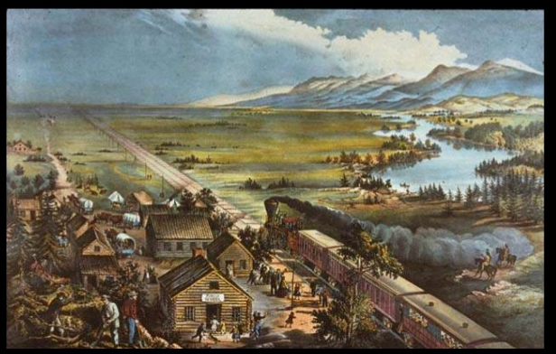
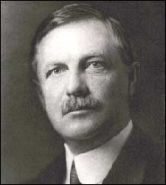
Social Mobility
Movement
*laborers moved often
*from one factory to another
The Turner Thesis
*Historian Frederick Jackson Turner
*the west was a “safety valve”
-during hard times people moved west
-west offered new opportunities
Middle Class
*began to grow as a result of growing industry
*easier to own a business and invest
*more opportunity to own land
Family changes
*sons and daughters much more likely to leave home
*large farms replacing small, family farms
*more hired farmhands than family run farms
*birth rate declines
*people more concerned with working

Slide 20
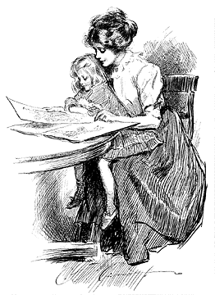
Women and the “Cult of Domesticity”
Different roles
*men and women had increasingly different roles
*women had no legal or political rights
*husbands had absolute authority
*women barred from higher education
*were to become mothers
-raise children and instill values
*not many occupational choices
-teachers, nurses and domestic servants
Separate spheres
*social networks for women important
-clubs, associations

Slide 21
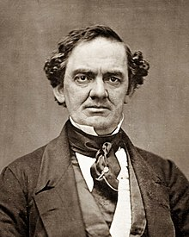
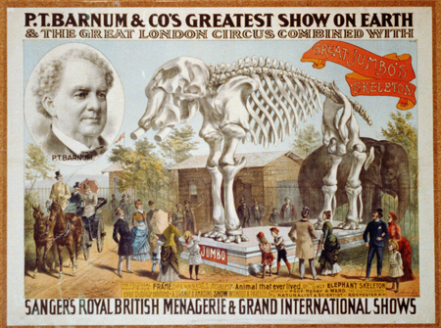
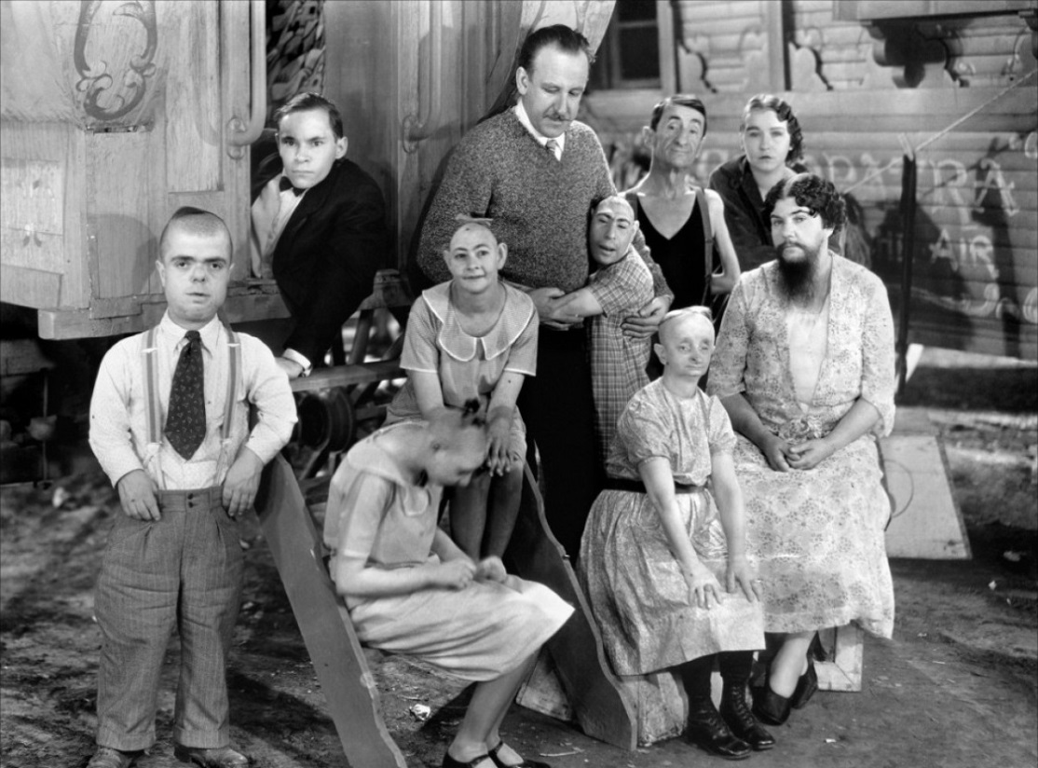
Leisure Activities
Working and Middle Class
*Sunday the only day off
*holidays important
*leisure time usually meant playing games, reading
*vaudeville shows, plays, theatre, lectures
P.T. Barnum
*traveling circus was very popular
-freak show, magicians, exotic animals

Slide 22
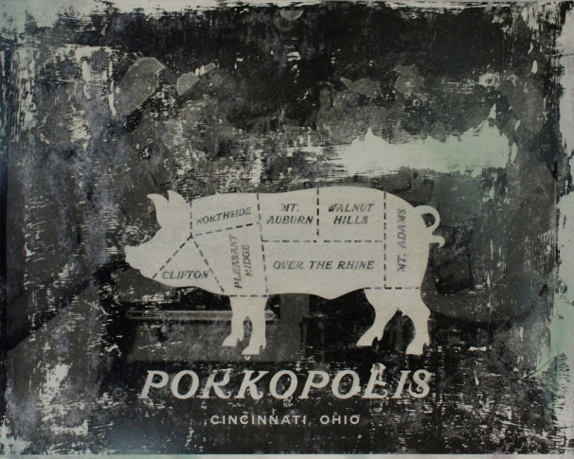
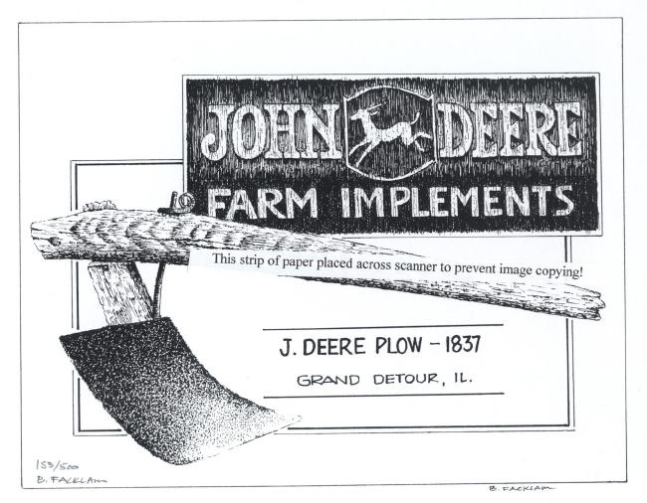
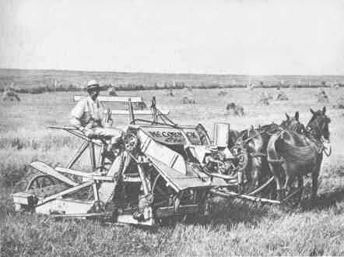
The Agricultural North
Northeastern Agriculture
*declined due to competition with west
*focused more on industry
*many Northeast farmers moved west
*some got involved in dairy farming
The Old Northwest (Ohio)
*mix of industry and agriculture
*Cleveland – industrial center
*more specialized agriculture
-Cincinnati - meatpacking industry (Porkopolis)
*used river systems to sell and trade goods
The Northwest (Michigan, Indiana, Illinois, Iowa, Minnesota, Missouri)
*wheat, potatoes, oats, livestock
*Cyrus McCormick’s reaper
-greatly increased wheat production
John Deere’s steel plow
-opened up farming in west
Rural life
*churches important – brought communities together

Slide 23
Ch. 10: America’s Economic Revolution
Focus Questions:
Identify some of the major cities that developed in the United States during the market revolution.
Identify some of the new immigrants who came to the United States and their characteristics.
Explain the push/pull factors of this new immigration.
Describe nativism and its impact on immigration.
Discuss major changes in transportation and communication during the era.
Explain changes in industry and business (i.e. inventors and inventions as well as the government’s role in business growth).
Identify the role of class, family and women during the era.
Explain the characteristics of Northern and western agriculture.
Notes:
23
The purpose of the focus questions is to help students find larger themes and structures to bring the historical evidence, events, and examples together for a connected thematic purpose.
As we go through each portion of this lecture, you may want to keep in mind how the information relates to this larger thematic question. Here are some suggestions: write the focus question in the left or right margin on your notes and as we go through, either mark areas of your notes for you to come back to later and think about the connection OR as you review your notes later (to fill in anything else you remember from the lecture or your thoughts during the lecture or additional information from the readings), write small phrases from the lecture and readings that connect that information to each focus question AND/OR are examples that work together to answer the focus question.

