Slide 1
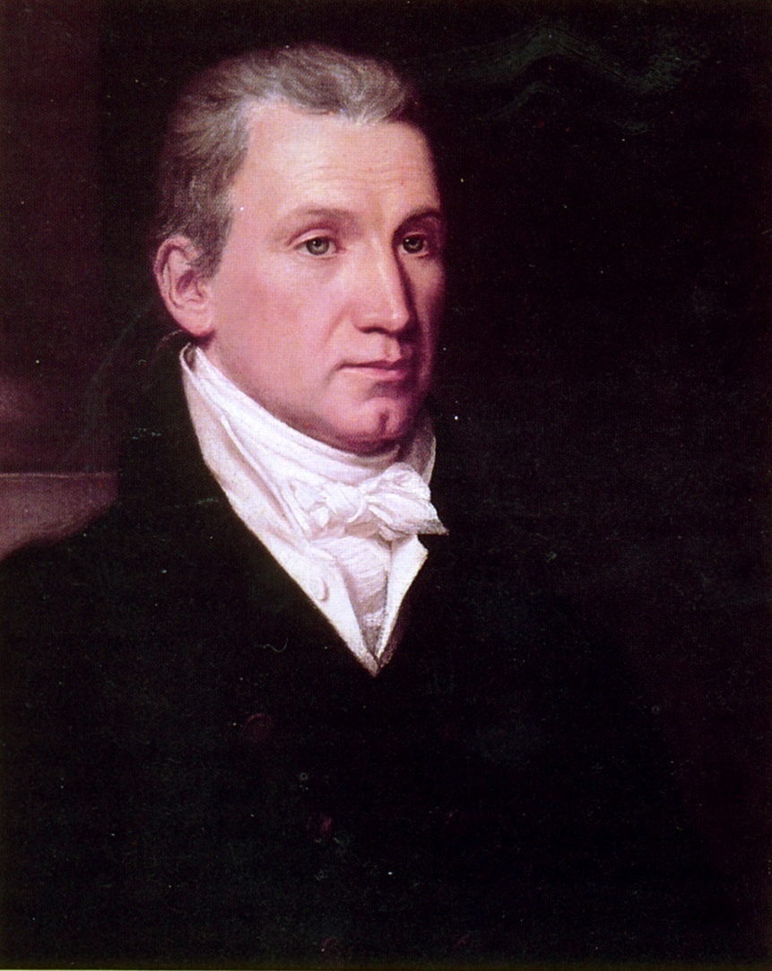
The “Era of Good Feelings” 1816-19
James Monroe

Slide 2
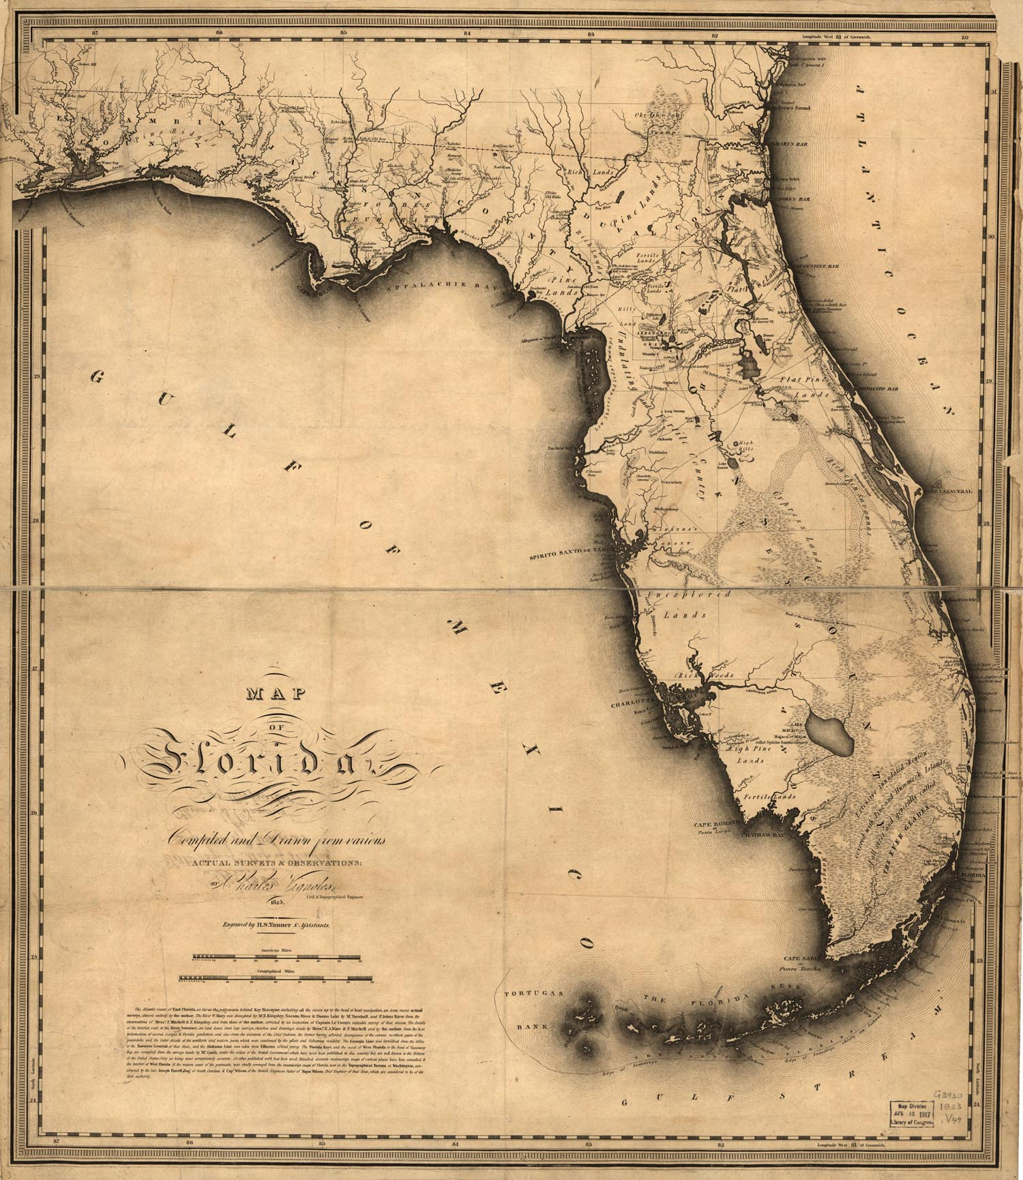
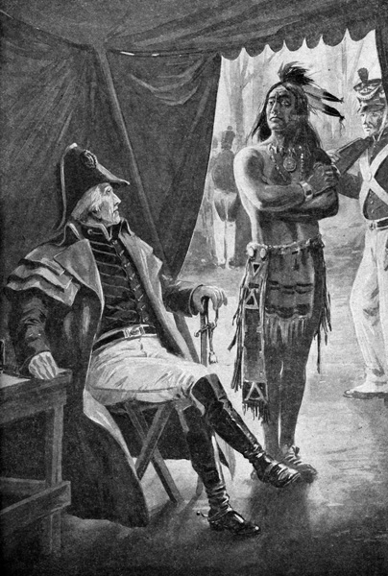
Extending the Boundaries of the U.S.
Issues in Florida
Jackson Vs Calhoun

Slide 3
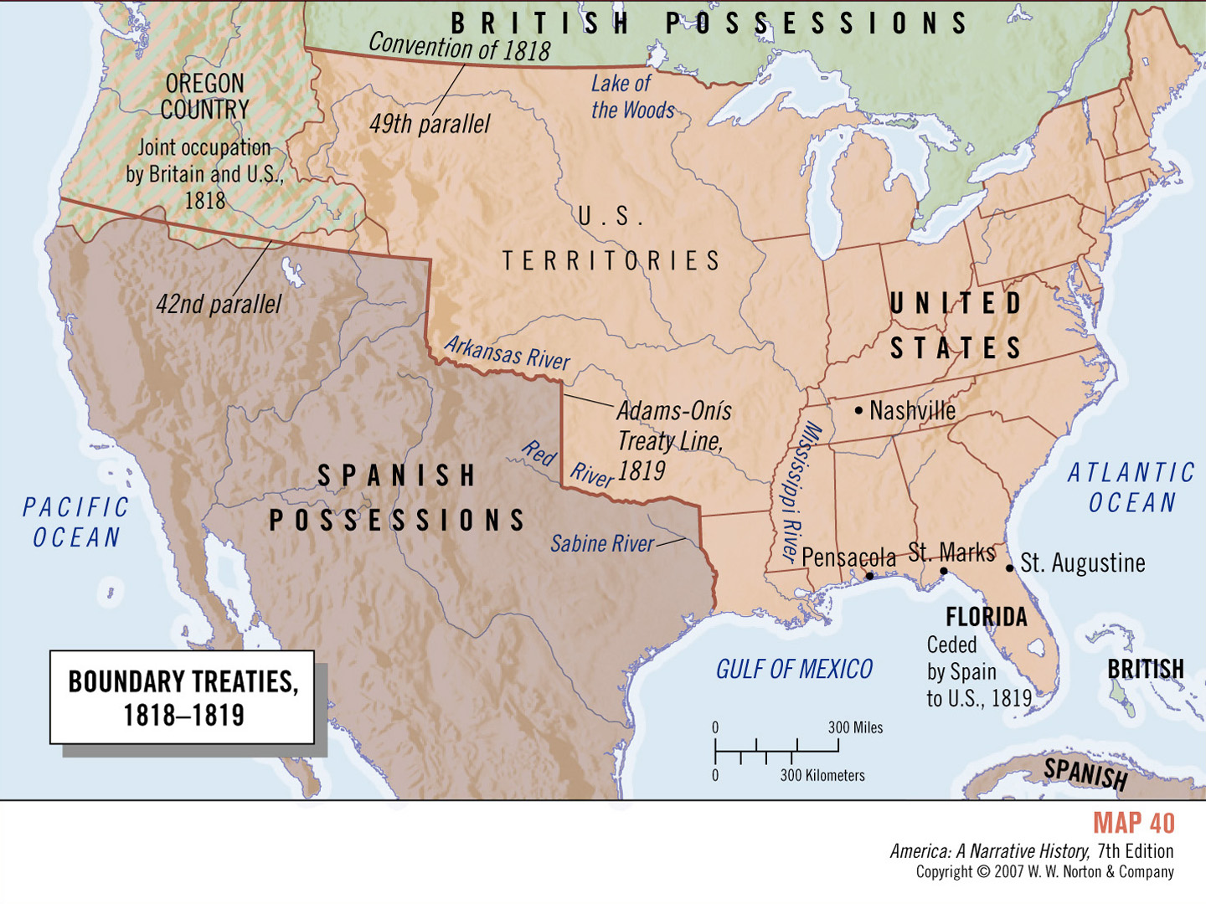

Slide 4
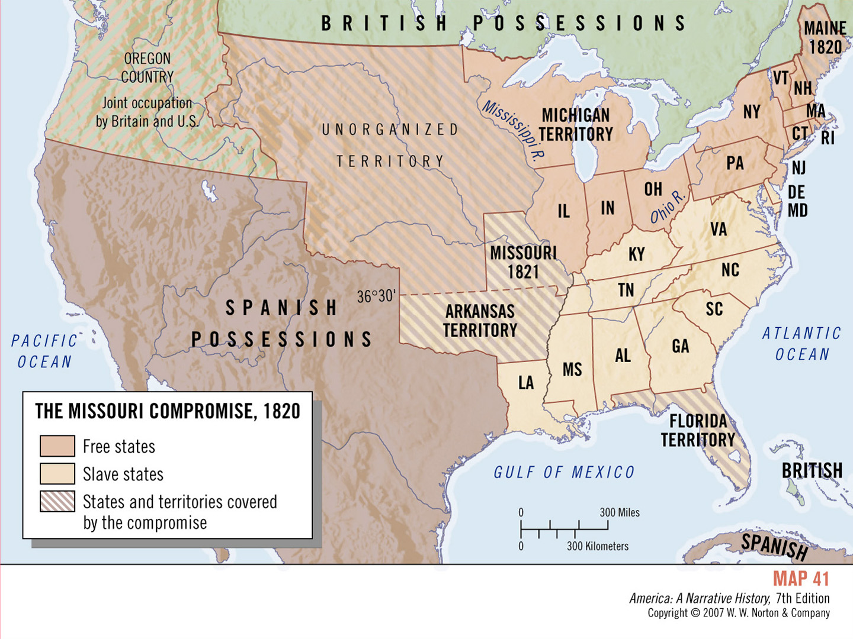
The Missouri Compromise of 1820
36’30” Parallel

Slide 5
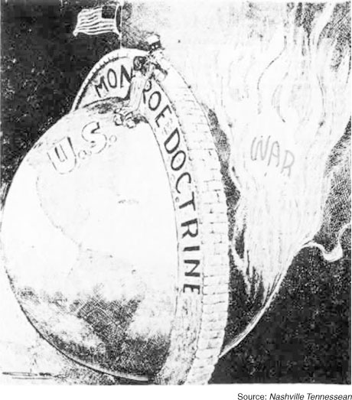
Nationalist diplomacy
●The Monroe Doctrine
1. Europeans were not to settle the American continent
2. Europeans were not to impress their politics in the Americas
3. U.S. would not interfere in Europe’s colonies
4. U.S. would keep out of European affairs

Slide 6
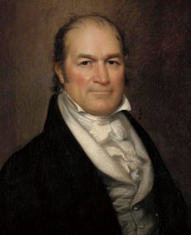
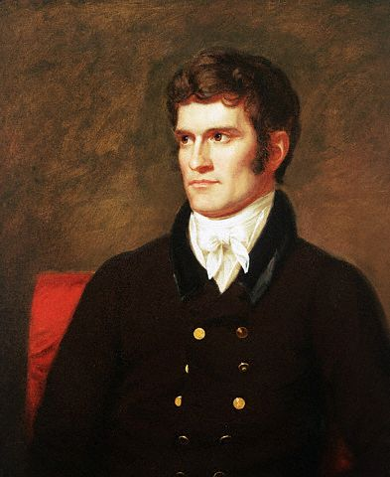
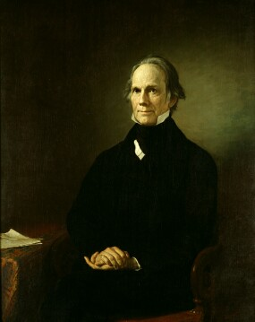
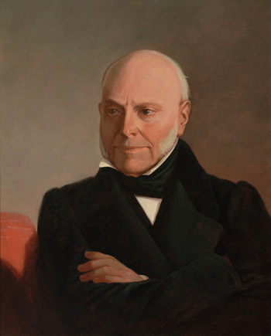
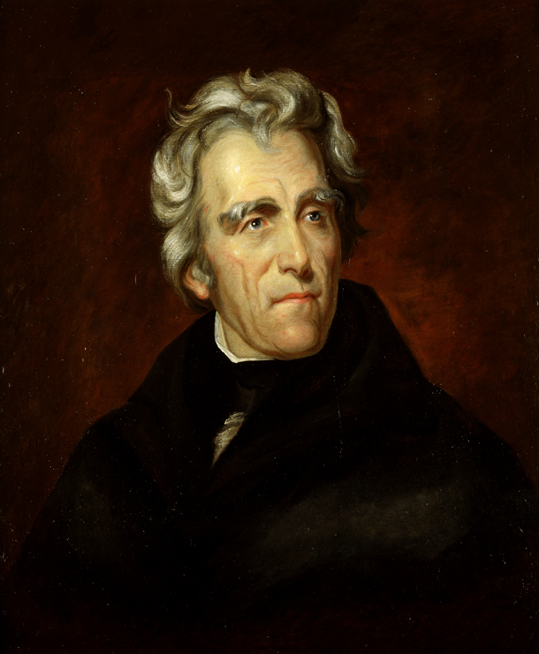
Election of 1824
William Crawford
John C. Calhoun
Henry Clay
John Quincy Adams
Andrew Jackson

Slide 7
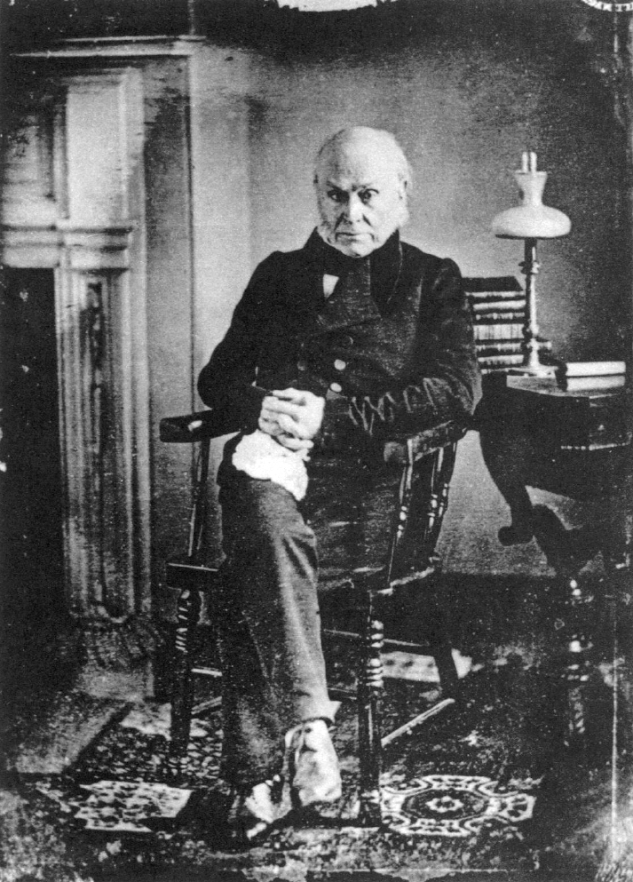
Presidency of John Quincy Adams
First photograph of a president
Tariff of Abominations

Slide 8
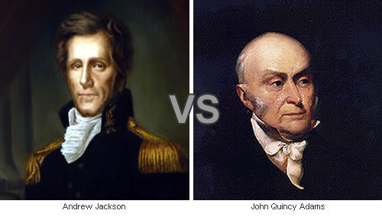
Election of 1828

