Slide 1
Ch. 12: Antebellum Culture and Reform
Focus Questions:
Identify writers of the period and what they wrote.
Who were the transcendentalists and what impact did they have on the era?
Describe some of the new societies and religious groups of the period.
Explain some of the reform movements of the era.
Analyze new sciences of the time.
What was the impact of education reform?
Explain new forms of rehabilitation.
Discuss the feminist movement and its impact.
Identify the aspects of the abolitionist movement .
Identify some of the movement’s supporters.
Notes:
1
The purpose of the focus questions is to help students find larger themes and structures to bring the historical evidence, events, and examples together for a connected thematic purpose.
As we go through each portion of this lecture, you may want to keep in mind how the information relates to this larger thematic question. Here are some suggestions: write the focus question in the left or right margin on your notes and as we go through, either mark areas of your notes for you to come back to later and think about the connection OR as you review your notes later (to fill in anything else you remember from the lecture or your thoughts during the lecture or additional information from the readings), write small phrases from the lecture and readings that connect that information to each focus question AND/OR are examples that work together to answer the focus question.

Slide 2
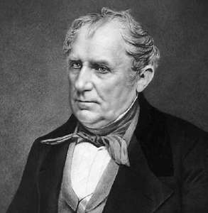
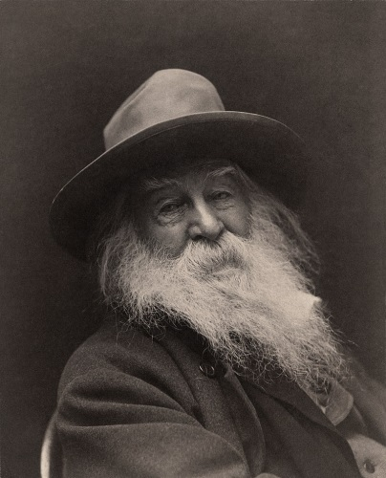
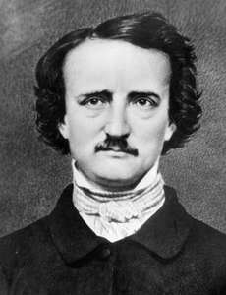
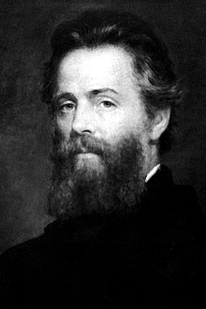
The Romantic Impulse
“Who reads an American book?”
*no one
*American artistic expression not taken seriously
Hudson River School
*Artists focused on landscape portraits
*portraying the power of nature
Literature and the Quest for Liberation
*writing about American frontier, nature, Indians, pioneers, violence, spirit, landscape
*James Fennimore Cooper – adventure writer
-The Last of the Mohicans (1826)
-The Deerslayer (1841)
*Walt Whitman – poetry about democracy, liberation of individuals, pleasures of the flesh (was a homosexual)
*Herman Melville – novelist, nature
-Moby Dick (1851): The human spirit was a troubled, often self-destructive force.
*Edgar Allen Poe – poet, short stories, dark, macabre
-The Raven (1845)
-Baltimore, died at 40, alcoholic
Southern Literature – Romanticized southern life
James Fennimore Cooper
Walt Whitman
Edgar Allen Poe
Herman Melville

Slide 3
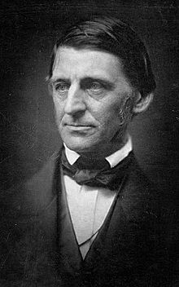
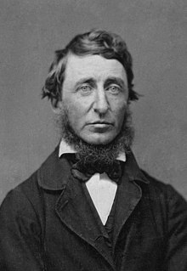
Transcendentalism
The Transcendentalists
*New England philosophers
*liberation from “understanding”
*cultivation of “reason”
*individuals should “transcend” limits of intellect
Ralph Waldo Emerson
*essayist, lecturer, poet, intellectual
*wrote about man’s relationship with the natural world
Henry David Thoreau
*Walden - lived at Walden Pond alone for two years
*Civil Disobedience – argued for passive resistance against unjust laws.
The Defense of Nature
*nature should not be exploited for profit
*spirituality came from nature not religion
Utopian Societies
*Brook Farm, MA. – residents shared labor an leisure
-experiment eventually failed and dissolved
*New Harmony – residents worked and lived in equality
-was an economic failure
Ralph Waldo Emerson
Henry David Thoreau

Slide 4
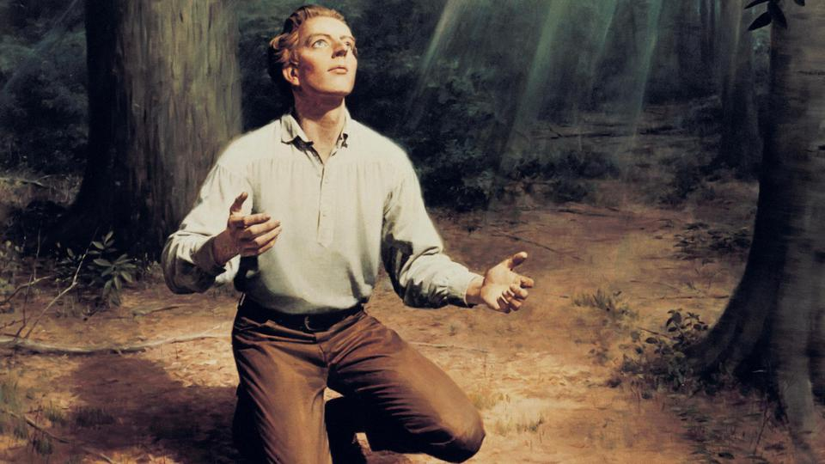
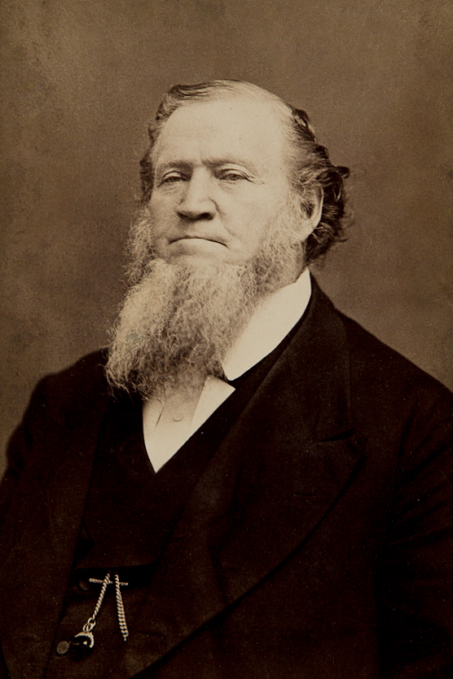
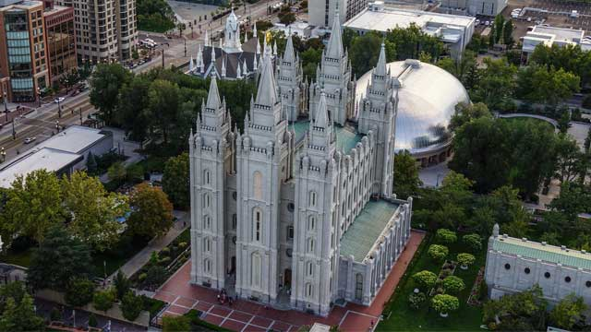
New Religions
Utopian Societies
*Oneidans – “free love” society
-rejected traditional ideas of family and marriage
-protected women from the bonds of marriage
*The Shakers – group who practiced complete celibacy
-6,000 members (mostly women)
-would “shake” themselves from sin
*The Mormons – Church of Jesus Christ of Latter-Day Saints
-Joseph Smith – Book of Mormon
-mostly people who felt out of touch with rapidly growing society
-Brigham Young led 12,000 followers to Utah
-founded Salt Lake city
-helped with further settlement of the west

Slide 5
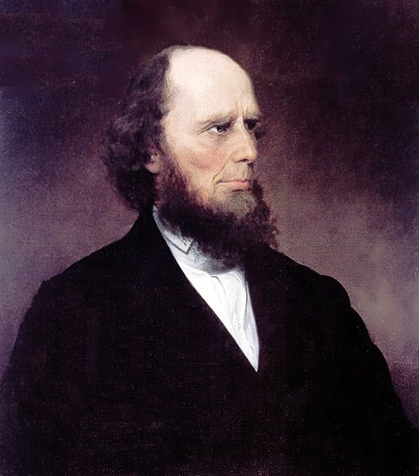
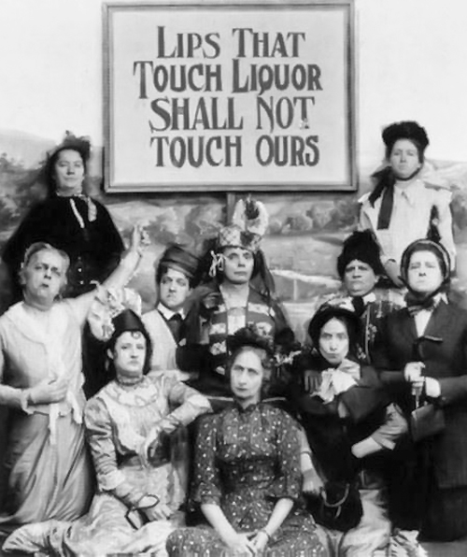
Remaking Society
2nd Great Awakening
*revival of morality of thought
*inspired many social reforms
Charles Grandison Finney – Presbyterian Minister
*individual effort would allow for salvation
*converted many in up-state NY (Burned-Over District)
Temperance
*push to limit alcohol consumption
*movement mostly led by women
*Why?

Slide 6
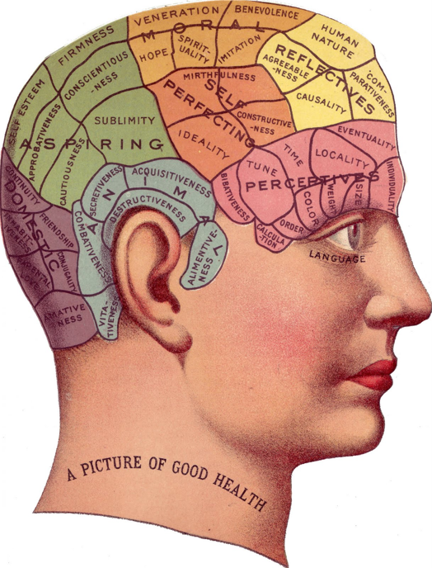
Health and Medicine
Health Fads
*lots of deadly outbreaks
*lack of understanding of how diseases spread
*basic knowledge of prevention
*people attempted to be more healthy.
-health spas
-hydrotherapy
-dietary changes
∙fruits, veggies, fiber
Phrenology
*science of studying the shape of the skull
*thought it could determine intelligence, fitness, behavior

Slide 7
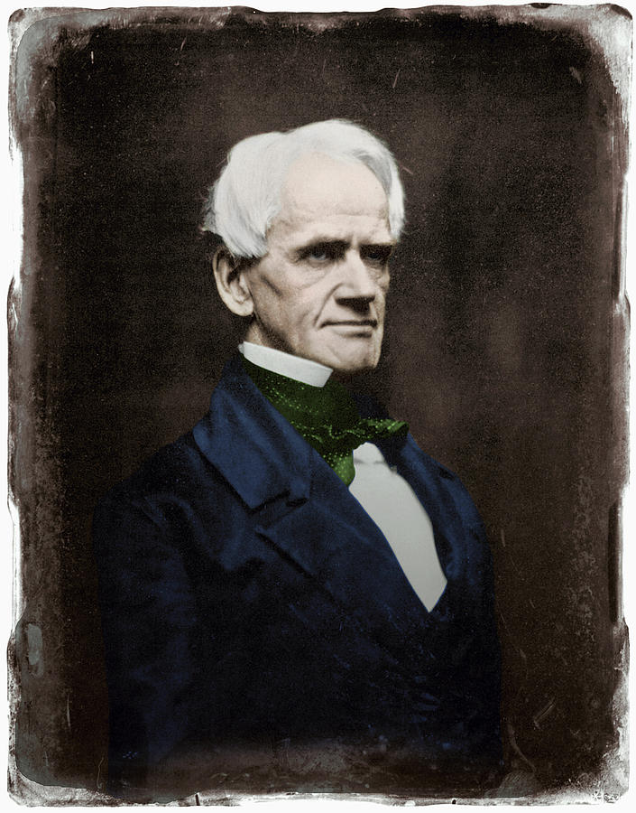
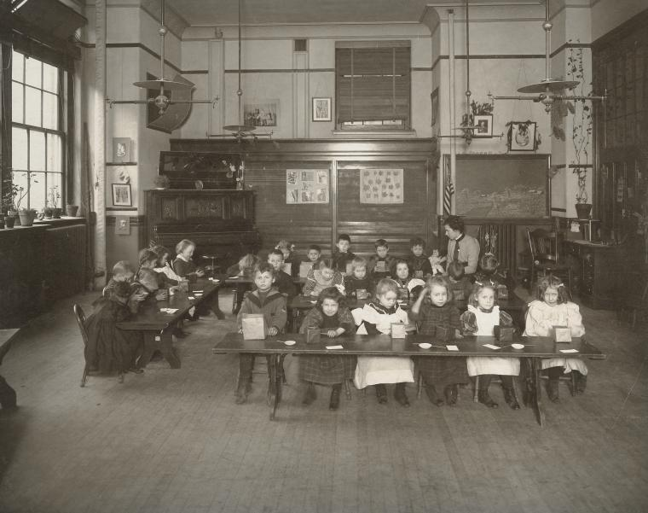
Reforming Education
Growth of Public Education
*interest grew in 1830’s
*Horace Mann “father of Education – Mass. Board of Education
*educated electorate = better protection of democracy
*Northern states built schools using taxes
-quality varied state to state
*teacher colleges developed
*schools in south and west inferior
*US had one of highest literacy rates in the world
*schools developed to help the handicapped
-schools for the blind, deaf

Slide 8
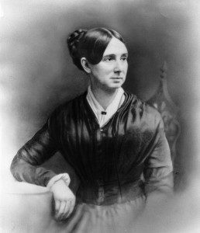
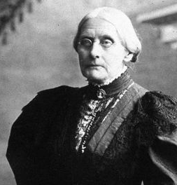
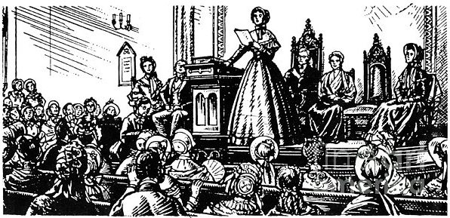
Rehabilitation
Prison and Mental Health Reform
*prisons were deplorable
*filled with debtors, mentally ill, senile, paupers, criminals
*penitentiary – meant to reform and rehabilitate criminals
Dorothea Dix – mental health reformer
*asylums – started housing the mentally insane
*orphanages for children
Indian Reservations
*enclosed region where natives could live isolated
*way of getting rid of natives
*protect Indians from white encroachment
*hoped to assimilate them into American society
Feminism – 1840’s
*movement to elevate the status of women
*Susan B. Anthony, Elizabeth Cady Stanton, Lucretia Mott wanted increased rights for women
Seneca Falls Convention (1848)
*movement launched for women's suffrage
*change was slow but eventually happened in 1920

Slide 9
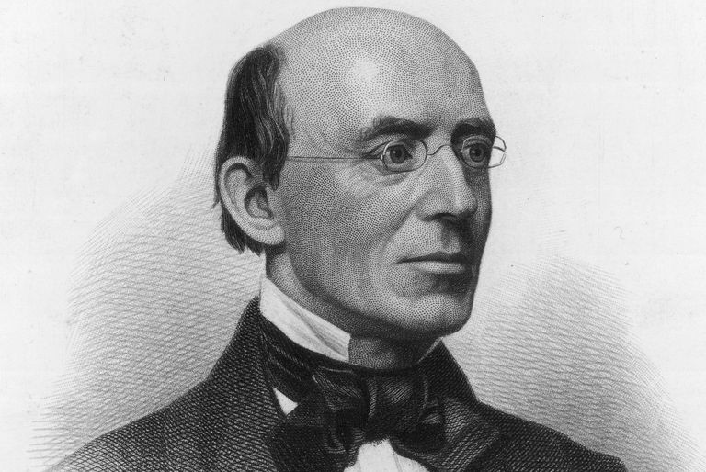
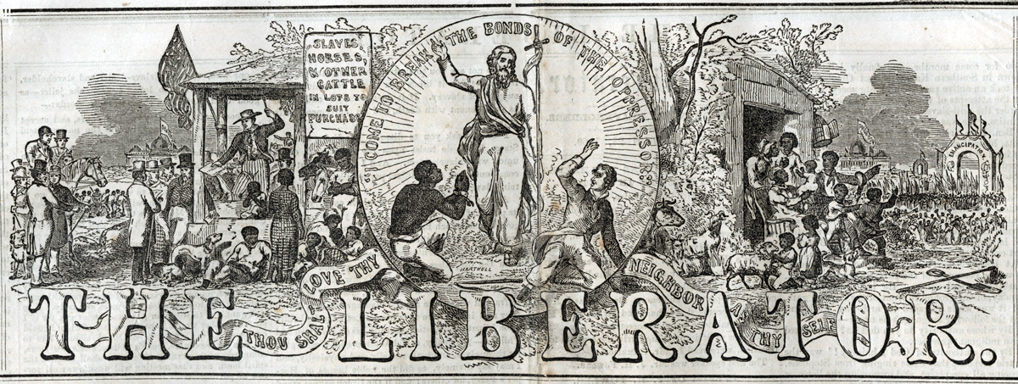
The Crusade Against Slavery
Early opposition to slavery
*American Colonization Society - 1817
-attempted to send AA back to Africa
-paid slave-owners to send slaves to Liberia
-failed due to lack of support from both whites and blacks
William Lloyd Garrison and Abolitionism
*radical abolitionist from Mass.
*published the Liberator
*demanded immediate universal abolition
*opposed recolonization of “already freed peoples”
*founded American Anti-slavery Society
-membership boomed in 1830’s
-helped spark creation of abolitionist political parties

Slide 10
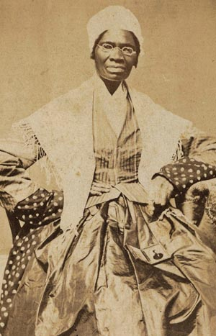
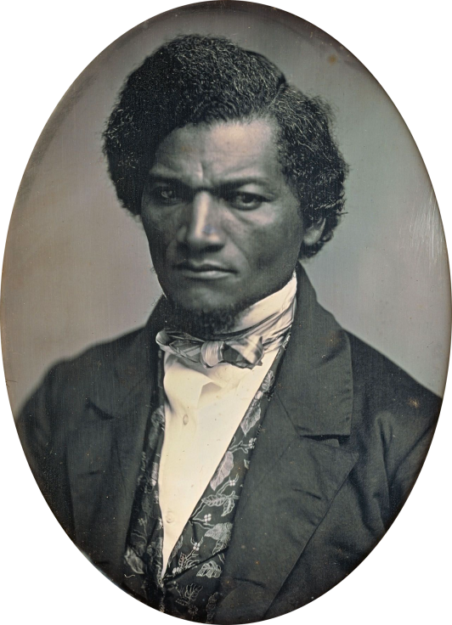
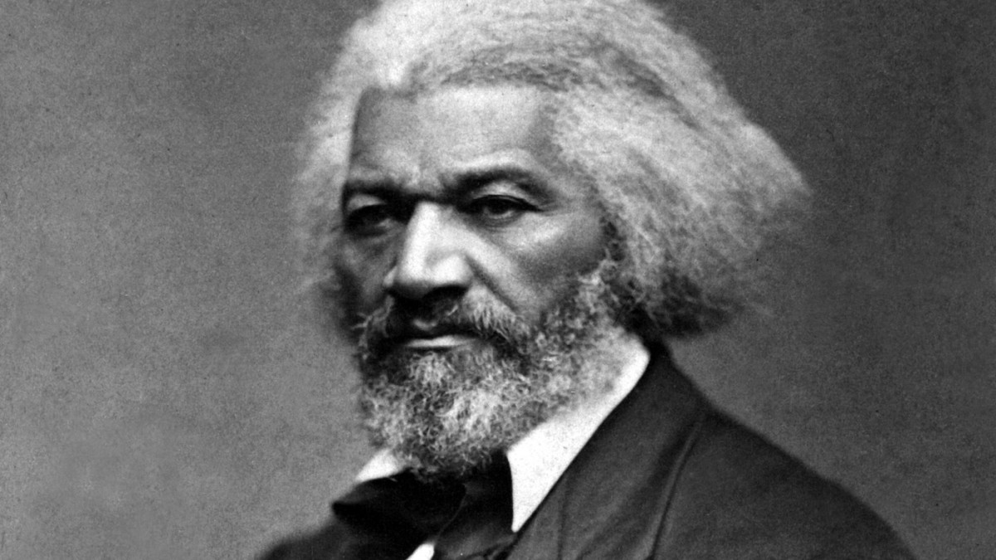
Black Abolitionists
Free Blacks in the North
*250,000 with almost no rights
*supported abolitionism and WLG
David Walker
*called for violence to end slavery
Sojourner Truth
*free black woman
*powerful and eloquent abolitionist
Frederick Douglas
*former slave from Maryland
*escaped to Mass. In 1838
*magnificent orator
*toured in England
*purchased his freedom in 1847
*demanded full social equality for slaves and women
*advised Lincoln
*promoted the Emancipation Proclamation

Slide 11
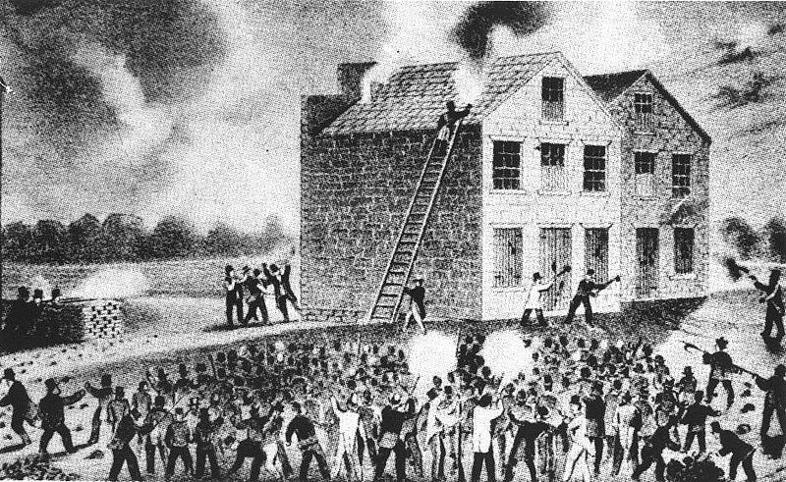
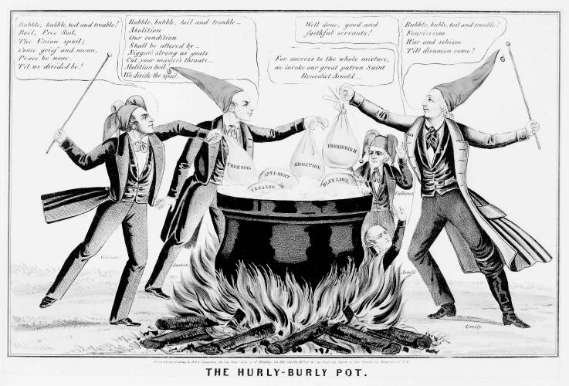
Abolitionism Divided
Anti-Abolitionism
*Northern abolitionists in the minority
*Northern businessmen opposed freeing slaves
*many acts of violence against abolitionists
-Elijah Lovejoy – newspaper editor murdered in Illinois
-anti abolitionist mobs throughout the north
Prigg v. Pennsylvania
*Northern states didn’t have to aid in capturing runaway slaves according to the Fugitive Slave Law
Free Soil Party
*wanted to prevent slavery from spreading to new territories
*gained a lot of support in the North
*eventually formed with other anti slavery parties to create the Republican party
Uncle Tom’s Cabin (1852) – Harriet Beecher Stowe
*powerful abolitionist propaganda
*praised in the north as a heroic epic
*reviled in the south
*enflamed sectional differences
*southern states passed laws forbidding anti-slavery material from being sold or published

Slide 12
Ch. 12: Antebellum Culture and Reform
Focus Questions:
Identify writers of the period and what they wrote.
Who were the transcendentalists and what impact did they have on the era?
Describe some of the new societies and religious groups of the period.
Explain some of the reform movements of the era.
Analyze new sciences of the time.
What was the impact of education reform?
Explain new forms of rehabilitation.
Discuss the feminist movement and its impact.
Identify the aspects of the abolitionist movement .
Identify some of the movement’s supporters.
Notes:
12
The purpose of the focus questions is to help students find larger themes and structures to bring the historical evidence, events, and examples together for a connected thematic purpose.
As we go through each portion of this lecture, you may want to keep in mind how the information relates to this larger thematic question. Here are some suggestions: write the focus question in the left or right margin on your notes and as we go through, either mark areas of your notes for you to come back to later and think about the connection OR as you review your notes later (to fill in anything else you remember from the lecture or your thoughts during the lecture or additional information from the readings), write small phrases from the lecture and readings that connect that information to each focus question AND/OR are examples that work together to answer the focus question.

Slide 13
Multiple Choice Exam: Things to Review
*Describe immigration after the War of 1812
*Impact of internal improvements on the economy
*Different elements of the Antebellum Economy
*What impact did the Lowell factory system have on industrialization?
*Identify the importance of certain inventions of the period.
*Impact of slavery on the economy
*The different elements of slavery during the Antebellum era
*Know the different regions of the south
*Identify: Abolitionists, Writers, Transcendentalists, inventors
*Know your reform movements and reformers
*Understand the different religious groups

