Slide 1
Ch. 13: The Impending Crisis
Focus Questions:
What is Manifest Destiny and how did it shape the United States?
By what means and why did Americans move west?
What was the appeal of certain areas such as Texas, California, and Oregon?
What impact did the Texas Revolution have in shaping American history?
Describe the events leading to the Mexican-American War.
Analyze the impact of the Mexican War.
Describe the Compromise of 1850 and the controversies surrounding it.
What impact did the Kansas-Nebraska Act have?
Evaluate the outcome of the Dred Scott decision.
Describe the impact of John Brown’s raid on Harpers Ferry.
Discuss the Election of 1860 and its outcome.
Notes:
1
The purpose of the focus questions is to help students find larger themes and structures to bring the historical evidence, events, and examples together for a connected thematic purpose.
As we go through each portion of this lecture, you may want to keep in mind how the information relates to this larger thematic question. Here are some suggestions: write the focus question in the left or right margin on your notes and as we go through, either mark areas of your notes for you to come back to later and think about the connection OR as you review your notes later (to fill in anything else you remember from the lecture or your thoughts during the lecture or additional information from the readings), write small phrases from the lecture and readings that connect that information to each focus question AND/OR are examples that work together to answer the focus question.

Slide 2
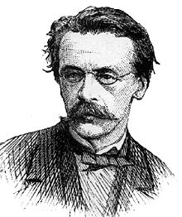
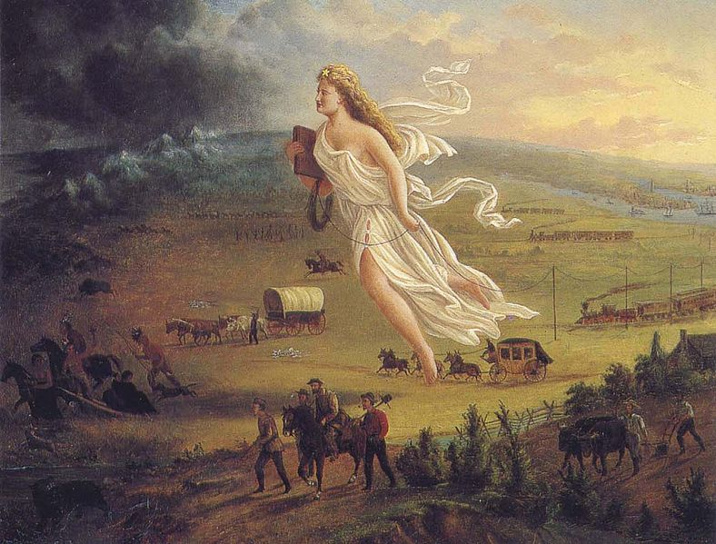
Looking Westward
Manifest Destiny
*John L. O’Sullivan – journalist who coined the phrase
*America’s God-given right to expand westward
* “From Sea to Shining Sea”
*racist motives
-Americans were superior to previous inhabitants
-spread democracy
-spread Christianity
Opposition
*Henry Clay and Whigs
-feared tensions over spreading slavery

Slide 3
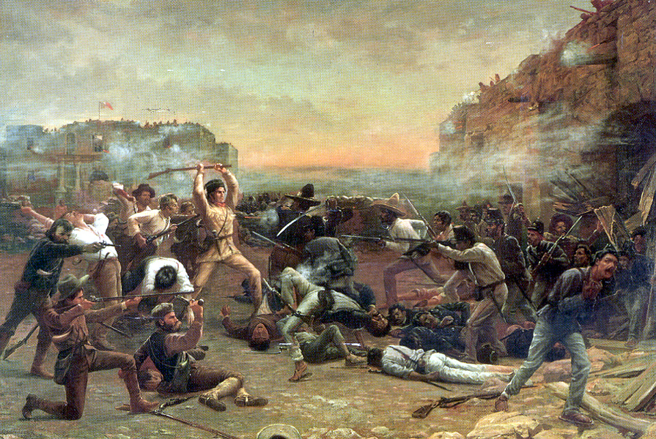
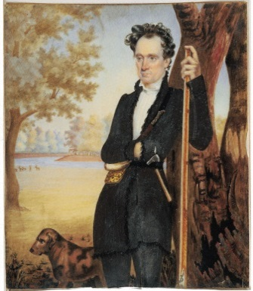
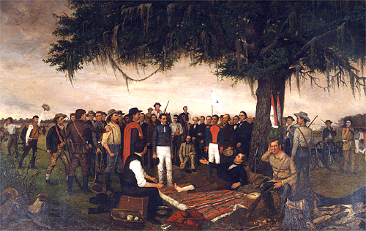
Texas
Americans in Texas
*US settlement began in 1820’s
*Mexican govt. promoted white settlement
-wanted money, taxes, commerce
Stephen F. Austin
*brought 300 white families to settle in Texas
*began cotton farming
*refused to follow Mexican edicts
-convert to Catholicism
-no slaves
-refused to pay taxes
Antonio Lopez De Santa Anna – seized control of Mexico
*sought to exert control over Texas by force
Texas Independence – March 2, 1836
*The Alamo: Feb. 23-March 6, 1836
*Battle of San Jacinto: April 21, 1836
*Treaty of Velasco – Republic of Texas (1836-45)
Opposition to Annexation
*Texans hoped for annexation
*many Americans (Jackson) opposed it due to slave issues
*Jackson, also afraid to start a war with Mexico
Notes:
Texas
*the beginning of American lust for Mexican territory really began with Texas
Early basis for American claims
*Mexico initially welcome the settlement of Texas by Americans to aid in boosting the productivity of the region
*the only problem was that by 1830 Texas had become a virtual province of the United States when the white population began to outnumber the Mexican population
American settlements
*the Mexican government first hired American empresarios to recruit people to settle large tracts of land in Texas
*one of the most famous and successful empresarios was Stephen F. Austin who had brought in 20,000 settlers by 1830 to settle the region along the Brazos River in what is today Brazoria County
*the land was perfect for growing cotton and soon southerners were flooding into Texas to take advantage of the cheap land and bringing their slaves with them
Mexican edicts cause friction
*the first signs of friction between Texans and the Mexican government developed over two big issues
*the first was the refusal of many Americans to become Mexican citizens which meant adopting the Roman Catholic faith
*most citizens were staunch Protestants and wouldn’t dream of it
*the second Mexican edict that angered settlers in was the abolishment of slavery within its borders
*initially, the Mexican government turned a blind eye to Texans’ refusal to abide by Mexican law but when the white population began to greatly outnumber the Mexican population Mexico responded
*they suspended immigration and the importation of slaves as well as arrest several Texans for breaking the laws
Santa Anna takes control
*things reached a pinnacle when General Antonio Lopez de Santa Anna became a totalitarian dictator in Mexico
*rumors began to spread that he planned to expel American immigrants completely from Texas and free their slaves
*when Santa Anna decided to send troops to Texas to put the population in their place
*Texans responded by raising an army and declaring their Independence on March 2, 1836
Independence
*before declaring independence Texas militias began popping up throughout Texas taking over towns
*one of the towns taken over was San Antonio by Austin with about 500 troops
*by February most of the troops had abandoned the town and those that remained had taken refuge in an abandoned mission known as the Alamo
*the troops were now under the leadership of a Mississippi lawyer by the name of William Barret Travis and included famed Tennessee frontiersman Davy Crockett and James Bowie
on February 23, 1836 Santa Anna’s small military force began to surround the Alamo and demanded the surrender of the 187 Texans defending it
*they responded by firing a cannon at the Mexicans
*a 12 day siege ensued and ended early in the morning of March 6 when the Mexican army overran the defenders killing every one but not before they killed 1,500 Mexicans
*the night before the siege took place the defenders actually threw a huge party to celebrate George Washington’s birthday
*Jim Bowie never actually took part in the battle as he was sick in bed probably suffering from pneumonia
*there were some reports that when Mexican soldiers entered the room where he was laying he began to curse them out in perfect Spanish and one officer ordered his tongue cut out before bayoneting him to death
*the only survivors inside the Alamo after the battle were a couple of slaves
*the youngest Alamo defender was 15
San Jacinto: April 21, 1836
*the Texas Revolution ended when Texas troops surprised Santa Anna and his army near modern day Houston at San Jacinto
*they were led by none other than Sam Houston
*over 600 Mexicans were killed and only a handful of Texans died
*after the battle Santa Anna was nowhere to be found
*later on he was found dressed as a private nursing a broken leg
*left with no choice, Santa Anna was forced to exchange his freedom and end the war by signing the Treaty of Velasco
Treaty of Velasco
*recognized Texas independence
*it, however, never settled the issue as to the border between the Republic of Texas and Mexico
*this would become a major problem later on when the United States annexed Texas
Republic of Texas: 1836-46
*immediately after gaining independence, Texas elected Sam Houston as its first President and legalized slavery
*the Texas government next voted for annexation into the United States but the proposal was refused by President Jackson for a number of reasons
Jackson/Van Buren refusal of Statehood
*he wanted to avoid the issue to make sure Van Buren could win the 1836 election without issue
*Jackson feared risking war with Mexico if the US annexed Texas so he decided to avoid the issue by instead recognizing Texas’ sovereignty
*Jackson also did not want to have to deal with the volatile issue of slavery should Texas become a state
Tyler’s stance
*in the 10 years Texas was a Republic the population exploded
*this only fueled the argument to bring Texas into the United States
*by the time John Tyler became president many people throughout the nation supported making Texas a state however Congress was not ready
to do so despite Tyler’s efforts to make it happen

Slide 4
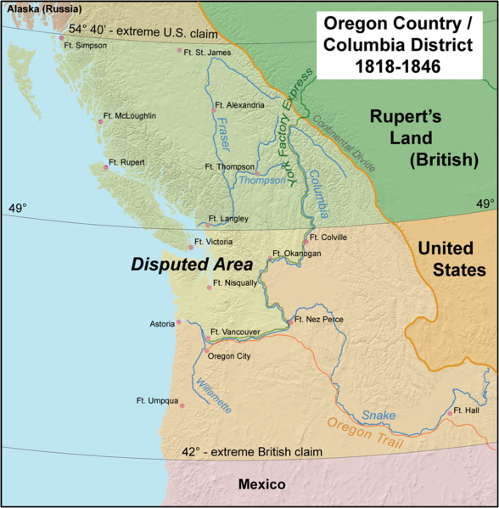
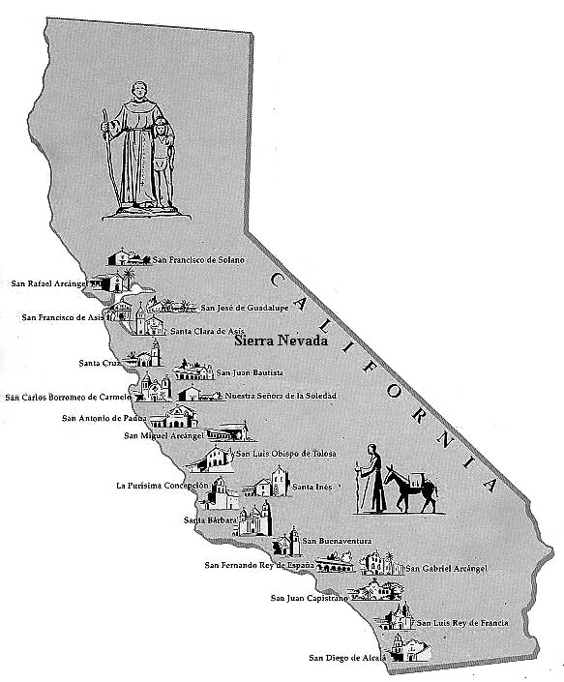
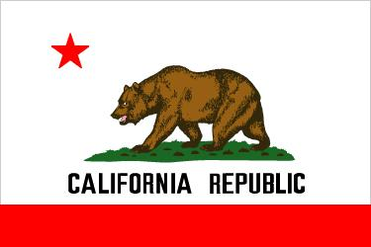
Further Expansion
Oregon
*jointly occupied by US and Britain from 1818-1840’s
*American interests grow in 1820’s-30’s
*mostly fur trappers, miners and lumbermen
“54’40’’ or Fight!”
*US claim Oregon territory up to 54th parallel
*threatens war with Britain
*settled at 49th parallel
California – “The Land of Milk and Honey”
*Mining
-gold rush
-49ers
*these areas soon had more Americans than Mexicans
*Bear Flag Revolt, 1848
Notes:
Why settlers headed west
The Rockies and Oregon
*by the 1820’s the fur trade between the Mississippi and the Rockies was at an end due to overharvesting
*as a result fur trappers began moving further west across the Rockies into Oregon territory where they found a haven for trapping and trading beaver pelts
*by the 1840’s the fur trade was virtually over due to over hunting however many trappers stayed because of the other raw materials the region offered
*this helped to create “Oregon Fever” as a flood of Americans headed to the region because of its lush forests and waterways
*even though Britain and the US shared Oregon Territory it quickly became more of an American territory
California
*the region was first settled by the Spanish in 1769 when Russian moved into Oregon territory and threatened Spanish claims to California
*Spain first sent settlers north into San Francisco and began to establish a series of missions south to San Diego
*the purpose of Spanish settlement in California was to convert the native populations in the region
*the Spanish also got heavily involved with cattle ranching in California establishing huge ranches with thousands of head of cattle on them
“Land of Milk and honey”
*once Spanish influence was replaced by a naive Mexican government, Americans fur traders began making their way south from Oregon into California calling it the land of milk and honey because of the abundance of natural resources
*another larger American population in California at the time were New England merchants who had gotten involved in sea trade between California and America’s east coast
*they would bring goods from Boston around Cape Horn and then head back to the east coast with cattle hides

Slide 5
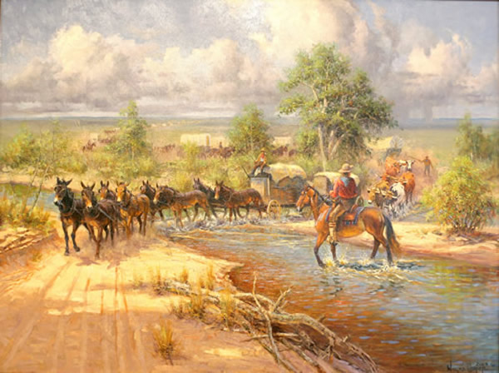
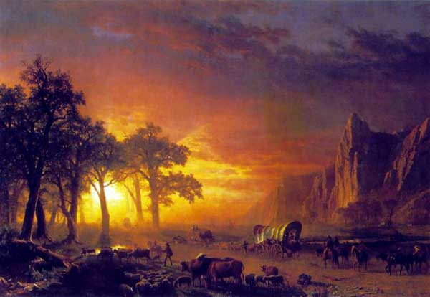
Westward Migration
Who?
*hundreds of thousands of whites between 1840-1860
*mostly prosperous young people
-Why young people with money?
*very diverse depending on destination
-farming = family units
-mining, lumber = men
Why?
*looking for new economic opportunities
*looking for a new start in life
How?
1. Oregon Trail – 2,000mi from Independence to Oregon
*many hardships
-climate, weather
-Indians, lack of food
-1 dead every 80 yards
*around 350,000 people migrated west
2. Santa Fe Trail – Independence to Santa Fe
3. Mormon Trail – Illinois to Salt Lake City, Utah
Notes:
Moving West: Trails
*one of the reasons why Americans became infatuated with the west and acquiring territory there was because of the trade that opened up within the western territories
Santa Fe Trail: St. Louis-Santa Fe
*Santa Fe had been the seat of the Spanish government in the west until 1821 when Mexico gained its independence from Spain
*Spain had mostly shut its doors to trade with the United States however the new Mexican government opened up trade in order to generate revenue
*the trail helped generate revenue for both countries as thousands of merchants risked Indian attacks
*there was so much trade in fact between the two nations that the peso became the most popular form of currency in Missouri
*the trail also allowed for the settlement of Mexican territory by whites
Oregon Trail: St. Louis-Pacific Ocean (2,000 miles long)
*most popular trail that took settlers west
*was also one of the most deadly (1 death every 80 yards)
*most deaths were due to exposure to the elements and not Indian attacks as most Indians in fact aided settlers in exchange for goods
*unlike the Santa Fe trail the Oregon Trail was not established for trade but the settlement of Oregon instead
*350,000 to California and Oregon between 1841-67
*the peak year of travel…1850 when 55,000 Americans risked traveling to Oregon
Mormon Trail: Illinois to Salt Lake City, Utah

Slide 6
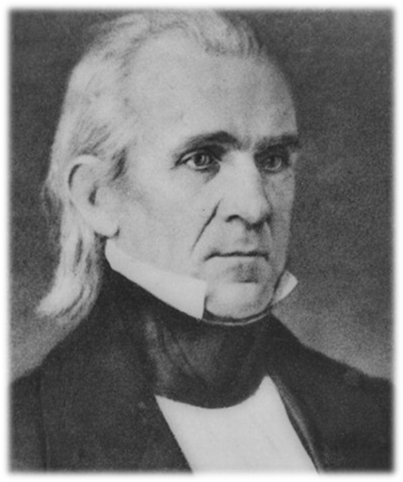
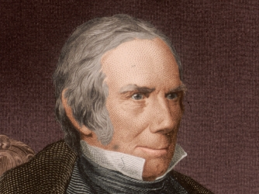
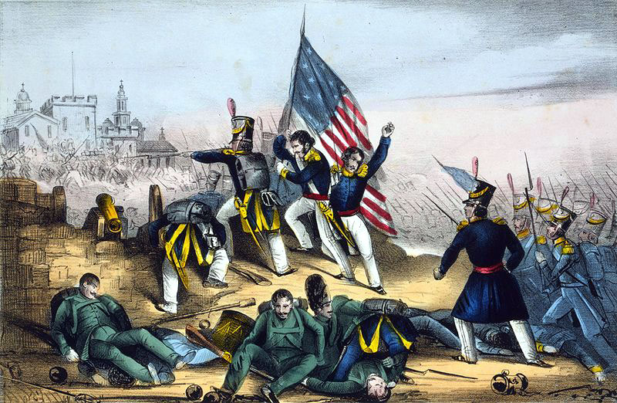
Expansion and War
Election of 1844
*key issue is annexation of Texas and expansion
*Polk (the Democrats) supports annexation
*Clay (Whigs) opposed to annexation
*Polk wins, Texas joins US in1845
Boundary Issues
*Texas claims Rio Grande River
*Mexico claims Nueces River
*John Slidell – attempts to negotiate w/Mexico
*US/Mexican troops sent to border
*fight breaks out
Mexican American War: April 1846 – Feb. 1848
* “Polk’s War”
*highly controversial
-opposed by many Americans
*US kicks Mexico’s butt
Treaty of Guadalupe-Hidalgo, 1848 – Nicholas Trist
*US pays Mexico $15m
*Rio Grande set as border
*US gains lots of territory (New Mexico, California, Arizona)
Vs.
Notes:
Polk Presidency
Election 1844
*the possible annexation of Texas was widely supported throughout the United States however most politicians tried to avoid the issue altogether
*in the 1844 election it became the single most important issue and political parties were split over the issue
*Whigs were against the annexation of Texas for fear that the slavery issue would erupt
*Democrats supported the Texas’ annexation in order to further expand the nation’s border
*Whigs wanted to avoid the issue because they feared it could result in a Civil War if Texas were annexed
*Democrats wanted to feed off support for annexation and decided they would then accomplish this should they win the election
*the Democrats won the election and their candidate, James K. Polk, became the youngest candidate to win the presidency
Polk in office
*was from Tennessee and gained the nickname “young hickory”
*he was a slaveholding racist who represented the growing Southern wing of the Democratic party
*he was also an expansionist who wanted to expand the US boundary into Texas and Oregon
Annexation of Texas
*the bill for Texas’ annexation passed on December 29, 1945
*Polk then vowed to gain California, New Mexico and settle the dispute over Oregon before he left office
Oregon demands
*after Texas, Americans then demanded the British give up their claims to Oregon territory
*the only problem I that they don’t agree as to where the border should be drawn
*Americans argue it should be at the 54th parallel/ The British argue the line should simply be extended along the 49th parallel
*a huge dispute erupted in Congress as many argued “54-40 or fight” threatening to go to war with Britain over the issue
*the issue was finally settled at the 49th parallel because the United States was pulled into a war with Mexico and did not want to risk fighting a two front war
Mexican War
*two days after Polk was sworn in Mexico severed diplomatic relations with the US
*Polk then immediately sent troops into Texas and California to prepare for the inevitable and protect American interest
*Mexico followed suite
Negotiations
*a year after things had gone sour between the two countries the US sent diplomat John Slidell to Mexico to negotiate peace and pay off the Mexican government with a payment of %25 million
*the negotiations failed and Mexico refused the offer
Provocation of an attack
*mean while US troops had been stationed along the border on the US side of the Rio Grande River
*since Mexico had never recognized the Rio Grande as the border between the two nations they felt the US had invaded their country
*on April 25, 1846 a detachment of 70 US soldier was attacked by 2,000 Mexican troops killing 11 Americans
*the nation responded with claims that Americans had been killed on American soldiers and that this was an act of war on the part of the Mexico and on May 14, 1846 the United States declared war on Mexico

Slide 7
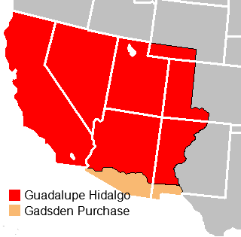
The war’s legacy
1. Highest death rate of any American war (mostly southerners)
2. U.S. gains 500,000 sq. miles of territory
3. Created more issues that eventually led to the Civil War
4. Experience for future Civil War leaders
Notes:
Treaty of Guadalupe Hidalgo: February 2, 1848
*Mexico recognized Rio Grande as boundary
*California and New Mexico ceded to the U.S.
*U.S. pay $15 million
The war’s legacy
*highest death-rate of any US War (11,550 dead from disease/1,700 from battle)
*U.S. gains 500,000 sq. miles of territory
*introduced many future Civil War leaders to battle
*led to Civil War
7

Slide 8
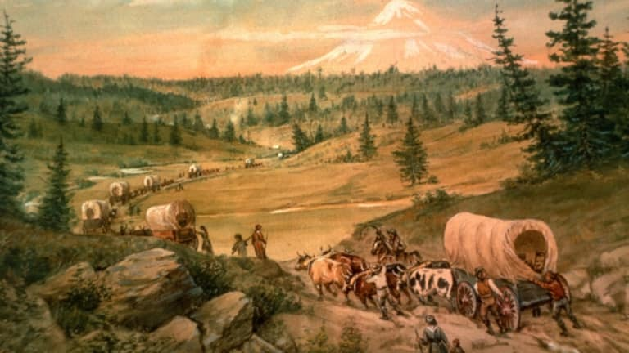
Crash Course Ep. 17: War and Expansion

Slide 9
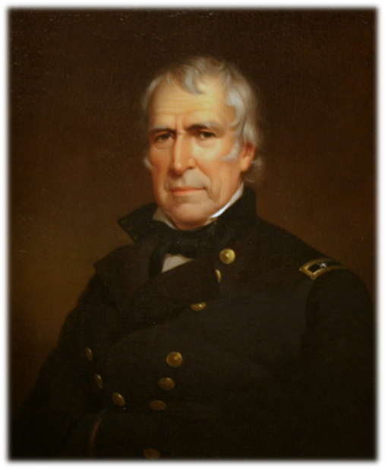
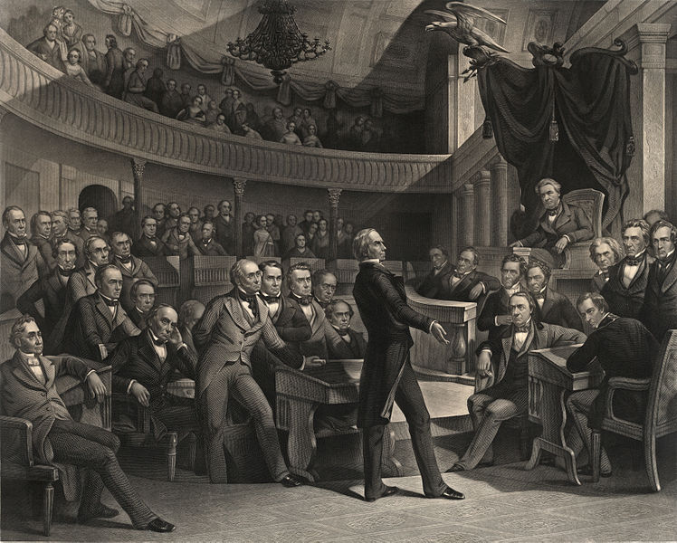
The Sectional Debate
Slavery and the Territories
*extending slavery became biggest issue
*Wilmot Proviso
-would prohibit slavery into new territories
-southerners outraged
*John C. Calhoun
*extending Missouri Compromise line
*Popular Sovereignty
-allow territories to decide
Zachary Taylor, 1849-50
*Mexican war hero elected president
*slave owner from Louisiana
*ironically, against expanding slavery
*refuses to sign early Compromise of 1850 bill
-says its too pro-slavery
-tells Henry Clay to re-write it

Slide 10
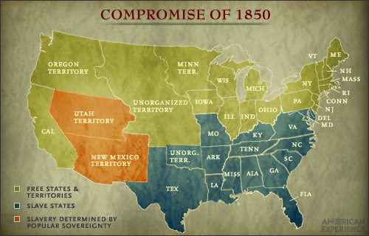
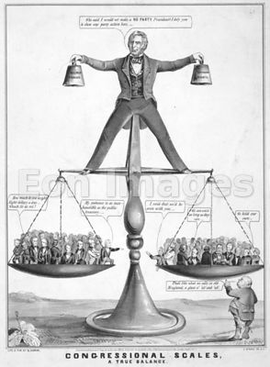
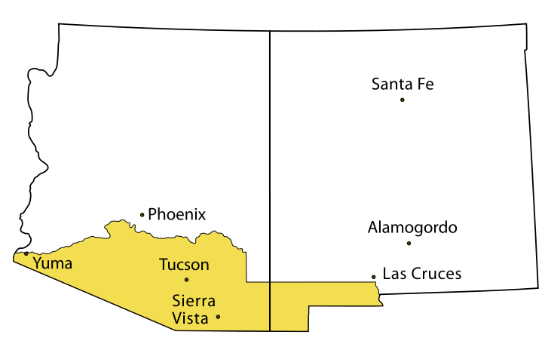
Rising Sectional Tensions
The Compromise of 1850
1. California admitted as a free state
2. Texas loses some land in exchange for its debt paid off
3. Popular Sovereignty in rest of ceded Mexican territory
4. Slave trade abolished in Washington D.C.
5. Stricter Fugitive Slave law enacted
-pissed off Northerners
Crisis of the 1850’s
*Comp. of 1850 clearly favored the south
*many Northerners pissed about FSL
*lots of Americans settling west of Missouri
*much of new land used for agriculture and future transcontinental railroad growth
Gadsden Purchase
*small strip of land needed to build southern trans-railroad
*US paid $10m
Notes:
Compromise of 1850
*the fact that Taylor wanted to make the new territory free, created an uproar throughout the south who threatened secession
*to top it all off southerners were angry at how lax fugitive slave laws were and the fact that Washington D.C. had proposed ending the slave trade and abolishing slavery within its borders
*Southerners were outraged because they felt that Washington D.C. was part of the south and if it became free territory then what would be next
Proposals
*as a result several political leaders, both north and south got together to create a system to deal with the territorial issue
*the initial proposals of the compromise favored the south greatly and Taylor threatened to veto the bill
*Taylor however, a southerner, died suddenly and his vice-president, Millard Fillmore, a New Yorker, decided to have the bill passed
Terms
*the bill clearly favored the South and consisted of five elements
California entered the Union as a free-states however, it elected far more pro-slavery Congressmen which people in the south hoped could change its position in the future
The border between Texas and New Mexico was set and Texas’ debt was paid
The Utah and New Mexico territory was established allowing for popular sovereignty to decide the slave issue
A fugitive slave law was passed which heavily favored slave catcher and pissed off northerners
The slave trade but not slavery was abolished in Washington D.C.
*the Compromise, though shaky, seemed to neutralize unrest in the country
*this, however would only last another ten years before war broke out between the states

Slide 11
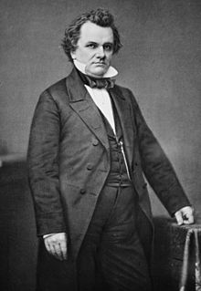
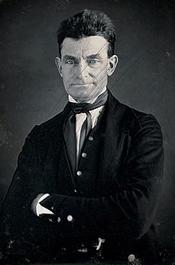
The Kansas-Nebraska Controversy
Stephen Douglas
*Illinois Senator
*trying to get transcontinental railroad in North
*proposed new bill to promote settlement in Kansas- Nebraska territory
*opposed by southerners
Kansas-Nebraska Act, 1854
*allowed popular sovereignty to solve issue
*basically repealed the Missouri Compromise
*pro-slavery and anti-slavery supporters pour into area
*both sides holding illegal elections
“Bleeding Kansas”
*tensions brewed for 2 years
*Lawrence, Kansas: pro-slavery supporters burned buildings
*Potawatomie Massacre
-John Brown – Abolitionist
-his posse murders pro-slavery advocates with broadswords
*basically the beginning of Civil War
Bleeding Sumner…
*further illustrated the growing differences within the nation
Notes:
Kansas-Nebraska Act
*issues over the territories of Kansas and Nebraska began to pop up and come to the forefront of American politics as well
*in 1854 Stephen A. Douglas, a Senator from Illinois, proposed the organization of the Territory west of Missouri (what was known as Kansas and Nebraska) in order to eventually make them states
*the main reason he wanted to do this was so he could begin building railroads in the region to further settle the west
*he feared that this would cause an uproar in the south because the territories would have banned slavery as they were above the 36’30” parallel
*in order to solve the issue he pushed through a bill that repealed the Missouri Compromise (which would have made the territories free states) and allowed them to decided the slave matter through popular sovereignty
*the idea was a disaster
*in order to gain control of the territories both pro and anti-slavery advocates would begin pouring into the region creating a mini-civil war of sorts
*both sides attempted to establish governments that supported their ideas
Bleeding Kansas
*after a vote was taken over the issue each side would accuse the other of illegally casting votes and refuse to recognize the outcome
*not only that but proslavery advocates from Missouri known as border ruffians would cross the border into Kansas vote illegally and then head back into Missouri
*eventually the arguments over voting turned into violence when pro-slavery advocates entered Lawrence, Kansas and burned down several buildings
*anti-slavery advocates retaliated harshly
*John Brown, a fanatical abolitionist from the north, marched into Pottawatomie, Kansas with his four sons and hacked five men to death, in front of their families, with broadswords
*the event sparked off a series of retaliations by both sides that became known as “Bleeding Kansas”
*in essence this was the beginning of the Civil War

Slide 12
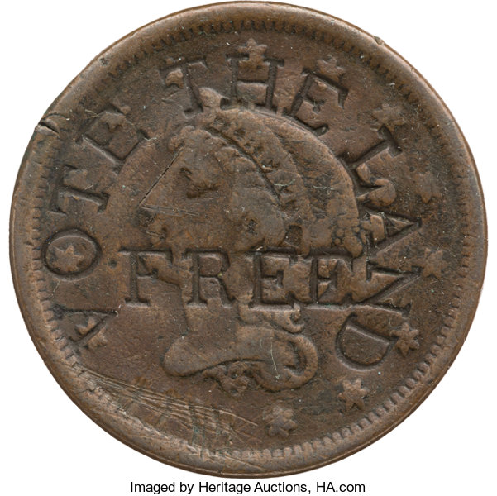
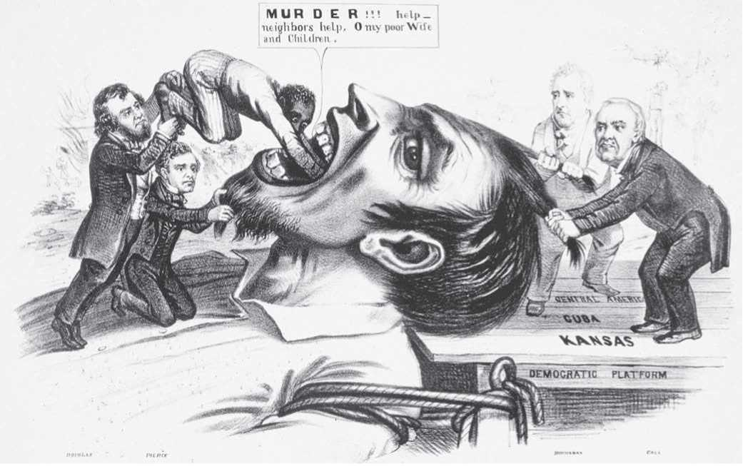
Differing Ideologies
Free-Soilers
*saw the nation progressing towards abolition
*supported free labor system
*felt it was necessary to nation moving forward
*slavery was the antithesis of democracy
*saw the north as prospering and the south as stagnant
*began to develop into the Republican Party
Pro-slavery argument
*slavery was good for the economy as a whole
*religious support
*slavery was good for black laborers
-they were taken care of
-treated better than free laborers in the north
-blacks were inferior and needed the structure of bondage

Slide 13
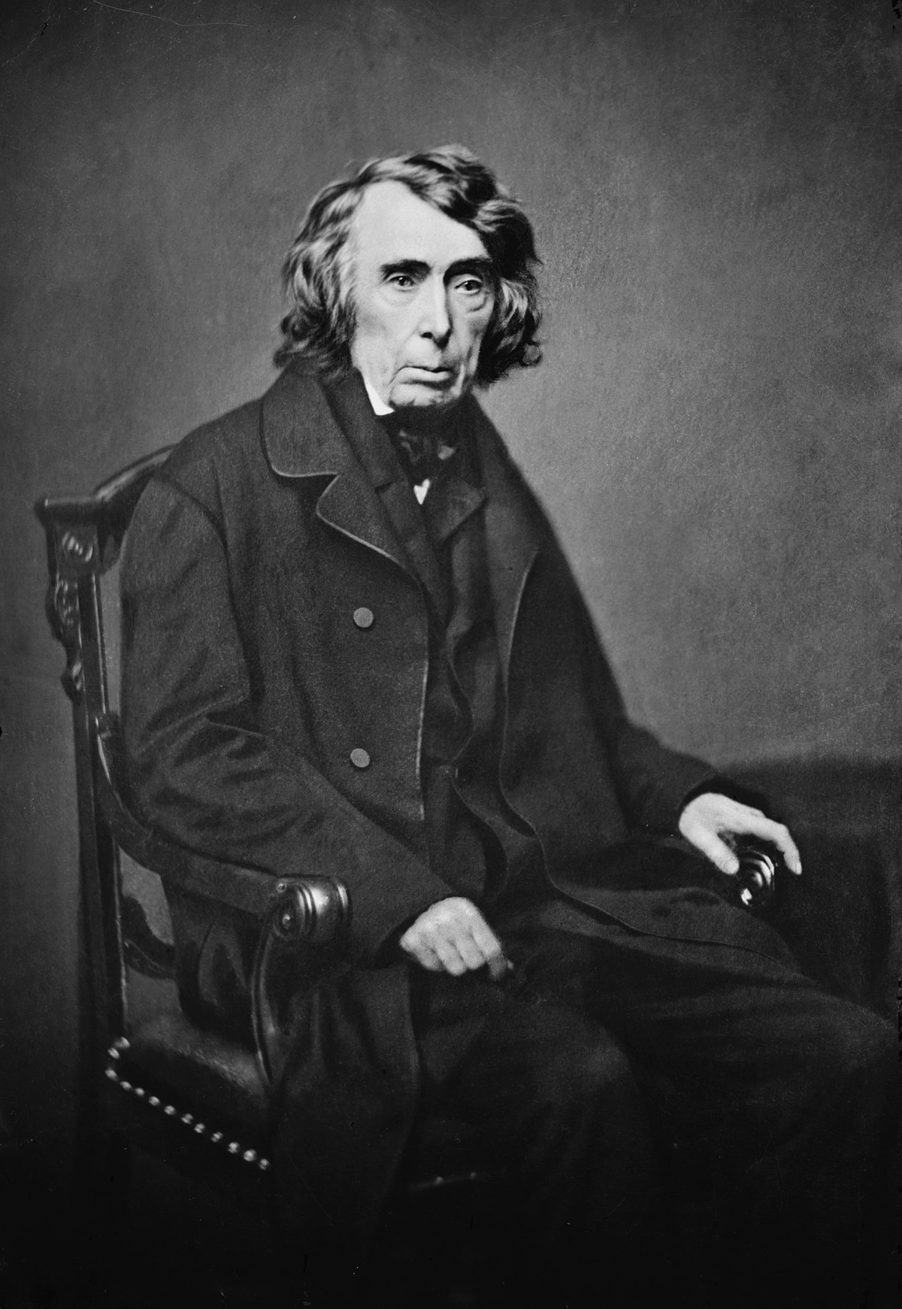
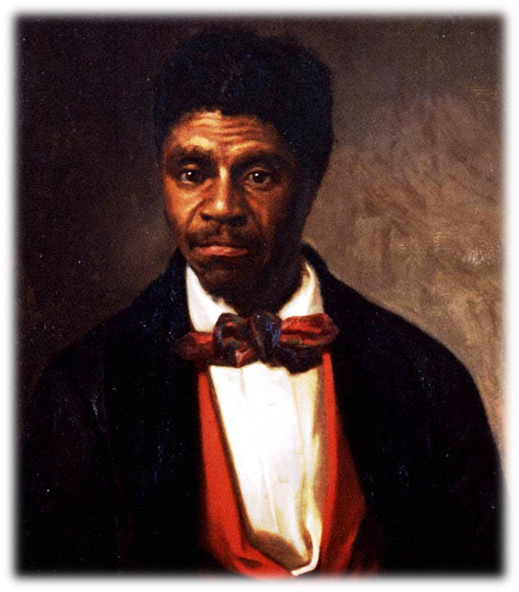
Dred Scott v. Sandford, 1857
Dred Scott
*slave who traveled to free territory w/master
*owner died
*Scott refused to return to owner’s family
*argued he was in free territory and was therefor free
Taney’s Decision
1. Slaves could not sue because they were property
2. 5th Amendment protects property rights even in free territory
3. Congress no longer had the right to exclude slavery from US territories
Outcome
*southerners elated
*northerners were horrified
Notes:
Dred Scott
*slave of an army medical Dr. from Missouri who moved with his master to Wisconsin territory and lived for years there
*married a free black woman and even had kids
*when his owner died the family expected Scott to return to Missouri but he refused and sued for his freedom on the grounds that he had lived in free
territory
*case eventually went to the Supreme court which made one of the most controversial decisions in its history
●The Dred Scott decision
1. Slaves could not sue because they were property and NOT citizens
2. Time in free territory did not make him free
3. Congress did not have the right to exclude slavery from a territory (this essentially got rid of the Kansas-Nebraska Act and the Compromise of 1850)

Slide 14
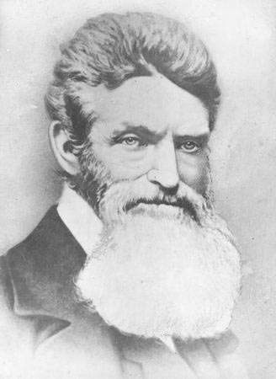
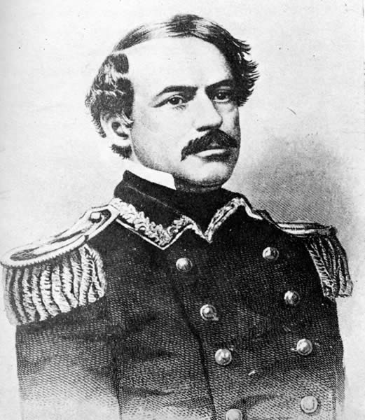
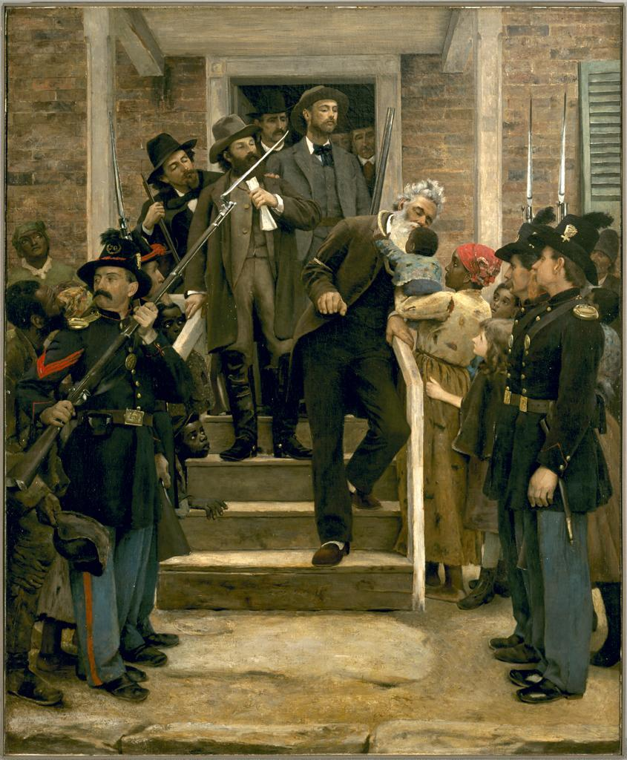
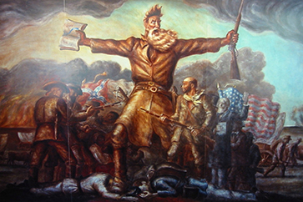
John Brown’s Raid, 1859
Harper’s Ferry, Virginia
*John Brown furious over Dred Scott decision
*takes over federal arsenal at Harpers Ferry
-hoping to start a massive slave rebellion in the south
-wants to give slaves guns and help them gain freedom
Outcome
*10 of his 18 men are killed and Brown captured
*found guilty of treason and executed (hung)
*celebrated and seen as a martyr in the north
*completely freaked out the south
*south on the verge of secession
Notes:
John Brown’s Raid
*partially in response to the Dred Scott decision and partially because he was crazy, John Brown emerged once again in the spotlight
*Brown had grown a beard and his abolitionist zeal had taken on a more extreme form
*on Oct. 16, 1859 Brown set out from Maryland with 21 followers towards the federal arsenal at Harpers Ferry, Virginia
*his goal was to capture as many weapons as possible and head into the south arming slaves and inciting slave revolts as he went
*he hoped to rouse the entire slave population into revolting and thereby gaining their own freedom
*this never happened
*Brown and his men were surrounded at Harpers Ferry by a young officer whose name was Robert E. Lee
*Brown was put on trial for treason and eventually hung but this was not the end of his legacy
*in the north he became a hero, a martyr, whose life and cause was celebrated (bells rung all across the north on his day of execution)
*southerners freaked!
*what if his plan had worked?
*what if there were more John Brown’s in the north
*worse yet, what if the abolitionist sentiment spread into politics and they began taking power?

Slide 15
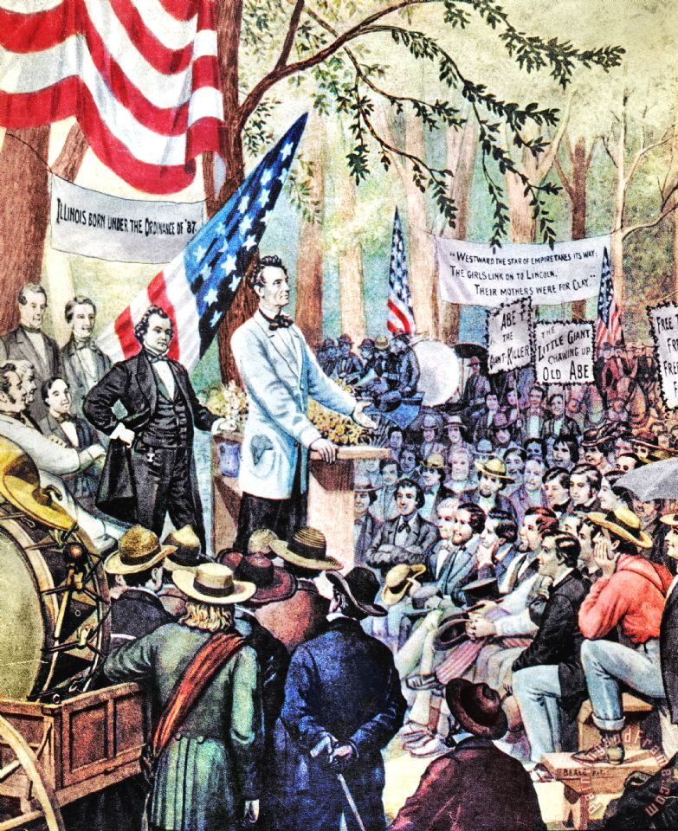
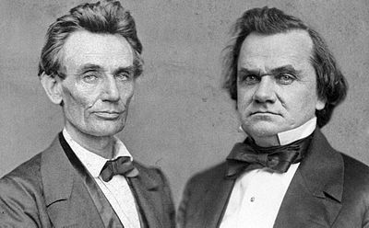
The Emergence of Lincoln
Lincoln Douglas Debates, 1858
*7 debates for Senate seat in Illinois
-Lincoln (Republican) Vs. Douglas (Democrat)
-Douglas wins election but Lincoln wins debates
-Republicans want him to run for president in 1860
Lincoln’s Position
*felt slavery was morally wrong
*felt blacks should have basic rights
*supported slavery where it existed but did not want it to spread

Slide 16
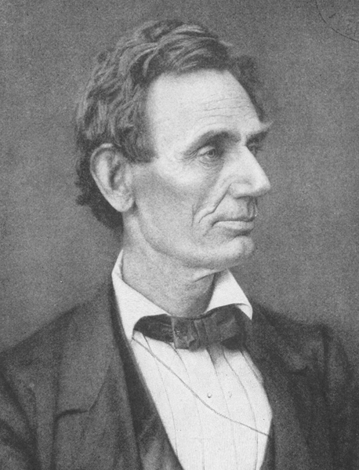
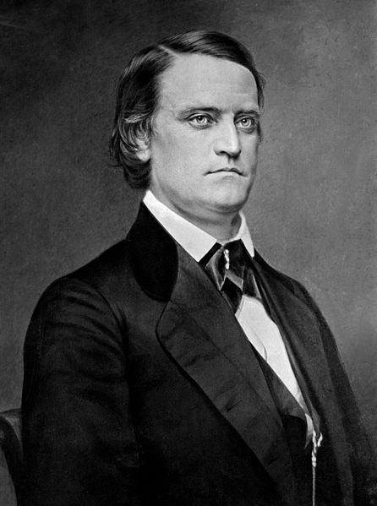
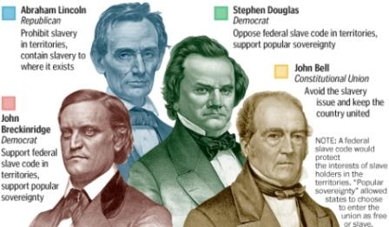
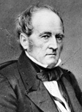
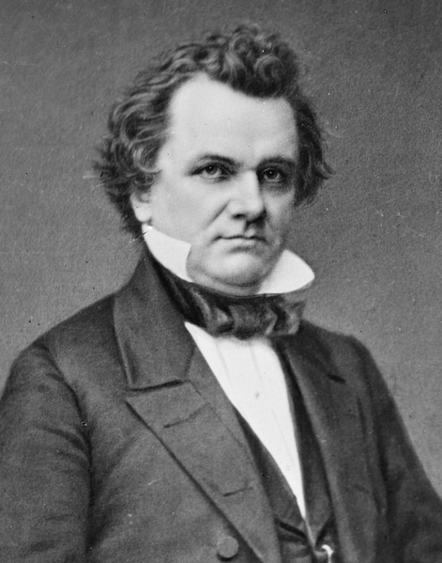
The Election of 1860
Abraham Lincoln (R)
John C. Breckinridge (D)
A House Divided
*most controversial election in US History
*neither side willing to accept a candidate that is not theirs
*Lincoln not even on southern ballots
*Lincoln wins and south calls for secession
*south views Lincoln as an abolitionist
*South Carolina becomes first state to secede
John Bell (C.U.)
Stephen A. Douglas (D)

Slide 17
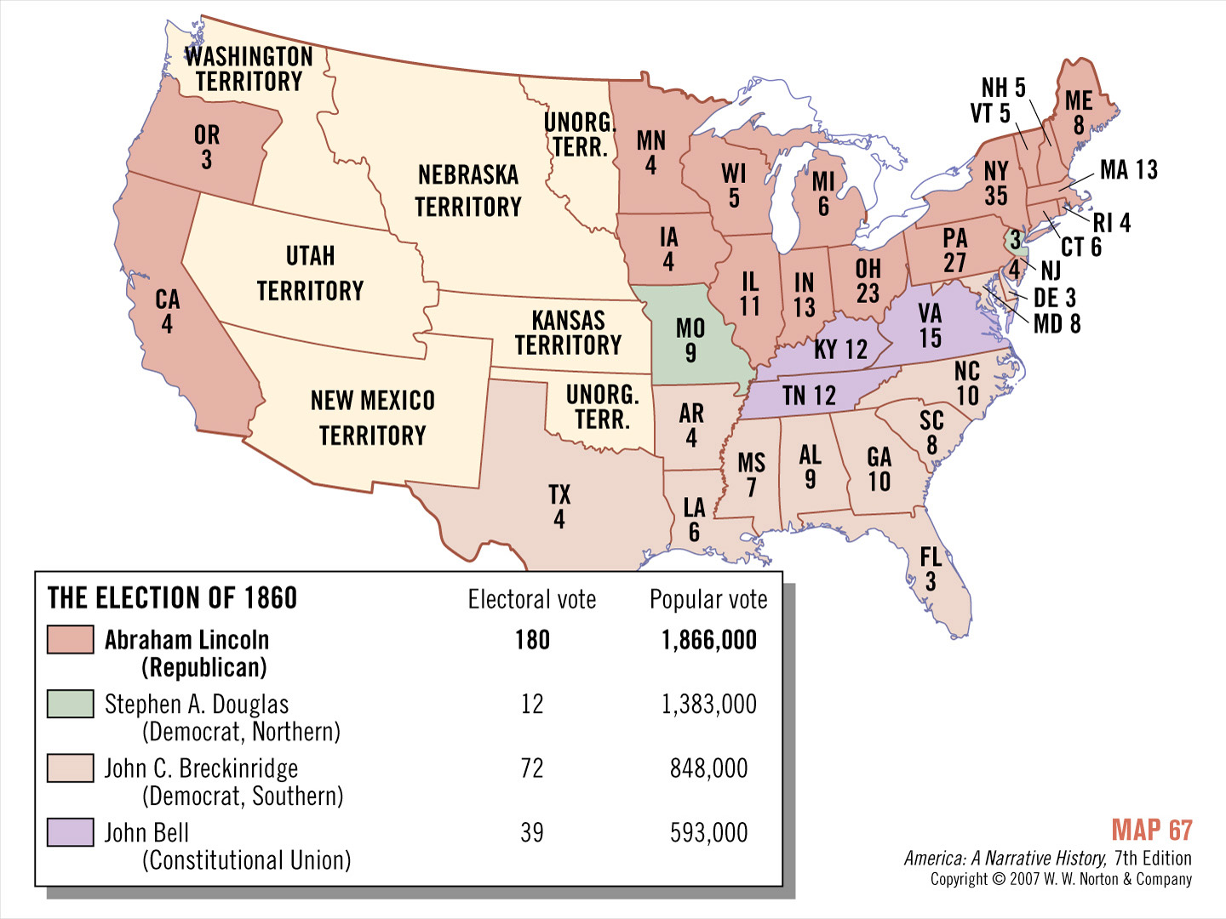
Map 5
Notes:
17

Slide 18
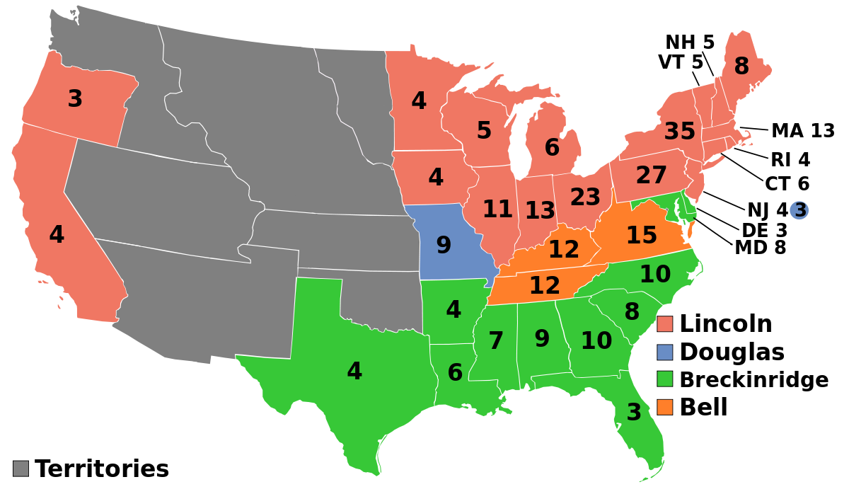
Crash Course Ep. 18: The Election of 1860 and the Road to Disunion

Slide 19
Ch. 13: The Impending Crisis
Focus Questions:
What is Manifest Destiny and how did it shape the United States?
By what means and why did Americans move west?
What was the appeal of certain areas such as Texas, California, and Oregon?
What impact did the Texas Revolution have in shaping American history?
Describe the events leading to the Mexican-American War.
Analyze the impact of the Mexican War.
Describe the Compromise of 1850 and the controversies surrounding it.
What impact did the Kansas-Nebraska Act have?
Evaluate the outcome of the Dred Scott decision.
Describe the impact of John Brown’s raid on Harpers Ferry.
Discuss the Election of 1860 and its outcome.
Notes:
19
The purpose of the focus questions is to help students find larger themes and structures to bring the historical evidence, events, and examples together for a connected thematic purpose.
As we go through each portion of this lecture, you may want to keep in mind how the information relates to this larger thematic question. Here are some suggestions: write the focus question in the left or right margin on your notes and as we go through, either mark areas of your notes for you to come back to later and think about the connection OR as you review your notes later (to fill in anything else you remember from the lecture or your thoughts during the lecture or additional information from the readings), write small phrases from the lecture and readings that connect that information to each focus question AND/OR are examples that work together to answer the focus question.

