Slide 1
Ch. 15: Reconstruction and the New South
Focus Questions:
What was Reconstruction and what was its purpose?
Explain the goals of Radical Republicans.
Identify both Lincoln and Johnson’s plans for reconstruction.
Identify some of the major legislation of Reconstruction (Freeman’s Bureau, Amendments, Tenure of Office Act, etc…)
Describe Johnson’s relationship with Congress (cite specific examples).
Analyze the southern reaction to Reconstruction (KKK, Black Codes, Jim Crow Laws)
Describe the Grant administration (positives/negatives/controversies).
Explain the impact of the Election of 1876.
Identify elements of the New South from a political, social and economic standpoint.
Notes:
1
The purpose of the focus questions is to help students find larger themes and structures to bring the historical evidence, events, and examples together for a connected thematic purpose.
As we go through each portion of this lecture, you may want to keep in mind how the information relates to this larger thematic question. Here are some suggestions: write the focus question in the left or right margin on your notes and as we go through, either mark areas of your notes for you to come back to later and think about the connection OR as you review your notes later (to fill in anything else you remember from the lecture or your thoughts during the lecture or additional information from the readings), write small phrases from the lecture and readings that connect that information to each focus question AND/OR are examples that work together to answer the focus question.

Slide 2
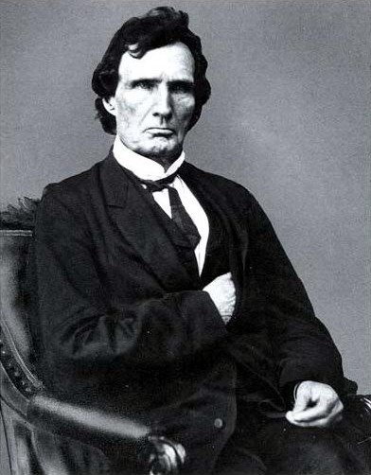
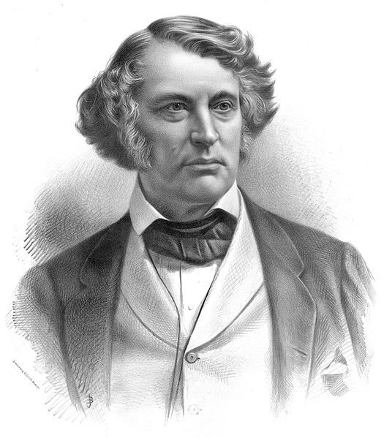
The Problem of Peacemaking
Reconstruction questions:
How should the South be readmitted?
Should leaders be punished?
Radical Republicans:
Thaddeus Stevens and Charles Sumner
Wanted harsh punishments for the South and its leaders
Wade-Davis Bill: (1864)
Majority of white males must pledge allegiance , abolish slavery in state constitutions, and disenfranchise Confederate leaders
Pocket-vetoed by Lincoln
Presidential Reconstruction plans
Lincoln’s 10% Plan: (1863)
Much more favorable than Radical Republicans
10% of voters in 1860 election took oath of loyalty
Lincoln hoped to extend suffrage to certain African-Americans
Johnson’s “Restoration Plan”: (1865)
Favored oath of allegiance, could pardon wealthy Confederates
Favored appointing a governor for each state
By end of 1865 all seceded states met requirements of Lincoln’s or Johnson’s plans

Slide 3
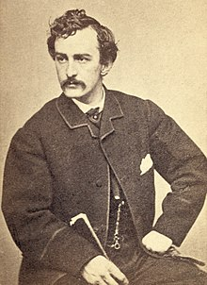
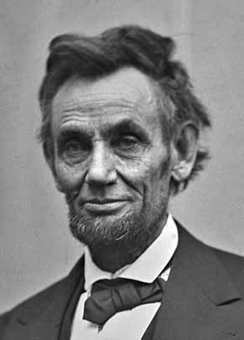
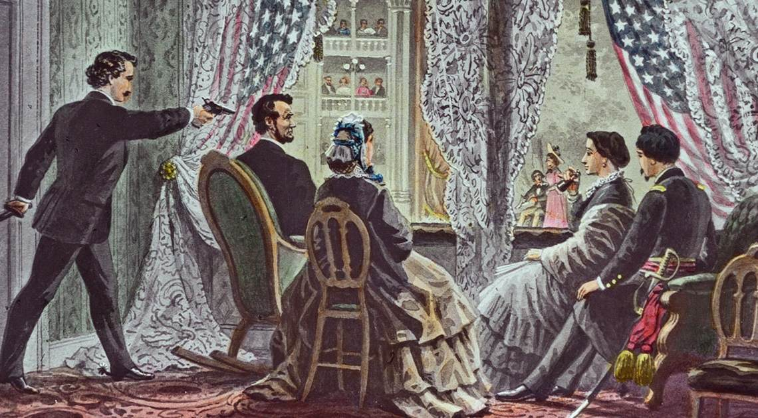
Lincoln’s Assassination: April 14, 1865
John Wilkes Booth
*southern actor and supporter of southern cause
*original plan was to kidnap Lincoln
*shot Lincoln in Ford’s Theatre
*escaped on horseback
*eventually caught and shot by troops
*8 other conspirators found guilty
*4 were hung

Slide 4
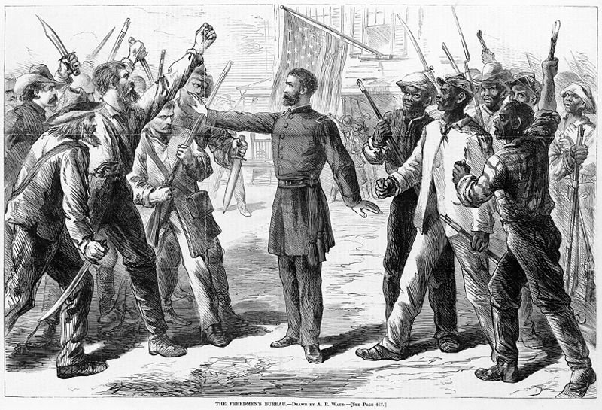
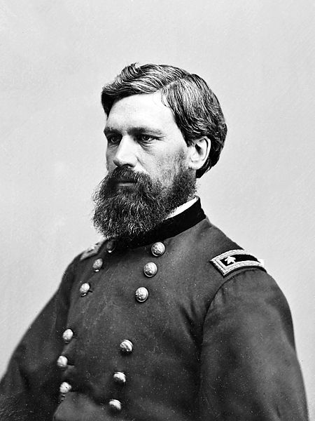
The Problem of Peacemaking
20% of the adult white male population died
“Lost Cause”:
Looking fondly at the South as it was pre-Civil War
Leaders were revered
Many whites wanted to preserve this culture and way of life
Differing views of “freedom”
Southern whites – freedom from the North and federal government
African Americans – same rights and protections as whites
Freedmen’s Bureau:
General Oliver Howard
Provided food, education, medical, legal and family assistance to former slaves and poor whites

Slide 5
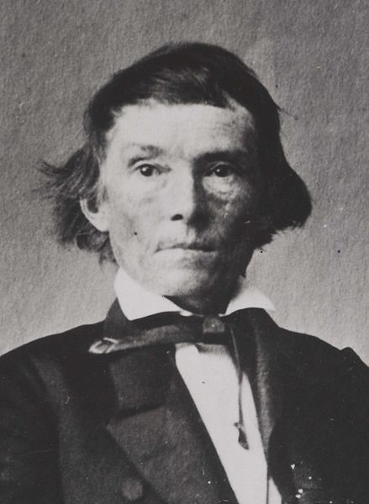
Radical Reconstruction
Why did Congress refuse to recognize Southern governments and begin “Radical Reconstruction?”
“Black codes”:
Harsh laws for African-Americans, could be arrested for being unemployed
Many Southern states elected high ranking Confederates to Congress
Alexander Stephens – Former VP of CSA became a Senator from GA
Civil Rights Act of 1866:
Like almost all acts, it was vetoed by Johnson, then overridden by Congress
Granted Citizenship to African Americans
13th Amendment:
Abolished slavery
14th Amendment:
Granted citizenship to those born in US, and guaranteed “equal protection under the law”
15th Amendment:
Suffrage could not be denied based on “race, color, or previous condition of servitude”

Slide 6
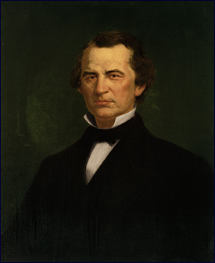
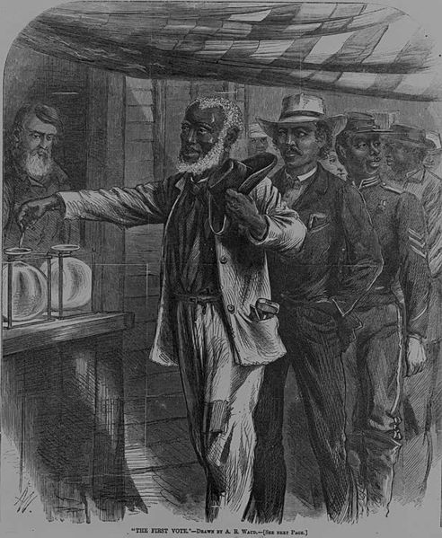
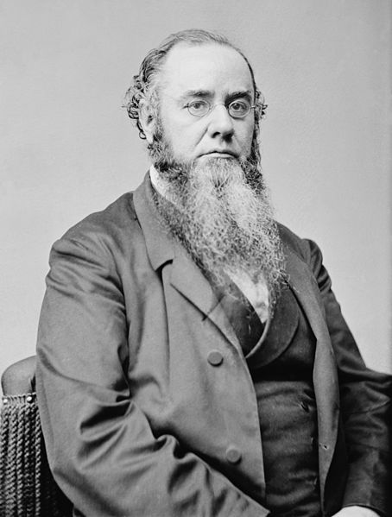
Radical Reconstruction
Congressional Reconstruction:
TN first state to be readmitted to Congress
The rest of the South was divided into 5 military districts
Congress must approve the state constitutions
3 states still not readmitted – (VA, TX, and MI)
Johnson is impeached:
Violated the Tenure of Office Act:
President must get consent of Senate before removing cabinet members
Johnson is impeached, however, he is NOT removed from office

Slide 7
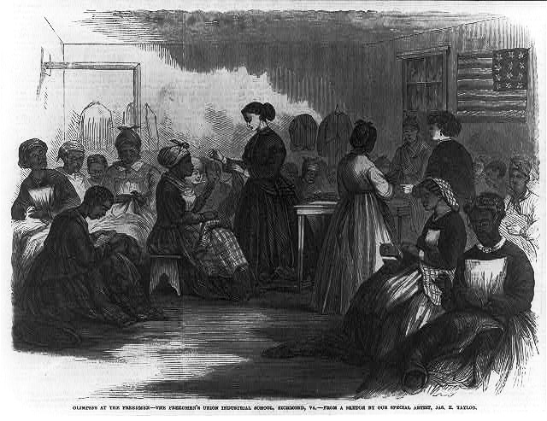
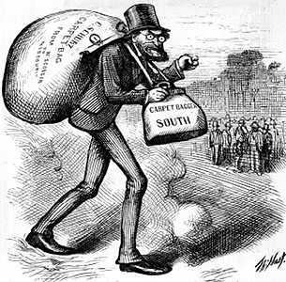
The South In Reconstruction
African-Americans made up a voting majority in SC, MI, LA, AL, and FL
Republicans benefited from this
Key terms to know:
Scalawags: Southerners that favored Reconstruction (mostly for economic reasons)
Carpetbaggers: Northerners that moved South during Reconstruction:
Doctors, lawyers, teachers
African-Americans:
Served as delegates to many state constitutions
20 became members of the House, and 2 in the Senate
Education:
Huge accomplishment during Reconstruction
By mid 1870s, 50% of white children, and 40% of black children went to school
South began to create segregated schools

Slide 8
The South In Reconstruction
“40 Acres and a Mule”
Never really happened, although some African Americans did gain land under the Freedmen’s Bureau
Tennant Farming:
Usually farmers who work for a wage or yearly salary
Don’t own the land or the crops grown
Sharecropping:
Renting land and paying via crops
If a drought or poor farming hit, tenants would be in trouble
Crop-Lien:
Receiving credit from a local store, usually at a HIGH rate (50-60%)
Usually led to debt for borrowers
African-American Women:
Usually worked in domestic tasks
50% of black women worked for money; most were married

Slide 9
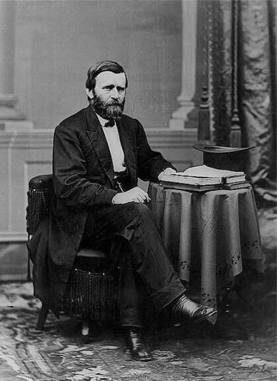
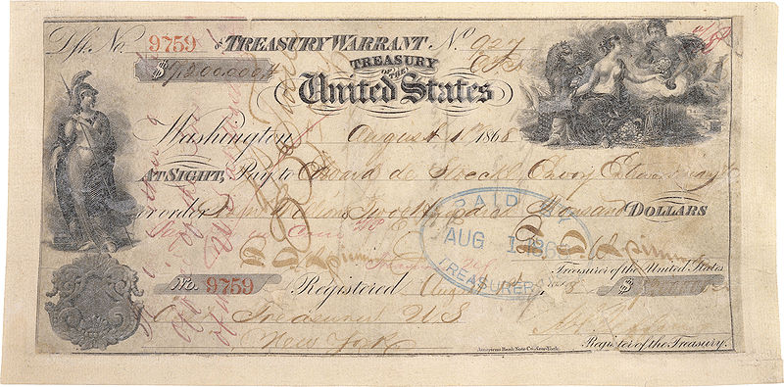
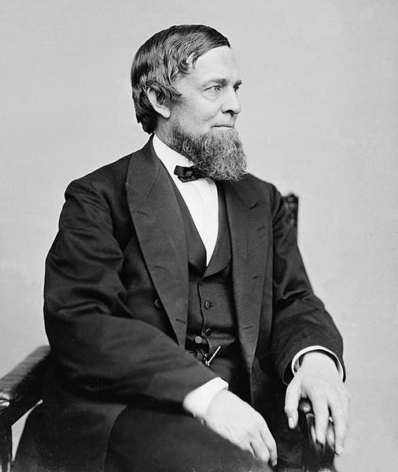
The Grant Administration
Most of his administration is associated with “scandal and corruption”
Regularly used the Spoils System
Republican Party split for the 1872 election over “Grantism”
In the end, Grant served two terms, 1869-1877 (tried for a third later)
Credit Mobilier:
Union Pacific RR company created bogus contracts to make $
Members of Congress, and Grant’s VP accepted bribes
Whiskey Ring:
Government officials were creating false tax reports
Secretary of War accepted bribes
Panic of 1873:
Worse depression of the century to that point
Began by over-investing in RRs
Debtors favored printing paper $ - increase money supply -> inflation -> easier to pay off debt
Specie Resumption Act:
New certificates would be based on gold; eliminate greenbacks
Seward’s Folly - 1867 (Not part of Grant)
William Seward purchased Alaska from Russia
Seen as a mistake by some, later produced large oil reserves

Slide 10
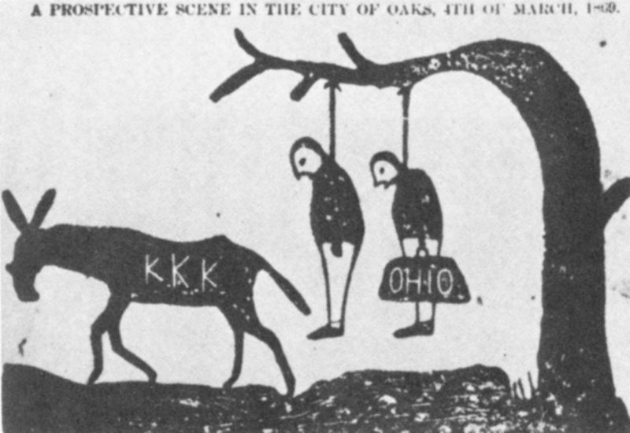
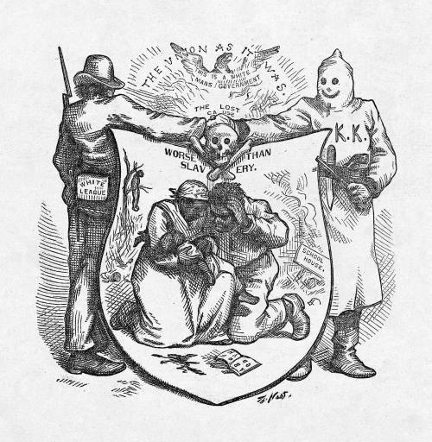
The Abandonment of Reconstruction
By 1877, Democrats “redeemed” 7 states in the South
Red Shirts and White League:
Forced whites to join the Democratic Party, monitored elections
KKK:
Terrorist organization that used to intimidate and prevent blacks from voting
Enforcement Acts: 1870-1871
Response to the KKK
Federal government could now prosecute criminals of federal law
President could use the military to protect individual rights
The Panic of 1873 weakened support for Reconstruction

Slide 11
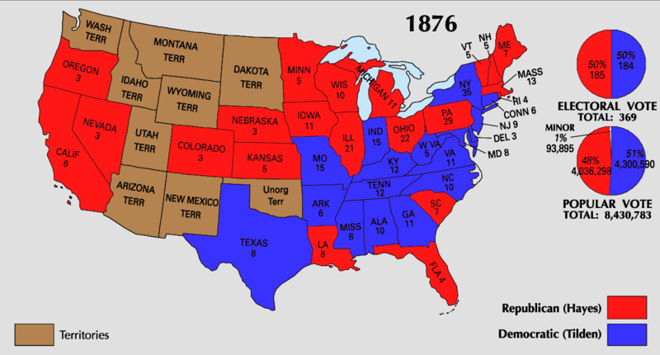
The Abandonment of Reconstruction
Compromise of 1877:
Hayes (Republican) v. Tilden (Democrat)
Tilden received 184 electoral votes to Hays 165; 185 needed to win
20 votes were in dispute
Eventually, all 20 were given to Hayes
Importance of the Compromise of 1877?
RECONSTRUCTION ENDS!
The military is withdrawn from the South
Many African-Americans felt betrayed
Legacy of Reconstruction:
Mostly a failure
Civil Rights not fully addressed
By 1878, all Southern states were back under Democrat control
“Bourbon Redeemers” were much more diverse
Retrenchment of govt. spending and maintaining white supremacy
Allowed in people that weren’t just W.A.S.P.s

Slide 12
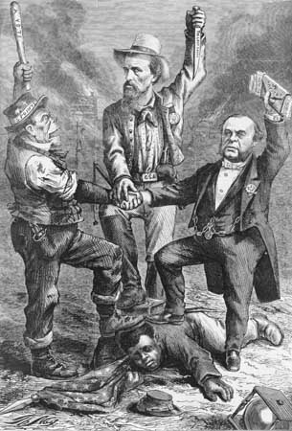

Slide 13
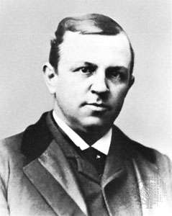
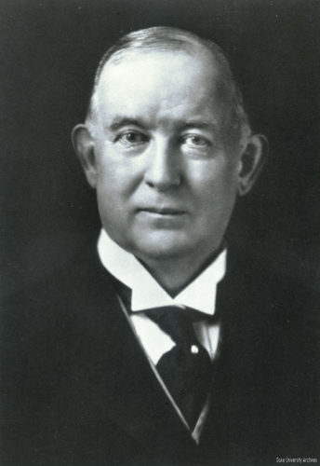
The New South
Education decreased
“schools are not a necessity”
Henry Grady’s “New South”
Atlanta newspaper editor who argued south needed to industrialize
south needed to employ former slaves
Industrialization came slowly at first
James Duke – American Tobacco Company
Textile Mills, Lumber, Iron, diverse agriculture, canning, fishing all new industires in south
RRs increased drastically in 1880s
Used the same gauge as the North (standard gauge)
Many factories refused to hire African-Americans
Those that did paid little and provided harsh jobs

Slide 14
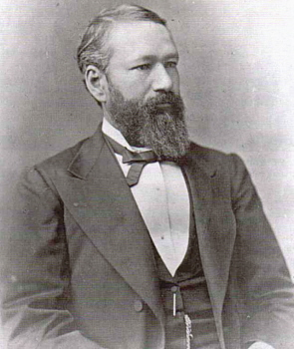
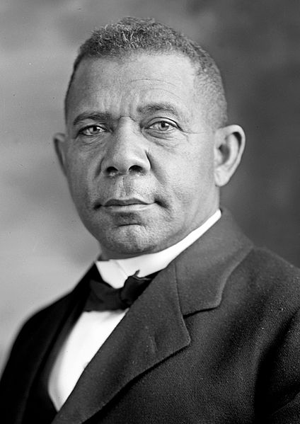
The New South
Black colleges increased
Booker T. Washington (former slave):
Tuskegee Institute
Advocated blacks to gain an education (vocational training)
Learning skills (today – plumbing, auto repair, etc.)
Believed African-Americans should “adopt the standards of the white middle class”
Economic gains before Social gains
The Atlanta Compromise:
African-Americans would NOT challenge segregation if they had economic opportunities
Civil Rights Cases of 1883:
14th Amendment did not prevent private discrimination, only government discrimination
Plessy v. Ferguson:
Established “Separate but equal”

Slide 15
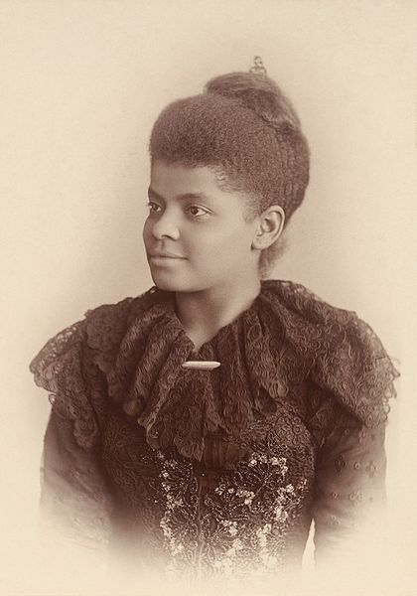
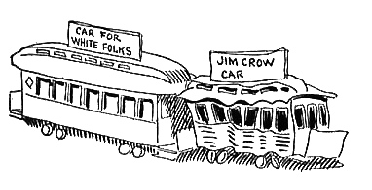
Disenfranchising African-Americans
Poll taxes:
Required a tax to vote
Literacy Tests:
Required to pass a test to vote
African-Americans often received a much harder test
Grandfather clause:
Poll taxes and literacy tests were not required to vote if their ancestors could vote in the election of 1860
Blacks could not vote in 1860
Jim Crow laws:
Legal segregation in the South
Upheld by Plessy v. Ferguson
Lynching:
Increased drastically in the 1890s
Ida B. Wells
Journalist that spoke out against lynching

Slide 16
Ch. 15: Reconstruction and the New South
Focus Questions:
What was Reconstruction and what was its purpose?
Explain the goals of Radical Republicans.
Identify both Lincoln and Johnson’s plans for reconstruction.
Identify some of the major legislation of Reconstruction (Freeman’s Bureau, Amendments, Tenure of Office Act, etc…)
Describe Johnson’s relationship with Congress (cite specific examples).
Analyze the southern reaction to Reconstruction (KKK, Black Codes, Jim Crow Laws)
Describe the Grant administration (positives/negatives/controversies).
Explain the impact of the Election of 1876.
Identify elements of the New South from a political, social and economic standpoint.
Notes:
16
The purpose of the focus questions is to help students find larger themes and structures to bring the historical evidence, events, and examples together for a connected thematic purpose.
As we go through each portion of this lecture, you may want to keep in mind how the information relates to this larger thematic question. Here are some suggestions: write the focus question in the left or right margin on your notes and as we go through, either mark areas of your notes for you to come back to later and think about the connection OR as you review your notes later (to fill in anything else you remember from the lecture or your thoughts during the lecture or additional information from the readings), write small phrases from the lecture and readings that connect that information to each focus question AND/OR are examples that work together to answer the focus question.

