Slide 1
Ch. 16: The Conquest of the Far West
Focus Questions:
What was the perception of the West before and after the Civil War? In what ways was it different?
Identity some of the groups who already lived in the west as well as some of the people who moved west and why they moved west.
In what ways was the west appealing for settlers?
What were some of the new industries that developed in the west and why were they important?
How was farming in the west different than farming in the south?
Explain the U.S. government’s policy towards the native population.
Identify some of the events that led to the pacification of the Native Americans.
Notes:
1
The purpose of the focus questions is to help students find larger themes and structures to bring the historical evidence, events, and examples together for a connected thematic purpose.
As we go through each portion of this lecture, you may want to keep in mind how the information relates to this larger thematic question. Here are some suggestions: write the focus question in the left or right margin on your notes and as we go through, either mark areas of your notes for you to come back to later and think about the connection OR as you review your notes later (to fill in anything else you remember from the lecture or your thoughts during the lecture or additional information from the readings), write small phrases from the lecture and readings that connect that information to each focus question AND/OR are examples that work together to answer the focus question.

Slide 2
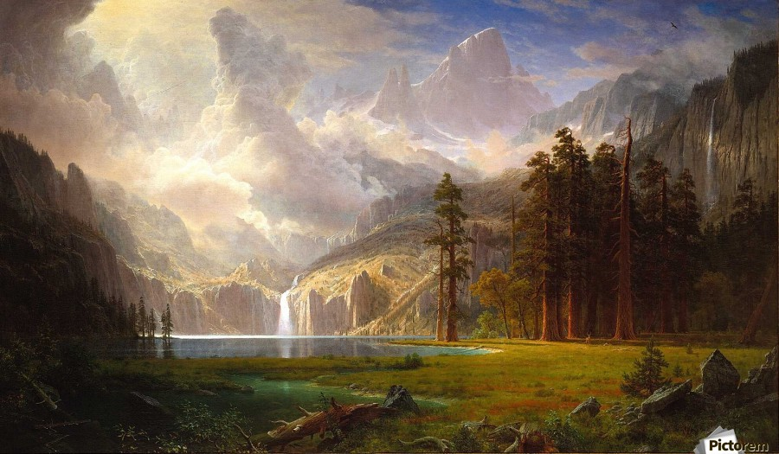
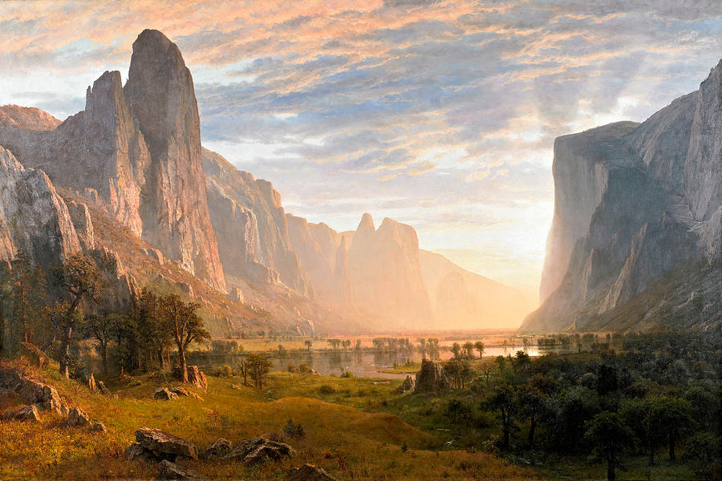
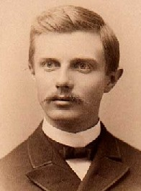
Romance of the West
The Landscape
*Americans had always been captivated by the west
*opportunities
-land
-beauty
-adventure
-new industries
-painters promoted tourism tours
The Last Frontier
*west had been seen as a “safety valve”
*when things get bad back east; head west
*was dangerous and uninhabited
Turner’s Frontier Thesis
*Frederick Jackson Turner – historian
*Significance of the West on American History
*the “frontier” ended in 1890
-how would America define itself?
-where else would we expand?
*Inaccuracies
-”Frontier” was not uninhabited
-the US would redefine expansion
Albert Bierstadt paintings

Slide 3
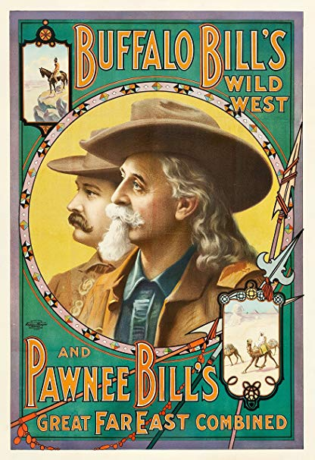
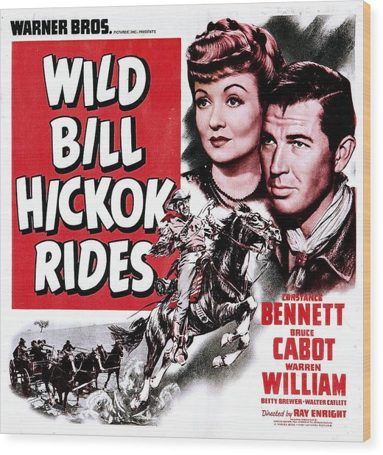
Pop Culture
Important Figures
*Mark Twain – Huck Finn, Tom Sawyer
*Teddy Roosevelt – fascinated with the west
*Frederick Remington – Painter/Sculptor
The “Wild West”
*Cowboys – mythologized
-represented free spirit of the west
-admired as heroes
-eulogized in literature, song, film, pictures
-wild west shows extremely popular
*Tombstone
*Wild Bill Hickok

Slide 4
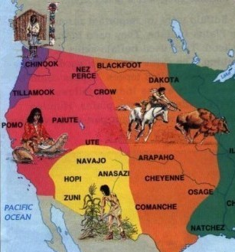
The Societies of the Far West
The Western Tribes
*Tribes of the Oklahoma Territory – (Cherokee, Creek)
*Pacific Coast tribes – (Chinook, Pomo)
-mostly permanent settlements
-fishing/hunting/trade
*Pueblo tribes of the Southwest – (Apache, Navajo, Comanche)
-mix of permanent and migratory settlements
-farming and trade important
*Plains Indians – (Sioux/Dakota, Cheyenne, Nez Perce)
-mostly migratory tribes
-hunted buffalo
-relied on horses introduced by Spanish
-extremely territorial and warlike
Weaknesses
*tribes not united
*susceptible to diseases
*outmanned and not technologically advanced

Slide 5
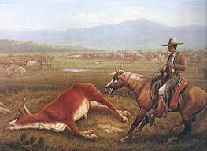
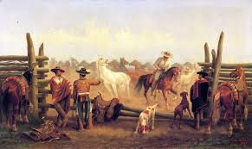
The Hispanic West
New Mexico
*50k Hispanics living in region after Mexican-American War
*controlled by small population of whites
*Hispanics maintained autonomy due to having a larger population and living far from white society
California and Texas
*Mexican aristocracy in California ruled until whites began pouring into the area
*many lost their lands and status
*same was happening in Texas
*white settlement did open up new economic ventures
*cattle ranching increased as well as trade

Slide 6
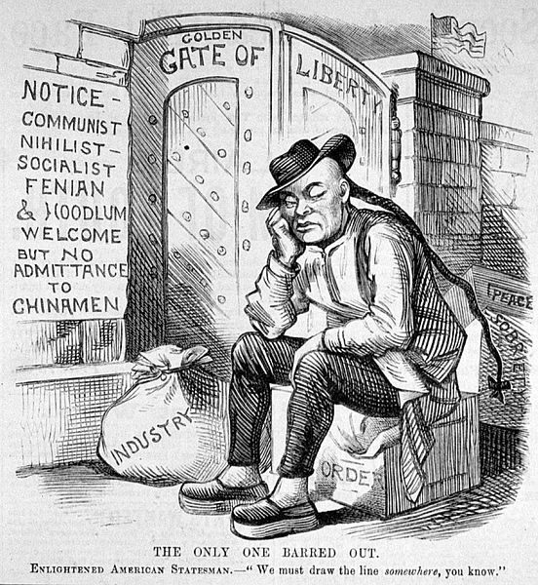
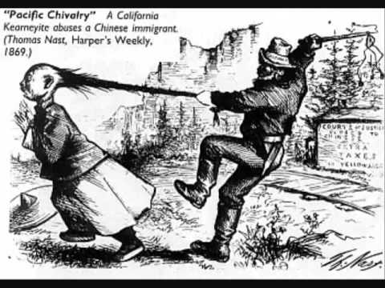
Chinese Migration
Immigration
*left poverty for American economic opportunities
*mainly went to California due to gold rush of 1848
*200k Chinese in California by 1880
*established “Chinatowns”
-San Francisco – merchants, business owners
*most became laborers in mines or on railroads
-90% of workers for the Central Pacific Railroad were Chinese
-often had the most dangerous jobs
-worked for the lowest wages
*whites saw them as rivals and hated them
Racism
*violence towards Chinese increased
-attacks on workers, burning businesses
*were seen as “unassimilable”
*whites feared their strange culture
-men wore “dresses”, clogs, had pigtails, bathed regularly
Chinese Exclusion Act
*permanently banned Chinese immigration until after WWII
*one of the most discriminated group in US history

Slide 7
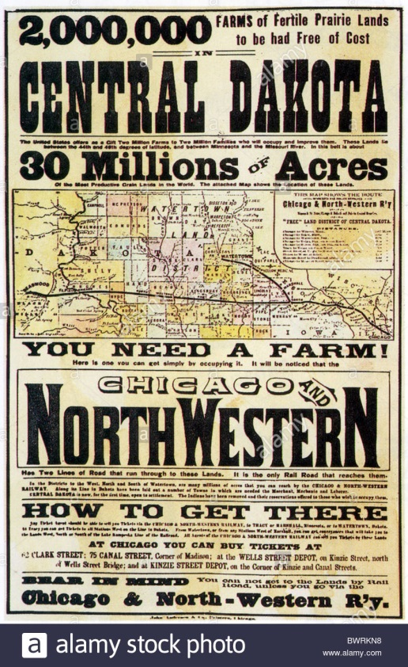
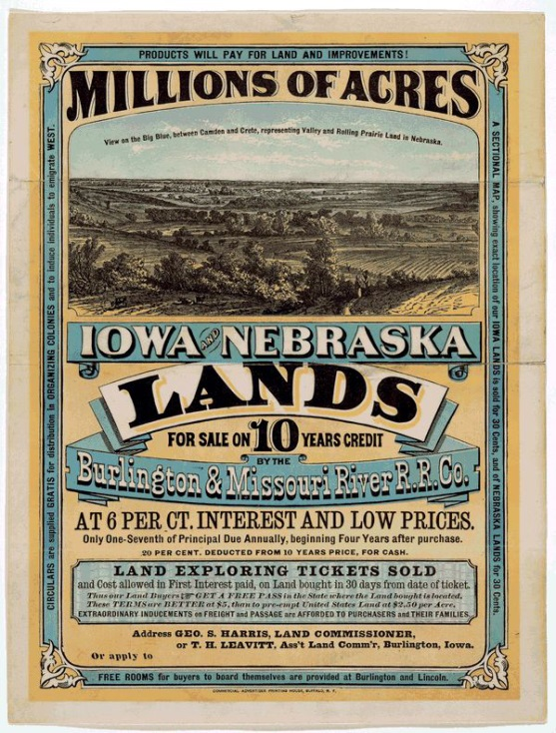
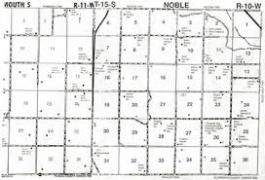
Migration from the East
Homestead Act of 1862
*led to the largest population movement in history
*gave 160 acres to anyone for free
-had 5 years to improve the land
*millions of people moved west
-2m immigrants between 1870-1900
*lots of fraud
*land wasn’t always good
*railroad companies and other corporations got most of the land
*nonetheless, resulted in large settlement and development of new states
Far and away scene

Slide 8
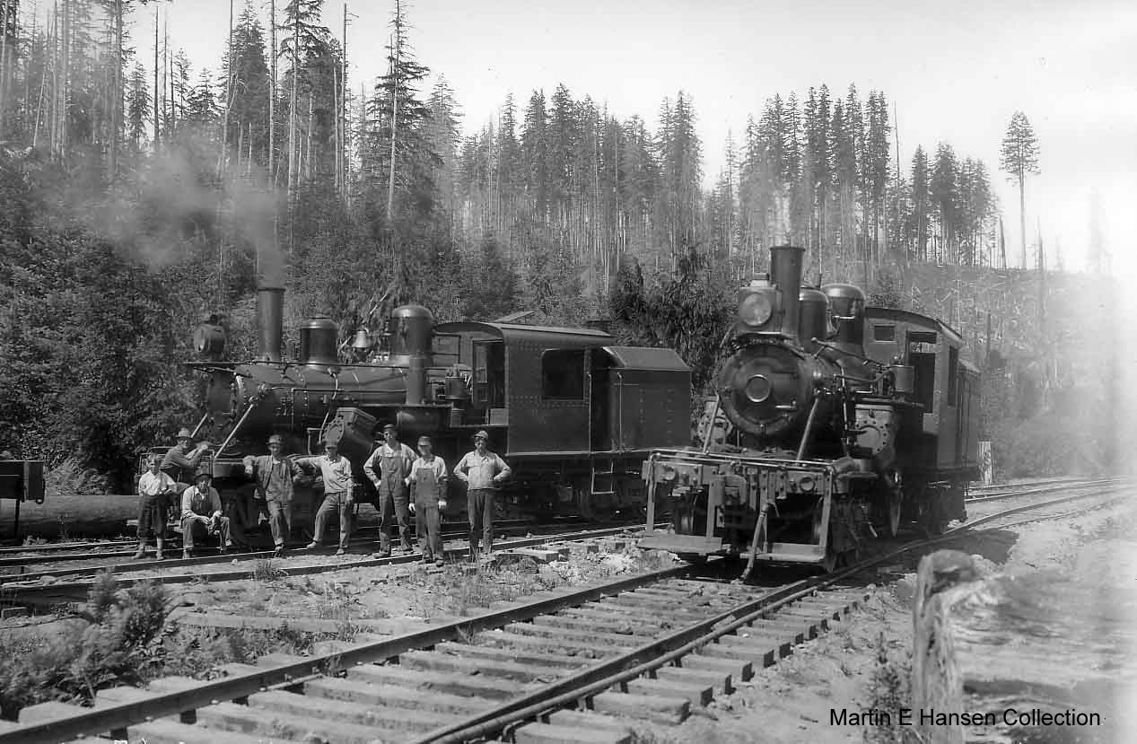
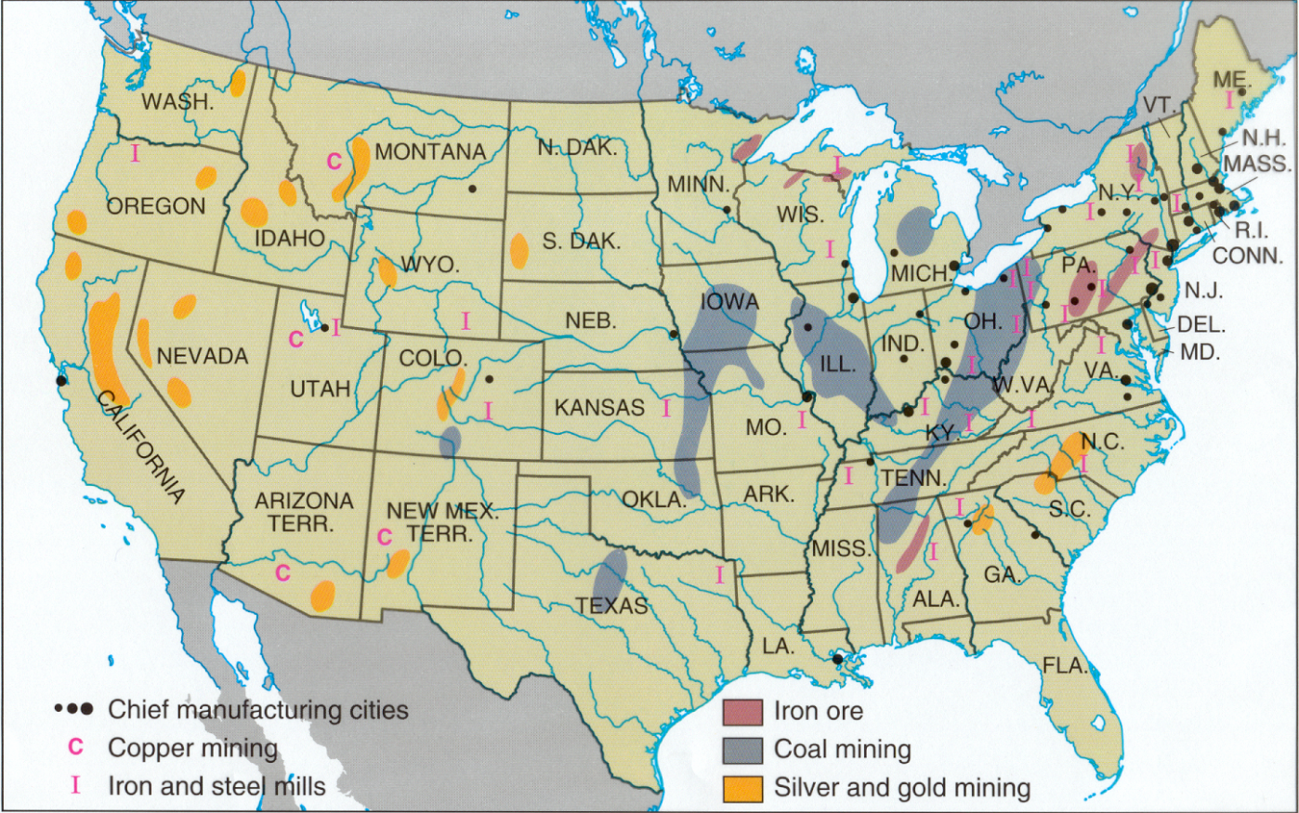
The Changing Western Economy
Connection with the East
*railroads gave easier access to the west
*many mines, farms, ranches, factories were owned by eastern companies
*growth of industry resulted in growth of population
*states developed as a result
*many of those states allowed for women’s suffrage
-needed women to vote in order to boost population
-thought women were more virtuous than men

Slide 9
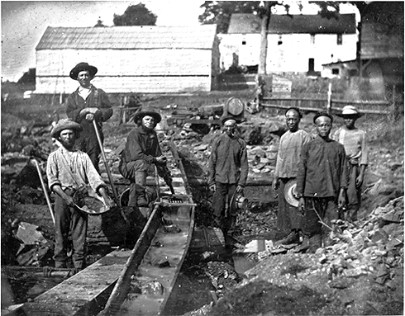
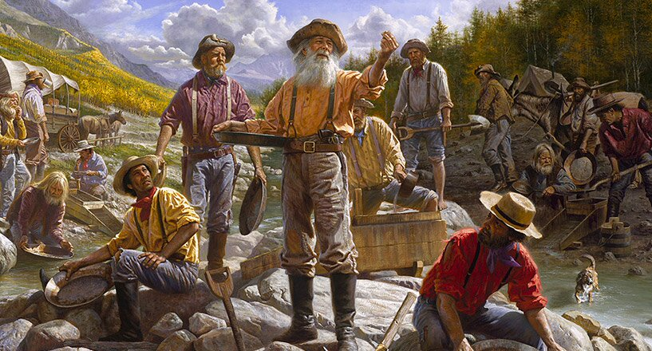
Mining
Mining Boom
*mining first great industry in the west
*important discoveries in Colorado, California, Utah, Nevada, the Dakotas, Montana
*drew people from all backgrounds
*mining came in cycles
-discovery
-boom towns → ghost towns
Boom Towns
*Denver, San Francisco examples of a few that survived
*Tombstone, Deadwood, Leadville = ghost towns
*breakdown of boomtowns
-cramped and dirty
-lawlessness was rampant
-lots of immigrants
-gender imbalance (not many women)
Comstock Lode - Nevada
*HTP Comstock – fur trapper who discovered silver
*largest silver discovery in history

Slide 10
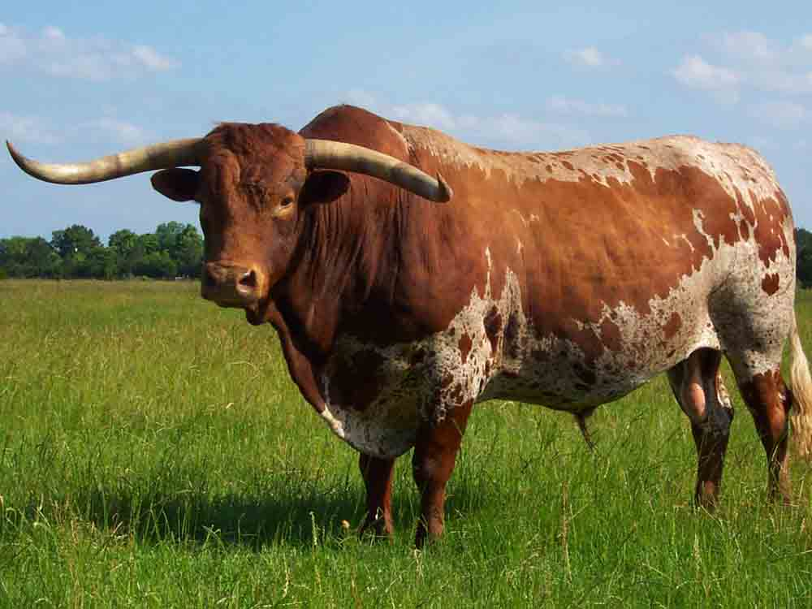
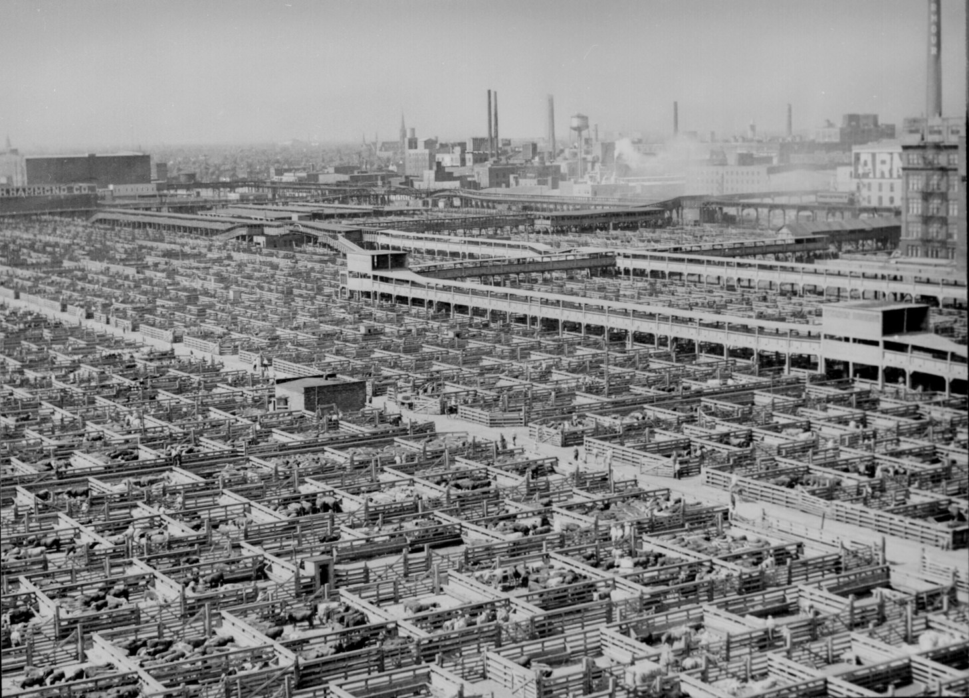
The Cattle Kingdom
Spanish/Mexican Origins
*roundups, open range cattle drives
*tools – (branding, lariats, saddles, chaps, spurs)
*the longhorn
Post Civil War
*5m cattle roaming Texas
*market for cattle boomed due to the war
-people wanted beef/leather
Cow Towns – Abilene, Dodge City, Wichita (Kansas)
*facilities where cattle could be bought and sold
*major railheads that could ship cattle to North and East
*millions of cattle driven along Chisolm Trail from Texas to Kansas, Nebraska, Wyoming, Montana, Colorado
Cowboy Life
*extremely dangerous and not glamourous
*about 1/3rd were former slaves
Technology
*refrigerated railcars and barbed wire ended open range
*large ranches developed

Slide 11
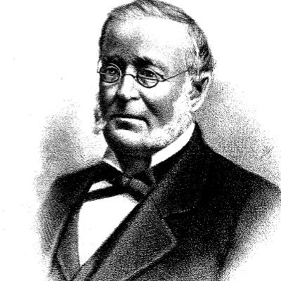
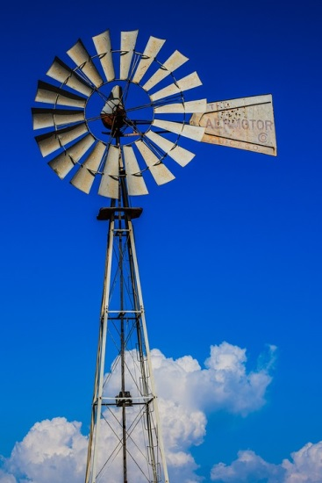
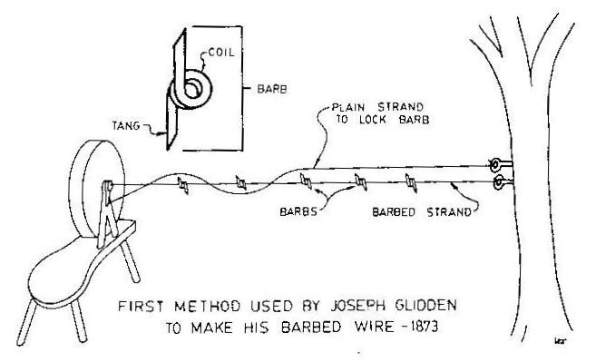
Farming the Plains
Important role of railroads
*produced a surge in western settlement
-western land now accessible
*made it easier to sell crops and get farming equipment
Barbed Wire – Joseph Glidden
*prevented cattle from grazing on farmland
*led to a fight between farmers and ranchers
Drought
*farmers had to find ways to irrigate crops
*mostly diverted rivers and streams
*prairie fan – windmills, wells, retention ponds
Commercial Agriculture
*began competing with small farmers
*farming now an international business
*overproduction led to a decline in crop prices
*American farmers have never really recovered

Slide 12
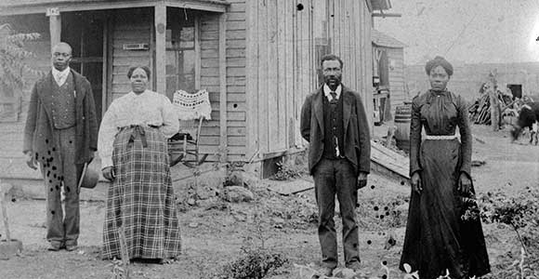
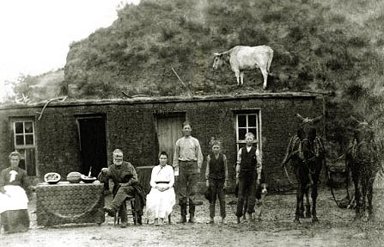
The Farmers
“Exodusters”
*African American farmers in the west – mostly Kansas
*mostly former slaves who wanted out of the south
“Sodbusters”
*farmers in the west
*named after the “sod” or topsoil in the plains
*extremely difficult life
-mostly isolated from outside world
-nature was harsh
-droughts were frequent
-weather unpredictable
-couldn’t afford shipping rates
-had to compete with “Bonanza” farms
*built “soddies” to live in
-homes made from bricks of grass

Slide 13
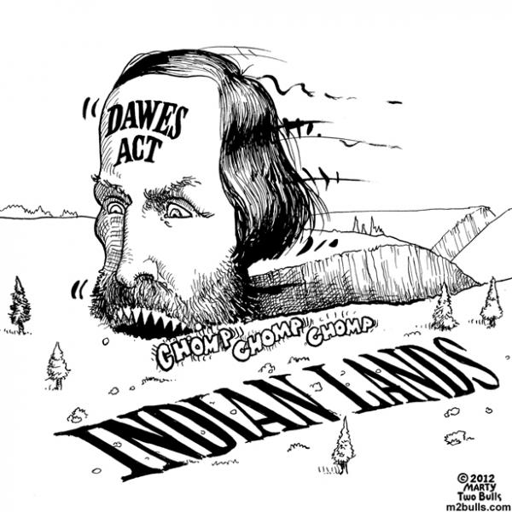
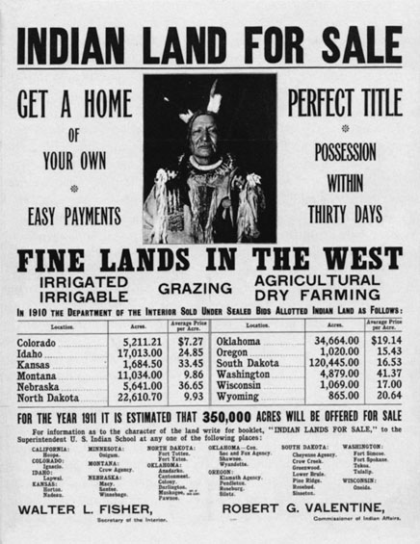
The Indians
Dispersal of the tribes
*migration spelt the end for natives and their lands
* “concentration policy” – push natives to one large area
*Reservation policy – poorly administered
-forced tribes into smaller areas
Dawes Act
*an attempt to assimilate natives into American society
*gave land to individual native families
*natives could gain partial citizenship if they agreed
*forced native children into boarding schools
-changed names, cut hair, forced to learn English, expected to convert to Christianity
Decimation of the Buffalo
*natives relied heavily on buffalo
-materially and spiritually
*white begin hunting them by thousands
*every dead buffalo = dead native
*1850’s -> 30m buffalo in Great Plains
*1900 -> 300 buffalo left
-mostly wiped out from hunting but some ecological

Slide 14
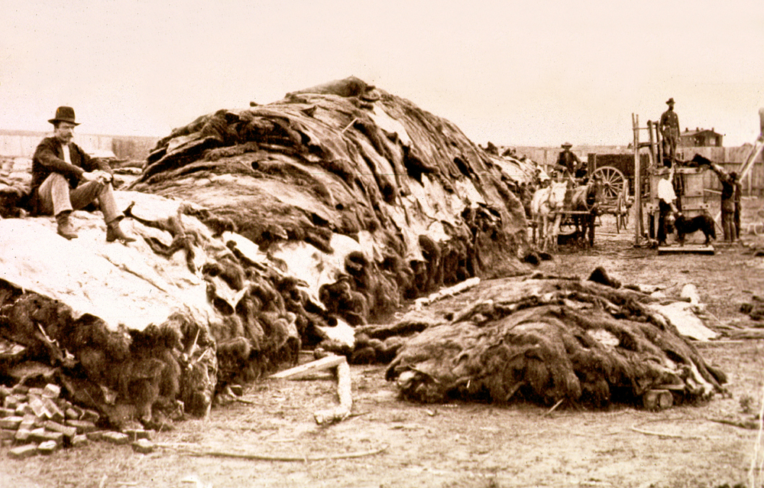
Demise of the buffalo
Notes:
14
Demise of the buffalo
*one of the events that led to the pacification of most of the tribes out west was the demise of the great buffalo herds
*to the plains Indians the buffalo was like a walking convenience store
*it was essential to the survival of the tribe
*knowing this, the government sanctioned the massive harvesting of buffalo herds
1. Intensive harvesting
*when the Spanish arrived in North America in the early 1500’s there were more than 30 million buffalo roaming the great plains
*by 1850 less than 10 million
*by 1900 a few hundred
*there were a few reasons for the drop in population
*intensive harvesting by buffalo hunters who killed more than 100 a day
*whites accounted for millions of buffalo deaths between 1870-80
*they literally shot the buffalo by the thousands and left them to rot on the prairie
*the only thing they took were the hides as they were worth a fortune back east
*this type of behavior was encouraged because, as one Army officer put it, “every dead buffalo is an Indian gone”.
*the Indians also helped dwindle down the number of buffalo roaming the plains
2. Replacement by cattle
*competition from livestock also led to the demise of the buffalo
*horses and cattle were growing in number in the west and taking over the grazing land of the buffalo
*cattle and horses also carried diseases that helped kill off the buffalo

Slide 15
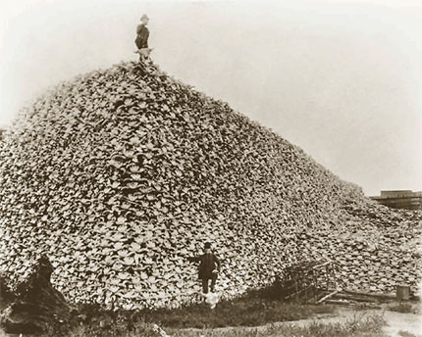
Notes:
15

Slide 16
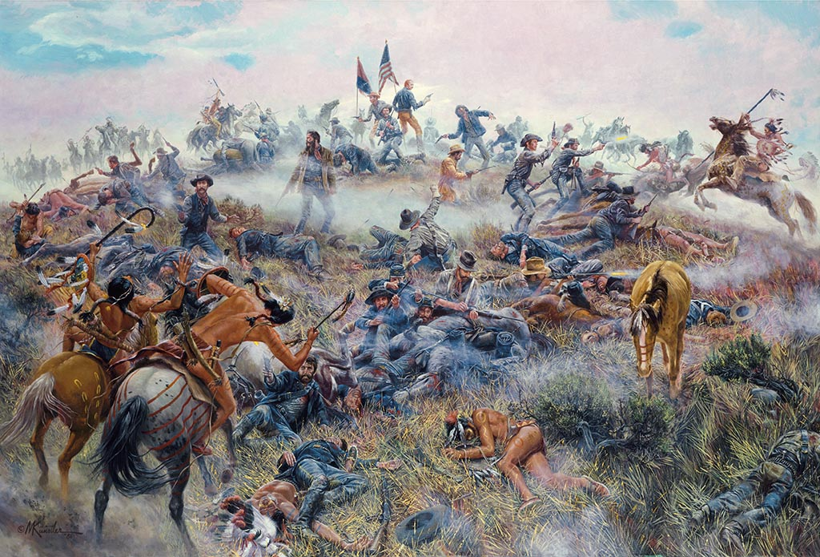
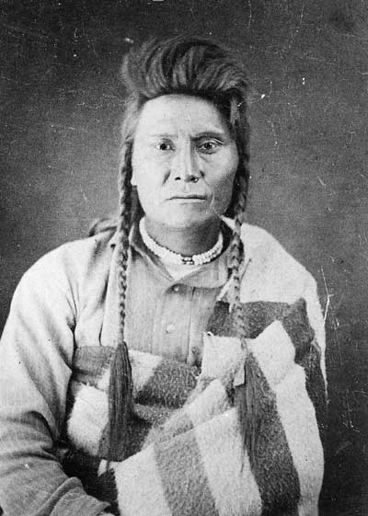
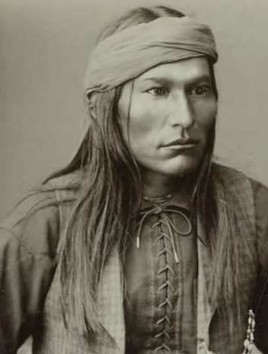
The Indian Wars
Sand Creek Massacre, Colorado – 1864
*Cheyenne in conflict with white miners
*105 women and children killed along Sand Creek
Battle of Little Bighorn, Montana – 1876
*George Armstrong Custer
*Chiefs Crazy Horse and Sitting Bull
*250 U.S. cavalry massacred by 2,500 Sioux warriors
Chief Joseph and the Nez Percé
*550 Nez Percé captured by U.S. Army attempting to escape to Canada
*forced onto reservation
Apache Wars
*Apache under leadership of Geronimo elude capture for 10 years in Arizona and Mexico
“I am tired. My heart is sick and sad…. I will fight no more forever.” -Chief Joseph
Geronimo

Slide 17
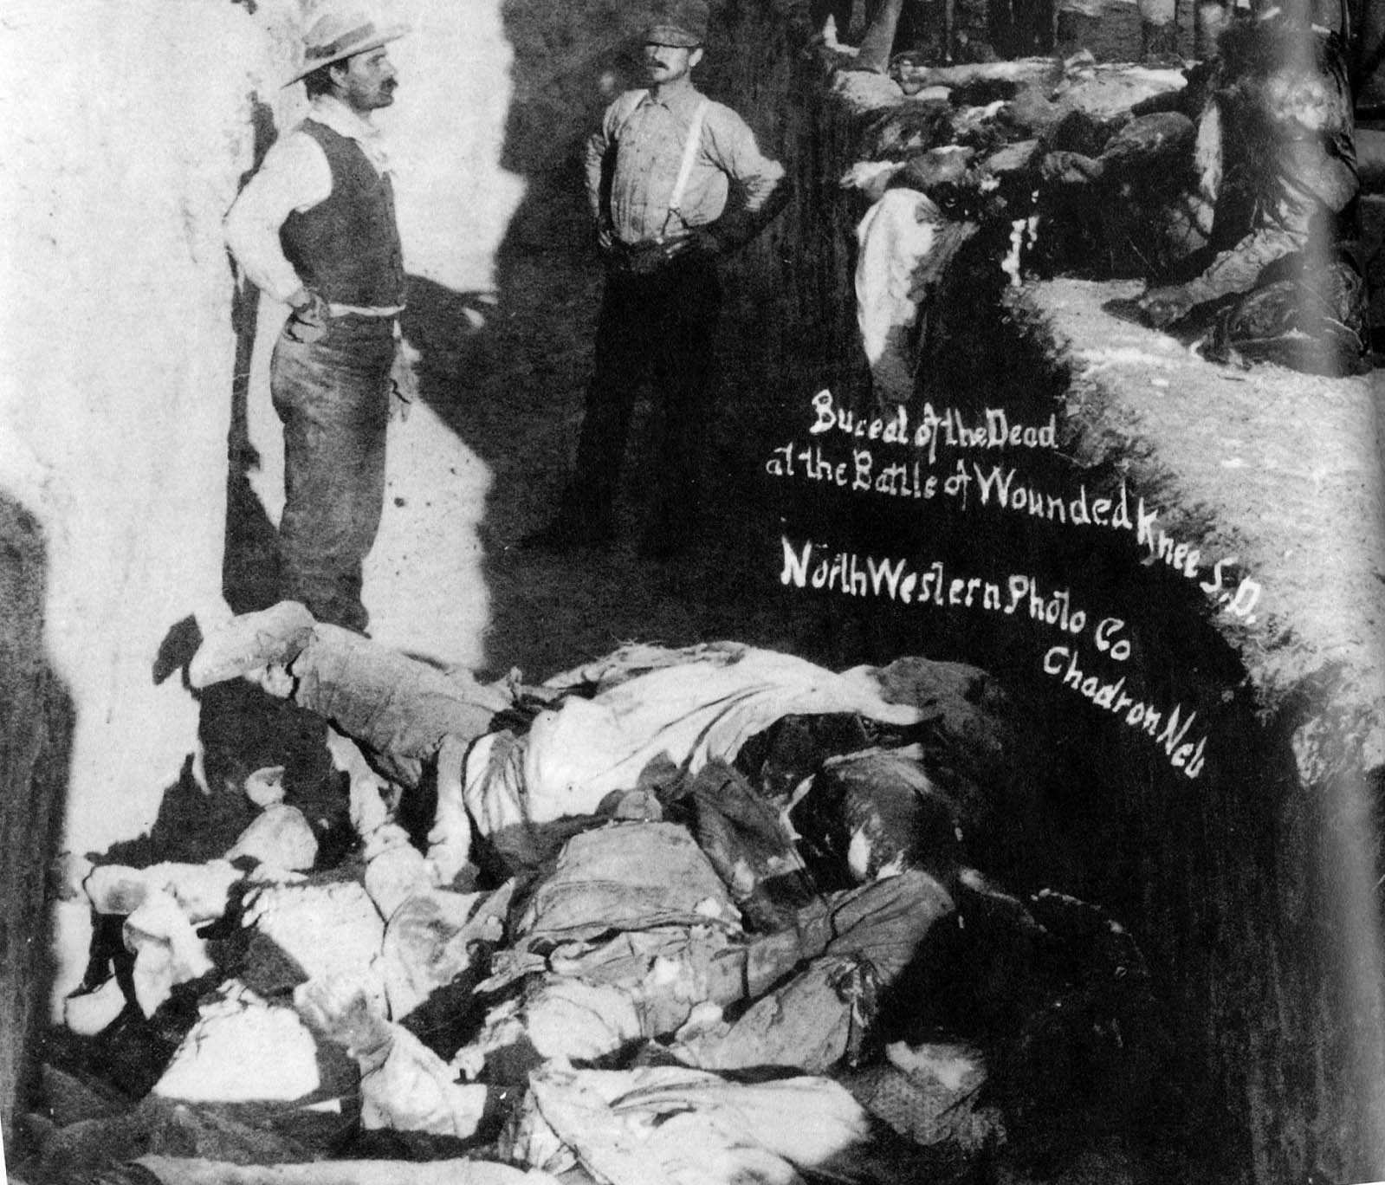
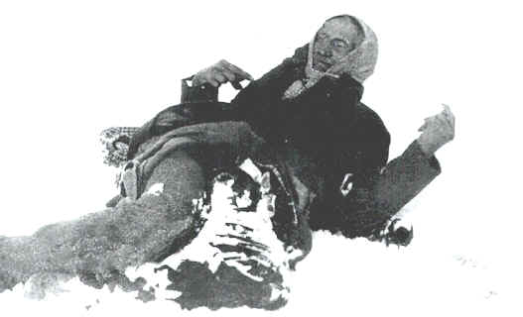
The Demise of the American Indian
Wounded Knee, South Dakota – Dec. 29, 1890
*300 Sioux women, children, elderly massacred
*dead bodies left frozen until spring
*last incident of Indian resistance

Slide 18
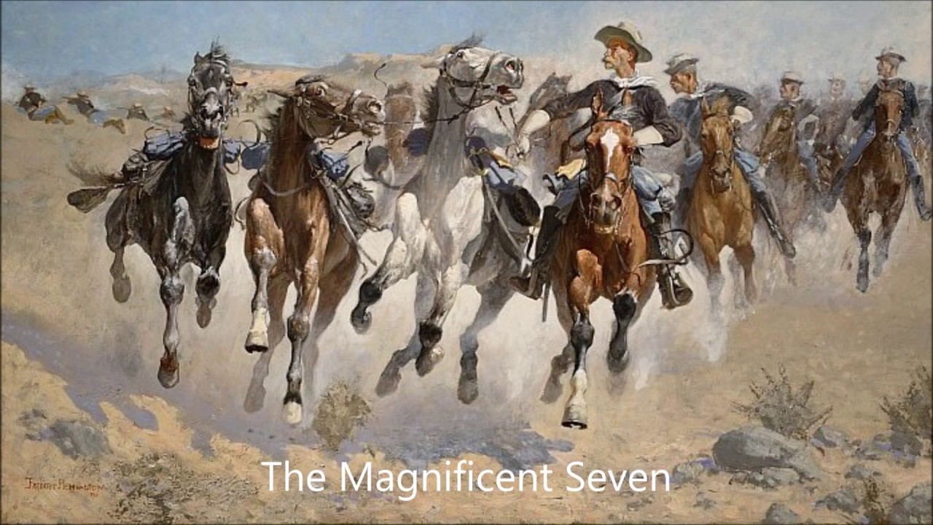
Crash Course U.S. History: The West

Slide 19
Ch. 16: The Conquest of the Far West
Focus Questions:
What was the perception of the West before and after the Civil War? In what ways was it different?
Identity some of the groups who already lived in the west as well as some of the people who moved west and why they moved west.
In what ways was the west appealing for settlers?
What were some of the new industries that developed in the west and why were they important?
How was farming in the west different than farming in the south?
Explain the U.S. government’s policy towards the native population.
Identify some of the events that led to the pacification of the Native Americans.
Notes:
19
The purpose of the focus questions is to help students find larger themes and structures to bring the historical evidence, events, and examples together for a connected thematic purpose.
As we go through each portion of this lecture, you may want to keep in mind how the information relates to this larger thematic question. Here are some suggestions: write the focus question in the left or right margin on your notes and as we go through, either mark areas of your notes for you to come back to later and think about the connection OR as you review your notes later (to fill in anything else you remember from the lecture or your thoughts during the lecture or additional information from the readings), write small phrases from the lecture and readings that connect that information to each focus question AND/OR are examples that work together to answer the focus question.

Slide 20
Ch. 16 SAQ
ANSWER A, B, and C
Briefly explain ONE reason for American migration into the west after the Civil War.
Briefly explain ONE example of Native American resistance to white expansion in the west.
Briefly explain ONE example of government policy towards Native American resistance.

