Slide 1
Ch. 17: Industrial Supremacy
Focus Questions:
Describe the Gilded Age; who coined the term and what the era was highlighted by.
Identify/Analyze/Describe the causes of post-Civil War industrial growth (i.e. the impact of technology, science, research, new types of businesses).
Who were the Captains of Industry? Identify each of them and their impact on the U.S. economy.
What big business practices allowed for the growth of monopolies and how did the government react to the growth of monopolies?
Identify some of the sources of opposition/critics to capitalism and new ideas like “Social Darwinism”.
Explain working conditions for men, women and children.
Identify new immigrants and their characteristics.
Describe attempts to unionize and some of the events associated with that.
Notes:
1
The purpose of the focus questions is to help students find larger themes and structures to bring the historical evidence, events, and examples together for a connected thematic purpose.
As we go through each portion of this lecture, you may want to keep in mind how the information relates to this larger thematic question. Here are some suggestions: write the focus question in the left or right margin on your notes and as we go through, either mark areas of your notes for you to come back to later and think about the connection OR as you review your notes later (to fill in anything else you remember from the lecture or your thoughts during the lecture or additional information from the readings), write small phrases from the lecture and readings that connect that information to each focus question AND/OR are examples that work together to answer the focus question.

Slide 2
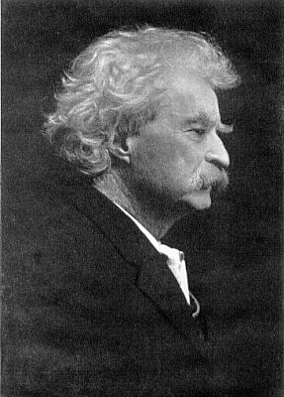
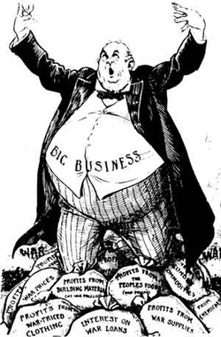
The Gilded Age ●Mark Twain’s: The Gilded Age: A Tale of Today
Notes:
The Gilded Age
*late 1800’s also became known as the “Gilded Age”
*originally, was the name of a book written by Mark Twain
*the term and the book both described the state of the nation at that time
*the term “gild” meant to cover something, usually a worthless metal, in gold leaflet to mask its value
*was the perfect analogy to describe the United States at that time
*showed how the excesses and wealth of a few hid the true nature of American life
*the majority of Americans did not reap the benefits of industrialization and live in immense poverty
*in fact only 1/10 owned about 9/10 of all the wealth in the United States
*lots of inconsistency in wealth distribution in the United States
2

Slide 3
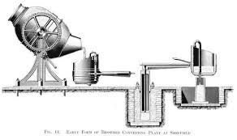
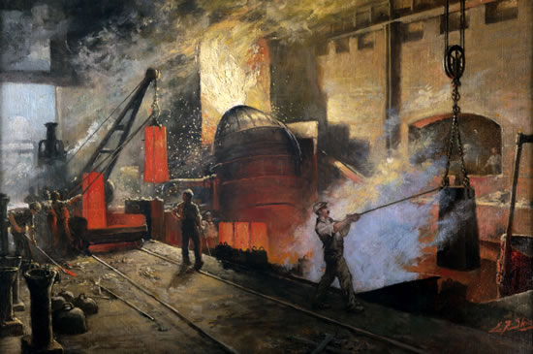
Sources of Industrial Growth: Technology
Steel – Bessemer Process
*Henry Bessemer invented new way of making steel
*burning out impurities from molten iron
*created a stronger and lighter steel
*steel could now be mass produced
-resulted in railroad boom, growth of cities
*steel industry centered around Pittsburgh
Petroleum
*mainly used as lamp fuel
*could now be used a lubricant in factory machines
*eventually used for internal combustion engines
-Henry Ford – automobile
-Wright Bros. - airplane
Railroads
*allowed other industries to grow
*set up time zones to better organize shipments
*connected the nation together
New Farming technologies
*mechanical reapers, gas powered tractors
*increased production to sustain growing population

Slide 4
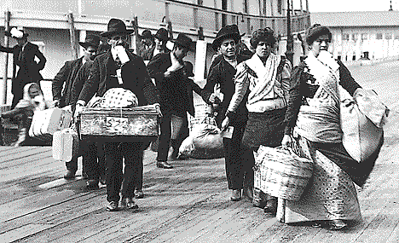
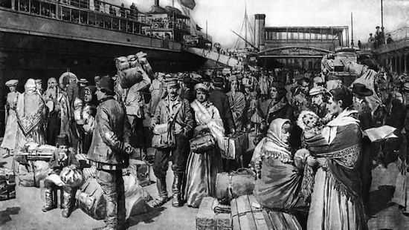
Sources of Industrial Growth: Population Boom
The Immigrant workforce
*demand for labor resulted in a flood of immigration
*the population boom further fueled industrial growth
*1865-1915 = 25 million immigrants came to America
*further drove down wages causing more tension
New Sources of Immigration
*1850-1880’s mostly northwestern Europe
-England, Ireland, Germany, Scandinavia
*1880-1920’s mostly southern and eastern Europe
-Italians, Poles, Russians, Greeks, Slavs, Czechs
Push/Pull factors
Characteristics of new immigrants
(List them)

Slide 5
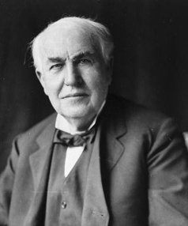
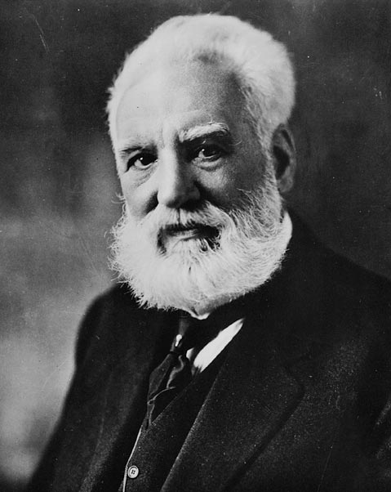
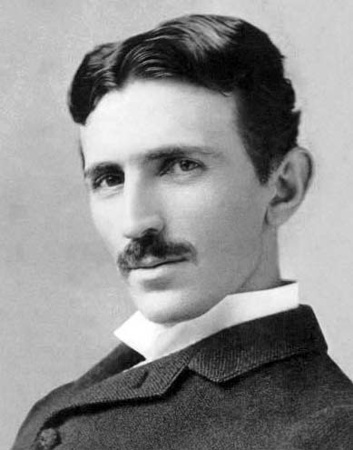
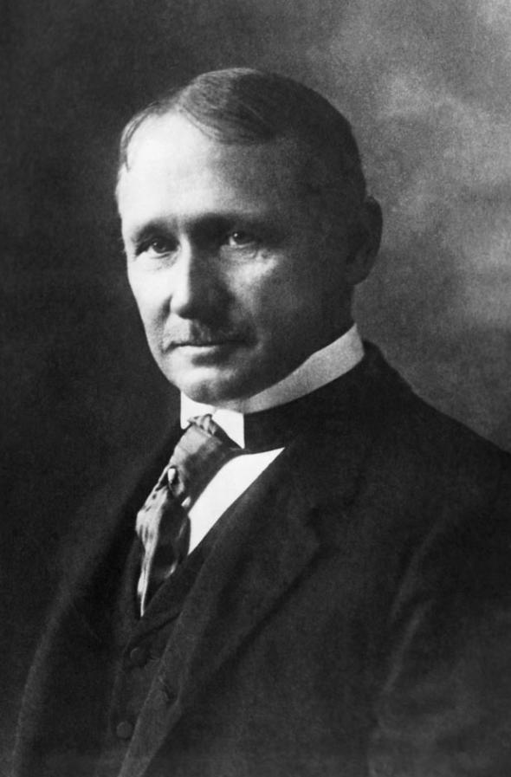
Sources of Industrial Growth: Scientific Development
Research and Development
*new technologies sped up production
*scientists/engineers played a big role in development
Thomas Edison
*(inventions)
*(company)
Alexander Graham Bell
*(inventions)
*(company)
Nikola Tesla
*A/C (alternating current)
*Tesla coils
Frederick Winslow Taylor - “Taylorism”
*developed practices to speed up production
*subdivide workers’ tasks
*make workers interchangeable
*reduce the need for highly trained workers

Slide 6
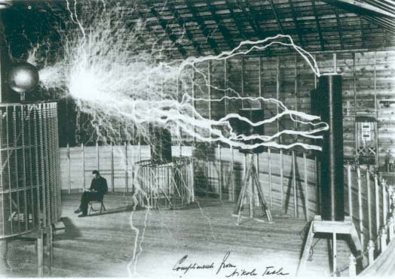
Notes:
6

Slide 7
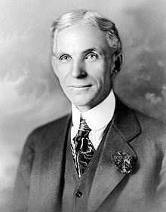
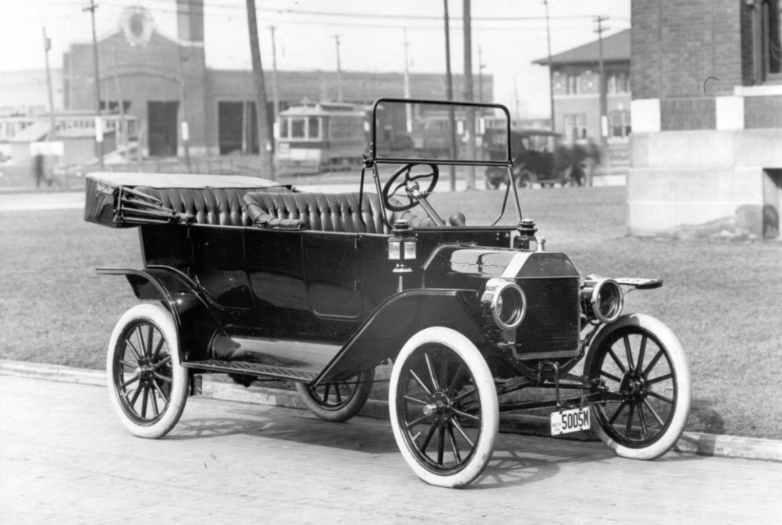
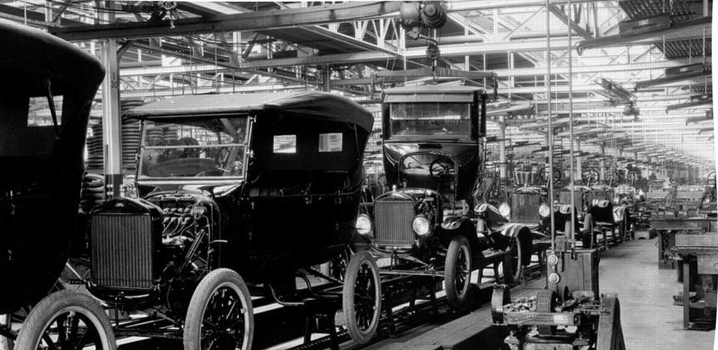
Henry Ford
The Automobile
*most important industry by 1920’s
*1896 – Ford built first automobile
*1908 – first Model T
*1917 – 5m Model T’s produced
The Moving Assembly Line – Ford Motor Company, 1914
*revolutionized production
*cut time to produce car from 12.5 hours to 1.5 hours
*could then raise wages and cut hours for workers
-highest wages in the country
-5 day work week/8 hours a day/3 shifts thanks to electricity
*lowered price on Model T from $950 to $300

Slide 8
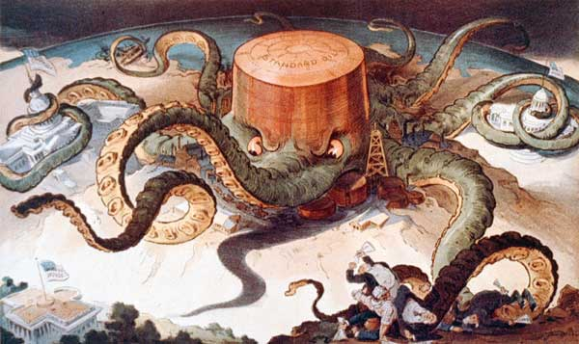
Sources of Industrial Growth: New Business Development
Corporations
*selling stocks to investors
-people own shares of the company
-limited liability – only risk is losing what you put in
*provided large amounts of capital (money) to businesses
Trusts and Holding Companies
*when corporations pool their money together
*several corporation under one
The Monopoly
*businesses that controlled entire industries
*were both good and bad
*achieved this through aggressive business practices
-creation of trusts and holding companies
-vertical integration (explain)
-horizontal integration (explain)

Slide 9
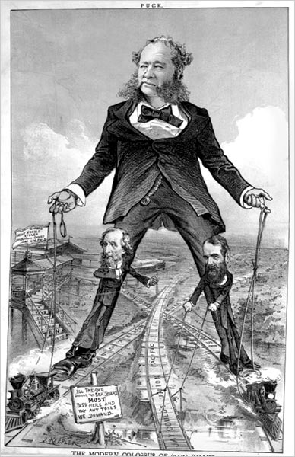
Railroad Tycoons
●Tycoons
*Cornelius Vanderbilt
*$100m then = $10b today
●Scandals
*Involving politicians
*Credit Mobilier
Notes:
Tycoons
*men who built their fortunes through shady business practices.
*many railroad tycoons get the label as being “robber barons” because of the government’s willingness to aid railroad companies in their growth and turn a blind eye to a lot of the corruption.
*acquired most of their wealth by swindling investors.
*bribed government officials and cheated their contracts and debts
Cornelius Vanderbilt
*probably one of the most notorious railroad tycoons and richest men in US history.
*was a former steamboat captain who built the largest steamboat fleet in America.
*began buying small railroad companies in New York.
*owned enough companies to connect New York to Buffalo and eventually bought lines that would connect New York and Chicago.
*when he died he was worth $100 million ($142 billion today) He left about 95% of his fortune to his son. His wife, received $500,000.
Jay Gould
*was a renowned swindler who made millions off the railroads.
*bought up railroads companies that were losing money and make a few cosmetic changes and then sell the companies for a huge amount of money.
*was also involved in a scheme to corner the gold market that eventually led to a nation wide depression.
Scandals
Involving politicians
*several politicians got involved in railroad scheming
*they awarded contractors by giving them bids to build or repair railroads and then take kick-backs once the job was done.
Credit Mobilier:
*was a fake construction company
*was one of these scandals that sapped $50 million dollars away from the Union Pacific railroad
*several politicians were involved in a bogus shareholding company that was selling shares well below their value
*even future president James Garfield was involved in the scandal.
9

Slide 10
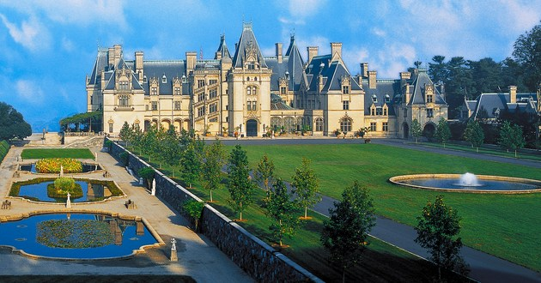
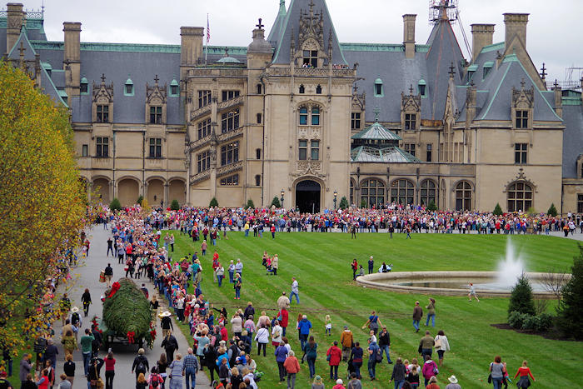
Biltmore Estate, Ashville, North Carolina
Built by Cornelius Vanderbilt's grandson, George Washington Vanderbilt in 1889-95
Largest privately owned home in America (175,000 sq ft.)
It’s big. I’ve been there.

Slide 11
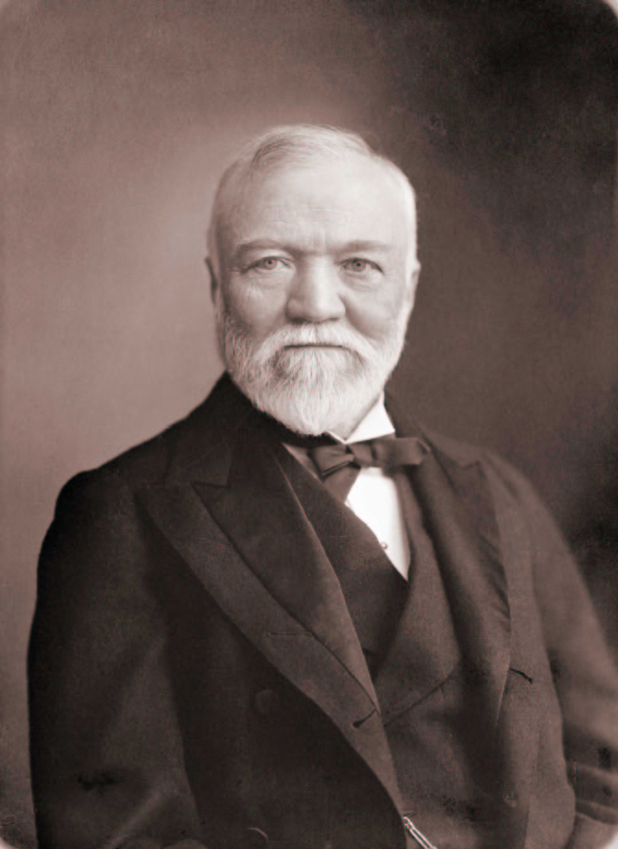
Captains of Industry/Robber Barrons
●Andrew Carnegie and the “Gospel of Wealth”
*Background
*The Steel Industry (Bessemer Process)
*Philanthropy
*$300m = $4.3b
Notes:
Andrew Carnegie
Background
*born of a poor Scottish immigrant
*at 14 he worked as a messenger at a telegraph office
*he became the private secretary to the superintendent of the Pennsylvania Railroad.
*when his boss was promoted Carnegie took his job.
*began investing in iron mills and factories as well as companies that built railroad bridges.
Involvement in steel
*being that he was in the railroad business he traveled a lot
*on one trip to England he met Henry Bessemer who had developed a new process by which to make steel stronger and cheaper
*Carnegie instantly decided to quit the railroad business and focus on building a steel empire in the United States
*he eventually turned steel from a 13,000 ton a year business to a 1.4 million ton a year business.
*a lot of this was due to steel becoming stronger because of the Bessemer process
*bridges became longer, buildings built taller, Railroad tracks stronger, weapons deadlier, tools stronger, machines more durable and ships faster
Philosophy for big business
*Carnegie was not a steel expert but a tremendous businessman
*was extremely shrewd and, like most captains of industry, sought to eliminate competition
*he insisted on having the most up to date equipment to save on costs and also felt that big business was a good thing no matter how harsh their methods were
*he wrote, “Gospel of Wealth” to illustrate his ideas
*in it he argued the responsibility of philanthropy
*he felt that the fortunes of the wealthy should be spent to improve humanity and not be spent frivolously by men of power
Legacy
*Carnegie became one of the most notable philanthropists in history and donated most of his fortune to Universities, libraries, parks and various other public venues
*he is often labeled as the second richest American in US history
*gave away over $300,000,000 or $4.3 billion.
11

Slide 12
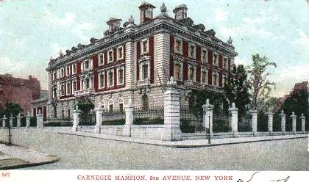
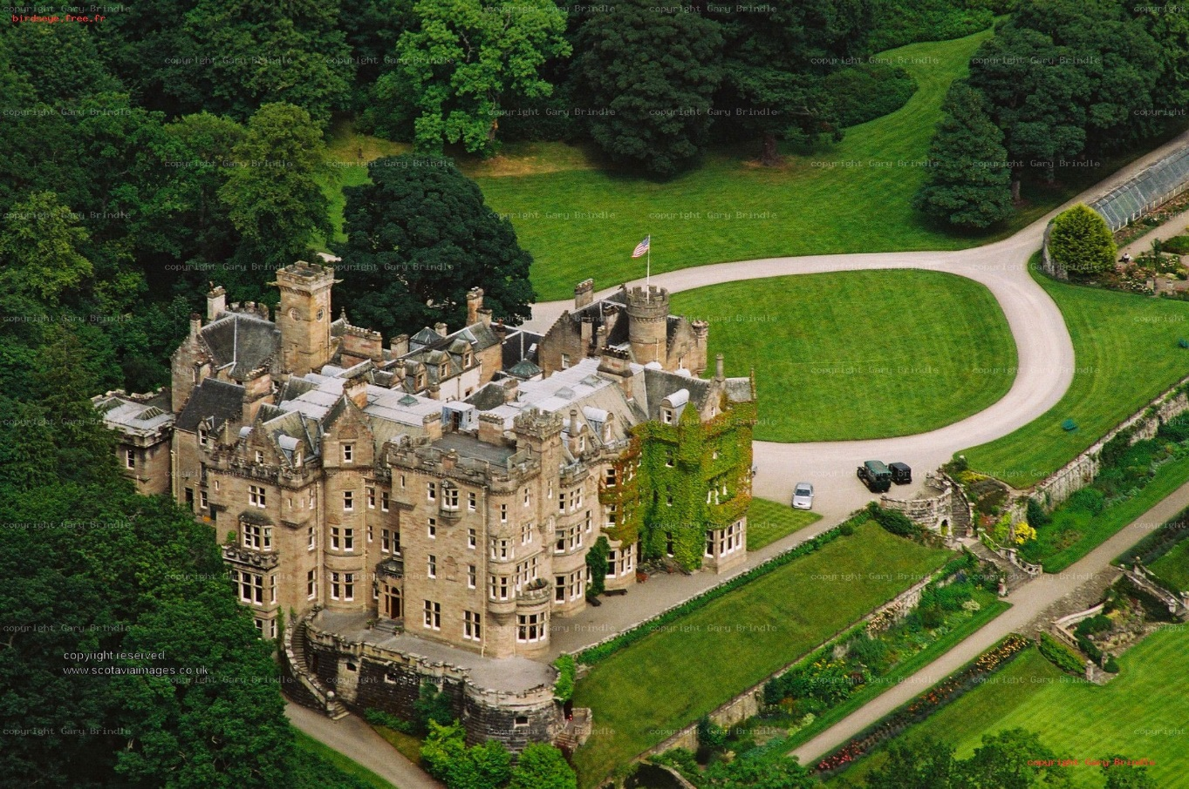
Ski Bo Castle in Scotland
Mansion in New York

Slide 13
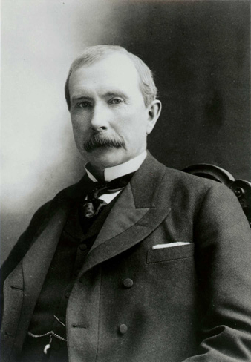
John D. Rockefeller and the oil industry
*Background
*Standard Oil business practices
*$1.4b = $200b
Notes:
13
John D. Rockefeller
*usually considered the most wealthy American in US history
*was worth around $1.4 Billion when he died which is about $200 Billion today
*was the founder of Standard Oil which became the largest oil refiner in the world at one point
Background
*was the son of a con man and a devout Baptist mother
*his father abandoned him and his six brothers and left his mother to raise them
*as a kid he was extremely self disciplined and obsessed with precision
*he decided to take his natural abilities and see if he could make money off the infantile oil industry
Standard Oil business practices
*Rockefeller became the richest man in modern history because of the oil empire he created with his company, Standard Oil
*became the World’s first and largest multinational corporation due to its business practices
*Rockefeller decided the best business move he could make was to eliminate as much of his competition as possible
*he began buying as many oil refineries as he could as well as owning the railroads that shipped in supplies and then shipped out his oil
*by 1879 he controlled 90% of the refineries in the nation
*the controlling power Standard Oil had on the national market was one of the reasons why the US government passed laws against large corporations and broke the company up in 1911

Slide 14
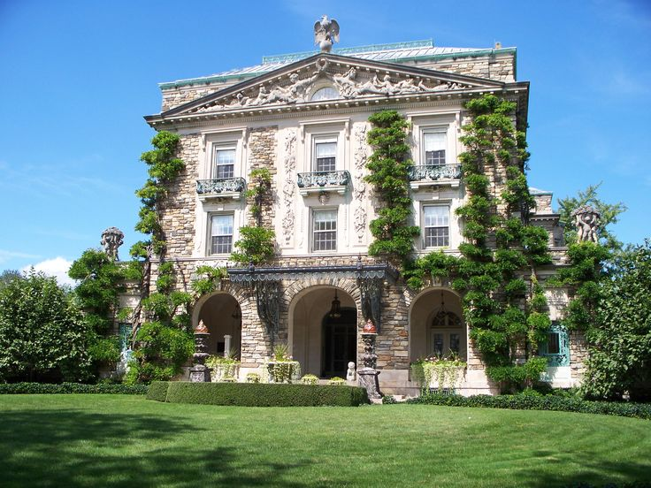
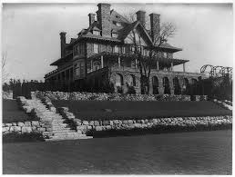
Kykuit, New York

Slide 15
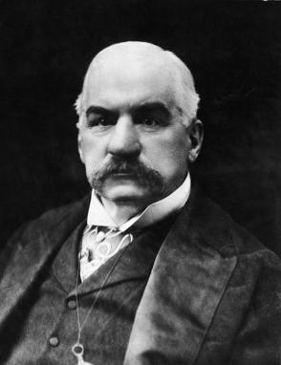
J. P. Morgan and investment banking
*Background
*Concentration on railroad financing
*Consolidation of the steel industry
*Invested in technology
*$80m = $1.5b
Notes:
J.P. Morgan
*one of the wealthiest men in American history
*worth about $80 Million or $1.5 Billion today
*was so wealthy that the U.S. government turned to him twice to bail the nation out of debt
*actually had more money than the U.S. govt. at one point
Background
*unlike Carnegie and Rockefeller, Morgan was born into wealth.
*father was an investment banker in London
*went to school in Switzerland and University in Germany
*was given an internship by his father at a bank in New York and made millions bringing in European capital to the US.
*once he made a fortune he got involved in the RR and Steel industries.
*also funded many of Tesla’s inventions along with Mark Twain who was a friend of Tesla
Concentration of railroads
*saw what Carnegie and Rockefeller were doing and decided to start buying up railroad companies and consolidating them.
*owned 1/6th of them by 1890
Consolidating the steel industry
*he next decided to consolidate the steel industry by buying up all the steel companies.
*eventually bought Carnegie’s US steel which became the first Billion dollar company in the US.
15

Slide 16
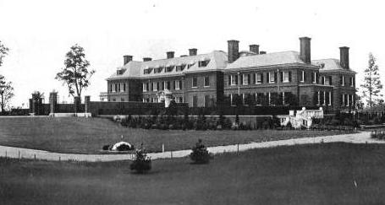
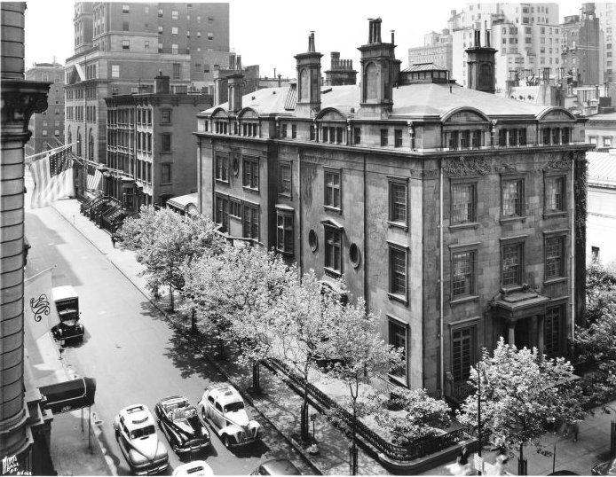
New York

Slide 17
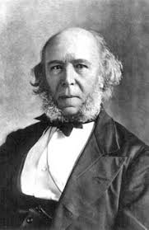
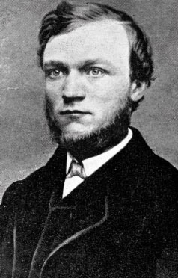
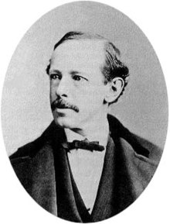
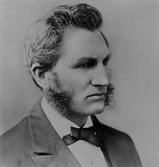
Opposing Views of Wealth
Herbert Spencer – Social Darwinism “Survival of the Fittest”
*applied Darwin’s theory to society and business
*success in life was due to certain traits
-hard work, acquisitiveness, thrift
*failure was due to laziness, stupidity, carelessness
*in society; the strong survived and the weak weeded out
*this was eventually applied to business success as well
The Gospel of Wealth
*book by Andrew Carnegie
*wealthy should not spend in excess
*they should give any excesses wealth to benevolent causes
-philanthropy, charity, libraries, education
*wealth should not be passed down to children
Horatio Alger
*wrote “rags to riches” stories
*most millionaires were not “self made” but had help
Lester Frank Ward
*Darwinist who felt humans have ability to help each other
Henry George
*Blamed monopolies for social problems
Spencer
Carnegie
Ward
Alger

Slide 18
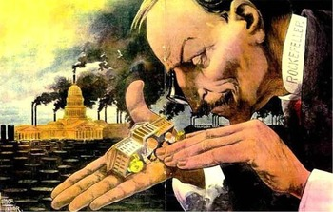
Criticism of Capitalism
Problems of monopolies
*wealthy pooled their money to become more wealthy
*high prices, low wages
*elimination of competition
*unequal distribution of wealth
-1% of families owned 88% of wealth
*prevented one’s ability to advance
Unstable economy
*economy fluctuated erratically in 1873-1893
*1893-1896 huge depression hit
*railroads charged high prices to ship goods
-farmers could not afford to ship goods

Slide 19
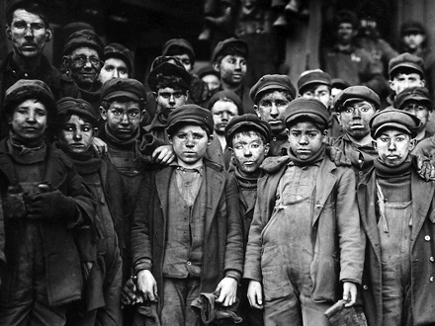
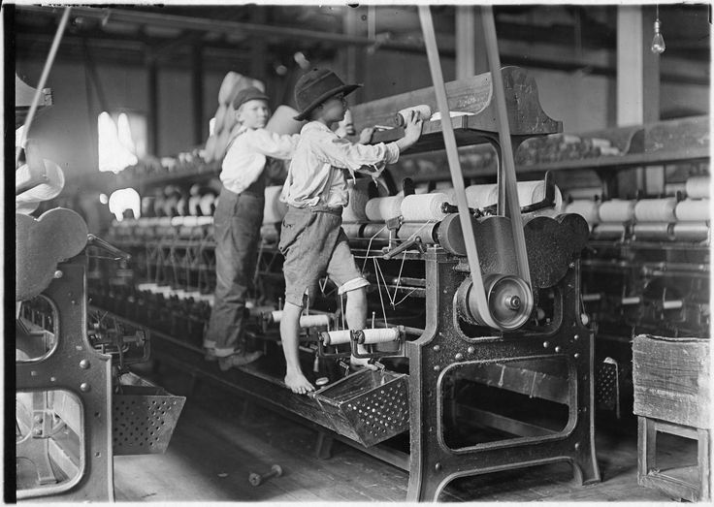
Industrial Workers in the New Economy
Conditions
*were dangerous and daunting
-10 to 12 hour workdays 6 days a week
*no job security
*repetitive tasks
*low wages and long hours
Women and Children
*worked for lower wages than men
*terrible conditions
*children not getting educated and paid next to nothing
*the family unit destroyed
-some women forced to stay home

Slide 20
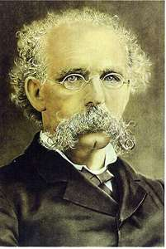
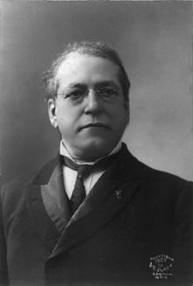
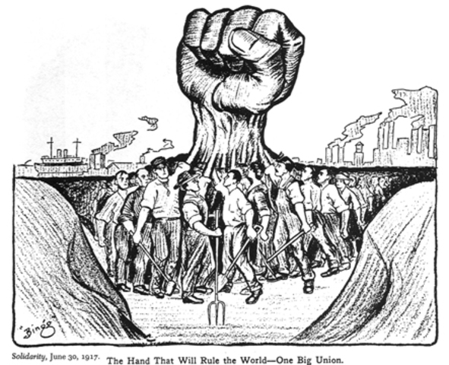
The Struggle to Unionize
National Labor Union
*the only way workers had power was by unionizing
*NLU – male only union that fought low wages brought on by female workers
-wanted to restrict women in the workplace
*organized strikes on a regular basis
*strikes usually turned violent
*government and the public never sided with unions
Molly Maguires – “radical” and violent union
*operated in Pennsylvania in the coal mines
*used violence and murder to intimidate owners
Knights of Labor
*welcomed almost all workers, even women
*under leadership of Terence Powderly: 700K members
*the union disappeared by 1890 due to Haymarket riot
American Federation of Labor - AFL
*leader: Samuel Gompers
*only skilled workers and mostly men
*used collective bargaining instead of strikes
*goal: fair pay based on market and better hours
Terrence Powderly
Samuel Gompers

Slide 21
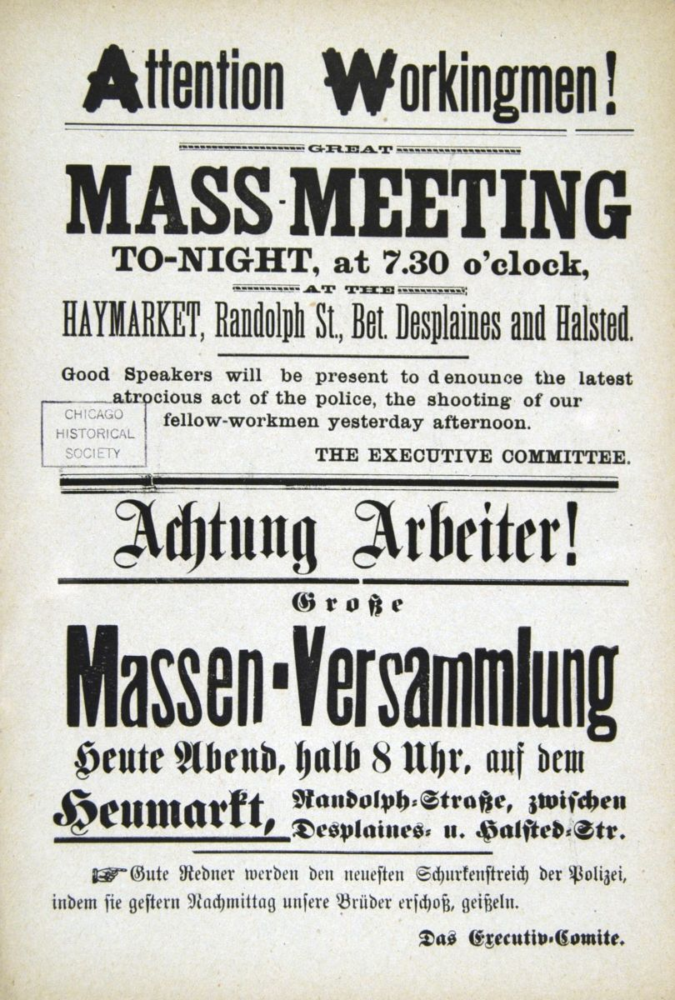
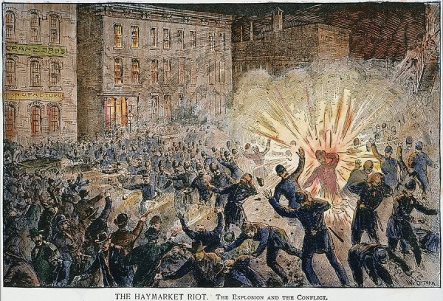
Unions and Violence
Haymarket Square Riot – Chicago, 1886
*strike at the McCormick Harvester Company
*day 1: police killed 4 strikers and ordered the rest to leave
*day 2: someone threw a bomb and killed 7 officers 67 injured
-police fire into crowd and kill 4 more strikers
*8 scapegoats were tried for murder and 7 found guilty
*4 executed, 1 committed suicide, 2 life in prison
*panic hit the nation as fear of social chaos spread
*unions seen as radicals led by anarchist and foreigners
(Notice the paper is partially in German)

Slide 22
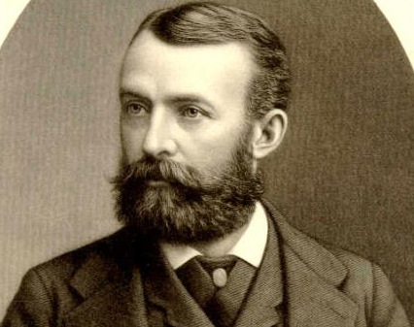
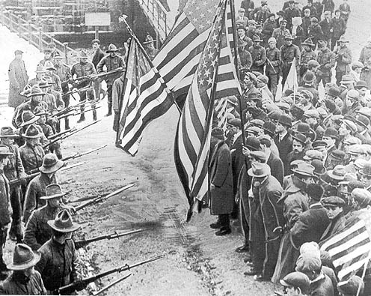
Unions and Violence cont.
Homestead Strike – Pennsylvania, 1892
*location: Carnegie’s Homestead Plant near Pittsburg
*constant wage cuts led to strike
*Henry Clay Frick, plant manager, called in 300 Pinkertons
*Pinkertons and workers battled for hours
*3 Pinkertons and 10 strikers died
*further hurt the perception of unions
Henry Clay Frick

Slide 23
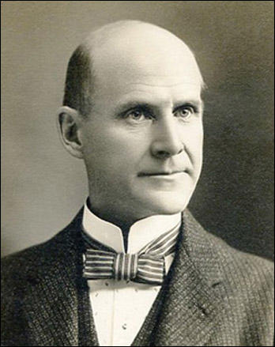
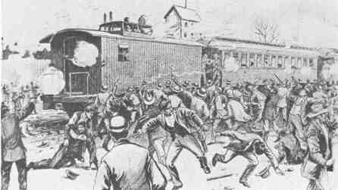
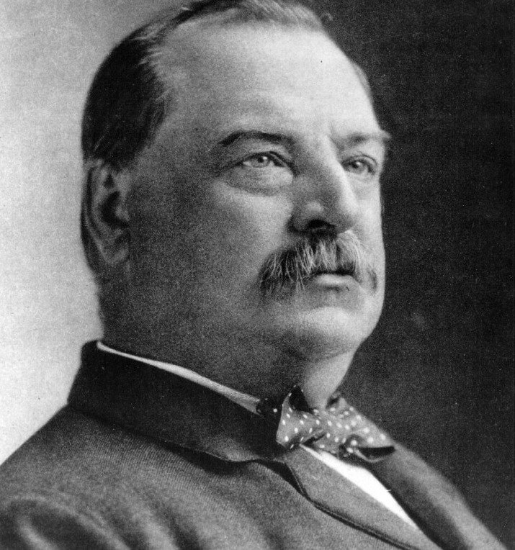
Unions and Violence cont.
The Pullman Strike – Chicago, 1894
*Pullman Palace Car Company cut wages
*thousands of railroad workers went on strike led by Eugene V. Debs
*resulted in strikes across the nation and paralyzed trade
*President Cleveland sent in 2,000 troops to put down strike
*Debs and followers were imprisoned and strikes ended
*Debs actually ran for president while in jail
Eugene V. Debs
Grover Cleveland

Slide 24
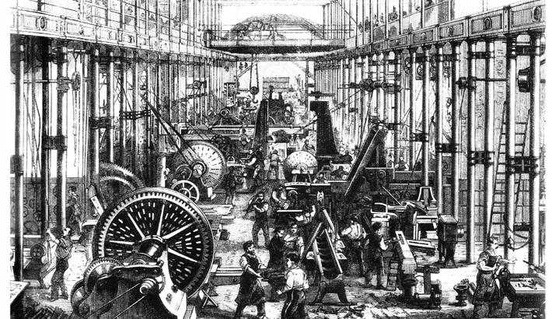
Crash Course US History: Industrialization

Slide 25
Ch. 17: Industrial Supremacy
Focus Questions:
Describe the Gilded Age; who coined the term and what the era was highlighted by.
Identify/Analyze/Describe the causes of post-Civil War industrial growth (i.e. the impact of technology, science, research, new types of businesses).
Who were the Captains of Industry? Identify each of them and their impact on the U.S. economy.
What big business practices allowed for the growth of monopolies and how did the government react to the growth of monopolies?
Identify some of the sources of opposition/critics to capitalism and new ideas like “Social Darwinism”.
Explain working conditions for men, women and children.
Identify new immigrants and their characteristics.
Describe attempts to unionize and some of the events associated with that.
Notes:
25
The purpose of the focus questions is to help students find larger themes and structures to bring the historical evidence, events, and examples together for a connected thematic purpose.
As we go through each portion of this lecture, you may want to keep in mind how the information relates to this larger thematic question. Here are some suggestions: write the focus question in the left or right margin on your notes and as we go through, either mark areas of your notes for you to come back to later and think about the connection OR as you review your notes later (to fill in anything else you remember from the lecture or your thoughts during the lecture or additional information from the readings), write small phrases from the lecture and readings that connect that information to each focus question AND/OR are examples that work together to answer the focus question.

Slide 26
Ch. 17 SAQ
Briefly explain ONE example of the causes of the rise in “big business” in America at the turn of the 19th century.
Briefly explain a SECOND cause.
Briefly explain ONE consequence of the rise in “big business” in America.

