Slide 1
The War to End All Wars
Focus Questions:
Be able to identify the unique characteristics of WWI . (I.E: Trench Warfare, New Technologies)
Describe the origins of the Great War.
Before joining the war, how did the United States cope with the war in Europe?
What events led to the United States joining the war?
What impact did U.S. involvement have on the war?
Describe Wilson’s Fourteen Points. Especially the Fourteenth Point.
Was the League of nations a success or a failure? Why?
Notes:
1
1
The purpose of the focus questions is to help students find larger themes and structures to bring the historical evidence, events, and examples together for a connected thematic purpose.
As we go through each portion of this lecture, you may want to keep in mind how the information relates to this larger thematic question. Here are some suggestions: write the focus question in the left or right margin on your notes and as we go through, either mark areas of your notes for you to come back to later and think about the connection OR as you review your notes later (to fill in anything else you remember from the lecture or your thoughts during the lecture or additional information from the readings), write small phrases from the lecture and readings that connect that information to each focus question AND/OR are examples that work together to answer the focus question.

Slide 2
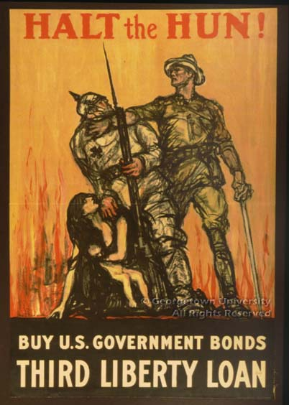
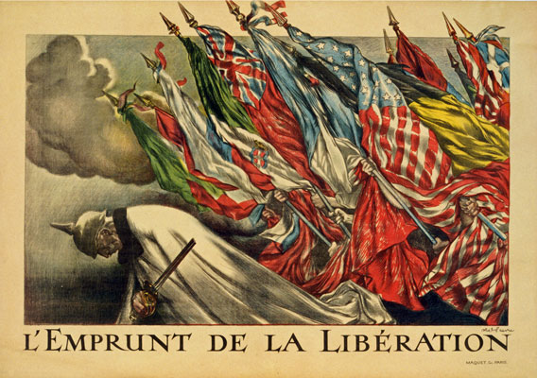
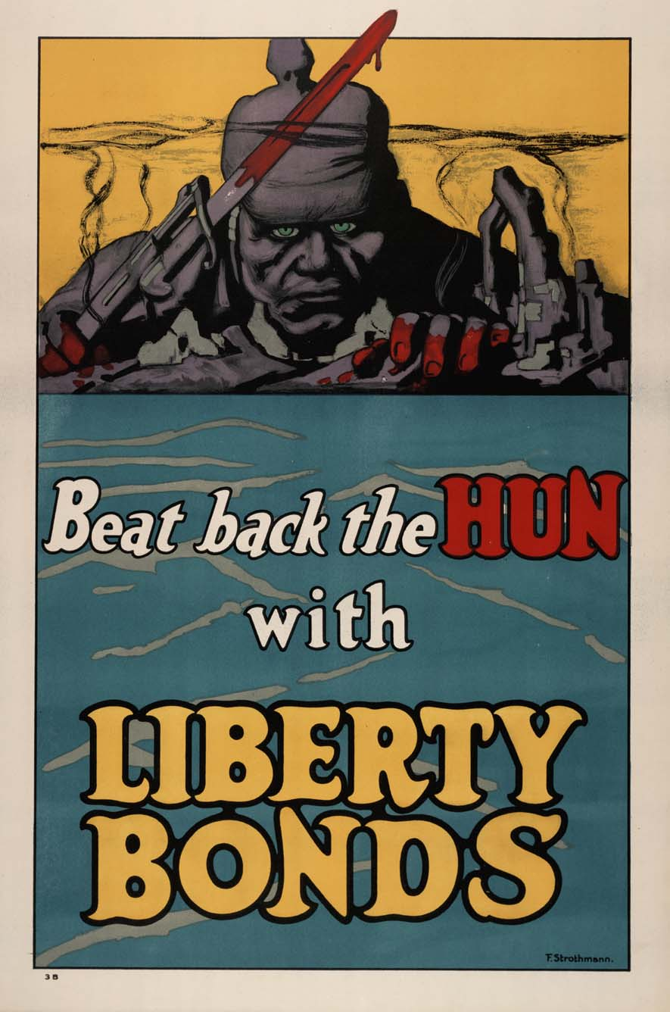
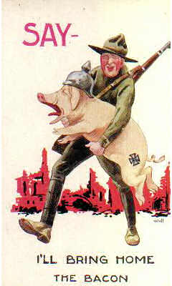
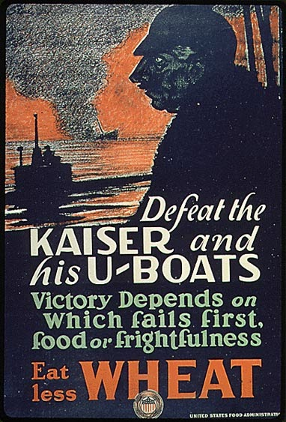
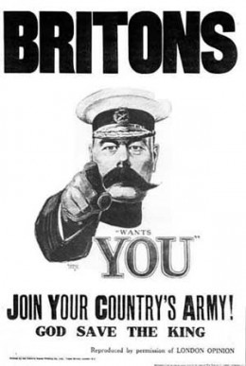
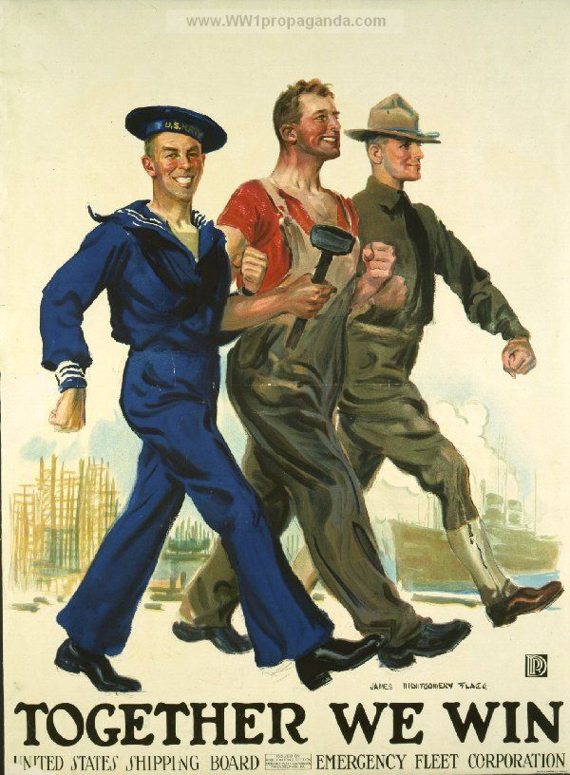
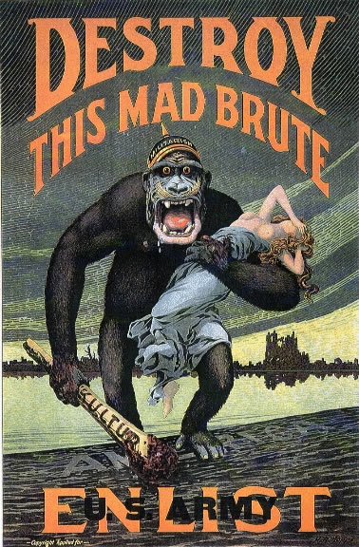
World War I

Slide 3
Causes of the War in Europe
Militarism
Alliances
Nationalism
Imperialism
Assassination

Slide 4
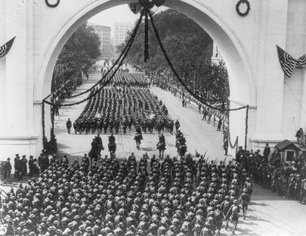
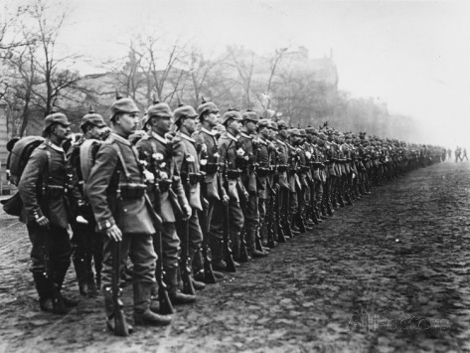
1. MILITARISM

Slide 5
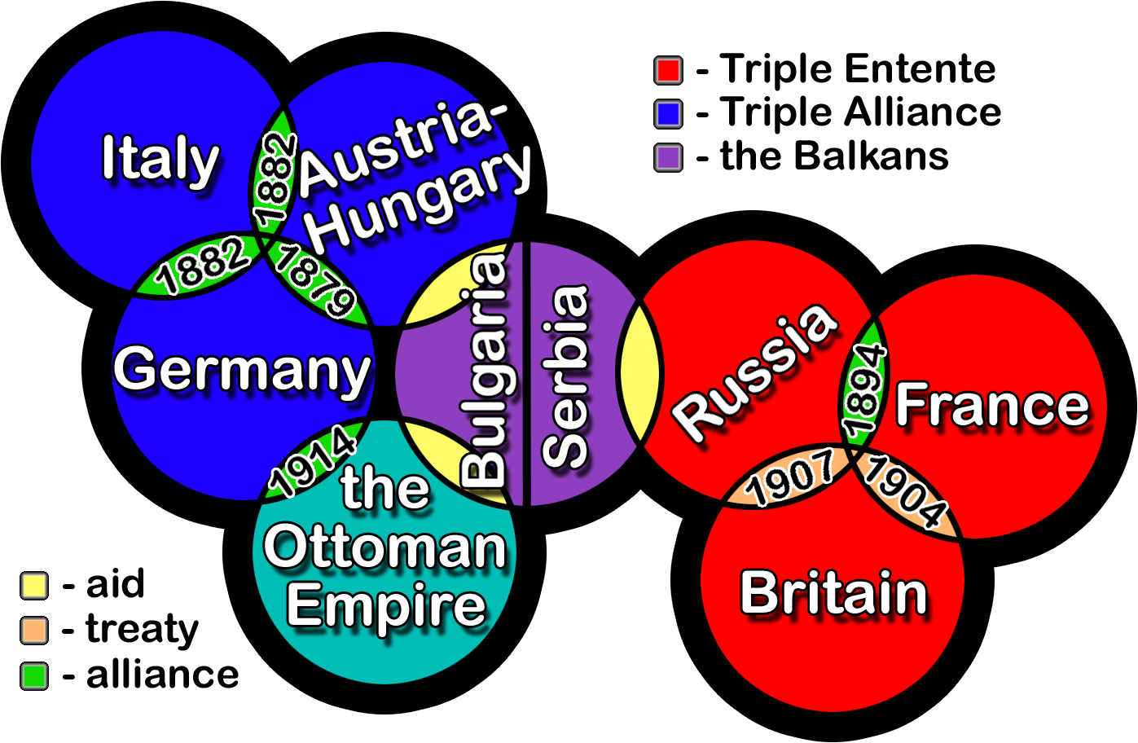
2. ALLIANCES
*Central Powers
*Triple Entente (Allied Powers)

Slide 6
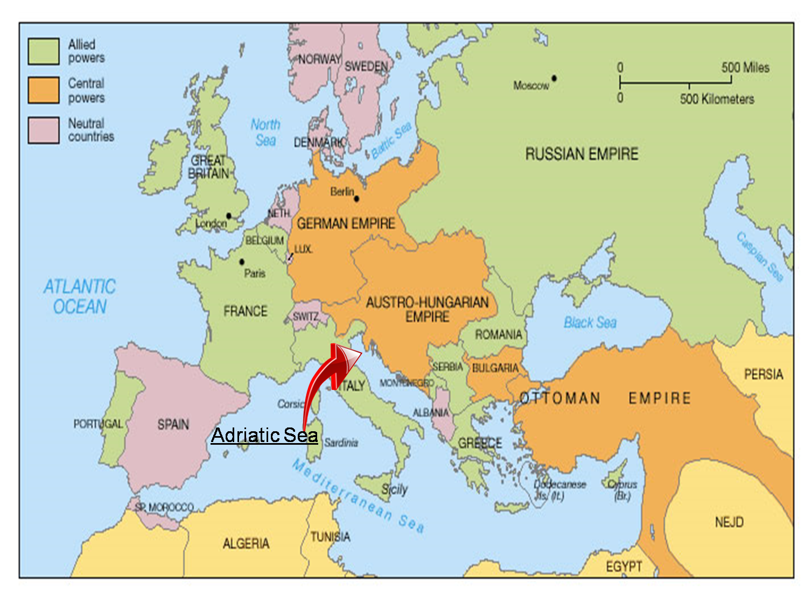

Slide 7
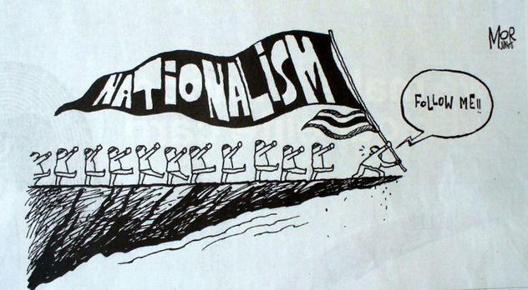
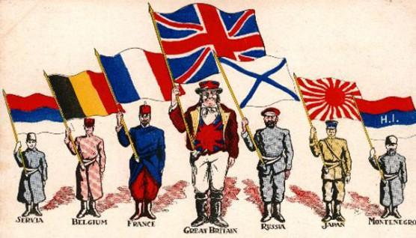
3. NATIONALISM

Slide 8
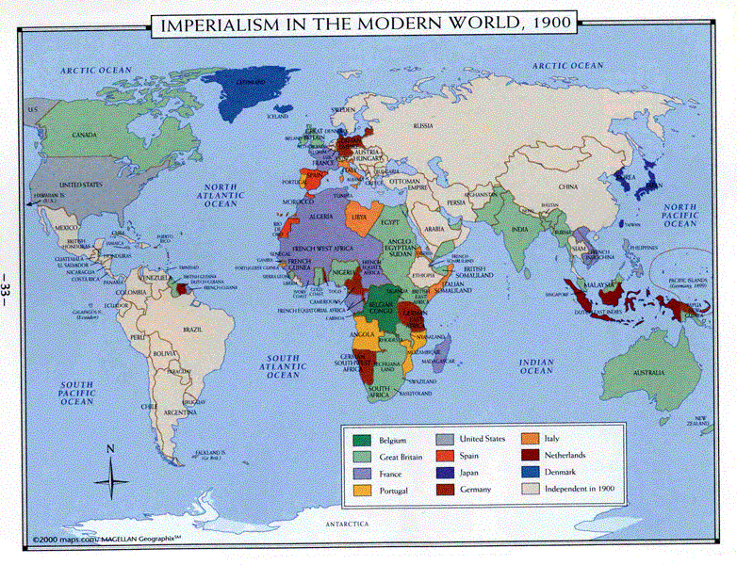
4. IMPERIALISM

Slide 9
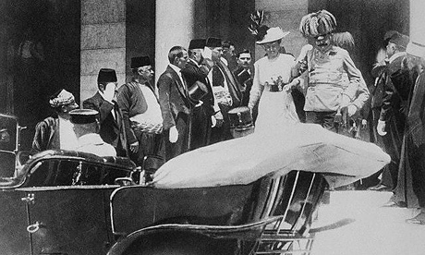
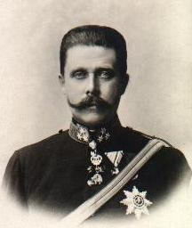
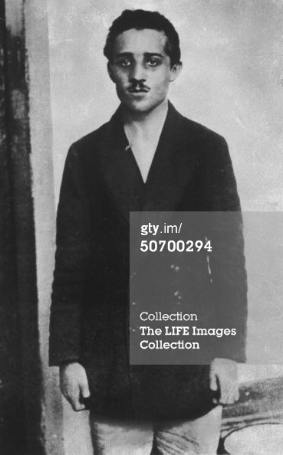
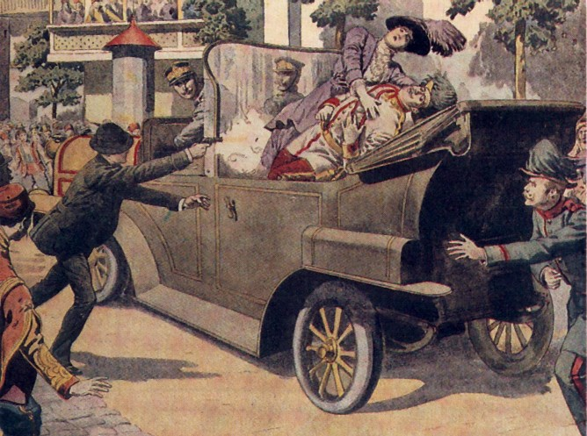
5. ASSASSINATION

Slide 10
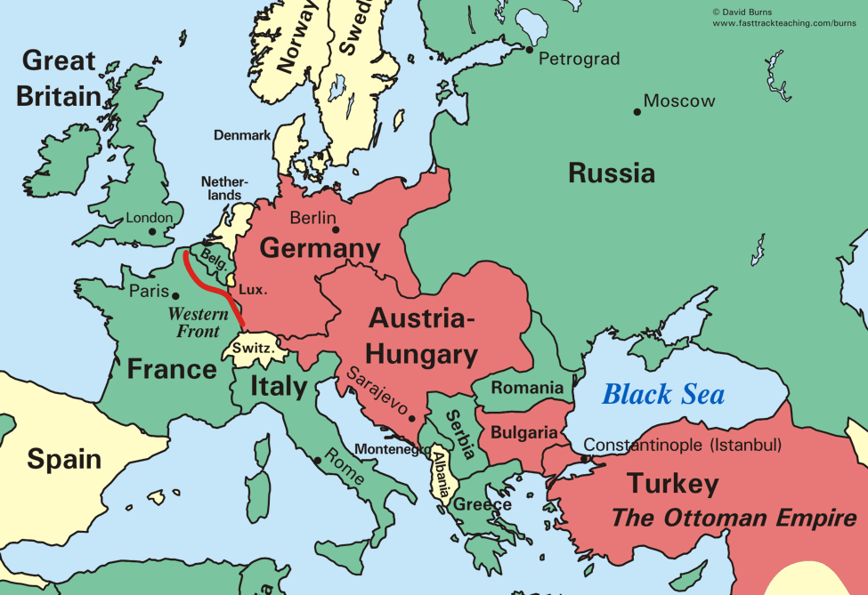
Causes:

Slide 11
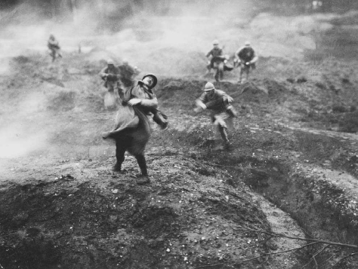
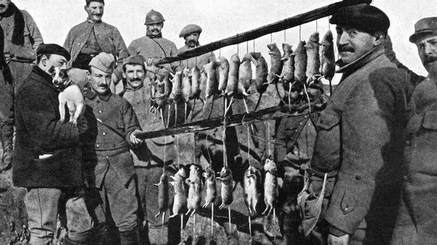
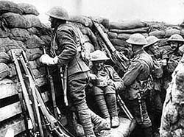
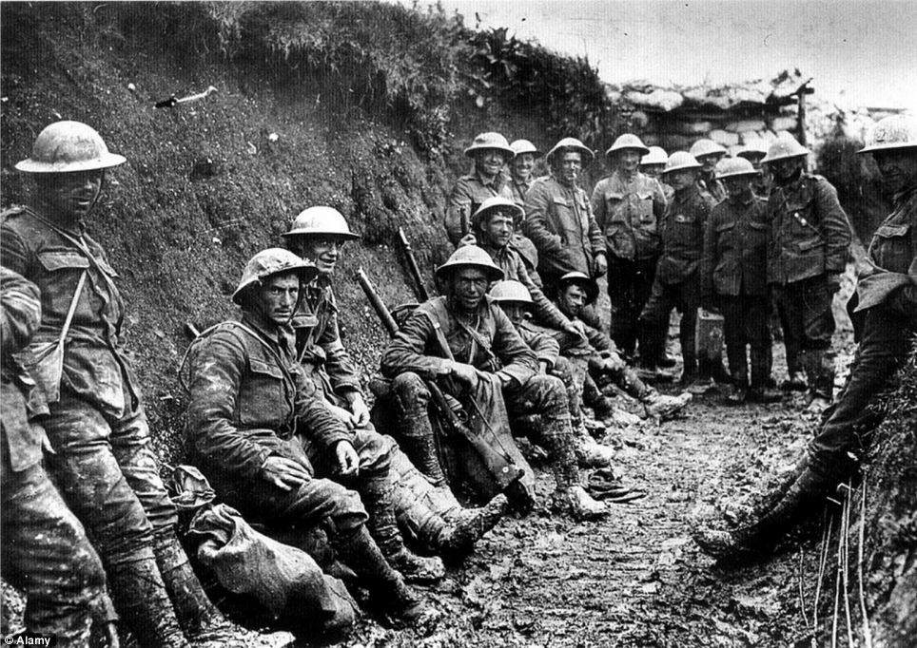
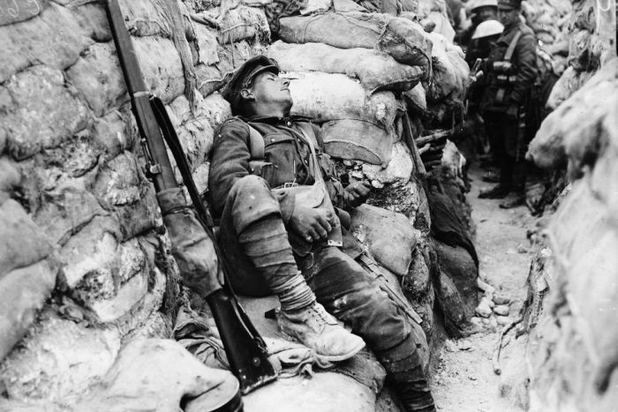
A new kind of Warfare (Trenches)
Trench Warfare

Slide 12
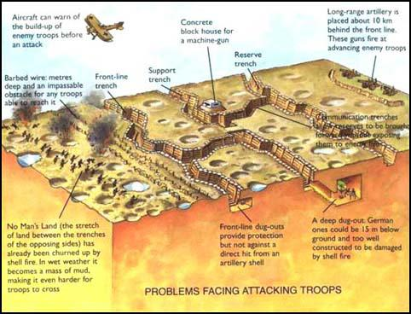

Slide 13
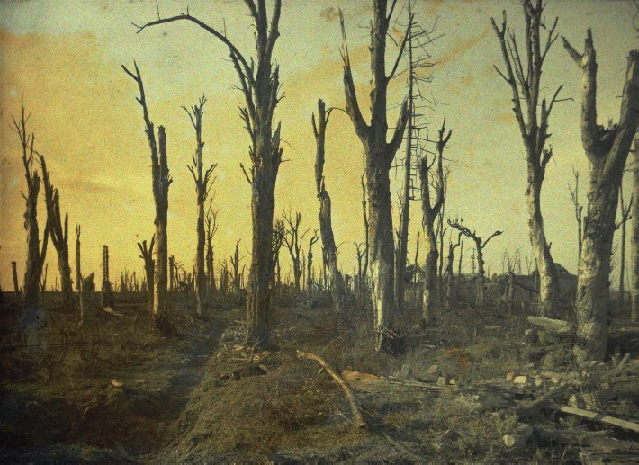
Infamous Battles: *Verdun *The Somme
Notes:
13
13

Slide 14
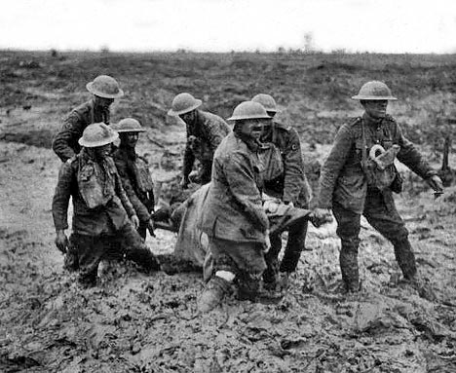
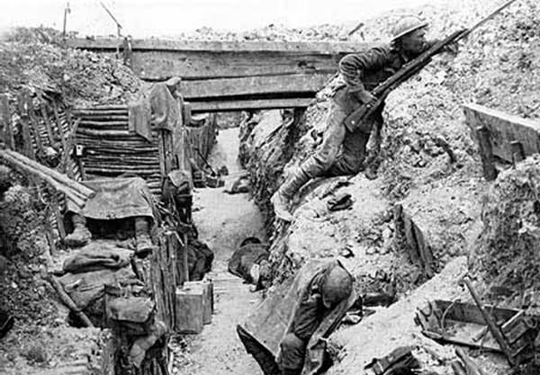
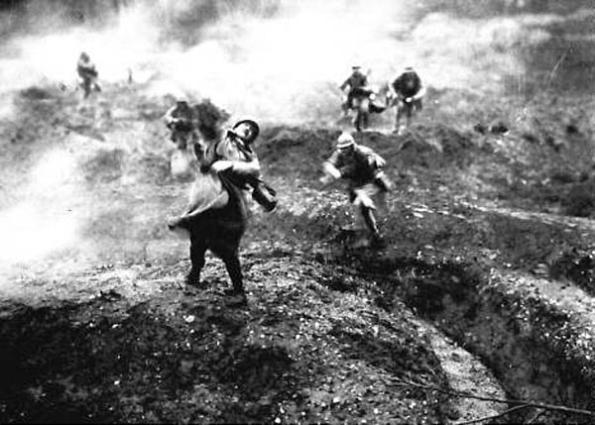
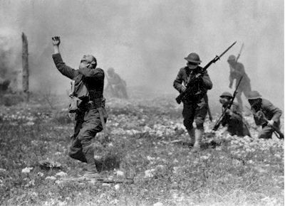
Notes:
14
14

Slide 15
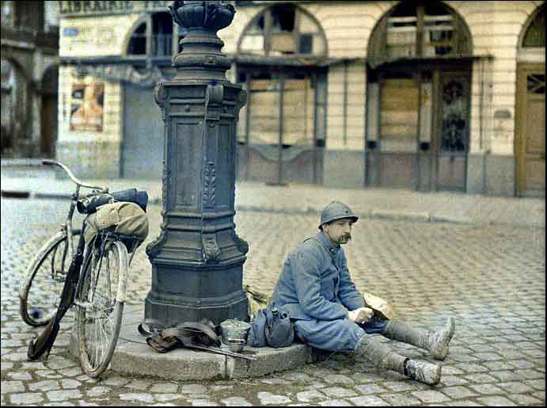
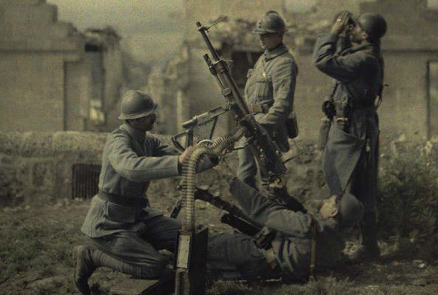
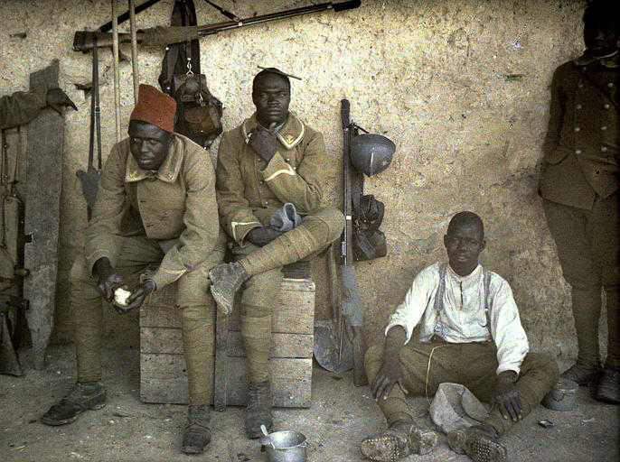
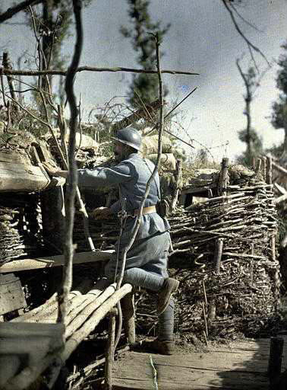
Colonial Soldiers
Notes:
15
15

Slide 16
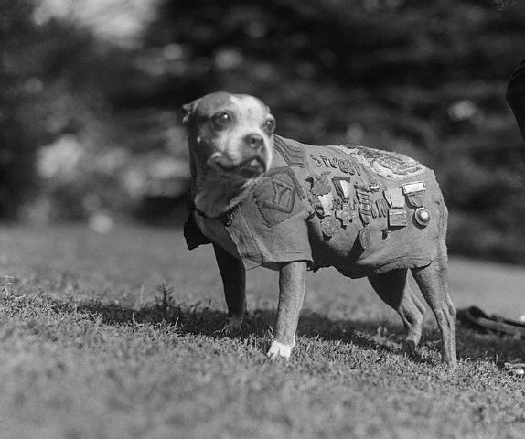
Sergeant Stubby
Notes:
16
16

Slide 18
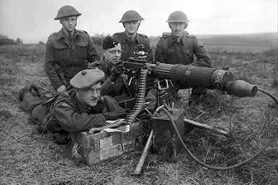
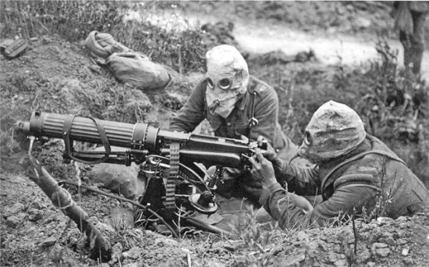
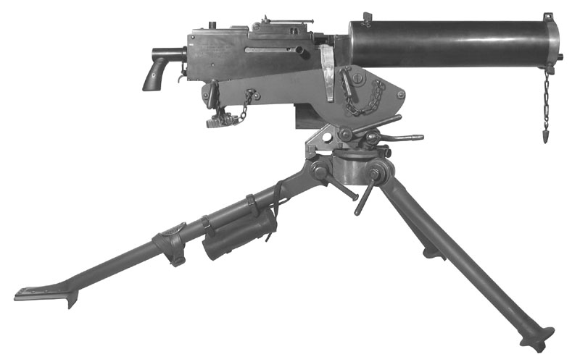
A new type of Warfare (Machine Guns)

Slide 19
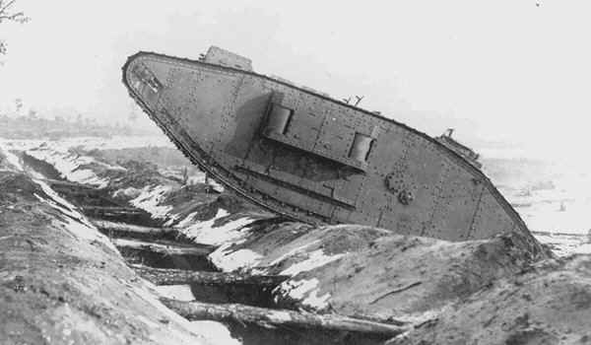
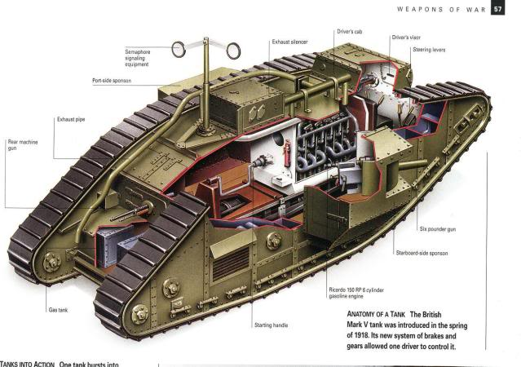
A new type of warfare (Tanks)

Slide 20
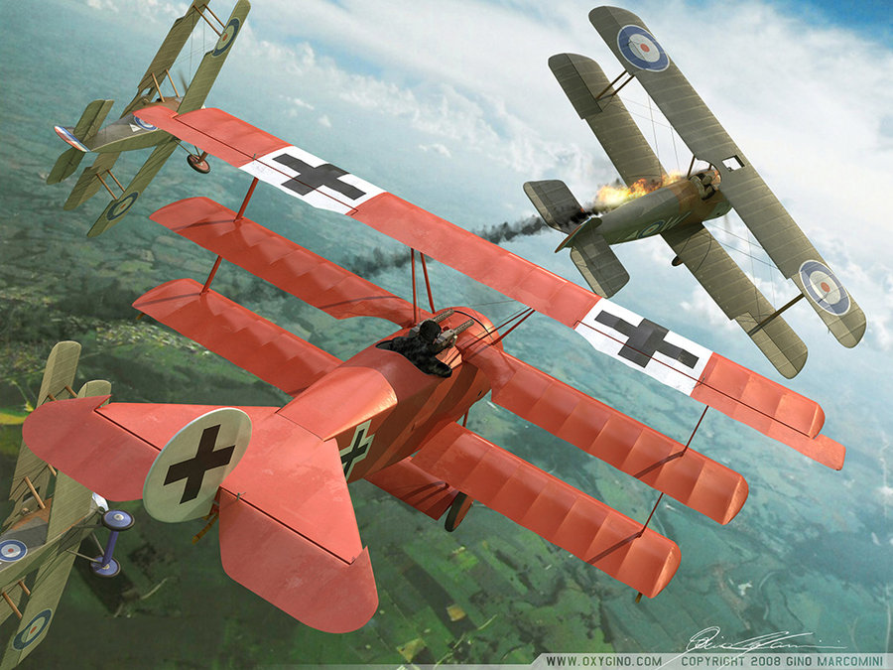
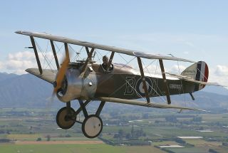
A new type of Warfare (Planes)

Slide 21
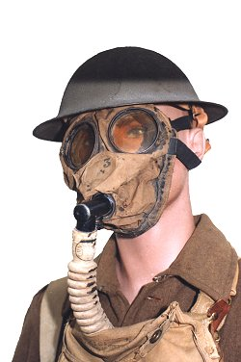
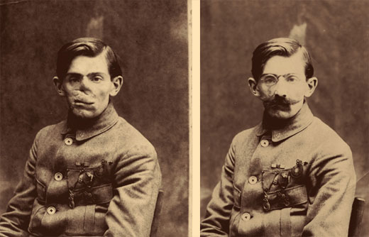
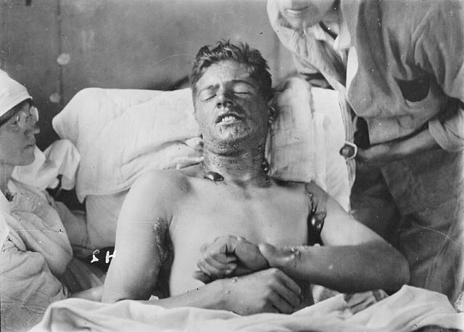
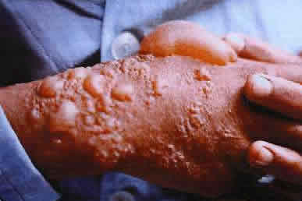
A new type of warfare (Gas)

Slide 22
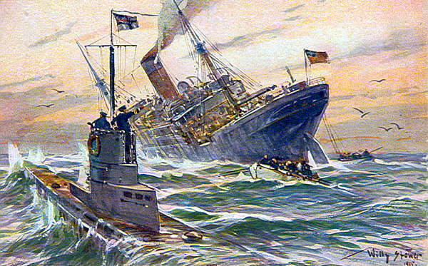
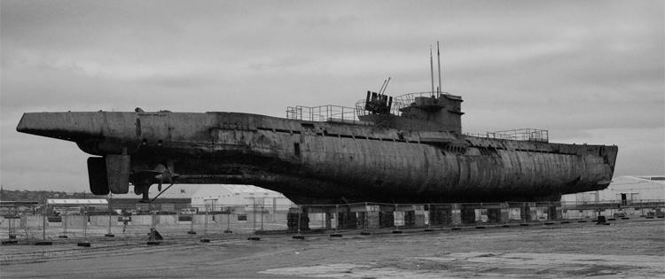
A new type of warfare (U-Boats)

Slide 23
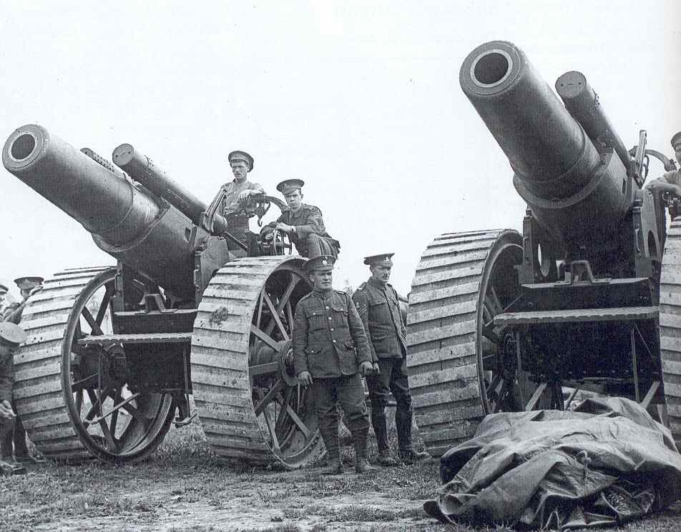
A new type of warfare (Artillery)
Most soldiers killed by artillery fire (67%)
Was much more accurate and deadly

