Slide 1
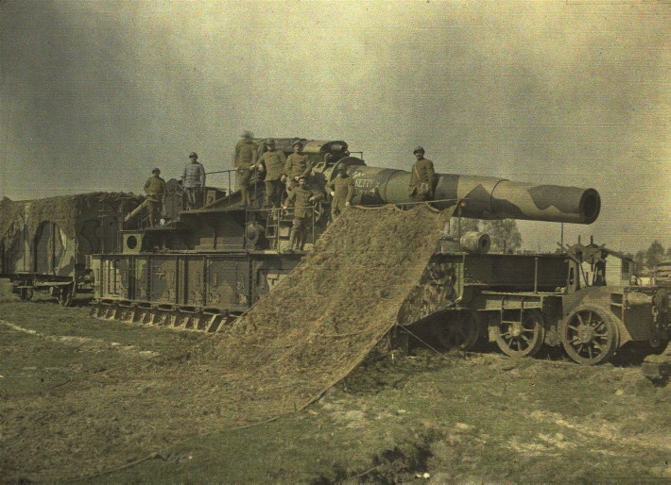
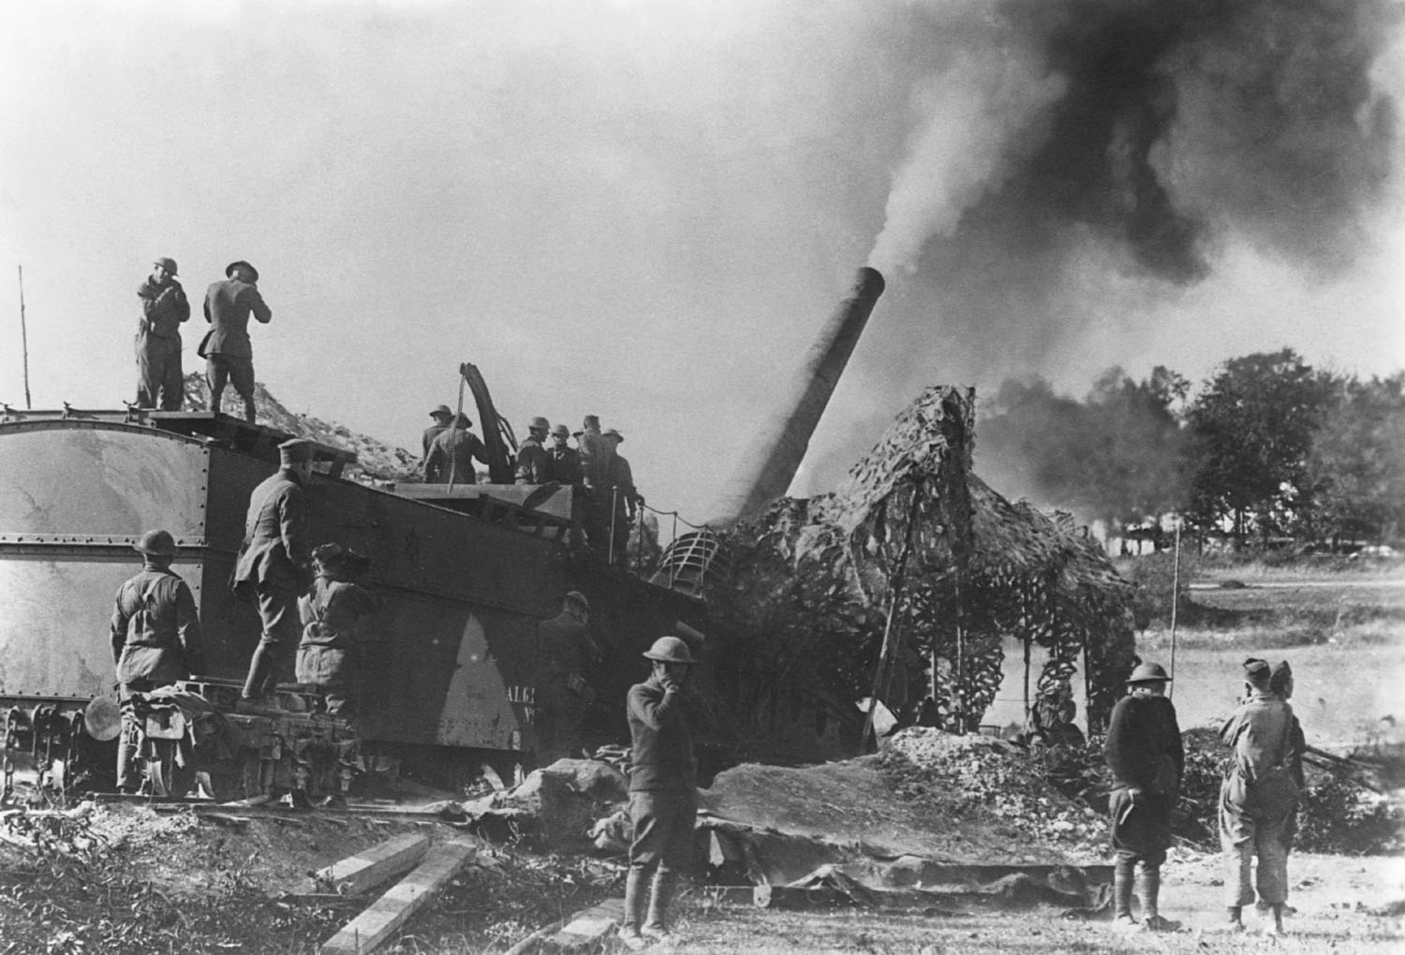
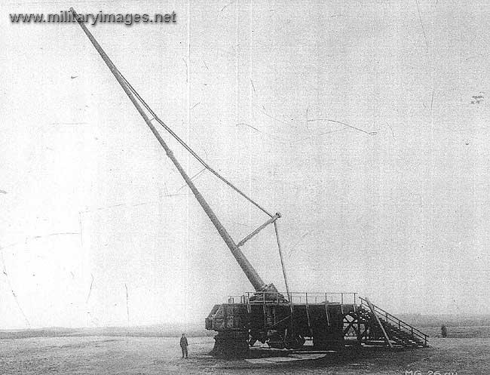
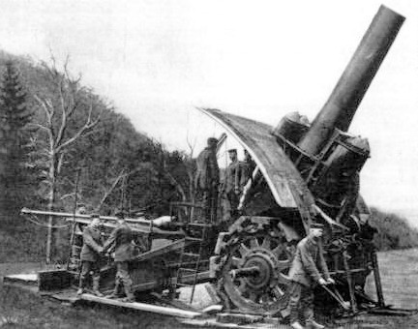
Artillery
Big Bertha
Paris Gun (Range: 84 Miles)
Notes:
1
Artillery
*great example of the type of artillery that was being used during the war
*huge guns that had to be transported by railroad
*hence the name “rail guns”
*this is what killed the majority of soldiers on both sides (67% of deaths caused by artillery fire)
*was greatly improved which was one of the reasons for the high casualty rate of the war
*much more deadly and accurate weapons
*67% of the deaths were caused by artillery fire
1

Slide 2
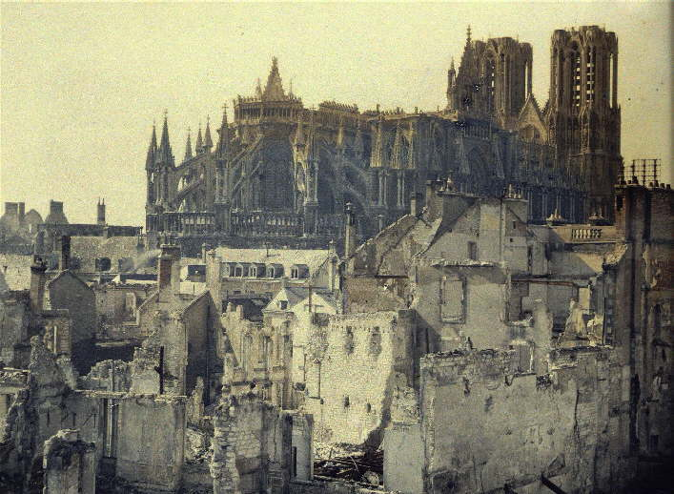
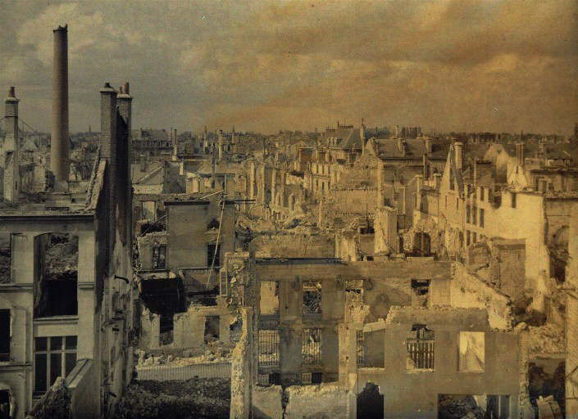
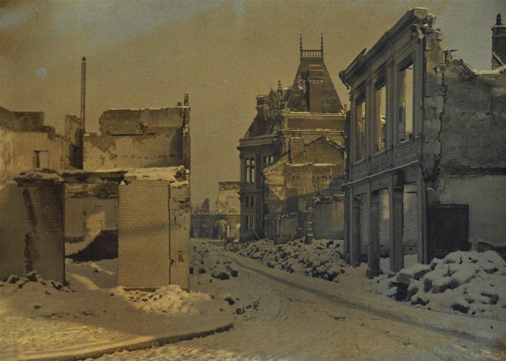
Notes:
2
2

Slide 3
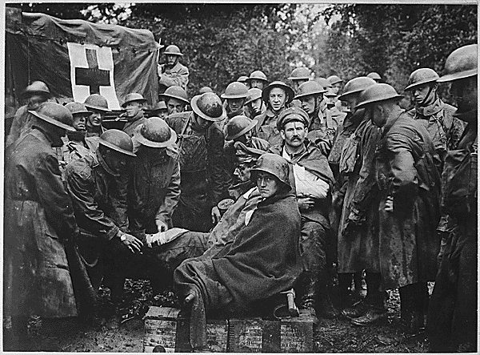
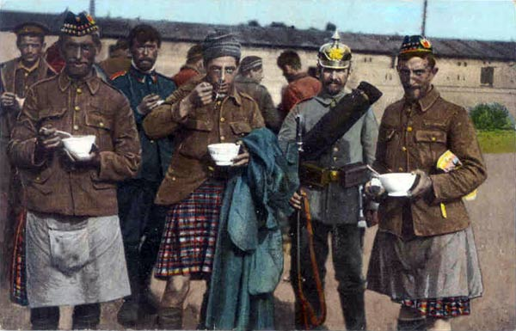
Notes:
3
“Live and Let live”
*during times of stalemate along the front, soldiers from both sides would show respect for each other by simply not killing one another
*both sides would deliberately abstain from hostile action toward one another
*illustrated the respect, chivalry and honor the war produced between each side
*snipers along quiet fronts would not shoot at one another
*if they saw a campfire cooking food they would allow the other side to eat instead of shooting at them or lobbing artillery at them
*in some cases one side would invite the other side to come over and eat or they would exchange goods
*Germans would trade schnapps with French for wine, the British for Scotch or the Russians for Vodka
*tobacco, food and coffee was also exchanged between the sides
*most of the time the sides were more than willing to give medical care to their captured comrades in arms
3

Slide 4
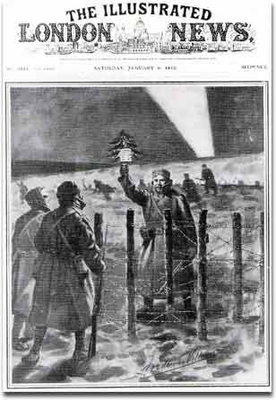
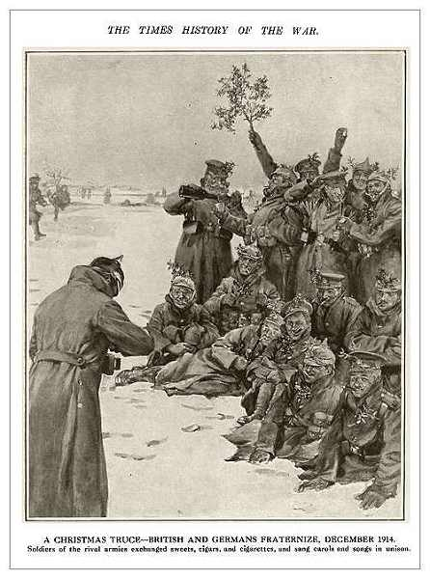
Christmas Truce 1914
Notes:
4
Christmas Truce 1914
*one very famous instance of respect between both sides was the Christmas Truce that took place in 1914
*were a series of unofficial ceasefires along the Western Front in 1914
*for about a week leading up to Christmas both sides (British and German and French and German) exchanged seasonal greetings and in some occasions gifts of food or souvenirs
*both sides sang songs from their trenches and celebrated Christmas without fear of retaliation
*there were several instances of troops coming up out of trenches to meet on the battlefield and exchange gifts with one another
*they ate and drank together
*played games and soccer against one another
*each side also allowed to gather on the battlefield and bury their dead comrades
*the next day both sides went back to blowing each other to smithereens
4

Slide 5
America Intervenes

Slide 6
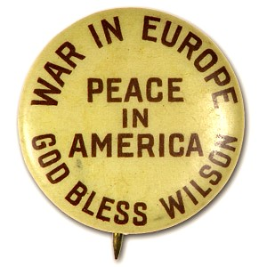
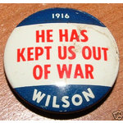
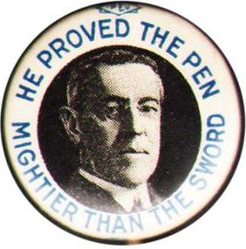
Neutrality
US remained neutral from 1914-1917
1916 Election

Slide 7
Reasons for U.S. Involvement
Sussex Pledge
Lusitania (Sinking of the Lusitania)
Unrestricted German U-Boat Warfare
Ties with Allies (Britain, France and Russia)
Zimmerman Telegram

Slide 8
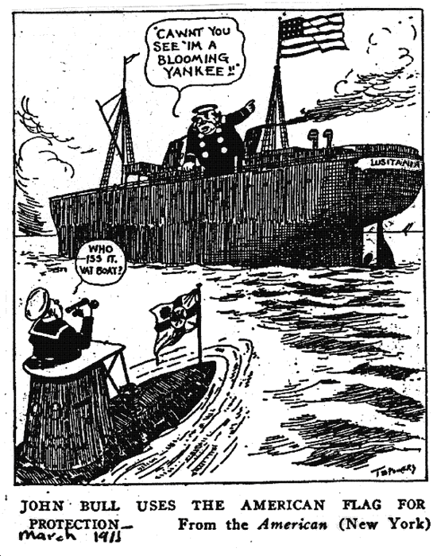
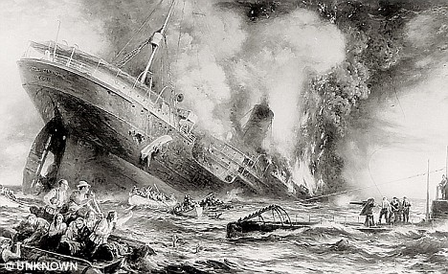
1. Sussex Pledge

Slide 9
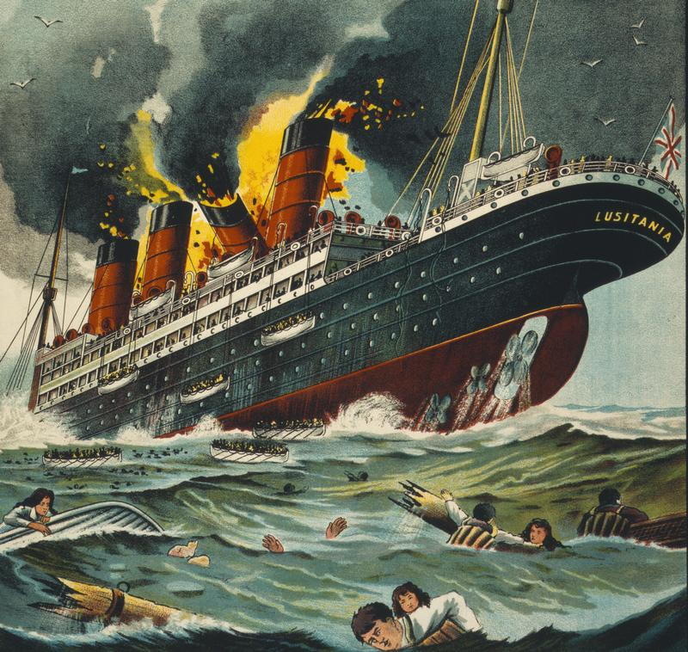
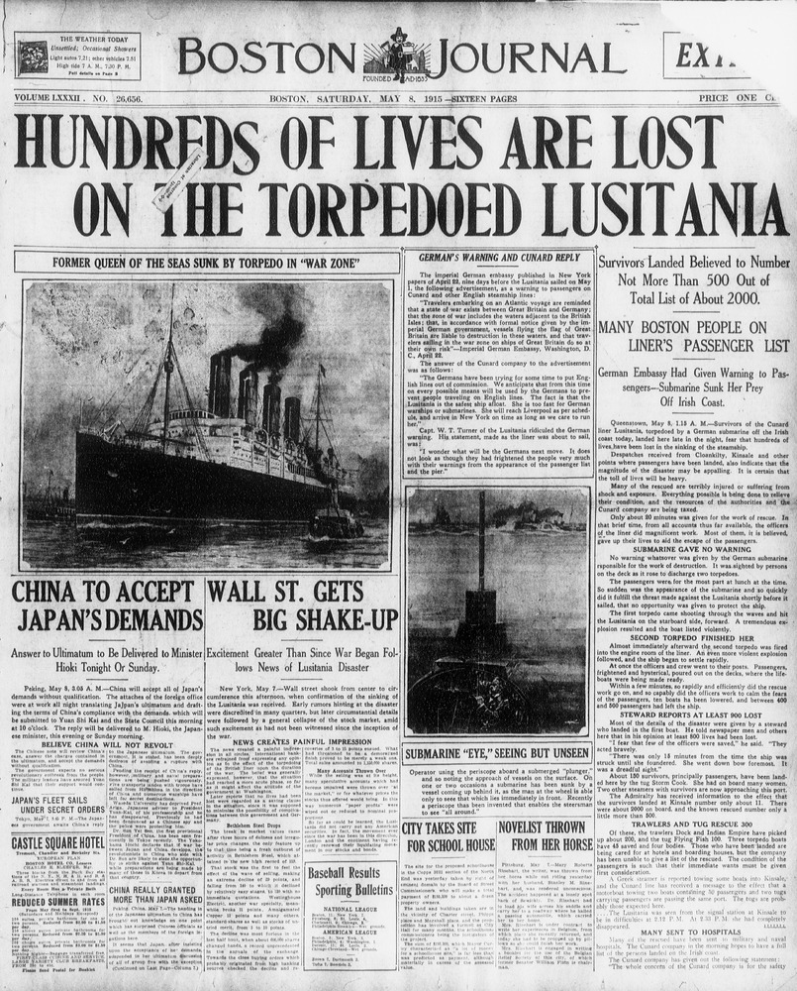
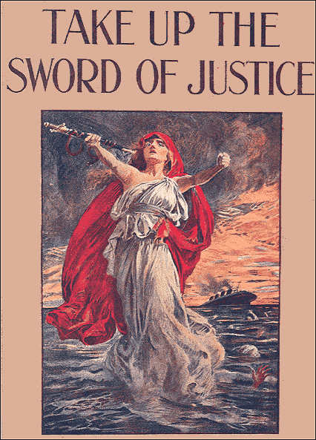
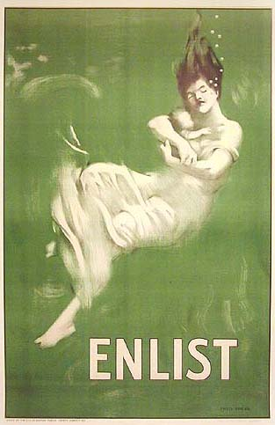
2. Sinking of the Lusitania
Notes:
A British passenger ship leaving NYC secretly carrying munitions for the British.
Sunk by a German sub
Killed 1,000, including 128 Americans.

Slide 10
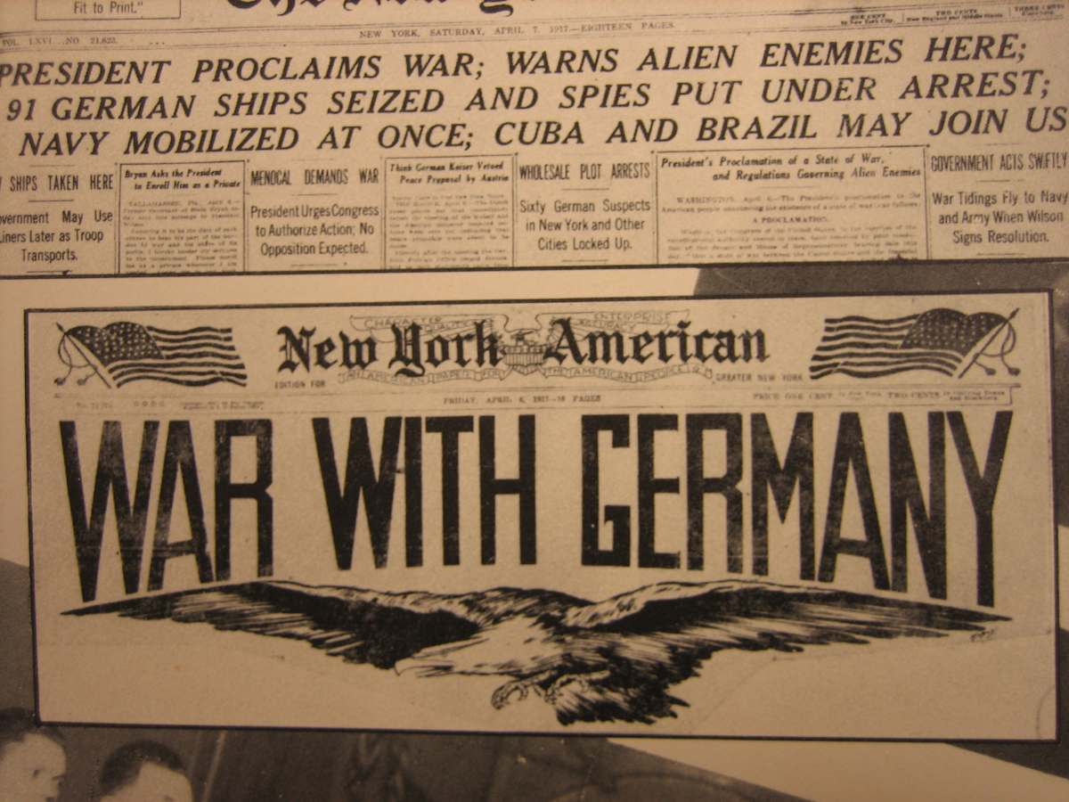
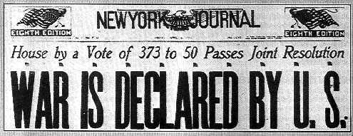
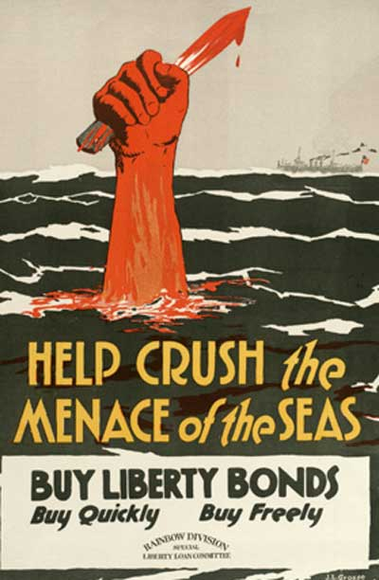
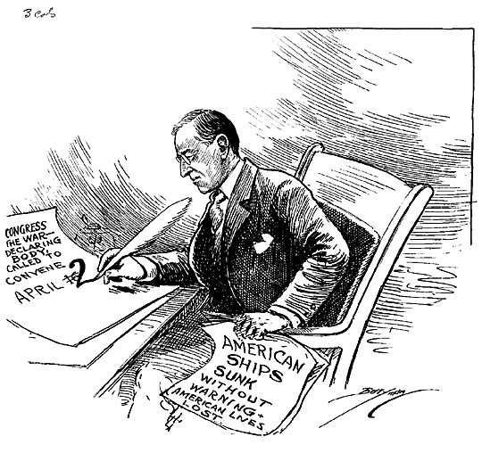
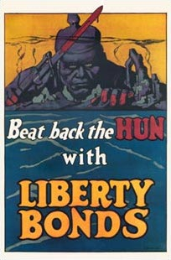
3. Unrestricted U-Boat Warfare
Notes:
Starving bc of British Blockade, German leaders announced that all ships in the blockaded areas would be sunk
Violated “freedom of the seas” for neutral nations
American merchant vessels were attacked so Wilson asked Congress to declare war on Germany

Slide 11
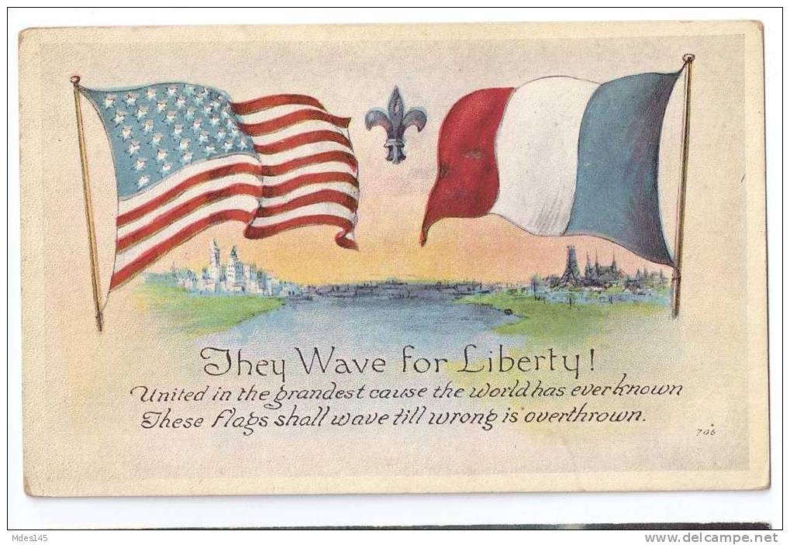
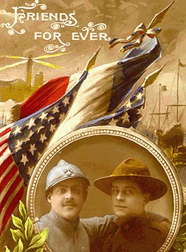
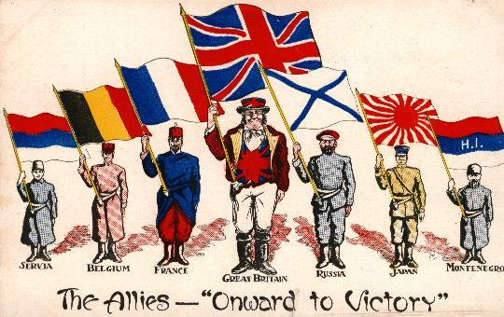
4. Closer Ties with Allies
Notes:
History and language of the U.S. was tied to Britain
U.S., Britain and France are all democratic
France aided America during the American Revolution
Russia was out of the war and France needed aid

Slide 12
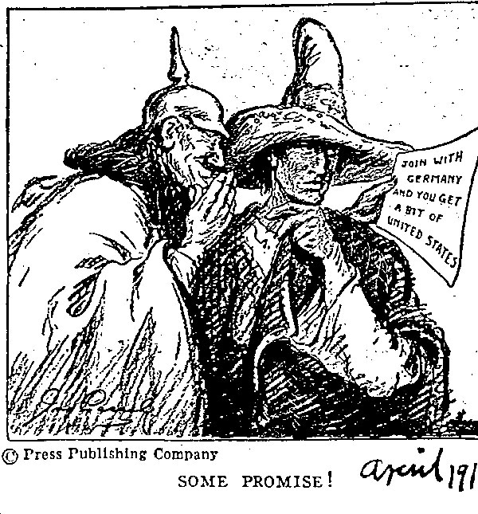
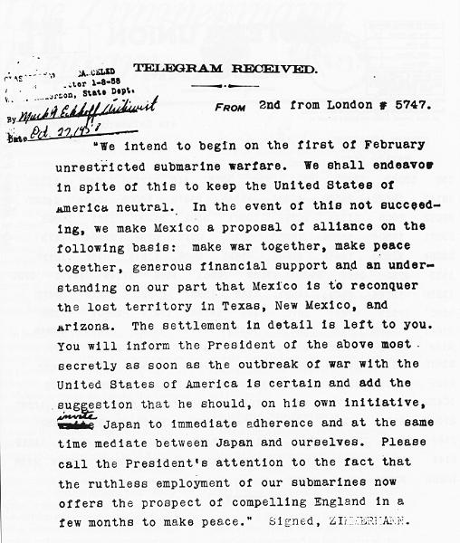
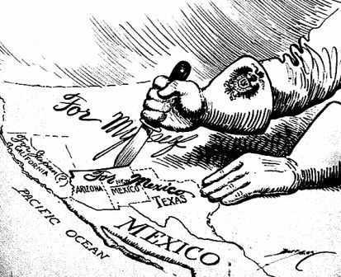
5. Zimmerman Telegram
Notes:
A secret message from Germany promising to return U.S. territories to Mexico if Mexico helped to defeat the U.S.
It was discovered and printed in U.S. newspapers

Slide 13
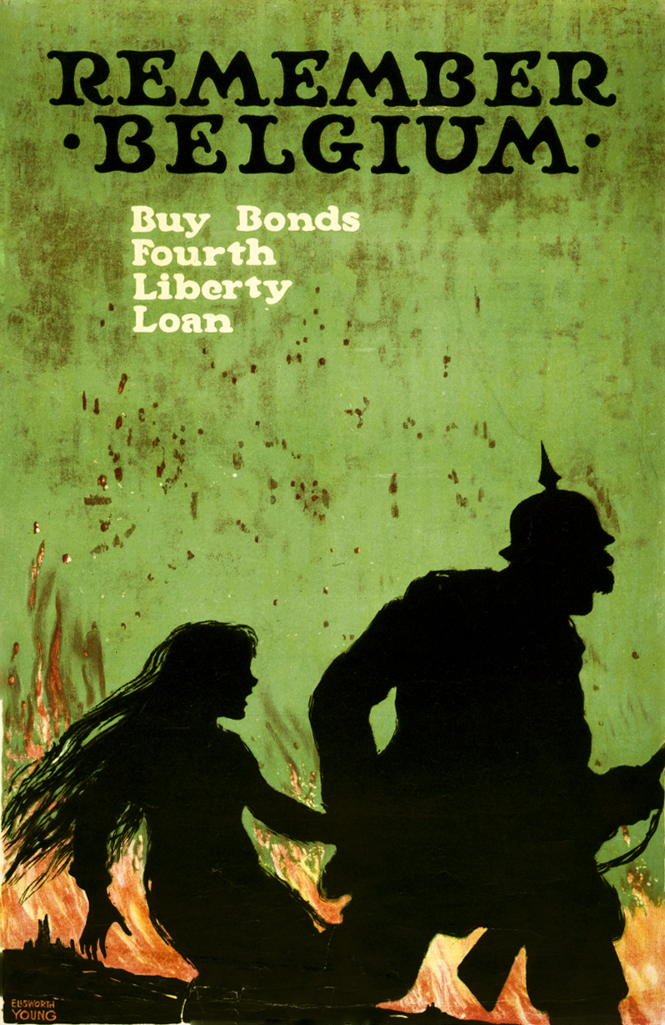
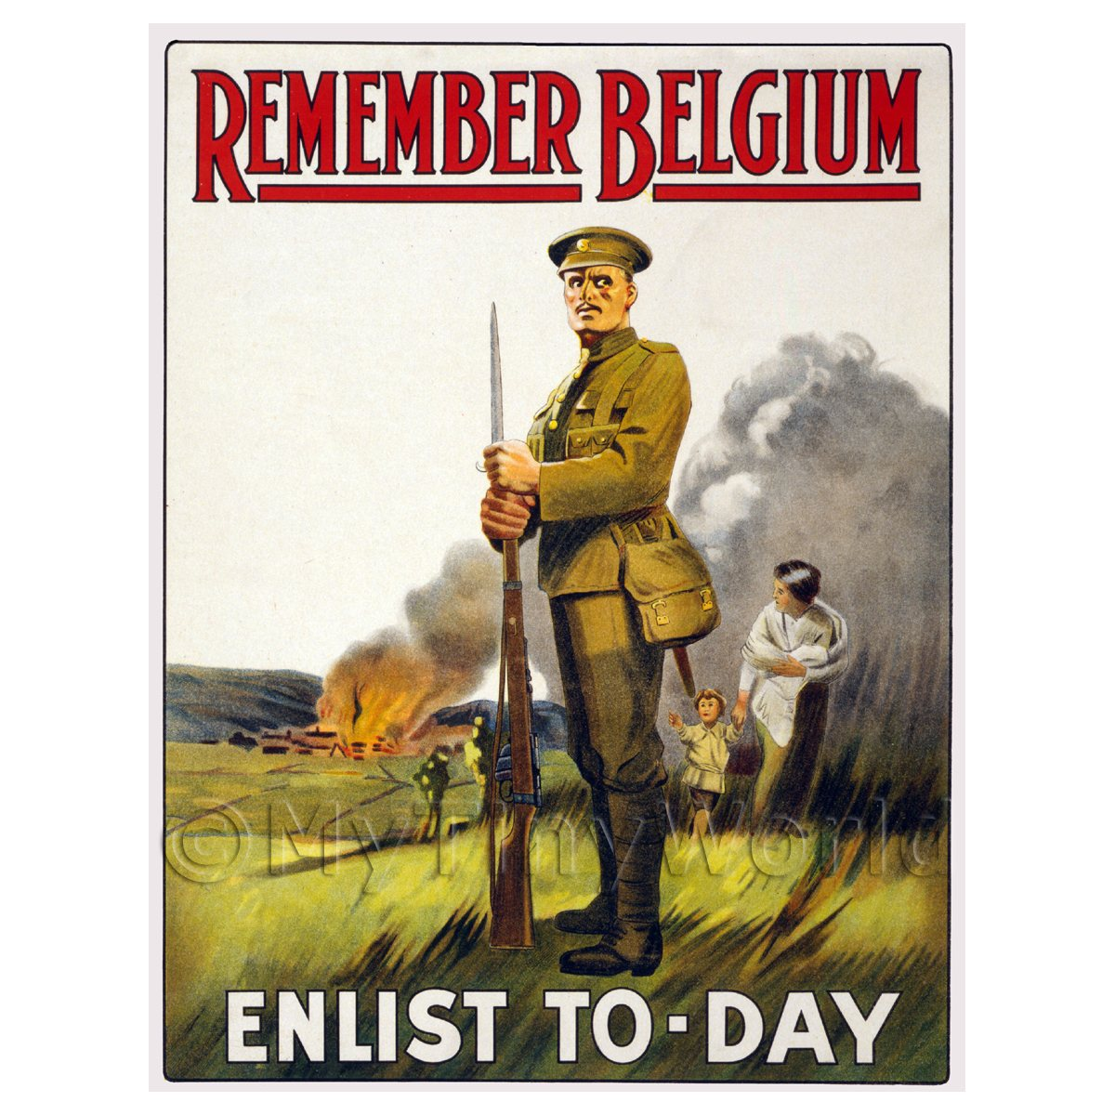
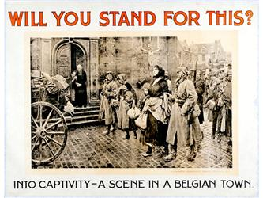
German Actions and Allied Propaganda
Notes:
Americans were shocked at the German invasion of neutral Belgium
American newspapers ran stories and pictures showing the violence against civilians
Causes many Americans to sympathize and volunteer to fight in Europe for Britain and France

Slide 14
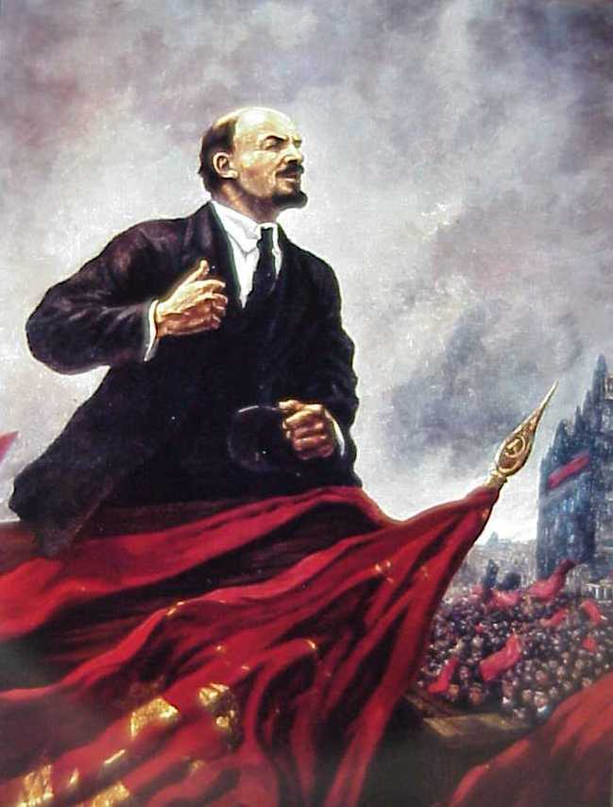
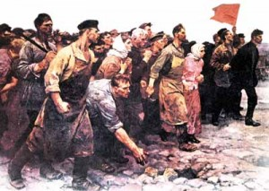
Russian (Bolshevik) Revolution (1917)
Notes:
Russia faced a revolution in 1917
The “Reds” or Bolsheviks won under the leadership of Vladimir Lenin and Joseph Stalin.
Russia became a communist country and pulled out of the war.
This left France and her allies vulnerable and unable to sustain a new German offensive.

Slide 15
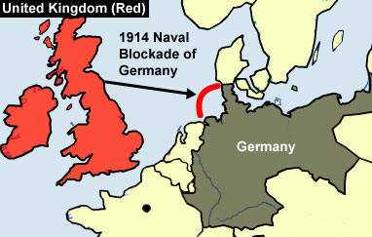
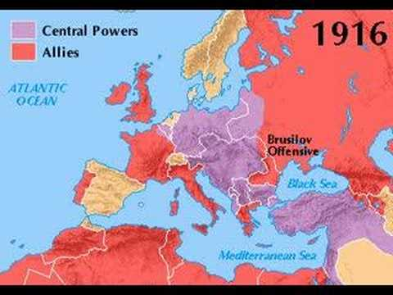
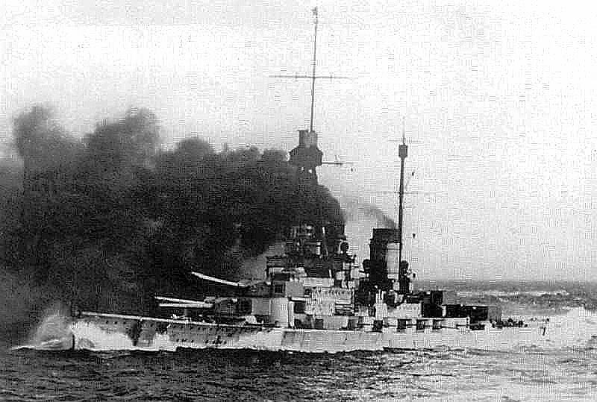
British Blockade
Notes:
British navy prevented food and arms from being shipped to Germany
German subs retaliated by sinking U.S. merchant ship delivering goods to Britain
U.S. became angrier with Germany

