Slide 1
Events During WWI

Slide 2
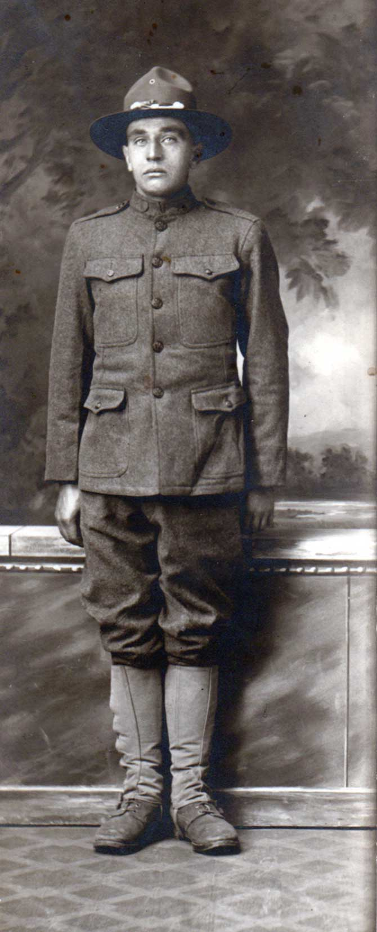
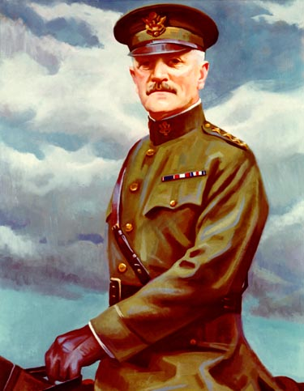
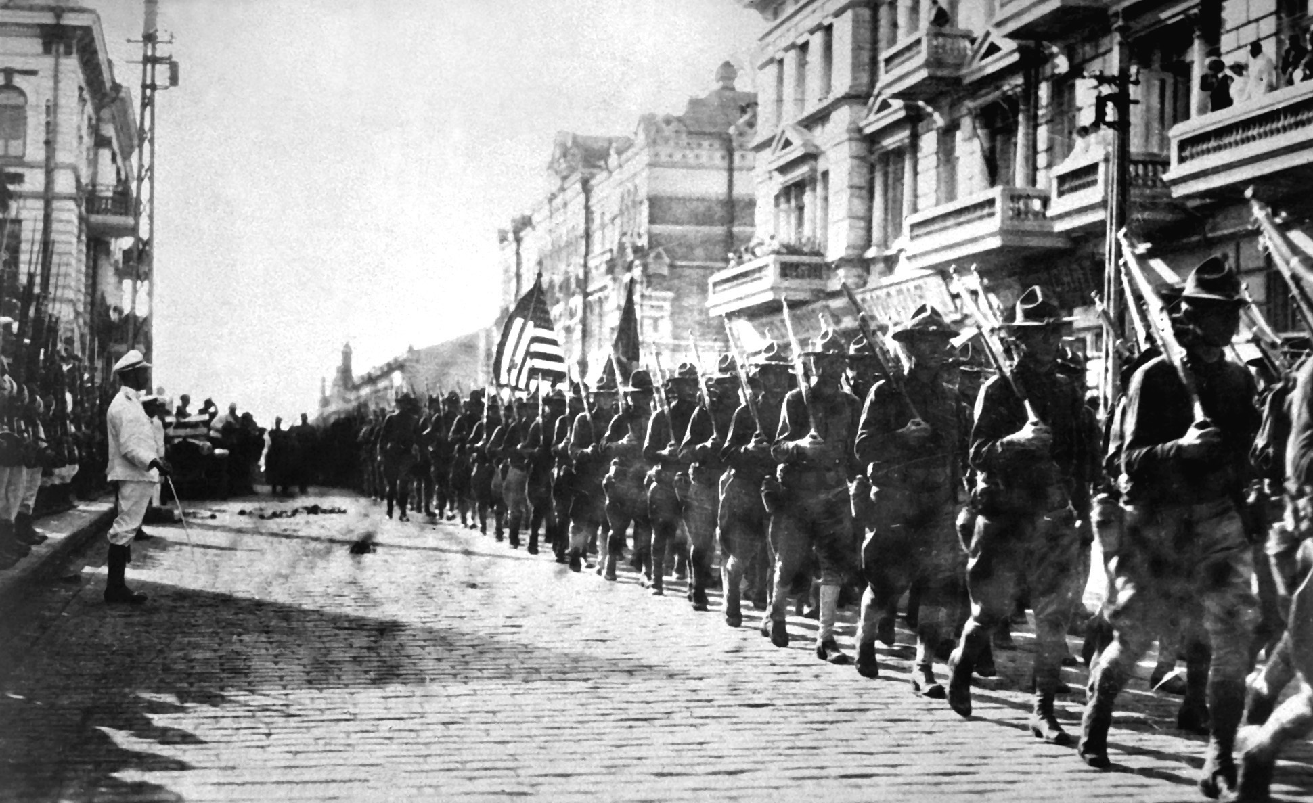
AMERICAN EXPEDITIONARY FORCE (AEF, 1917)
Gen. John J. Pershing
Independent America Army

Slide 3
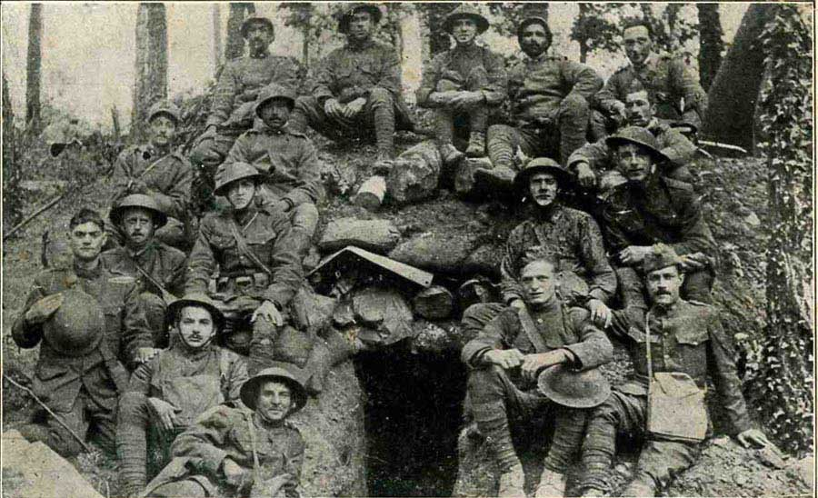
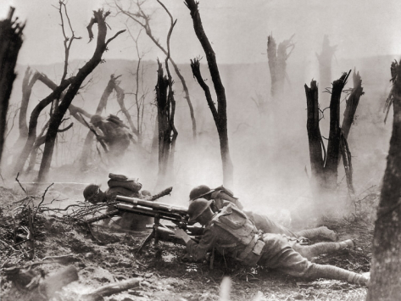
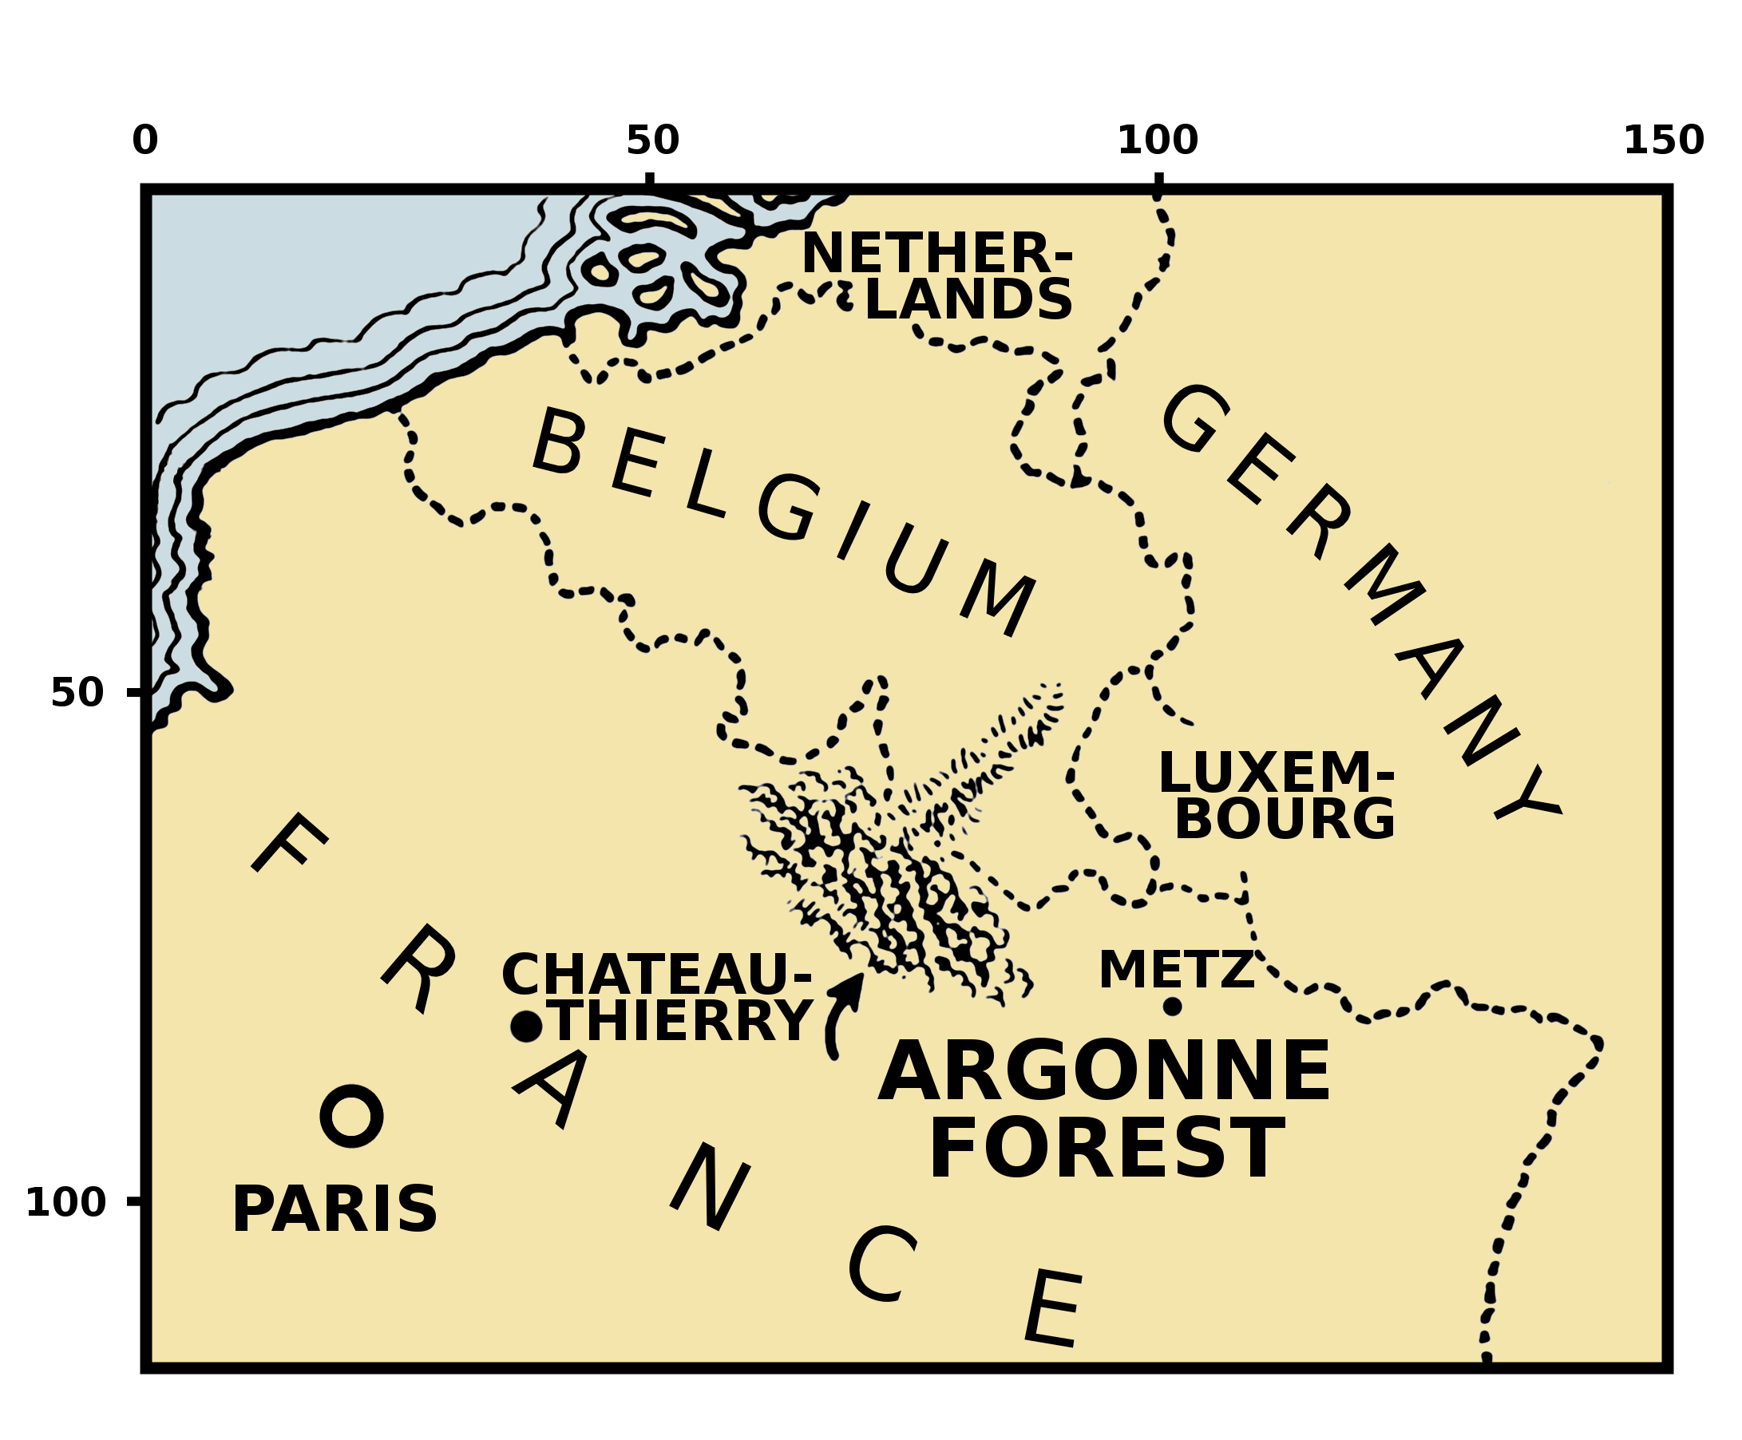
BATTLE OF ARGONNE FOREST 1918
American battle fought in NE France against Germany
Steep terrain, miles of barbed wire, high concrete walls, deep pit traps, machine gun nests
Fought by 600,000 AEF, Germans defeated
117,000 AEF died in 1 ½ months

Slide 4
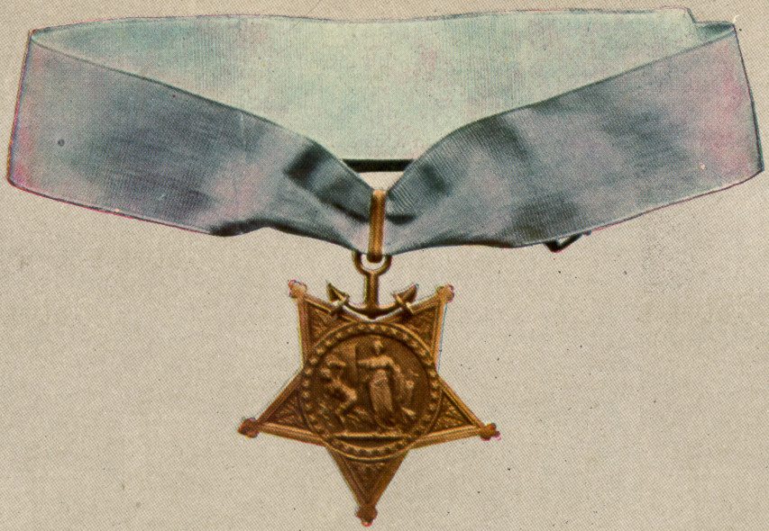
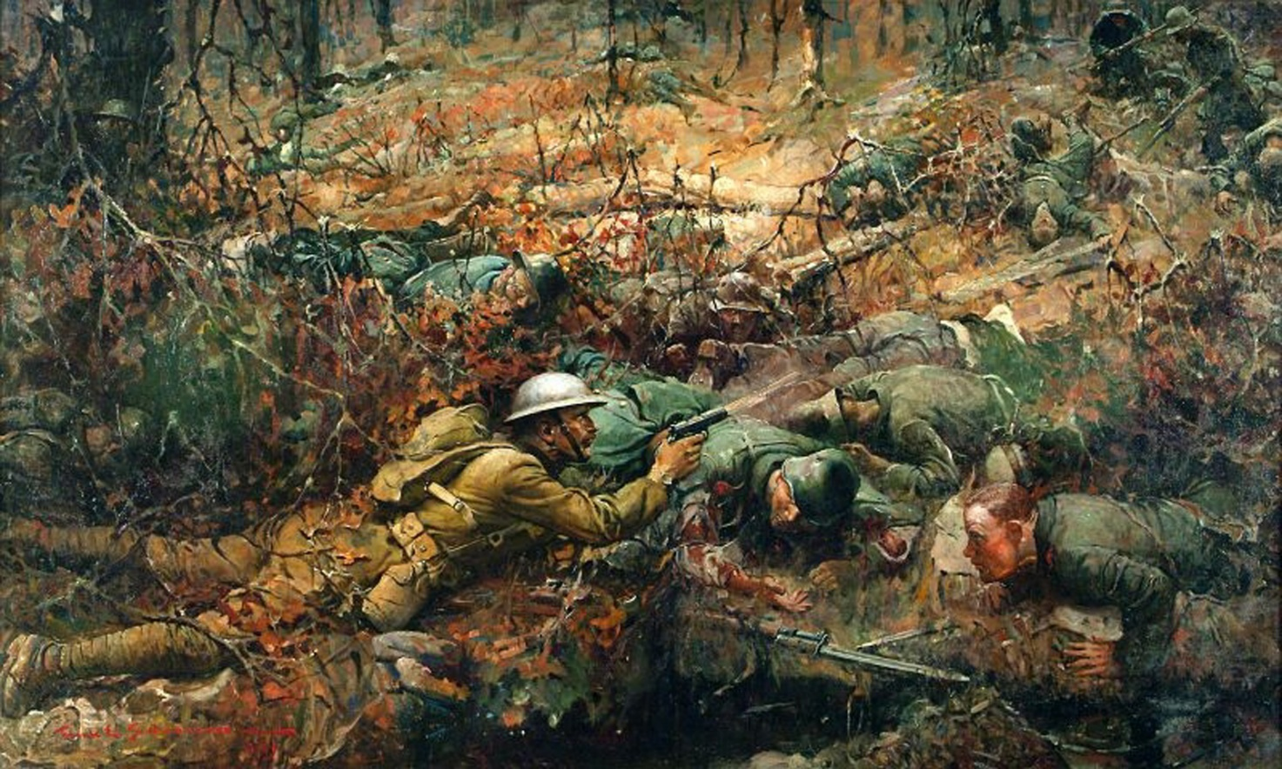
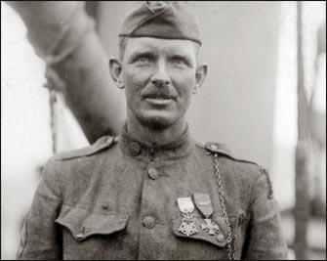
Alvin York
Medal of Honor
Awarded to 3,400 soldiers
Alvin York
Objected to military service, but was drafted
Single handedly killed 25 Germans & captured 132
One of the most decorated soldiers in U.S. history.

Slide 5
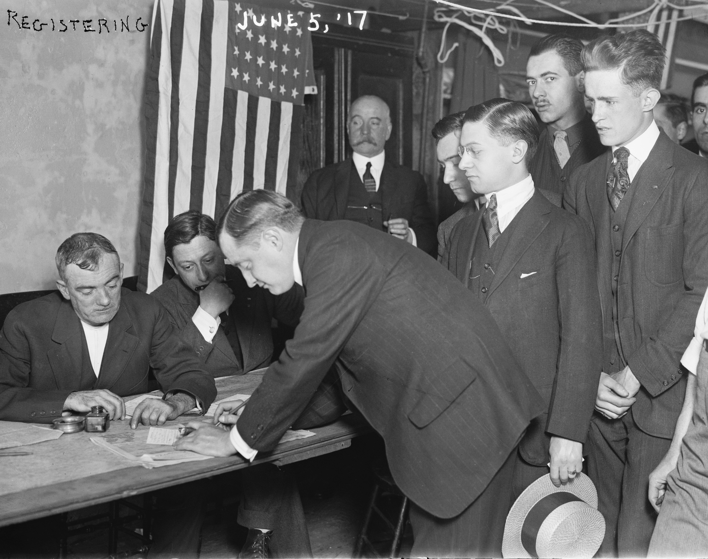
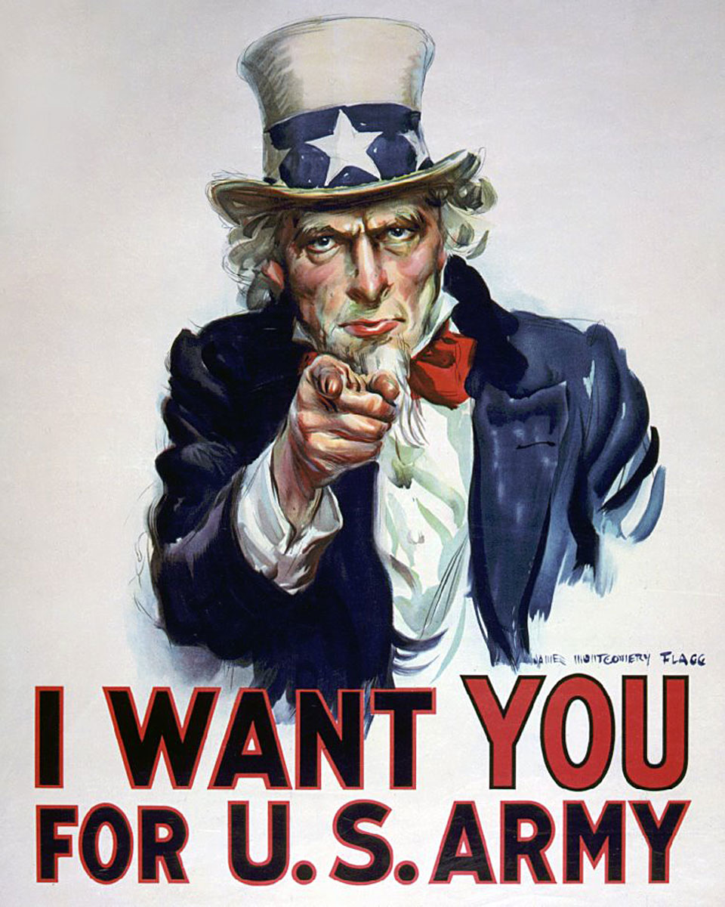
The Home Front
Wilson given sweeping powers by Congress:
Placed railroads under government control
Regulated the economy
Passed the Selective Service Act (1917)
Millions registered for the draft
Espionage Act of 1917
Made it a crime to criticize the war effort

Slide 6
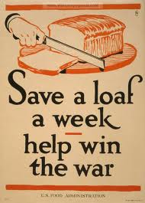
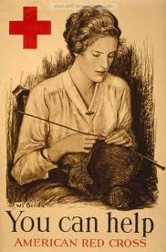
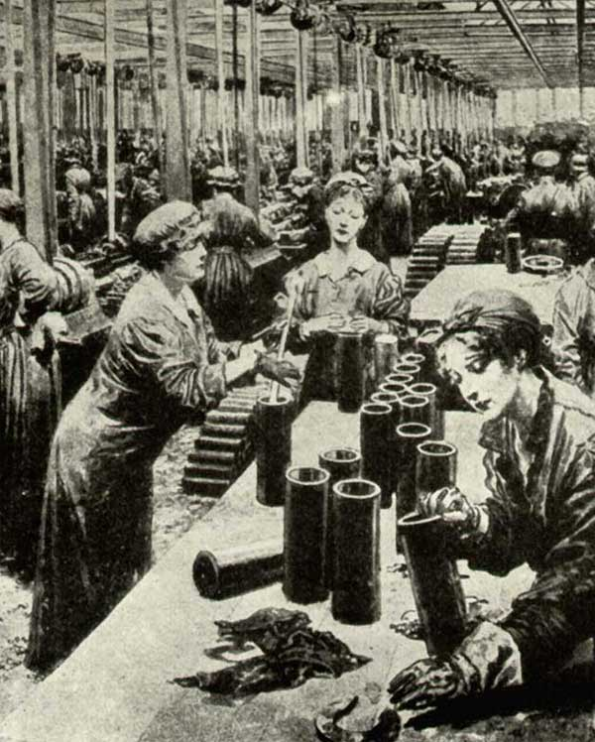
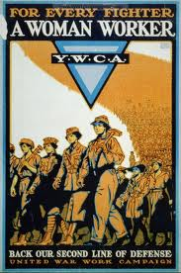
The Home Front:
Women and African-Americans
War Bonds
American Economic Growth

Slide 7
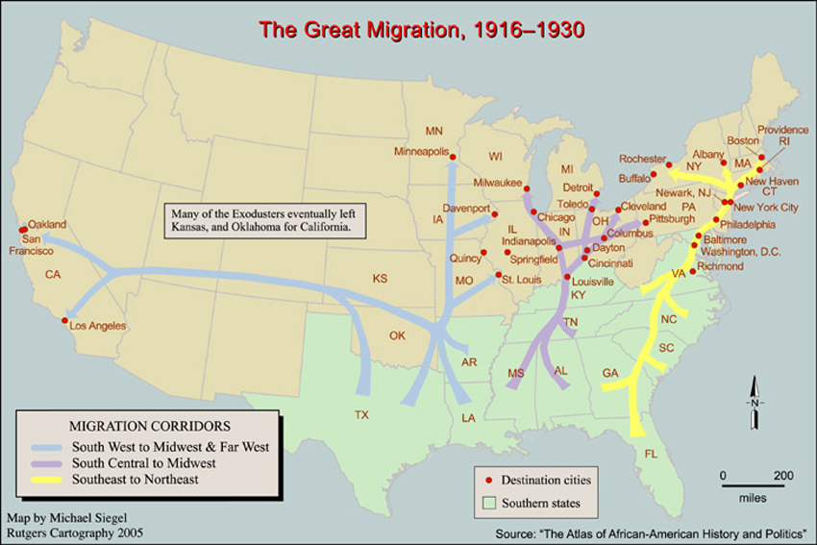
THE GREAT MIGRATION
Movement of African-Americans from the south to the north to fill jobs during WWI
Thriving industries in the north meant that Blacks had job opportunities there.

Slide 8
The War’s end

Slide 9
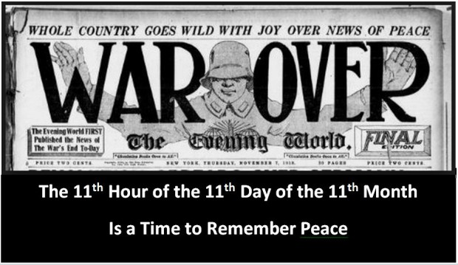
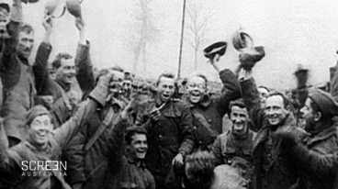
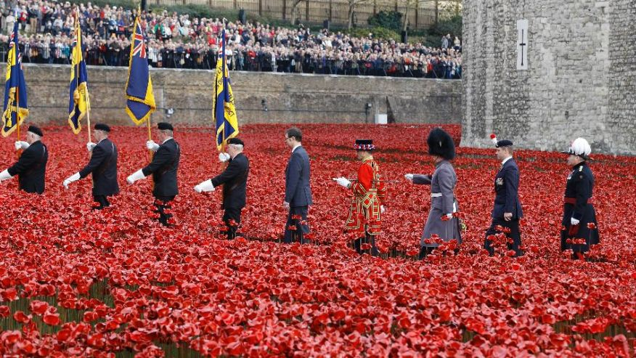
Armistice Day: November 11, 1918 @ 11:00a.m.
Notes:
The war came to an end November 11, 1918 at 11:00a.m. (Also known as the 11th hour of the 11th Day of the 11th month.)
This brought an official cease fire to the war so that a peace treaty could be written in the following months.
Today Armistice Day is celebrated as Veteran’s Day.

Slide 10
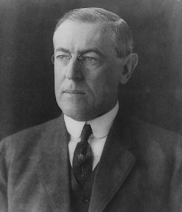
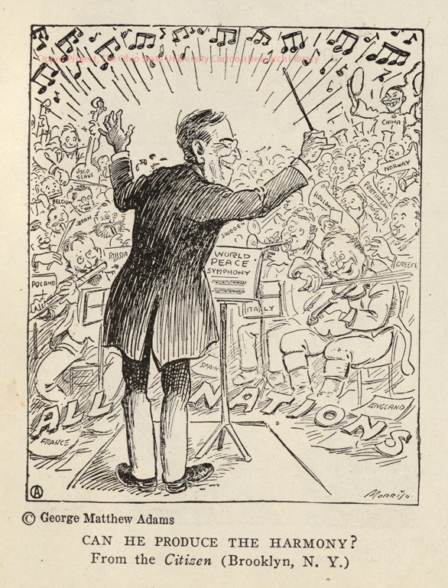
Wilson’s 14 Points
Speech by Wilson as a basis for the peace treaty & stated U.S. war aims
Main Points:
1. Create new nation-states- Poland
2. Break up Austria-Hungary
3. Freedom of the Seas
4. No more secret treaties, open diplomacy
5. 14th Point=League of Nations- Group of nations who would mediate worldwide peace

Slide 11
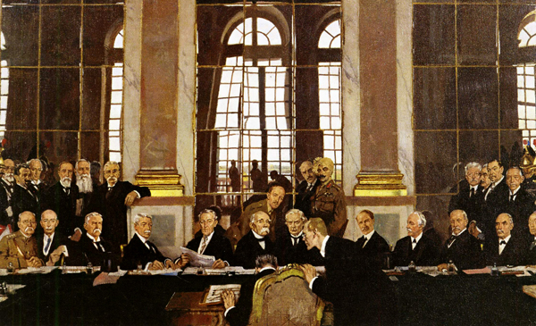
Treaty of Versailles
Ended WWI
Dealt harshly with Germany
Main Points:
1. Germany lost territory
2. Austria-Hungary and Ottoman Empire were broken up into separate nation-states
3. Germany forced to de-militarize
4. The League of Nations was created

Slide 12
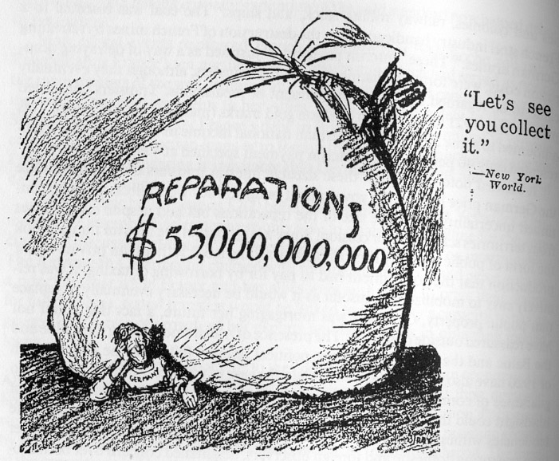
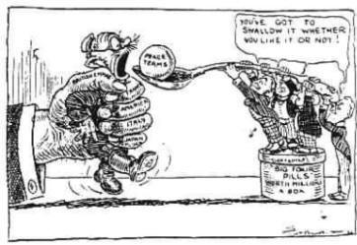
5. Reparations
Payments made by Germany to the Allies for damages during WWI.
War Guilt Clause- Germany forced to accept blame for starting war.
Crippled Germany’s economy and created tremendous bitterness.
Some say this eventually led to WWII.

Slide 13
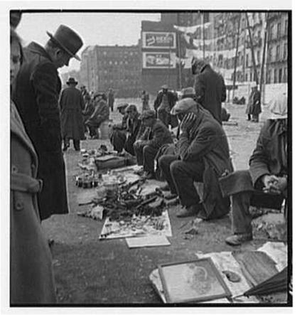
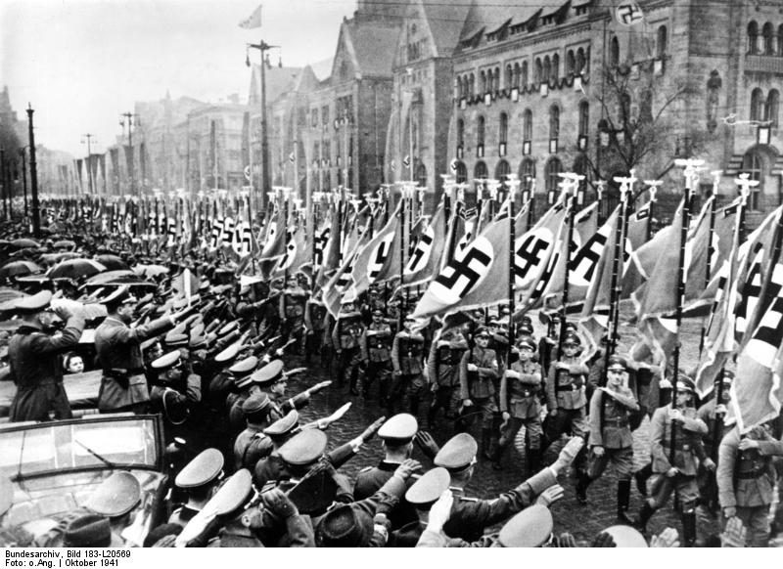
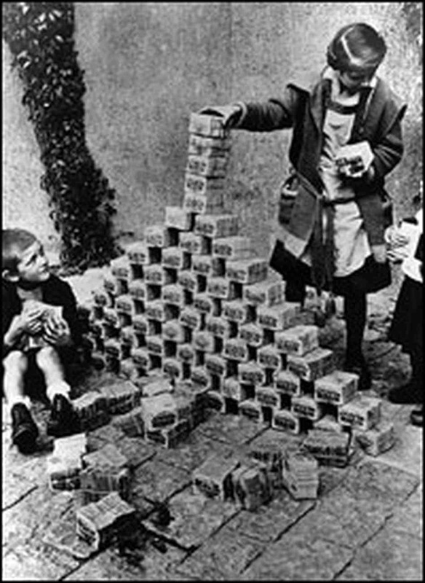
Failures of the treaty of Versailles
German Economy plummeted
Europe’s economy followed
Created German Bitterness
Led to the rise of dictators
Led to the remilitarization of Germany
Led to retaking of territory

Slide 14
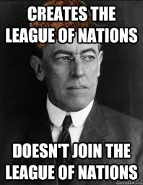
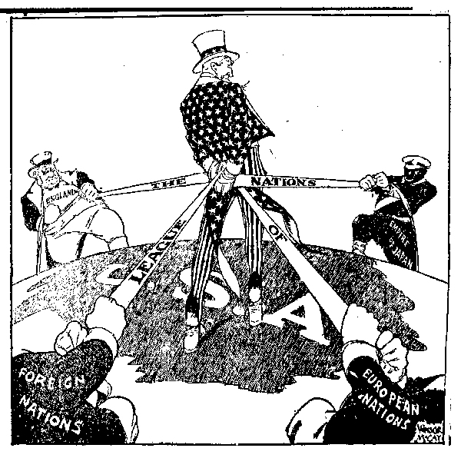
The League of Nations
Wilson hoped it would prevent war, but opponents believed it would pull U.S. into future wars
Henry Cabot Lodge- member of Congress who strongly opposed the League of Nations, “U.S. would lose freedom of action”
Senate never ratified the treaty and U.S. never joined the League of Nations

