Slide 1
Post War 1920’s
Focus Questions:
What impact did WWI have on American Society?
Explain why the 1920’s were known as the Roaring 20’s and the Jazz Age.
Examine the impact of the First World War on American society. (I.E.: The Red Scare, Nativism, Fundamentalism)
Identify the effects of the 18th Amendment.
What were some of the changes in American industry that led to prosperity after the war?
Describe how the roles of women and African Americans changed during the 1920’s.
Identify the different elements of the Harlem Renaissance movement.
What kind of pop culture became popular during the 1920’s?
Notes:
1
The purpose of the focus questions is to help students find larger themes and structures to bring the historical evidence, events, and examples together for a connected thematic purpose.
As we go through each portion of this lecture, you may want to keep in mind how the information relates to this larger thematic question. Here are some suggestions: write the focus question in the left or right margin on your notes and as we go through, either mark areas of your notes for you to come back to later and think about the connection OR as you review your notes later (to fill in anything else you remember from the lecture or your thoughts during the lecture or additional information from the readings), write small phrases from the lecture and readings that connect that information to each focus question AND/OR are examples that work together to answer the focus question.

Slide 2
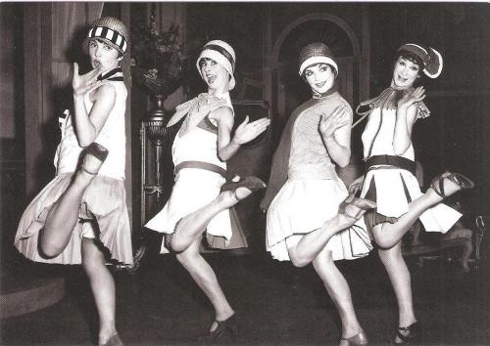
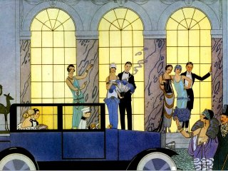
The Roaring Twenties (The Jazz Age)
Notes:
1920’s postwar America
*the decade following the Great War was a time of tremendous change throughout the World and the United States
*the United States, especially, would witness a new prosperity that it had never had in its history
*Americans had the highest quality of life of any nation in the world and had more money to spend
*to counteract the depression that hit after the war the three Republican presidents during the 20’s took a hands off approach to fixing the problem
*they allowed the economy to flourish on its own without interfering at all
*the economy made a drastic transformation and with it caused tremendous change as well
*the period know as the “roaring twenties” was almost like a second Gilded Age and led to a revolution within American society
*in a lot of ways the “roaring twenties” represented a conflict between old school rural America and the new liberal urban America
A renewal of industrial growth
Rise of a new middle class who could afford to buy the new products being made
Introduction of new technologies
Loosening of social and cultural restrictions
Radical social and cultural movements

Slide 3
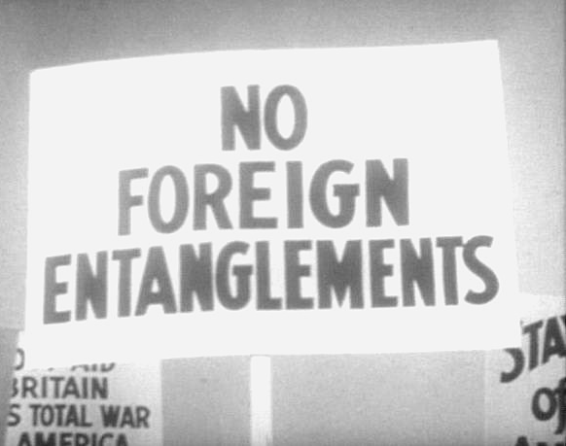
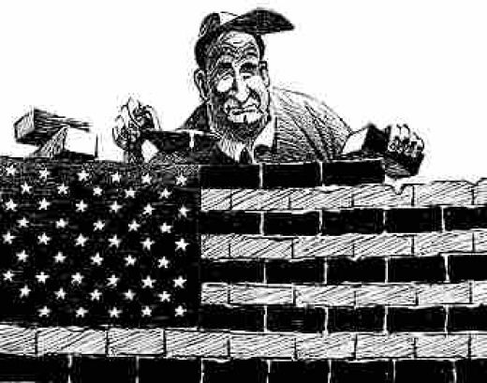
Impact of the First World War
●Isolationism and Urbanization
●Political, social and cultural radicalism
●Economic and industrial advances
Notes:
Isolationism
*WWI changed the World more than any event in the nation’s history
*the horrors of WWI led many to believe that the nation needed to further isolate itself from Europe
*restrictions were placed on immigration and the nation turned its focus to growing industrially
*the nation became a consumer culture as the middle class expanded
*its also led to the loosening of moral standards within the United States
*in order to better cope with the horrors of WWI Americans and Europeans alike found new ways to take their minds off dreary daily life
*some people became more religious while others lost hope in humanity and stopped believing in God
*in order to do this people moved into the cities
*was during the 1920’s that the United States started to become a more Urbanized nation
*half the nation lived in American cities by the end of the era
Political, social and cultural radicalism
*the war had also changed America socially
*Rise in Nativism (Red Scare/Immigrant Restrictions/KKK)
*Rise in Fundamentalist/Moralists ideas (Scopes Trial/prohibition)
*many movements
1. Women’s movement
2. African American movement
3. Jazz movement
4. Sports movement “Golden Age” of sports
Economic and Industrial Advances
*U.S. economy thrived during the war but took a major hit afterwards
*was a couple of years before the economy recovered
*after a couple of years the U.S. saw the largest economic growth in its history
*largely due to new industries created after war
*(Automobile industry, commercial aircraft industry, domestic product industry)

Slide 4
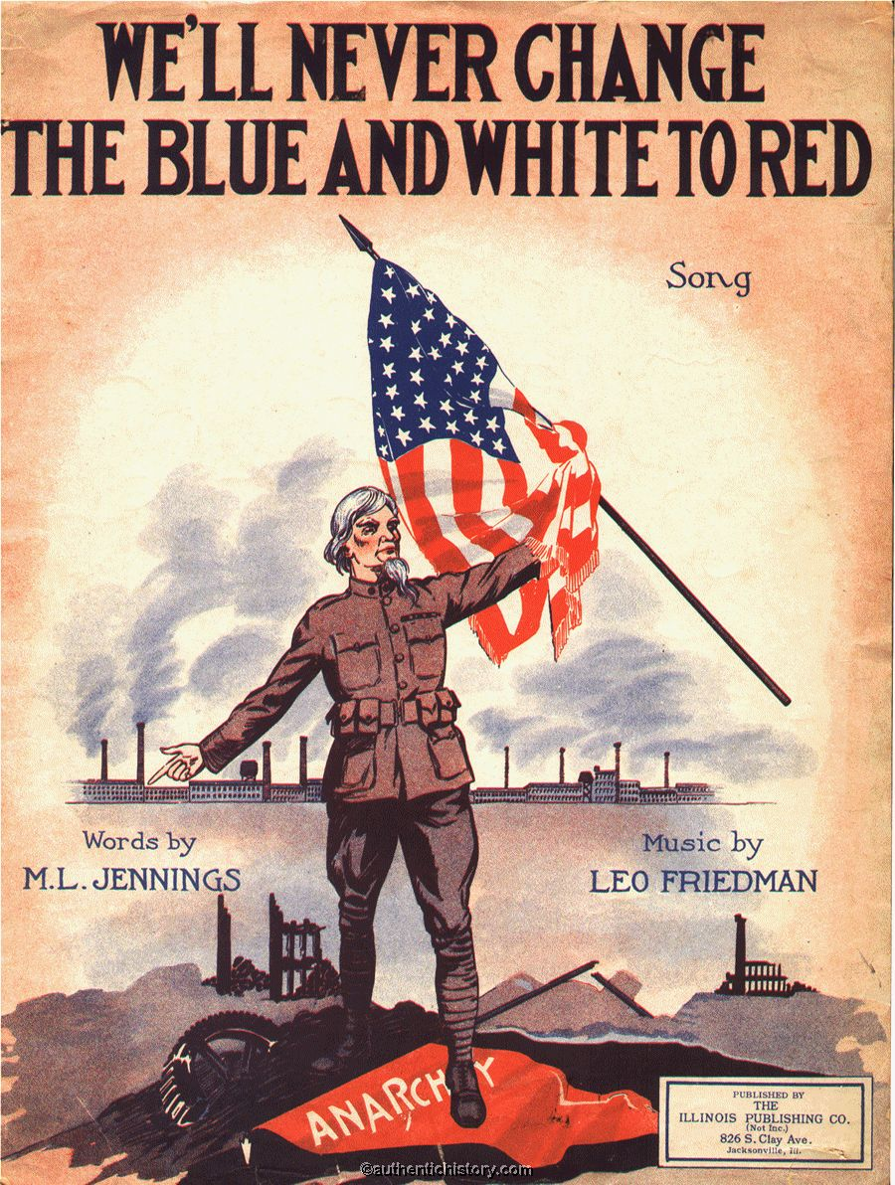
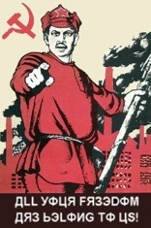
Social Reactions in the 1920s
●The Red Scare
Notes:
Red Scare
*occurred for a couple of reasons
*the number one reason for the “red scare” outbreak in the United States was a result of the aftermath of the Russian Revolution
*many Americans feared the growing number of immigrants coming into the United States from central Europe and Russia
*thought they would bring with them their radical ideas
*when a series of labor strikes broke out in the United States many Americans blamed Communism because many of the workers involved with and leading the strikes were immigrants from Communist nations
*as a result Americans became suspicious of Communist ideas and attempted to prevent its spread
*the most important effect of the “red scare” was the increased power of certain government institutions
*the FBI during the 1920’s grew tremendously under the leadership of J. Edgar Hoover

Slide 5
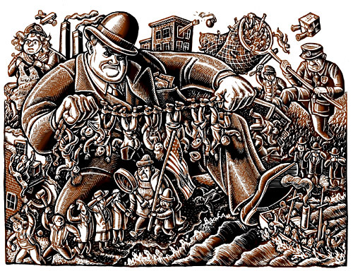
The Palmer Raids
●The Quota System
Notes:
The Palmer Raids
*a series of raids that took place in the early 1920’s led by Attorney A. Mitchell Palmer
*meant to sniff out anarchists and send them back to their countries of origin
*deported more than 500 communists
*resulted in a series of riots in over 30 cites
*there were two bombing that resulted from the riots including one at Palmer’s home
The Quota System
*Fear of immigrants and their influence led to restrictions and Immigration Acts.
*Limits were placed on how many immigrants could come from certain areas.
*this was especially true of immigrants that came from communist nations or immigrants with communist sympathies.
*Targeted Russians and banned Chinese.

Slide 6
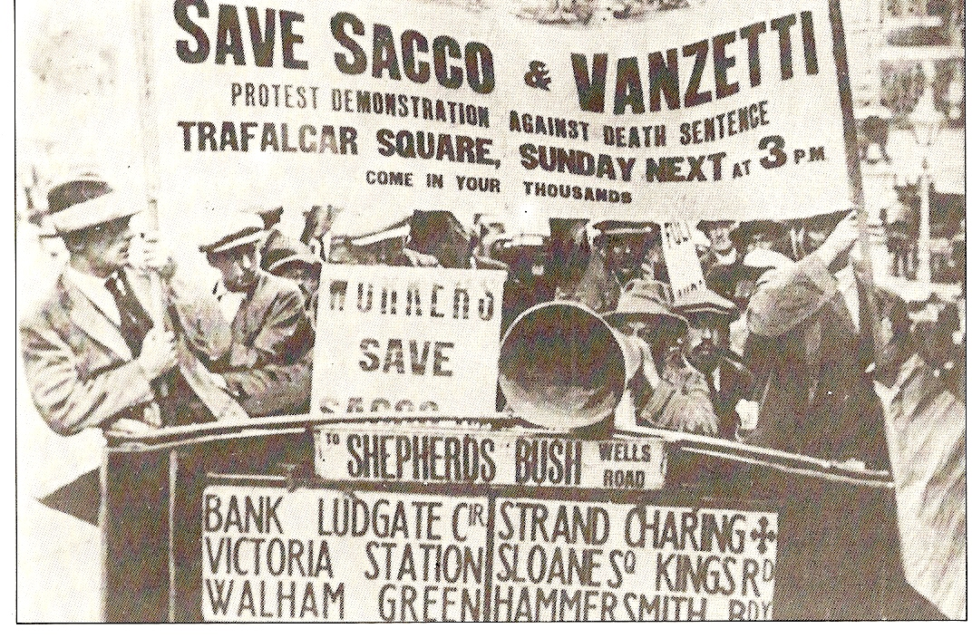
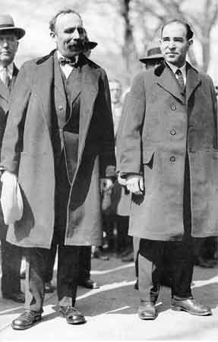
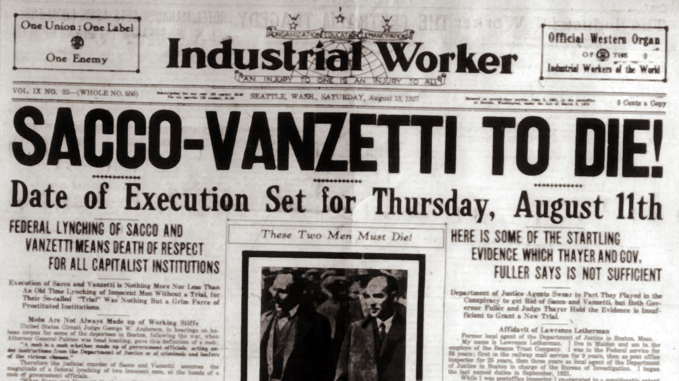
●Sacco and Vanzetti
Nativism
Notes:
Sacco and Vanzetti
*in 1921 two Italian immigrants who were accused of killing two men
*many people in the US felt the men were innocent but had been singled out because of their radical political ideologies
*were put on trial with little evidence and found guilty
*eventually, news of the trial went global and the men gather a supportive following of millions throughout the world
*for six years they appealed their sentence and pledged their innocence till the day they were executed
*many people in the US protested the trial and the execution of the two men
*on the 50 year anniversary of the trial the governor of Massachusetts exonerated the two men
*example of racism towards immigrants

Slide 7
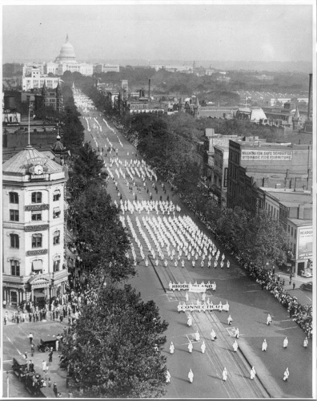
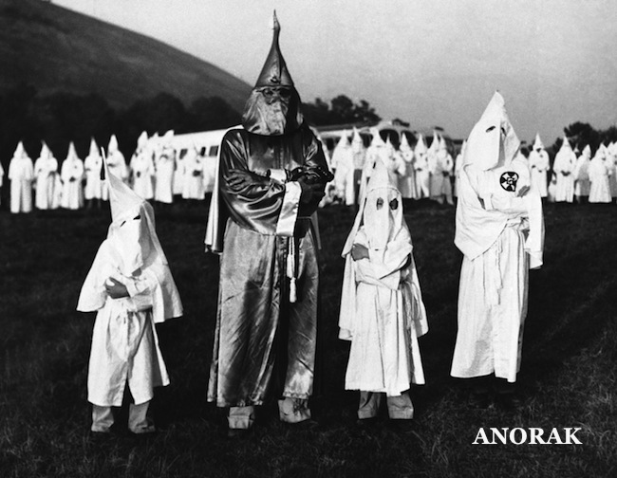
Nativism
●The rise of the Klan
Notes:
Nativism
*was a response to the fear of the growing number of non-white, non-protestant, non-democratic groups in the US after WWI
*there was also a growing fear that the immigrant groups coming into the nation after WWI did not support American values
KKK
*one group which gained a lot of notoriety during the 20’s was the KKK
*membership soared to between 3-8 million throughout the 20’s
*was a new and improved Klan however
*they began aiming their bigotry towards a wider audience
*they still targeted blacks, but now included immigrants, Catholics, Jews and any group that didn’t support American values to their list of hatred
*this was proof that the Klan were expanding their horizons
*no longer did they single out blacks but they targeted any group that was not a W.A.S.P. (White Anglo Saxon Protestant)
*for the first time in its history, membership spread not only throughout the south but the north as well
*in fact their were more people per capita in the Klan in Indiana, Illinois and Ohio than anywhere else

Slide 8
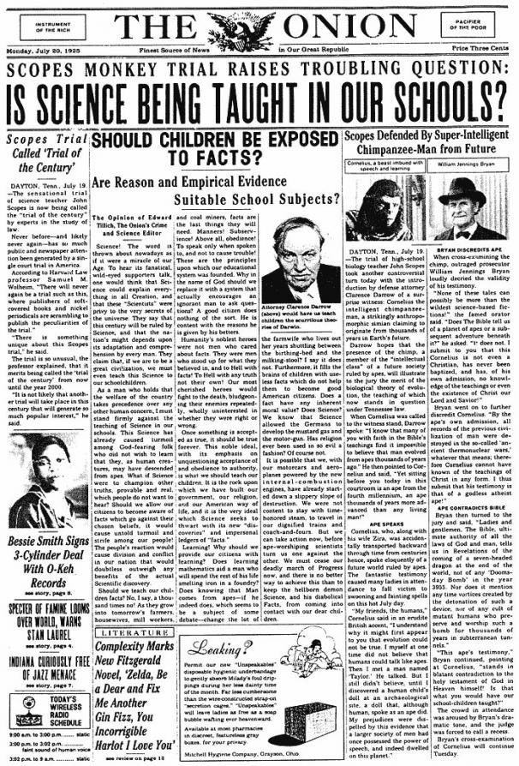
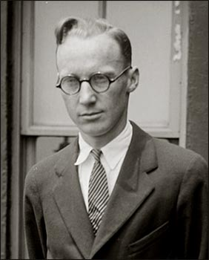
Fundamentalism and Morality
•Scopes “Monkey” Trial
Notes:
Fundamentalism
*was a Protestant religious movement during the 20’s and a great example of the rift growing within American society
*fundamentalism gained power after WWI because people blamed the war and its aftermath on the fact that society had distanced itself from the teachings of the bible
*fundamentalist argued for a return to living a life based on biblical interpretation
*this meant restricting what was being taught in schools
*Fundamentalists refuted certain scientific teachings such as those by Darwin and the Theory of Evolution
*they then began to get anti-creation laws passed
Scopes Trial
*8 day trial that took place in the summer of 1925 in Dayton, Tennessee
*symbolized the bitter conflicts that rocked the nation during the 20’s between old school rural society and a growing liberal urban society
*1925 Tennessee passed a law forbidding the teaching of Evolution
*High school teacher John Scopes decided to test the law and was put on trial
*William Jennings Bryan, former Senator, Secretary of State and presidential candidate, acted as the prosecutor
*Famous Chicago lawyer and admitted agnostic, Clarence Darrow, defended Scopes
*the trial became a huge ordeal and was broadcast live on radios throughout the nation
*it was a circus that became known as the “Monkey” trial
*Scopes was found guilty and paid a $100 fine
*however, the trial made Fundamentalists look ridiculous
*on a number of occasions Darrow called out Bryan on biblical interpretation and made him look like a complete idiot
*Bryan died less than a week after the trial

Slide 9
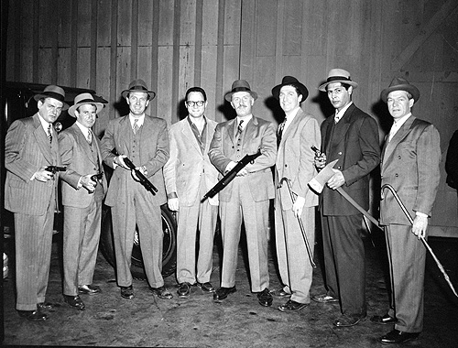
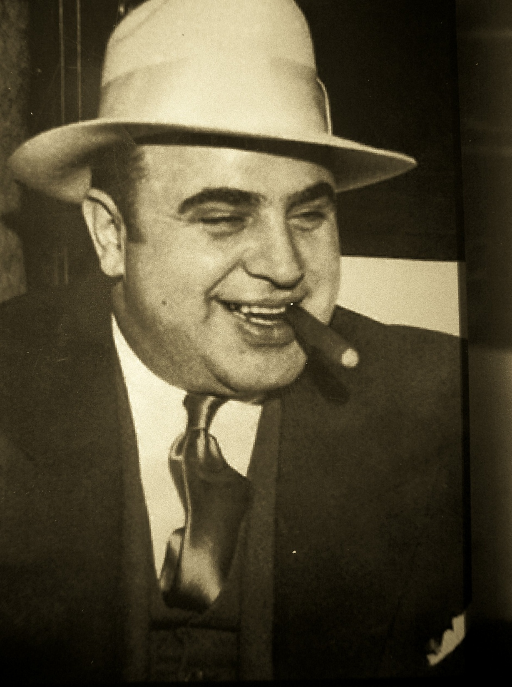
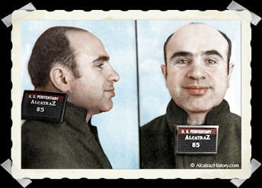
Prohibition (18th Amendment) and organized crime
Al Capone
Notes:
Prohibition and organized crime
*prohibition represented another clash between rural and urban America
*long before the war temperance organizations were trying to limit and or make alcohol illegal in the United States
*after the Great War they gained enough support to pass the 18th Amendment
*the thought was that the new law would clean up America by reducing alcohol related crime and preventing certain immigrant groups from drinking
*the law was a complete and utter failure
Failure of the Volstead Act
*the act succeeded in ridding the nation of saloons but, as cities began to explode, it only increased illegal activity
*speakeasies began to pop up throughout the nation (secret clubs that sold illegal alcohol)
*illegal alcohol was produced everywhere (bootleggers, moonshiners made white lightning and stock cars to transport liquor, bathtub gin was made in homes, rumrunners along the coasts)
*more importantly the law resulted in an explosion of organized crime throughout the nation especially in cities that were near the Canadian border
*the law was nearly impossible to enforce as the US had 10,000 miles of borderland and coastline
*bringing in illegal alcohol became big business for smugglers who were more than happy to risk breaking the law to provide thirsty Americans with booze
Organized crime
*thrived off making and selling illegal liquor
*Al Capone, a bootlegger out of Chicago, reportedly made $60,000,000 off the sale of illegal alcohol
*was also, as were most Gangsters of the period, involved in the murders of several other gangsters over the distribution of illegal booze and territory
*many innocent citizens were caught in the crossfire and a war essentially broke out in the nation
*for many, Capone was seen as a modern day Robin Hood because he gave money to the poor and sponsored soup kitchens
*in the end Capone was indicted for tax evasion and spent the rest of his life behind bars but died soon after from syphilis
Law Enforcement
*it was during the 1920’s that law enforcement grew as well
*Elliot Ness became famous for going after bootleggers with his “Untouchables”
*the FBI also increased its power during the era fighting violators of the 18th Amendment

Slide 10
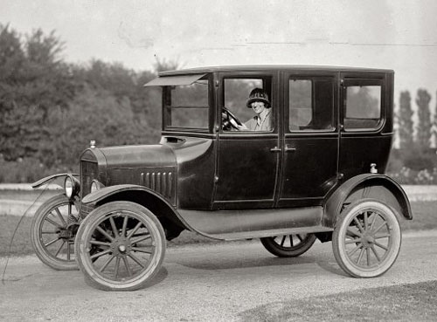
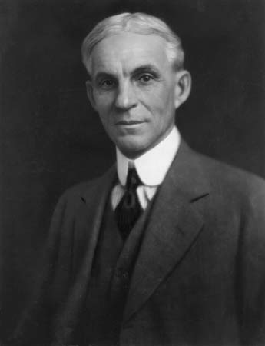
Emergence of modern industrialization
●Henry Ford and the automobile
Notes:
Emergence of modern industrialization
*one of the movements resulting from the war was the modernization of the nation
*new innovations in technology would help shape change within the United States
*the mass production of automobiles and radios would make communication and travel much faster
*news from all over the world became instantaneous
*during the 20’s the US government was extremely supportive of industrial growth and began to loosen restrictions on businesses
Henry Ford
*no one person changed the United States after the war more than Henry Ford
*likewise, no other product transformed the nation more than the automobile
*Henry Ford not only revolutionized the automobile industry but almost every other in the country as well
*during the 1920’s the car industry became the largest in the nation and, like the railroad industry, helped fuel other industries as well
*more than 15 million Model T’s were sold throughout the 20’s
*in order to serve the needs of the automobile industry, large amounts of steel, rubber, petroleum, lead and nickel had to be produced
*in order to accommodate the millions of cars that were being sold each year the government had to greatly increase the number of road mileage connecting the nation together
*this helped produced hundreds of thousands of jobs
Ford’s revolutionary business practices
*Ford introduced several new industrial practices but the most important one he introduced was the moving production line
*parts moved down a belt and were assembled by workers who were experts at a certain job
*this meant that cars (Model T’s) could be built in 93 minutes
*every ten seconds a Model T rolled off the assembly
*Ford also paid his employees more than double what they would make at other factories
*his thinking in doing this was logical
*paying employees more meant that they could afford to buy the products they were making resulting in the growth of industry
*since Model T’s could be built at such a rapid pace the price stayed down and more people could afford them (average cost $300)
*he also cut working hours from 6, 8 hour days a week to 5, 8 hour days a week allowing workers more leisure time
*this meant more time to spend money
Domestic products
*during the 20’s other new domestic products made their way into most American homes
*refrigerators, electric irons, vacuum cleaners, electric washer and dryers, radios were all being produced at a rapid rate
*helped create jobs and make these products more affordable
*more importantly these products allowed Americans to have more time to do other things
*Americans, as a result, spent more time participating in leisure activities

Slide 11
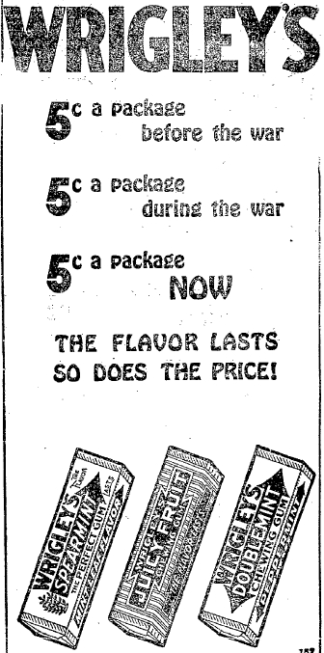
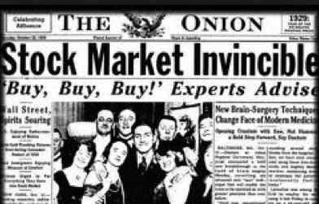
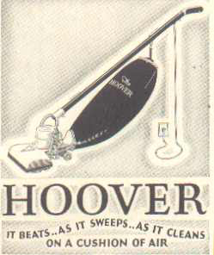
Domestic Products
●Mass consumption
Notes:
New domestic products
*Household appliances, radio and motion pictures provided new jobs and changed the American way of life.
Mass Consumption
*More time & money = buying on credit.
*Consumers could buy expensive products and pay them off with installment plans and interest.
*Speculation = people buy things only for the hope of selling them for more.
*The rich got richer and the poor went into debt.

Slide 12
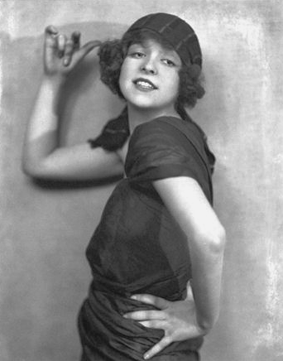
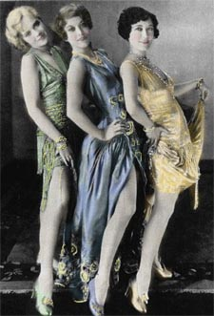
Changing role of women
●labor, suffrage, flappers, sexuality
Notes:
Changing role of women
*the war played a tremendous part in changing the lives of women
*millions of women worked in jobs that fueled the war effort and wanted to keep their jobs afterward
*was one of the reasons the 19th Amendment was signed
*after the war women wanted to maintain the freedoms they had gained
*the war had also given women a new sense of identity in society
*they began to express themselves in new and more sexual ways
*many women began to push the boundaries of what was acceptable in society
*women were smoking and drinking in public
*they were kissing men, wearing make-up and dancing
*flappers were a new and exploding fashion in the United States (short loose skirts that flapped around when women danced)
*flappers were a new breed of women who went to Jazz clubs during the 20’s

Slide 13
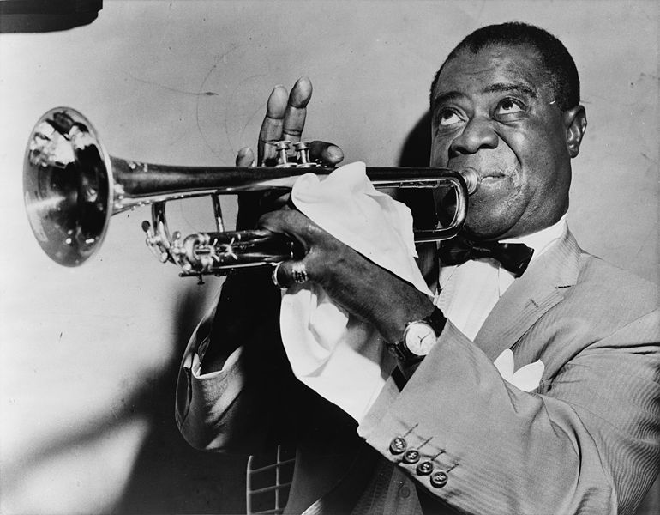
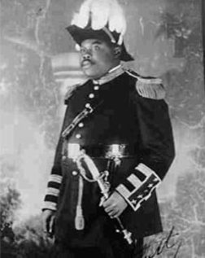
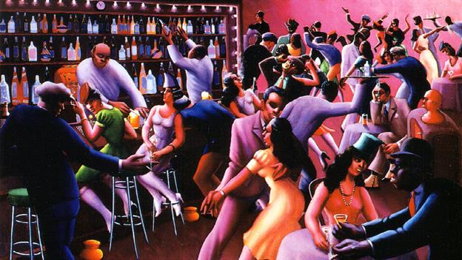
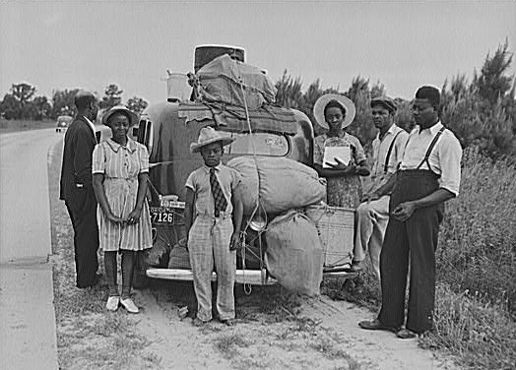
African American Movement
●Great Migration
●Harlem Renaissance
●Marcus Garvey
Notes:
African American Movement
*two of the largest movements in the US after the First World War involved blacks and women
*the war itself had opened up several doors for both groups
*neither group wanted to give up the new freedoms and rights they had gained during the war
*blacks had fought in Europe and gained important jobs in industries throughout the nation during the war
*they sought to maintain these new freedoms after the war
*millions of women worked in jobs that fueled the war effort and wanted to keep their jobs afterward
The Great Migration north
*between 1916 and 1920, 500,000 African Americans migrated out of the south and headed north to seek new opportunities
*did so in order to find jobs in the emerging war industries popping up throughout the north
*after the war black soldiers and their families moved north to escape discrimination
*white northerners did not open up their arms to the new black migrants
*violence often erupted throughout the north as whites and blacks clashed
*riots in northern cities broke out though the north as well as the nation’s capital costing the lives of several blacks
The Harlem Renaissance
*was an African American movement that had its beginnings in Harlem, New York
*the Harlem Renaissance was a political movement led by DuBois, an art movement, a literary movement led by Langston Hughes, a musical movement
*was highly influential in opening doors for black expression and aided in loosening social and cultural restraints
Marcus Garvey and Negro Nationalism
*was a black nationalist from Jamaica who moved to New York when he was 28
*started a movement known as the “Back to Africa” movement
*wanted blacks to make their way back to Africa and create a new African Empire led by black Americans who Garvey felt could help civilize Africa
*once in Africa, Garvey would become president and appoint black Americans to important positions
*his idea was crazy and never came to fruition but Garvey inspired blacks to fight for equality and inspired hope amongst the African American community
*eventually was found guilty of mail fraud and was deported back to Jamaica

Slide 14
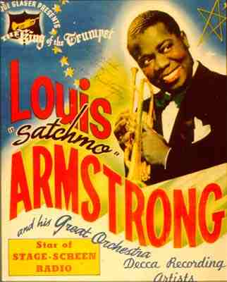
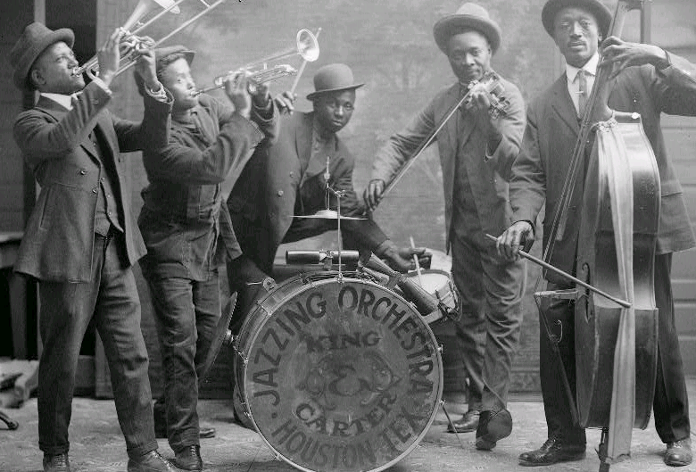
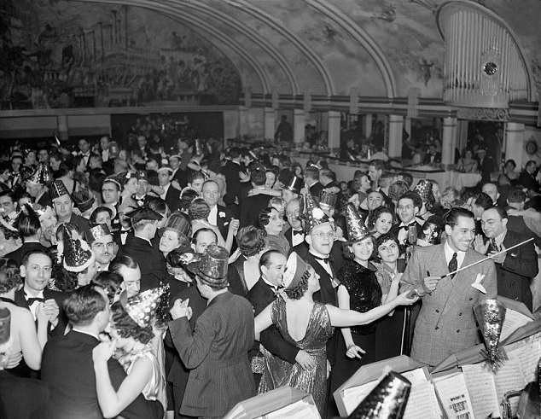
Jazz Music
Notes:
The Jazz Age
*the 20’s era could just as easily be called the Jazz Age named after the most popular form of music at the time
*Jazz, for most Americans, was more than simply music, it was a way of life
*the music was first played in New Orleans and had African American roots
*as blacks moved out of the south and into the north they brought their music with them and started an urban craze throughout the US
*Jazz clubs opened up in every major city and provided a place where Americans could socialize, dance and drink till the wee hours of the night
*became one of the most popular forms of entertainment of the time and was the inspiration for a youth rebellion in the country

Slide 15
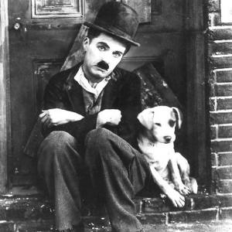
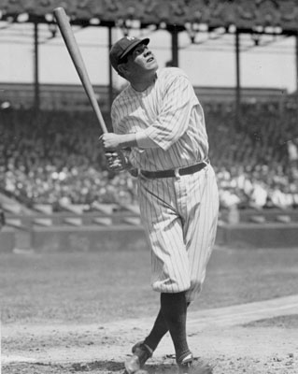
Cultural changes
●The “Golden Age” of Sports
●Movies
Notes:
Cultural Changes
*another glaring example of the cultural differences between rural and urban society was in the new kinds of leisure activities Americans participated in
*the expanding middle class had more money and time to spend on leisure during the era and they did it up big
Golden Age of Sports
*the 1920’s, for many historians, was the golden age of sports in America
*some of the most famous Americans during the 20’s were sports figures
*baseball, more than any other sport, entertained millions of Americans during the era
*during the 20’s the Yankees dominated
*went to the World Series 6 times and won it 3
*the most popular Yankee and baseball player was by far Babe Ruth
*was sold to the Yankees by the Boston Red Sox in 1919
*at the time Boston was the hottest team in baseball as they had won 5 world Series including the first one
*after they traded Ruth Boston didn’t win a World Series for 86 years (a period known as the Curse of the Bambino)
*the man epitomized baseball and is still arguably the greatest baseball player ever (3rd all time home runs, 1st slugging %)
*was one of the best hitters in baseball but many people don’t realize that he was one of the best left handed pitchers in baseball ever
*one of only three men to hit three home runs in a World Series game
Movies
*movies defined and created American culture in the 20’s
*whenever a new dress or hairstyle appeared in a movie it became the newest fad for women
*though most movies were silent movies in the 20’s they greatly shaped American interests
*the average middle class American went to the movies once a week
*movie making became a huge industry in California
*first movie studios began to pop up in California around the Hollywood area
*why California? Because it offered the best weather and natural sunlight in the nation
*artificial light was hard to come by and extremely expensive

