Slide 1
The Great Depression & New Deal
Focus Questions:
What were the causes of the Great Depression?
Explain Hoover’s response to the economic crisis and why it failed.
Describe the human cost of the depression.
Identify the importance of FDR’s election and his initial plan to solve the crisis of the Depression.
Identify the three “R’s” that were part of FDR’s New Deal programs.
Be able to describe some of the more important New Deal programs and whether they were successful or not.
What controversies surrounded FDR’s presidency?
What impact did the dust bowl have on the Depression?
Explain the legacy of the Great Depression.
Notes:
1
The purpose of the focus questions is to help students find larger themes and structures to bring the historical evidence, events, and examples together for a connected thematic purpose.
As we go through each portion of this lecture, you may want to keep in mind how the information relates to this larger thematic question. Here are some suggestions: write the focus question in the left or right margin on your notes and as we go through, either mark areas of your notes for you to come back to later and think about the connection OR as you review your notes later (to fill in anything else you remember from the lecture or your thoughts during the lecture or additional information from the readings), write small phrases from the lecture and readings that connect that information to each focus question AND/OR are examples that work together to answer the focus question.

Slide 2
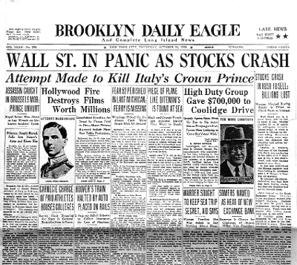
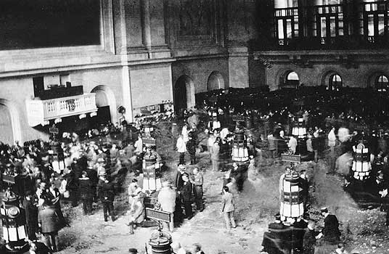
The Stock Market Crash
Black Tuesday: October 29, 1929

Slide 3
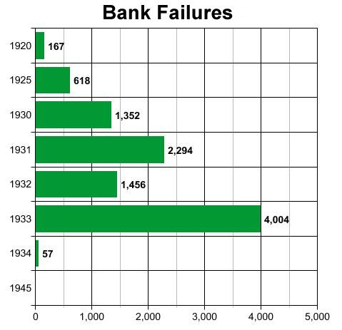
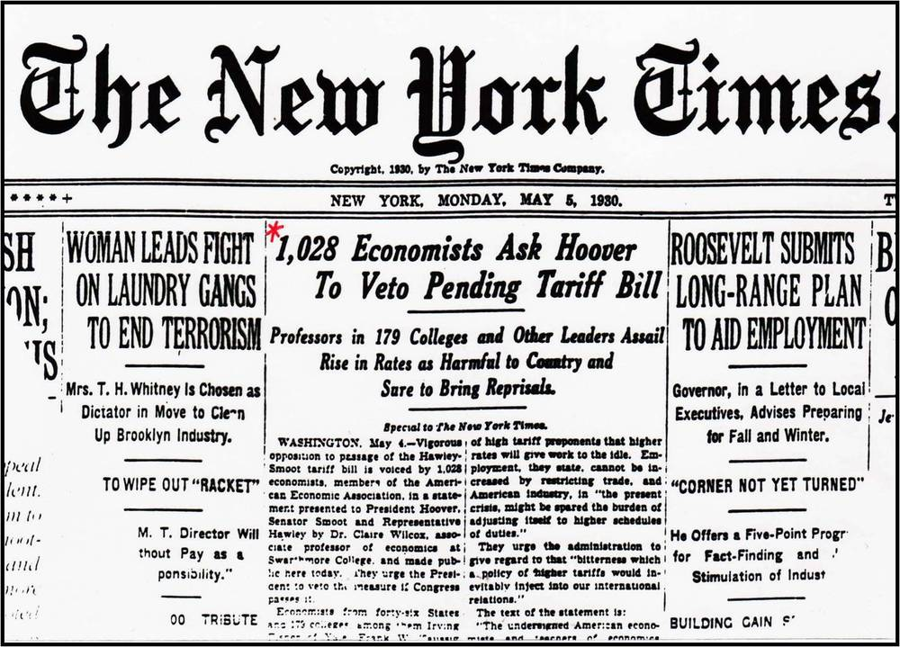
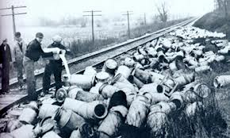
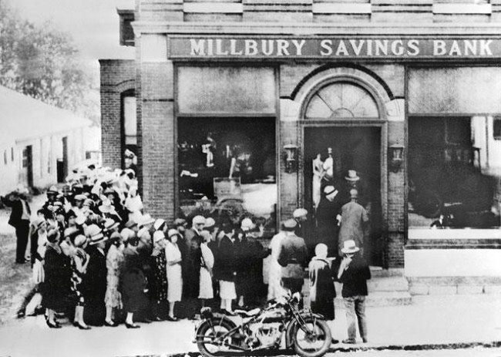
Causes of the Crash/Great Depression
1. Overproduction
4. High Tariffs
2. Speculation
3. Shaky Banking

Slide 4
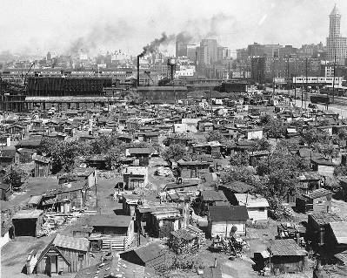
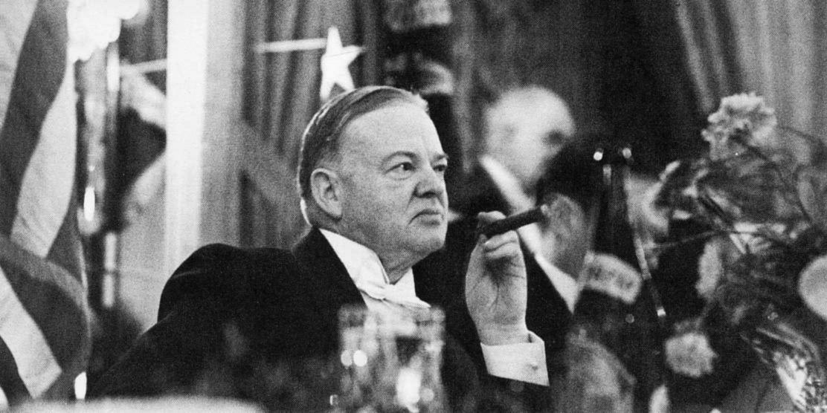
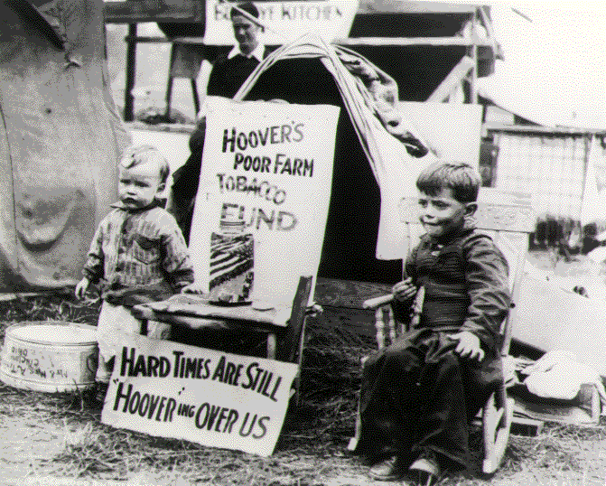
The Great Depression
Hoovervilles
●Hoover’s Administration 1929-1933

Slide 5
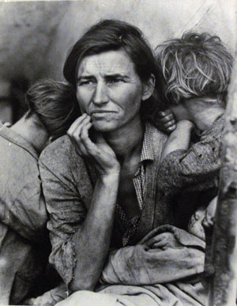
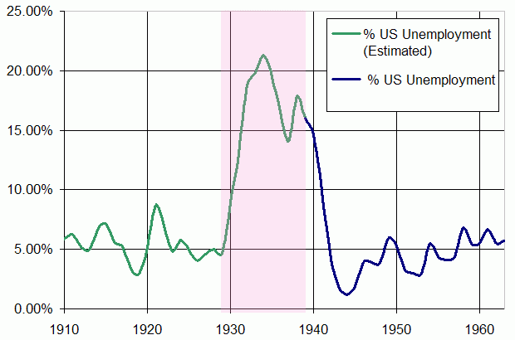
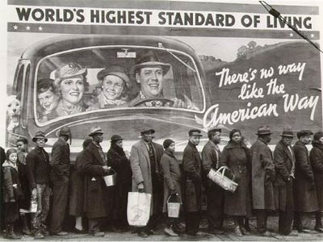
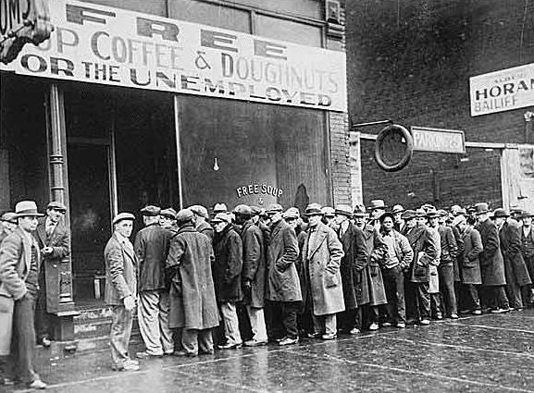
The Human Impact
●Unemployment
●Hunger
●Homelessness
Dorothea Lange

Slide 6
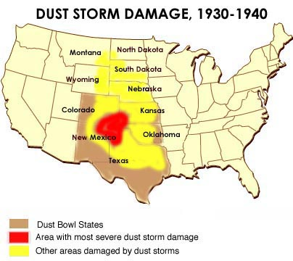
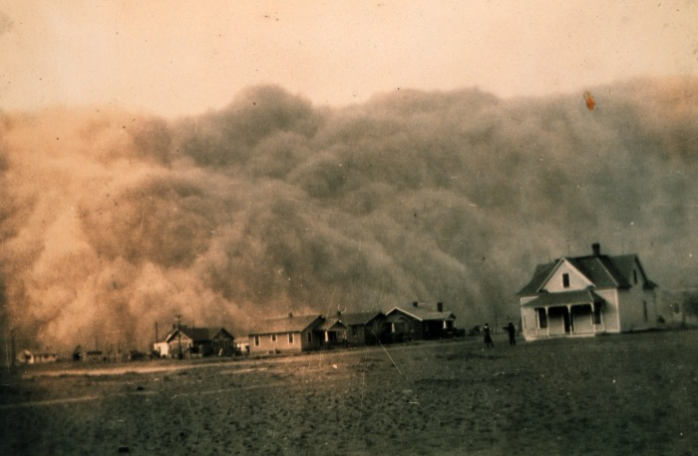
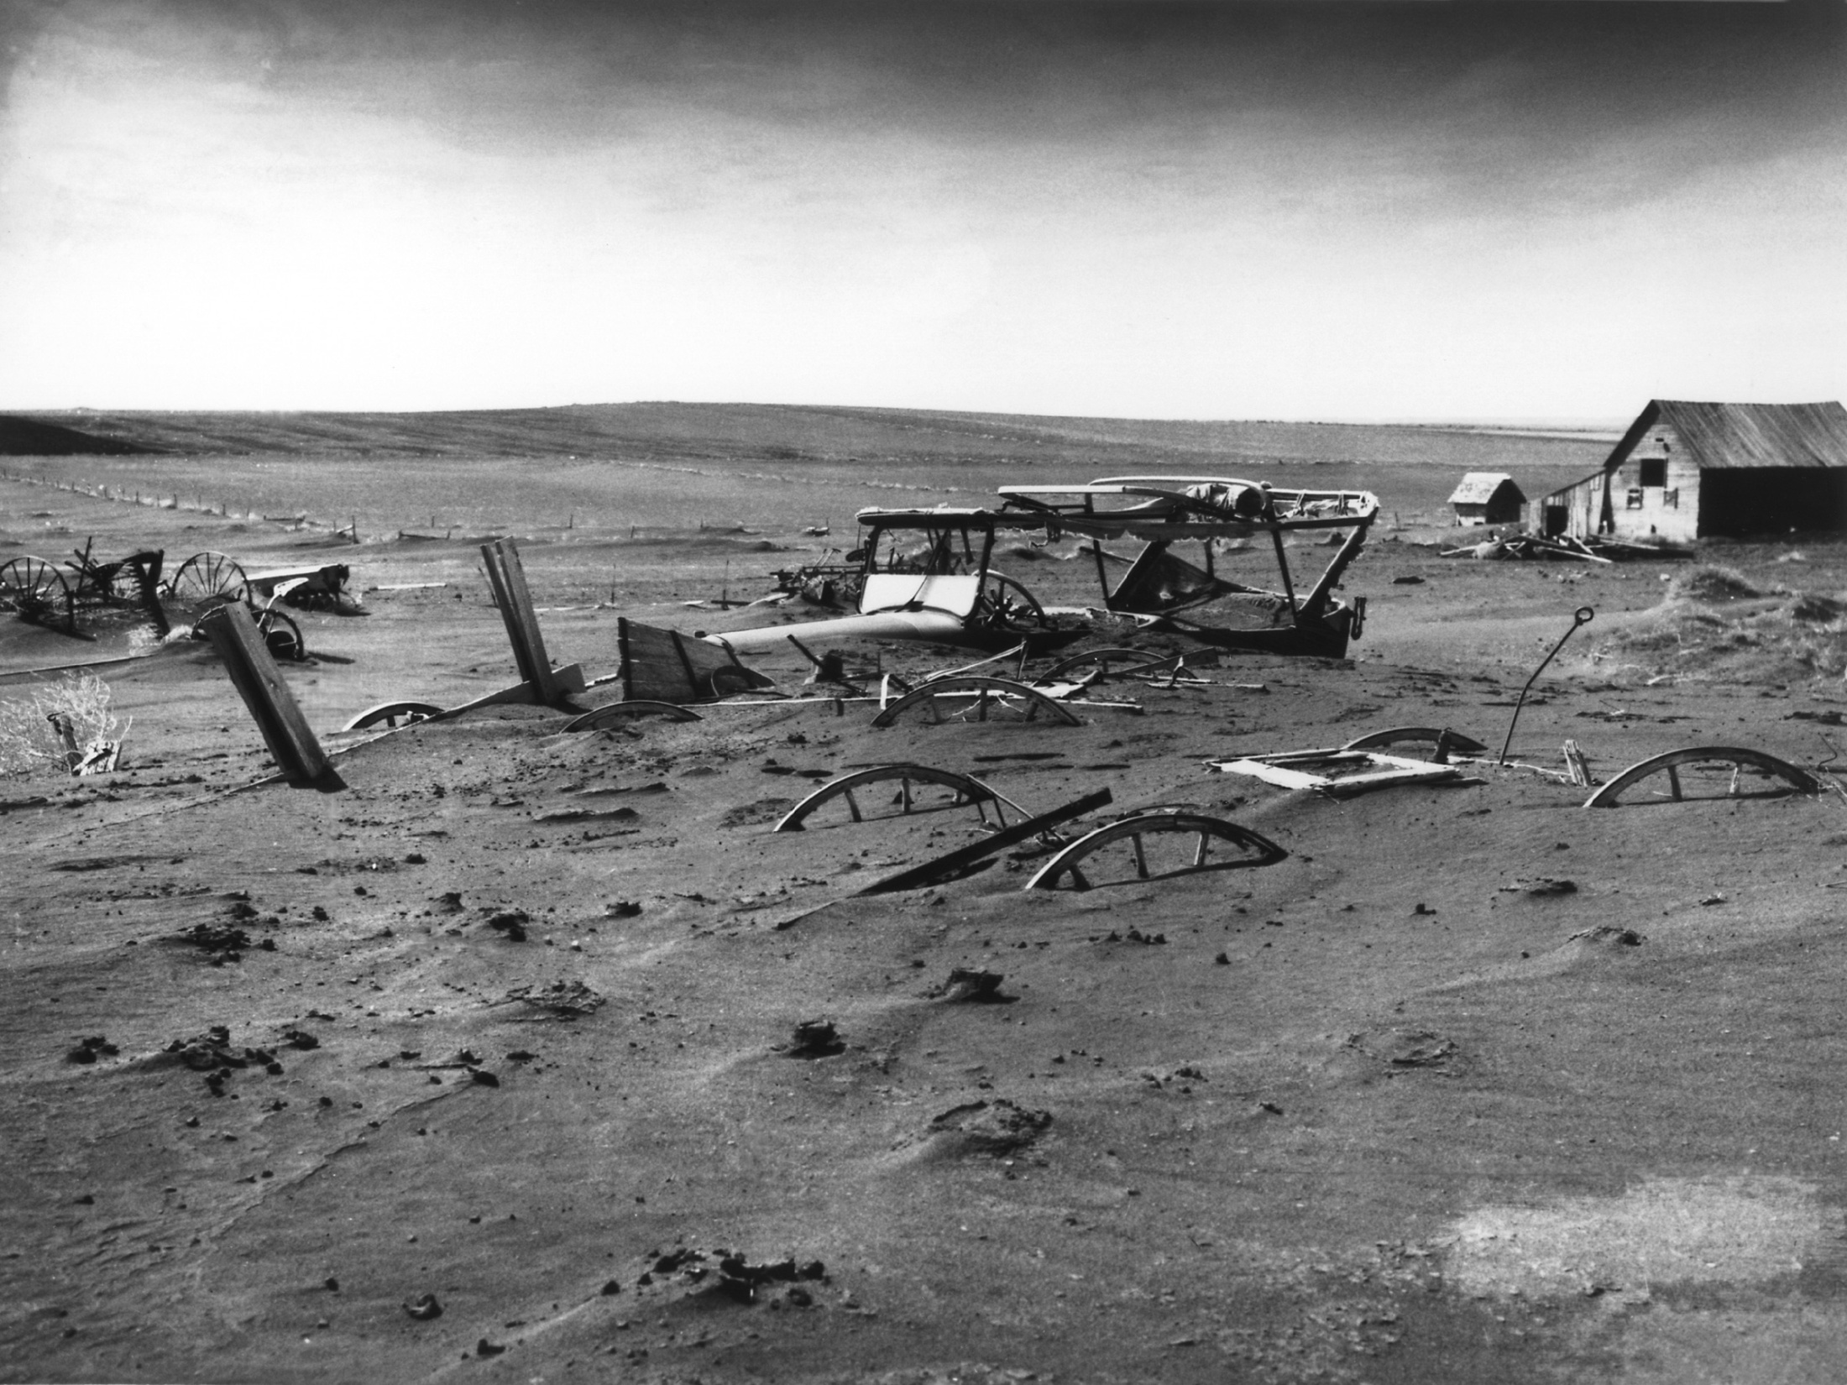
The Dust Bowl

Slide 7
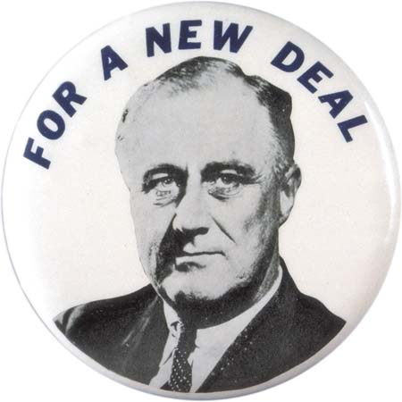
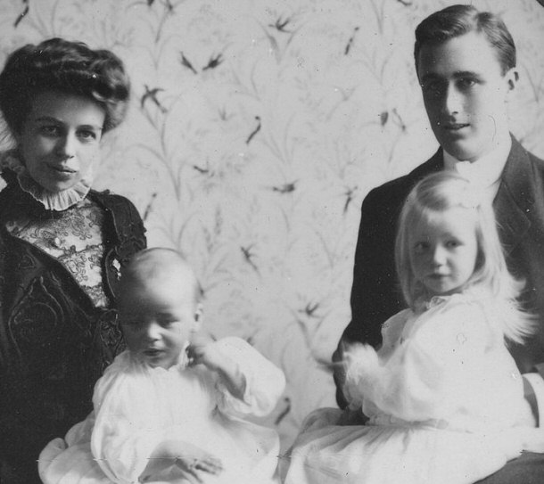
Franklin Delano Roosevelt: New Deal
●Election of 1932
●FDR’s Background

Slide 8
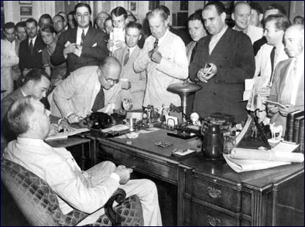
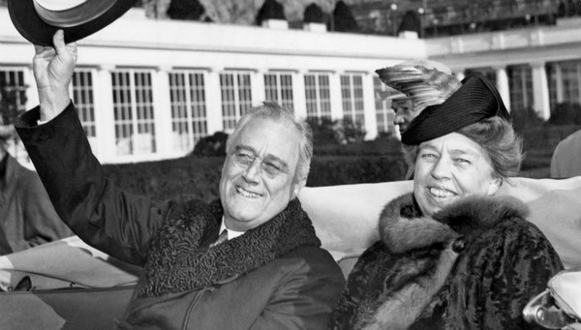
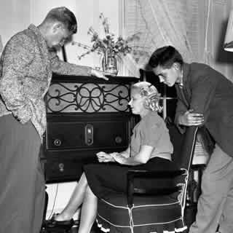
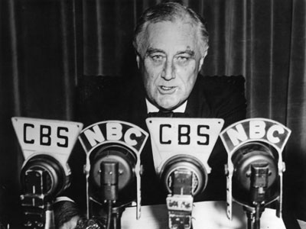
The President and the People
●Fireside chats
●Unscripted press conferences
●Eleanor Roosevelt

Slide 9
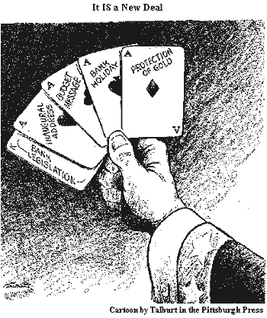
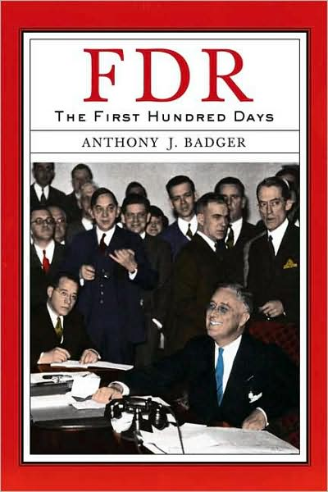
Roosevelt’s First 100 Days
1. Fix the Banking Crisis
2. Pass legislation to fix the Depression
3. The Three R’s: Also known as Alphabet Soup

Slide 10
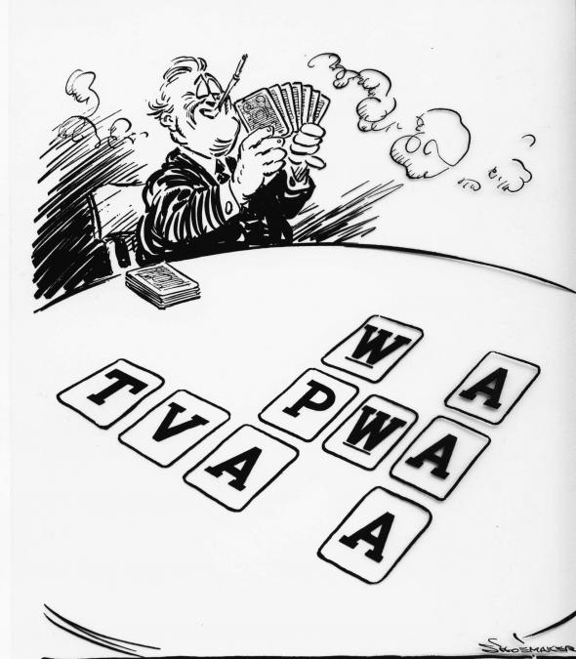
●Civilian Conservation Corps (CCC)
Relief measures
●Civil Works Administration (CWA)

Slide 11
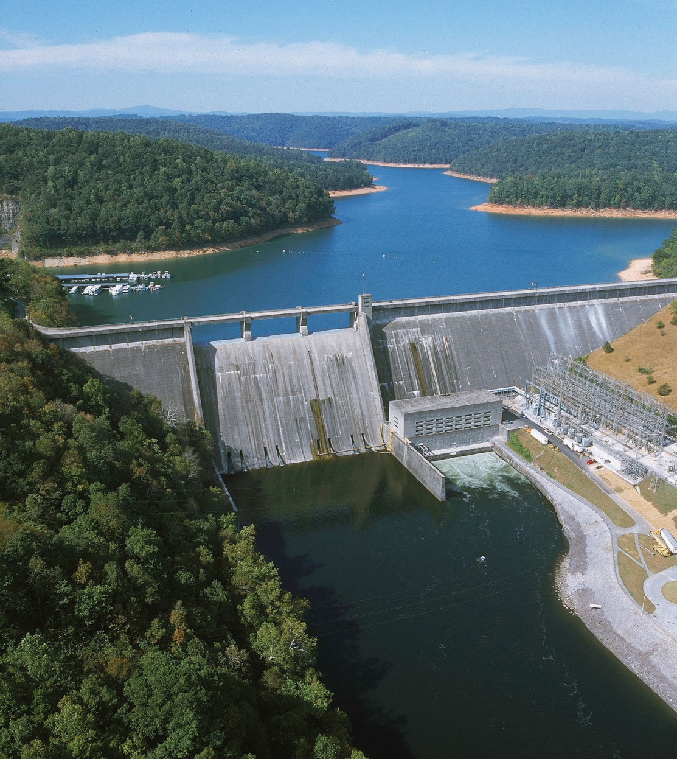
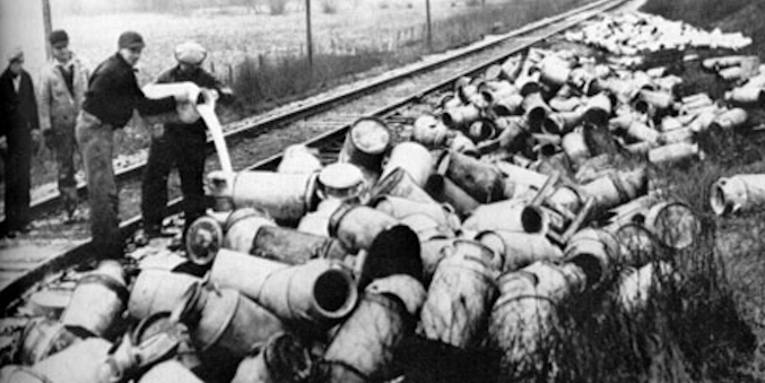
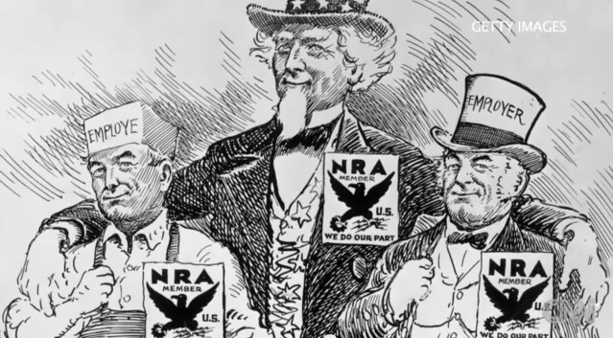
Recovery
●Agricultural Adjustment Agency (AAA)
●National Recovery Administration (NRA)
●Tennessee Valley Authority (TVA)
Notes:
Recovery through regulation
*Roosevelt and his cabinet felt that efficient regulation of big businesses as well as the farming sector would help with economic recovery
AAA
*agriculture in America was hit the worst by the depression
*one of the biggest problems was the overproduction of crops which drove prices into the ground and sent the agricultural sector spiraling out of control
*the government decided to create an agency to regulate the prices of crops and livestock
*in order to save prices the government amazingly decided to destroy excess crops and livestock in order to fix the price problem
*millions of gallons of milk were poured out
*6 million hogs were slaughtered
*farmers were encouraged to under produce and were paid to not grow crops or use their land
*amazingly enough it worked and crop prices began to stabilize by 1935
NRA
*did two things: stabilized the business sector by setting prices and eliminating competition and it provided jobs along with setting labor standards
*it established forty hour work weeks and salaries
*had many problems such as forcing small businesses to go under
TVA
*one of the most successful of the New Deal Acts
*brought millions of jobs and power to one of the poorest regions in the nation, the Old South
*the goal of the TVA was to create a series of damns along the Tennessee River in order to generate power and create a series of lakes in the region
*the TVA brought new industries into the region which in turn generated money that would go back into the communities
*the TVA improved schools, libraries and, more importantly, brought cheap electric power into the region for the first time ever

Slide 12
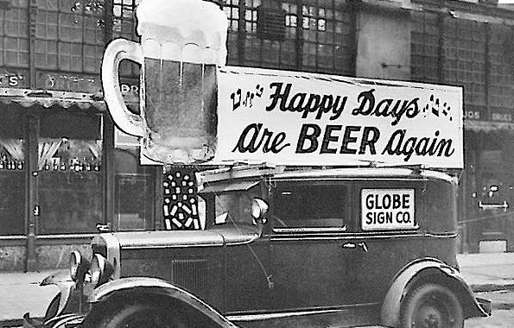
Reform
●Federal Deposit Insurance Corporation (FDIC)
●21st Amendment (Beer-Wine Revenue Act)
Notes:
Reform
FDIC
*was established to put more faith in the banking system
*it strengthened the banking system by guaranteeing deposits
*abandoning the gold standard was highly controversial but it did help to stabilize the economy by
Economy Act
*cut government salaries, reduced payments to veterans and reduced spending on outdated agencies
21st Amendment
*amended Prohibition
*great way for the government to generate revenue especially in a depression

Slide 13
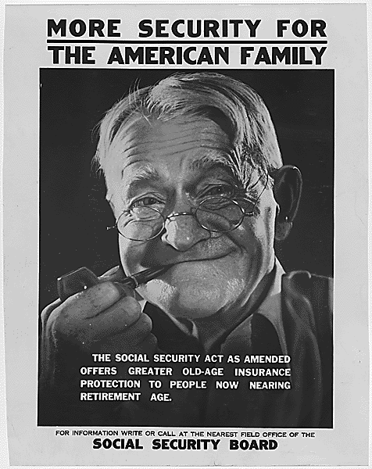
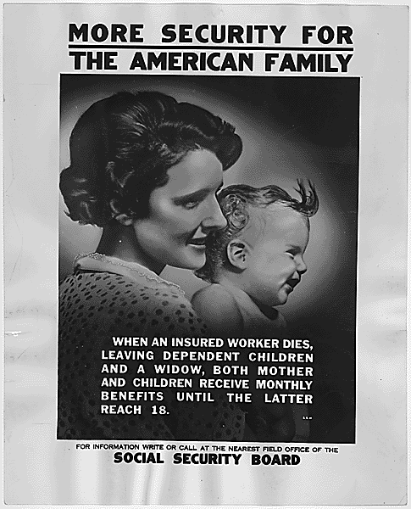
Beyond the first 100 days
●Works Progress Administration
●Social Security Act

Slide 14
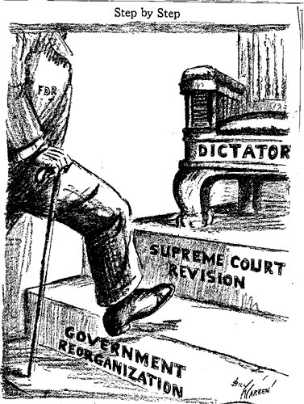
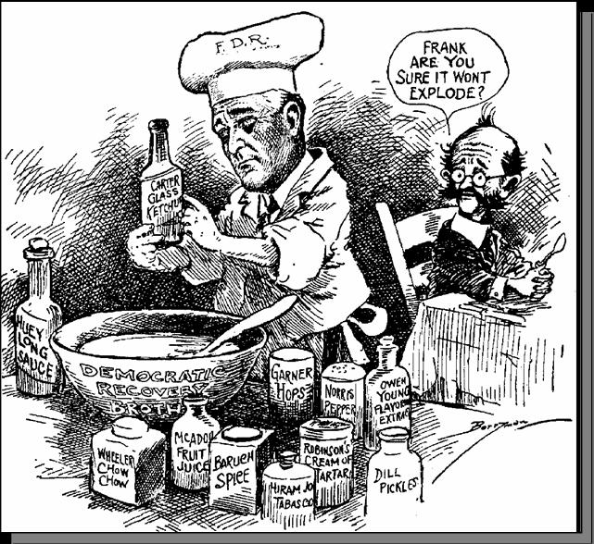
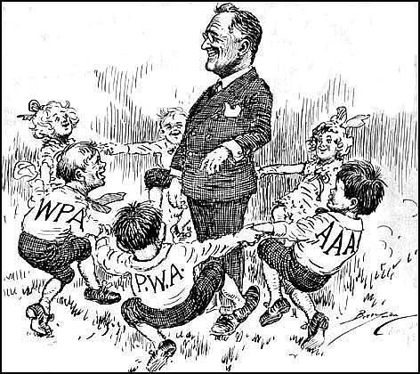
Opposition to the New Deal
●Successes
●Failures
●Supreme Court

Slide 15
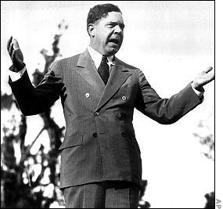
Critics of FDR
Huey P. Long: “Every Man A King”

Slide 16
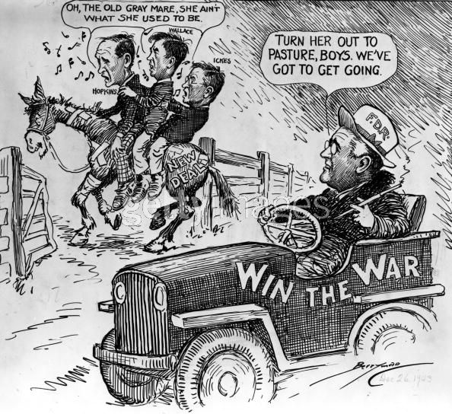
Legacy of the New Deal
●1936 Election

