Slide 1
Ch. 20: The Progressives
Focus Questions:
Explain the reasons the progressive movement began.
Describe some of the goals of the progressive movement.
Identify who the muckrakers were and their accomplishments.
Identify some of the important social reformers of the time and their goals.
Describe labor, business and government reform.
Analyze the new legislation that was passed during the era and what problems they attempted to fix.
Identify the three progressive presidents and their policies. (be as thorough with this as you can)
Notes:
1
The purpose of the focus questions is to help students find larger themes and structures to bring the historical evidence, events, and examples together for a connected thematic purpose.
As we go through each portion of this lecture, you may want to keep in mind how the information relates to this larger thematic question. Here are some suggestions: write the focus question in the left or right margin on your notes and as we go through, either mark areas of your notes for you to come back to later and think about the connection OR as you review your notes later (to fill in anything else you remember from the lecture or your thoughts during the lecture or additional information from the readings), write small phrases from the lecture and readings that connect that information to each focus question AND/OR are examples that work together to answer the focus question.

Slide 2
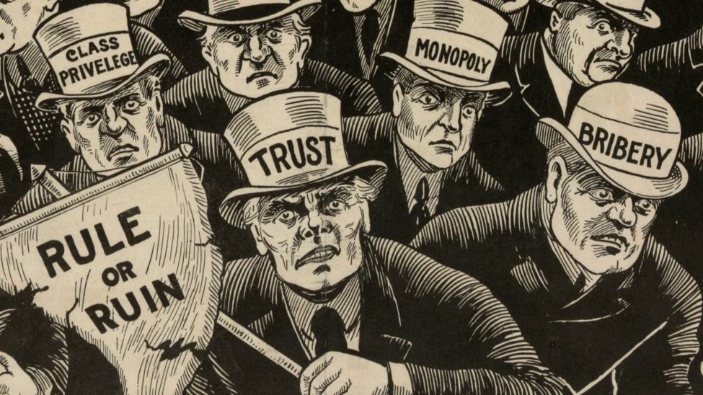
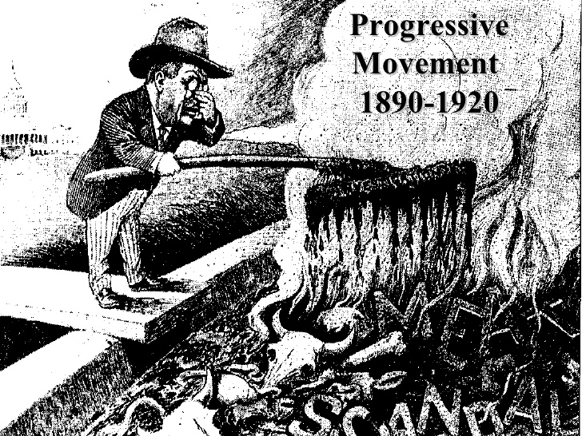
The Progressive Impulse
Belief in Progress
*mostly middle-class, women, Christians, city-dwellers
*society was capable of improvement and advancement
*laissez-faire capitalism and Social Darwinism were insufficient
*Progressives wanted to fix the ills of the Gilded Age:
-Political reform, Efficiency in Business and Government, Regulation of Monopolies, Social Reform
Varieties of Progressivism
*Antimonopoly – fear of concentrated power
-encouragement of the regulation of trusts
*faith in knowledge
-knowledge was important in making society more humane
The Social Gospel Movement
*Christian movement to try and aid those in need
*development of social welfare organizations – Salvation Army
*wanted to help improve the lives of city dwellers
-child labor laws, better working conditions, social safety nets

Slide 3
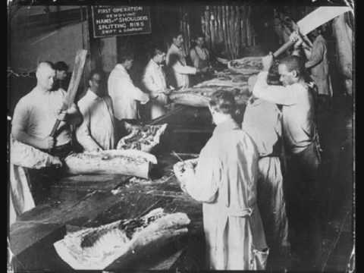
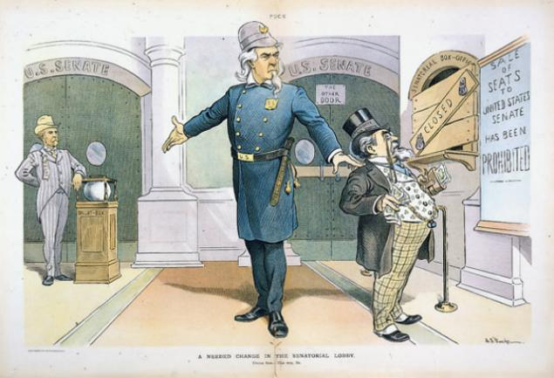
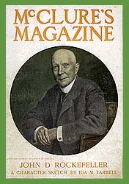
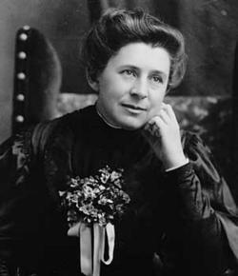
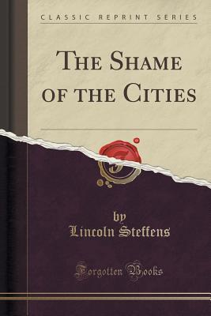
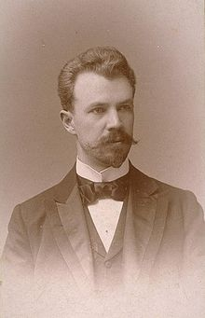
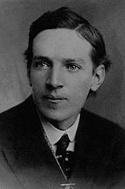
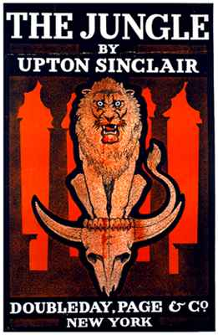
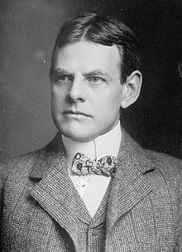
Muckrakers
Muckrakers – journalists who exposed evil and corruption in society
*term coined by Teddy Roosevelt
Ida Tarbell
*investigated shady business practices of Rockefeller’s Standard Oil
*Anti-Trust Laws
Lincoln Steffens – The Shame of Cities
*exposed corrupt political machines in N.Y. and other big cities
*initiative, referendum, recall, Pendleton Act
Upton Sinclair – The Jungle
*exposure of the meat packing industry in Chicago
*Meat Inspection Act and Pure Food and Drug Act
Jacob Riis – How the Other Half Lives
*exposure of tenements and city life
*building codes, child labor laws, better working conditions
David Phillips – The Treason of the Senate
*17th Amendment
Ida Tarbell
Lincoln Steffens
Upton Sinclair
David Phillips

Slide 4
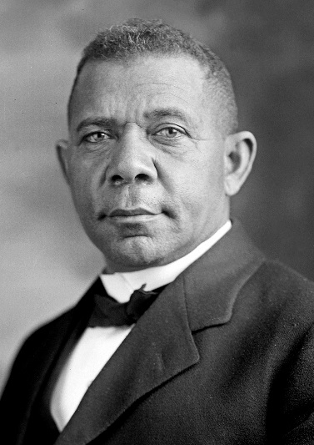
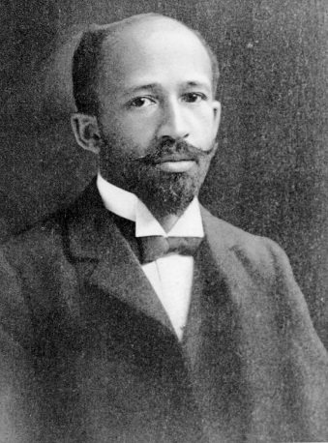
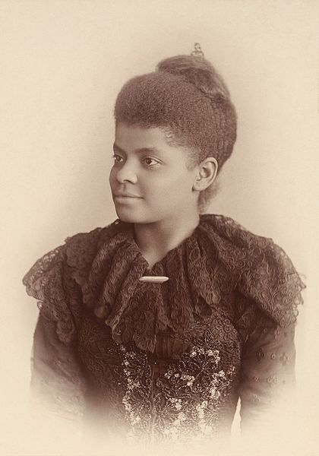
African America Social Reformers
Ida B. Wells
*muckraker/journalist
*organized the anti-lynching movement in the South
Booker T. Washington
*educator and founder of Tuskegee institute
-trade school
*called for gradual equality, education and economic independence for AA first
W.E.B. DuBois
*founder of the NAACP (National Association for the Advancement of Colored People)
*called for immediate, forceful equality for blacks
*highly critical of Booker T. Washington
Booker T. Washington
Ida B. Wells
W.E.B. DuBois

Slide 5
Labor
Growth of Professions and Professional Groups
*need for more managers within companies
-begin to make of a large middle class
*American Medical Association (AMA)
-strict educational standards and practices for doctors
*American Bar Association
-strict educational standards and practices for lawyers
*National Association of Manufacturers
*National Farm Bureau Federation
Women and Professions
*women excluded from most professions
*settlement houses, teaching, social work
*General Federation of Women’s Clubs (GFWC)
-coordinated the activities of local women’s organizations
*Women’s Trade Union League (WTUL)
-middle class reformers seeking protective legislation for women in the workplace – better pay, hours, conditions

Slide 6
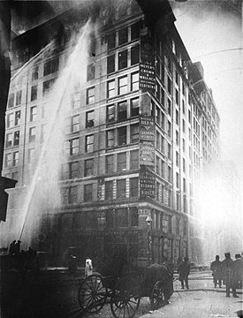
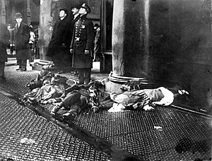
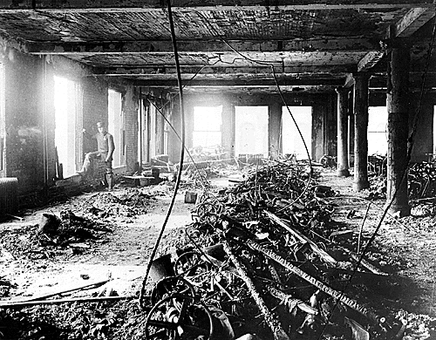
Labor Reform
Triangle Shirtwaist Factory Fire – 1911
*factory in New York that hired only women
*exits kept locked to prevent theft and idleness
*fire broke out killing 146 women
-many jumped to their deaths from 9th floor
*80k people protested the next day
Outcome
*strict factory laws passed
*building safety codes passed
*restrictions on child and women’s labor
*workmen’s compensation laws

Slide 7
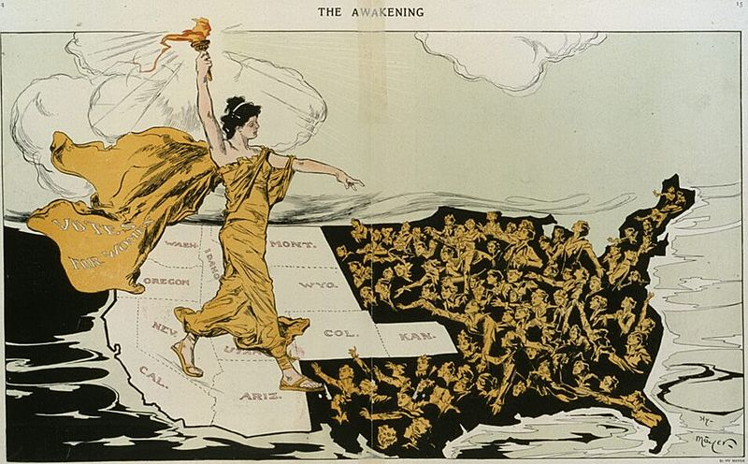
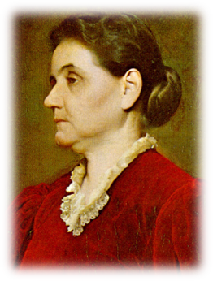
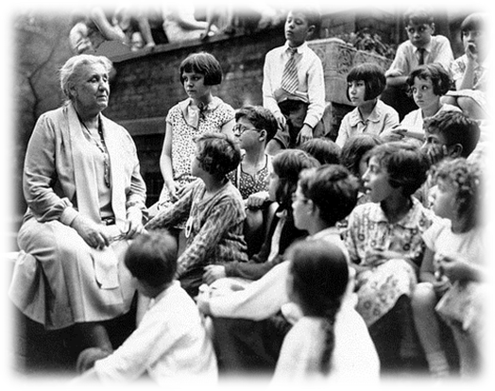
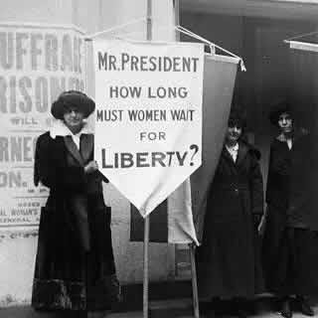
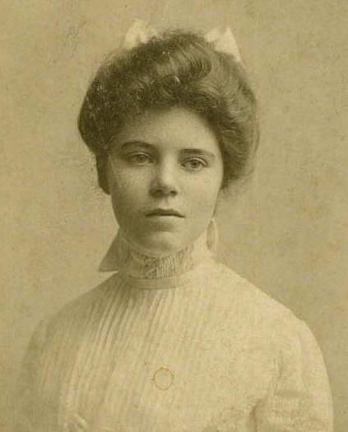
Women and Reform
Jane Addams – The Hull House Movement, Chicago
*temporary homes meant to help immigrant families
*more than 400 across the nation
*run by middle class women
*aided immigrants in learning English, finding jobs, child care
Francis Willard – Women’s Christian Temperance Union
*18th Amendment - Prohibition of Alcohol
Margaret Sanger – Planned Parenthood
*birth control/contraception
*eugenics and nativism
Alice Paul – the “Suffragettes”
*founder of National Women’s Party
*protested outside the Whitehouse
-arrested, tortured, hunger strike
*19th Amendment, 1920 – Women’s Suffrage
*allowed women to enact social change through voting
Jane Addams
Alice Paul

Slide 8
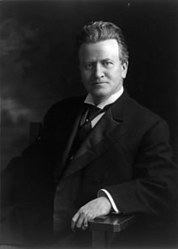
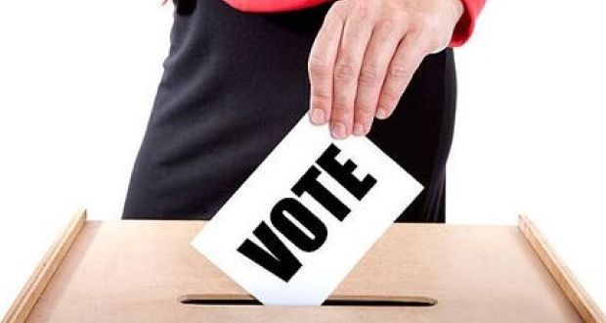
Government Reform
The Assault on Parties
*many progressives felt the path to change was through government reform
*less influence of party bosses due to secret ballots
*middle class called for a change on the local level
-electing city officials instead of appointing them
-in some instances, getting rid of political parties
*resulted in a decline of voter turnout – 1900 (73%), 1912 (59%)
State Level Reforms
Initiative – introducing laws through petitions
Referendum – people voting directly for or against a law
Recall – removing politicians from office
Direct Primaries – people vote for candidates directly
Secret Ballots – prevented voter intimidation by machines
National Reforms
*17th Amendment – Direct election of Senators
Robert La Follette – Wisconsin, Governor
*helped pass laws regulating railroads and utilities and creating workers compensation, graduated taxes
Robert La Follette

Slide 9
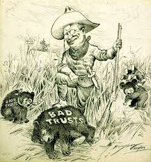
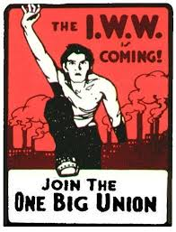
Business Reform and the Rise of Socialism
Decentralization and Regulation
*many felt there were “good and bad” trusts
*bad trusts harmed competition and the economy
-they should be broken up
*good trusts could be regulated and supervised instead
Socialism
*favored government control of certain industries
*calls for socialism growing during this period
*many thought socialism would create wealth equality
Eugene V. Debs
*union leader who got 1m votes in 1912 election
*gained massive support from workers and immigrants
Industrial Workers of the World (IWW) – “Wobblies”
*radical union that organized strikes and protests
*supported unskilled laborers
*many leaders imprisoned
*gov. used Sherman Anti-Trust Act to prosecute members
“We should enter upon a course of supervision, control, and regulation of those great corporations” – Teddy Roosevelt

Slide 10
Crash Course US History Ep. 27: Progressivism

Slide 11
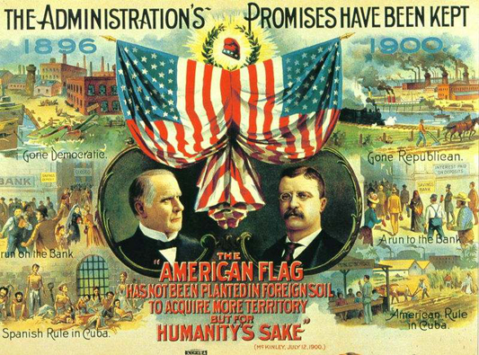
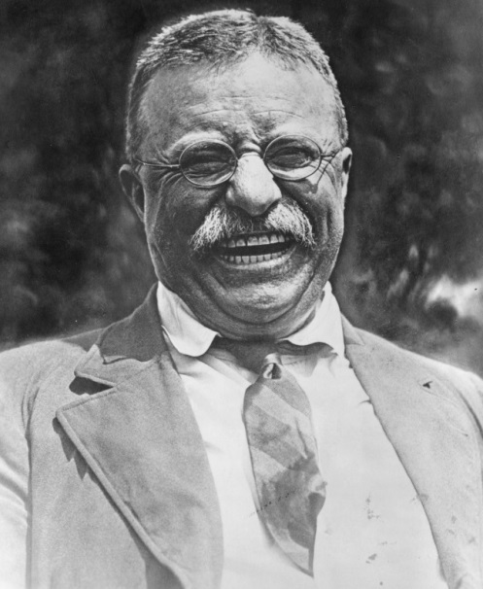
Theodore Roosevelt (R) – 1901-1909
Roosevelt’s Background
*wealthy NY family
*well educated – Harvard
*New York legislator, tragedy, cowboy, Police Commissioner, Asst. Sec. of Navy, Gov. of New York, Vice President, President
Election of 1900
*Roosevelt replaces McKinley’s 1st V.P.
*Republicans actually looking to shut T.R. up
*McKinley assassinated = “Uh, Oh”
President Roosevelt – youngest Pres. in History, 42
* “Speak softly and carry a big stick”
*The “Bully Pulpit”
*probably loved the presidency more than any other
Election of 1904
*TR wins by a huge margin
*promises not to run for a “third” term
*claimed it was the biggest regret of his life

Slide 12
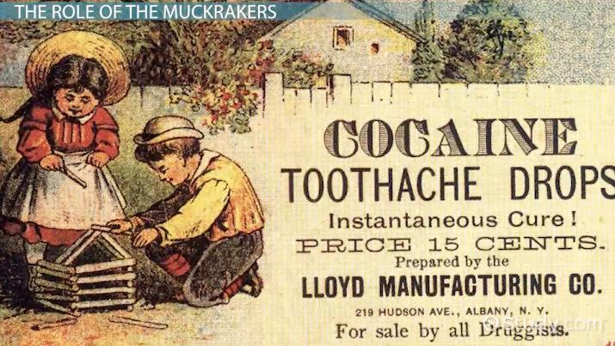
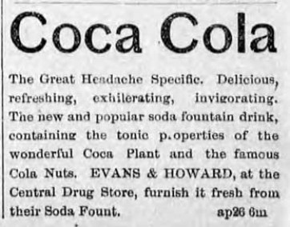
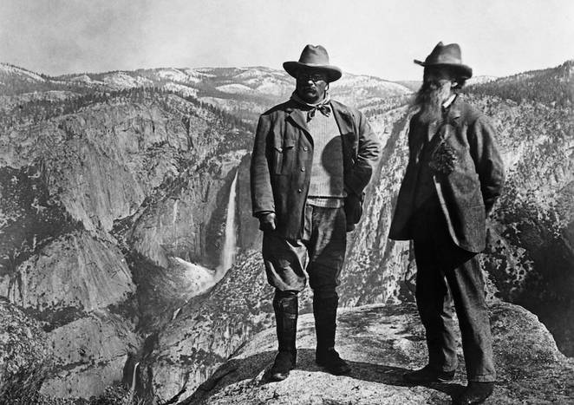
The Square Deal
1. Regulation of monopolies
*Northern Securities Case
-Hepburn Railroad Regulation Act
-broke up J.P. Morgan’s RR monopoly
2. Protection of workers and consumers
*Coal Strike of 1902
-Roosevelt sided with workers
-saved Americans from a huge crisis
*Pure Food and Drug Act/Meat Inspection Act
-created Food and Drug Administration (FDA)
-required inspections of meat and restriction of certain medicines
3. Conservation
*TR’s greatest achievement
*Gifford Pinchot – National Forest Service
*National Reclamation Act/National Park Service
-protected 5 million acres (1/5th) of land in the US
*John Muir – Yosemite National Park, California

Slide 13
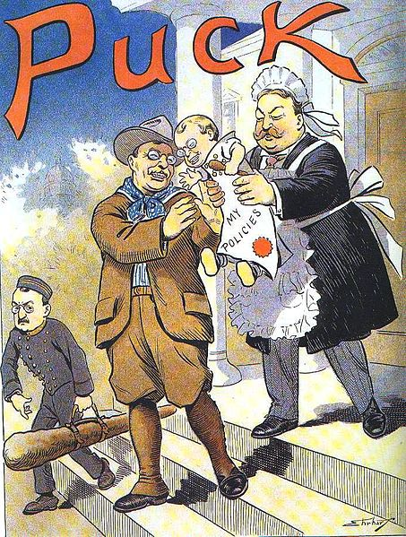
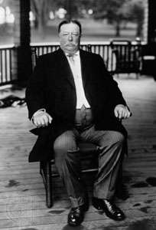
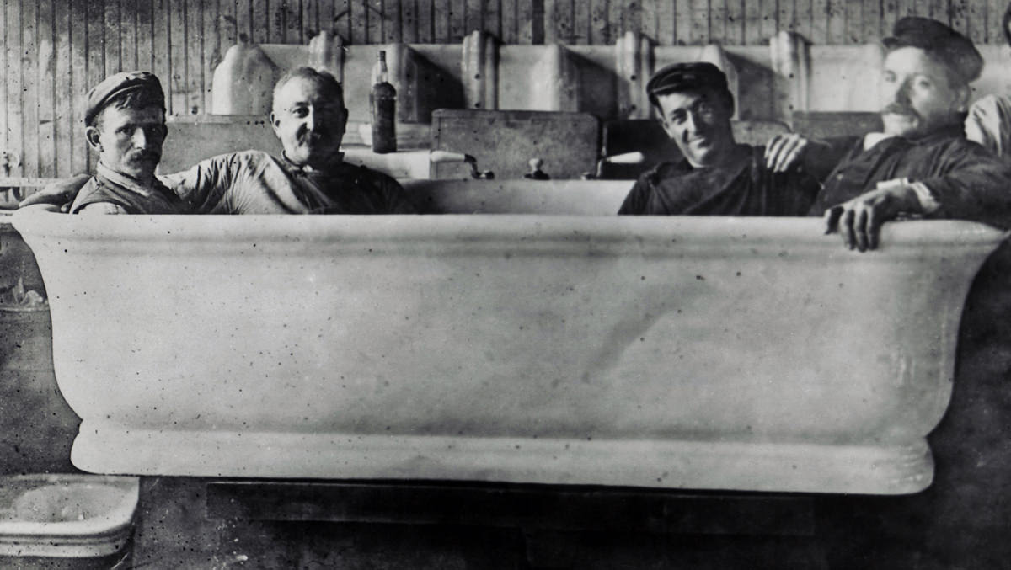
William Howard Taft (R) – 1909-1913
Troubled Succession
*Taft hand picked by T.R. to continue his legacy
*lawyer from Cincinnati
*former Gov. of Philippines
*largest president (300+lbs)
*later became Chief Justice of Supreme Court
*more of a “trust-buster” than T.R.
“New Nationalism”
*increased federal government
*wanted income tax (16th Amendment, worker’s compensation, tariff reduction
Payne-Aldrich Tariff
*barely lowered the tariff
*ticked off progressives
Undoing of TR legacy
*firing of Gifford Pinchot
*defunding of conservation bills
*ticked off T.R.!!!

Slide 14
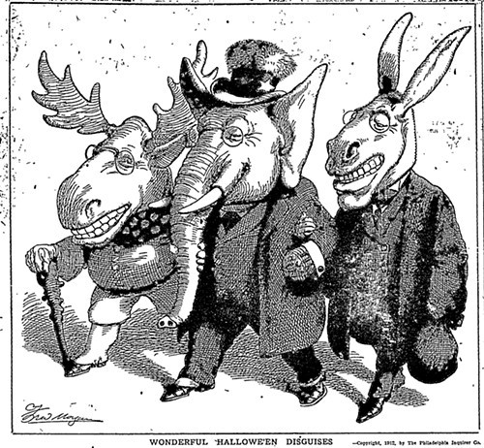
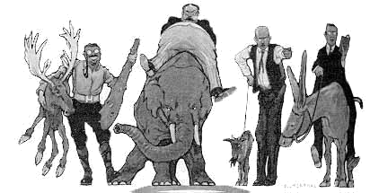
Election of 1912
T.R. vs. Taft
*T.R. looking to restore his legacy
*runs for president in 1912
*Roosevelt wants republican nomination
*brutally attacks Taft on a personal level
*Taft not willing to let T.R. bully him and wins GOP nomination
*T.R. runs as third party (Progressive or “Bull Moose” party)
*T.R. assassination attempt
*T.R. actually got more votes than Taft
*split vote allowed Democrat, Woodrow Wilson to win
-1st Democrat since Cleveland
-1st southerner since Johnson (1869)
- “supposedly” parties switched
-Wilson more progressive than T.R. and Taft combined
(*It should be noted the Eugene V. Debs ran from prison…)

Slide 15
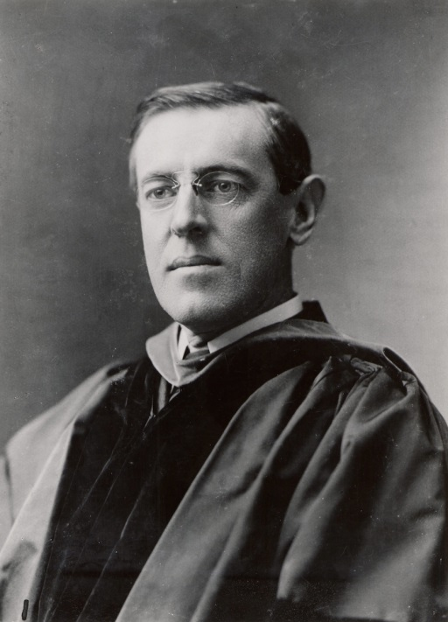
Woodrow Wilson (D) – 1913-1921
Wilson’s Background
*born in Virginia
*only president with a PhD
*taught political science at Princeton
*President of Princeton University - 1902
*Governor of New Jersey – 1910
*racist, bigot who supposedly refused to shake hands with African Americans
*did not support women’s suffrage
*extremely religious
*1st wife died in 1914, remarried in 1915
*some say she was our first female president

Slide 16
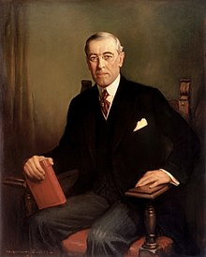
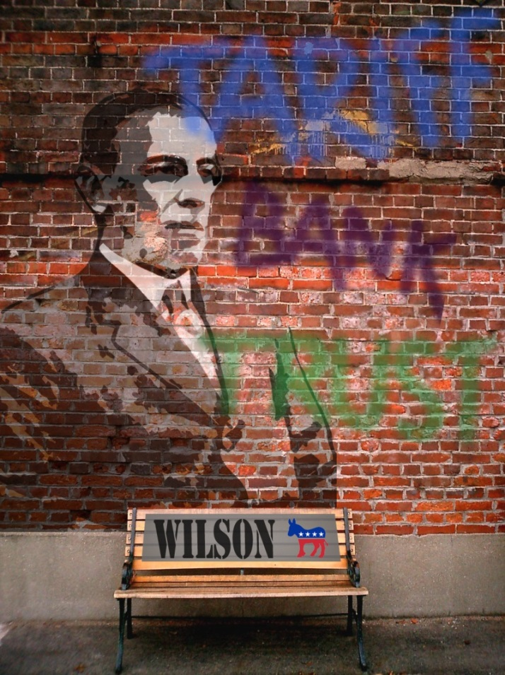
Wilson’s “New Freedom”
1. Lowering of Tariff – Underwood-Simmons Tariff
*significantly lowered tariff to bring in competition
*16th Amendment (income tax) passed to make up for revenue loss
2. Federal Reserve Act - 1913
*created Federal Reserve Banking system
*responsible for increasing and decreasing money supply
*sets interest rates
*stores gold
3. “Trust-Busting”
*Federal Trade Commission Act
-regulatory agency that allowed businesses to police themselves
*Clayton Anti-Trust Act
-gave more power to Sherman Anti-Trust Act
-made interlocking directories illegal (couldn’t manage multiple companies)
-unions and agricultural organizations exempt from anti-trust prosecution
-later, supported measures to aid farmers and regulate child labor

Slide 17
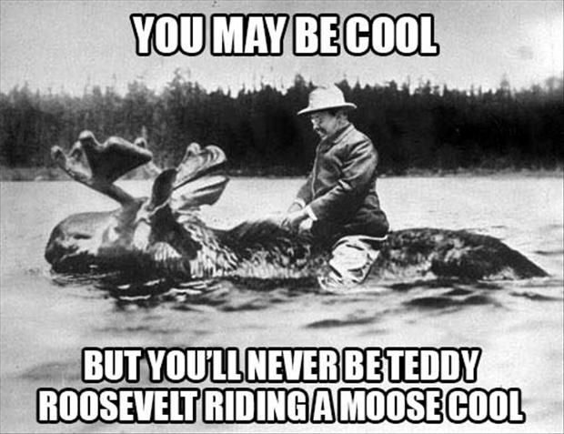
Crash Course US History Ep. 29: The Progressive Presidents

Slide 18
Ch. 20: The Progressives
Focus Questions:
Explain the reasons the progressive movement began.
Describe some of the goals of the progressive movement.
Identify who the muckrakers were and their accomplishments.
Identify some of the important social reformers of the time and their goals.
Describe labor, business and government reform.
Analyze the new legislation that was passed during the era and what problems they attempted to fix.
Identify the three progressive presidents and their policies. (be as thorough with this as you can)
Notes:
18
The purpose of the focus questions is to help students find larger themes and structures to bring the historical evidence, events, and examples together for a connected thematic purpose.
As we go through each portion of this lecture, you may want to keep in mind how the information relates to this larger thematic question. Here are some suggestions: write the focus question in the left or right margin on your notes and as we go through, either mark areas of your notes for you to come back to later and think about the connection OR as you review your notes later (to fill in anything else you remember from the lecture or your thoughts during the lecture or additional information from the readings), write small phrases from the lecture and readings that connect that information to each focus question AND/OR are examples that work together to answer the focus question.

Slide 19
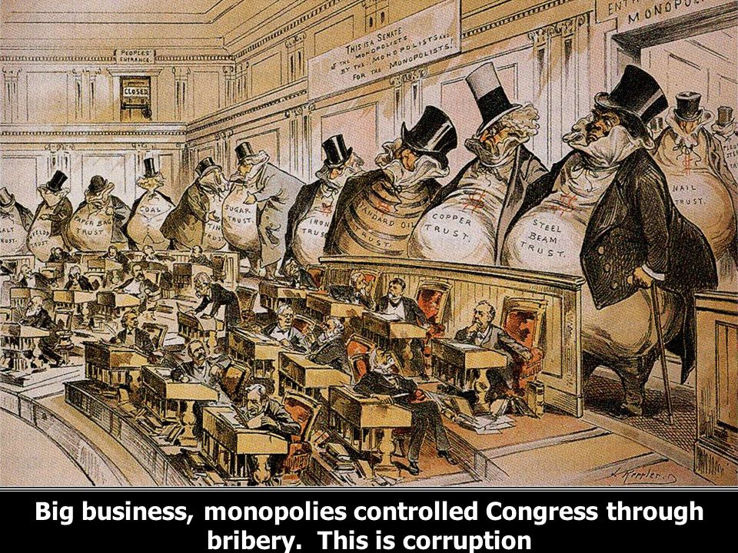
SAQ
Briefly explain the opinion expressed by the artist about ONE of the following: Monopolies, Senators, Society as a whole
Briefly explain ONE development that might give that opinion some validity.
Briefly explain ONE way this issue was fixed or reformed by progressives.

Slide 20
Progressive era DBQ
Analyze the impact that reformers and muckrakers had on enacting changes to American society, whether good or bad, during the progressive era.
On a sheet of lined paper:
Contextualize and write a thesis/claim.
HAPP/HIPPO all four documents
You do not have to answer the questions for each document unless it helps you out. (If you want to turn them in tomorrow I will replace a low or missing daily grade)
You may use your DBQ notes that you took last time.
This will be a major grade, utilize your time wisely, work from bell to bell…
*Remember: you are analyzing the documents and not the photographs as the photos are merely there as a visual.*

Slide 21
Ultimate Guide to the President Ep. 4: Call of Duty

