Slide 1
Ch. 22: The “New Era” (The Roaring 20’s)
Focus Questions:
Explain why the 1920’s were known as the Roaring 20’s and the Jazz Age and the impact of WWI on America.
Analyze the economy and labor during the 1920’s.
Describe the new cultural changes in America.
Explain how the roles of women, youth and African Americans changed during the 1920’s.
Identify the different elements of the Harlem Renaissance movement.
Identify the effects of the 18th Amendment.
Analyze elements of the nativist movement and the resurgence of the KKK.
What impact did fundamentalism have on the era?
Identify each of the 20’s presidents and important aspects of their terms.
Notes:
1
The purpose of the focus questions is to help students find larger themes and structures to bring the historical evidence, events, and examples together for a connected thematic purpose.
As we go through each portion of this lecture, you may want to keep in mind how the information relates to this larger thematic question. Here are some suggestions: write the focus question in the left or right margin on your notes and as we go through, either mark areas of your notes for you to come back to later and think about the connection OR as you review your notes later (to fill in anything else you remember from the lecture or your thoughts during the lecture or additional information from the readings), write small phrases from the lecture and readings that connect that information to each focus question AND/OR are examples that work together to answer the focus question.

Slide 2
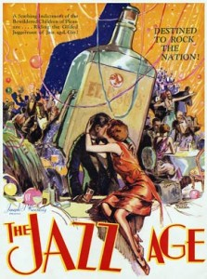
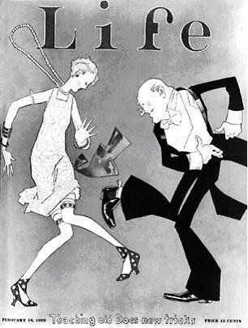
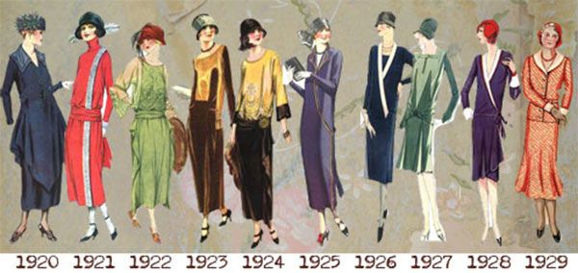
The Roaring 20’s or Jazz Age
Impact of WWI
*Isolationism & Urbanization
-more people live in urban areas than rural areas
-Americans weary of foreign involvement
*political, social, and cultural radicalism
-”Red Scare”, Palmer Raids, nativism, fundamentalism, The Great Migration
*economic and industrial advances
-mass consumerism, new technologies, rapid economic growth

Slide 3
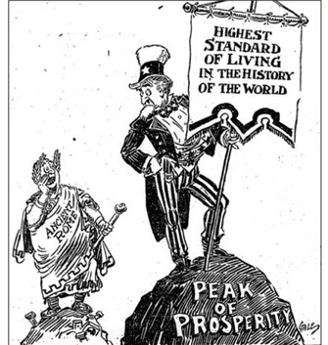
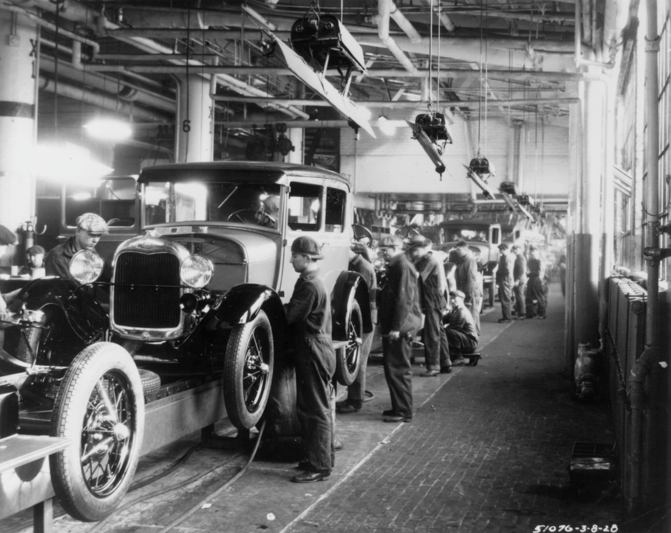
The New Economy
1920’s Prosperity
*economy boomed more than ever before
*mostly due to a lag in Europe’s economy
*manufacturing rose by 60% during the decade
*much of this was also a result of new technologies
Technology and Growth
Automobiles
*automobile industry became most important
*stimulated: rubber, glass, oil, steel and other metals
*road construction created millions of jobs, housing boom, fueling stations
*people went on vacation more
Communication
*better radio technology than before
*every American owned a radio by end of 20’s
*radio programs and advertising important
*25 million phones by late 1930’s (1 out of 6 people)
Transportation
*planes deliver mail, commercial aviation, faster trains using diesel-electric engines

Slide 4
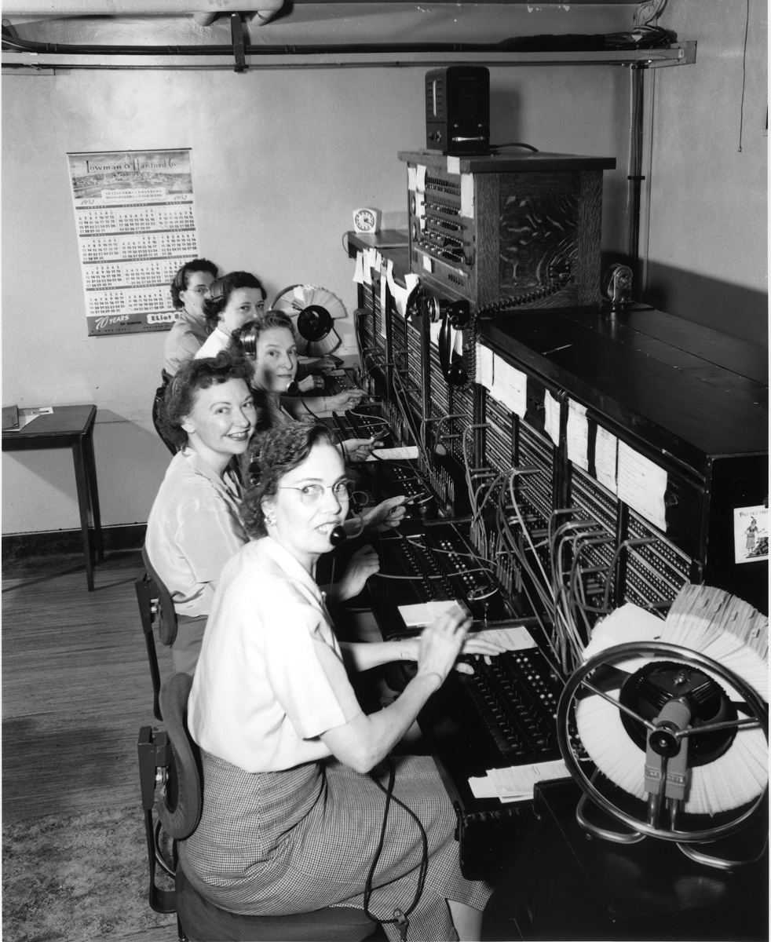
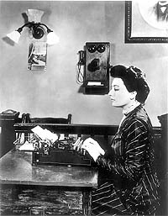
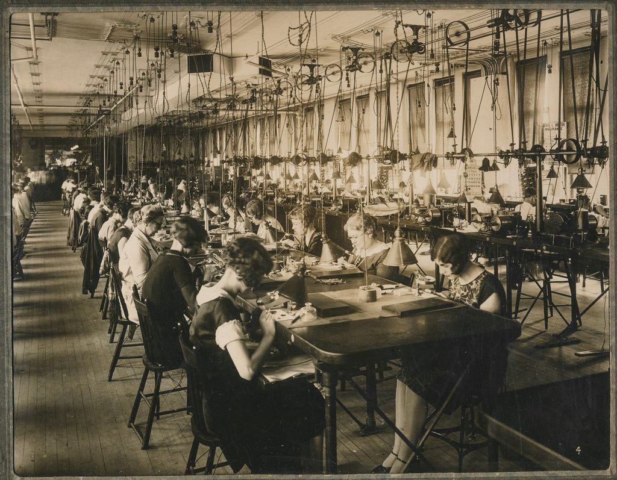
Labor
Welfare Capitalism – Henry Ford
*shorter workweek, higher wages, paid holidays
*workers made more money and had more leisure time to spend money
“Pink Collar” jobs – Women
*secretaries, sales clerks, phone operators
*lower paying jobs
African Americans
*janitors, dishwashers, garbage collectors, etc.
Japanese Americans
*California made it difficult to buy land
Supreme Court
*made it difficult for unions to aid workers
Farmers
*overproduction rampant
*never recovered from WWI
*Coolidge vetoed legislation for farmers subsidies

Slide 5
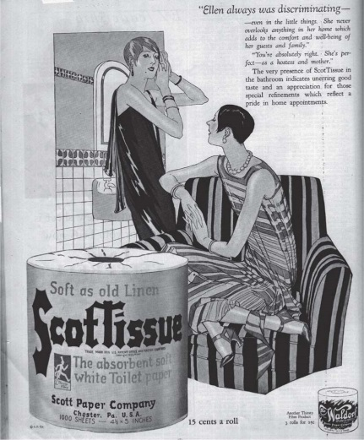
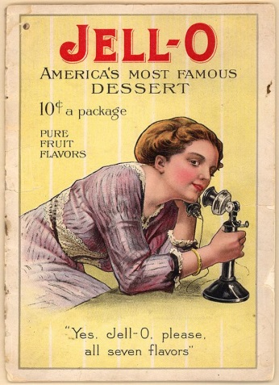
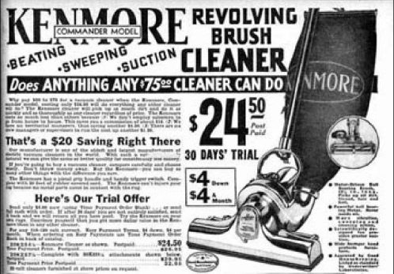
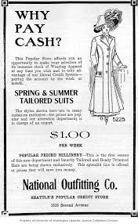
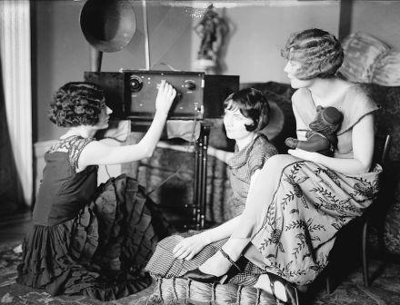
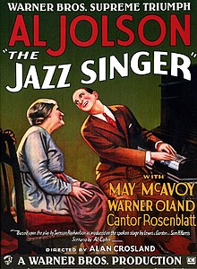
The New Culture
Consumerism
*America increasing mass consumption
*people made more money and had more time off
*people able to buy a plethora of new products
-electric appliances (refrigerators, washing machines, vacuums, electric irons), cosmetics, fashion designer clothes, cigarettes, gum
*buying on credit, layaway became available
Advertising
*helped sell even more products
*radio and newspapers advertised products
*magazines – Time, Reader’s Digest, Saturday Evening Post
Movies & Radio
*The Jazz Singer – first “talkie” movie
*Motion Picture Association – HOLLYWOOD, Ca.
*National Broadcasting Corporation (NBC) formed in 1927

Slide 6
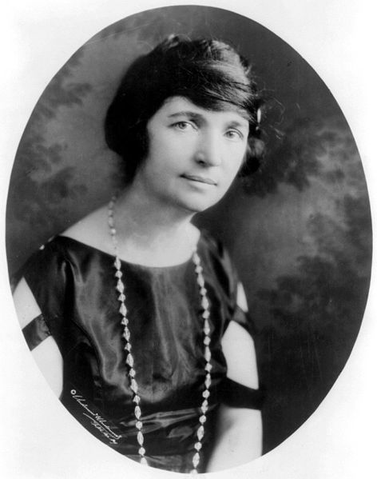
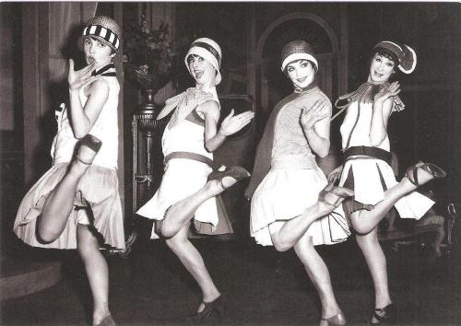
Women
Limited job opportunities
*lower class women limited in jobs
*middle class women got married and stayed home
*upper class – doctors, lawyers, business execs.
Margaret Sanger – Planned Parenthood
*advocated birth control, contraception
*idea of motherhood changing
Flappers
*more of an image
*women who wore short dresses and hair
*smoked, drank, danced (gasp!), kissed boys in public (gross!)
*mostly due to women gaining more freedoms in society
*women now determining elections and legislation

Slide 7
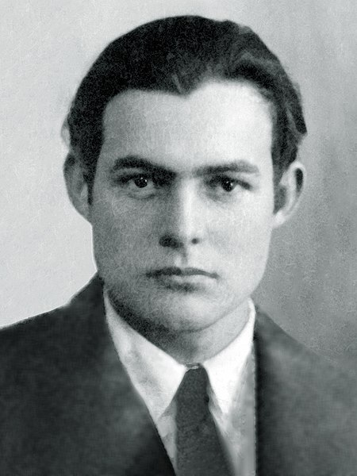
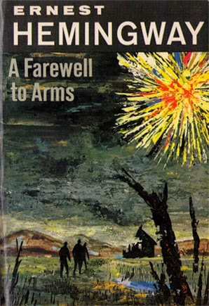
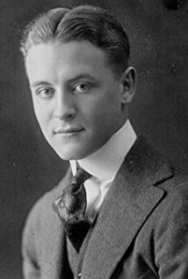
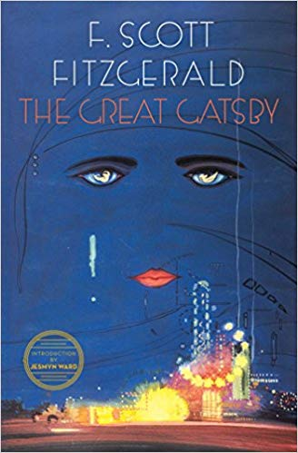
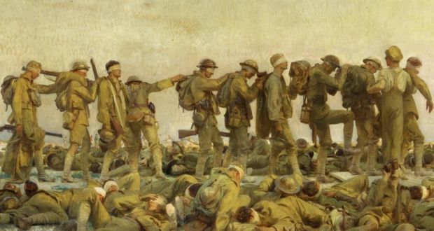
Youth Culture
Education and Youth
*high school attendance doubled
*college enrollment tripled
*more people attending vocational schools
“Lost Generation”
*WWI generation that became disenchanted with society
*writers that were critical of culture and consumerism
*anti-conformity (similar to Beatniks and Hippies)
*Ernest Hemingway – A Farewell to Arms
-WWI soldier, amazing novelist, committed suicide
*F. Scott Fitzgerald – The Great Gatsby
-wrote about the extravagancies of the 20’s

Slide 8
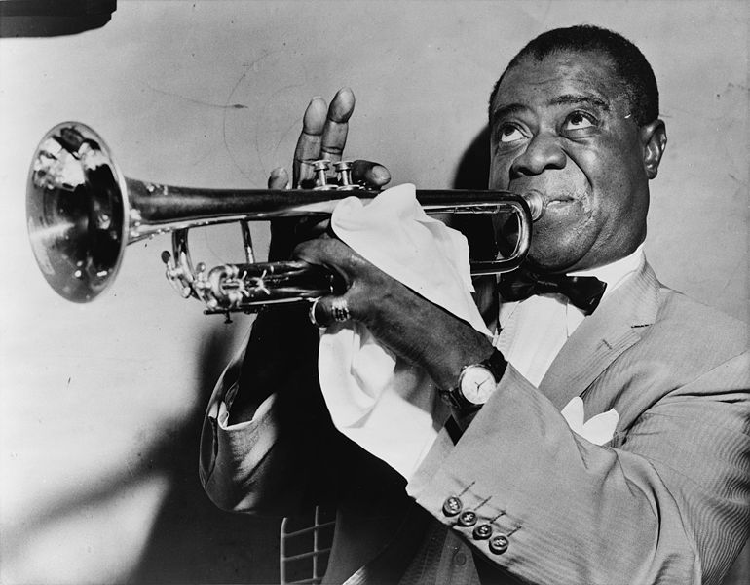
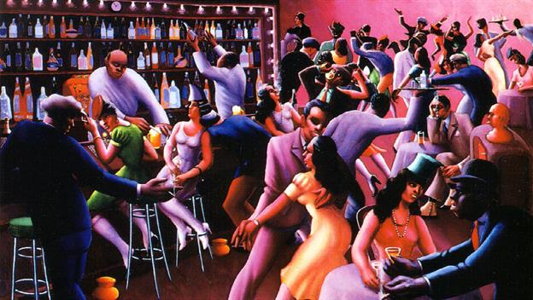
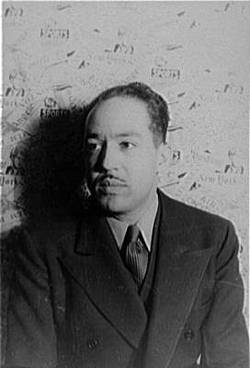
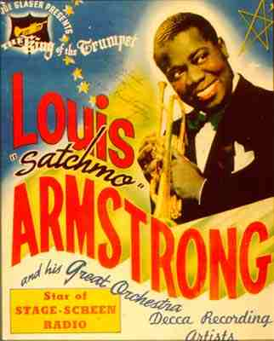
African American Culture
The Harlem Renaissance – AA literary, artistic movement
*mostly started because of Great Migration
*blacks bringing their culture to the big cities in the north
*in many ways helped the Civil Rights movement
Jazz Music
*originated in New Orleans and spread north
*nightclubs began to pop up
*jazz music extremely popular for all colors and backgrounds
*more of a movement than anything
Langston Hughes – “I am a Negro-and beautiful”
*African American poet and writer

Slide 9
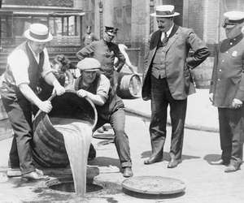
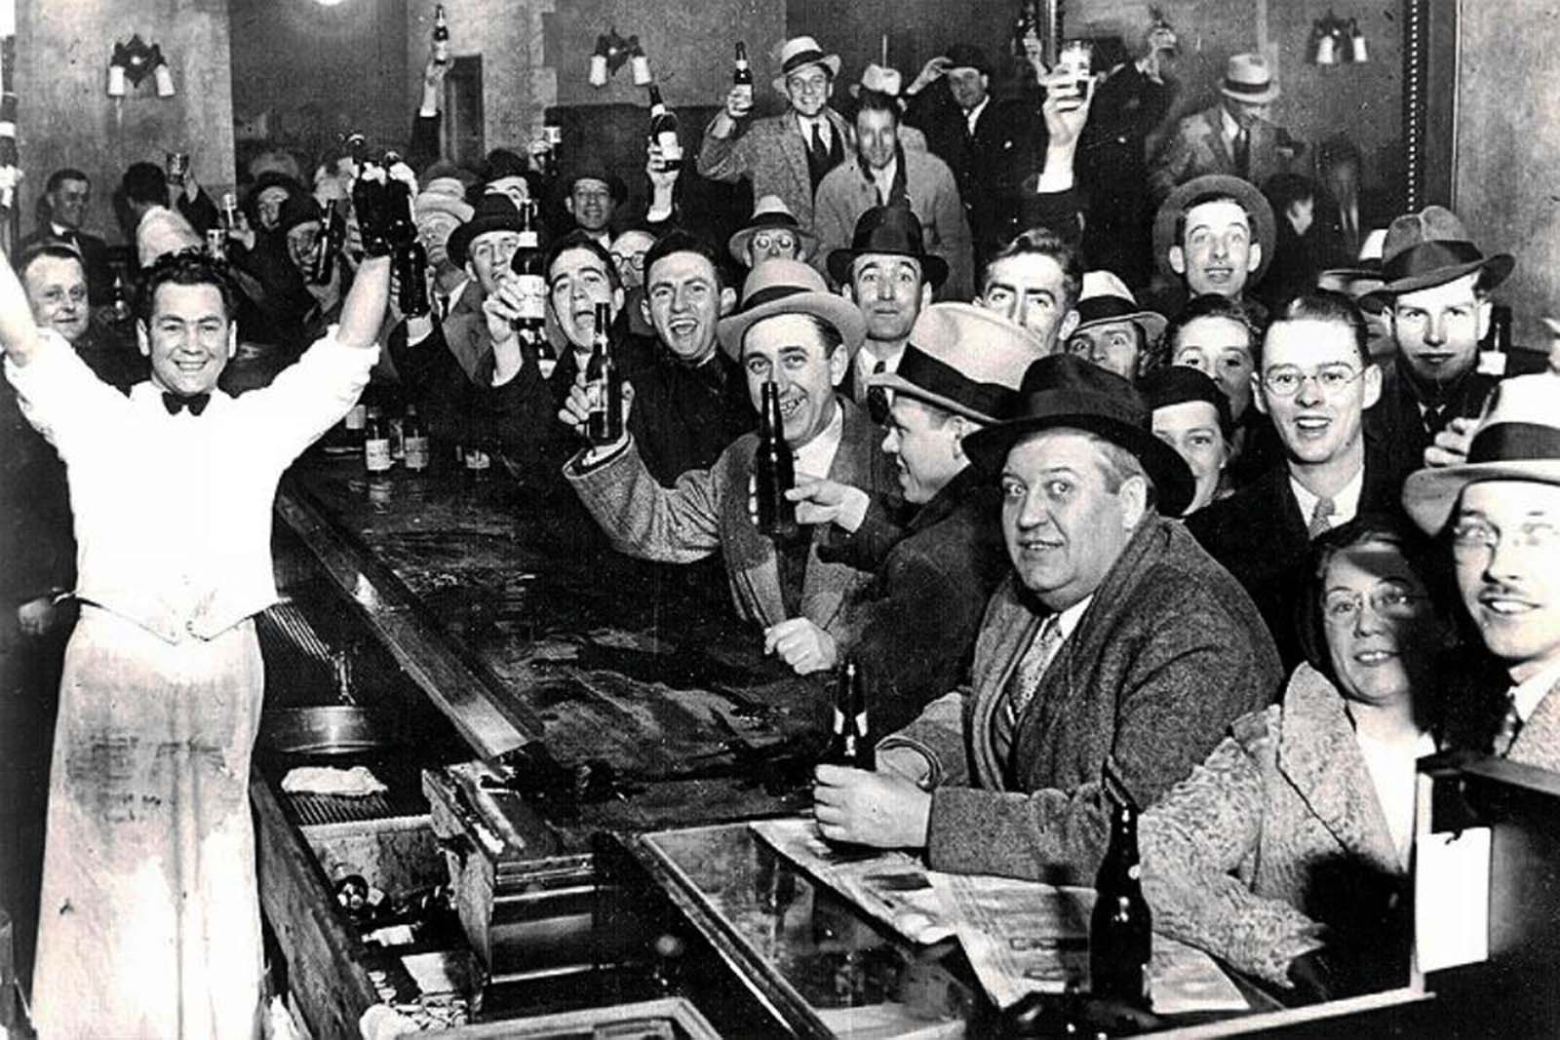
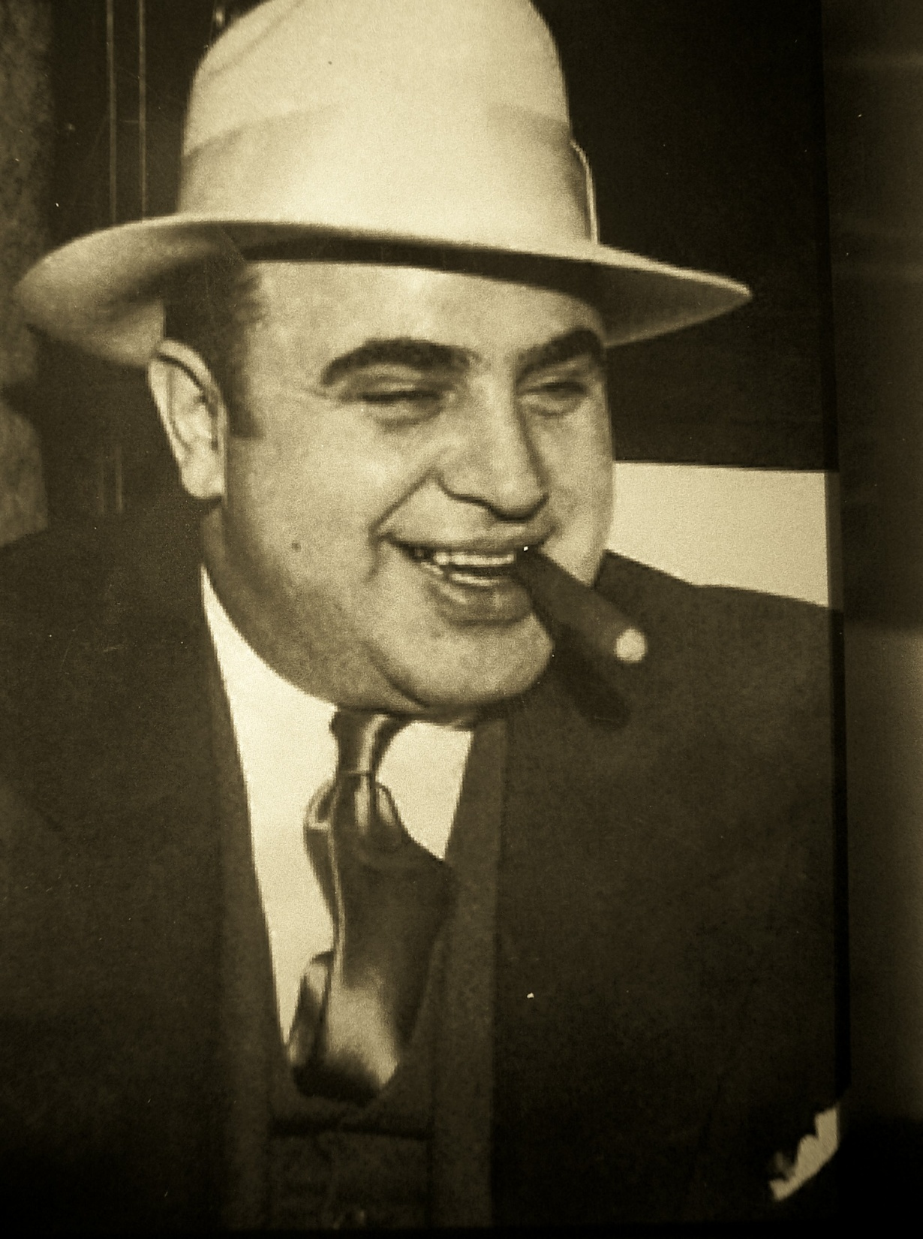
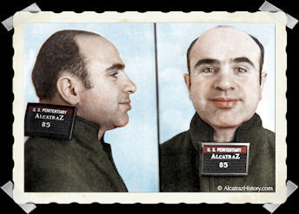
Conflicts of Culture
Prohibition (18th Amendment)– the “noble experiment”
*made alcohol sale, production, and distribution illegal
*ultimately a massive failure
*people found numerous ways to break the law
-speakeasies, moonshining, bootlegging, stock cars
*Americans drinking more than ever
*weak enforcement of the law
*resulted in an increase in organize crime
Al Capone – Chicago mob boss
*most notorious gangster of his time
*bribed city officials
*made millions off of selling illegal alcohol
*St. Valentines Day Massacre – 7 murdered
*sent to prison for tax evasion

Slide 10
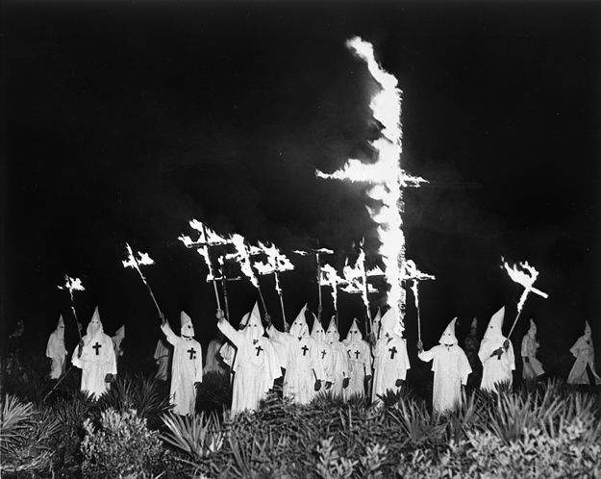
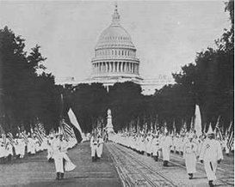
Nativism and the Klan
Anti-Immigration
*many Americans associated immigrants with radicalism
*many sought to restrict immigration through quotas
*Sacco and Vanzetti
National Origins Act, 1924
*reduced European quota from 3% to 2% per year
*banned Chinese and eastern Asian immigration entirely
*favored immigration from Nordic countries
The New Klan
*KKK had died off in 1870’s
*made a resurgence in the 20’s
-membership swelled to well over 4 million
-high membership in northern states (Indiana had the highest membership in the country) as well as big cities (Chicago, Detroit)
*many Klan leaders were elected to office
*terrorized blacks, immigrants, Catholics and Jews
-public whippings, lynching, arson, boycotting business

Slide 11
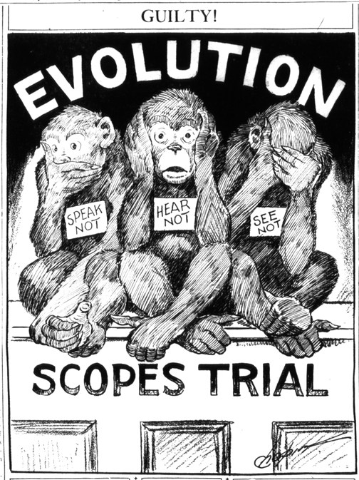
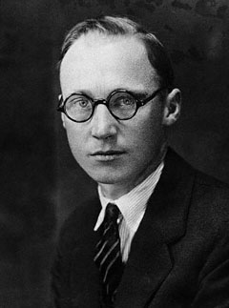
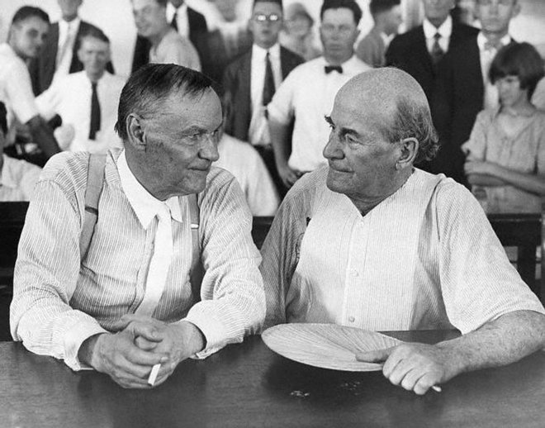
Fundamentalism
Religious Division
*modernists – attempted to adapt religion to science (mostly urban and middle class)
*fundamentalists – biblical traditionalists (mostly rural and southern)
*many southern states passed laws against teaching certain scientific theories (Darwin’s theory of evolution)
Scopes “Monkey” Trial
*John T. Scopes – Tennessee teacher who taught biology
*supported by the ACLU (American Civil Liberties Union)
*Scopes arrested and trial ensued
*Clarence Darrow Vs. William Jennings Bryan
*Scopes lost and forced to pay $100 (eventually waved)
*trial was a circus and made fundamentalists look ridiculous
*fueled old school vs. new school for many years

Slide 12
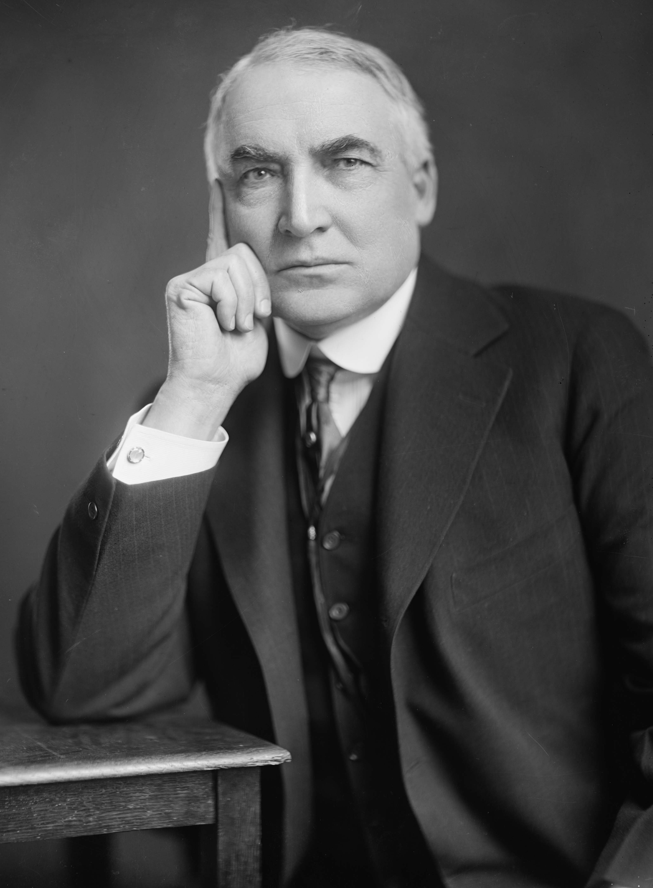
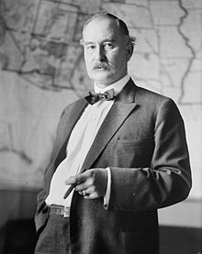
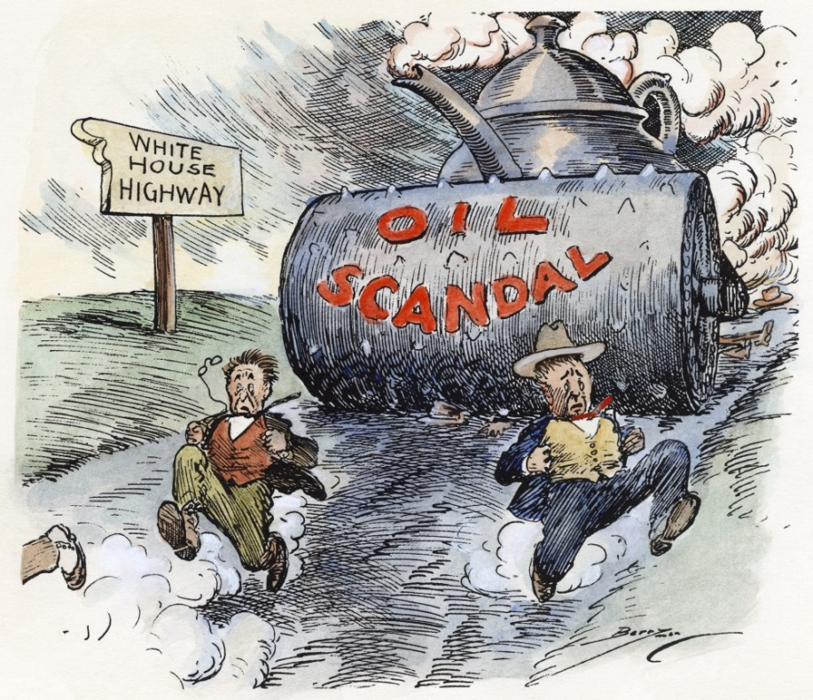
1920’s Presidents
Republican Resurgence
*R’s dominated the presidency and Congress during 20’s
*mostly pro-business and encouraged growth
*favored laissez-faire capitalism and isolationism
Warren G. Harding (R), 1921-1923
*promised a “Return to Normalcy”
*gambler, drinker, and womanizer (Nan Britain)
*presidency racked with scandal
-Teapot Dome – cabinet members leasing govt. oil to oil companies for kickbacks
-Albert Fall – Sec. of Interior spent a year in prison
*Harding died in 1923 while touring the west
*V.P. Calvin Coolidge sworn in

Slide 13
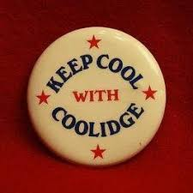
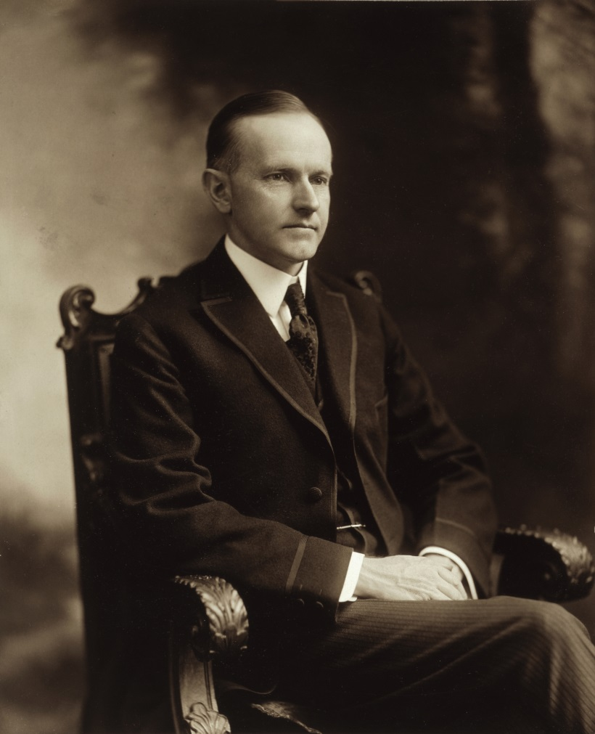
Calvin “Silent Cal” Coolidge (R), 1923-1929
“Keep Cool with Coolidge”
*former gov. of Massachusetts
*extremely introverted and quiet
*wanted to clean up politics after Harding
*pro-business - “The business of America is business”
*raised the tariff
*oversaw the most prosperous time in American history
Andrew Mellon - Sec. of Treasury
*tax cuts for the wealthy
*trickle down economics (later used by Reagan)

Slide 14
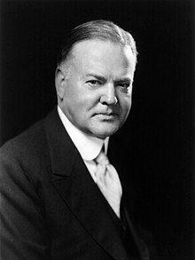
Herbert Hoover (R), 1929-1933
Hoovers “Voluntarism”
*self-made millionaire
*former Sec. of Commerce
*felt businesses should voluntarily cooperate with the public to set better prices and wages
*stock market crashed less than a year into his presidency
*Hoover’s response made things worse (he did nothing)
*brought us into the Great Depression

Slide 15
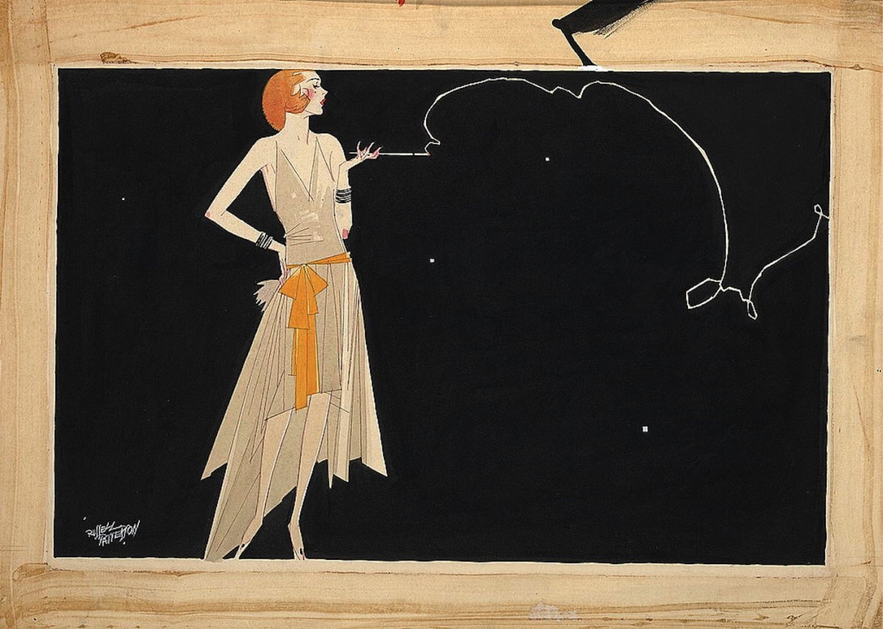
Crash Course Ep. 32: The Roaring 20’s

Slide 16
Ch. 22: The “New Era” (The Roaring 20’s)
Focus Questions:
Explain why the 1920’s were known as the Roaring 20’s and the Jazz Age and the impact of WWI on America.
Analyze the economy and labor during the 1920’s.
Describe the new cultural changes in America.
Explain how the roles of women, youth and African Americans changed during the 1920’s.
Identify the different elements of the Harlem Renaissance movement.
Identify the effects of the 18th Amendment.
Analyze elements of the nativist movement and the resurgence of the KKK.
What impact did fundamentalism have on the era?
Identify each of the 20’s presidents and important aspects of their terms.
****Don’t forget to register for the AP Exam!!! Do this before Spring Break!!!*****
Notes:
16
The purpose of the focus questions is to help students find larger themes and structures to bring the historical evidence, events, and examples together for a connected thematic purpose.
As we go through each portion of this lecture, you may want to keep in mind how the information relates to this larger thematic question. Here are some suggestions: write the focus question in the left or right margin on your notes and as we go through, either mark areas of your notes for you to come back to later and think about the connection OR as you review your notes later (to fill in anything else you remember from the lecture or your thoughts during the lecture or additional information from the readings), write small phrases from the lecture and readings that connect that information to each focus question AND/OR are examples that work together to answer the focus question.

Slide 17
Ch. 22 SAQ
Analyze one source of conflict in 1920’s America.
Analyze a second source of conflict in 1920’s America.
Explain how these sources of conflict helped shape American culture, society, the economy of the 1920’s.

