Slide 1
World War II (Part II)
Focus Questions:
Describe the American reaction to joining the war (I.E. the social changes that occurred).
Identify WWII social changes and terms such as the OWI, the WPB, Victory Gardens, War Bonds, and WAC.
Discuss the Allied strategy once the Americans joined the war.
Describe the North African, Italian and European Campaigns (Famous leaders and Battles).
Explain the Holocaust and the worldwide reaction to it.
Analyze the end of the war in Europe.
Describe the Pacific Campaign, its leaders and battles.
Analyze the controversy of using nuclear weapons, the end of the war and its impact.
Notes:
1
The purpose of the focus questions is to help students find larger themes and structures to bring the historical evidence, events, and examples together for a connected thematic purpose.
As we go through each portion of this lecture, you may want to keep in mind how the information relates to this larger thematic question. Here are some suggestions: write the focus question in the left or right margin on your notes and as we go through, either mark areas of your notes for you to come back to later and think about the connection OR as you review your notes later (to fill in anything else you remember from the lecture or your thoughts during the lecture or additional information from the readings), write small phrases from the lecture and readings that connect that information to each focus question AND/OR are examples that work together to answer the focus question.

Slide 2
World War Two

Slide 3
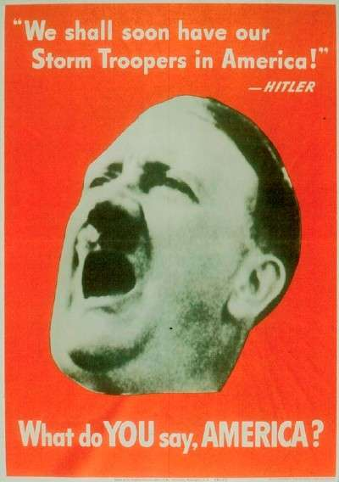
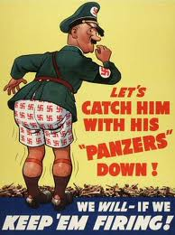
Mobilization at home
●Mobilization of the armed forces
●Scientific developments and Military Research

Slide 4
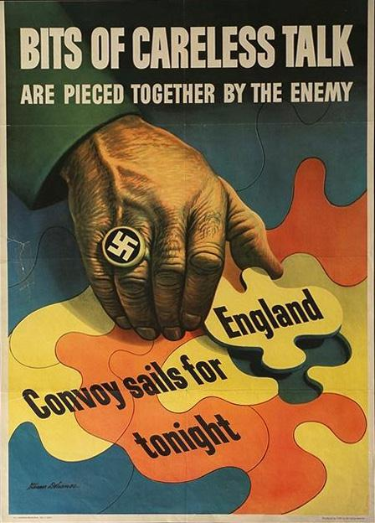
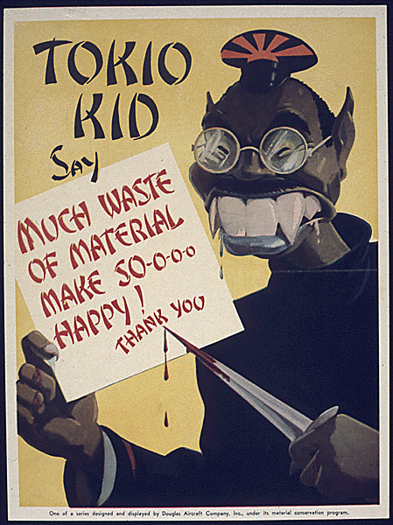
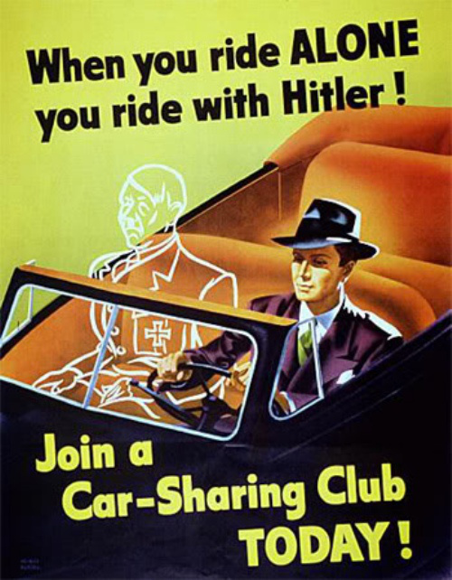
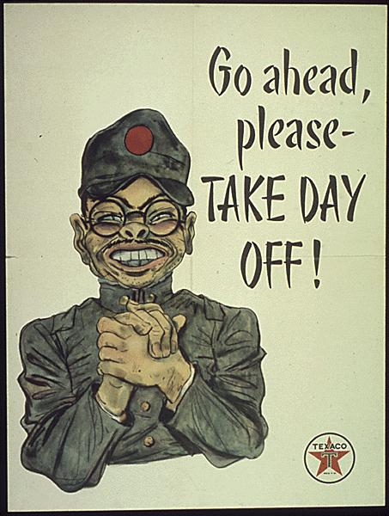
The Office of War Information (OWI)
Propaganda

Slide 5
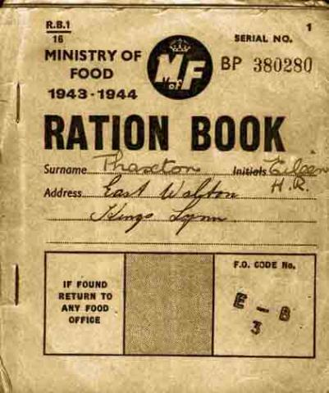
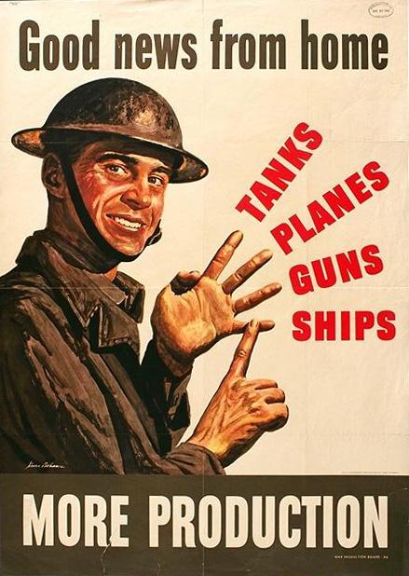
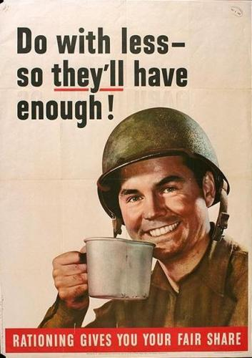
Economic conversion to war
Rationing
War Production Board (WPB)

Slide 6
Victory Gardens

Slide 7
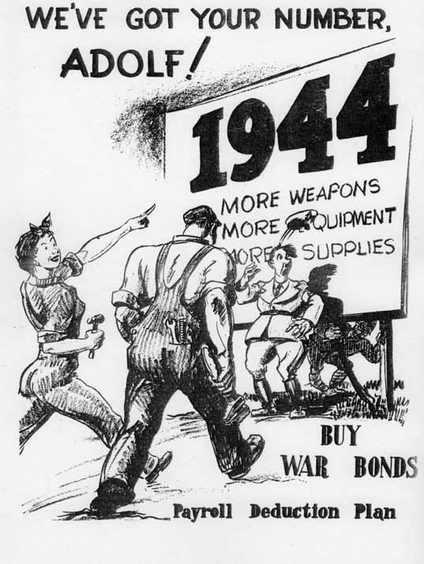
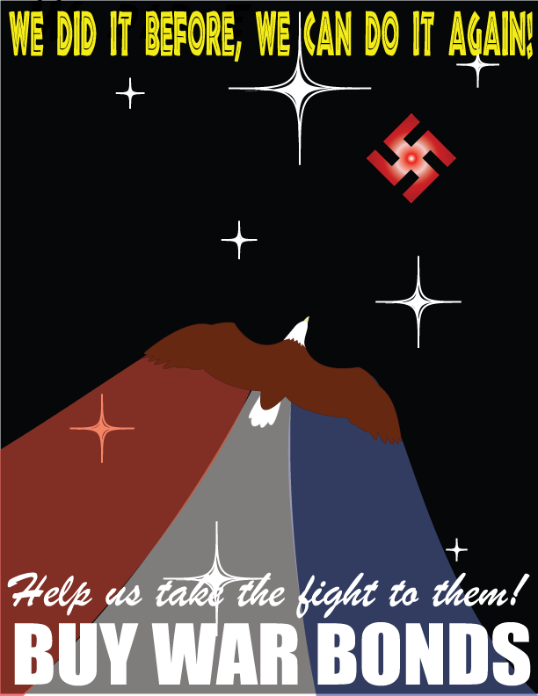
Financing the war
War Bonds

Slide 8
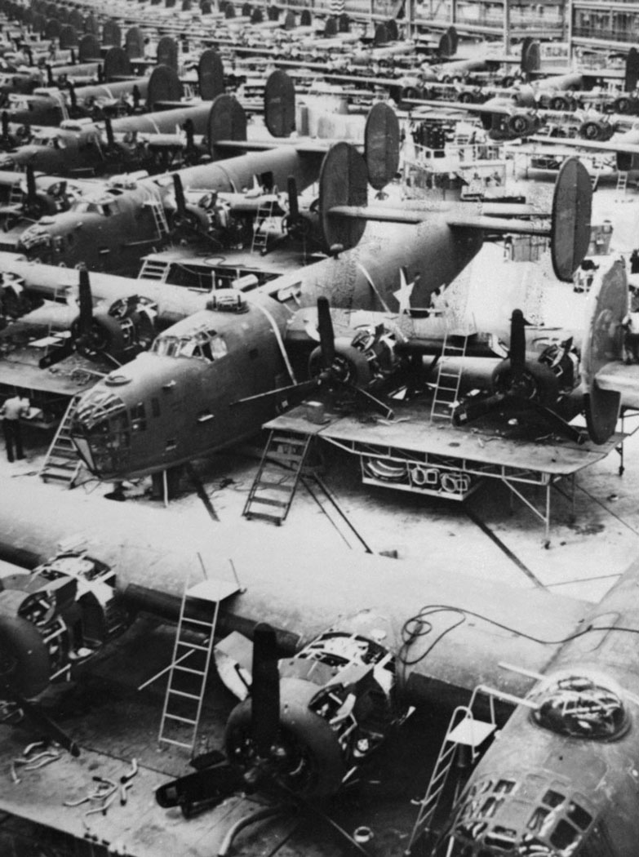
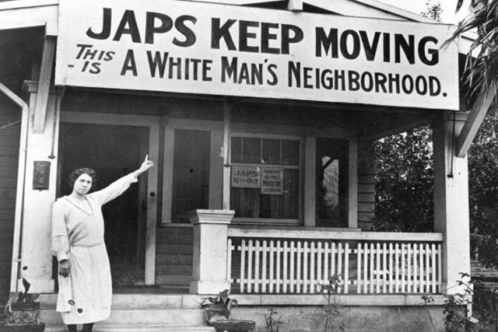
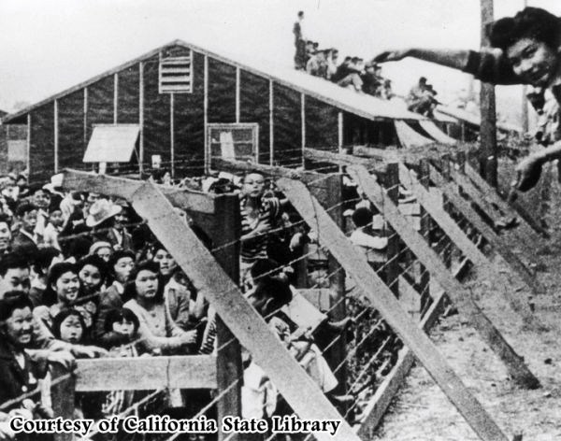
Social effects of the war
Western Migration
Internment Camps
Executive Order 9066

Slide 9
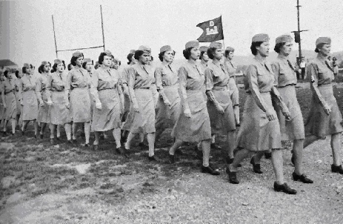
Women
Rosie the Riveter
Women’ s Army Corps (WAC)

Slide 10
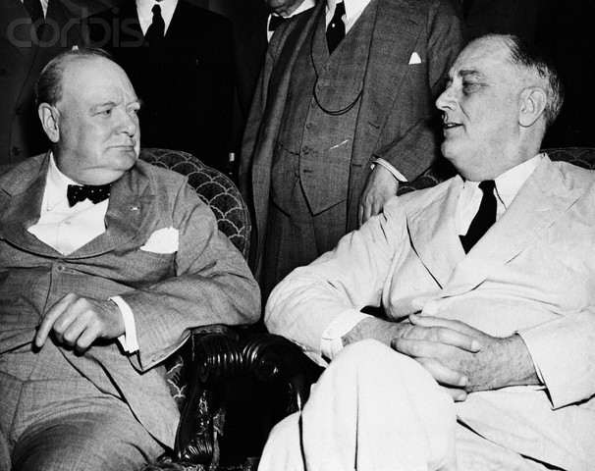
The war in Europe
●Basis for moving against Germany first
●Joint conduct of the war
●The decision for the North African invasion

Slide 11
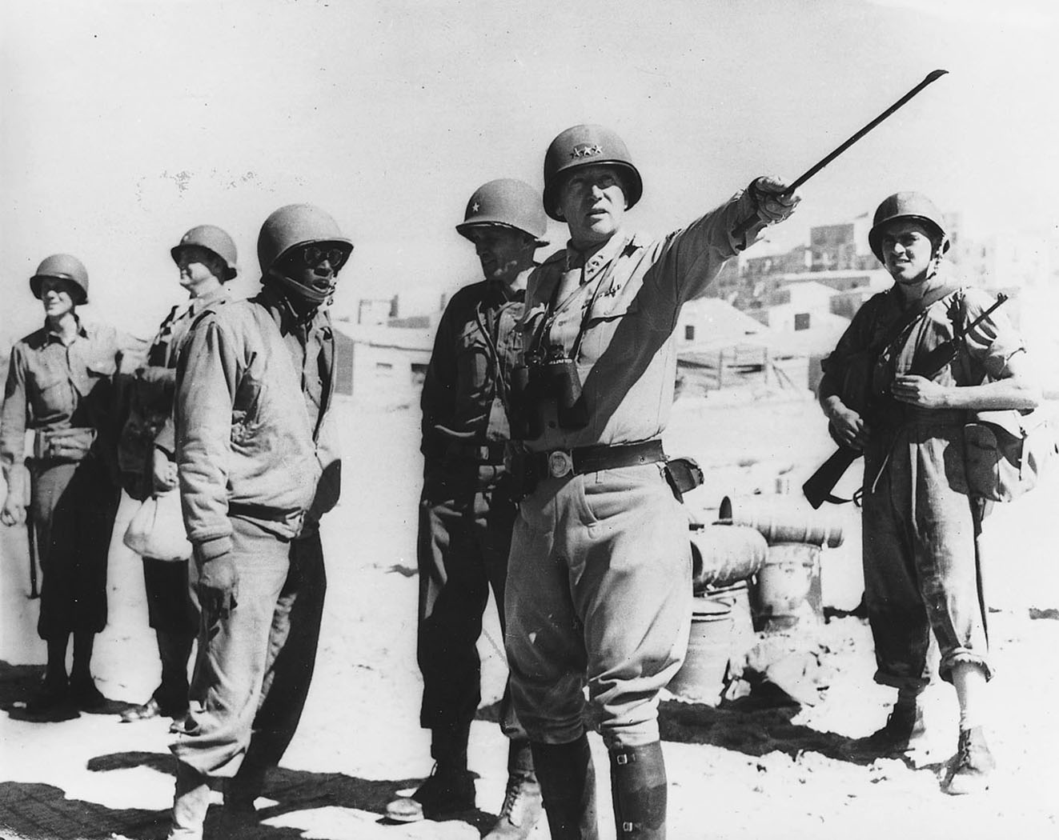
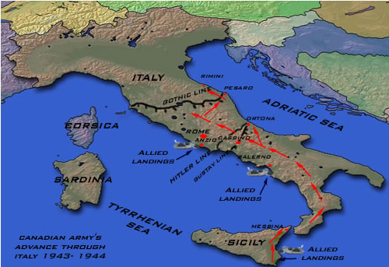
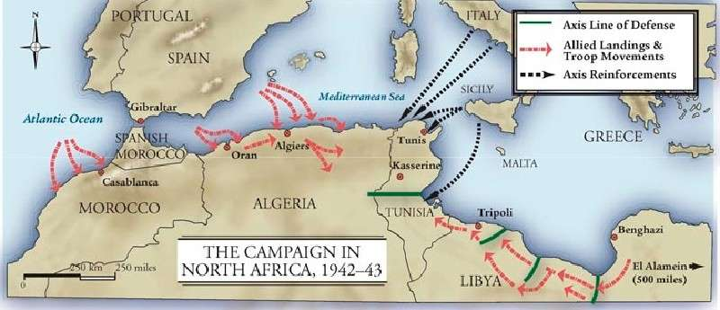
North African campaign: 1942
Italian Campaign: 1943-44
General George S. Patton

Slide 12
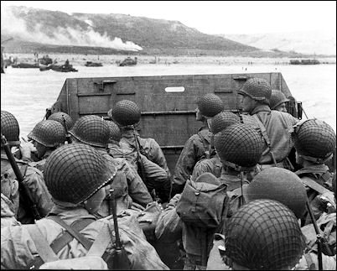
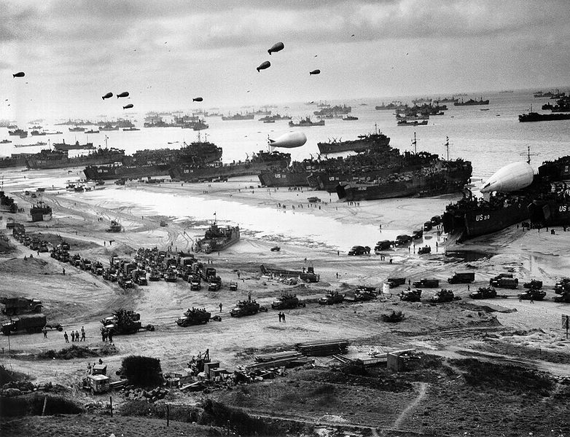
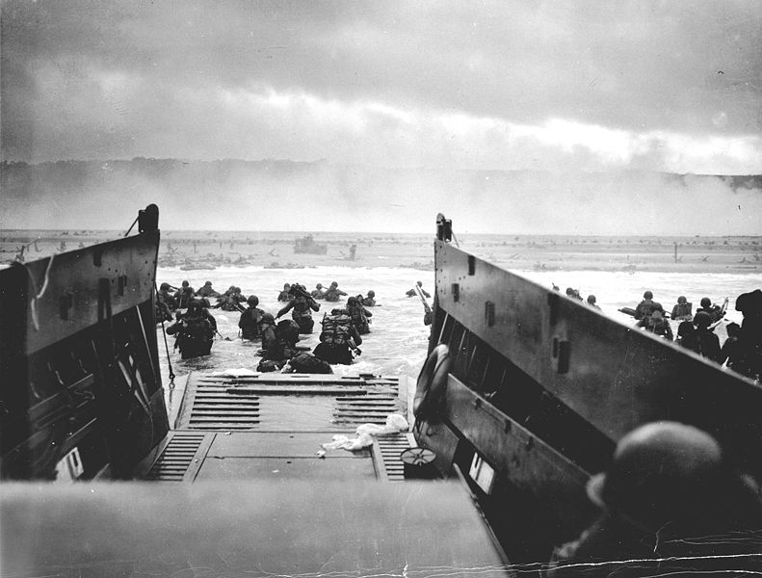
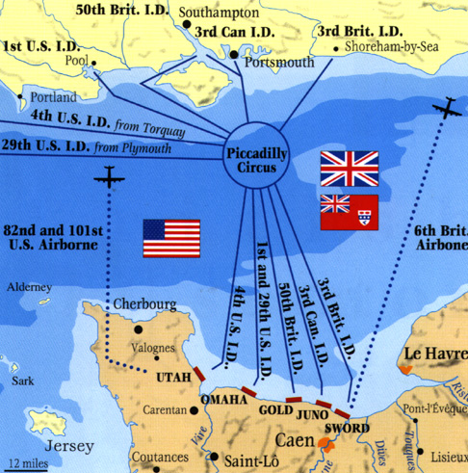
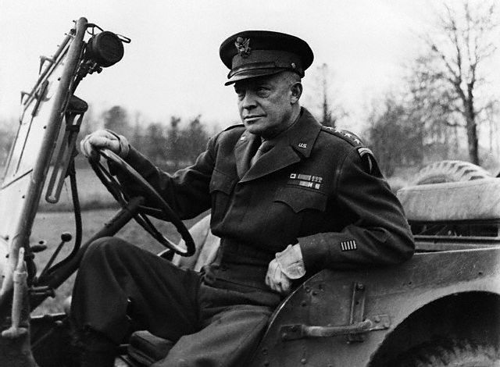
D-Day Invasion: “Operation Overlord” June 6, 1944
General Dwight D. Eisenhower

Slide 13
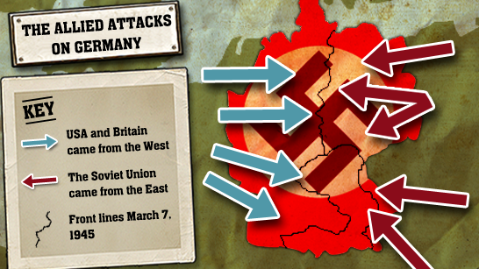
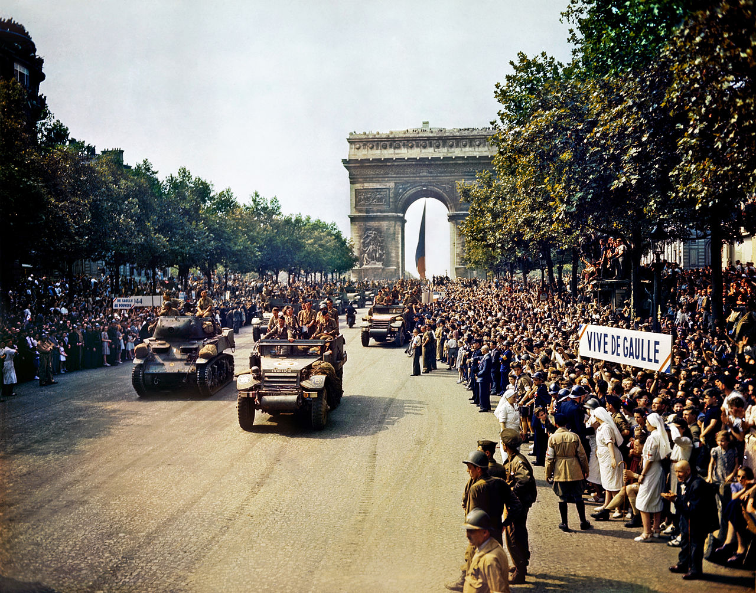
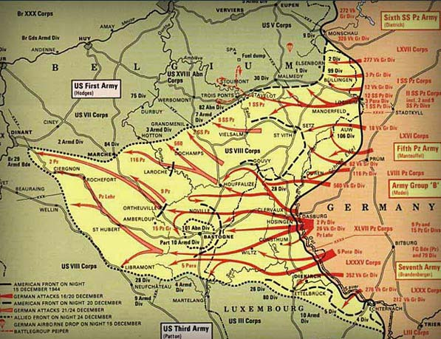
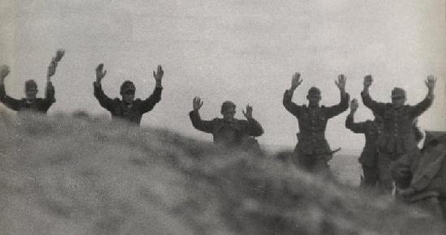
The end of the war in Europe
●Closing in on Germany
●Liberation of Paris (Aug. 25, 1944)
●Battle of the Bulge (Dec. 16, 1944- Jan. 25, 1945)

Slide 14
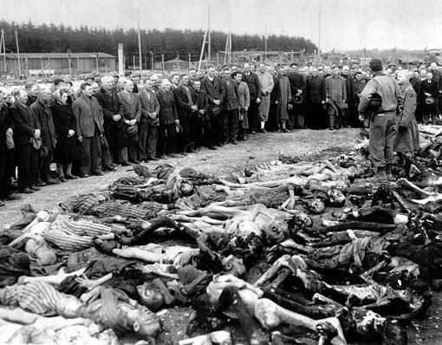
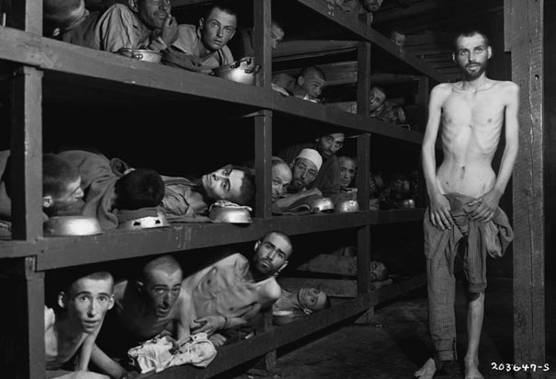
Hitler’s Final Solution: The Holocaust

Slide 15
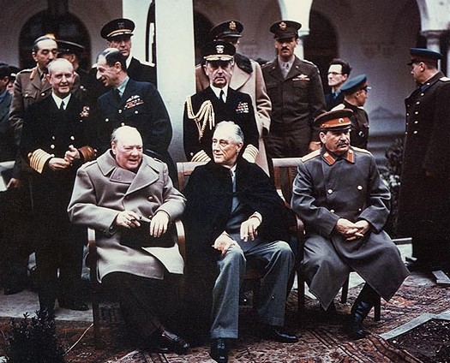
The Yalta Conference

Slide 16
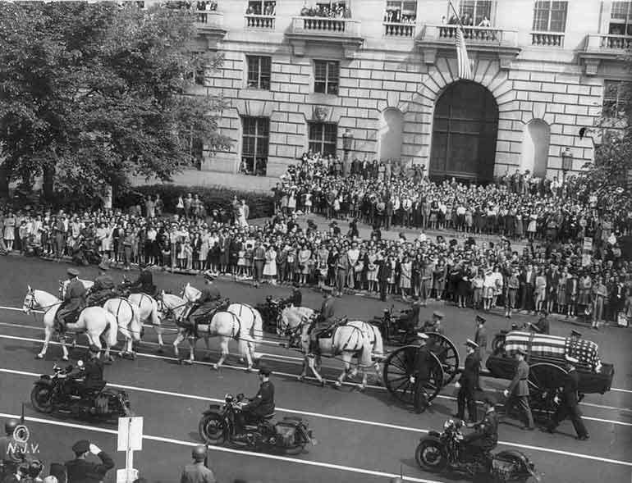
FDR’s death: April 12, 1945

Slide 17
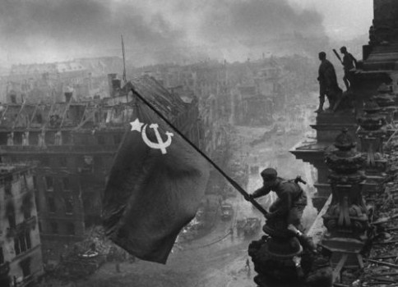
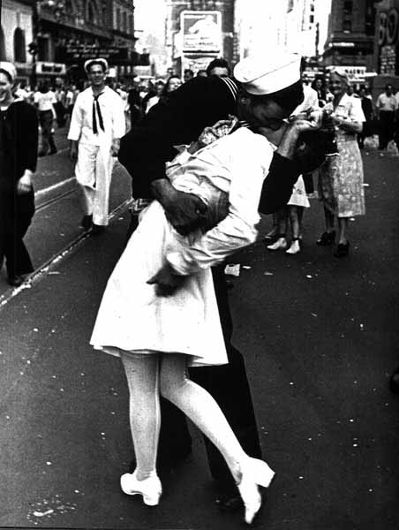
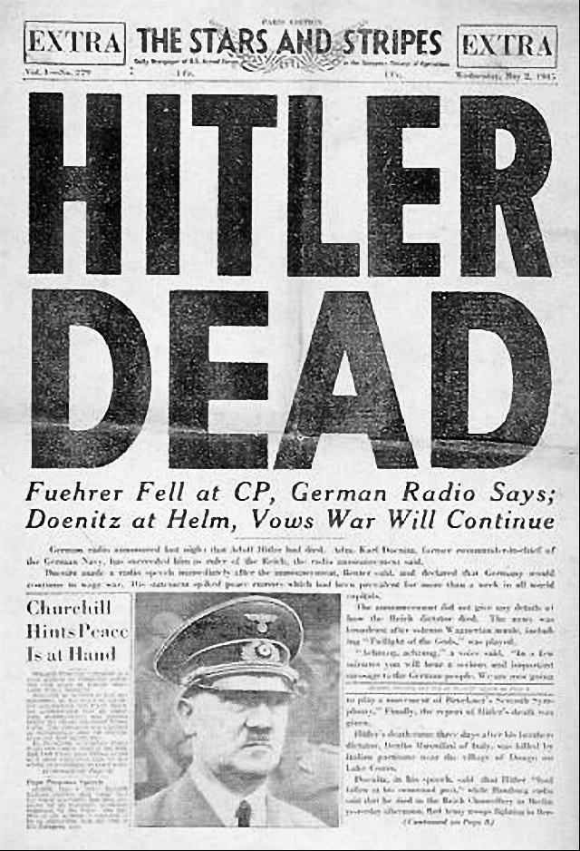
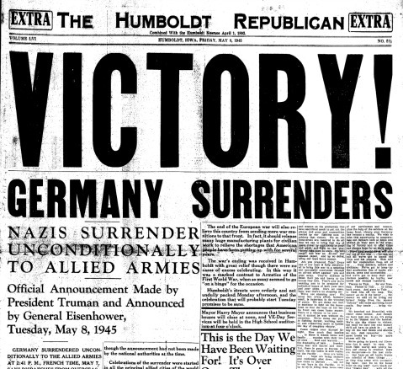
The Fall of third Reich
VE Day May 8, 1945
Hitler’s Death: April 30, 1945

Slide 18
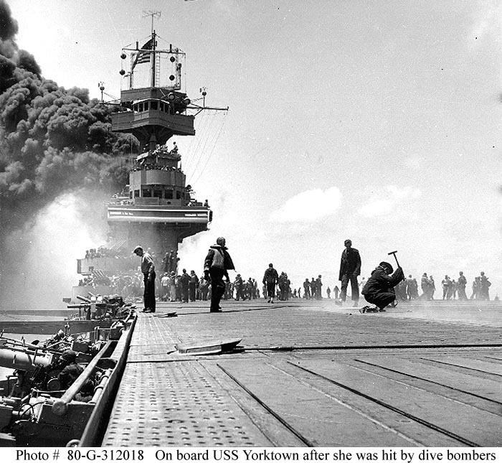
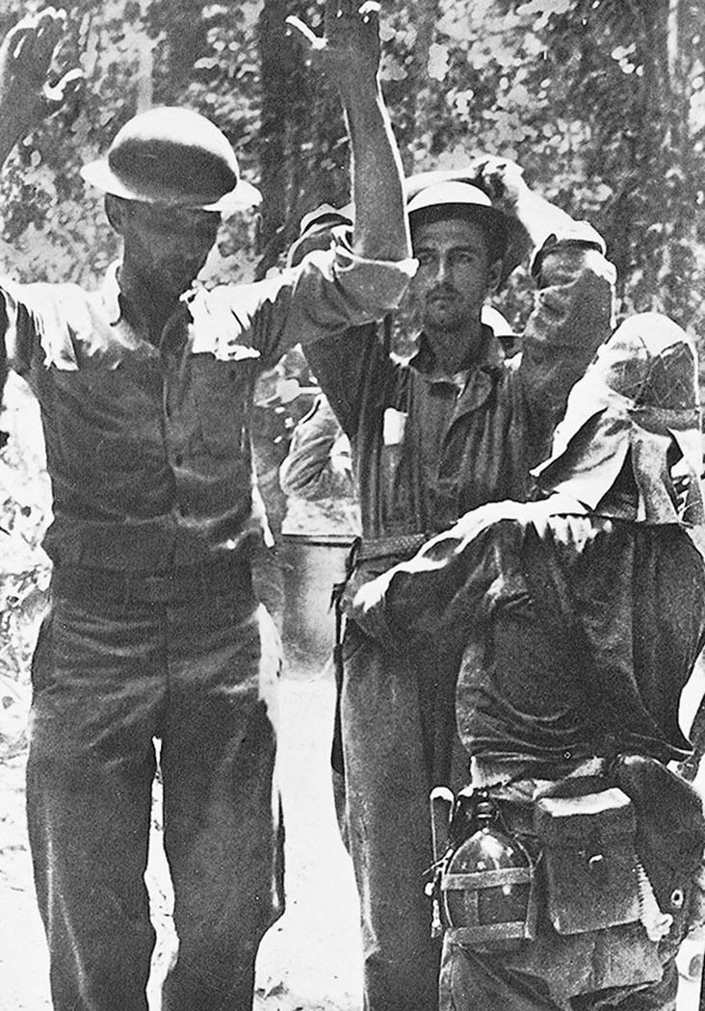
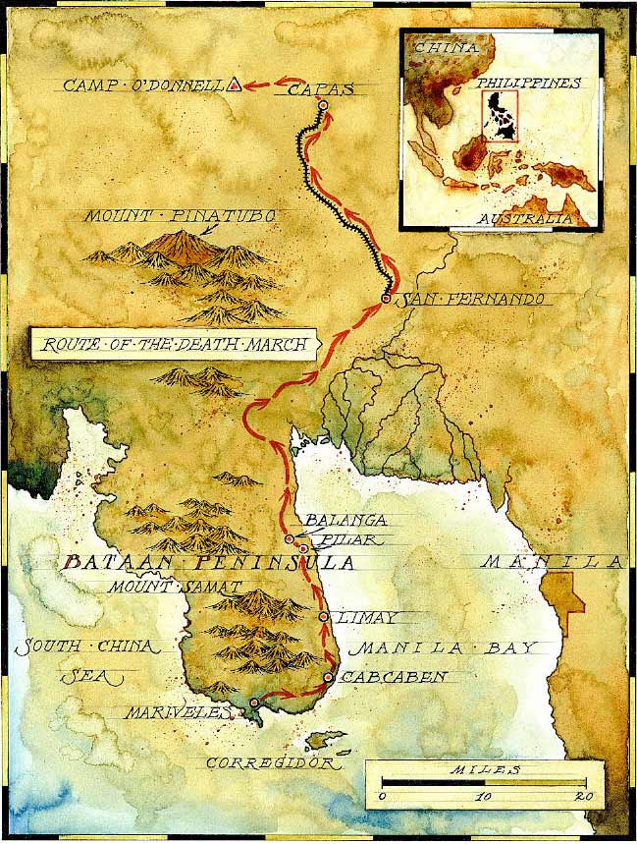
The War in the Pacific
●Battle of Midway (June 4-7, 1942)
●Surrender of the Philippines (Bataan Death March)

Slide 19
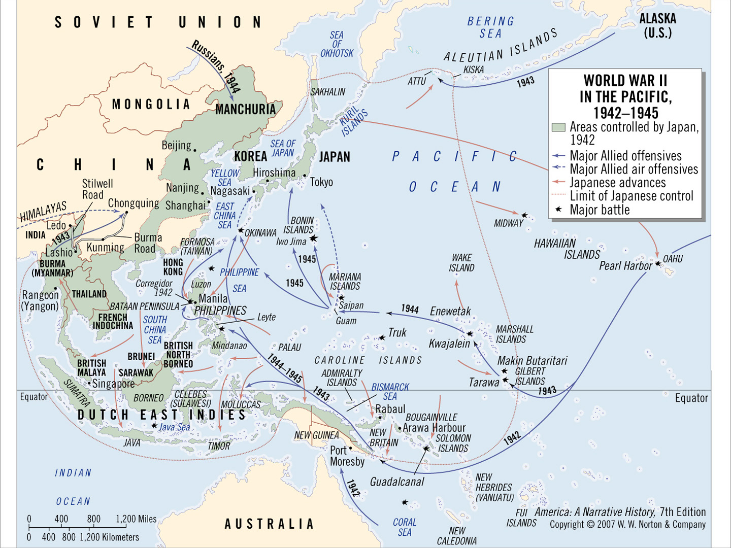

Slide 20
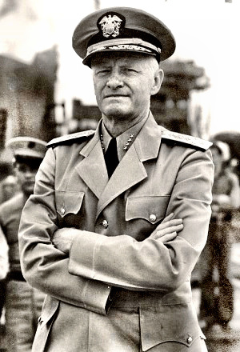
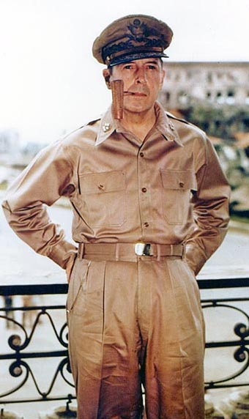
American Leadership in the Pacific
General Douglas MacArthur
Admiral Chester Nimitz

Slide 21
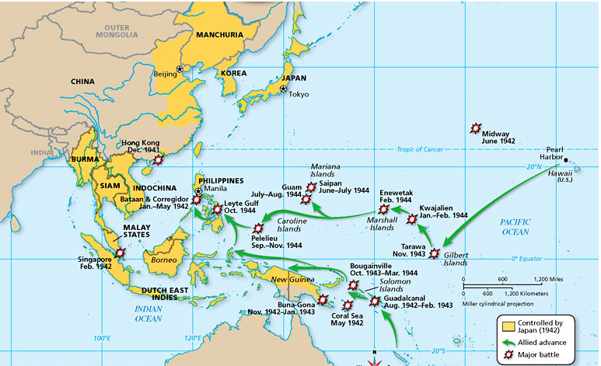
American Strategy in the Pacific
●“Leapfrogging” or Island Hopping

Slide 22
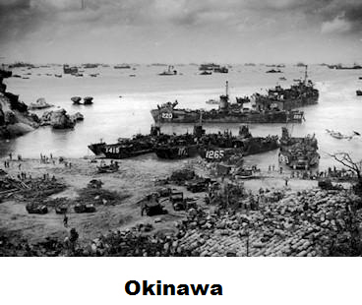
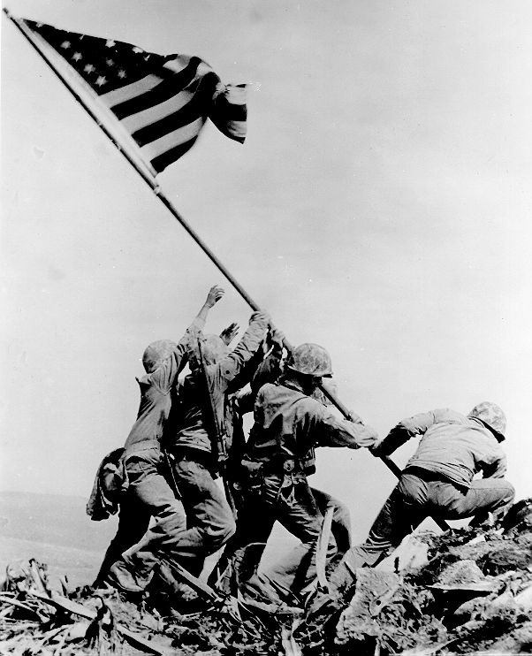
New Japanese Strategy: Kamikaze (divine wind)
●Occupation of Iwo Jima and Okinawa

Slide 23
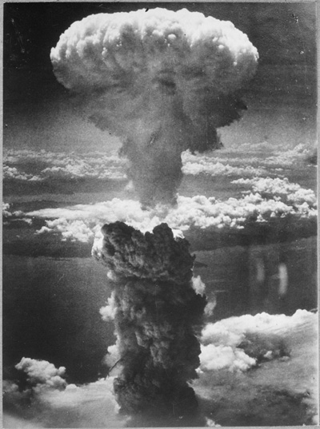
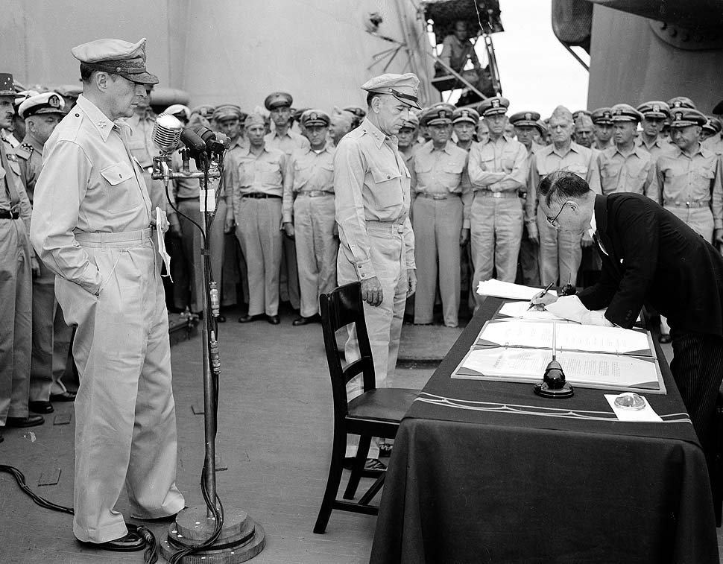
The Atomic Bomb
Japan Surrenders: August 15, 1945
Hiroshima: August 6, 1945
Nagasaki: August 9, 1945

Slide 24
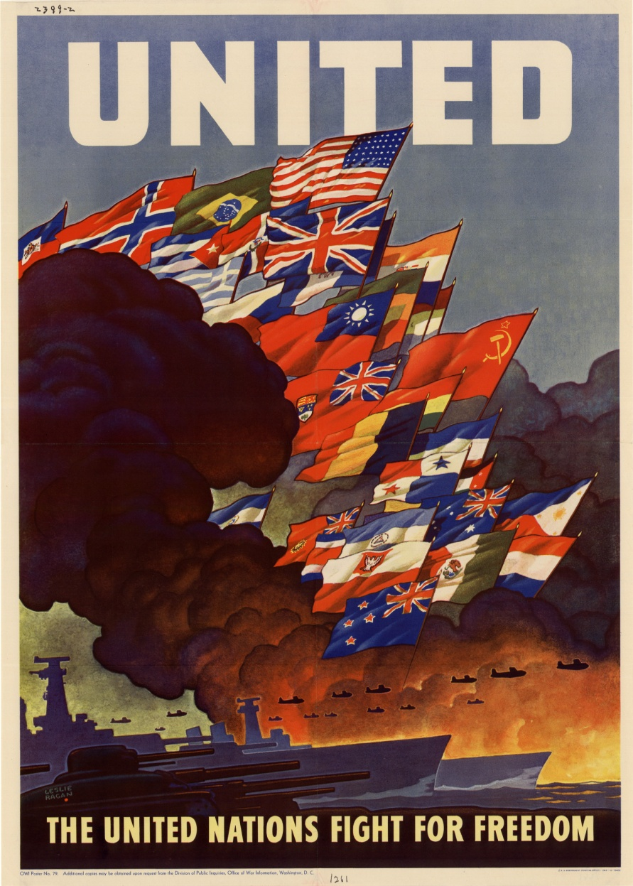
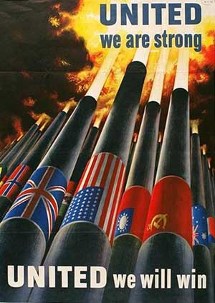
Final ledger on the war

