Slide 1
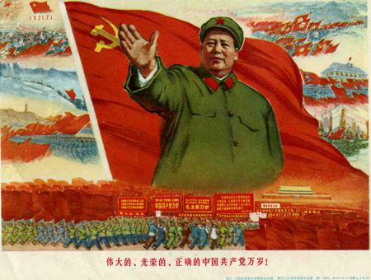
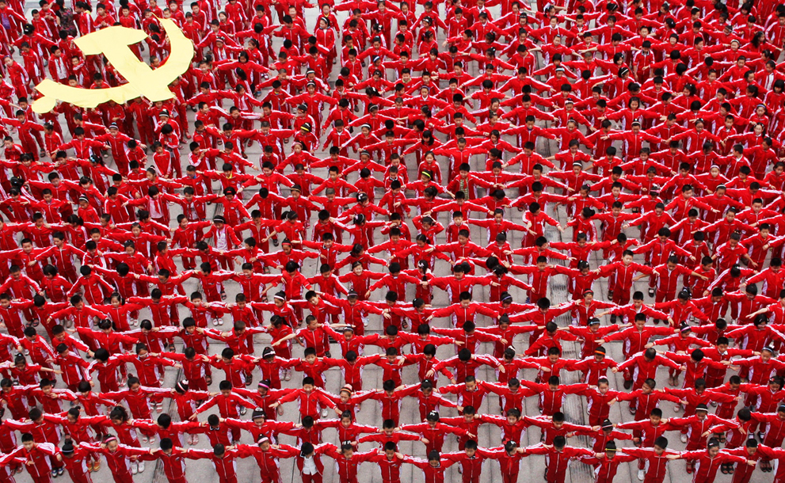
Containment in Asia
China falls to communism: 1949
Mao Zedong

Slide 2
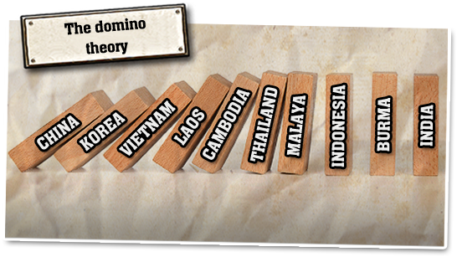
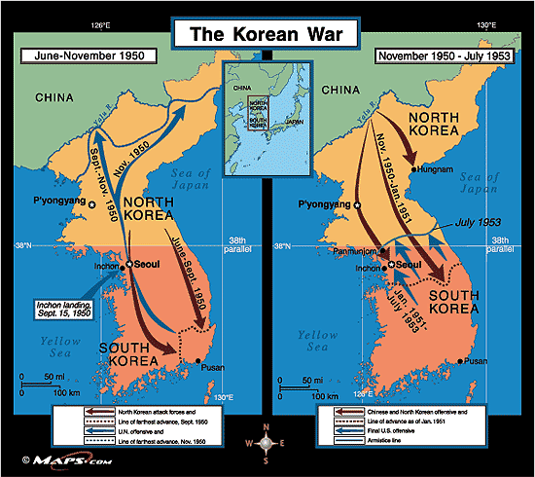
The “Domino Theory”

Slide 3
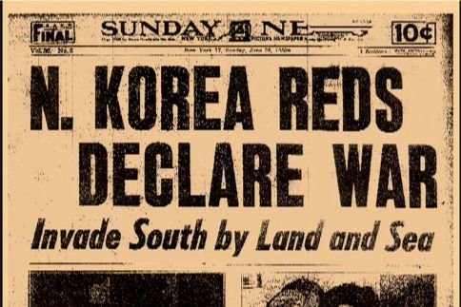
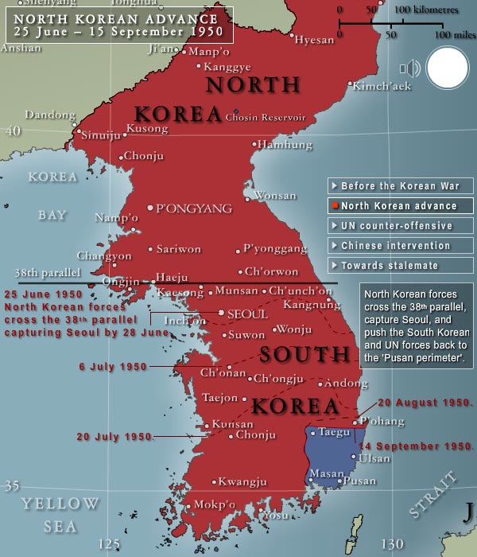
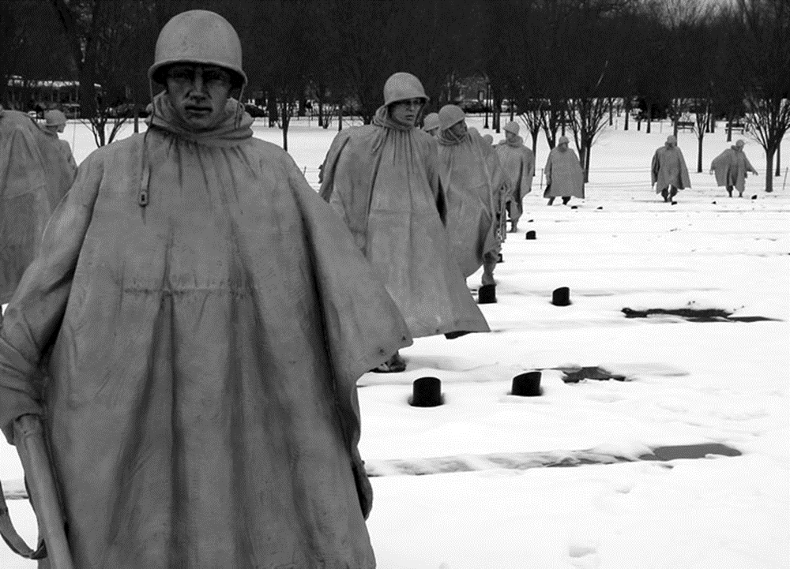
The Korean War: 1950-53

Slide 4
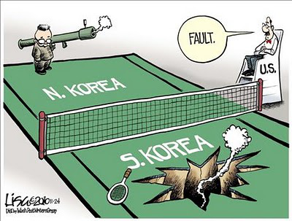
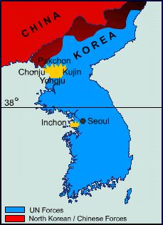
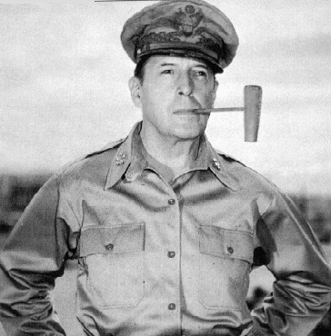
Gen. Douglas MacArthur

Slide 5
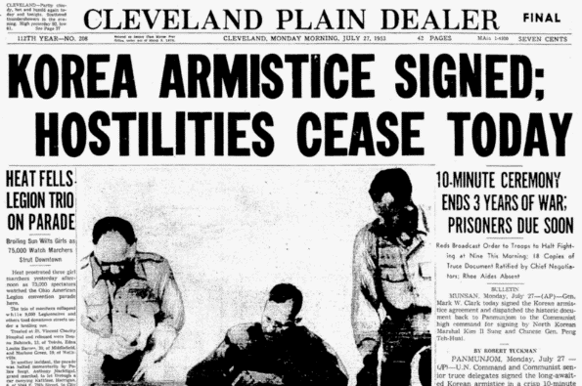
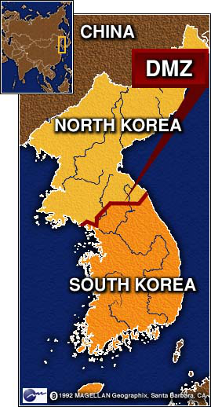
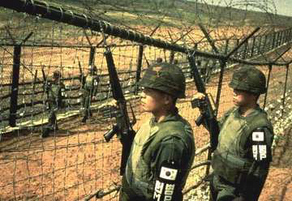
End of the Korean War
1952- Dwight D. Eisenhower was elected President & pledged to end the war
1953- an armistice was signed between US and North Korea
Agreed to:
A “demilitarized zone” between N. & S. Korea
Transfer of prisoners of war
Korea was left divided exactly as it was before the war

Slide 6
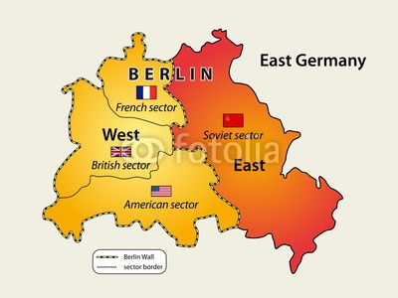
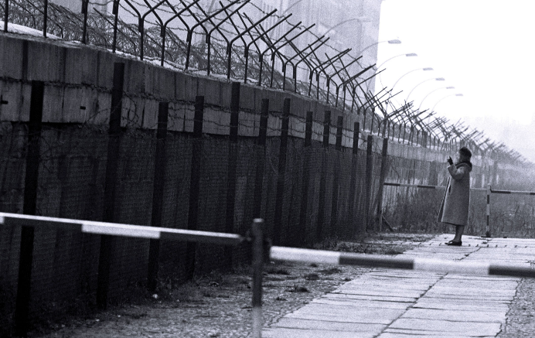
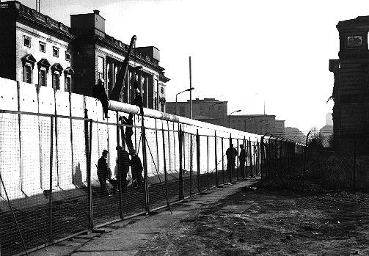
Further communist gains
Hungarian Revolution: 1956
Berlin Wall: 1961
Invasion of Czechoslovakia: 1968

Slide 7
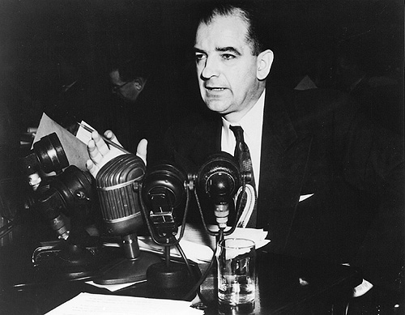
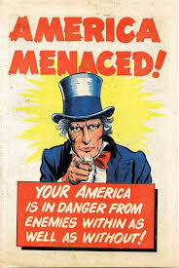
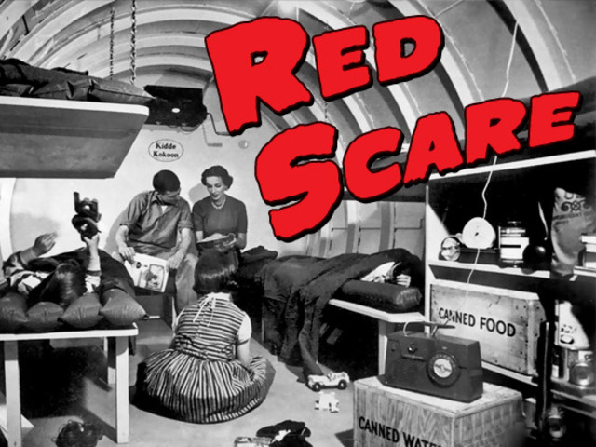
The McCarthy Hearings 1950
Sen. Joseph McCarthy

Slide 8
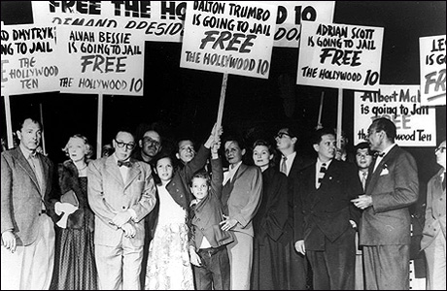
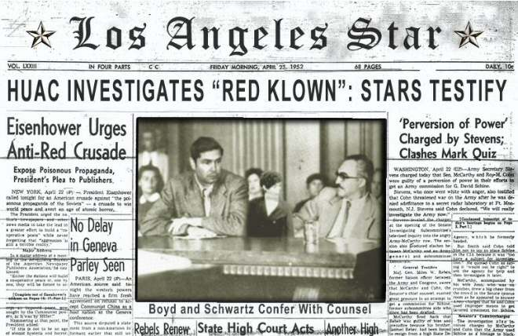
The House Un-American Activities Committee (HUAC)

Slide 9
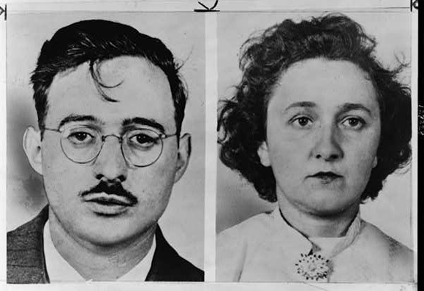
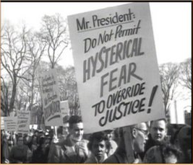
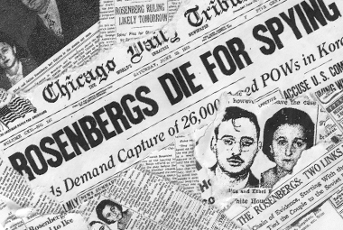
The Rosenberg Trials 1950
Julius and Ethel Rosenberg
Venona Papers

