Slide 1
Ch. 23: The Great Depression
Focus Questions:
Describe the stock market crash of 1929.
Explain the different causes of the Great Depression.
Analyze the human cost of the depression.
Identify the influence of the dust bowl and who it impacted the most.
What was the effect on minorities?
Describe how the depression impacted American culture.
Explain Hoover’s response to the economic crisis and why it failed.
Analyze the 1932 election and its results.
Notes:
1
The purpose of the focus questions is to help students find larger themes and structures to bring the historical evidence, events, and examples together for a connected thematic purpose.
As we go through each portion of this lecture, you may want to keep in mind how the information relates to this larger thematic question. Here are some suggestions: write the focus question in the left or right margin on your notes and as we go through, either mark areas of your notes for you to come back to later and think about the connection OR as you review your notes later (to fill in anything else you remember from the lecture or your thoughts during the lecture or additional information from the readings), write small phrases from the lecture and readings that connect that information to each focus question AND/OR are examples that work together to answer the focus question.

Slide 2
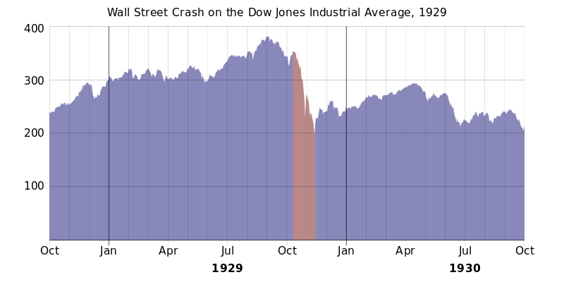
The Coming of the Great Depression
The Great Crash
*bull market – stock prices rising quickly in 1928
*October 29, 1929 (Black Tuesday)
-$16 million lost
-$30 million lost by the end of the week
*buying on “margin” and rampant speculation brought us into a depression

Slide 3
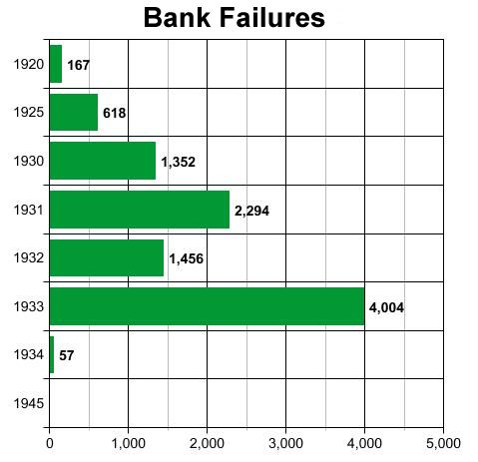
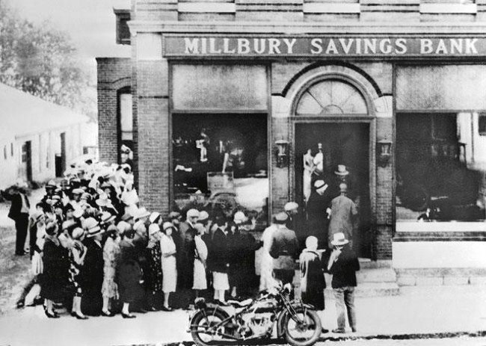
Causes of the Depression
Overproduction
*production by end of 20’s outweighed demand
*prices and wages dropped as a result
Unequal Distribution of Wealth
*1/2 of families living below poverty level
*reliance on credit put them further into debt
Lack of Exports (Tariffs)
*tariffs prevented us from selling surplus overseas
International Debt – Dawes Plan
*give Germany $ to payoff reparations to Britain/France
*Britain/France $ to pay off U.S. loans
*only created a cycle of debt that Europe couldn’t pay off
Lack of Diversification
*US economy relied too heavily on a couple of industries
-automobiles and construction
*when they slowed down so did the whole economy
Banking Crisis
*the crash resulted in a bank rush – people withdrawing their money
*banks began to fail at a rapid rate
*9,000 closed between 1930-1933 – money supply decreased by 1/3rd

Slide 4
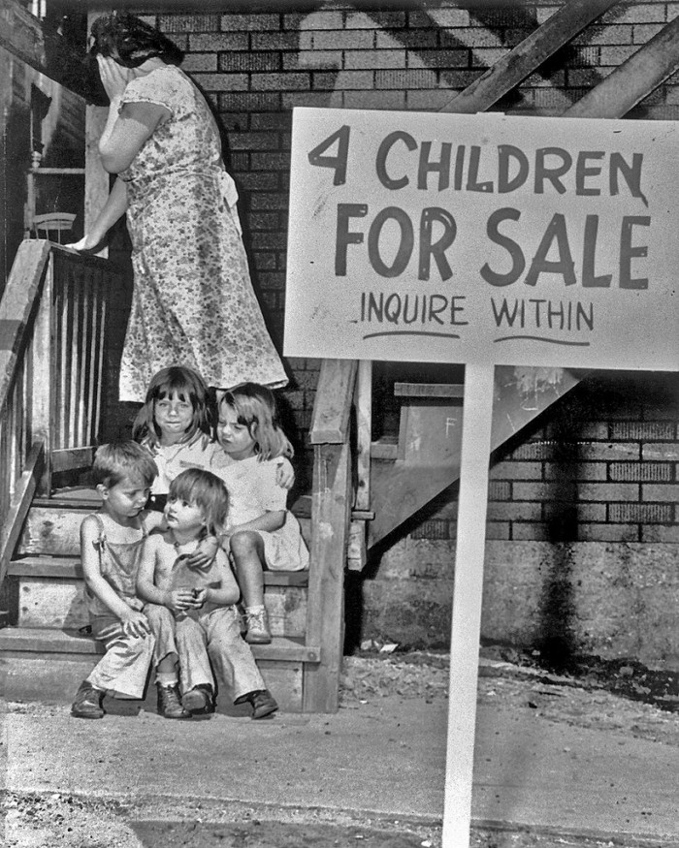
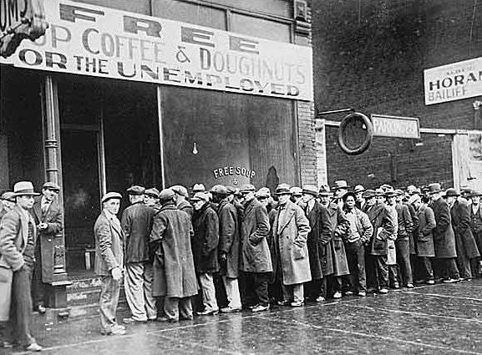
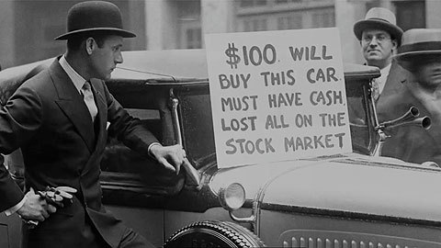
The American People in Crisis
Unemployment
*the industrialized North was hit the hardest
*Ohio unemployment was over 50%
*across the nation it rose to between 15% - 25%
Misery Index
*marriages and national birth rate declined rapidly
*suicide rates doubled
*charities could not keep up
*breadlines and soup kitchens helped some
*divorce rate declined – why?
*men abandoned their families
*hobos traveled the nation looking for work

Slide 5
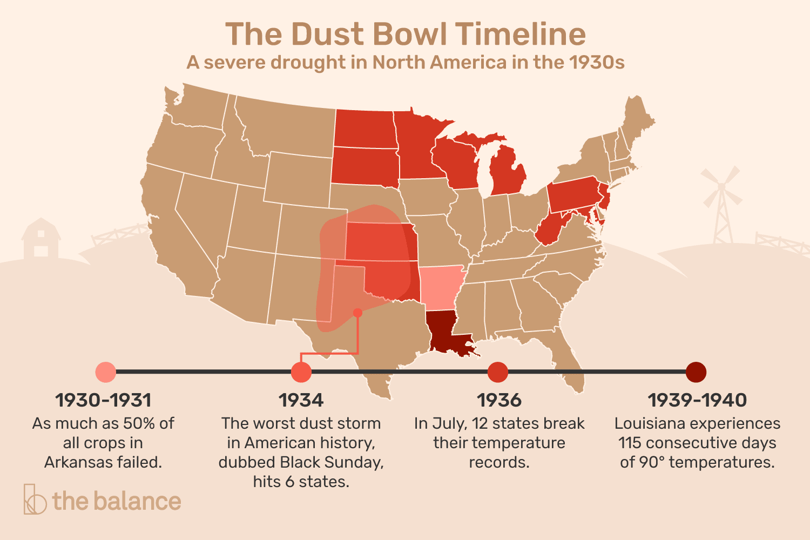
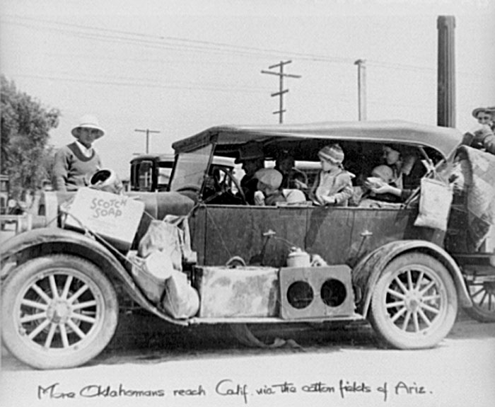
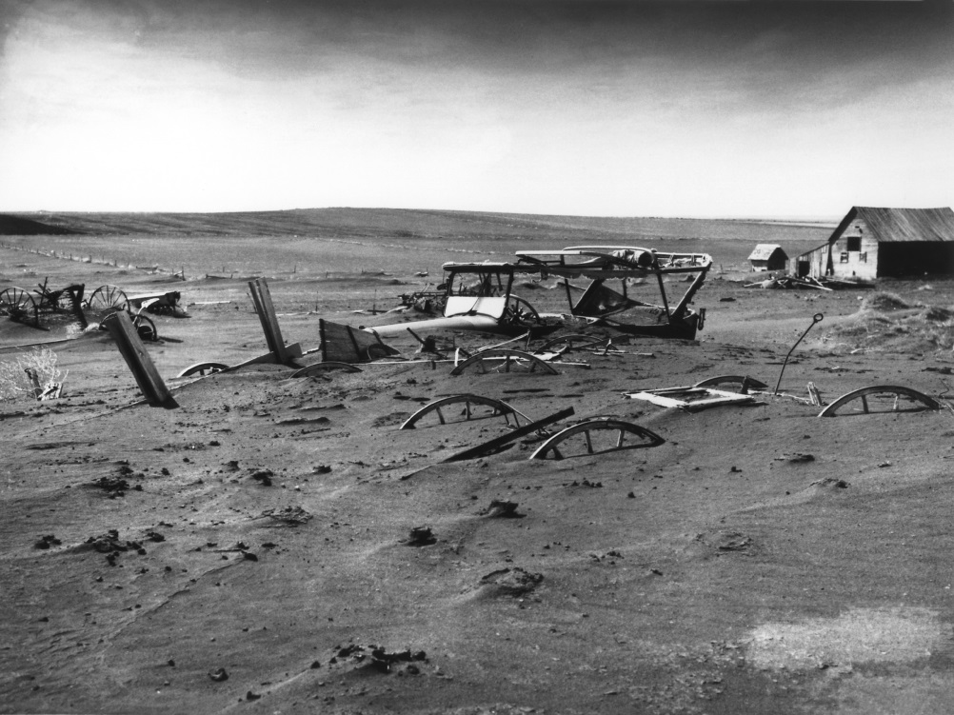
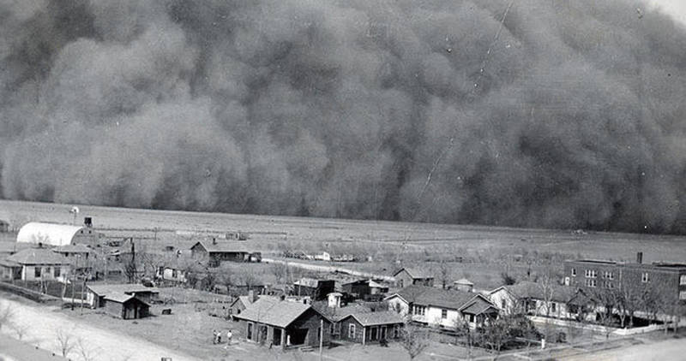
The Dust Bowl
The Farmers
*income declined by 60%
*1/3rd lost their land
Drought
*decade long catastrophic drought hit in 1930
*stretched from Texas to the Dakotas, Colorado to Missouri
* “Black Blizzards” – massive dust storms
-resulted from no rainfall, wind and over cultivation
-some storms reached the east coast
“Okies” – farming families from the Midwest
*left by the thousands to find work
*most headed for California due to abundance of jobs there

Slide 6
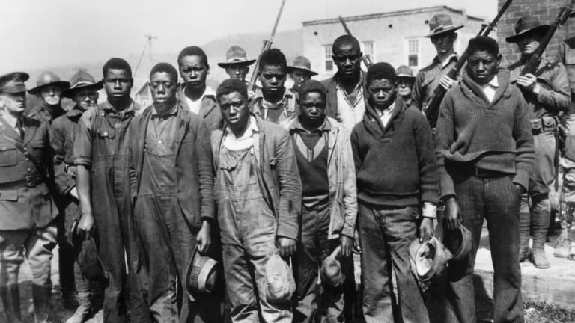
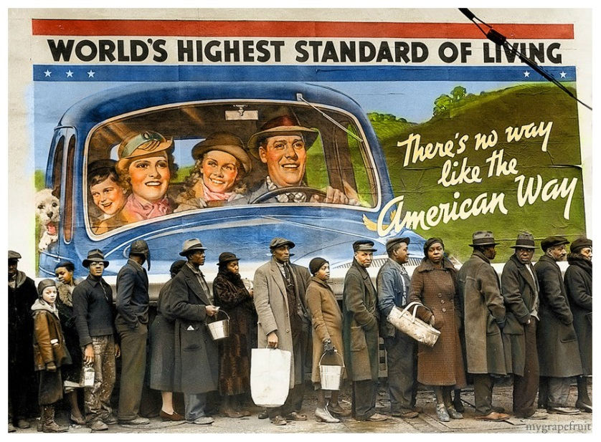
Minorities in the Depression
Relief for Minorities
*most did not benefit from relief programs
*they were the last to be hired and first to be fired
African Americans
*first to lose their jobs (50% unemployment in the south)
*segregation and discrimination still rampant
*Scottsboro Case
-9 AA men accused of rape
-all white jury found them guilty, 8 sentenced to death
-all were released from jail many years later
Mexican Americans
*2 million of Mexican descent, mostly migrant workers
*some were forced out of the country
Asian Americans
*many Japanese along west coast fought discrimination
Women
*women encouraged not to work so that men could
*white women found it much easier to get jobs

Slide 7
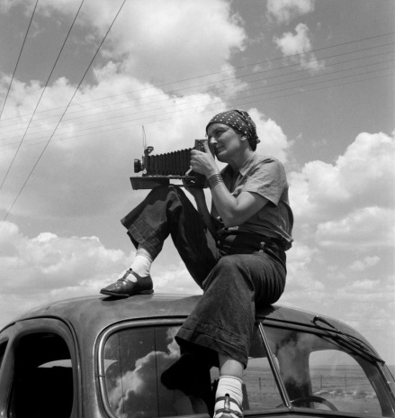
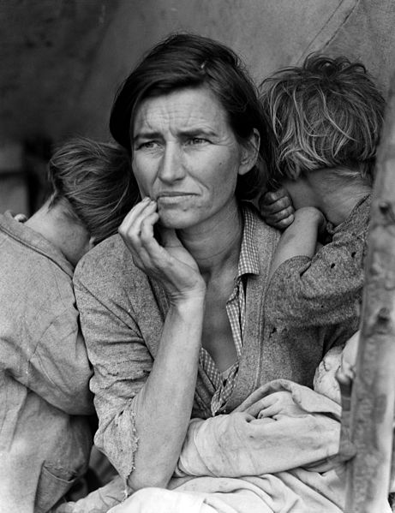
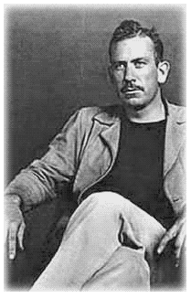
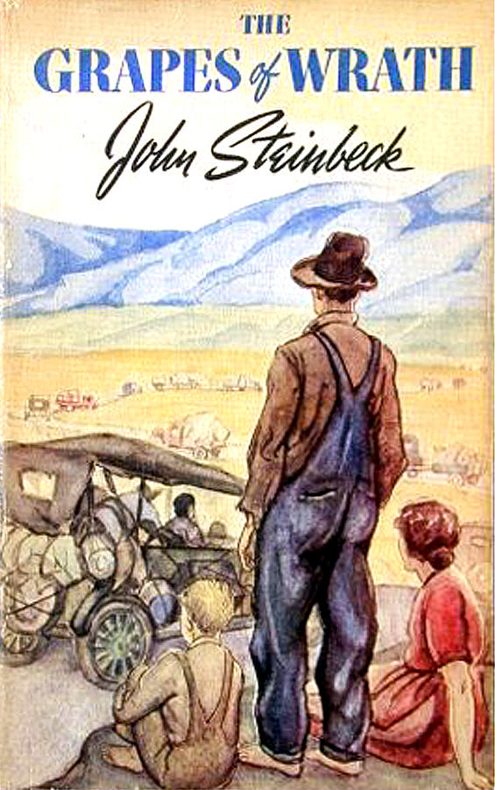
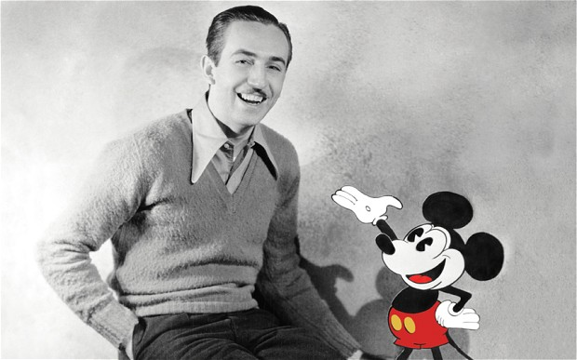
The Depression and American Culture
Photography
*govt. sought to document the misery people went through
*Dorothea Lange – photographed depression era families
Literature
*John Steinbeck – The Grapes of Wrath
-follows a migrant farm family going to California
*some wrote about hardships but some diverted attention away from all of the misery
Radio
*largest source of entertainment and a way to take people’s minds off the depression
-soap operas, plays, news
-the Hindenburg live broadcast – “Oh the humanity!”
-Orson Welles – War of the Worlds
* “Fireside Chats” – FDR
Movies
*were a cheap form of entertainment
*Walt Disney animation films becoming popular (Snow White, 1937)
*The Wizard of Oz, Gone with the Wind

Slide 8
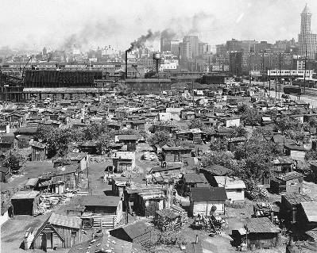
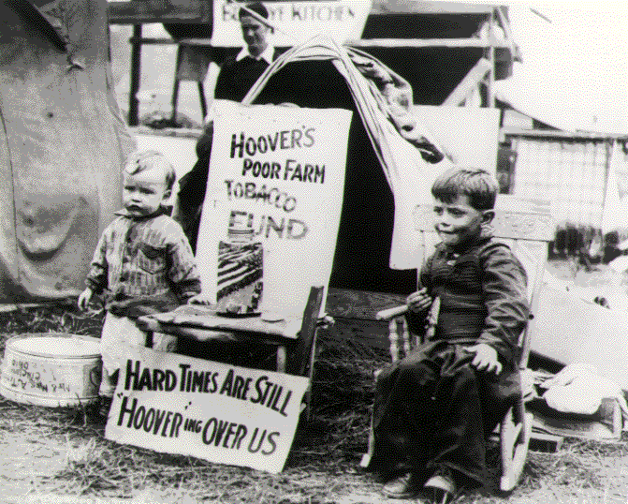
The Failed Presidency of Herbert Hoover
Hoover’s Failures
*volunteerism – businesses keeping wages an prices steady
-urged businessmen to not fire workers or slow production
*lack of govt. aid due to fear of deficit spending
Hawley-Smoot Tariff
*raised tariff on European and farm goods
*prevented American businesses/farmers from selling surplus overseas
Reconstruction Finance Corporation
*provided loans to banks, RR’s and businesses
*failed due to not providing enough money
Declining Support
*Hoover’s policies making things worse
* “Hoover Hotels”, “Hooverville's”, “Hoover Blankets”, “Hoover Flags”
“Bonus Army” – 1932
*WWI vets who were promised bonuses in 1945
*didn’t want to wait, wanted it immediately
*marched to Washington D.C.
*were dispersed by US Army led by Gen. Douglas MacArthur
*big mistake by Hoover

Slide 9
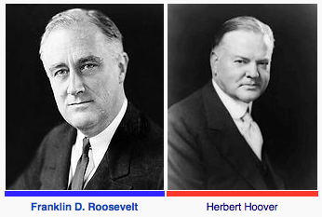
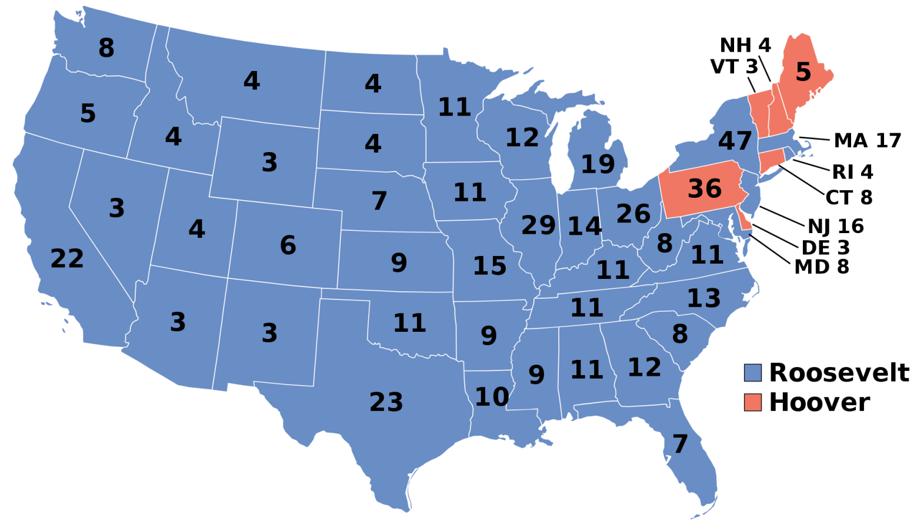
Election of 1932
Hoover (R) vs. Franklin D. Roosevelt (D)
*FDR wins in a landslide
* “the only thing we have to fear is, fear itself”
*20th Amendment – moved inauguration date for Congress to Jan 3rd /for president to Jan 20th (gets elected officials in power sooner/limits “lame duck” presidents)
Banking Crisis
*thousands more banks failed
*FDR inherits massive financial and social crisis

Slide 10
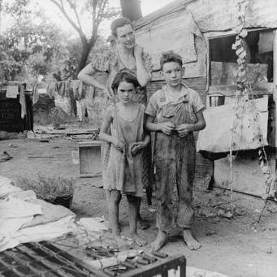
Crash Course Us History Ep. 33: The Great Depression
A few things…
AP exam registration! Get it done!
Exam next Tuesday

Slide 11
Ch. 23: The Great Depression
Focus Questions:
Describe the stock market crash of 1929.
Explain the different causes of the Great Depression.
Analyze the human cost of the depression.
Identify the influence of the dust bowl and who it impacted the most.
What was the effect on minorities?
Describe how the depression impacted American culture.
Explain Hoover’s response to the economic crisis and why it failed.
Analyze the 1932 election and its results.
Notes:
11
The purpose of the focus questions is to help students find larger themes and structures to bring the historical evidence, events, and examples together for a connected thematic purpose.
As we go through each portion of this lecture, you may want to keep in mind how the information relates to this larger thematic question. Here are some suggestions: write the focus question in the left or right margin on your notes and as we go through, either mark areas of your notes for you to come back to later and think about the connection OR as you review your notes later (to fill in anything else you remember from the lecture or your thoughts during the lecture or additional information from the readings), write small phrases from the lecture and readings that connect that information to each focus question AND/OR are examples that work together to answer the focus question.

