Slide 1
Ch. 24-25: Civil Rights and Vietnam
Focus Questions:
Describe the major Civil Rights events of the 1950’s.
Describe the major Civil Rights events of the 1960’s.
Identify important legislation passed as a result of the Civil Rights movement.
Identify important court cases of the era.
Analyze the progression of American involvement in Vietnam.
Identify the importance of the Gulf of Tonkin Resolution.
Explain the type of warfare in Vietnam and new weapons.
Why was the war so difficult to fight?
How did the war change politics and culture in America?
Explain the outcome and legacy of the Vietnam War.
Notes:
1
1
The purpose of the focus questions is to help students find larger themes and structures to bring the historical evidence, events, and examples together for a connected thematic purpose.
As we go through each portion of this lecture, you may want to keep in mind how the information relates to this larger thematic question. Here are some suggestions: write the focus question in the left or right margin on your notes and as we go through, either mark areas of your notes for you to come back to later and think about the connection OR as you review your notes later (to fill in anything else you remember from the lecture or your thoughts during the lecture or additional information from the readings), write small phrases from the lecture and readings that connect that information to each focus question AND/OR are examples that work together to answer the focus question.

Slide 2
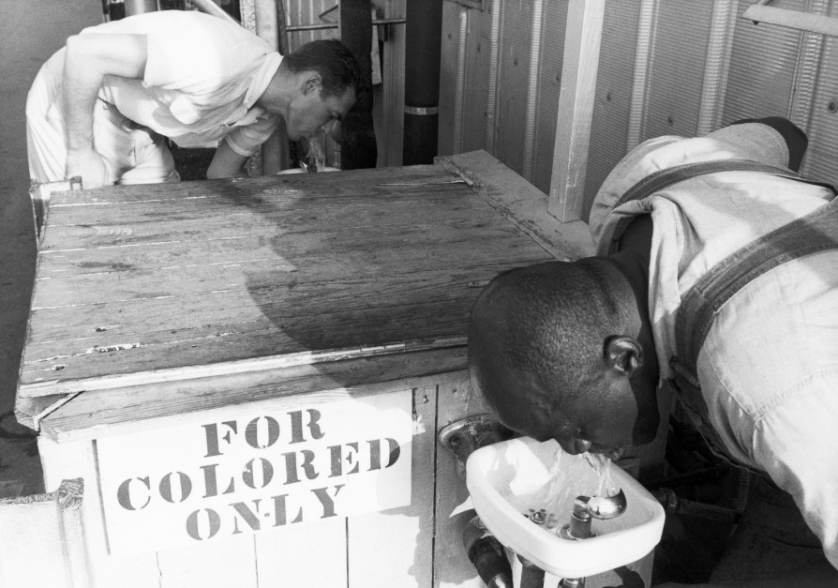
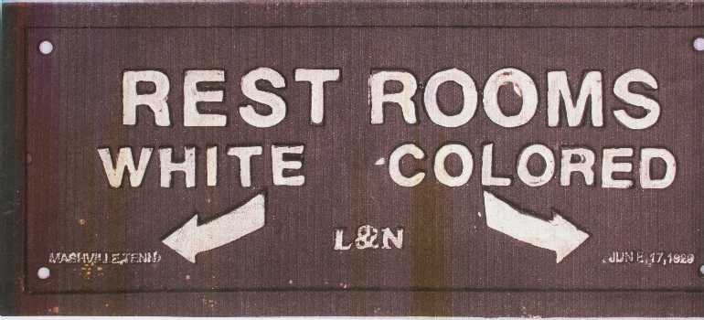
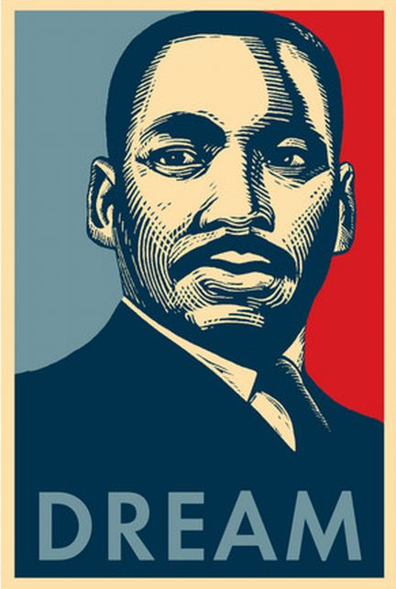
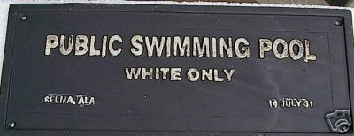
Civil Rights in America

Slide 3
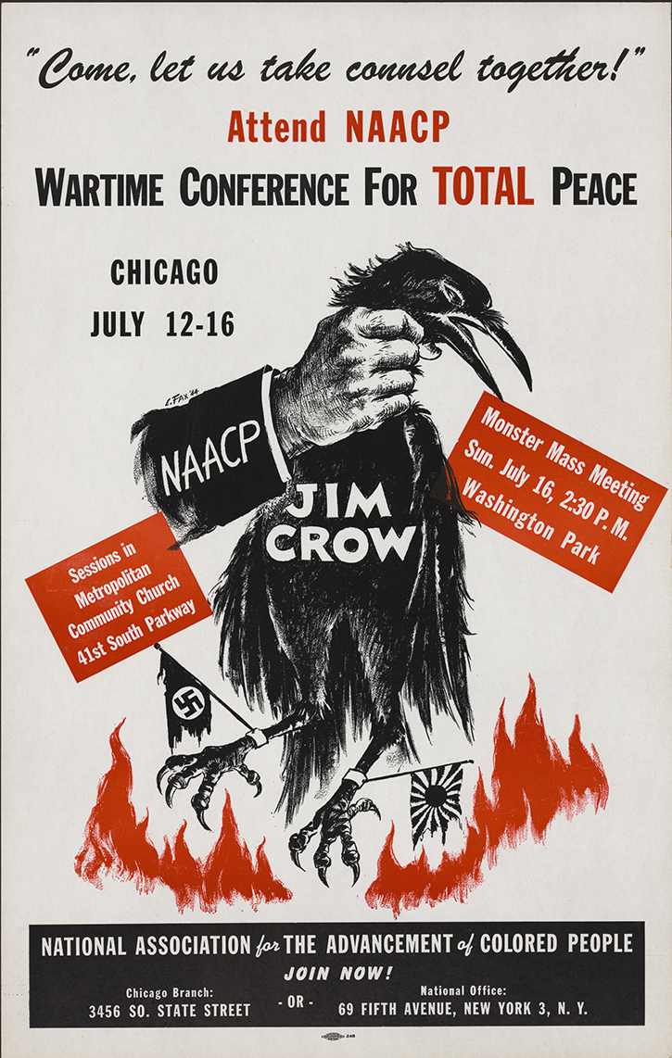
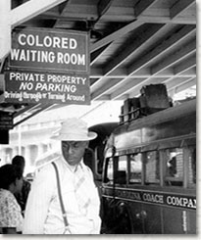
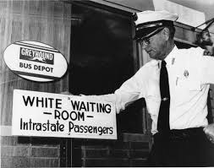
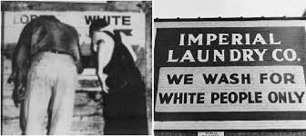
The Origins of the movement
Plessy Vs Ferguson (1896)
Reconstruction Amendments
14th Amendment and its importance
Jim Crow Laws

Slide 4
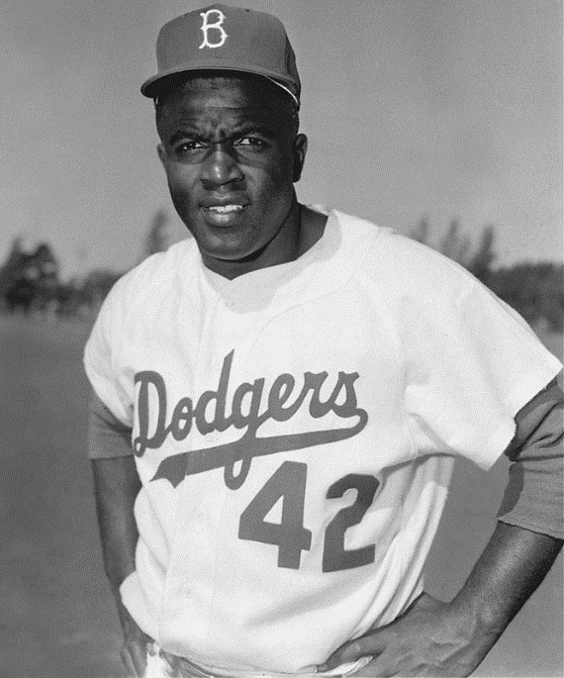
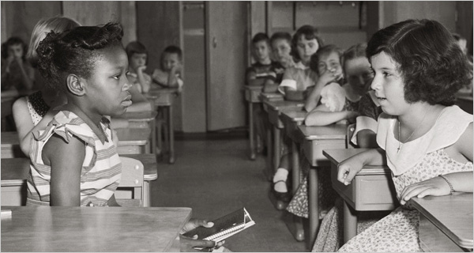
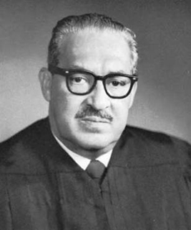
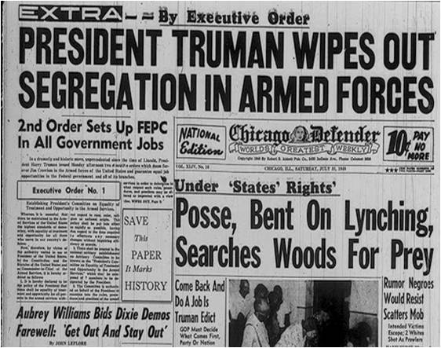
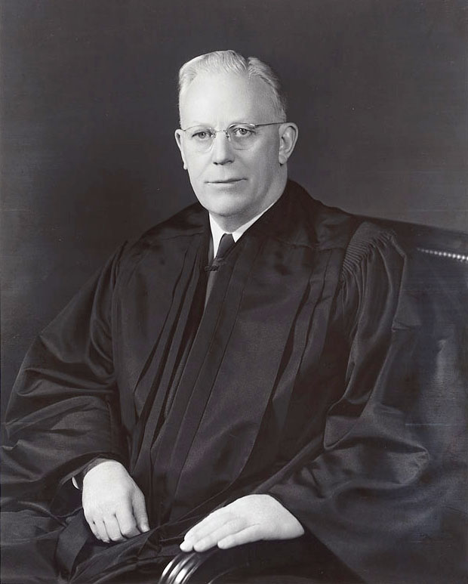
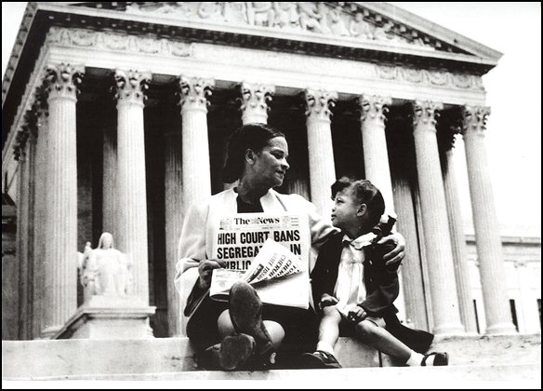
Civil Rights Under Truman
1947-Jackie Robinson
1948-Desegregation of the Military
Brown Vs. Board of Education (1954)
Thurgood Marshal
Chief Justice Earl Warren

Slide 5
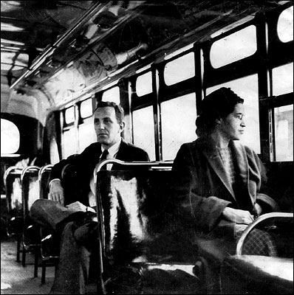
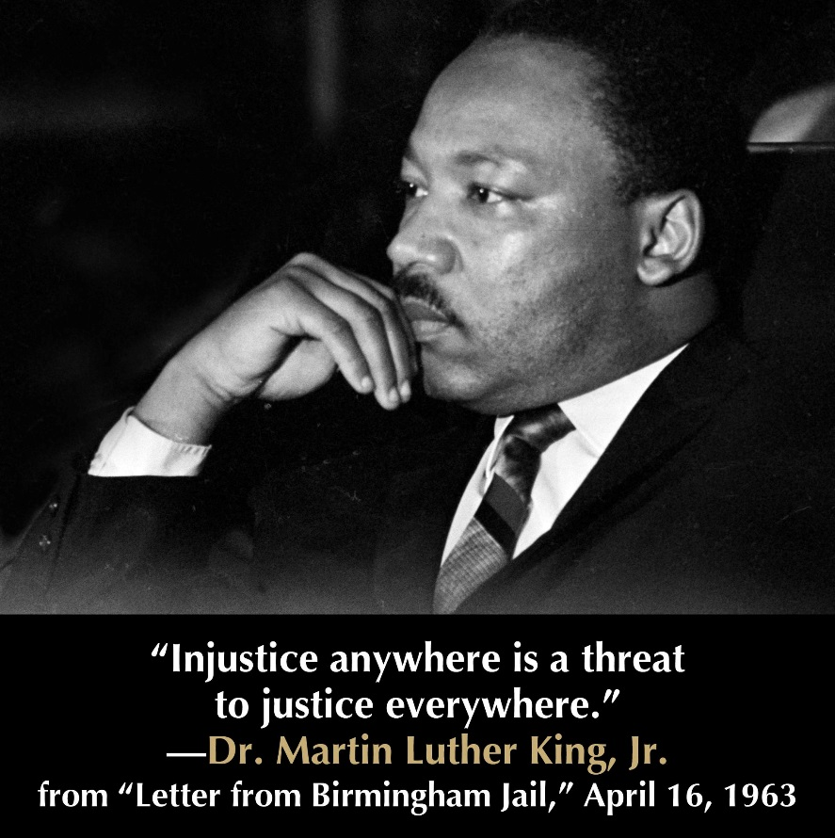
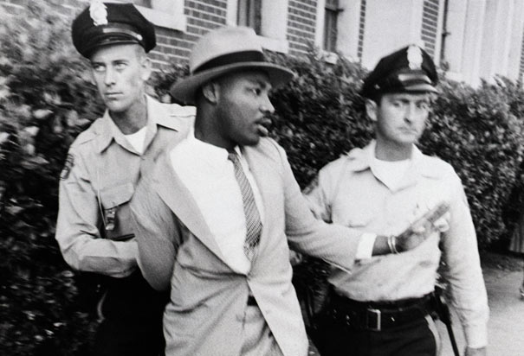
Civil Rights Under Eisenhower: March to Freedom
Montgomery Bus Boycott (1955-56)
Rosa Parks
Dr. Martin Luther King Jr.
Civil Disobedience
Birmingham Arrest (30 total)

Slide 6
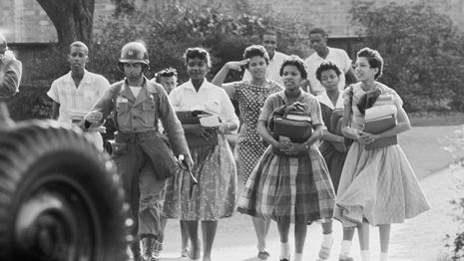
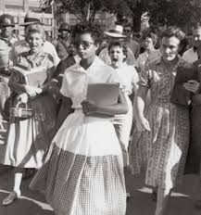
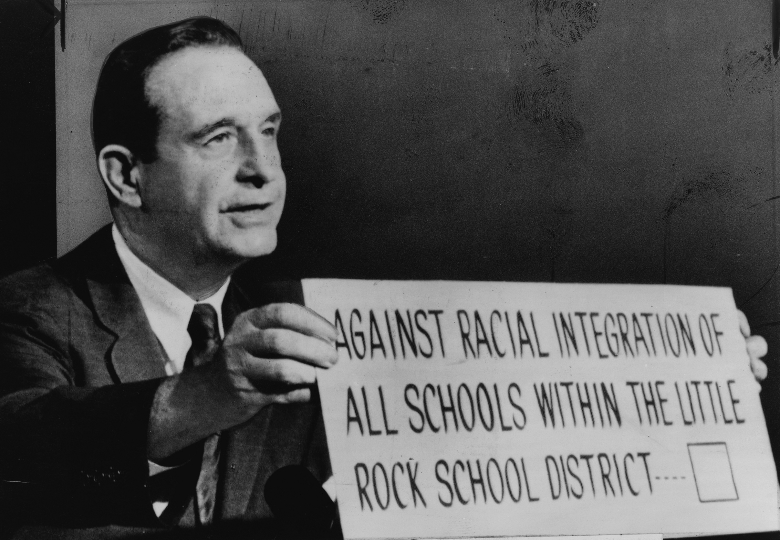
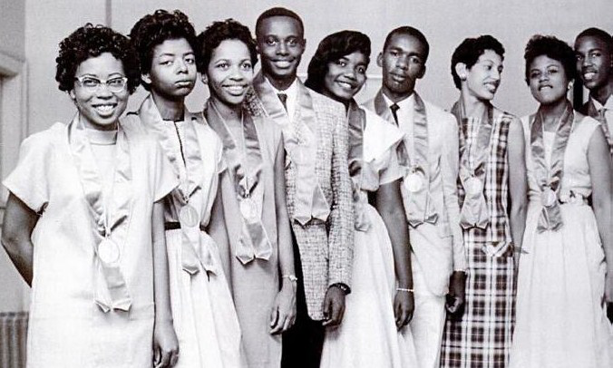
Little Rock, Arkansas 1957
Orval Faubus
Eisenhower’s response
Little Rock Nine
Southern Response to integration
Lester Maddox (Ga)
George Wallace (Ala)

Slide 7
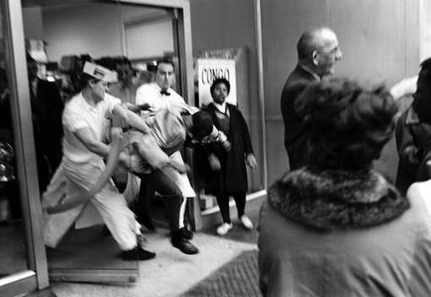
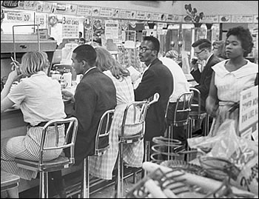
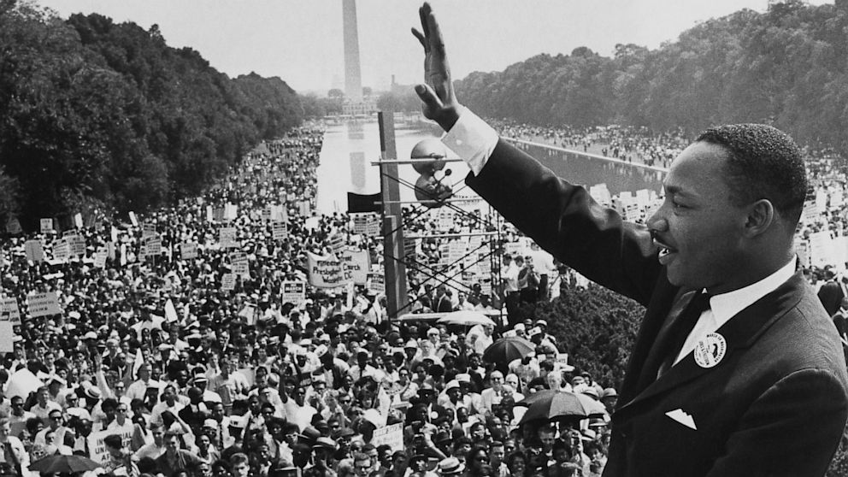
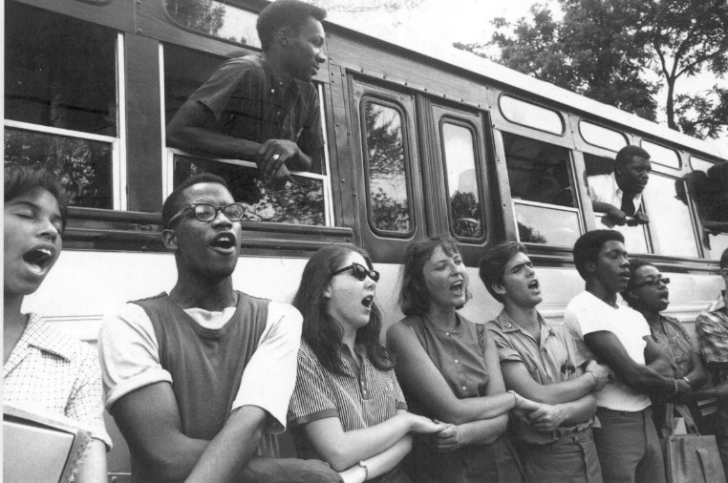
Civil Rights Under Kennedy: Civil Rights Spreads
Sit-ins-1960
Freedom Rides-1961
March on Washington-1963

Slide 8
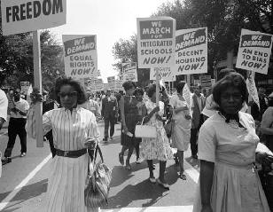
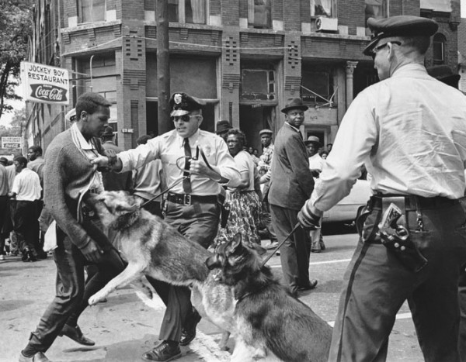
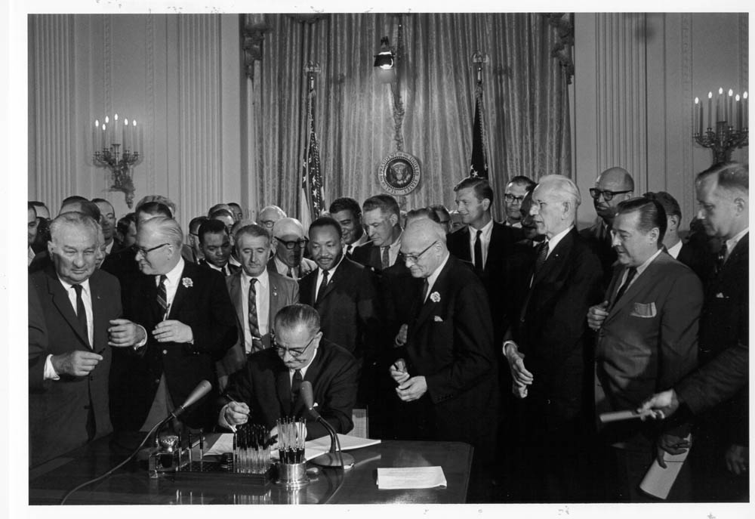
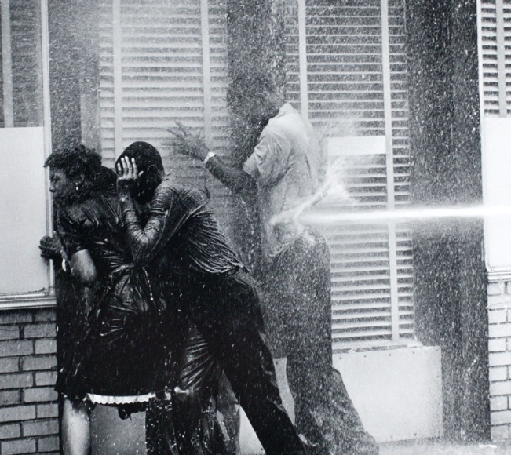
Civil Rights Under Johnson: Civil Rights Legislation
Birmingham Riots-1963
Civil Rights Act of 1964
Proh. disc. Based on race, color, religion, ethnic origin
No fed. aid to segregated schools
Selma March-1965
Voting Rights Act of 1965
Fed. Govt. registers voters
24th Amendment (eliminates poll taxes)

Slide 9
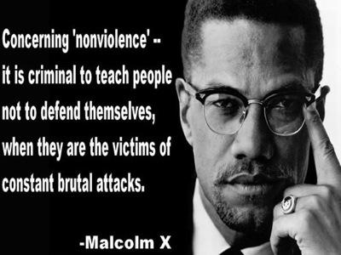
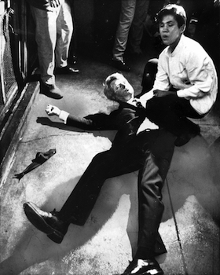
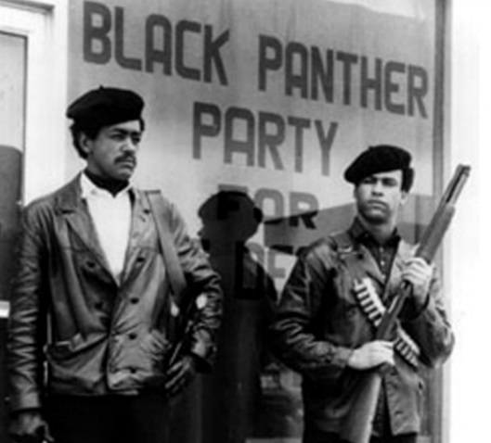
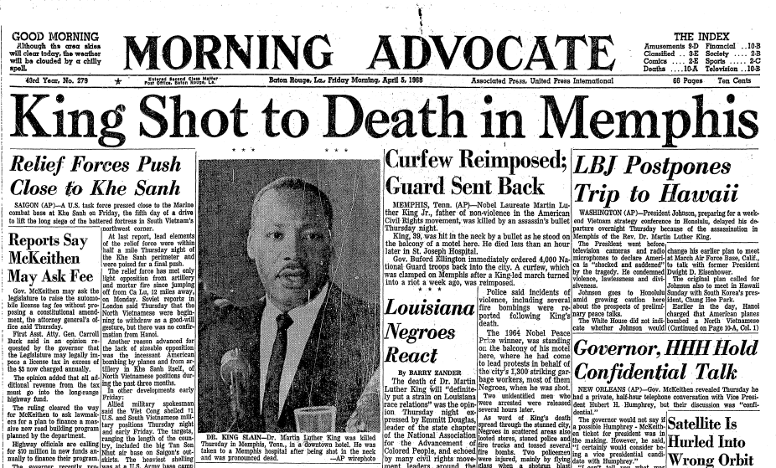
Powder keg of the 60’s
Malcolm X
Black Muslims
Opposition to King
Assassination-1965
Black Panther Party
Robert Kennedy-1968
Martin Luther King Jr.-1968

