Slide 1
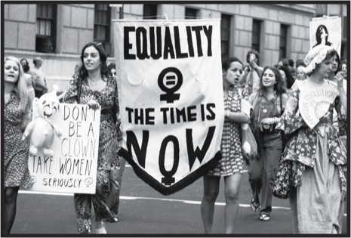
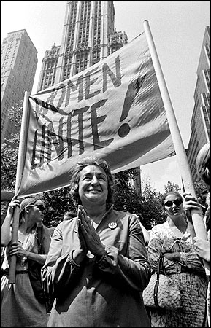
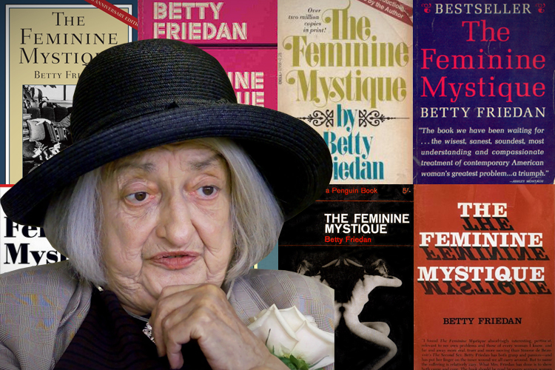
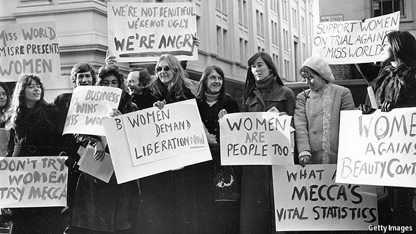
Expanding Civil Rights
Women’s Liberation Movement (WLM) (Late 60’s)
Inspired by expansion of AA Civil Rights
NOW (National Organization of Women)
Betty Friedan
Feminine Mystique
Notes:
Expanding Civil Rights
1950’s and 1960’s women were expected to be wives and mothers.
The WLB sought greater economic and social equality for women in a movement known as Feminism.
Inspired by
the Civil Rights Movement.
a “Sexual Revolution” changing how women were seen.
expanding leadership and social sciences.
NOW
Formed by Betty Friedan.
She wrote The Feminine Mystique which challenged middle class women to be as capable as men and to compete for the same jobs and pay.

Slide 2
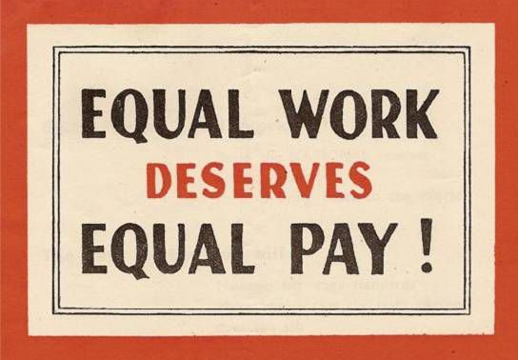
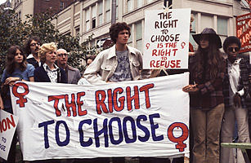
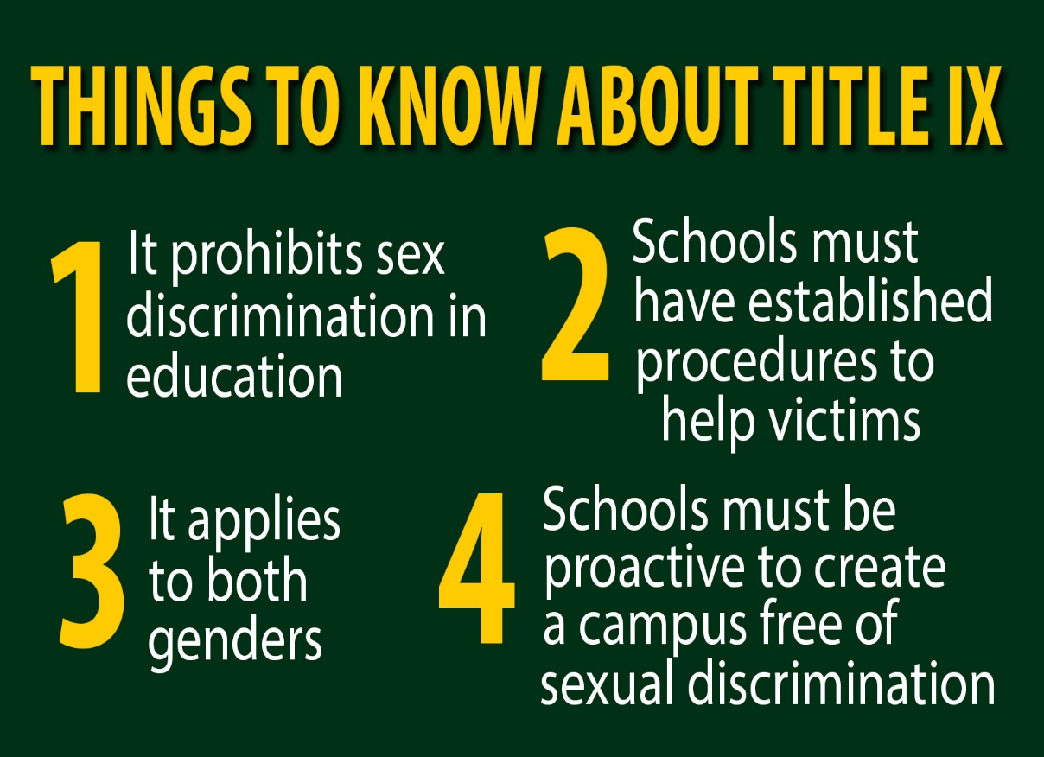
Achievements of the Movement
Education
Title IX (Ban sex Disc. In education)
Workforce
Equal Pay Act
Roe v. Wade (Legal Abortion)
Notes:
Education
There was a large push to educate women. Title IX was added as part of the Educational Amendments Act to ban sex discrimination in education.
New Attitudes
Ending discrimination in employment by instituting the Equal Pay Act to pay men and women equally. And recognizing a woman’s “right to choose” in Roe v. Wade.

Slide 3
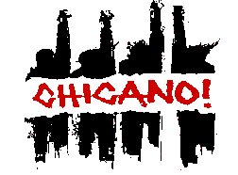
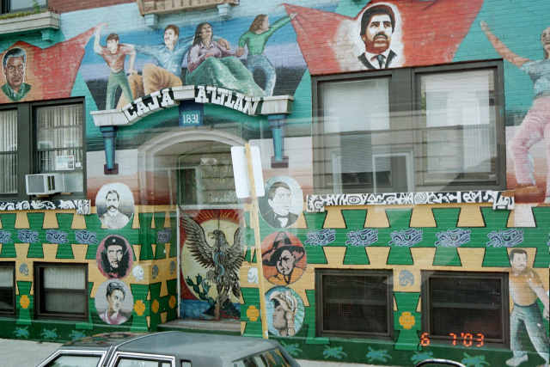
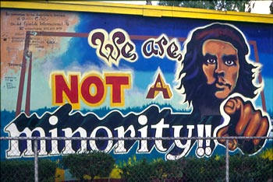
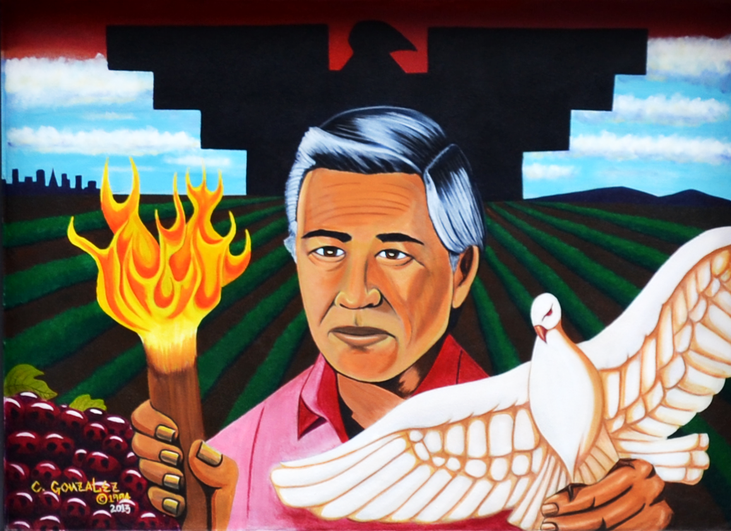
The Chicano Movement
Goals
Equal Rights
Voting Rights
Workers Rights
Chicano Mural Movement
Notes:
Taking lessons from black leaders, Mexican-Americans, known as Chicanos, formed their own movement.
The movement focused on issues such as farm workers’ voting and political rights.
All over barrios, ethnic neighborhoods, Mexican-Americans expressed the appreciation of their culture through painting the sides of buildings.
It increased the sense of identity and showed the desire for justice for people who lacked other representation.

Slide 4
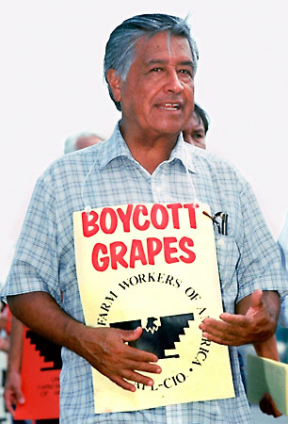
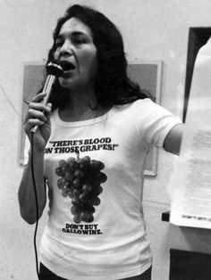
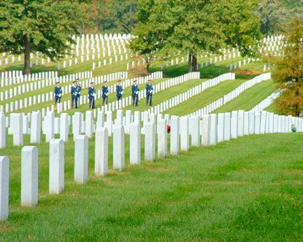
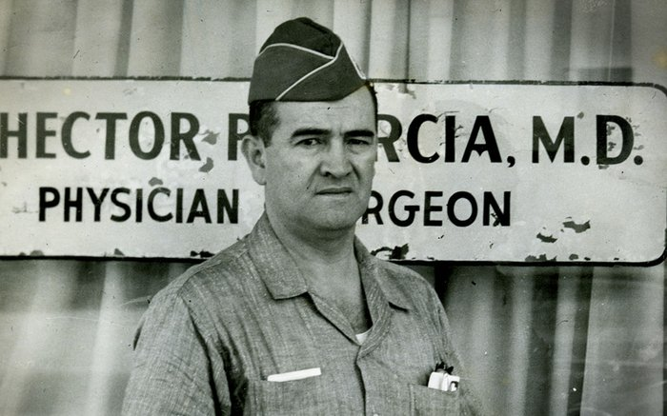
Famous Activists
Hector P. Garcia
Veterans Rights
Cesar Chavez
UFW (United Farm Workers)
NFWA (National Farmworkers Association)
Dolores Huerta
Notes:
Garcia was a WWII veteran who disliked that Chicanos were discriminated against in society.
He learned of a Mexican-American soldier who was being denied burial by a Texas funeral home.
He arranged a highly-publicized burial for the soldier in Arlington National Cemetery.
He organized migrant farm workers in California and demanded better wages and working conditions.
His approach was non-violent, similar to MLK, using boycotts and strikes to improve the lives of the farm workers.
Dolores Huerta was a labor leader who helped him form the Nat’l Farm Workers Assoc. and worked for women’s rights as well.

Slide 5
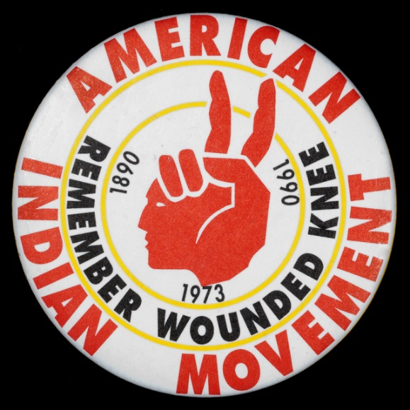
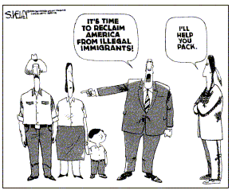
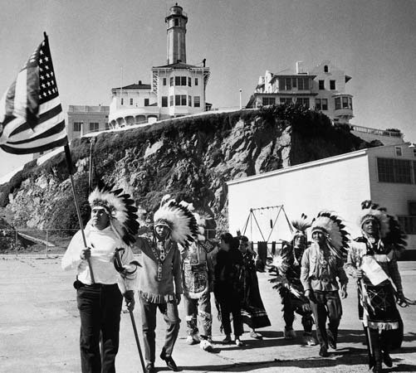
American Indian Movement (Aim)
Goals
Land reclamation
Alcatraz
“Native American”
Understanding of P.O.V.
Notes:
“Red Power” grew and AIM was born as Indians experienced failing support from the government.
They wanted respect for their heritage and introduced “Native American” as a term, wanting Americans to have a greater understanding of their point of view.

