Slide 1
The Cold War: Eisenhower/Kennedy/Johnson Years
Focus Questions:
Describe elements of Eisenhower’s presidency (I.E. domestic and foreign policies).
Describe elements of Kennedy’s presidency (I.E. domestic and foreign policies).
Be able to analyze and describe certain events such as the launch of Sputnik, the Bay of Pigs, the Cuban Missile crisis and Kennedy’s assassination.
Analyze Johnson’s presidency.
Notes:
1
The purpose of the focus questions is to help students find larger themes and structures to bring the historical evidence, events, and examples together for a connected thematic purpose.
As we go through each portion of this lecture, you may want to keep in mind how the information relates to this larger thematic question. Here are some suggestions: write the focus question in the left or right margin on your notes and as we go through, either mark areas of your notes for you to come back to later and think about the connection OR as you review your notes later (to fill in anything else you remember from the lecture or your thoughts during the lecture or additional information from the readings), write small phrases from the lecture and readings that connect that information to each focus question AND/OR are examples that work together to answer the focus question.

Slide 2
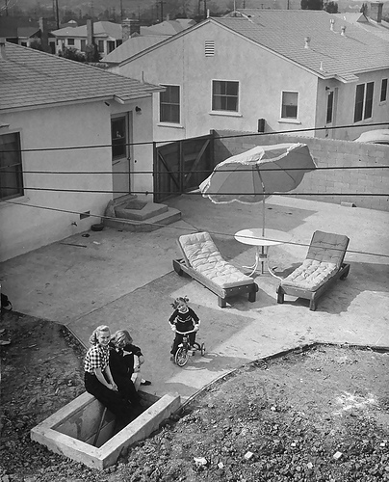
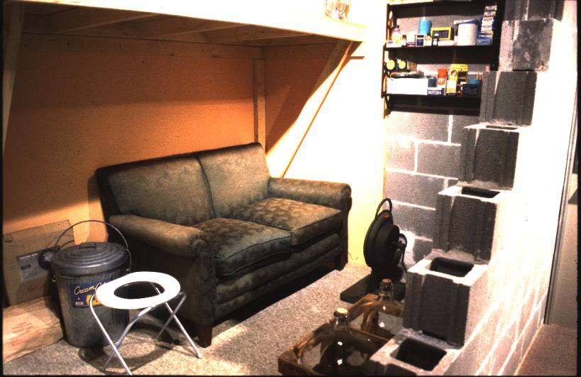
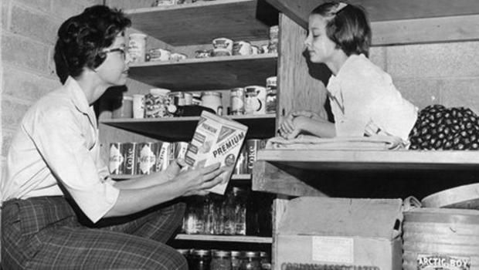
What do you think these images show?
Why do you think it was built?
List 3-5 things you would not be able to live without.

Slide 3
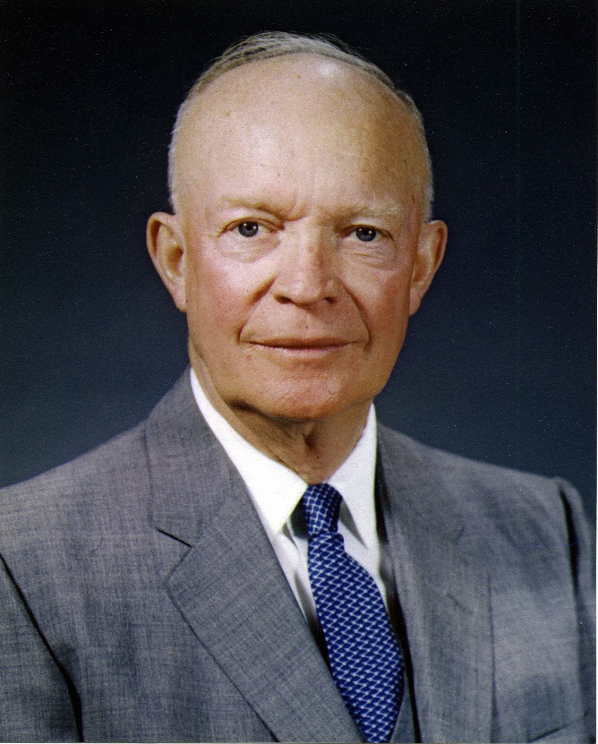
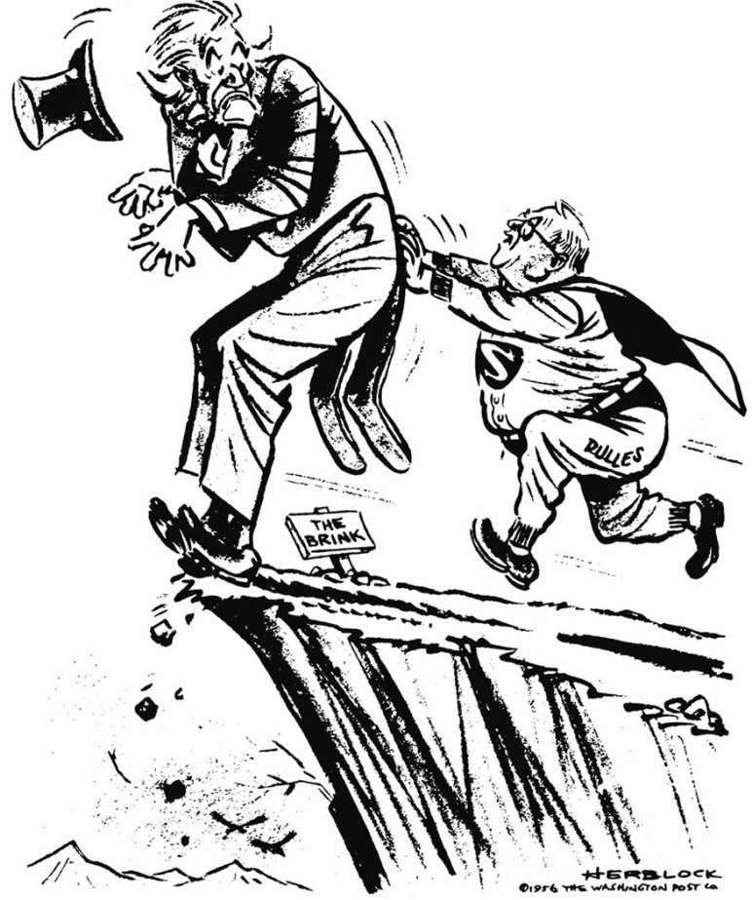
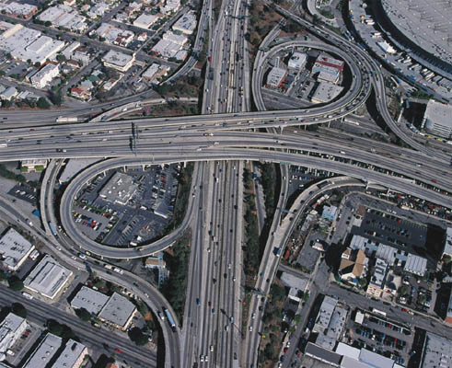
Dwight D. Eisenhower
Foreign Policy
Brinkmanship
Domestic Policy
Interstate Highway Act 1956
Housing Boom
Economic Prosperity
Conformity

Slide 4
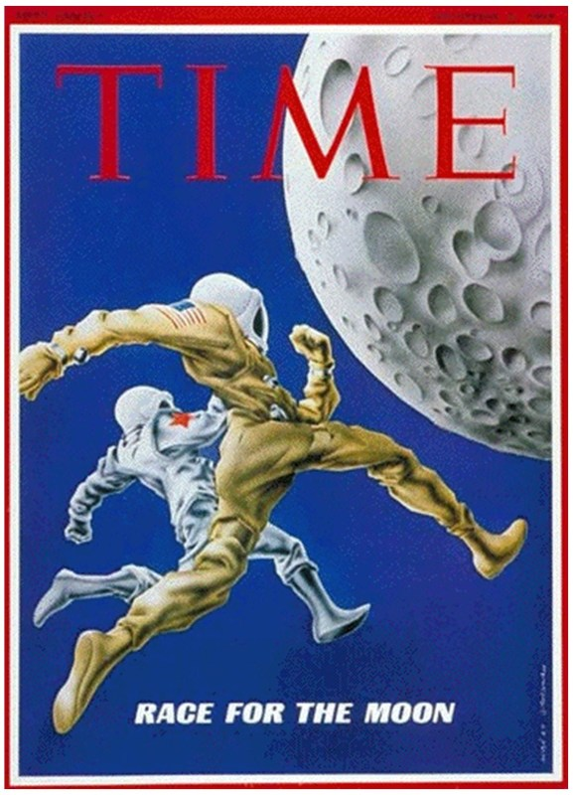
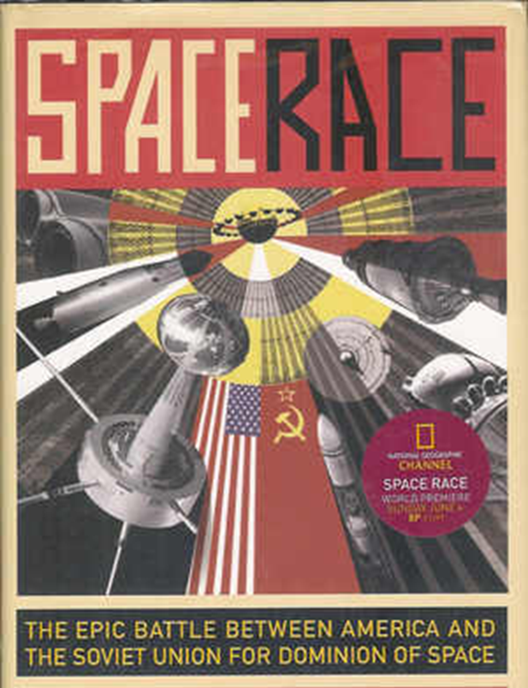
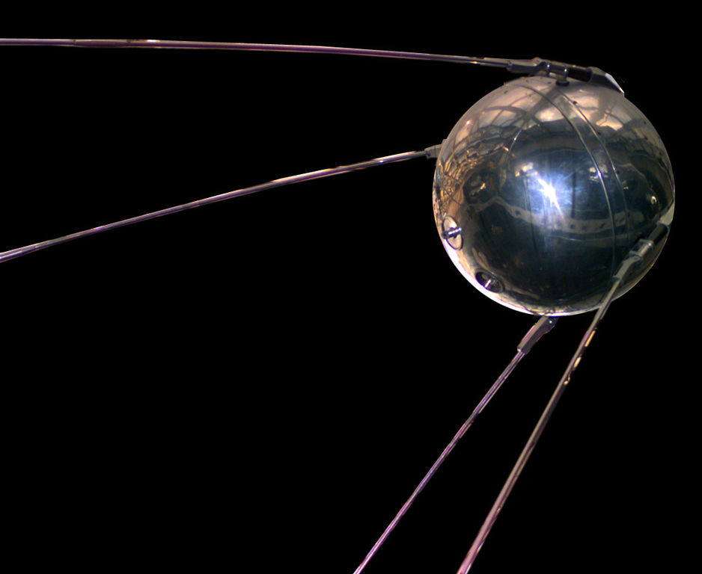
The Space Race
Sputnik: 1957
Notes:
The race between the U.S. and USSR to explore space
Sputnik
the first man-made satellite launched into space by the USSR in1957

Slide 5
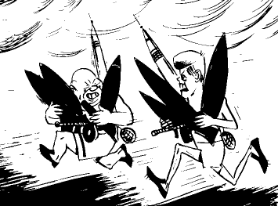
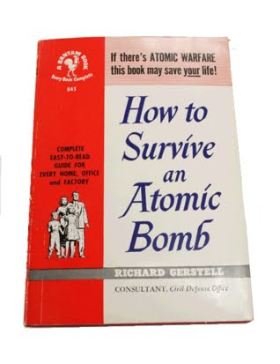
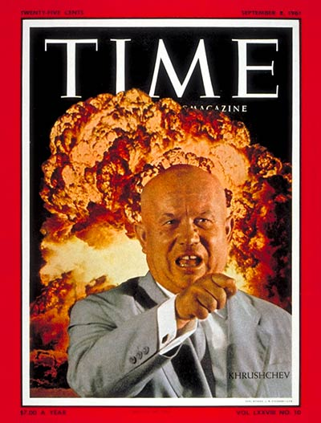
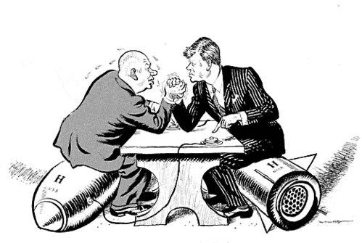
The Arms Race
Notes:
The mass development and build-up of the A-bomb & the Hydrogen Bomb by both the U.S. and the USSR.

Slide 6
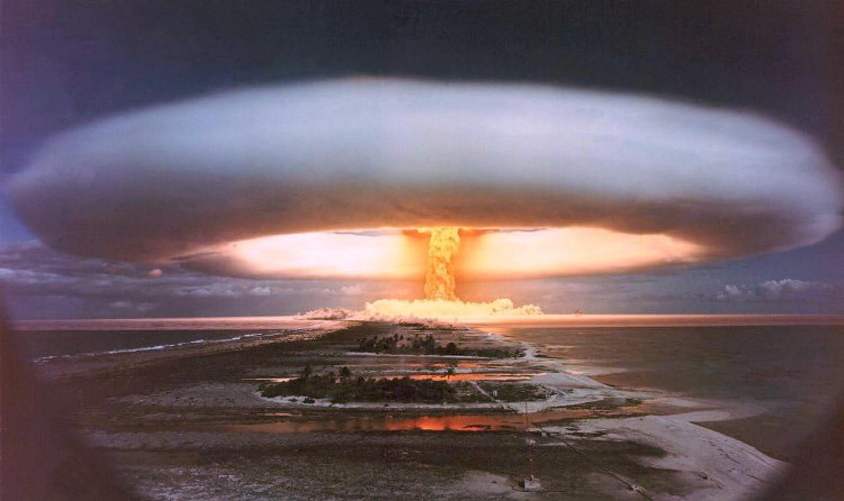
Notes:
Hydrogen bombs
-just to give you an idea of how deadly nukes had become since the Atomic bomb (20,000 tons of TNT)
-a Hydrogen bomb had the power of 15 million tons of TNT
-the explosion itself got hotter than the Sun’s core.
-radiation poisoning would cover about 7,000 square miles

Slide 7
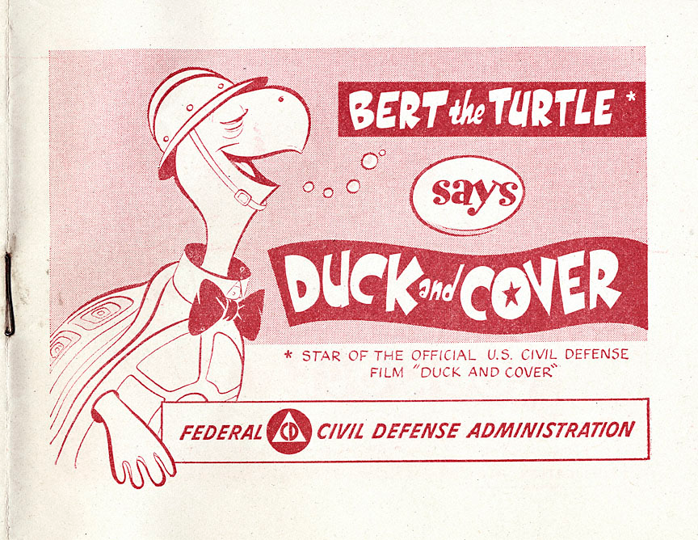
Duck and Cover

Slide 8
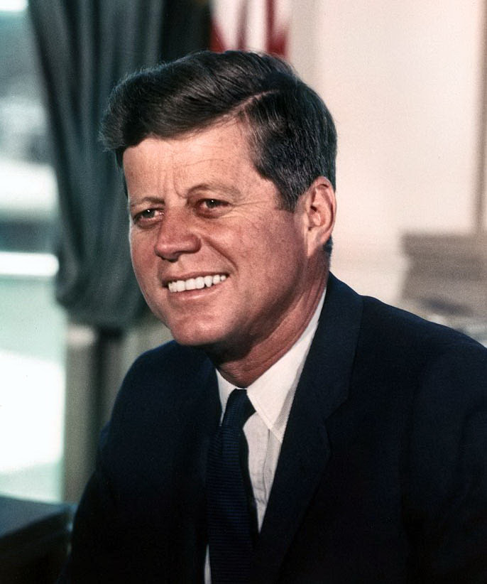
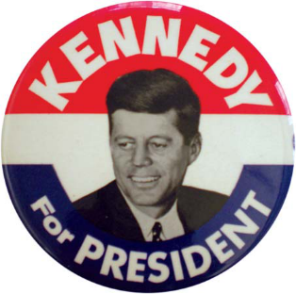
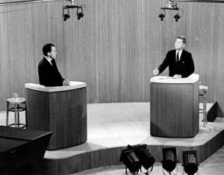
John F. Kennedy
1960 Election
Notes:
1st time candidates debated on TV
JFK beat Nixon & became the youngest man ever elected to the Presidency
“Ask not what your country can do for you, but what you can do for your country”

Slide 9
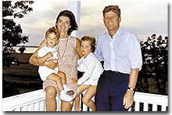
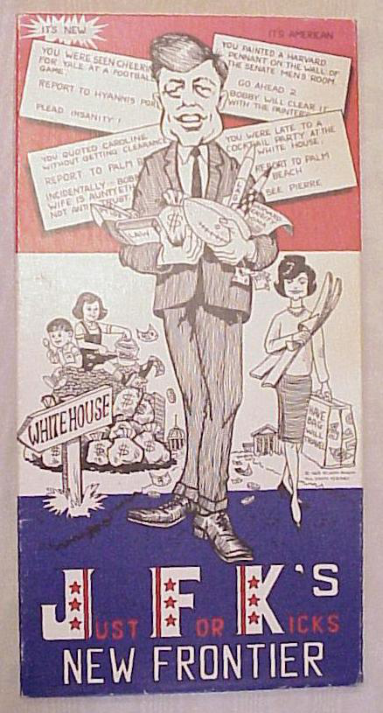
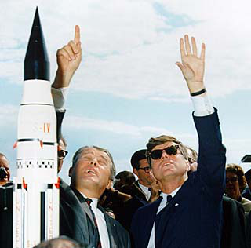
Kennedy
Domestic Policy
New Frontier
Peace Corps
Space Race
John Glenn
Notes:
Tax cut, Medicare, civil rights legislation, aid to education
Volunteers go to developing countries
1st American to orbit earth

Slide 10
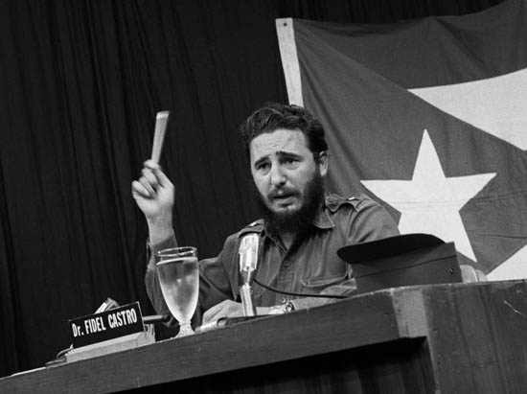
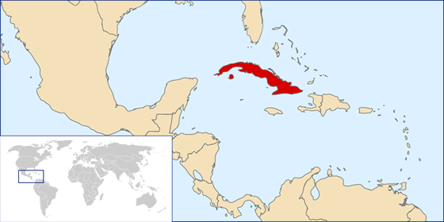
Kennedy
Foreign Policy
Cuba

Slide 11
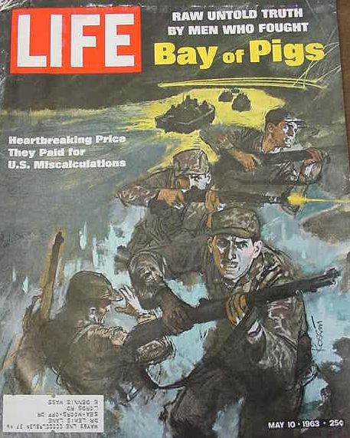
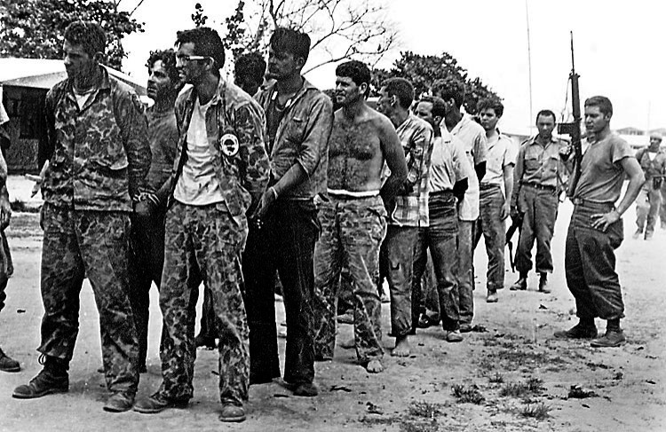
Bay of Pigs Invasion
Notes:
Plan to secretly train Cuban exiles in the U.S. to invade Cuba and overthrow Castro
JFK refused to provide air power = biggest mistake
Embarrassing failure

Slide 12
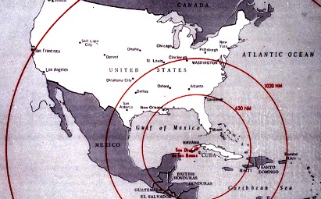
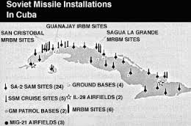
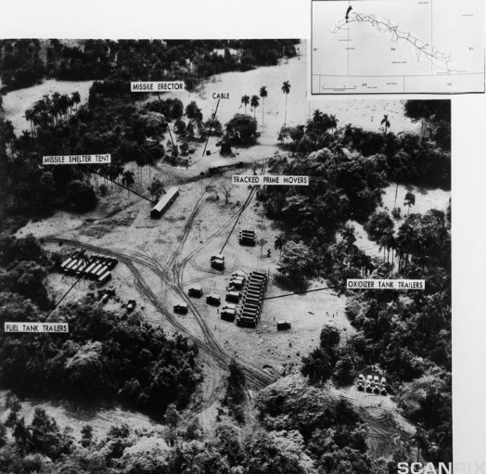
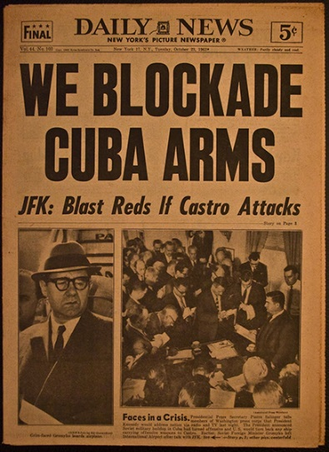
Cuban Missile Crisis 1962
Notes:
Castro knew U.S. was involved with Bay of Pigs
Cuba secretly started preparing silos for nuclear missiles
Soviets could easily bomb the U.S now
JFK ordered a naval blockade of Cuba

Slide 13
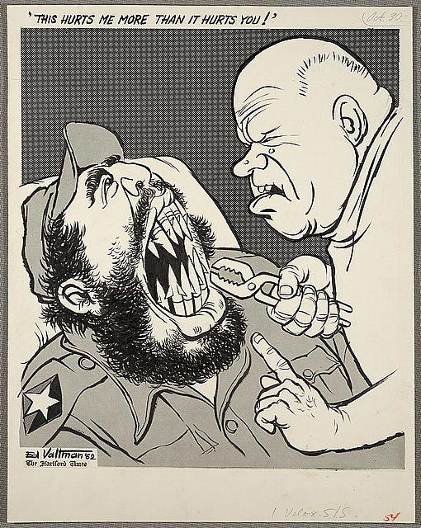
Outcome
Khrushchev agreed to withdraw missiles for a pledge that the U.S. would not invade Cuba
Kennedy withdrew missiles from Turkey
Became the closest the world has ever come to a nuclear war

Slide 14
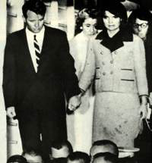
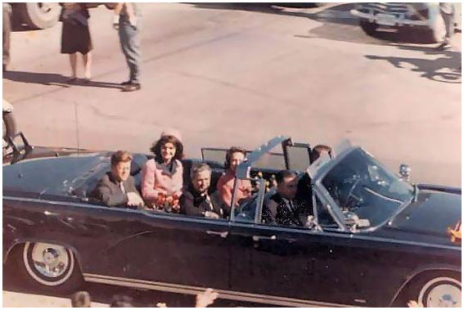
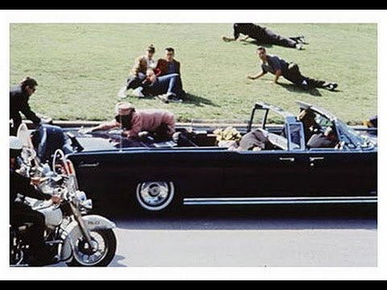
Kennedy’s Assassination: November 22, 1963
Dallas, Texas
http://www.history.com/topics/us-presidents/john-f-kennedy/videos/john-f-kennedy-assassinated

Slide 15
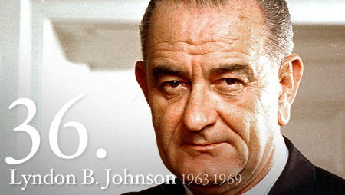
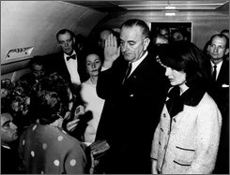
Notes:
VP for JFK- sworn in as president hours after JFK was assassinated

Slide 16
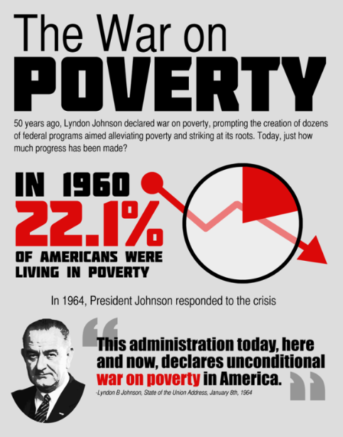
The Great Society
Federal legislation to transform American society:
A failure due to the cost of the Vietnam War- many still remained in poverty
Great Society
Programs
Civil Rights
-laws
-affirmative action
War On Poverty
-job corps for teens
-aid depressed areas
Medicare
-SS to provide
Medical care
and insurance
Aid to Cities
-$ for urban
planning and rental
assistance

