Slide 1
Ch. 24:The New Deal
Focus Questions:
Identify the importance of FDR’s election and his initial plan to solve the bank crisis.
Identify the three “R’s” that were part of FDR’s New Deal programs.
Be able to describe some of the more important New Deal programs and whether they were successful or not.
What controversies surrounded FDR’s presidency?
Identify the critics of the New Deal and what ideas did they have?
Explain how the New Deal impacted women and minorities.
In what way was the New Deal a failure?
In what way was the New Deal a success?
Notes:
1
The purpose of the focus questions is to help students find larger themes and structures to bring the historical evidence, events, and examples together for a connected thematic purpose.
As we go through each portion of this lecture, you may want to keep in mind how the information relates to this larger thematic question. Here are some suggestions: write the focus question in the left or right margin on your notes and as we go through, either mark areas of your notes for you to come back to later and think about the connection OR as you review your notes later (to fill in anything else you remember from the lecture or your thoughts during the lecture or additional information from the readings), write small phrases from the lecture and readings that connect that information to each focus question AND/OR are examples that work together to answer the focus question.

Slide 2
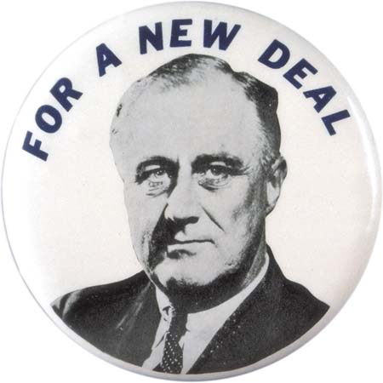
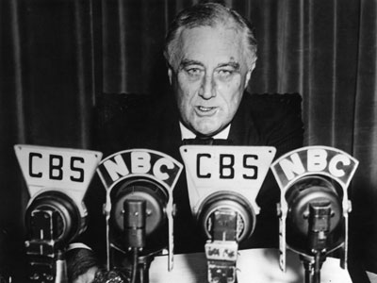
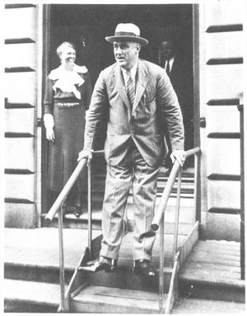
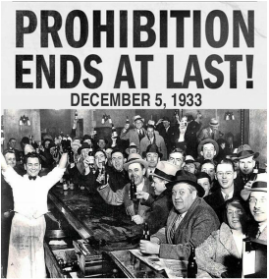
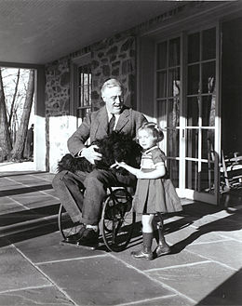
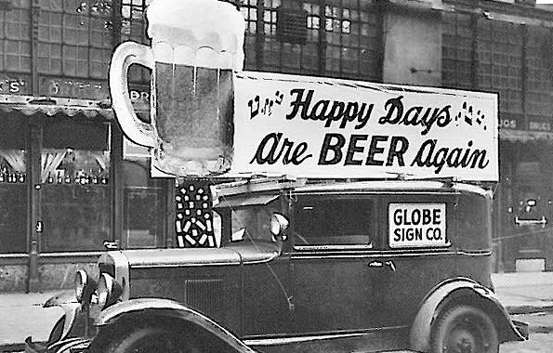
Launching the New Deal
Roosevelt’s Personality
* “the only thing we have to fear is, fear itself”
*FDR positive and confident
*used “Fireside Chats” to speak directly to the people
*Roosevelt’s polio and relationship with the press
Restoring Confidence
“Bank Holiday”
*FDR knew the banking crisis must be fixed first
*shut all the banks down for four days
*Emergency Banking Act, 1933
-allowed stable banks to re-open
-banks only accepted deposits, no withdrawals
-billions of $ poured back into banks
21st Amendment – Beer-Wine Revenue Act, 1933
*repealed prohibition
*govt. could now tax legal alcohol
*brought in billions of $

Slide 3
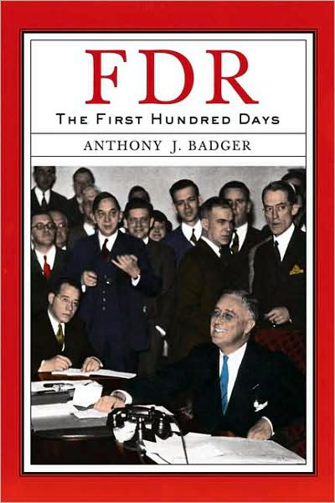
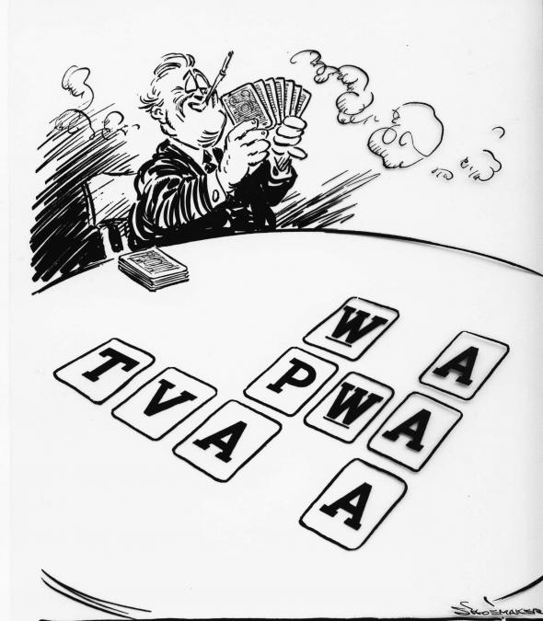
Roosevelt’s 100 Days
Three “R’s” – “Alphabet Soup”
*1st 100 days, a large number of laws were passed
*FDR’s philosophy was to pass a ton of laws, if they didn’t work get rid of them
*most of them fell into three categories
1. Relief – short term measures to help people immediately
-mainly agencies that created jobs to help the unemployed
-loans to farmers and homeowners
2. Recovery – measures to help stimulate the economy
-agencies that regulated the economy, stock market, provided jobs
3. Reform – long term measure to prevent another depression and help fix the economy
-permanent legislation some of which still exists today

Slide 4
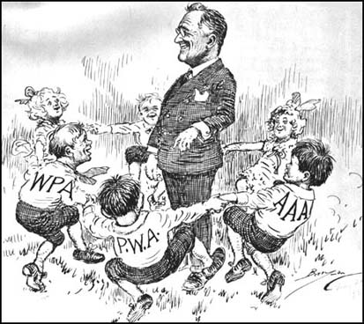
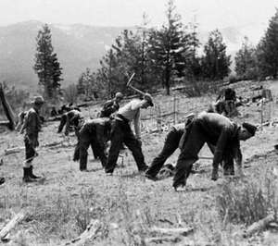
Relief
“Priming the Pump”
*giving jobs to consumers so people will buy more
*meant to kick start the economy back up
Federal Emergency Relief Act (FERA)
*gave money to local govts. to create jobs
*internal improvement, infrastructure
Civilian Conservation Corps (CCC)
*gave jobs to millions of young men (18-25)
*mainly improving national parks
Public Works Administration (PWA)
*created jobs through community projects
Civil Works Administration (CWA)
*temporary construction projects for 4 million people
Work Progress Administration (WPA)
*created jobs for writers, musicians, artists
*largest of all the New Deal programs

Slide 5
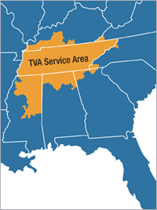
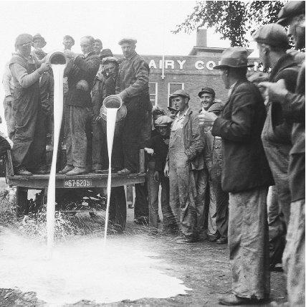
Recovery
National Recovery Administration (NRA)
*businesses must set minimum wage and prices
*Wagner Act – gave workers right to form unions
*eventually ruled unconstitutional by Supreme Court
Agricultural Adjustment Agency (AAA)
*meant to stabilize crop prices
*farmers forced to destroy crops and livestock
-6 million pigs slaughtered
*farmers paid not to produce
*complete and utter failure
*ruled unconstitutional
Tennessee Valley Authority (TVA)
*built 21 dams in American south
*provided jobs, cheap electricity, recreation, and revitalized the south

Slide 6
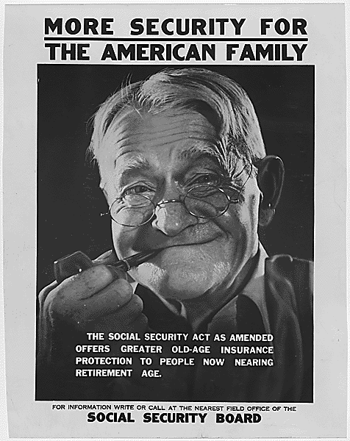
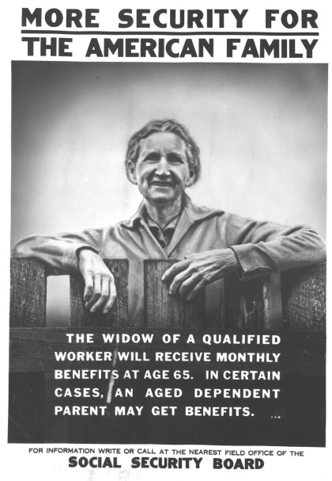
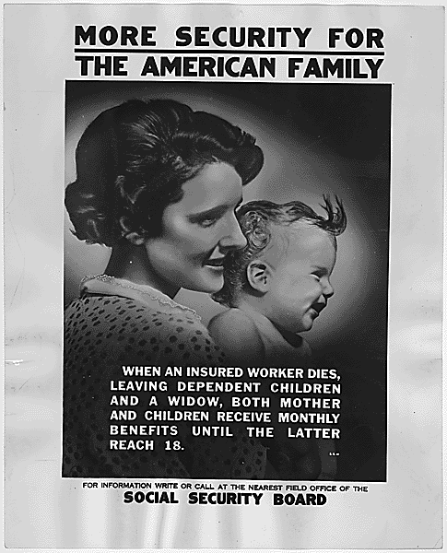
Reform
Glass Steagall Act - Federal Deposit Insurance Corporation (FDIC)
*insured banks so people’s money was safe, regulated banks
Securities and Exchange Commission (SEC)
*watches and regulates the stock market
Social Security Act
*provides workers with unemployment insurance
*old age pensions
*allowed old people to retire so young people had jobs
*controversial as it was paid for through a payroll tax

Slide 7
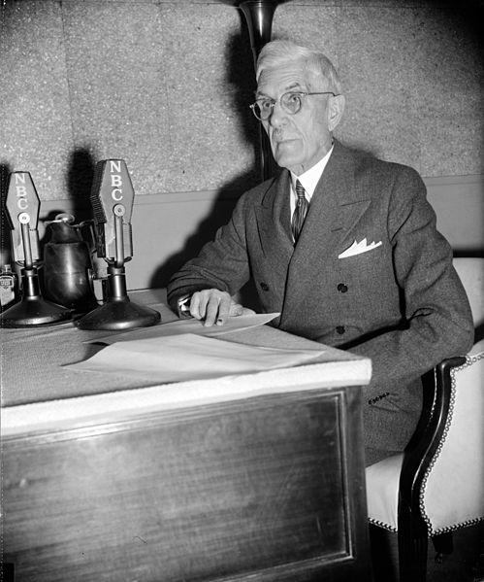
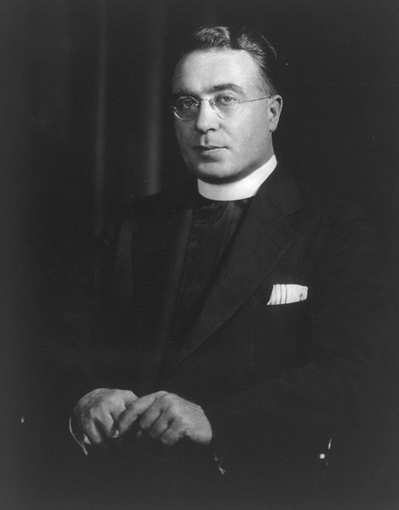
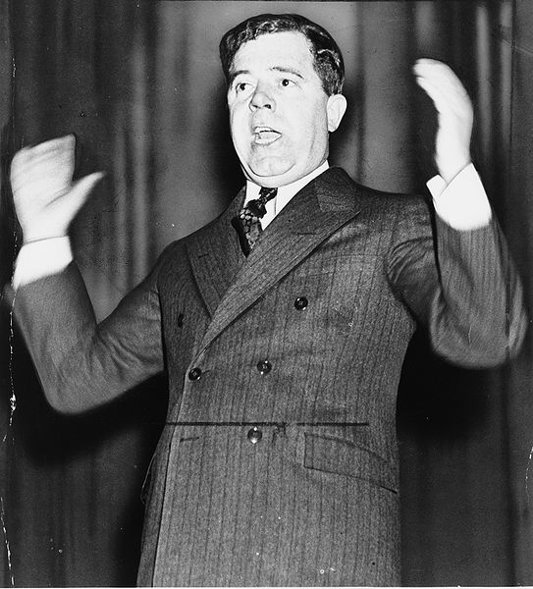
The New Deal in transition
Critics of the New Deal
*most criticism came from the right (Republicans)
*many saw New Deal policies as “dictatorial”
*conservatives felt they were socialist not democratic
*some on the left felt the New Deal didn’t do enough
Dr. Francis E. Townsend
*wanted pensions for the elderly
*would free up jobs and pump money into the economy
*eventually became SS
Father Charles E. Coughlin
*had the largest radio following in America
*anti-Semite, fascist, wanted banking reform
*wanted to punish banks
Huey Long the “Kingfish” – Gov. of Louisiana
*flamboyant, charismatic, dictator-like
*advocated drastic (communist) measures
* “Share-our-wealth Society – “Every man a king”
-living wage for every American, home, car
-paid for by taxing the hell out of the rich
*ran against FDR in 1935 but assassinated

Slide 8
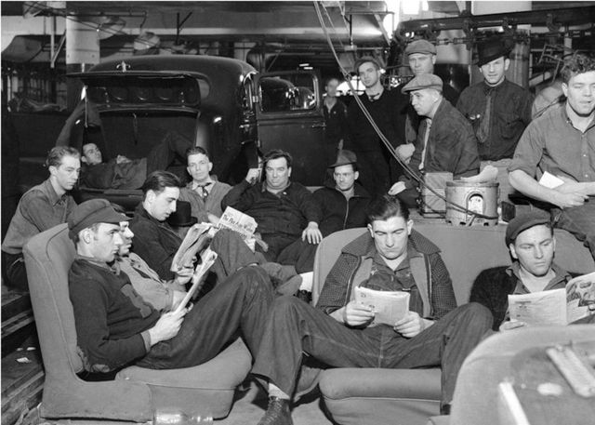
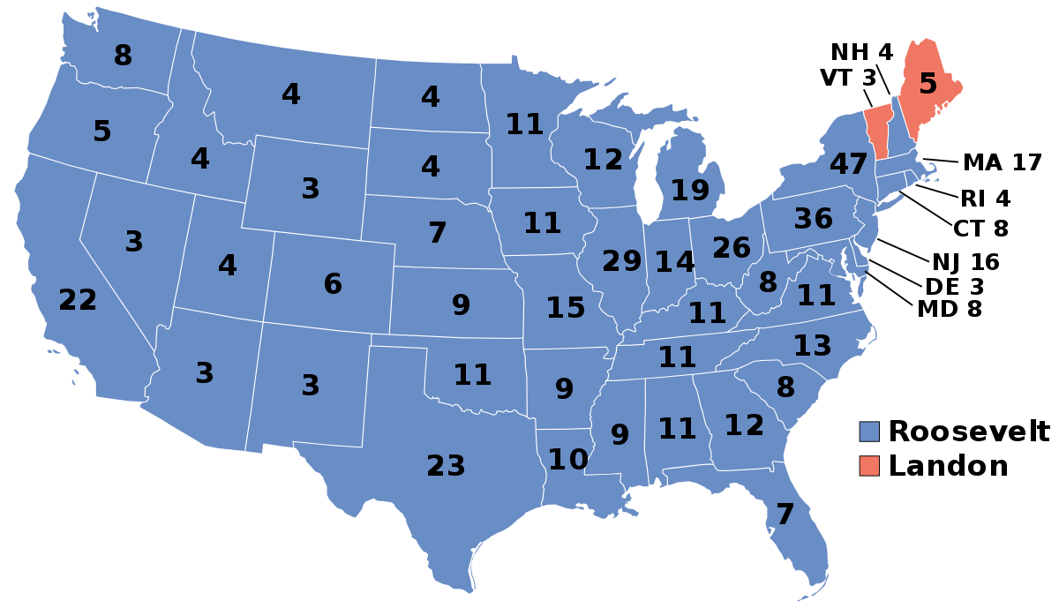
The Second New Deal – 1935
Labor
*S.N.D. focus mainly on labor and business reform
*organized labor grew rapidly during depression
National Labor Relations Board (NLRB) – Wagner Act
*gave more power to unions
American Federation of Labor (AFL)
*organized union based on skill sets
Congress of Industrial Organizations (CIO)
*rivaled the AFL by allowing female members
Sit-Down Strikes
*autoworkers demanding better pay by sitting down on the job
Social Security
WPA
Election of 1936
*economy reviving allows FDR to win in a landslide
*Democrats controlled both houses of Congress

Slide 9
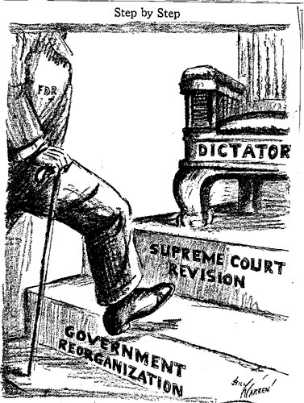
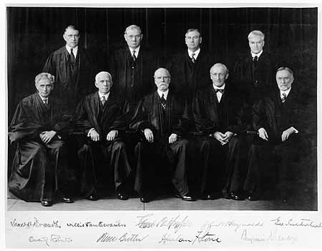
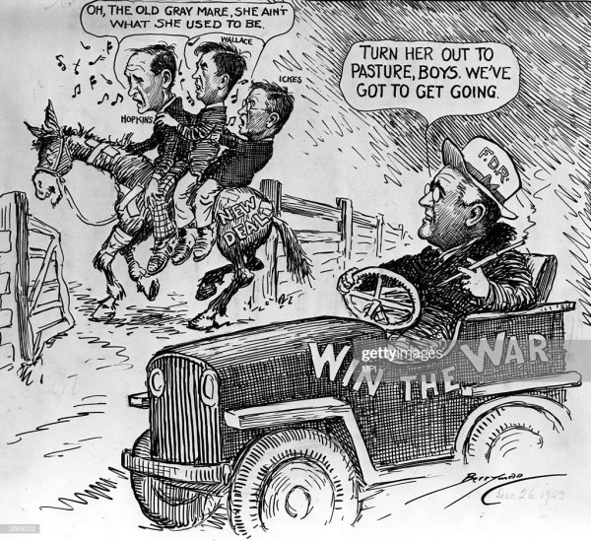
The New Deal in Disarray
The Court Packing Plan
*Dems didn’t control the Supreme Court
*lots of New Deal legislation ruled unconstitutional
-NRA, AAA
*Roosevelt proposed adding 6 new justices
*this would allow him to appoint liberal judges
*critics on both sides vilified FDR
*Congress refused to pass the bill
*did major damage to his administration
*people accused FDR of trying to become a dictator
Retrenchment and “Roosevelt Recession” – 1937
*millions of jobs cut due to fear of inflation
*caused a recession similar to 1932-33
*Roosevelt forced to put $5 billion back into economy
End of the New Deal – 1938
*opposition from congress grew due to excessive spending
*conflict overseas concerning many
*rise of dictators in Europe cause US to abandon the New Deal and begin preparations for war

Slide 10
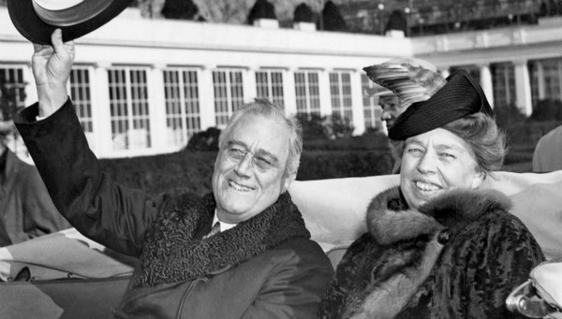
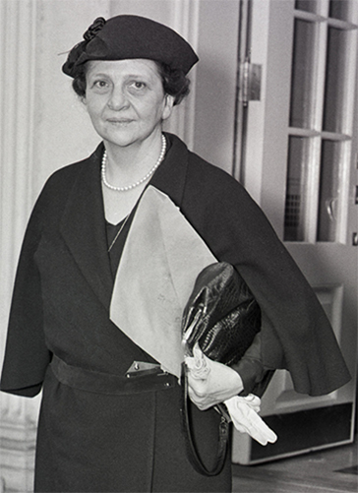
Limits of the New Deal
African Americans
*N.D. did very little for AA
*N.D. did not prevent discrimination in hiring or segregation (“Jim Crow”) in the south
*nonetheless, FDR and Eleanor sympathetic to equality
*“Black Cabinet” – FDR appointed several AA to positions
Indian Reorganization Act
*undid Dawes Act
*gave land back to tribes
Women
*widespread support from women despite limited jobs
*many women gained presidential appointments
*Francis Perkins – Sec. of Labor
-first female cabinet member in history
*What is FDR doing by catering to women?
Eleanor Roosevelt
*played an important role in her husbands presidency
*considered first modern day First Lady
*traveled the nation and met with minority and women’s groups
*championed humanitarian, women’s and AA causes
*What is FDR doing?

Slide 11
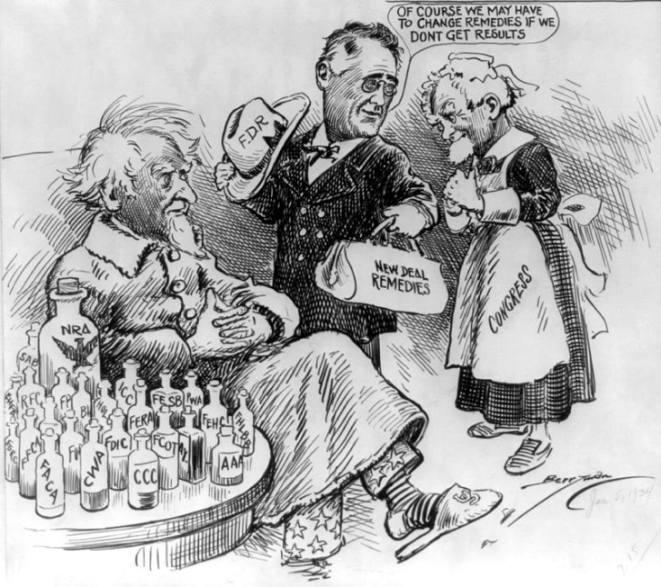
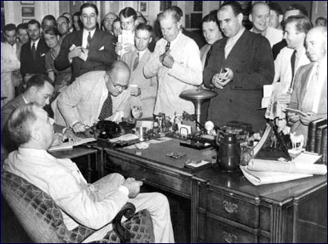
Legacy of the New Deal
The South and West
*vast majority of public works affected these regions
*public dams, public works, farm aid mostly in west (Hoover Dam)
*helped prepare the west for WWII
*south also benefitted greatly
*south was modernizing thanks to new upgrades
Criticisms of the New Deal
*never helped the economy recover
*possibly stifled recovery
*millions of Americans still suffered
*WWII production is what ended the Depression
Positives of the New Deal
*increased economic regulatory entities
-banking and stock market
*economic development of South and West
*federal welfare state established
*increased peoples expectations of the government
-i.e. LBJ’s Great Society
*people expected the govt. to aid in a crisis

Slide 12
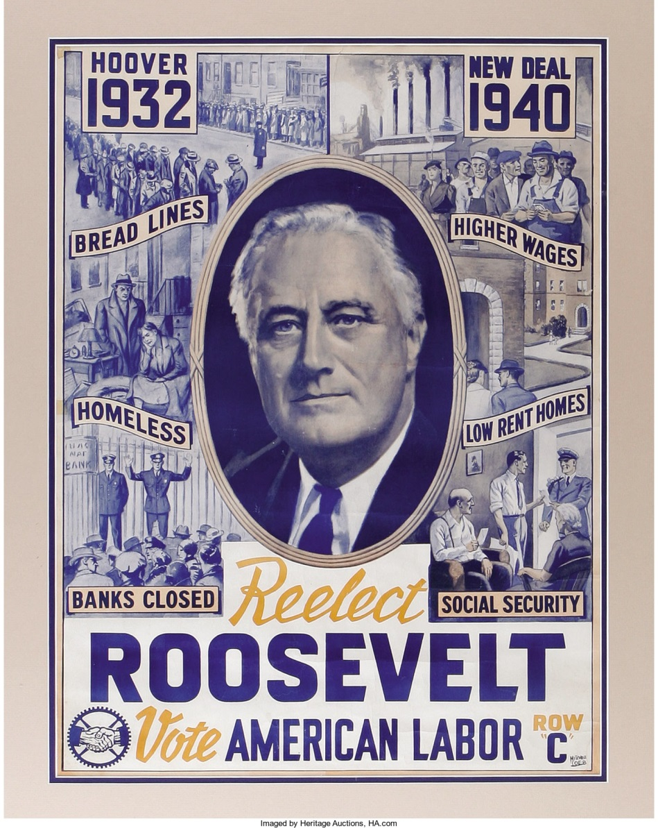
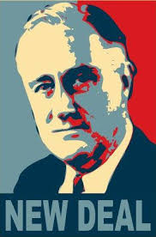
Crash Course US History Ep. 34: The New Deal

Slide 13
Ch. 24:The New Deal
Focus Questions:
Identify the importance of FDR’s election and his initial plan to solve the bank crisis.
Identify the three “R’s” that were part of FDR’s New Deal programs.
Be able to describe some of the more important New Deal programs and whether they were successful or not.
What controversies surrounded FDR’s presidency?
Identify the critics of the New Deal and what ideas did they have?
Explain how the New Deal impacted women and minorities.
In what way was the New Deal a failure?
In what way was the New Deal a success?
Notes:
13
The purpose of the focus questions is to help students find larger themes and structures to bring the historical evidence, events, and examples together for a connected thematic purpose.
As we go through each portion of this lecture, you may want to keep in mind how the information relates to this larger thematic question. Here are some suggestions: write the focus question in the left or right margin on your notes and as we go through, either mark areas of your notes for you to come back to later and think about the connection OR as you review your notes later (to fill in anything else you remember from the lecture or your thoughts during the lecture or additional information from the readings), write small phrases from the lecture and readings that connect that information to each focus question AND/OR are examples that work together to answer the focus question.

Slide 14
Ch. 23-24 SAQ
Discuss ONE of the effects of the Great Depression on either American: society, culture, government or the economy.
Explain how the New Deal attempted to improve this issue.
Analyze whether or not the New Deal was a success or a failure.

