Slide 1
Ch. 24-25: Civil Rights and Vietnam
Focus Questions:
Describe the major Civil Rights events of the 1950’s.
Describe the major Civil Rights events of the 1960’s.
Identify important legislation passed as a result of the Civil Rights movement.
Identify important court cases of the era.
Analyze the progression of American involvement in Vietnam.
Identify the importance of the Gulf of Tonkin Resolution.
Explain the type of warfare in Vietnam and new weapons.
Why was the war so difficult to fight?
How did the war change politics and culture in America?
Explain the outcome and legacy of the Vietnam War.
Notes:
1
1
The purpose of the focus questions is to help students find larger themes and structures to bring the historical evidence, events, and examples together for a connected thematic purpose.
As we go through each portion of this lecture, you may want to keep in mind how the information relates to this larger thematic question. Here are some suggestions: write the focus question in the left or right margin on your notes and as we go through, either mark areas of your notes for you to come back to later and think about the connection OR as you review your notes later (to fill in anything else you remember from the lecture or your thoughts during the lecture or additional information from the readings), write small phrases from the lecture and readings that connect that information to each focus question AND/OR are examples that work together to answer the focus question.

Slide 2
Vietnam 1964-1975

Slide 3
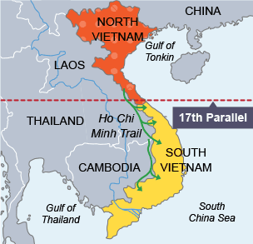
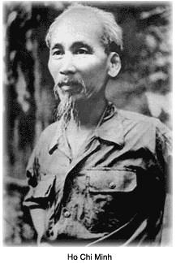
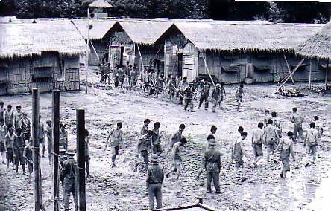
Background
French Colony
French Indo-China (1887-1954)
Ho Chi Minh takeover (1954)
Geneva Conference (establishment of N. & S. Vietnam)
Re-education
Land reform

Slide 4
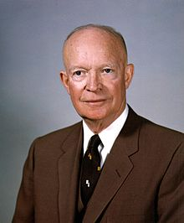
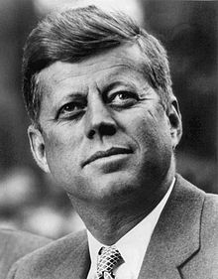
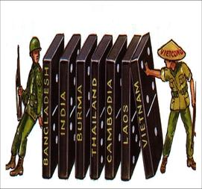
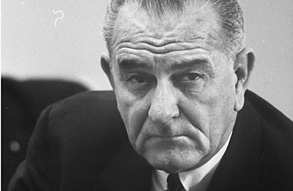
The Domino Theory
Eisenhower and Vietnam
Support for French troops
Kennedy and Vietnam
Military advisors
Johnson and Vietnam
Warships in Gulf of Tonkin

Slide 5
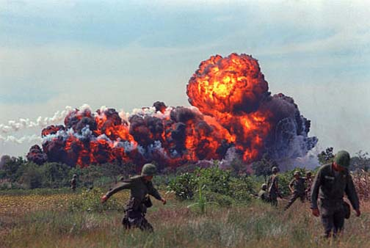
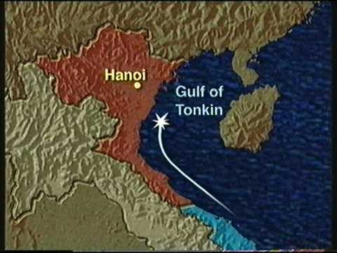
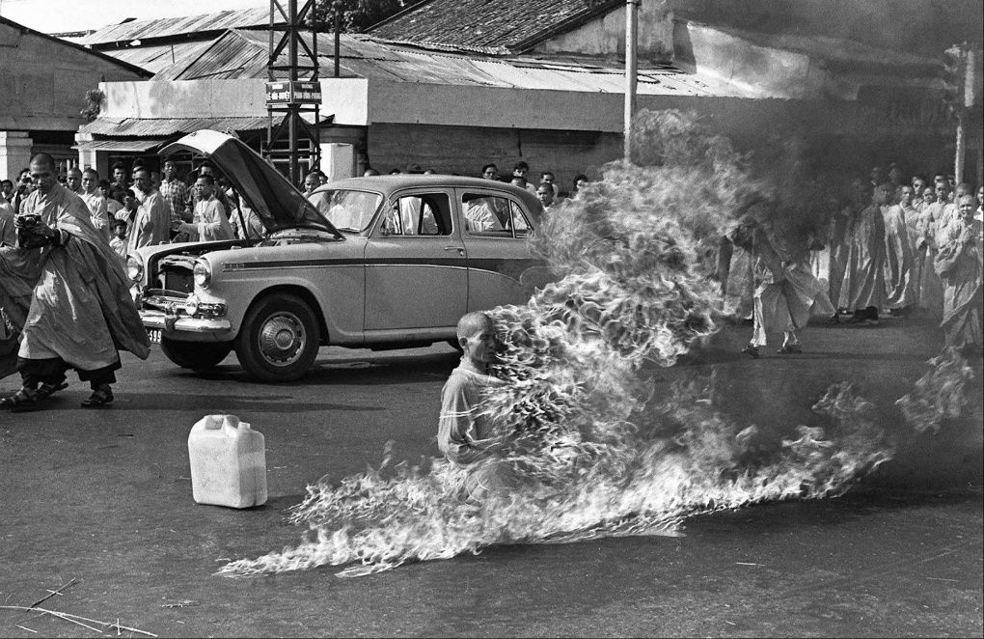
The War Escalates
Gulf of Tonkin Resolution (1964)
USS Maddox
Congress gives Johnson full military powers
Operation Rolling Thunder
Napalm
Agent Orange
1968- ½ Million soldiers

Slide 6
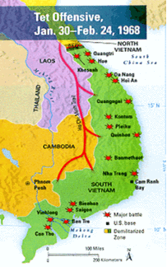
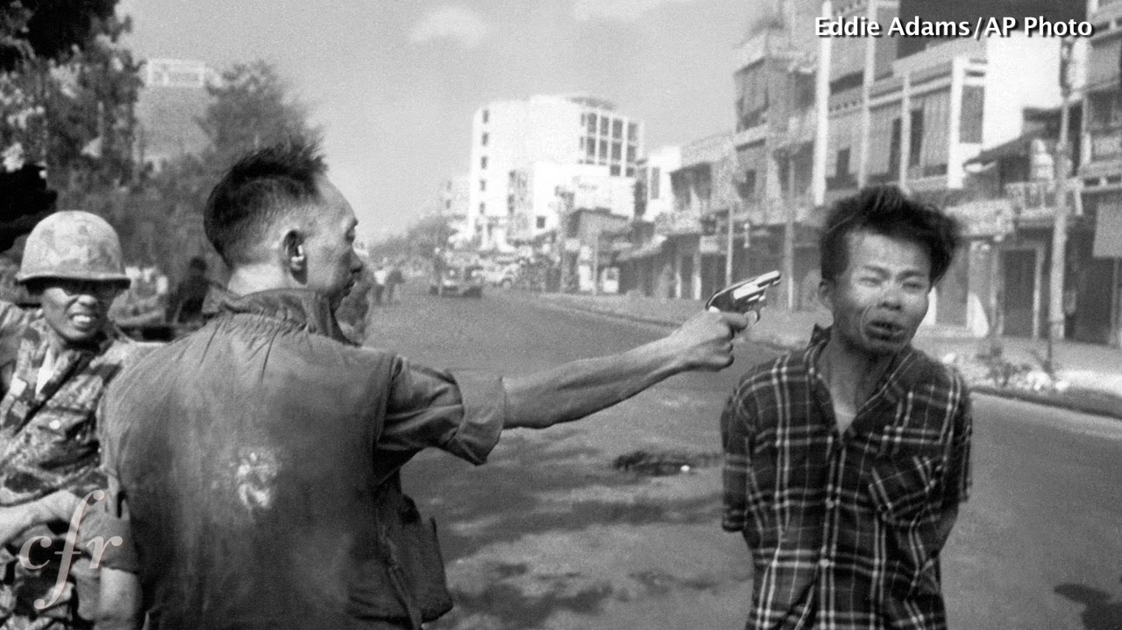
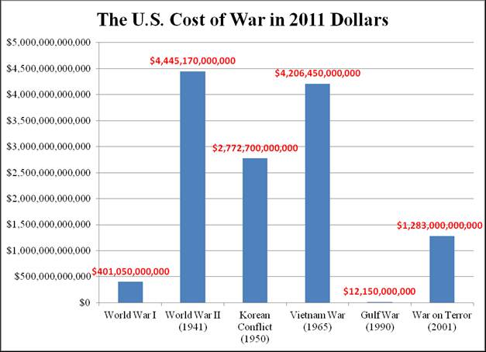
Turning Points
Tet Offensive (1968)
Perception of enemy vs reality
Cost of the war
($25 Billion a year)
Credibility Gap
Govt. vs. Media

Slide 7
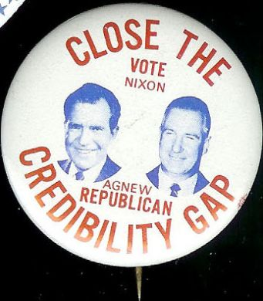
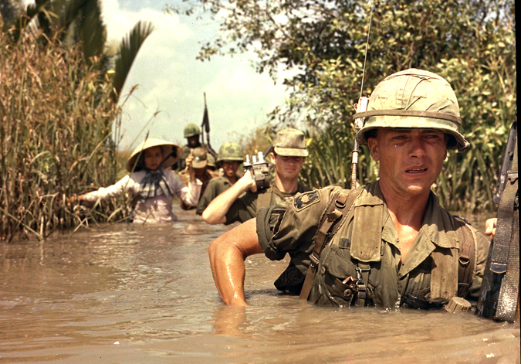
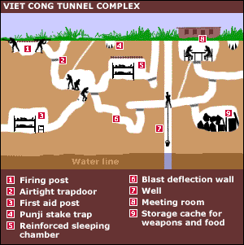
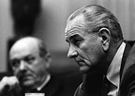
Difficulties of Success
Popularity of Ho Chi Minh (Father of Vietnam)
Cause (Vietnamese Independence)
Failure of S. Viet. Govts.
Guerilla Warfare
Vietcong/Vietminh
The Anti War Movement
Credibility Gap
Pentagon Papers
Doves/Hawks

Slide 8
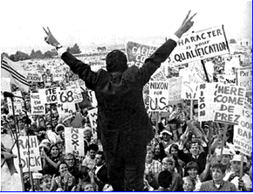
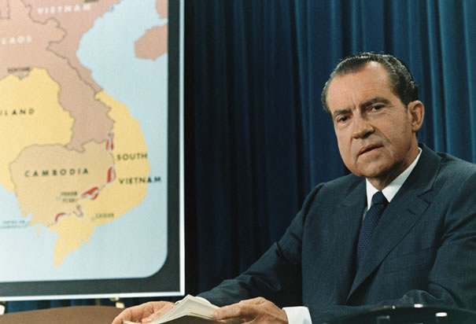
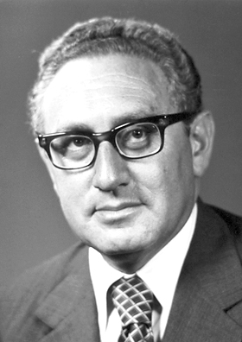
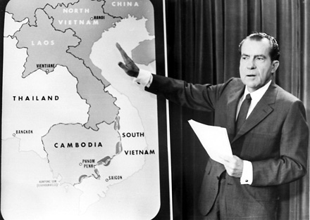
Nixon’s War (1969-74)
Promise of, “Peace with Honor”
Silent Majority
Vietnamization (Nixon/Kissinger)
Escalating the War to Cambodia

Slide 9
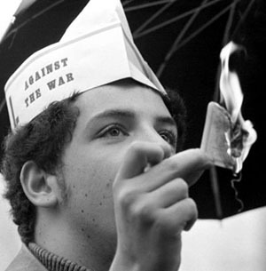
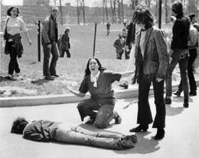
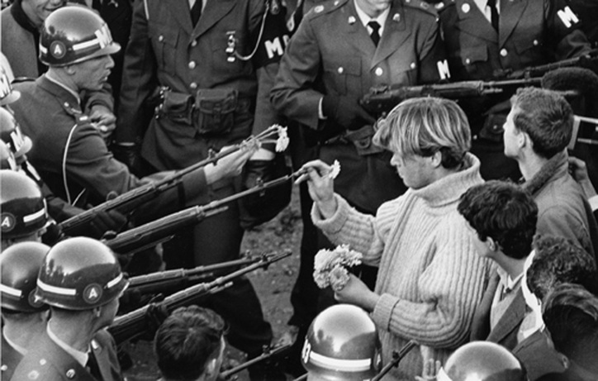
Anti War Protests
Burning of Draft Cards
26th Amendment
Kent State Protests

Slide 10
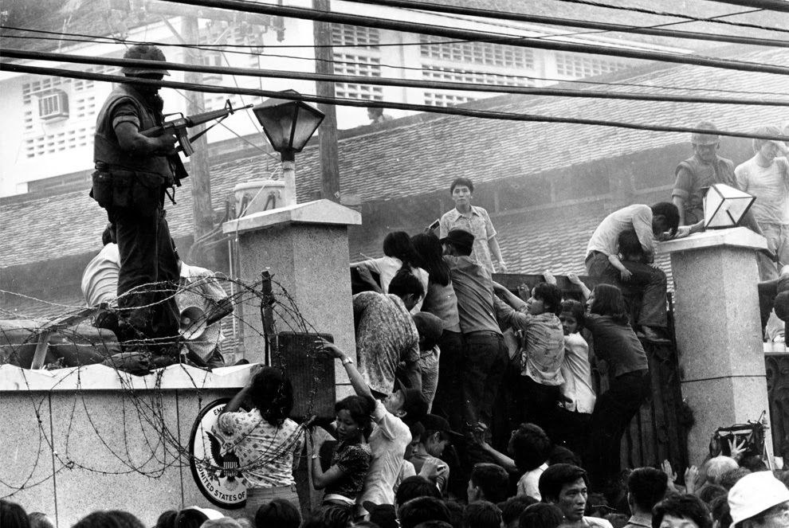
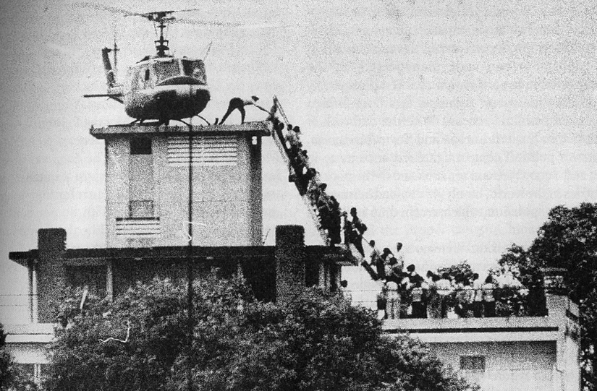
End of Vietnam
1973-Cease Fire
Fall of Saigon (1975)
Final ledger and Legacy of the War
58,000 Americans dead
Millions of Vietnamese dead
War Powers Act – Limits presidential power during war
Credibility Gap has never closed
United States seen in a negative light
Trying to be the world’s police force
Why wars today are not popular w/citizens

