Slide 1
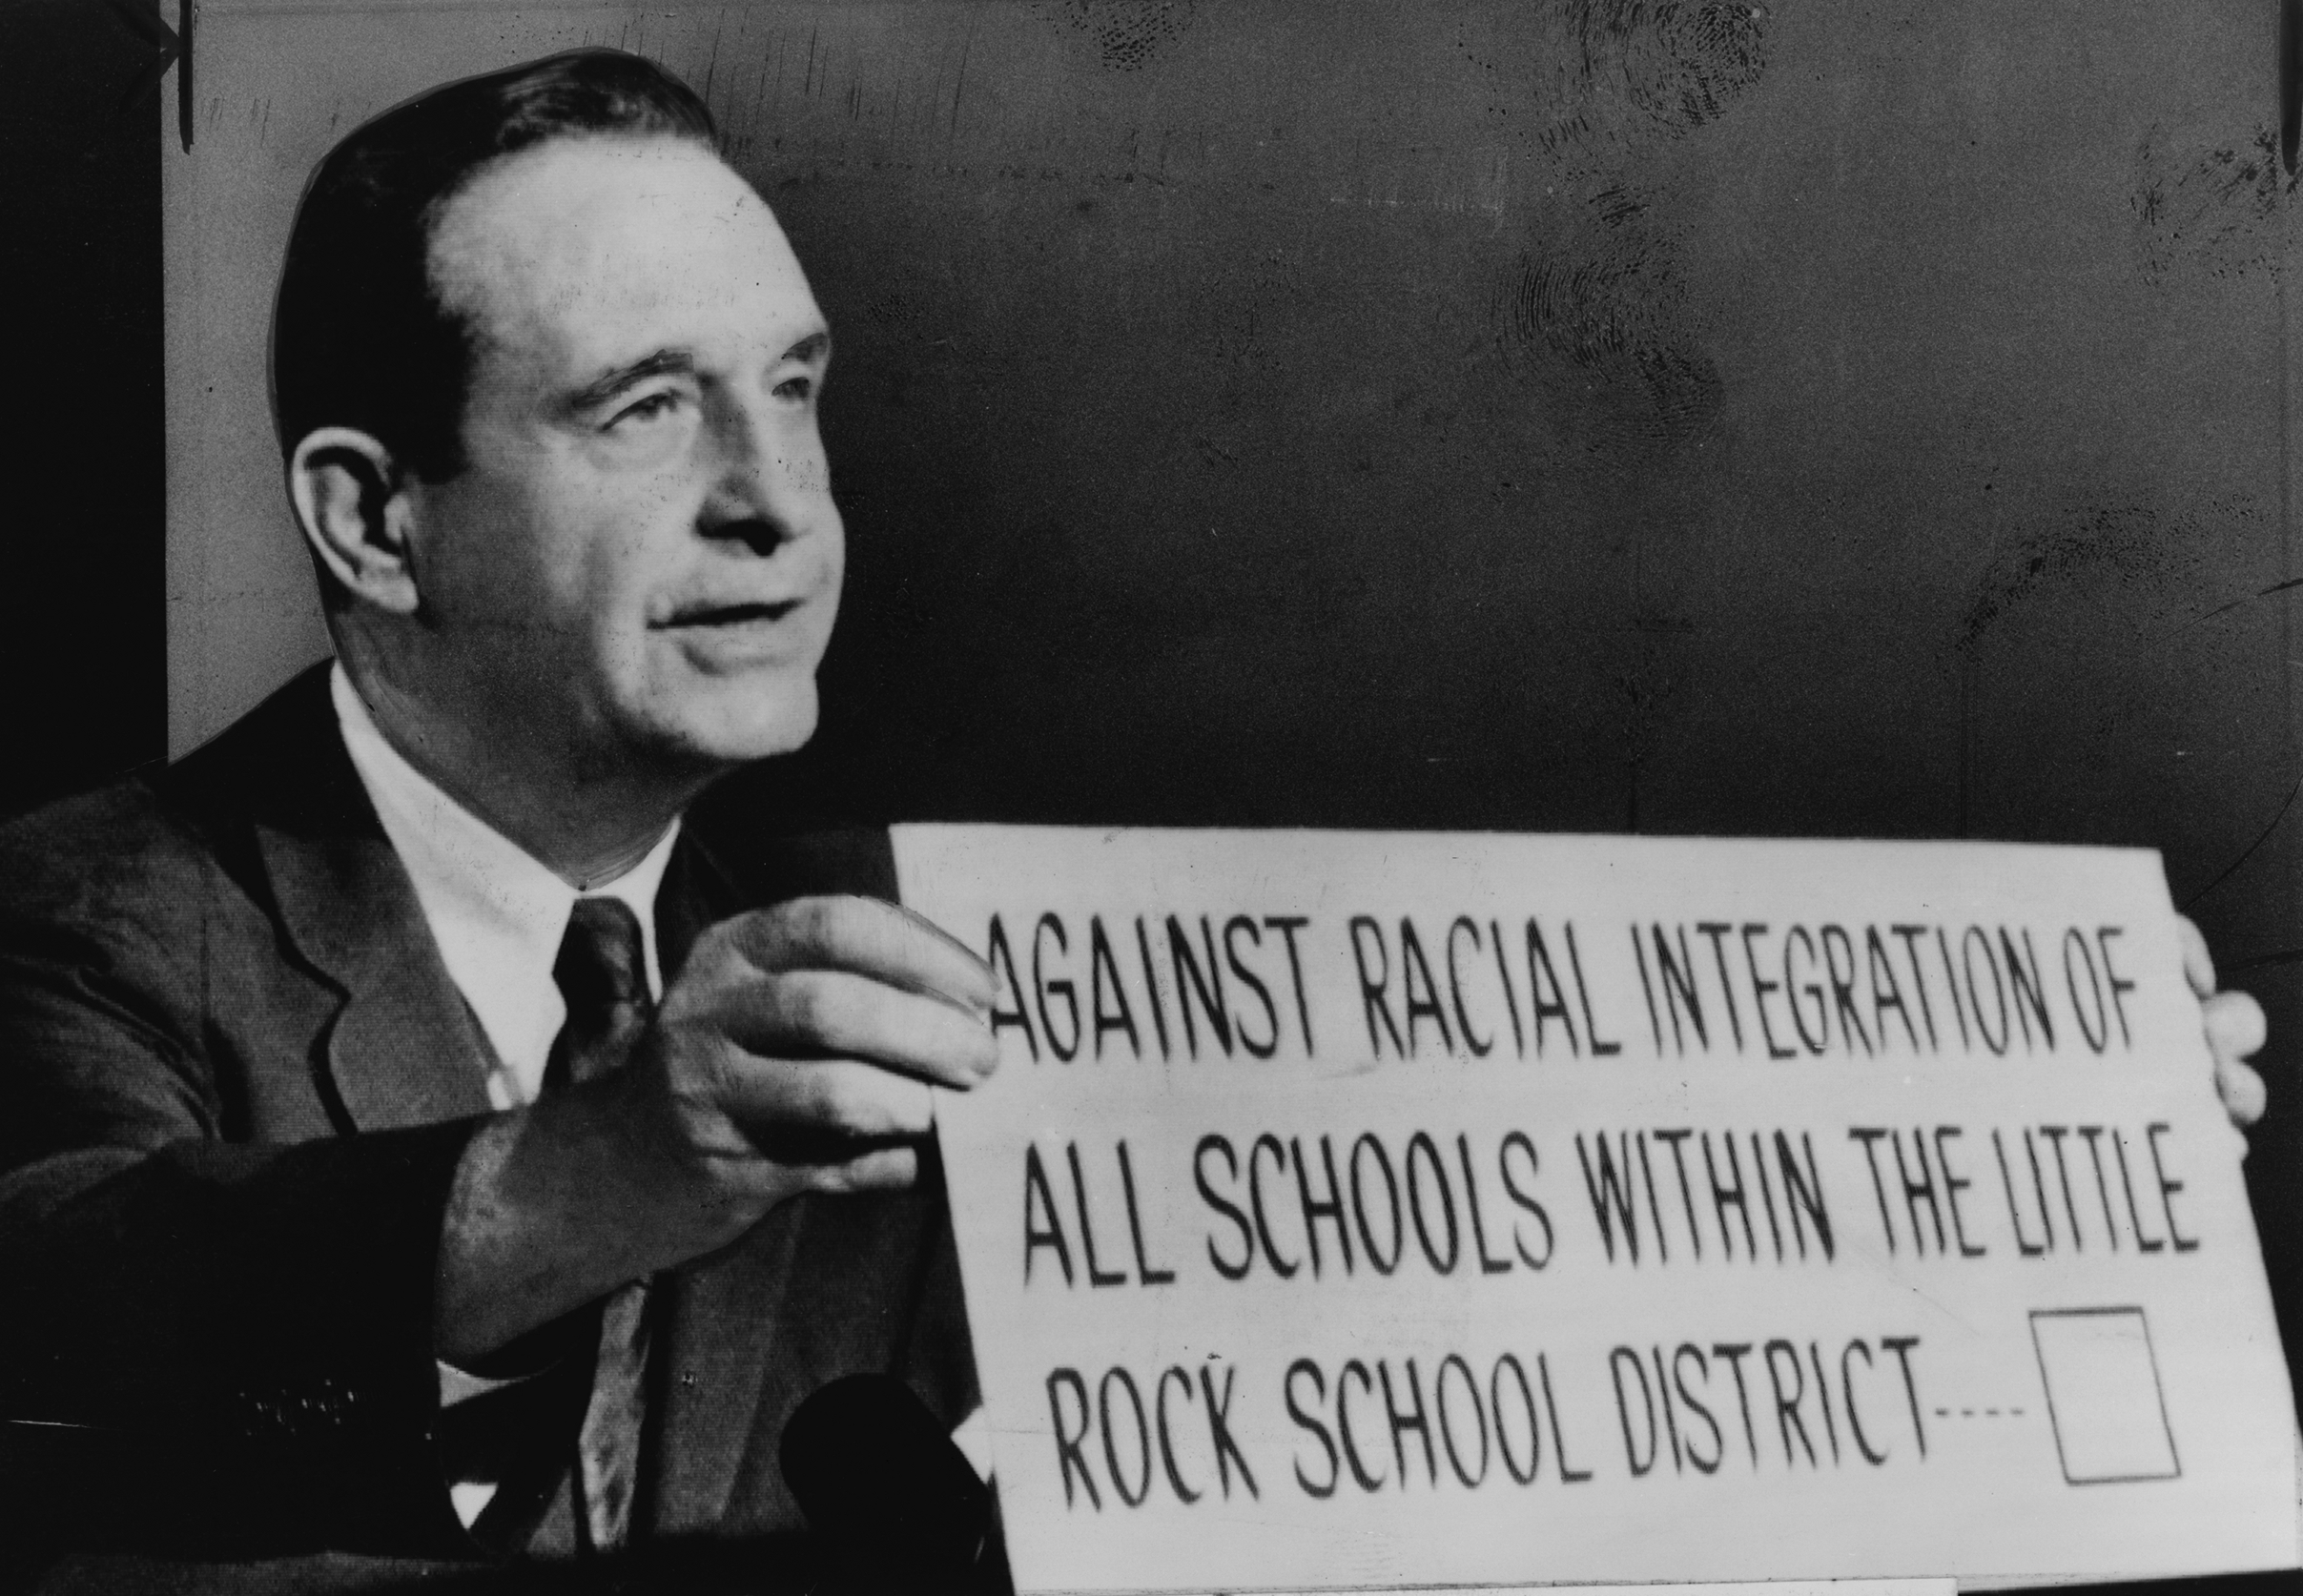
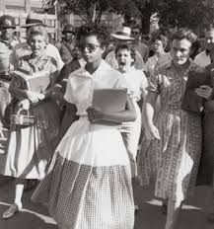
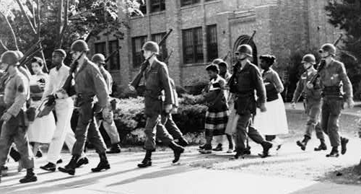
Little Rock, Arkansas 1957
Orval Faubus
Notes:
Orval Faubus
Gov. of Arkansas
Ordered the AK National Guard to surround the all-white Little Rock HS to prevent 9 black students (the “Little Rock Nine”)
from entering
Refused to provide protection to the black students
Pres. Eisenhower sent troops to make sure the students could attend

Slide 2
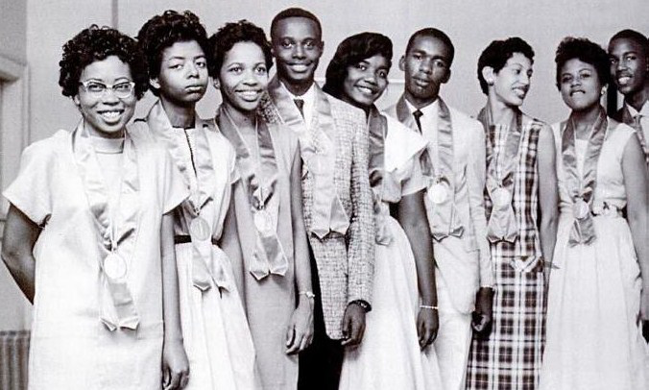
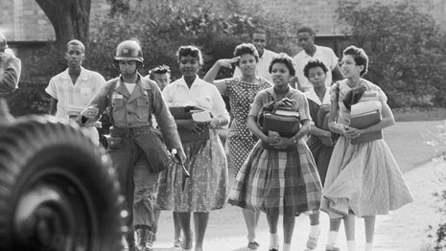
Little Rock Outcome
Other Governors:
Lester Maddox-
Alabama Gov. George Wallace
Notes:
Gov. Faubus closed the school down & asked to postpone integration
SC ruled against any delay & forced the school to reopen
Other Governors:
Lester Maddox- waved an ax at AA trying to enter his restaurant, later elected Gov. of GA
Alabama Gov. George Wallace- stood at the door to the U of Alabama to stop two AA from enrolling

Slide 3
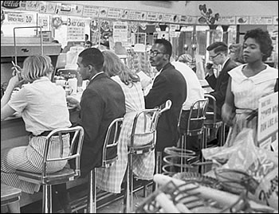
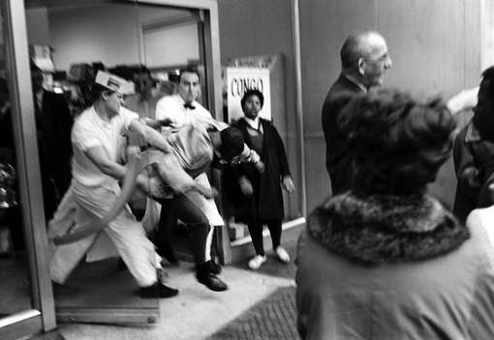
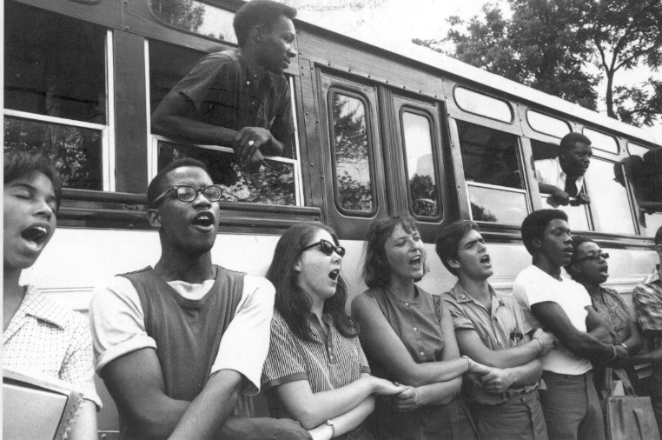
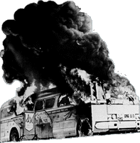
Sit-ins & Freedom Rides 1960-61
Notes:
Sit-ins
AA students sat at “whites only” lunch counters throughout the South
Freedom Rides
Interracial groups rode buses in protest
Result: stores desegregated & hired AA, confrontations forced the govt to intervene

Slide 4
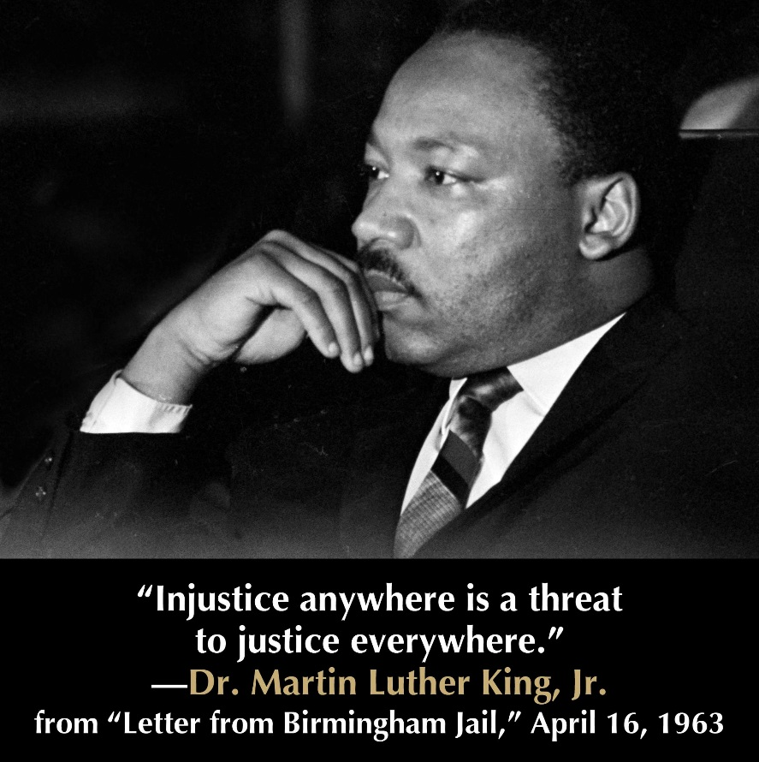
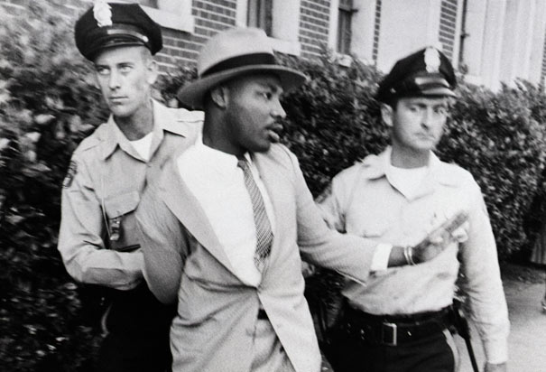
Martin Luther King Jr.
Believed in:
Non-violence
Civil disobedience
“Letters from a Birmingham Jail”
Notes:
Believed in:
Non-violence
Civil disobedience- if govt passed an unjust law, ppl should hold peaceful marches, boycotts, picketing, & demonstrations
Arrested while leading a march in Birmingham, AL
“Letter from a Birmingham Jail”
Explained the reasons why AA could no longer patiently wait for their constitutional rights from the courts

Slide 5
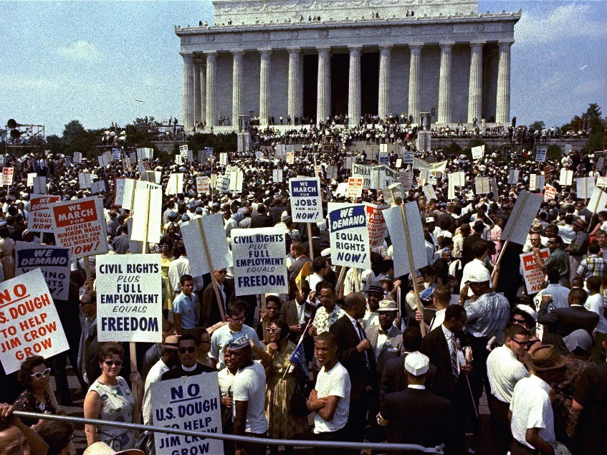
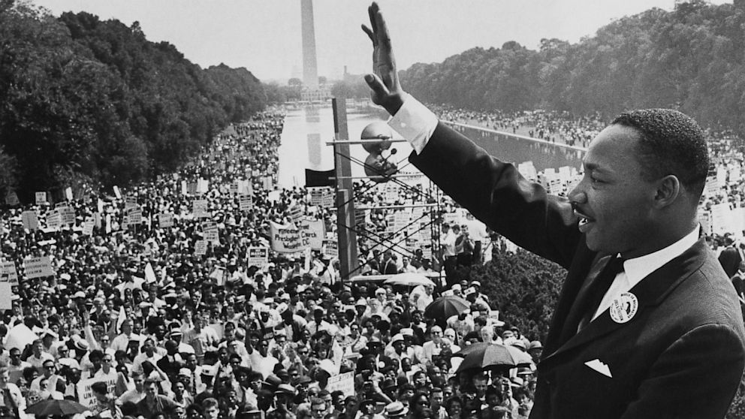
The March on Washington 1963
Notes:
MLK & other civil rights leaders organized a march to pressure Congress to pass the new CR bill
250,000 attended-largest demonstration for human rights in US history
MLK met with JFK, but JFK was assassinated a few months later

Slide 6
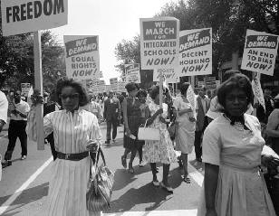
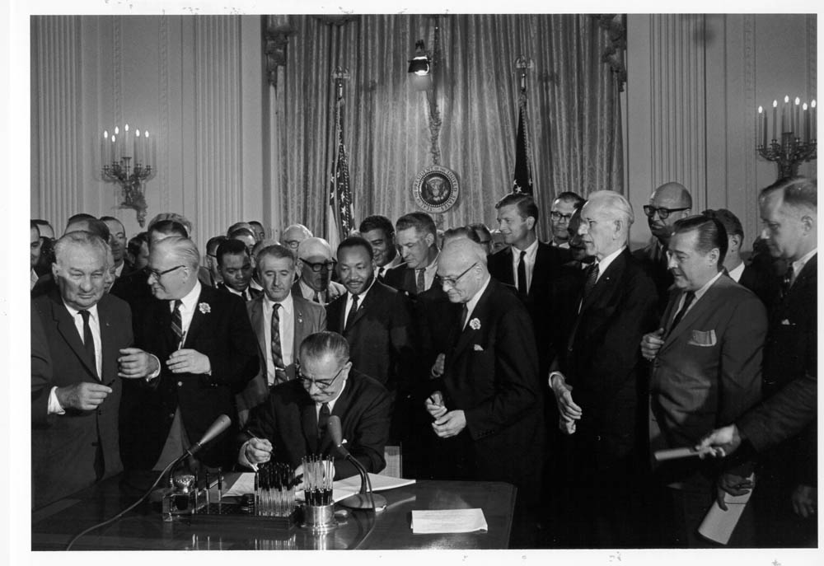
Civil Rights Act of 1964
Equal Employment Opportunity Commission
Notes:
Prohibited discrimination based on race, color, religion, or ethnic origin in hotels, restaurants, and all places of employment
doing business with the fed govt
Cut off fed. aid to schools with segregation
Gave the fed. govt power to register voters
Equal Employment Opportunity Commission enforced the laws

Slide 7
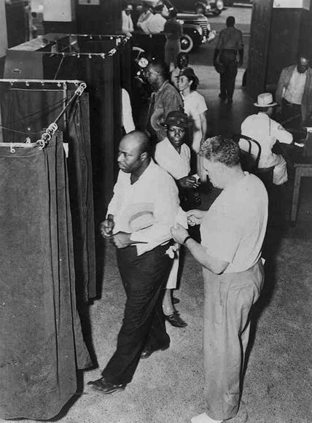
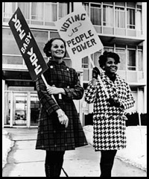
The Road to Equal Voting Rights
24th Amendment
Selma Marches
Voting Rights Act of 1965
Notes:
24th Amendment
1964 eliminated poll taxes in federal elections
Selma Marches
Voting demonstrators were attacked in Selma, AL
Pres. Johnson reacted by introducing a voting rights bill
Voting Rights Act of 1965
Ended poll taxes and literacy tests

Slide 8
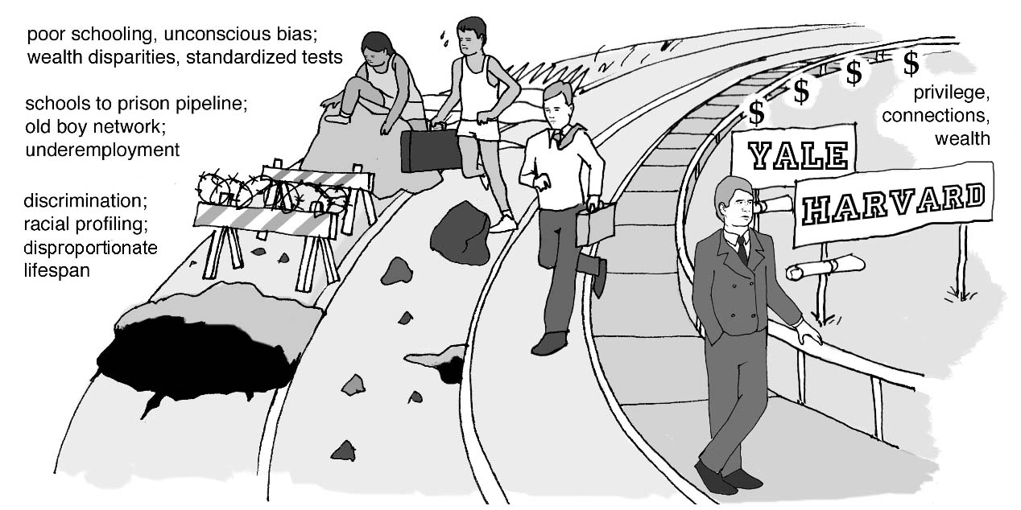
Affirmative Action
Notes:
Programs increased minority #s in colleges, careers, and many businesses to correct past imbalances
Critics called it reverse discrimination
Phased out over time

Slide 9
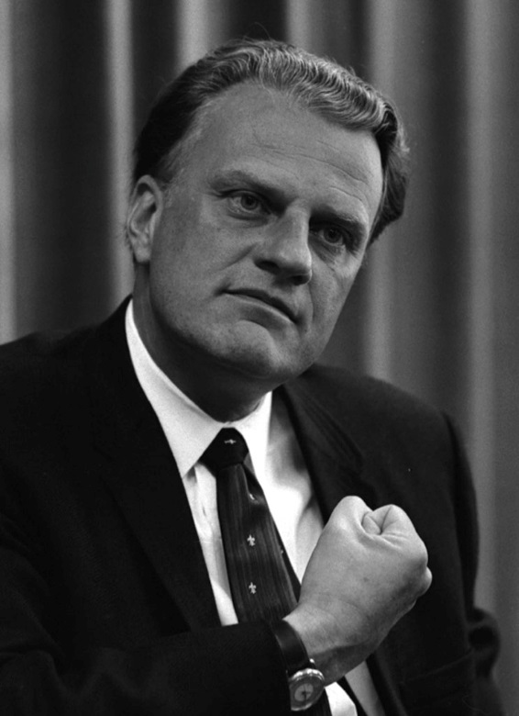
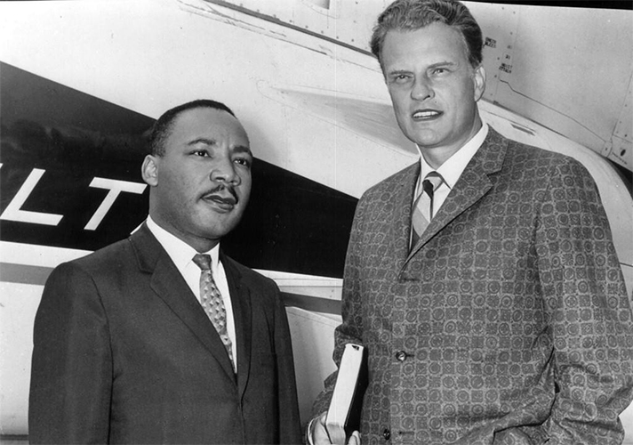
Billy Graham
Notes:
Christian preacher who supported civil rights
Paid to bail out MLK & toured with him
Advised Pres. Eisenhower to send troops to help Little Rock Nine

Slide 10
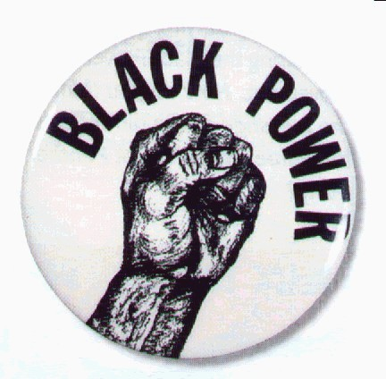
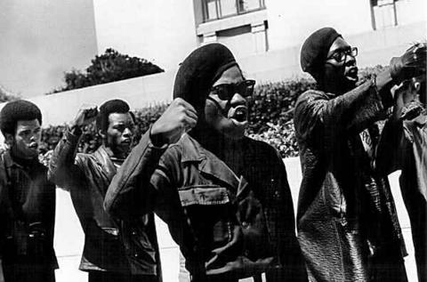
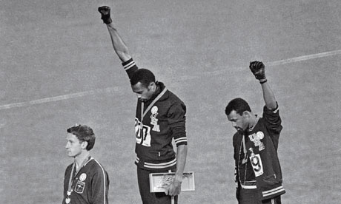
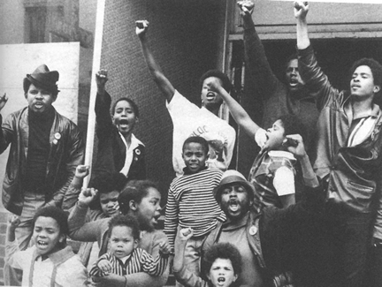
Black power
Notes:
Non-violent methods were not powerful enough
Blacks should control their own communities & businesses to free themselves from domination of whites

Slide 11
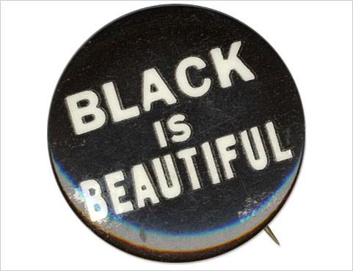
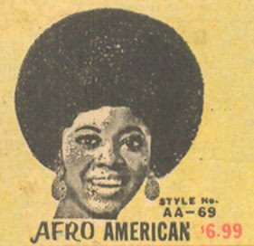
Search for a new Identity
Notes:
“Black is beautiful”
Afro haircuts & fashion based on African culture

Slide 12
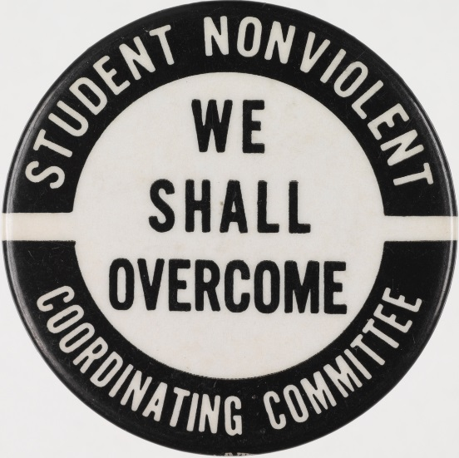
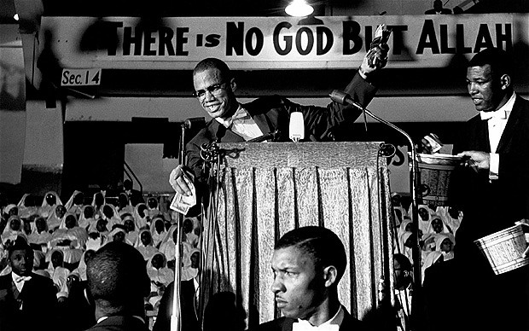
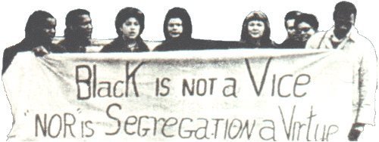
New Groups Emerge
Student Non-Violent Coordinating Committee (SNCC)
Black Muslims
Notes:
Student Non-Violent Coordinating Committee (SNCC)
Banned white participation
Black Muslims
Islam should be the black religion & form their own state

Slide 13
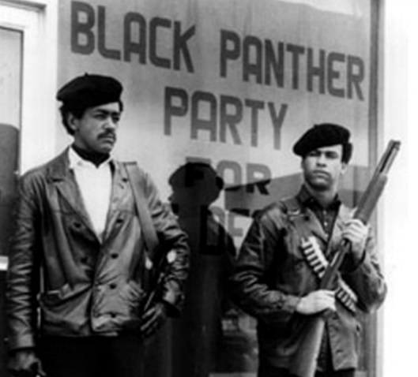
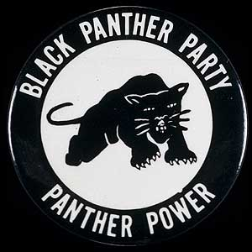
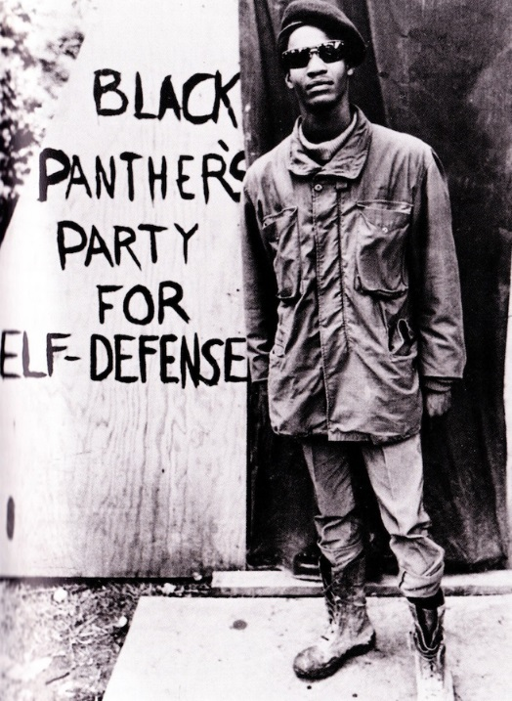
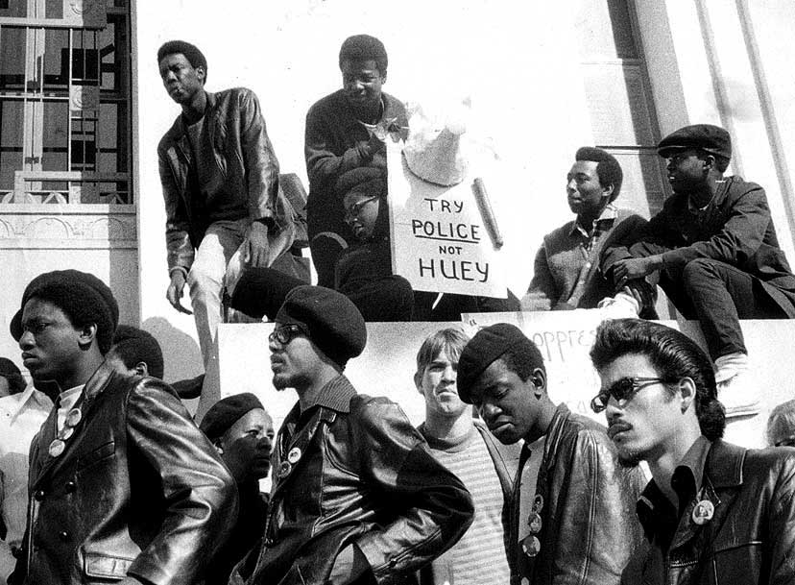
Black Panthers
Notes:
Black activists who demanded more opportunities and benefits for blacks
Full-employment, decent housing, & education
Founded in Oakland, CA
Claimed the right to carry weapons to protect black neighborhoods from the police

Slide 14
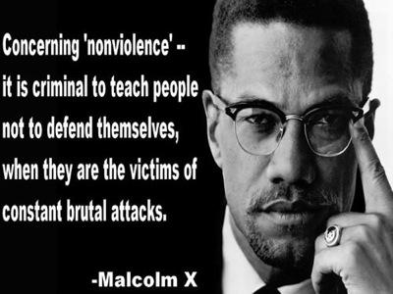
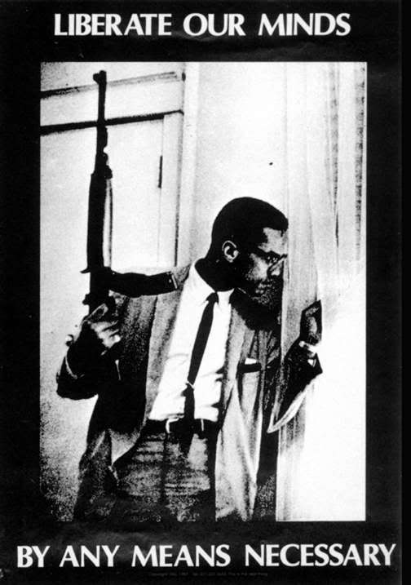
Malcolm X
Notes:
Black Muslim leader who questioned MLK’s non-violence
Should meet violence with violence
Assassinated by rival Black Muslims in 1965

Slide 15
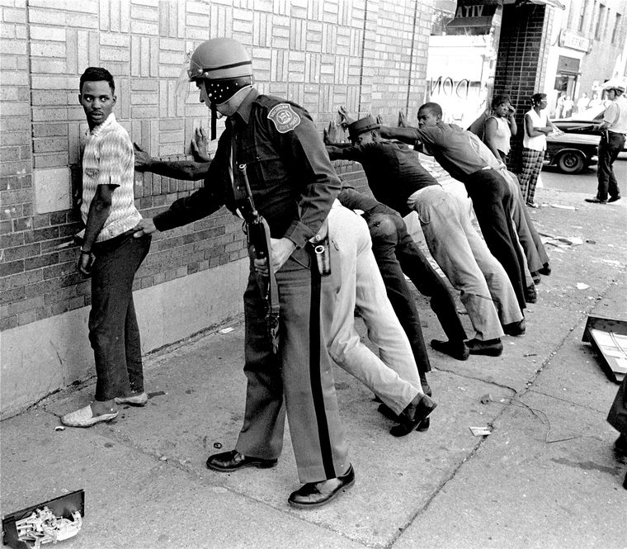
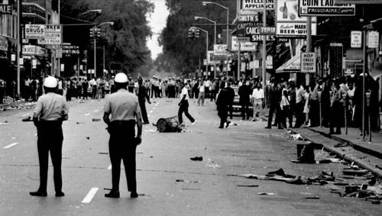
The Ghettos Erupt 1968
Ghettos
Watts Riots-1965
Notes:
Ghettos- ethnic communities in decaying inner cities where blacks were forced to live
Whites would not sell their middle class homes to blacks
Frustration erupted in a series of riots
April 1968 MLK was assassinated by a white supremacist in TN
Sparked race riots across the nation
Showed that there was still work to be done to eliminate racism

