Slide 1
Ch. 25: The Global Crisis, 1921-1941
Focus Questions:
Explain why the Treaty of Versailles was seen as a failure.
Identify attempts at US neutrality before WWII.
Identify the totalitarian dictators who took power before WWII.
What was the American response to the looming fog of war throughout the world?
Describe the events that led to the outbreak of WWII.
Explain how the United States got further away from neutrality.
Explain the importance of US aid to Britain and how the invasion of Russia was a turning point in the war.
Analyze why the United States eventually joined the war effort and the outcome of the Pearl Harbor attack.
Notes:
1
The purpose of the focus questions is to help students find larger themes and structures to bring the historical evidence, events, and examples together for a connected thematic purpose.
As we go through each portion of this lecture, you may want to keep in mind how the information relates to this larger thematic question. Here are some suggestions: write the focus question in the left or right margin on your notes and as we go through, either mark areas of your notes for you to come back to later and think about the connection OR as you review your notes later (to fill in anything else you remember from the lecture or your thoughts during the lecture or additional information from the readings), write small phrases from the lecture and readings that connect that information to each focus question AND/OR are examples that work together to answer the focus question.

Slide 2
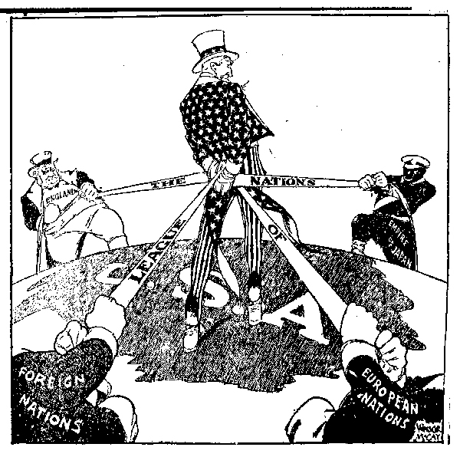
The Diplomacy of the New Era
Replacing the League
*US negotiated separate treaties with Central Powers
*sought to secure certain safeguards from future wars
Washington Naval Conference, 1921
*meeting between US, Britain and Japan
*promised to restrict build-up of large navies
*no way to enforce the agreement
Kellogg-Briand Pact, 1928
*pact between 62 nations
*agreed to outlaw war
*no way to enforce the agreement
Hoover
*refused to support Roosevelt Corollary
*supported circular loans to Europe
Dawes Plan (circular loans)
*US banks loan $ to Germany -> pays B&F -> pays US
*everyone’s economy crashes
FDR
*ended circular loans
*European nations defaulted on their payments to US

Slide 3
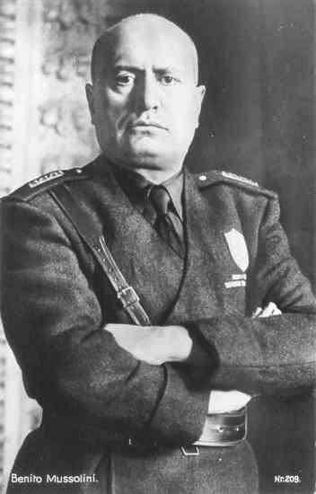
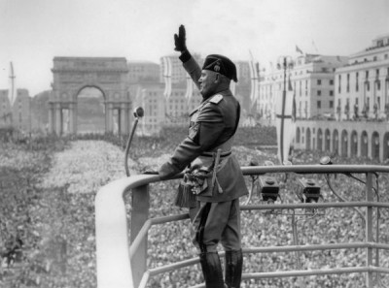
The Rise of Totalitarianism: Fascism
Benito Mussolini (Italy)
*leader of the Fascist Party
-highly nationalistic and militaristic
-govt. controlled; media, military, economy
*wanted to recreate the Roman Empire
*began expanding territory
Invasion of Ethiopia, 1935
*action protested by the League of Nations
*Italy resigned from the League and formed Axis w/ Germany

Slide 4
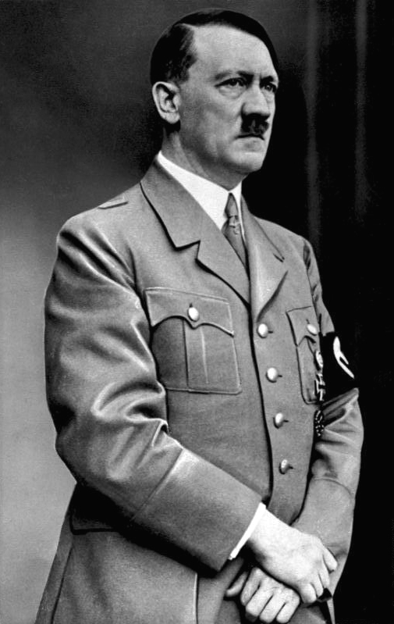
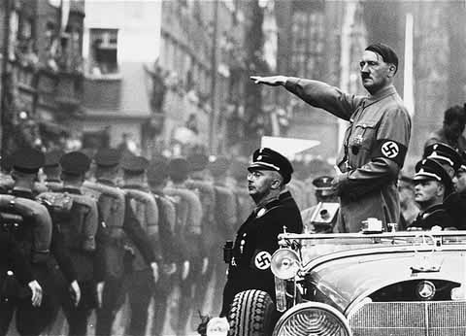
The Rise of Totalitarianism: National Socialism
Adolf Hitler (Germany)
*rose to power due to bad economy
*leader of the Nazi (National Socialist German Workers) Party
*remilitarized Germany
Lebensraum “Living Space”
*the need to expand territory to make room for the Aryan “master” race
*Mein Kampf “My Struggle” – the Final Solution

Slide 5
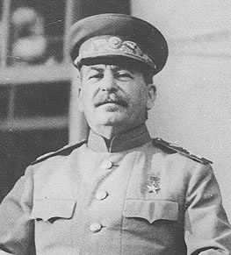
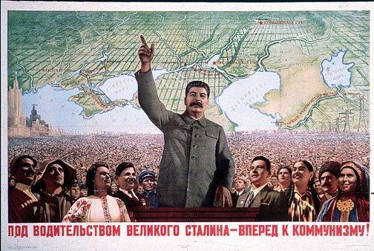
The Rise of Totalitarianism: Communism
Joseph Stalin (Russia)
*rose to power along with Lenin
*instituted a communist regime
-govt. control of everything
-equal distribution of wealth
-dissenters sent to gulags (millions died)
*this soured the relationship with the US
*FDR tried to open up trade with Soviets
-US recognized Stalin’s regime for first time in 1933
*relationship eventually broke down again

Slide 6
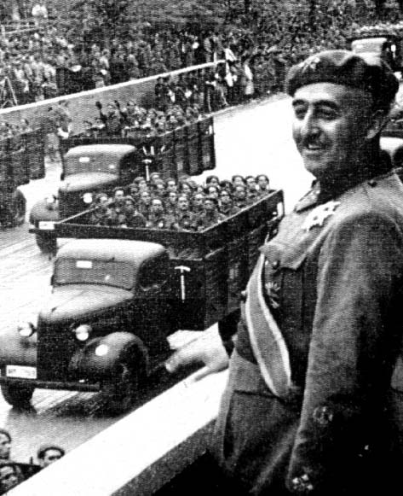
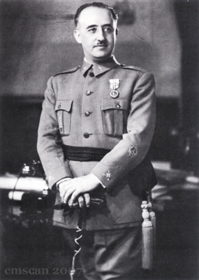
The Rise of Totalitarianism: Fascism
Francisco Franco (Spain)
*Spanish Civil War, 1936
*longest lasting fascist regime (1970’s)
*good relationship with Hitler and Mussolini

Slide 7
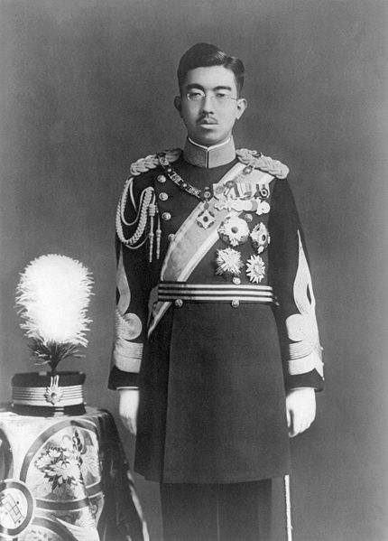
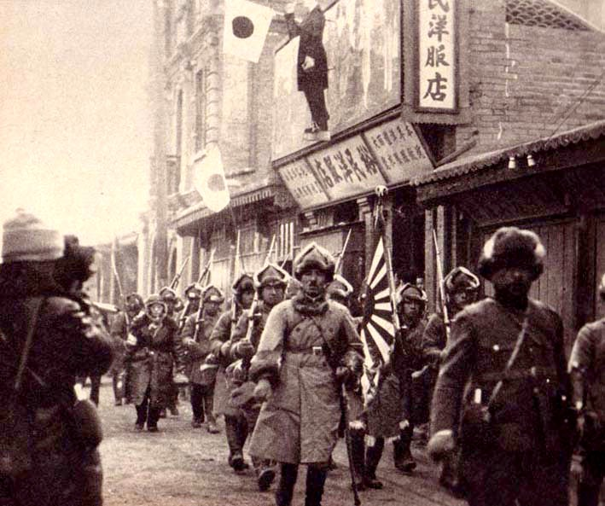
The Rise of Totalitarianism: Militarism
Emperor Hirohito (Japan)
*hands over control of the govt. to the military after coup
*Japan looking to expand throughout Pacific
Invasion of Manchuria, 1931
*thousands of civilians murdered
*Japan leaves League of Nations and joins Axis Powers
Further Invasion of China, 1937
*numerous atrocities
*condemned by the US
*US issues economic sanctions on Japan
-freeze Japanese assets in US - no more oil, rubber, steel

Slide 8
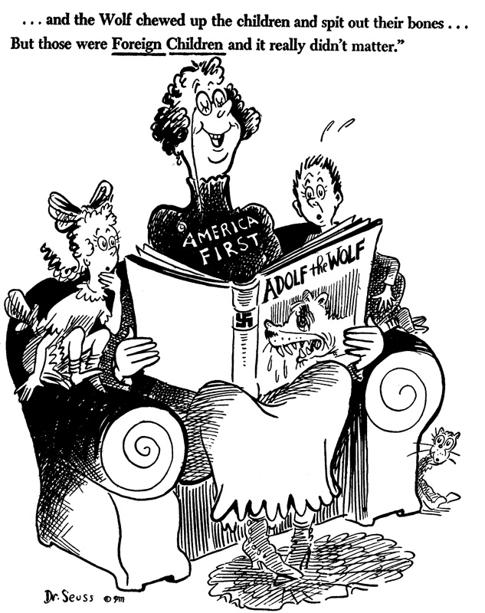
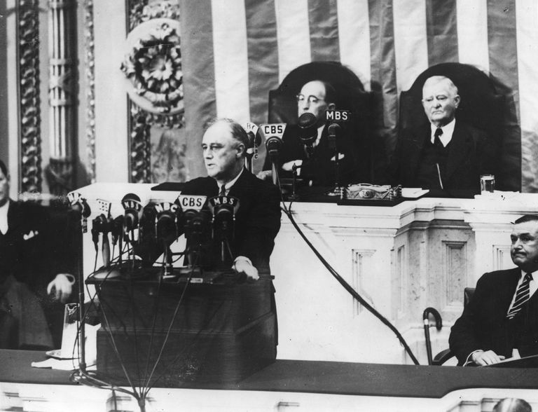
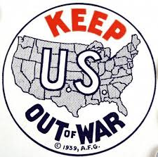
The Rise of Isolationism
Neutrality Acts (1935-1937)
*designed to keep US out of foreign entanglements
*US could not sell weapons to nations at war
-didn’t matter if nation was aggressor or victim
- “cash and carry” policy on non-military goods
Quarantine Speech – FDR, October, 1937
*Response to Japanese aggression in China
*belligerent nations should be “quarantined”
-peaceful nations should not trade with nations at war
-many people criticized FDR for this

Slide 9
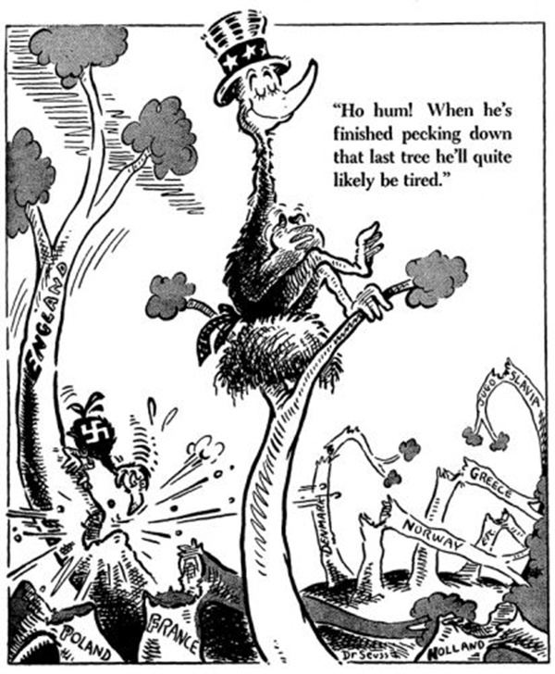
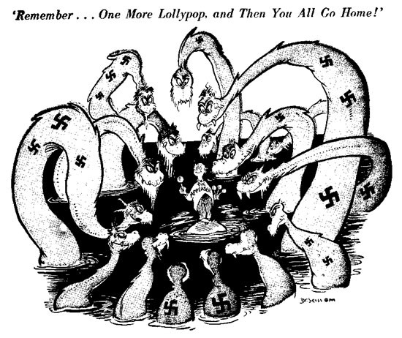
The Failure of Appeasement
German occupation of the Rhineland, 1936
*clear violation of the Treaty of Versailles
Hitler’s Anschluss - 1938
*occupation of Austria & Sudetenland (Czechoslovakia)
The Munich Agreement, 1938
*conference in Munich between Germany, Britain, France
*Hitler agreed to stop occupying territory
*claimed to only be bringing German speaking people together
*Britain and France support appeasement to avoid war
*massive failure when Hitler invades all of Czechoslovakia
Invasion of Poland, 1939
*Germany introduces new style of warfare: Blitzkrieg
-fast moving troops supported by; vehicles, tanks, planes
*Britain and France declare war on Germany
Nazi-Soviet Nonaggression Pact, 1939
*Germany takes western Poland
*Russia agrees to take eastern Poland
Invasion of Denmark, Norway, the Netherlands, Belgium

Slide 10
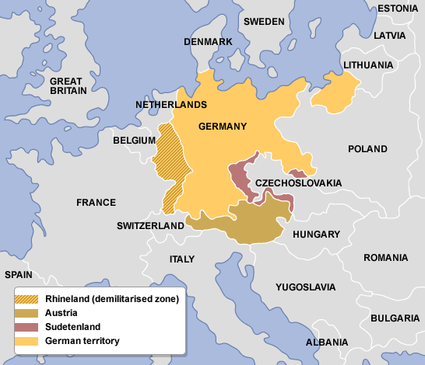
Notes:
This map shows German gains prior to their invasion of France
Germany had taken European leaders completely by surprise
They had militarized and taken large parts of Europe with no resistance

Slide 11
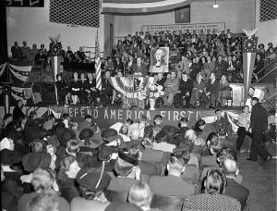
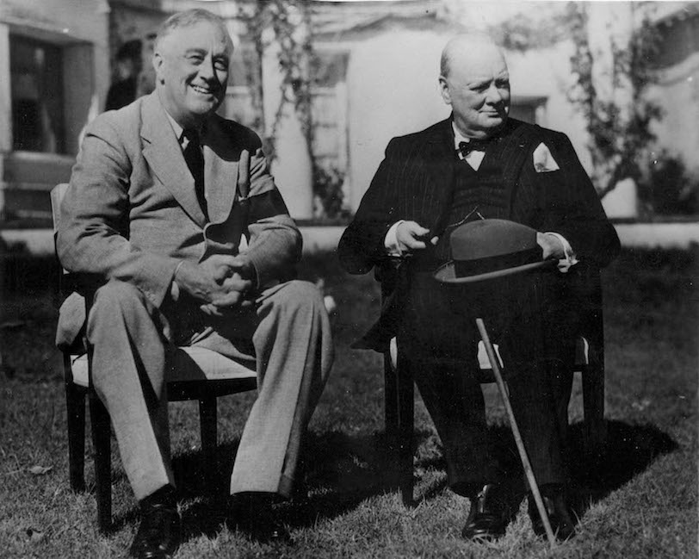
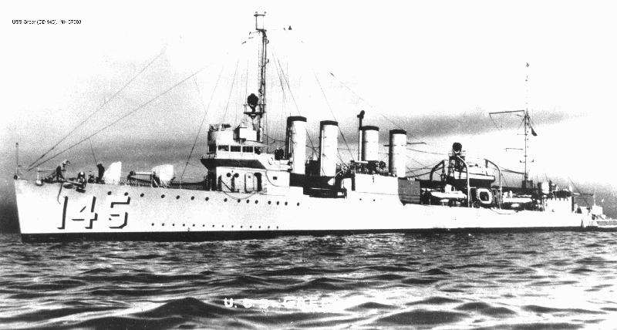
Shifting Public Opinion
Committee to Defend America
*interventionists who favored aid to allies
America First – isolationists (Charles Lindbergh)
Neutrality Act of 1939
*designed to help B & F
*US could sell weapons to democracies via “cash and carry”
Arsenal of Democracy speech
*FDR claimed US should aid European nations resisting Germany
Atlantic Charter
*wartime meeting between US (FDR) and Britain (Churchill)
*outlined economic and wartime cooperation

Slide 12
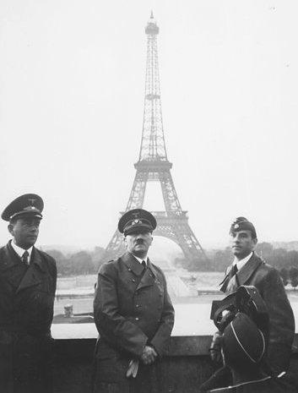
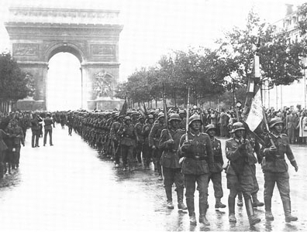
The Storm in Europe
Fall of France - May 1940
*French defenses totally unprepared for the Blitz
-billions poured into outdated defenses along Maginot line
*British soldiers rescued at Dunkirk
*Vichy France established
-French army loyal to Nazis

Slide 13
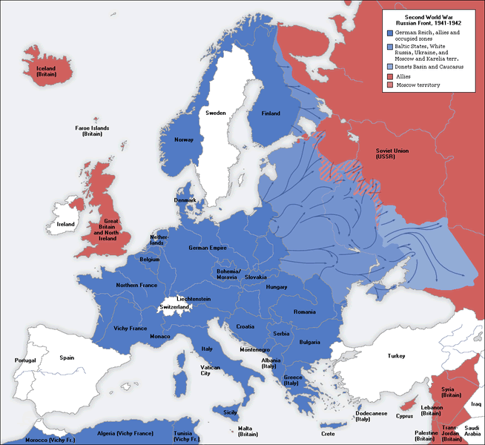

Slide 14
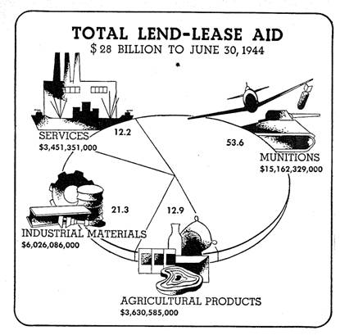
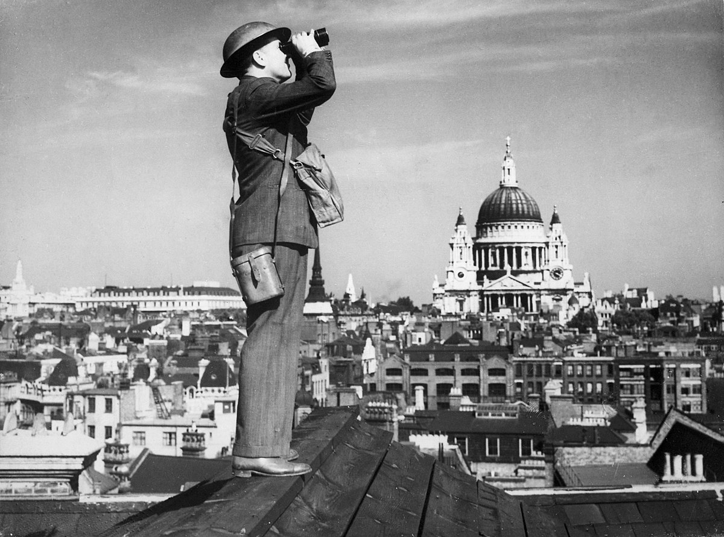
The Storm in Europe
The Battle of Britain, June-October, 1940
*Hitler turns his attention to Britain
*24-7 bombardment by air
*Britain refuses to surrender
Lend-Lease Act, 1940
*Britain could no longer afford, “cash and carry”
*FDR needed to find a way to help our ally
*afraid that if Britain fell the US would be next
*LLA allowed US to “sell, lend or lease” anything to any nations whose defense was vital to the US
*many argue this saved Britain and got US involved

Slide 15
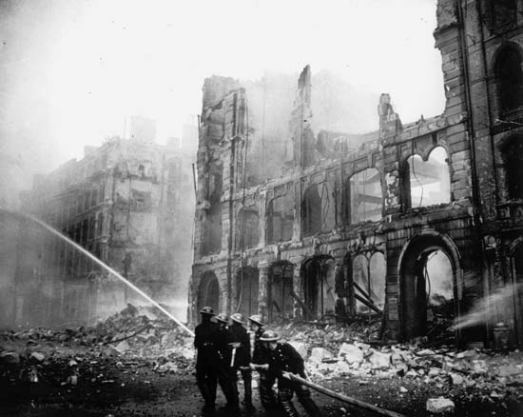
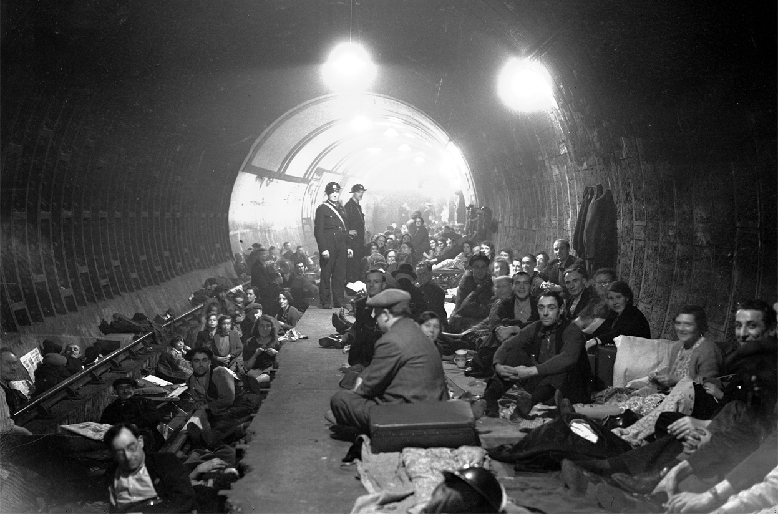
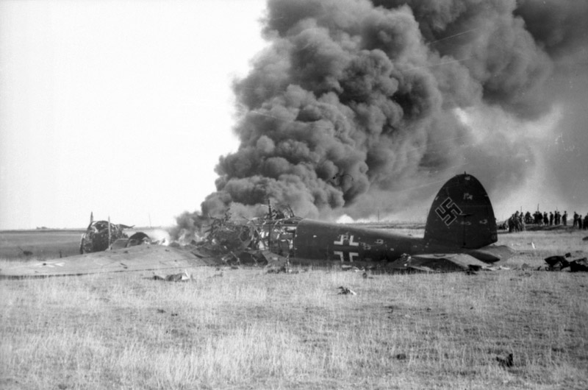
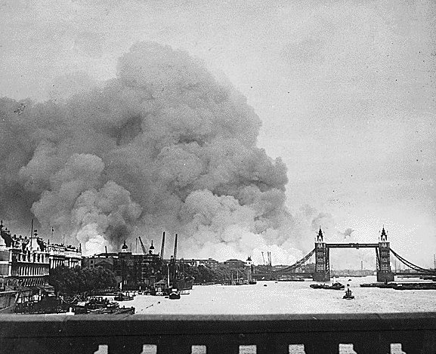
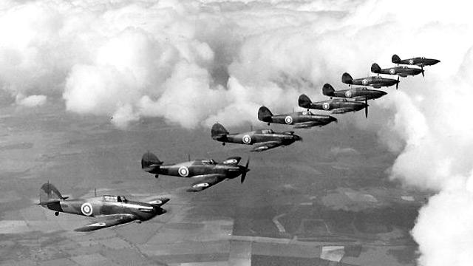
The Battle of Britain
Notes:
Battle of Britain
-was the largest aerial bombing campaign in history
-once Germany finished with France they turned their efforts toward neutralizing Britain
-After the debacle of the Munich Agreement, Prime Minister Neville Chamberlin was replaced by Winston Churchill
-Many expected the British to negotiate a peace with Hitler but instead Churchill delivered a defiant speech to Parliament intended to rally the British people and hopefully persuade isolationist US to join Britain
-Once Britain refused to surrender Germany began to soften British defenses for a future land invasion by implementing numerous bombing raids into mainland Britain
-London was hit the worst however the British proved to be hard headed
-eventually the British RAF (Royal Air Force) began to turn the tide and inflict huge losses on the German Luftwaffe
-by October the Germans had failed to destroy British air defenses and was forced to give up hope of taking Britain
-was seen as the first major defeat of the Germany army and a major turning point in the war

Slide 16
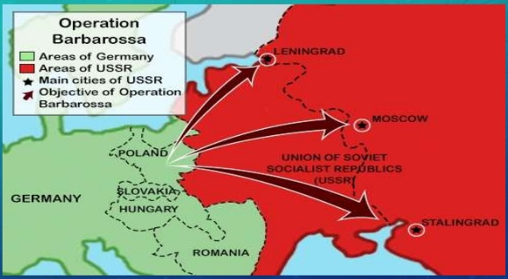
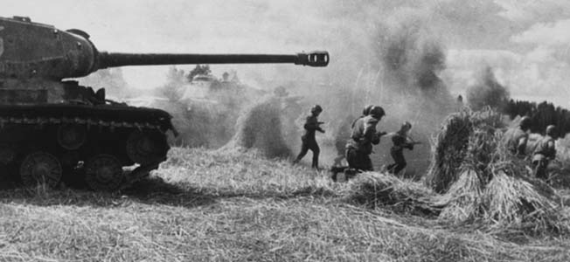
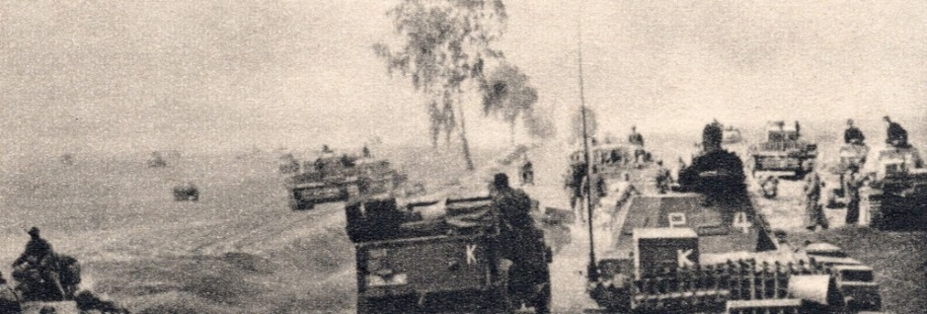
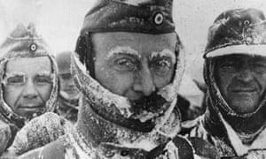
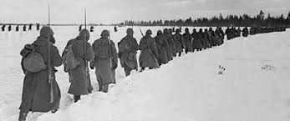
Operation Barbarossa
Hitler’s invasion of Russia, June 1941
*Germany unable to gain victory over Britain
*decides to invade Russia
-needs access to Russian oil and land
*one of Hitler’s biggest mistakes and a turning point in the war
-underestimated Russian resistance and climate
-millions of casualties for both sides
-Germany now fighting a two front war

Slide 18
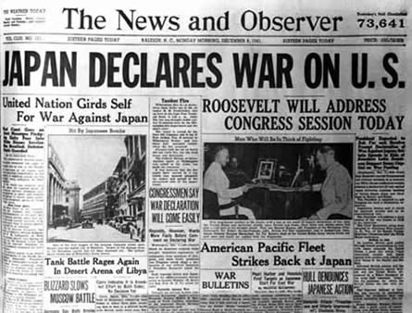
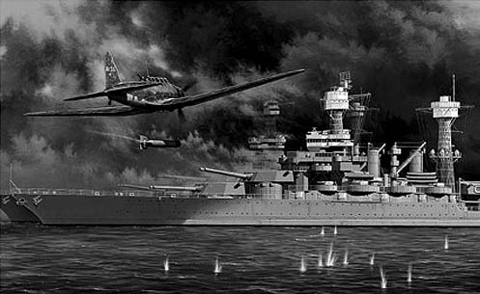
Awaking a Sleeping Giant
Pearl Harbor – December 7, 1941
*weeks before attack the Japanese sought peace
*they were secretly planning the attack
*hoped to damage America’s fleet and take us out of war
*hundreds of Japanese planes attacked in two waves
-188 US planes destroyed
-19 ships sunk including 4 battleships
-2,400 killed and 1,200 wounded (mostly on USS Arizona)
Failures of the attack
*none of US aircraft carriers destroyed
*none of our fuel tankers or dry docks destroyed
*underestimated American resolve and mobilization ability
FDR’s Speech – “A date which will live in infamy”
*FDR asks for a declaration of war on December 8

Slide 19
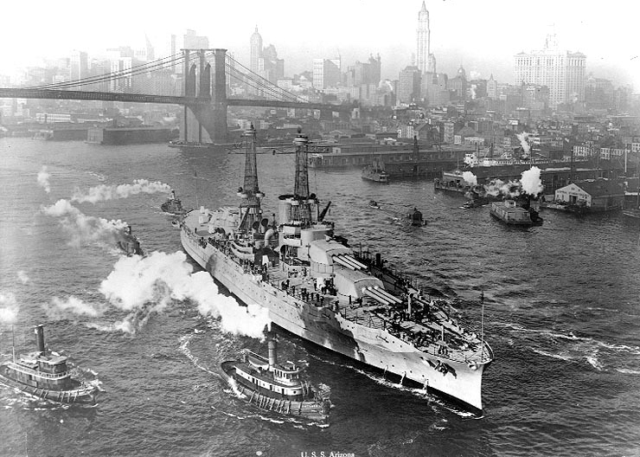
USS Arizona in New York

Slide 20
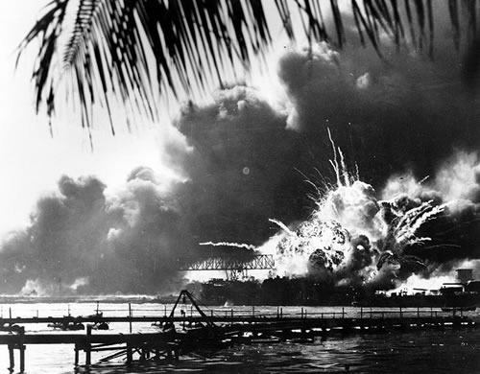
USS Arizona

Slide 21
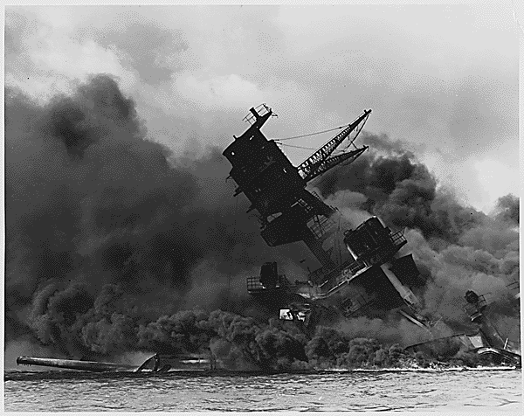

Slide 22
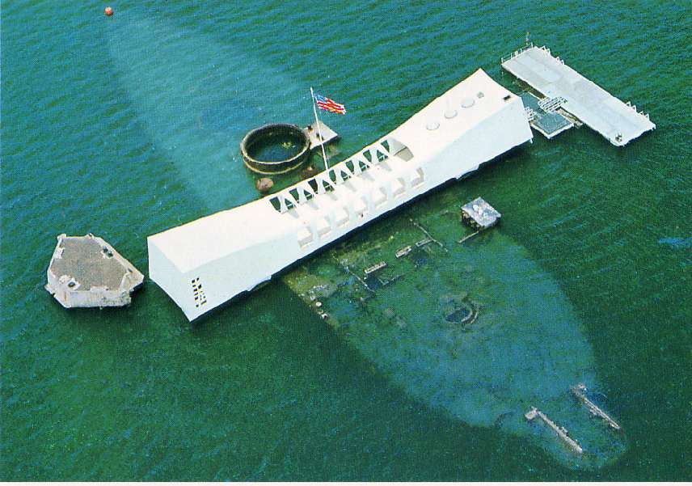

Slide 23
Pearl Harbor Attack:
https://youtu.be/-ZJ3T7PBO6Q

Slide 24
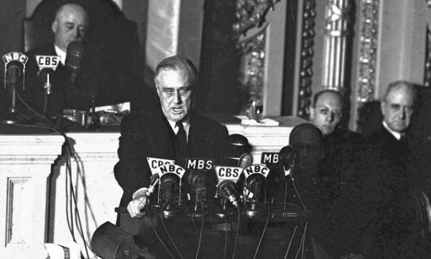
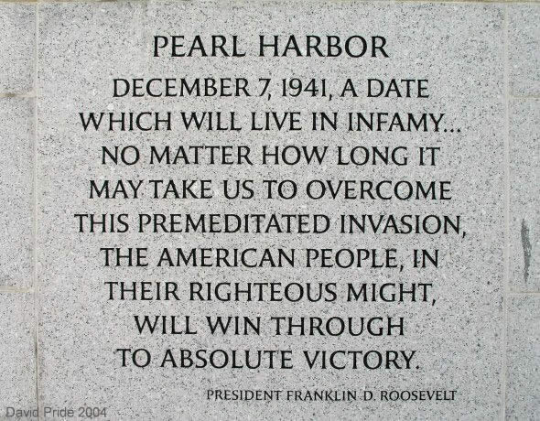
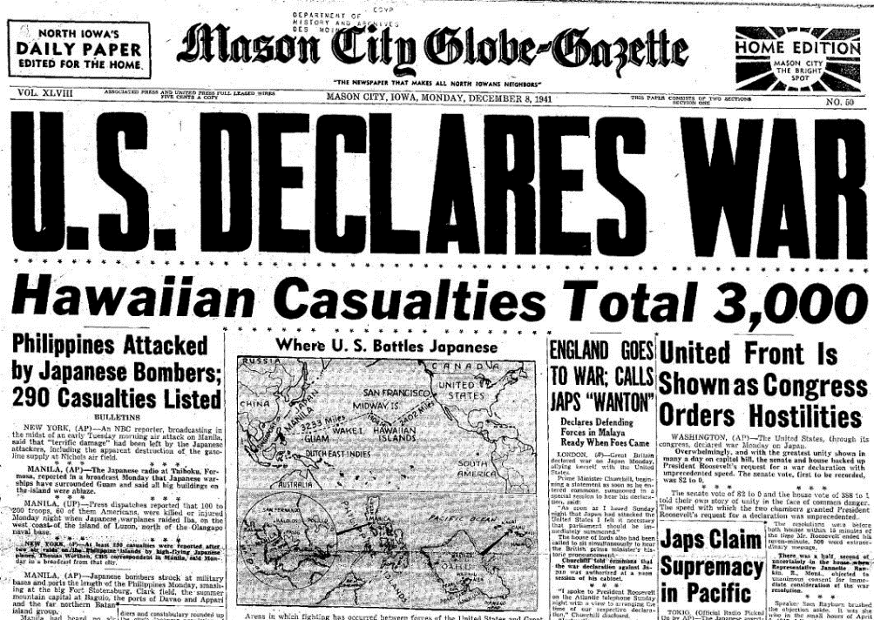
Declaring War:
http://www.youtube.com/watch?v=s7hc0oyEfgE

Slide 25
Ch. 25: The Global Crisis, 1921-1941
Focus Questions:
Explain why the Treaty of Versailles was seen as a failure.
Identify attempts at US neutrality before WWII.
Identify the totalitarian dictators who took power before WWII.
What was the American response to the looming fog of war throughout the world?
Describe the events that led to the outbreak of WWII.
Explain how the United States got further away from neutrality.
Explain the importance of US aid to Britain and how the invasion of Russia was a turning point in the war.
Analyze why the United States eventually joined the war effort and the outcome of the Pearl Harbor attack.
*Homework is due tomorrow (Ch. 25) and Monday (Ch. 26)*
Notes:
25
The purpose of the focus questions is to help students find larger themes and structures to bring the historical evidence, events, and examples together for a connected thematic purpose.
As we go through each portion of this lecture, you may want to keep in mind how the information relates to this larger thematic question. Here are some suggestions: write the focus question in the left or right margin on your notes and as we go through, either mark areas of your notes for you to come back to later and think about the connection OR as you review your notes later (to fill in anything else you remember from the lecture or your thoughts during the lecture or additional information from the readings), write small phrases from the lecture and readings that connect that information to each focus question AND/OR are examples that work together to answer the focus question.

Slide 26
Ch. 25 SAQ
Briefly explain ONE example of American efforts in the 1920’s and 30’s to deal with the increasing global political crises, while still remaining in a relatively isolationist position.
Briefly explain a SECOND example of American efforts in the 1920’s and 30’s to deal with the increasing global political crises, while still remaining in a relatively isolationist position.
Briefly explain ONE example of how the US broke away from that isolationist position due to events in the 1930’s and 40’s.

