Slide 1
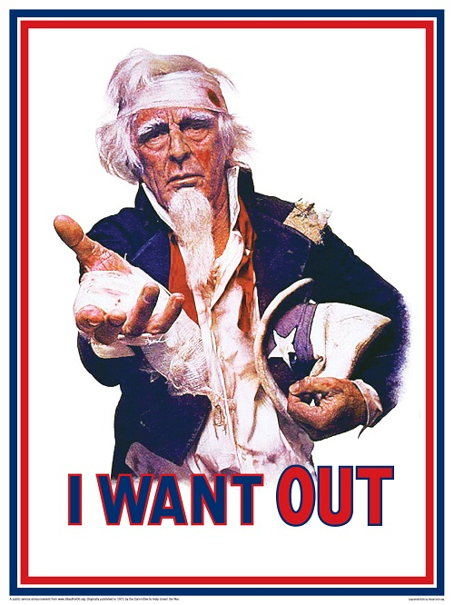
Counterculture of the 1960’s

Slide 2
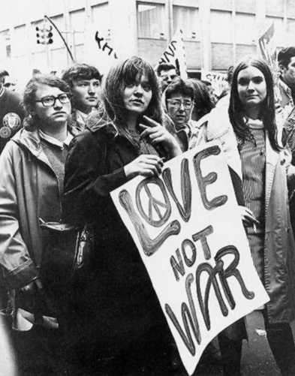
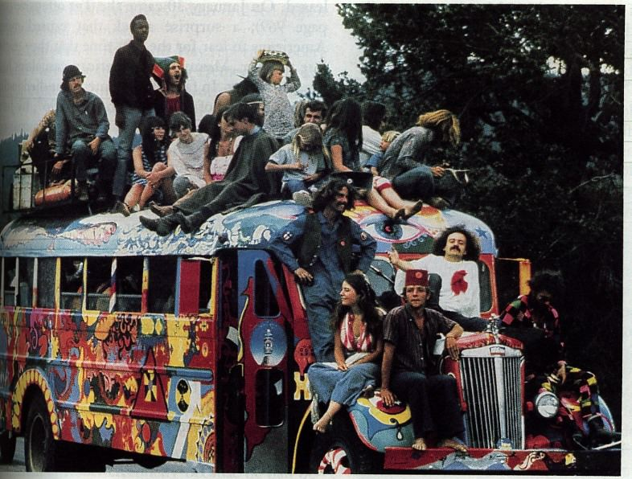
The Youth Culture of the 60’s
“Baby boomers” who reached their 20’s by the 1960’s
Influenced by post-war prosperity & TV
Objected to corporate America & the “Establishment”
Those in charge of society

Slide 3
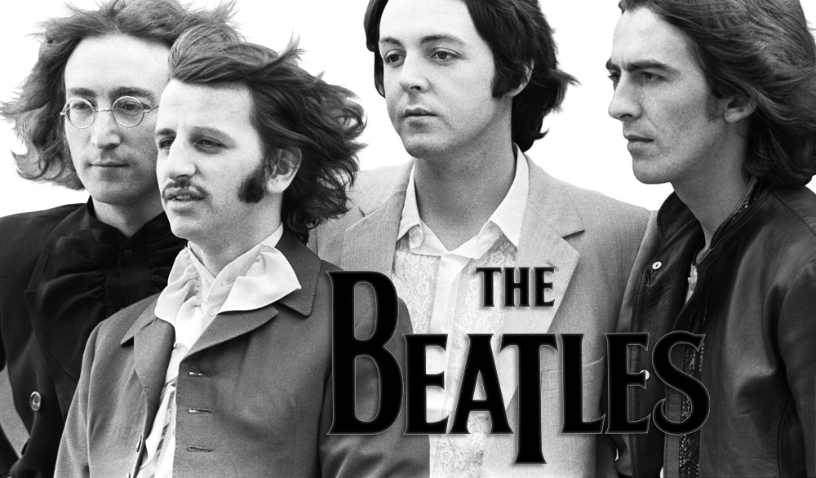
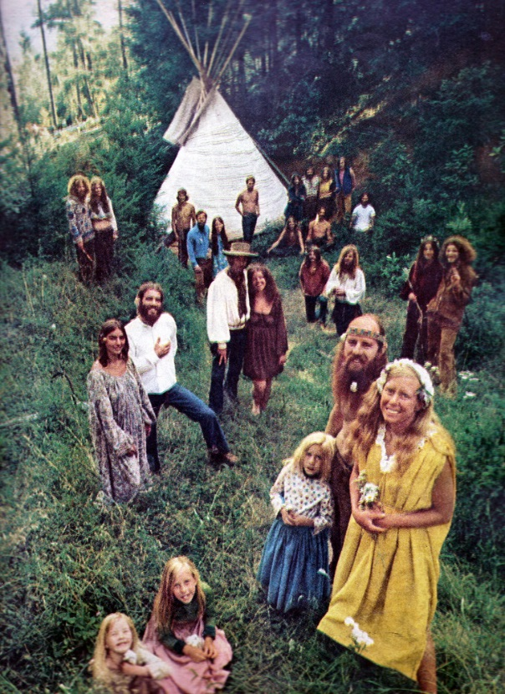
New Life-Styles
The Beatles
A rock band from England
Introduced new fashions and long hair styles for males
The new youth culture experimented openly with drugs & sex
Hippies
Left mainstream society altogether & went to live on self-sufficient communes

Slide 4
Beginning of the Vietnam War 1954-1973

Slide 5
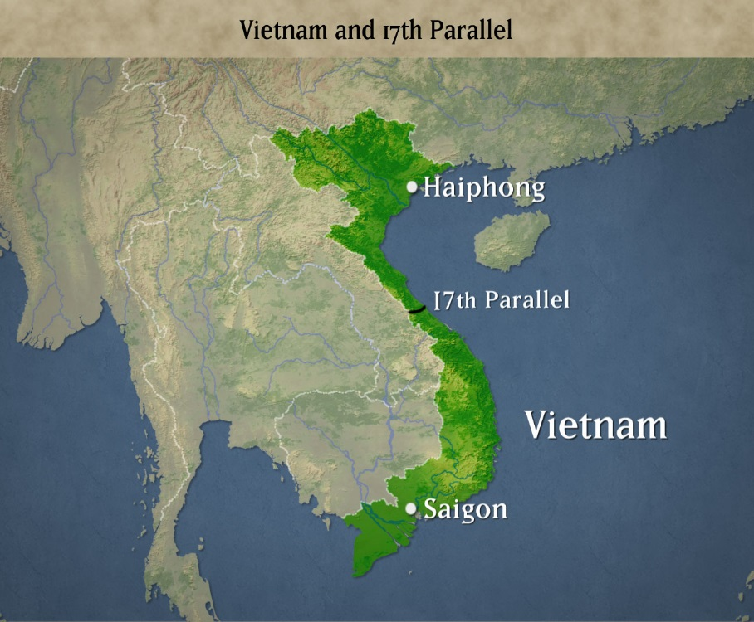
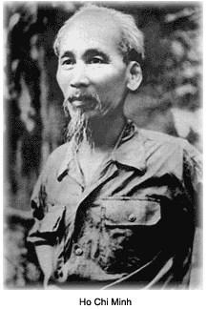
Vietnam
Once was a French colony in Indochina
1954 Ho Chi Minh defeated the French rulers
Geneva Conference
Vietnam was divided into 2 nations-
North- controlled by Ho Chi Minh & communists
South- controlled by Western nations
Supposed to be reunited after elections in 1956

Slide 6
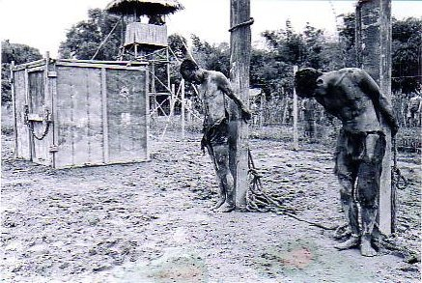
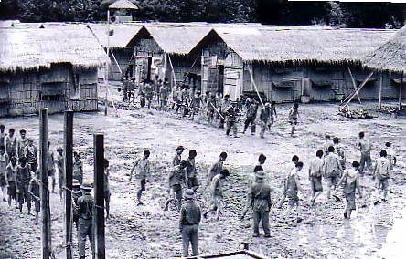
Ho Chi Minh introduced:
Land reform-
Break the power of the village leaders to form a new class of leaders who have no ownership of the land
“Re-education”-
Imprisoning people from S. Vietnam to torture and abuse them
S. Vietnam refused to hold elections since they would not be free in the North

Slide 7
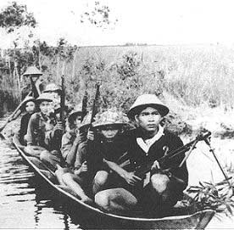
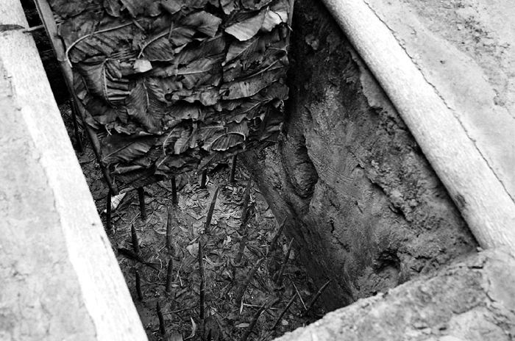
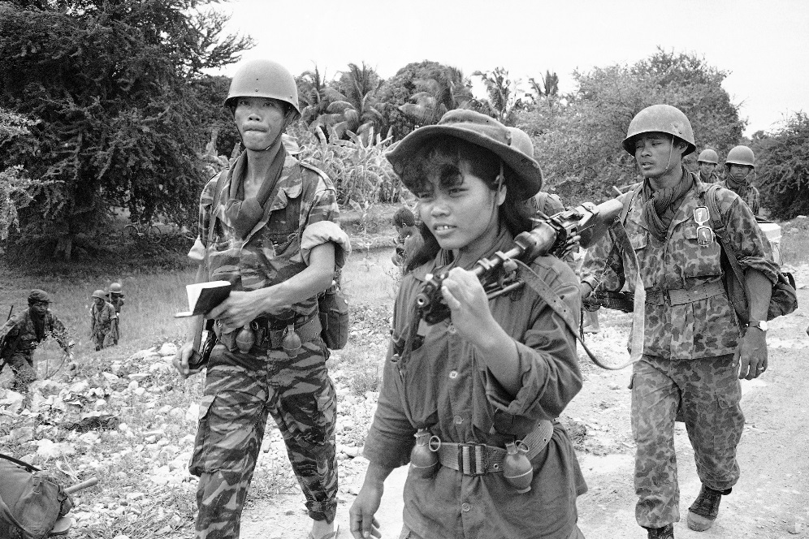
Vietcong
South Vietnamese Communists
Supported by N. Vietnam
Started a guerrilla war against the govt of S. Vietnam
Assassinated officials and seized control

Slide 8
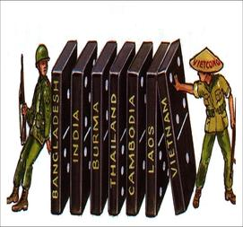
U.S. & the Domino Theory
Belief that if S. Vietnam fell to communism, neighboring SE Asian countries would also fall to communism like a row of dominos
Pres. Kennedy sent aid and U.S. military advisers to help S. Vietnam fight the Vietcong

Slide 9
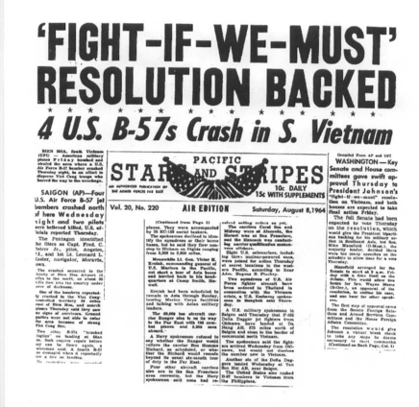
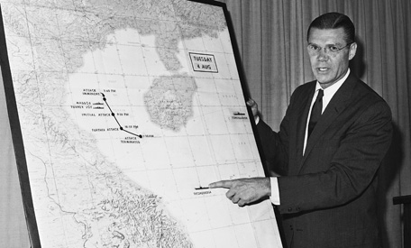
Gulf Of Tonkin Resolution 1964
Pres. Johnson announced that the N. Vietnamese had attacked U.S. ships in international waters in the Gulf of Tonkin
Congress gave him full military powers
Revealed years later that the ships had been in N. Vietnamese waters

Slide 10
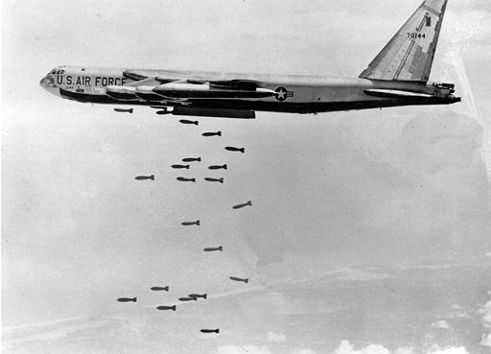
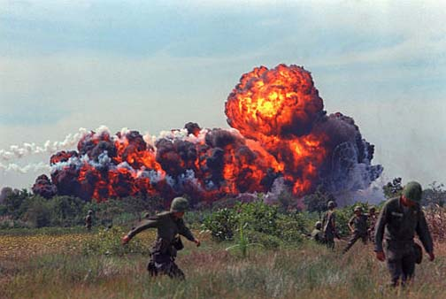
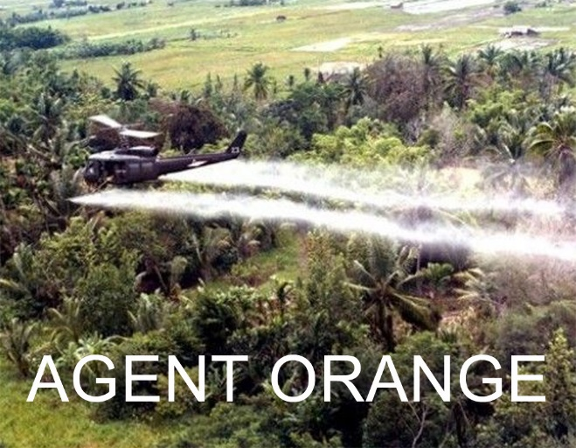
Johnson Escalates the War
Ordered massive bombing raids
Sent more combat troops to S. Vietnam
1968- ½ million US soldiers were there
New weapons:
Napalm- a sticky gasoline-based jelly that burns
Agent Orange- an herbicide that destroyed the jungle cover used by the Vietcong to hide

Slide 11
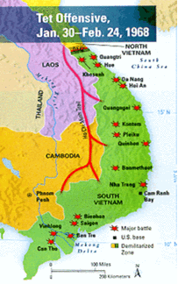
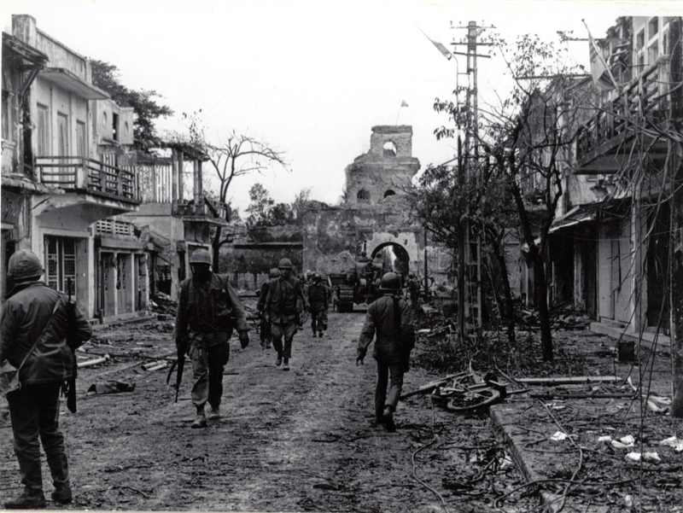
The Tet Offensive
1968- Vietcong seized the capital city of S. Vietnam, Saigon
American forces finally drove away the Vietcong but proved that a victory was far away
Showed the American public that the Vietcong were not weak, under-supplied or disorganized like they thought

Slide 12
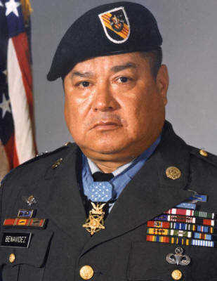
Roy Benavidez
Carried wounded members of his platoon to rescue helicopters while facing enemy fire
Saved 8 men
Awarded the Congressional Medal of Honor by Pres. Reagan in 1981

Slide 13
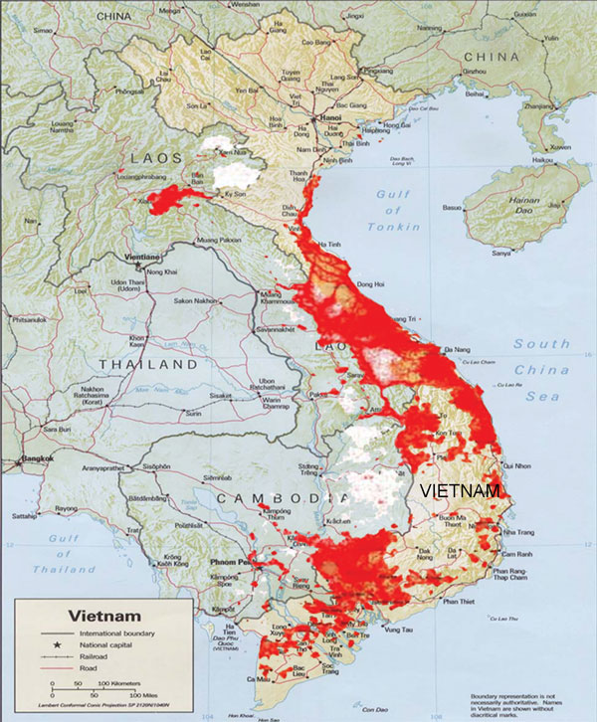
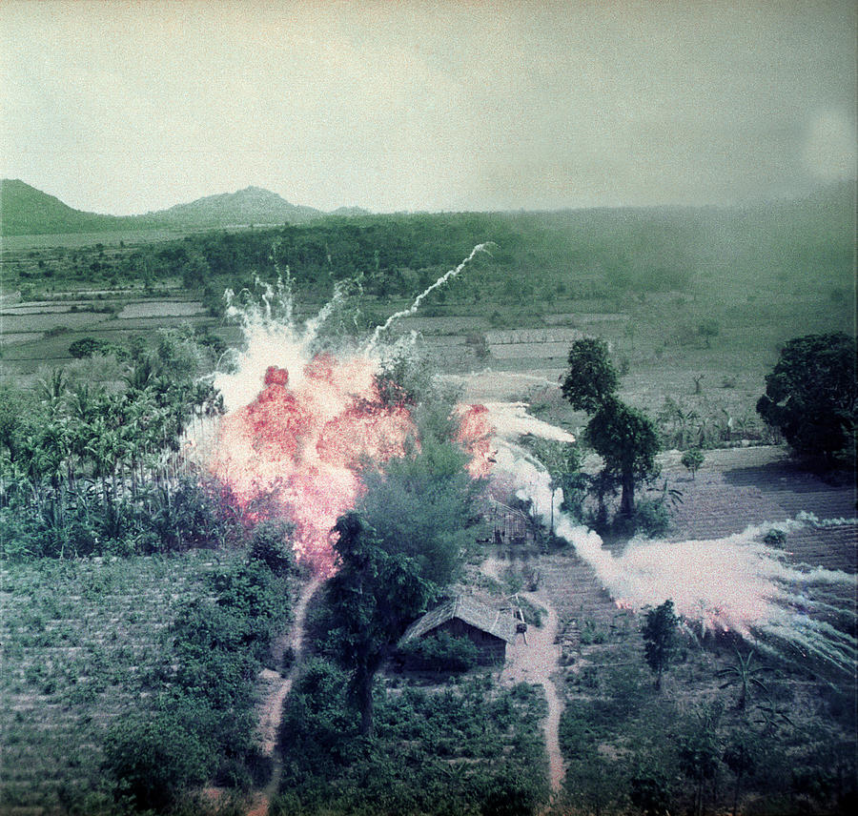
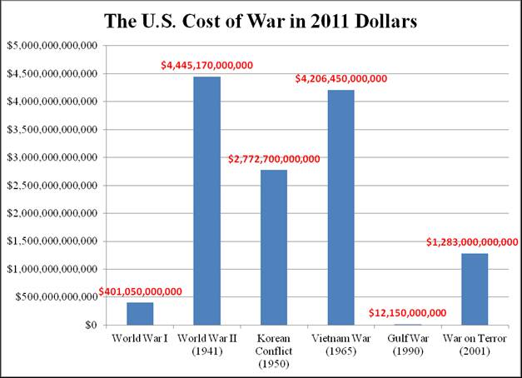
By the end of 1968:
US had dropped more bombs on Vietnam than it had in all of WWII
The war was costing $25 billion a year
US was unable to win because of:

Slide 14
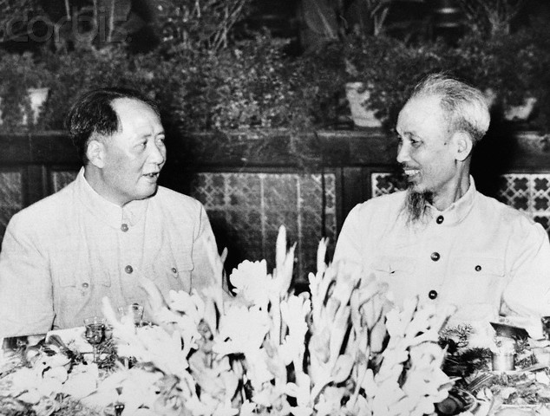
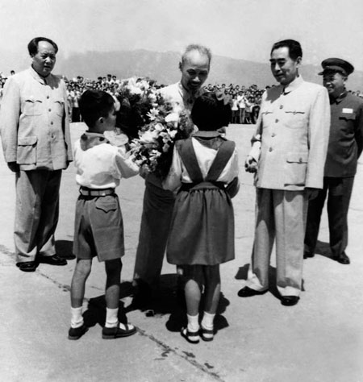
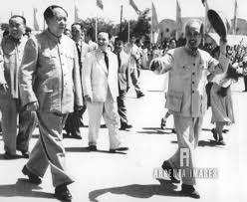
1. Popularity of Ho Chi Minh
He was seen as the “father” of Vietnam who was fighting for independence
People were willing to suffer large losses to re-unify their country
S. Vietnamese govts failed to gain popular support

Slide 15
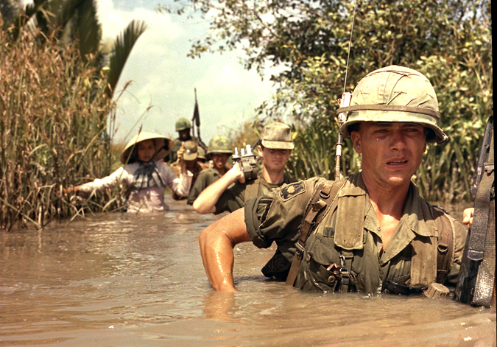
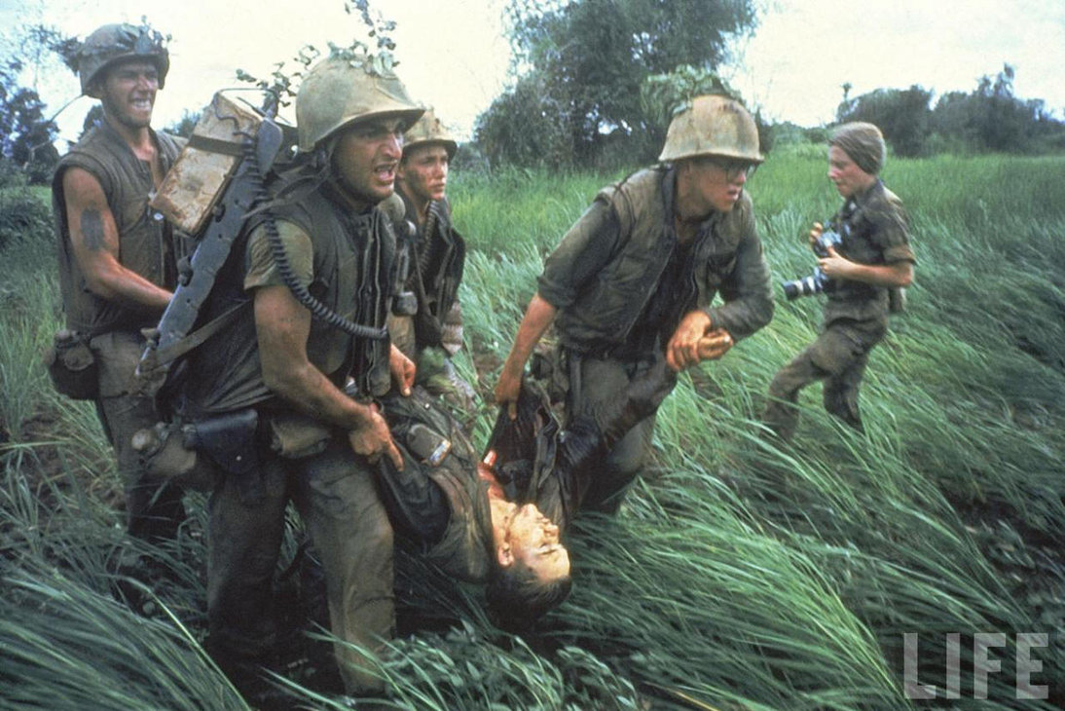
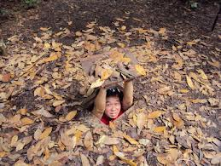
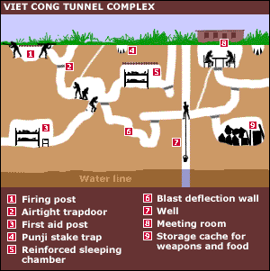
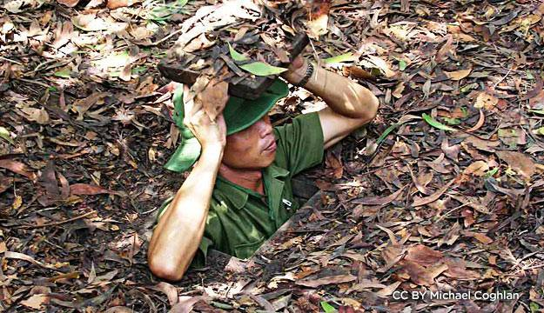
2. Difficulties of Guerrilla Warfare
https://www.youtube.com/watch?v=6gdumxfsTgQ
American soldiers were not familiar with the Vietnamese language, people or physical environment
Unable to tell who was friendly or the enemy
Jungles were an ideal cover for Vietcong

Slide 16
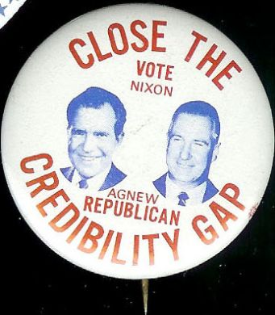
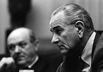
3. The Anti-War Movement
The Media
Showed the destructiveness of the war
Johnson promised everything was going according to plan
Led to a “credibility gap” as Americans lost faith in their government.
“Doves” wanted to end the war, “hawks” supported it.

Slide 17
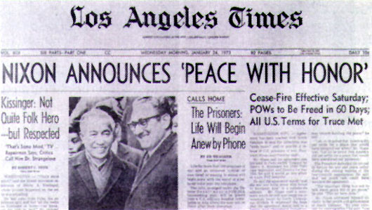
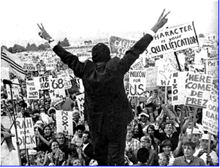
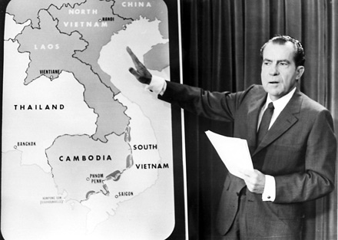
Richard Nixon as President
Republican
Promised Americans “peace with honor” in Vietnam
War dragged on for 5 more years under Nixon

Slide 18
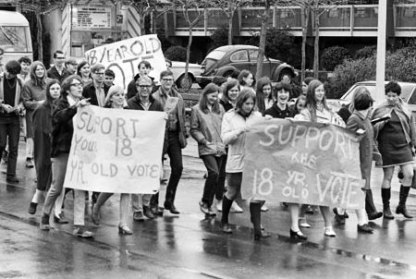
26th Amendment
Lowered the voting age to 18
During the Vietnam War, 18 year olds were old enough to be drafted, but were told they were not old enough to vote
Many Americans believed this was unfair

Slide 19
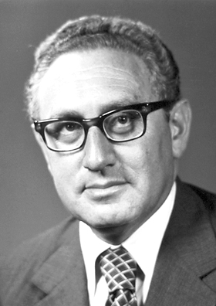
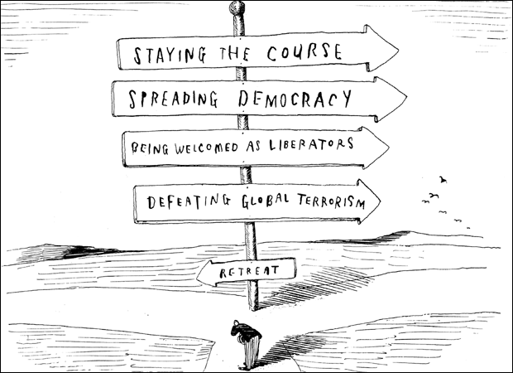
Nixon’s Vietnamization
Secretary of State Henry Kissinger worked with Nixon on the policy
S. Vietnam’s army began to take over fighting
U.S. began to withdraw forces
Increased bombing in North and more aid for the South.

Slide 20
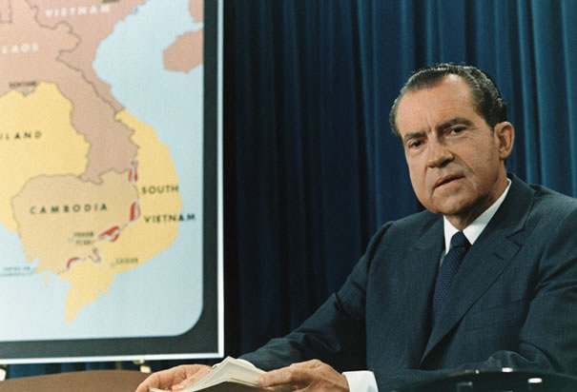
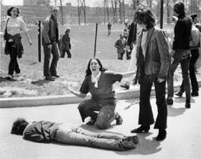
Invasion of Cambodia
Nixon thought he could end the war if he created multiple routes into Vietnam through Cambodia
U.S. invaded and Americans were shocked
In 1970, protests and the Kent State shootings led to the closing of colleges across the nation

Slide 21
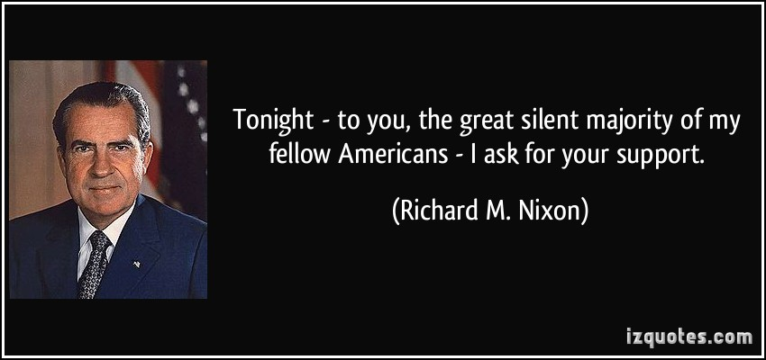
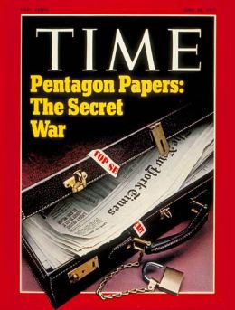
Nixon’s Diplomacy
Nixon negotiated with China and the Soviets to encourage peace
“Silent Majority”
Nixon supposed that many American’s quietly supported the war
Pentagon Papers
Published in the NYT, the documents showed presidents before Nixon refused to end the war because defeat was a disgrace

Slide 22
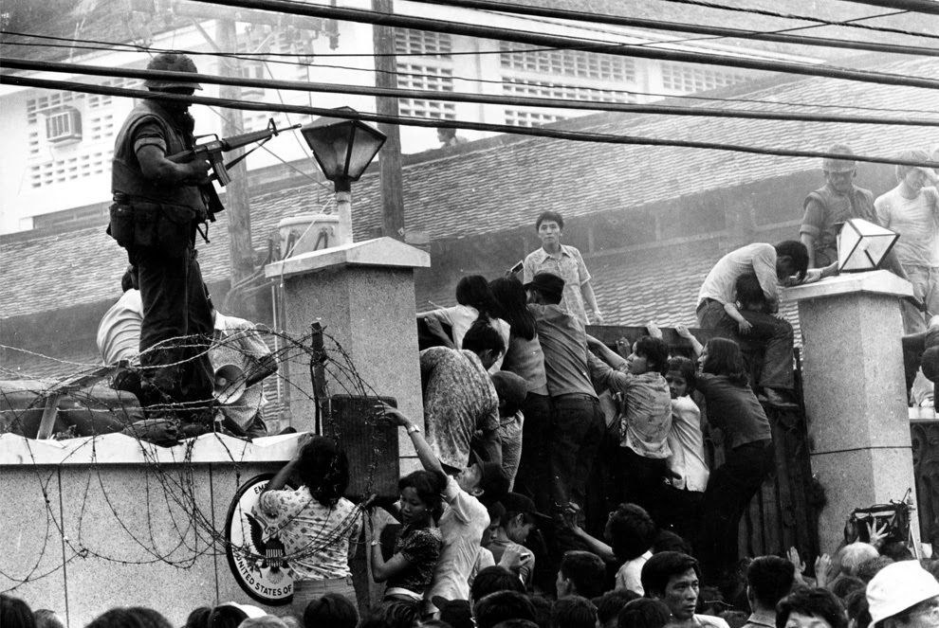
The Fall of Saigon
Through Vietnamization, U.S. troops were gradually reduced
In 1973, a cease-fire was called with the North, though fighting continued
In 1975, Saigon fell to the North and any remaining supporters of the U.S. were sent to “re-education camps”

Slide 23
The Legacy of the War
Death & Destruction: 58,000 Americans died, millions of Vietnamese killed and left homeless.
Impact: Expenses ended Great Society and brought inflation. It also divided America and showed how important public opinion is to government.
Limits of Pres. Power: War Powers Act- requires Pres. to inform Congress within 48 hours of troop movement, without support in 60 days, Pres. must withdraw.

