Slide 1

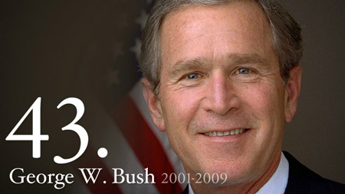
The George W. Bush Presidency
https://www.youtube.com/watch?v=vSx7_9EhnhM

Slide 2
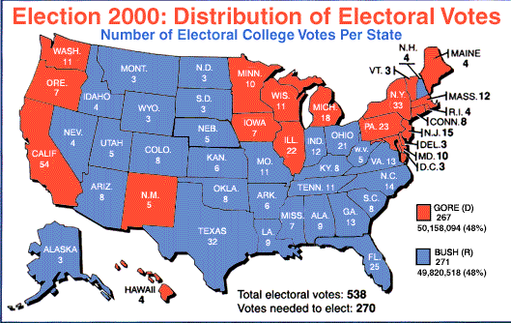
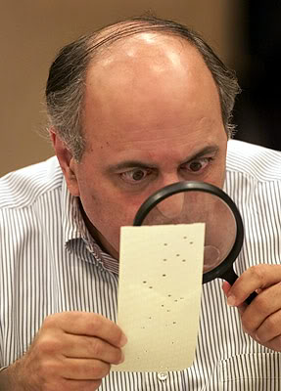
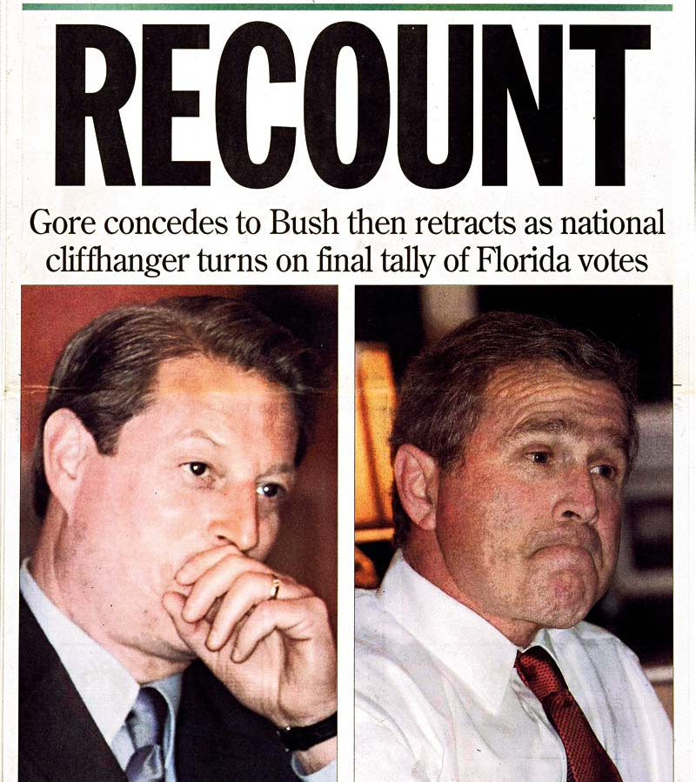
The Election of 2000
Clinton’s VP Al Gore ran against George W. Bush.
Third-party voting for Ralph Nader and a downturn of the economy swung votes to Bush.
The election came down to Florida, and Bush won the election by less than 1,000 votes.

Slide 3
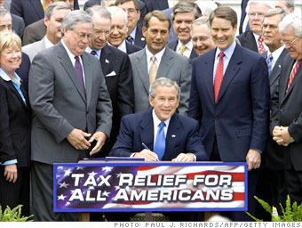
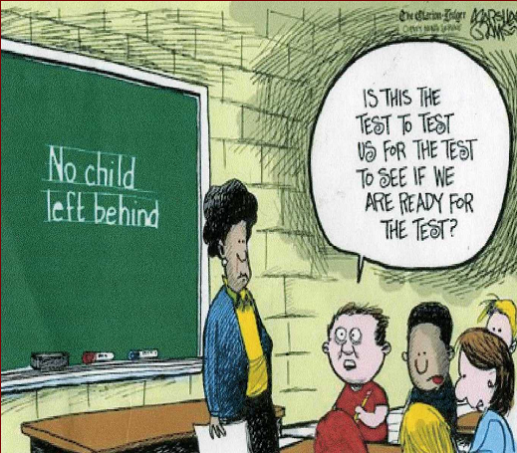

Domestic Policy
More tax cuts!
Dropping interest rates!
No Child Left Behind
  Requires states to test in math and English
  Determines money and rating given to schools

Slide 4
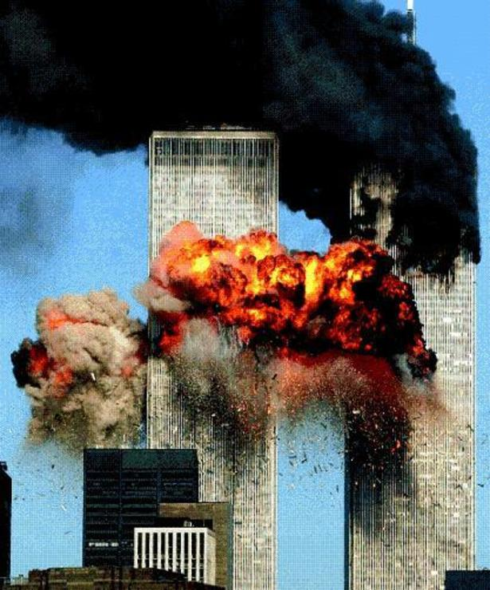
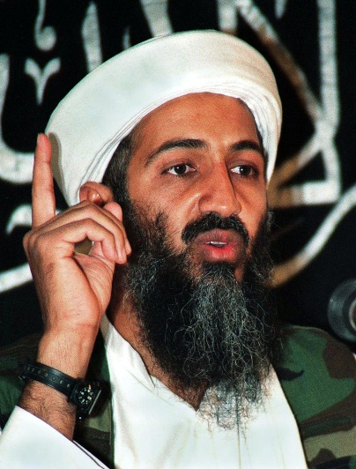
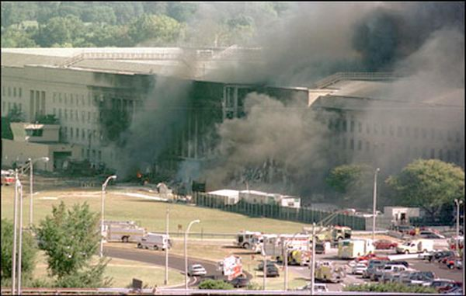
September 11, 2001
Early in Bush’s first term, America was attacked.
3,000 people were killed as terrorists from al-Qaeda took control of 4 flights and crashed them into the World Trade Center and the Pentagon.
Osama bin Laden took credit for leading the group.
https://www.youtube.com/watch?v=1EIVCPCwXy8

Slide 5
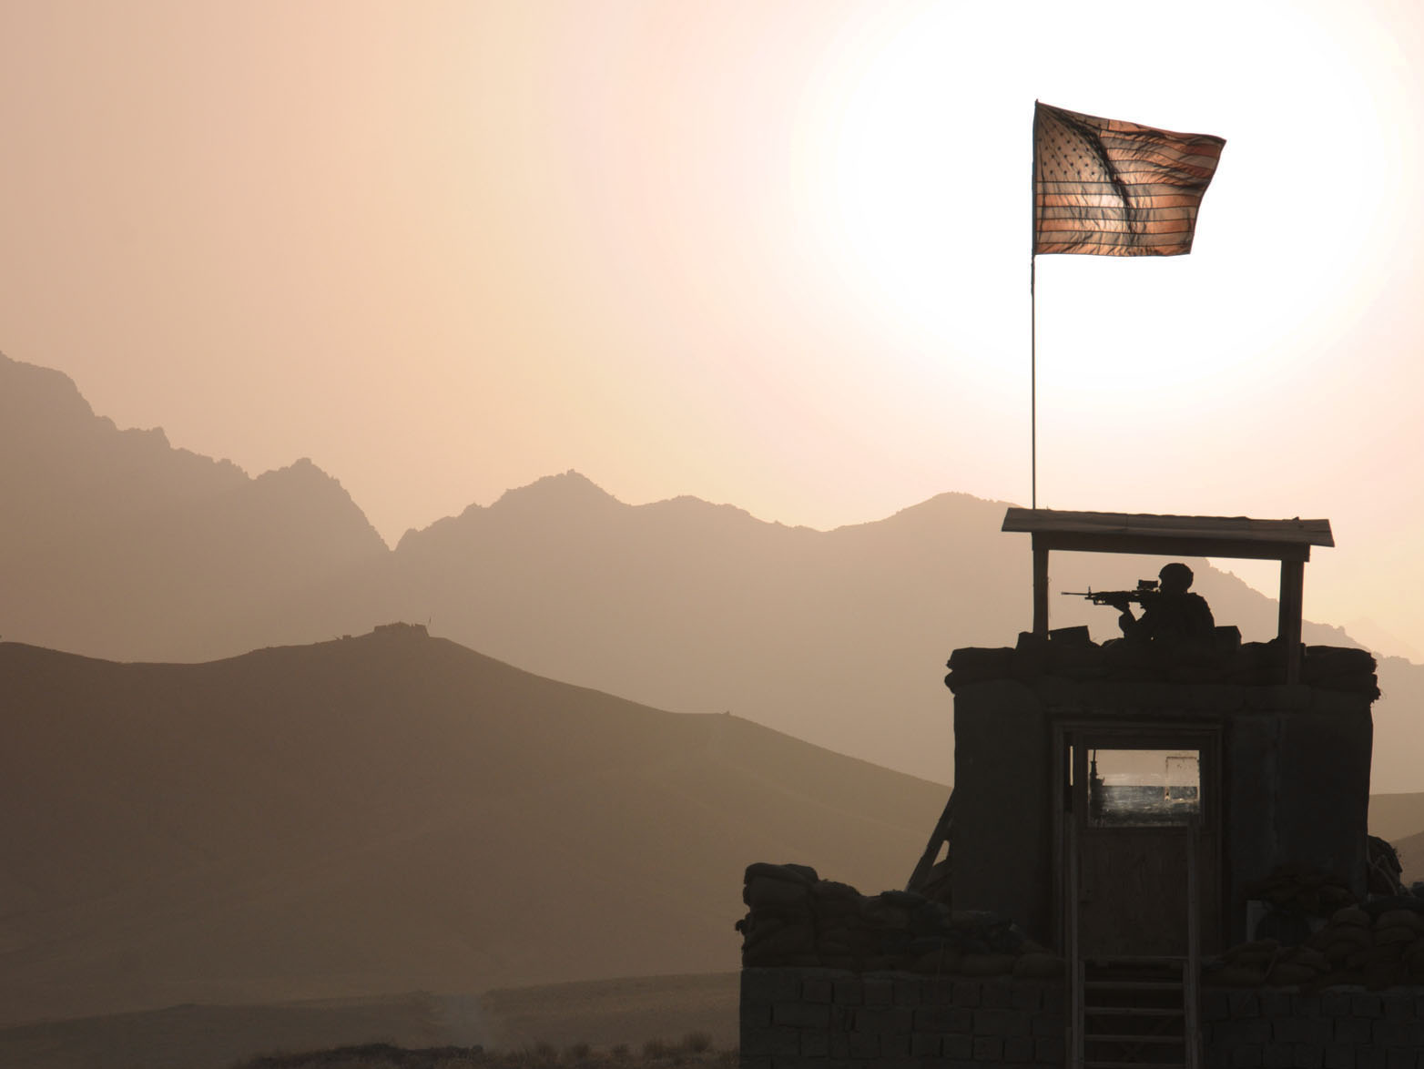
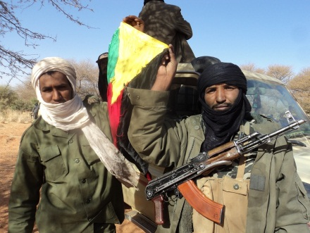
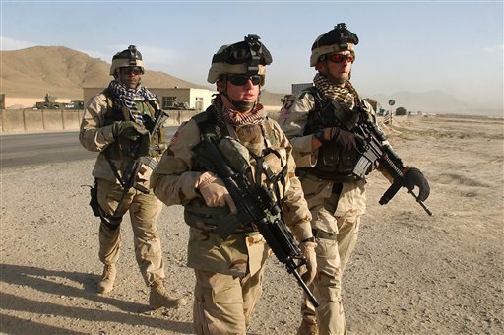
War on Terror
Launched on countries who harbor terrorists.
  Oct. 2001 air and ground assaults topple Taliban and al-Qaeda bases.
  Bin Laden escaped.
  Prisoners sent to Guantanamo Bay, Cuba, where rights of the Constitution are not guaranteed and where they were tortured for information.

Slide 6
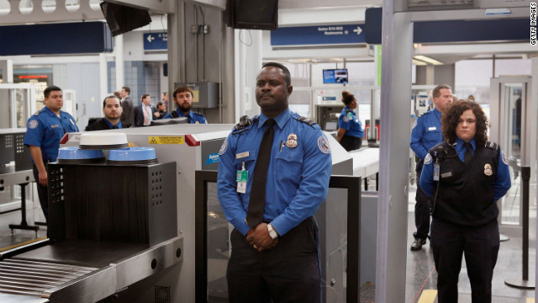
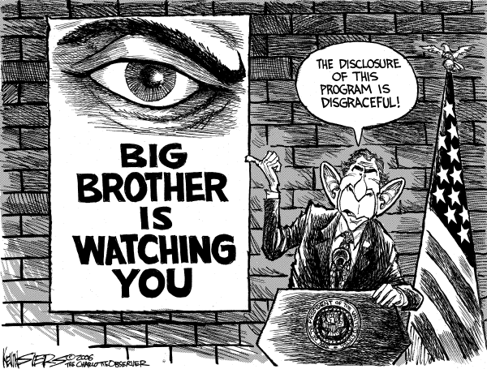
Constitutional Issues
Transportational Security Agency (TSA) now runs screenings at airports.
Dept. of Homeland Security to monitor and coordinate intelligence.
USA Patriot Act expanded law enforcement.

Slide 7
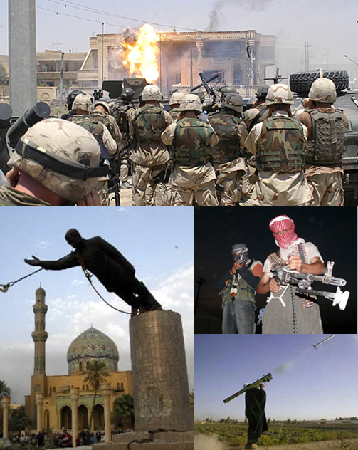
The War in Iraq
The gov’t feared that Saddam Hussein would supply terrorists with new weapons.
UN inspectors checked for WMDs and found none, but many still feared WMDs existed.
After several warnings, we invaded Iraq in 2003 and deposed Saddam Hussein.

Slide 8
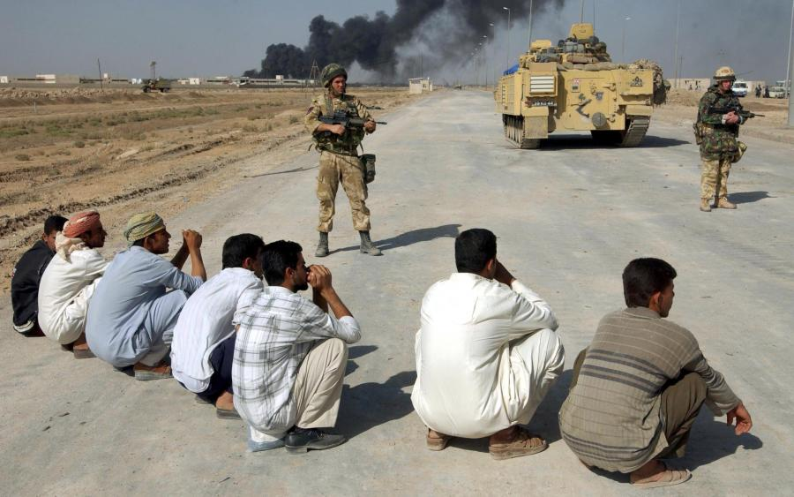
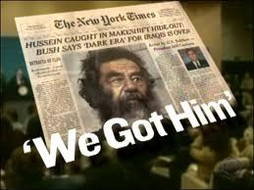
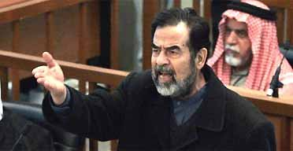
The war did not end quickly:
  Several ethnic groups fought
  Iraqi people did not like American troops
  We tortured prisoner at Abu Ghraib
  It took 3 years for Saddam’s trial and execution

Slide 9
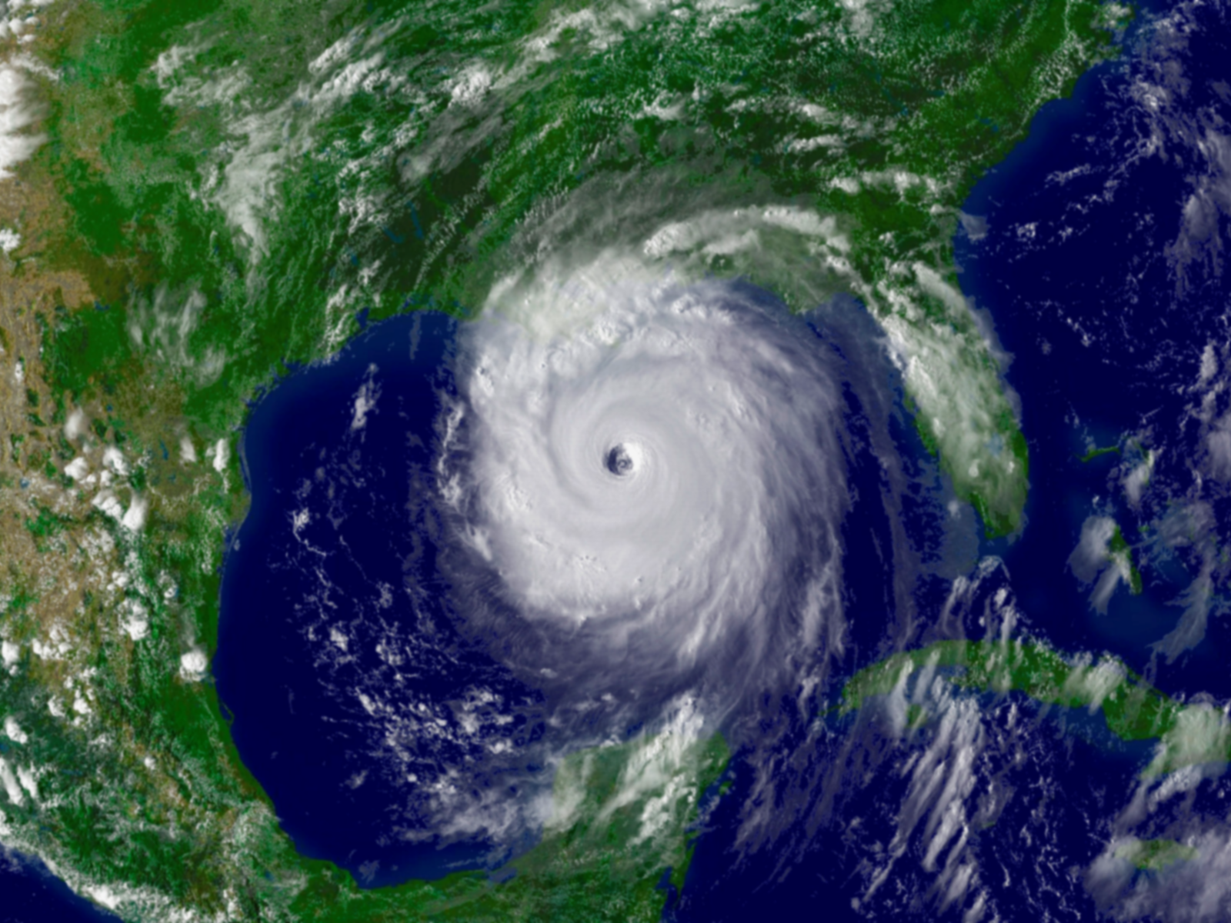
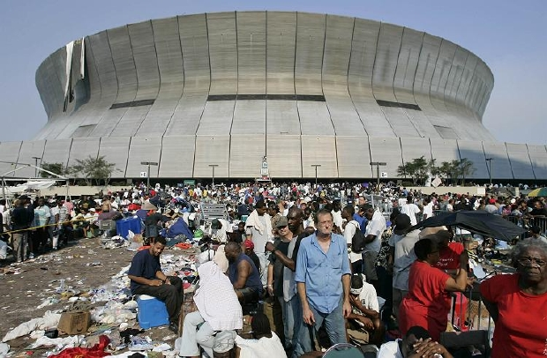
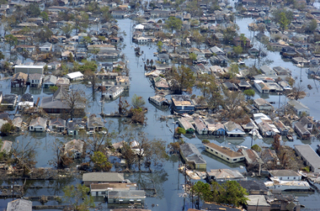
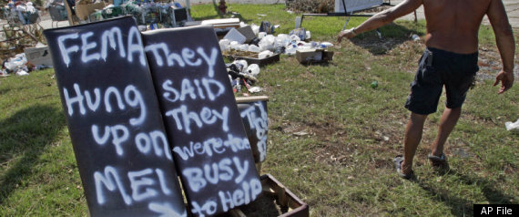
Hurricane Katrina
At the beginning of Bush’s second term, Hurricane Katrina struck the South.
It was a powerful storm that broke through the levees protecting New Orleans, LA.
It was the most expensive hurricane on record and many criticized the gov’t for poor relief efforts.
https://www.youtube.com/watch?v=ooGsvj5SeHE

Slide 10
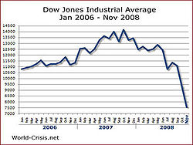
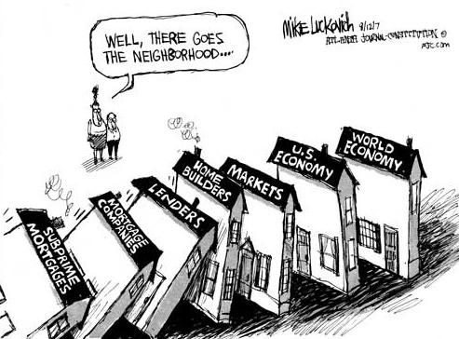
Financial Crisis of 2008-9
In 2000, the Federal Reserve lowered interest rates to stimulate the economy.
  More purchases and higher prices
  People bought homes they could not afford
  Banks began trading mortgages
By 2007 the housing “bubble” burst and the number of foreclosures increased.

Slide 11
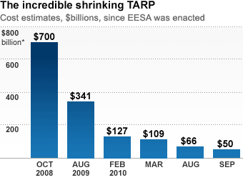

Troubled Asset Relief Program
TARP was signed into law by Bush in 2008.
It created a temporary buffer between lenders and homeowners.
Authorized the Emergency Economic Stabilization Act (EESA) for up to $700 billion to fix bad investments and banks.

Slide 12
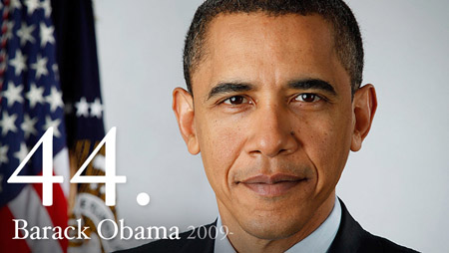
The Obama Presidency
https://www.youtube.com/watch?v=Npg7Sgun1h0

Slide 13
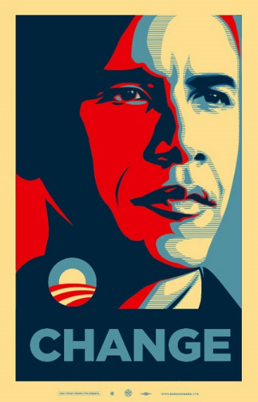
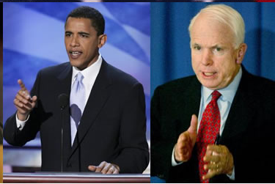
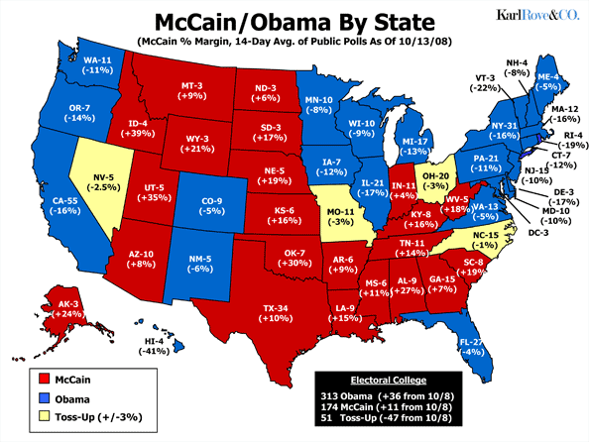
The Election of 2008
Obama beat Hillary Clinton to become the Democrat Party candidate.
He beat John McCain (R) who was running with Sarah Palin.
Most expensive election, but “change” was in the air as Obama became the first African American president.

Slide 14

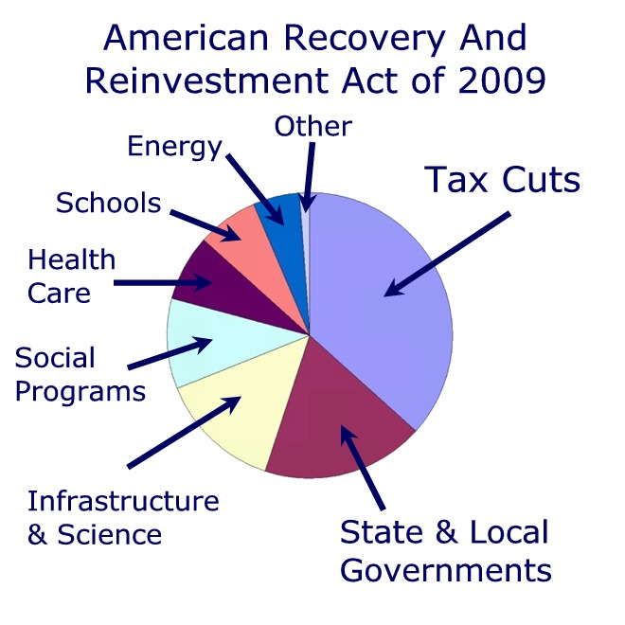
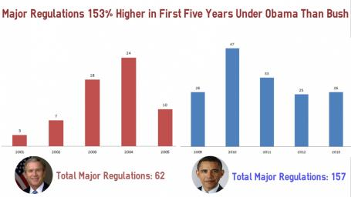
Response to Financial Crisis
Obama wanted to stimulate the economy through jobs, schools, regulating banks and health care.
2009— Obama agreed to the American Recovery & Reinvestment Act (ARRA) to give more than $700 billion to spur the economy.

Slide 15
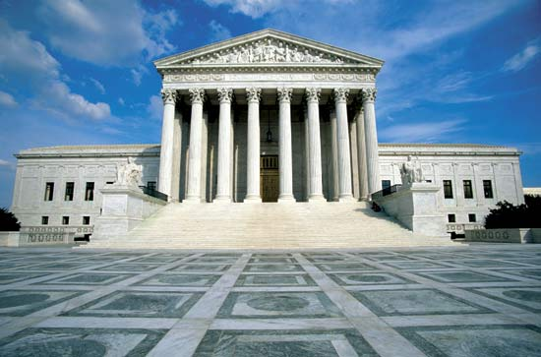
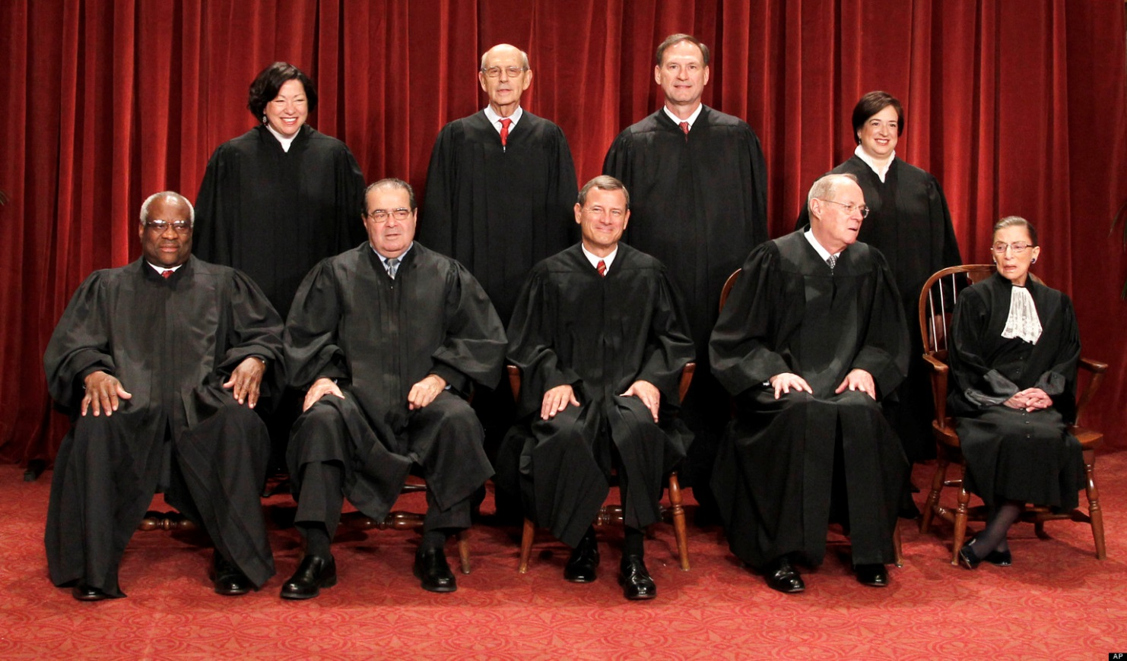
The Supreme Court
Conservative
Liberal
Swing Voter
Sonia Sotomayor
Stephen Breyer
Samuel Alito, Jr.
Elena Kagan
Clarence Thomas
Antonin Scalia
John Roberts
Anthony Kennedy
Ruth Ginsburg
President Obama nominated Sonia Sotomayor for the Supreme Court in 2009, making her the first Hispanic Justice and the third woman.
He also nominated Elena Kagan in 2010.

Slide 16
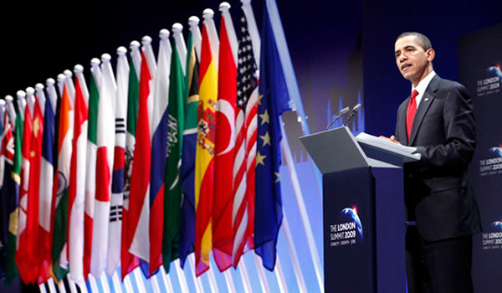
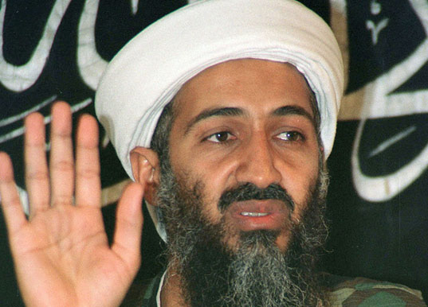
Foreign Policy
Middle East
  Gradually withdraw troops
  Peace in Israel
  Discourage dictators (Arab Spring)
Europe
  Close contact during financial crisis
Asia
  Continued trade and loans
http://www.youtube.com/watch?v=V514j6fxIIY
May 1, 2011
http://www.youtube.com/watch?v=K8j8LpwDo7Q

