Slide 1

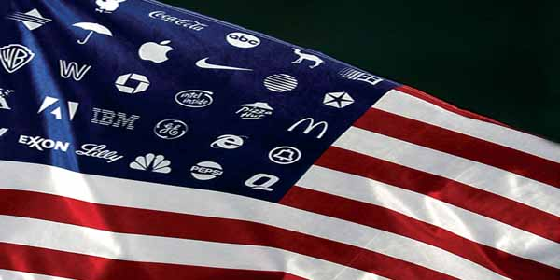
A Global Country

Slide 2
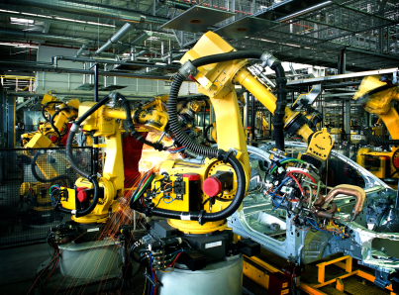
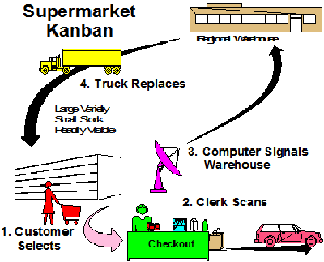
Technology at Work
Modern technology has led to changes in manufacturing and production.
New innovations take ideas and make them happen in a faster way using robotics.
Time-study analysis has allowed us to see where changes are needed.

Slide 3
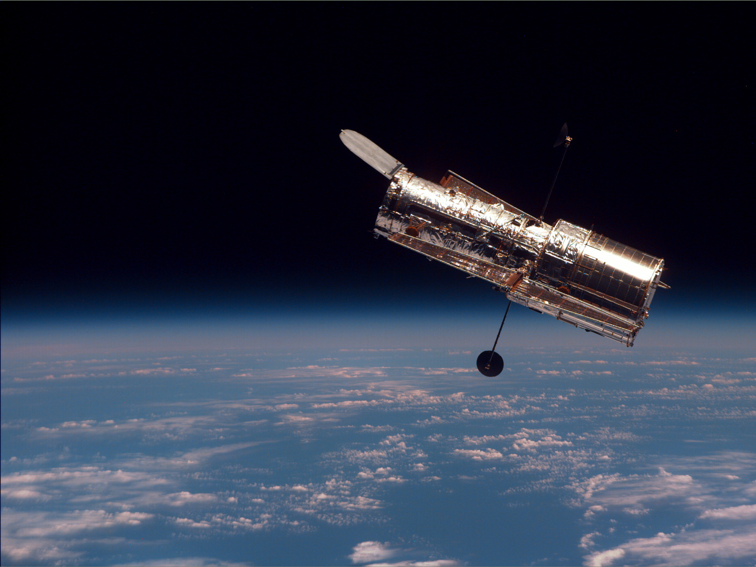
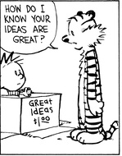

Free Enterprise Technology for Our Needs
Free enterprise allows people to buy, sell and create their own products.
  Encourages new ideas and how to use them
  Inspires new tech. to solve problems
  Has helped in fields such as medicine create new vaccines and treatments

Slide 4



Medicine and Health
Genetic engineering has led to the source of many conditions and diseases.
New vaccines and antibiotics have allowed us to treat and cure many diseases.
America is becoming more health-conscious in limiting negative diets and habits.

Slide 5
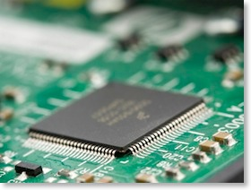
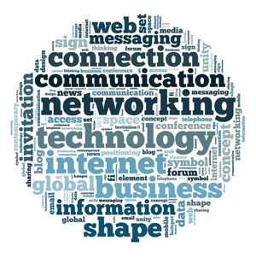

The Computer Revolution
Information Technology (IT) has helped the economy.
Investments into computer silicon chips, which replaced transistors, have increased the speed of technology while shrinking the space needed for it.
INTERNET! E-Commerce!
https://www.youtube.com/watch?v=HGNpBtneHM0

Slide 6
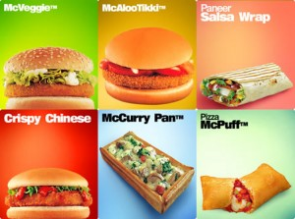
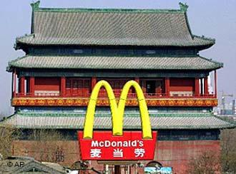

Globalization
As multinational corporations rise, the world is becoming a “smaller” place.
Communication has become easier, linking people and places like never before.
This has also led to different rules and regulations for different types of businesses.

Slide 7
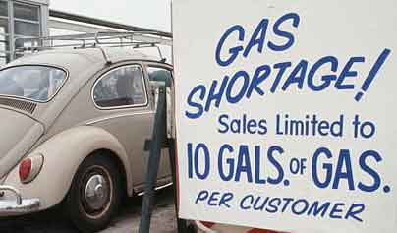
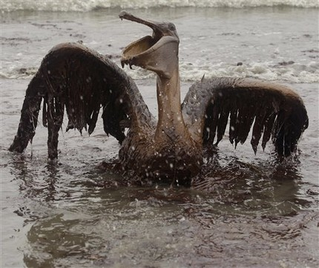
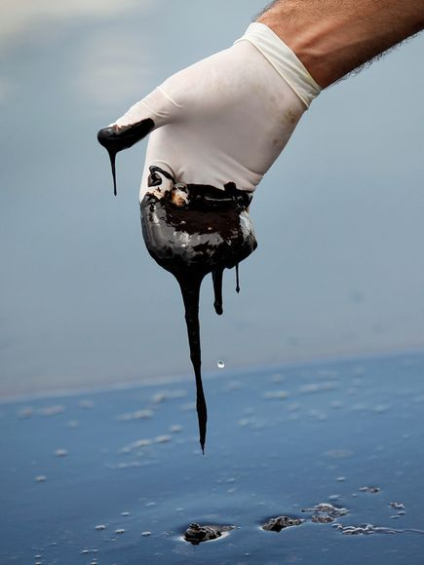

Energy
Population growth and rising standards have led to a need for more energy.
Since the 1970s and the OPEC embargo, we have looked for safe and affordable energy and have begun conservation and developing alternative sources.

Slide 8
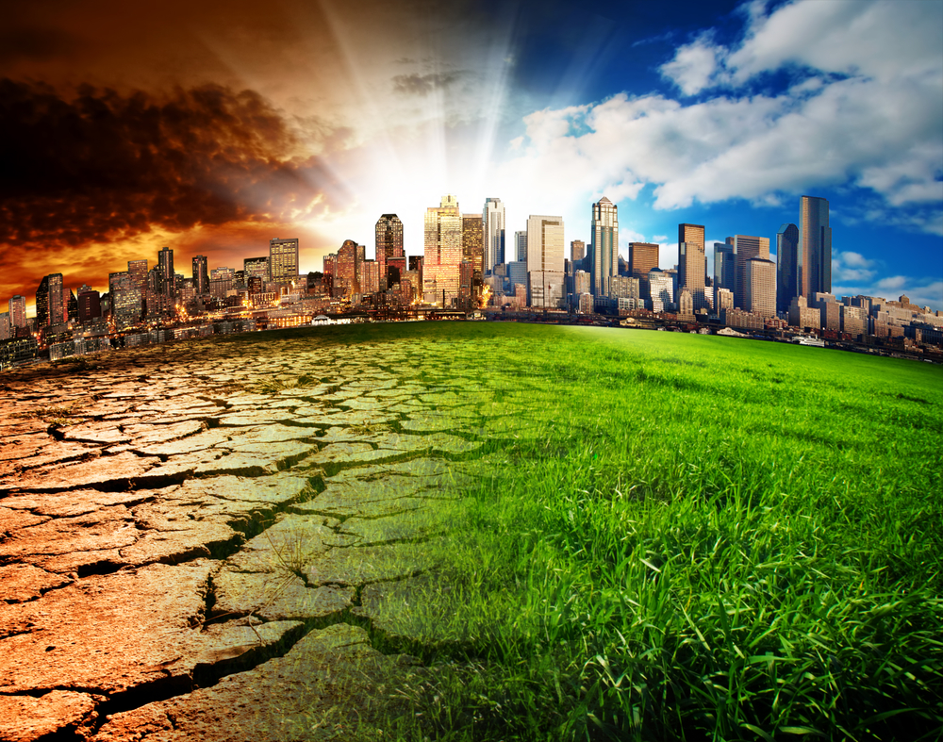
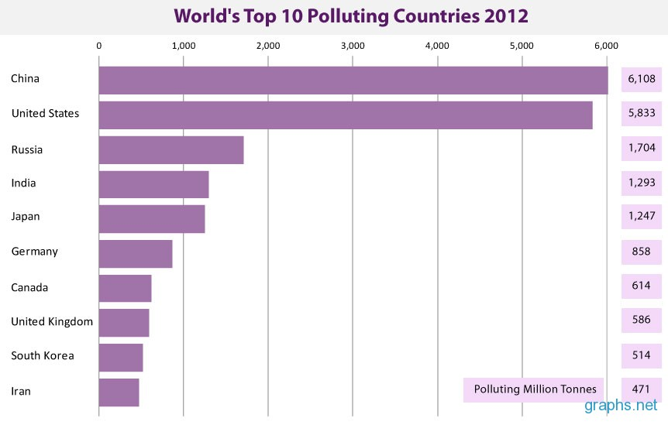

The Environment & Government
Global Warming from the Greenhouse Effect, acid rain and the ozone layer have become major topics.
The government is now seen as responsible for it and takes measures to protect it.

Slide 9

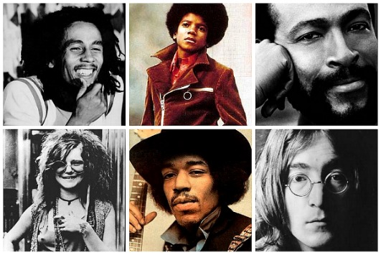

Music, Art & Television
Music & the arts have been heavily influenced by many musicians and have existed in many different forms.
Cable and the internet have spread use and creativity in various media.
People are now relying on technology and the digital world for film and music.
https://www.youtube.com/watch?v=lExW80sXsHs

