Slide 1
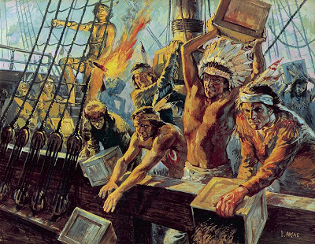
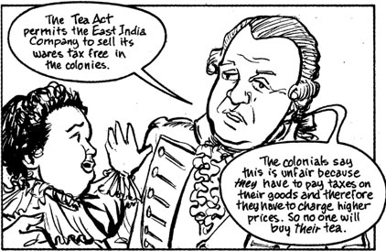
Crisis approaching
●Tea Act, 1773
The Boston Tea Party: December 16, 1773

Slide 2
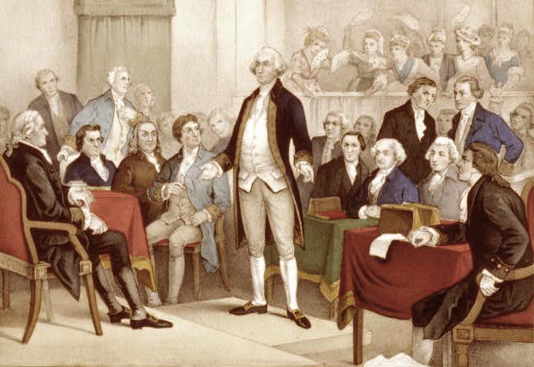
First Continental Congress, September 1774

Slide 3
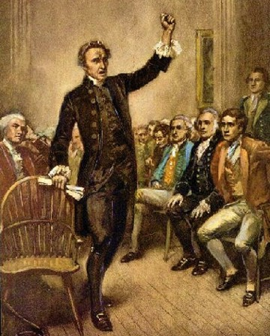
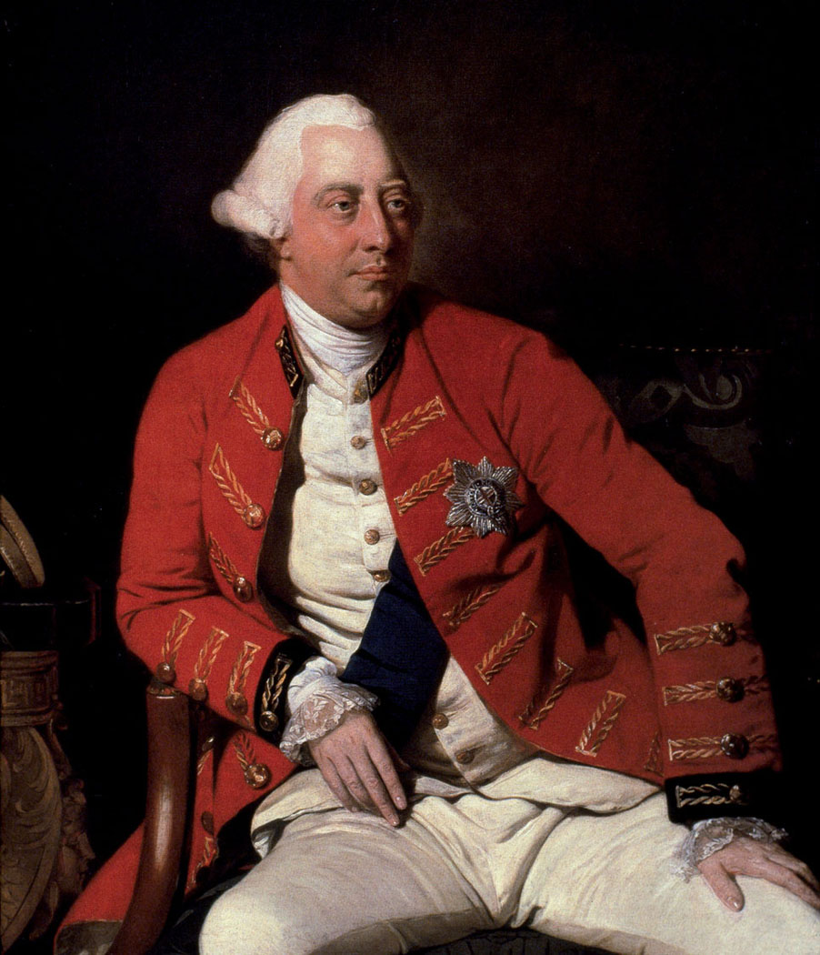
●British response
●Patrick Henry and war

Slide 4
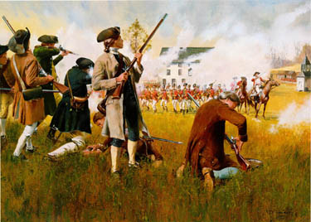
“The shot heard round the World”
Lexington and Concord: April 19, 1775

Slide 5
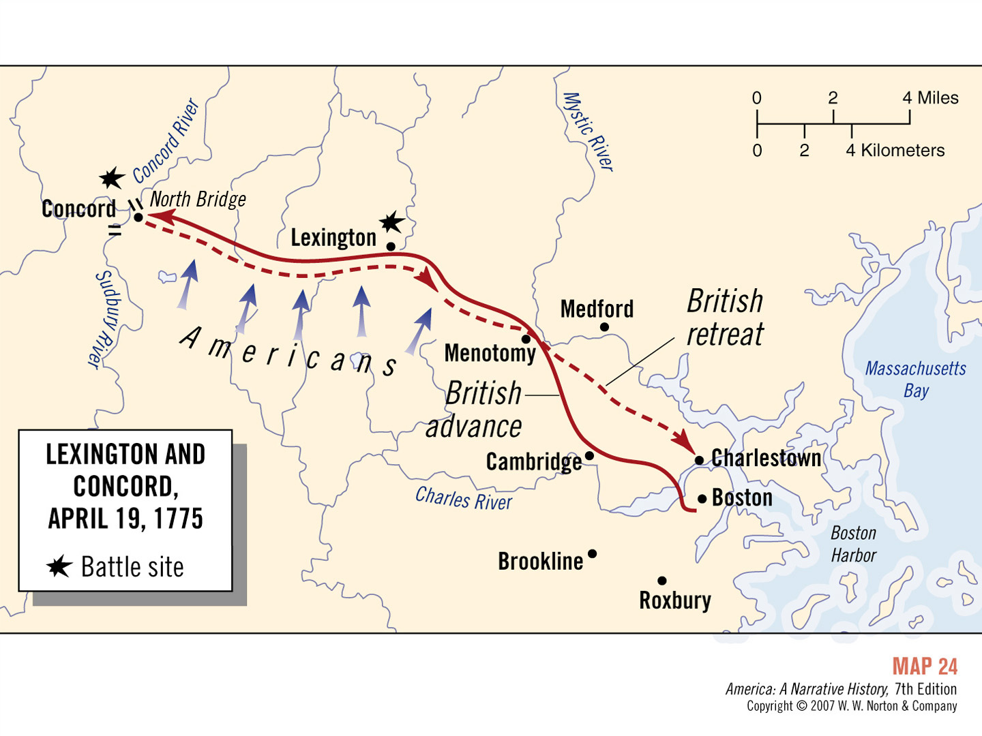
Map 2

Slide 6
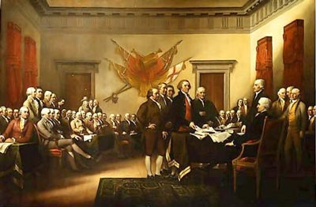
Second Continental Congress : 1775

Slide 7
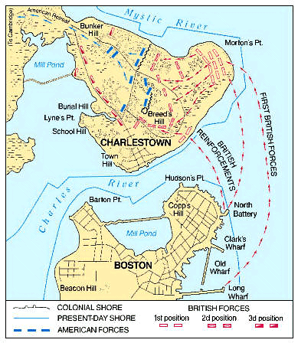
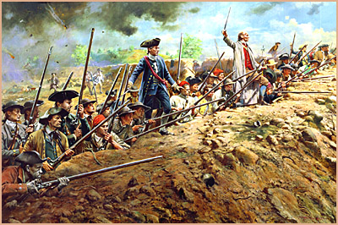
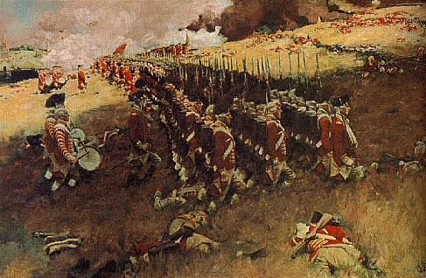
Battle of Bunker Hill, July 17, 1775
“Don’t fire till you see the whites of their eyes” – Israel Putnam
British: 3,000 Men
Colonialists: 2,400 Men

Slide 8
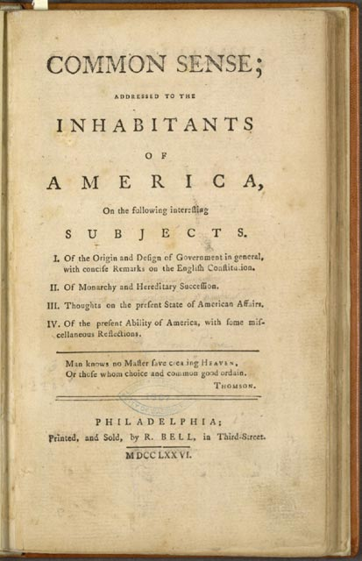
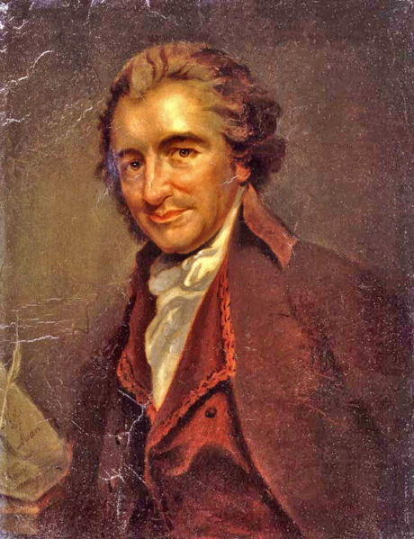
Thomas Paine’s, Common Sense

Slide 9
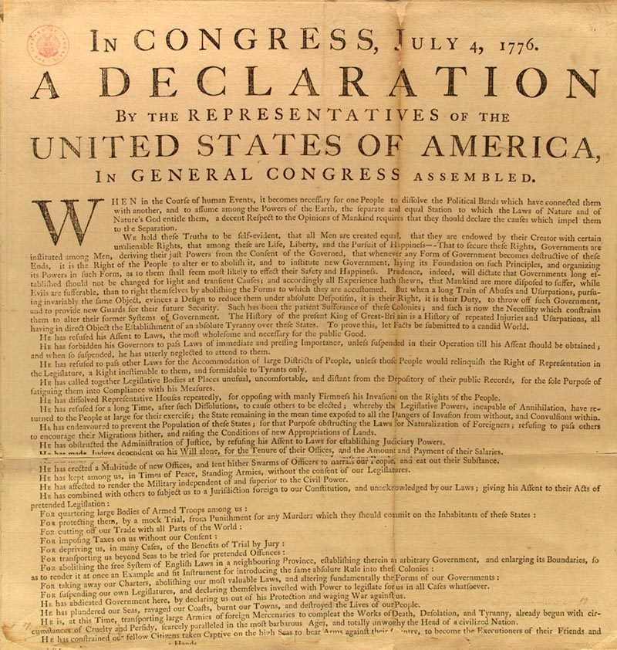
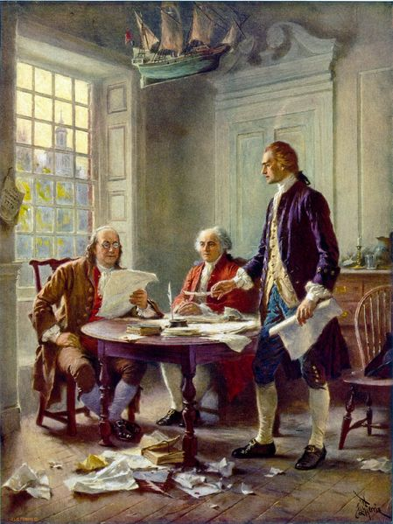
Declaration of Independence, July 4, 1776

Slide 10
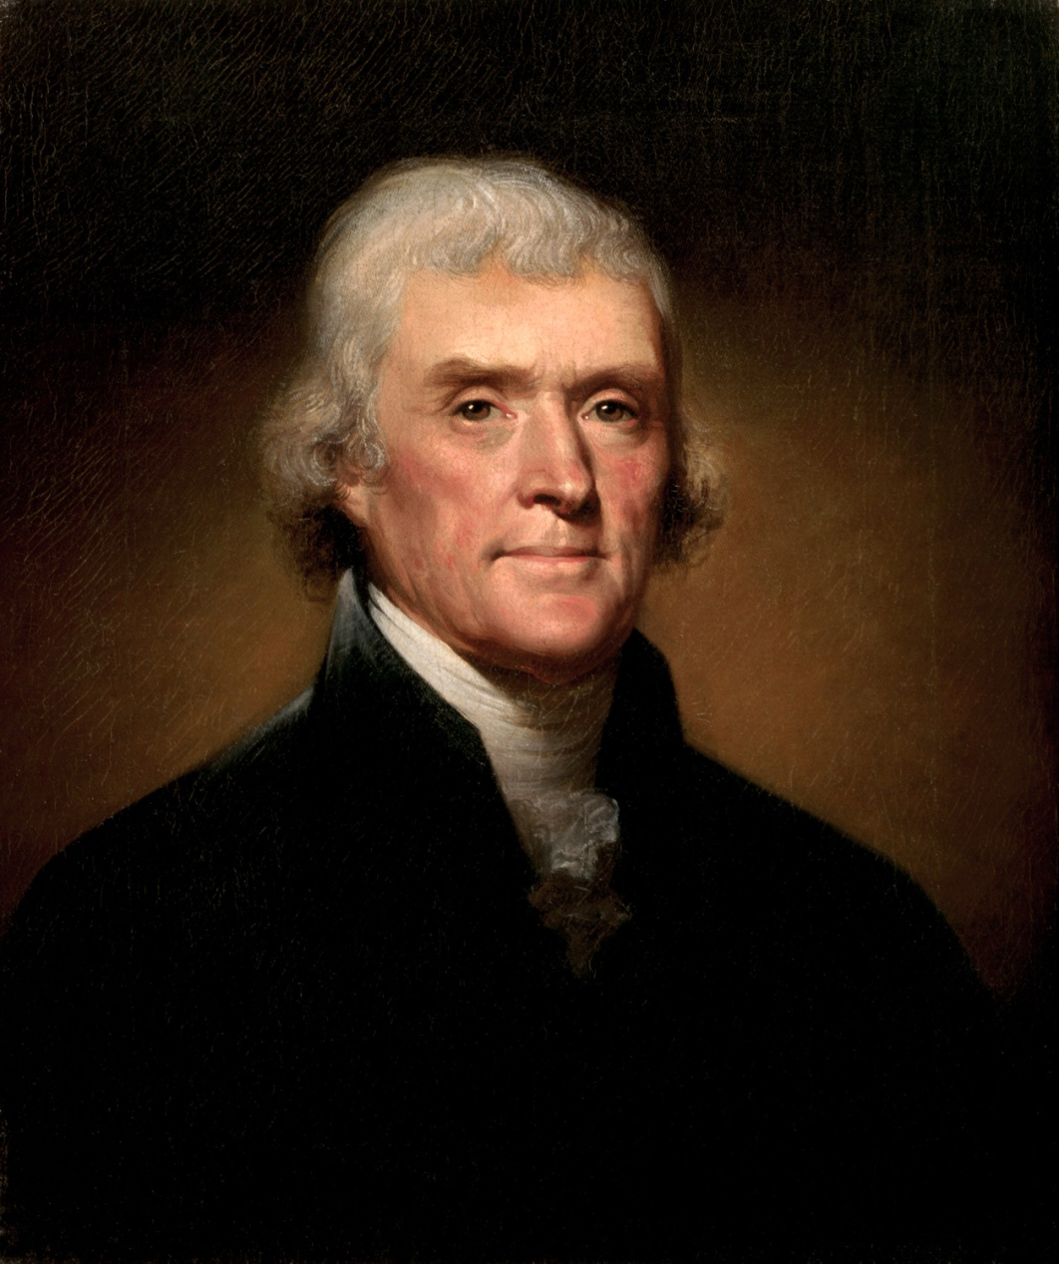
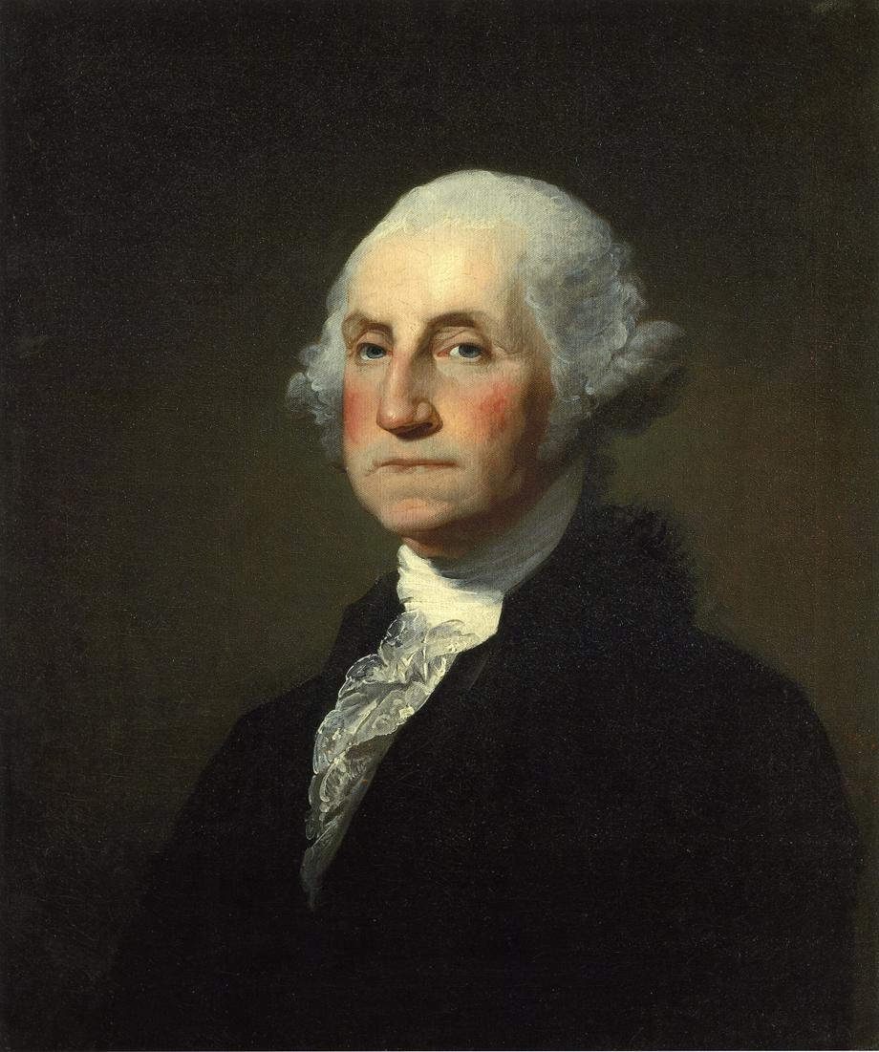
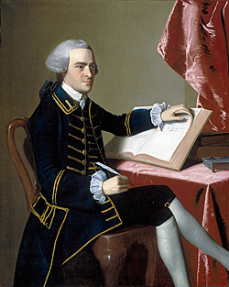
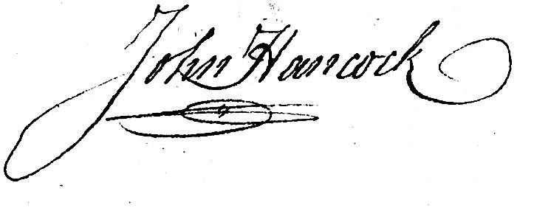
Individual reasons supporting the Revolution
Thomas Jefferson
George Washington
John Hancock

Slide 11
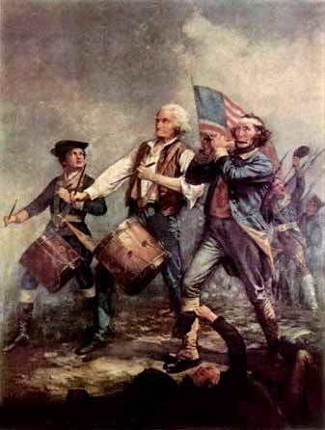
Causes of the American Revolution
1. Less Autonomy
2. Trade Regulation
3. Tax Burdens
4. No Representation
5. Nationalism
6. Restrictions on settlement
7. Political differences
“…we always had governed ourselves, and we always meant to. They didn’t mean we should”- Revolutionary Veteran 67 years after Lexington

