Slide 1
APUSH
We’ll go over some of the test once everyone has taken it.
You have 5 days (next Monday) to do corrections.
You have till Friday to do corrections/rewrite your LEQ for up to a “70”.
This must be done before or after school in here, not at home.
We will not be doing this all year. Figure them out.
You may not redo/correct daily grades we do in class. They are a test of your knowledge over the notes and the readings. If you don’t like your grade on quizzes then do better.
Also, I will not be here tomorrow. You will have a sub and an assignment to finish using the chromebook. It is due at the end of class.

Slide 2
Ch. 7: The Jeffersonian Era
Focus Questions:
What changes had the nation gone through during Jefferson’s presidency?
Describe Jefferson as a person before and during his presidency.
Identify the domestic and foreign issues during Jefferson’s presidency.
Describe Madison’s presidency and the War of 1812.
Notes:
2
The purpose of the focus questions is to help students find larger themes and structures to bring the historical evidence, events, and examples together for a connected thematic purpose.
As we go through each portion of this lecture, you may want to keep in mind how the information relates to this larger thematic question. Here are some suggestions: write the focus question in the left or right margin on your notes and as we go through, either mark areas of your notes for you to come back to later and think about the connection OR as you review your notes later (to fill in anything else you remember from the lecture or your thoughts during the lecture or additional information from the readings), write small phrases from the lecture and readings that connect that information to each focus question AND/OR are examples that work together to answer the focus question.

Slide 3
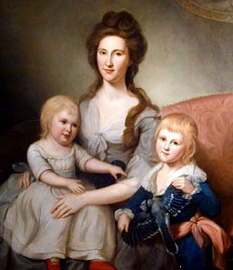
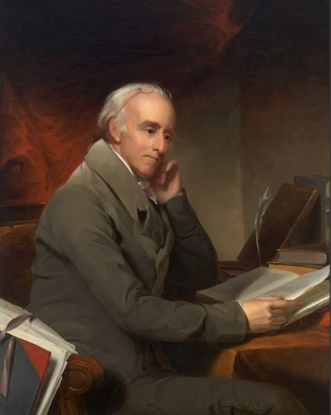
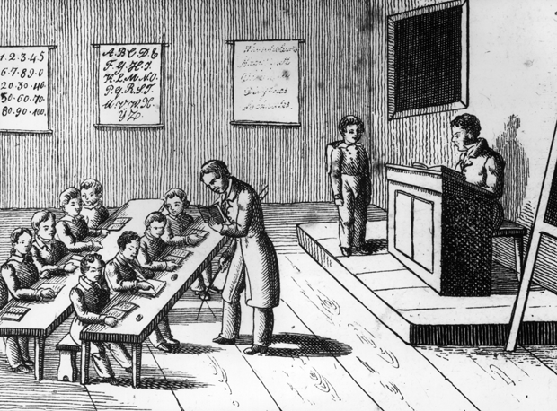
Culture and Nationalism
Education
*Important to Jefferson to have an educated citizenry
*pushed for public education but not all states had it
*mostly established private schools for wealthy whites
Women
*basic education
*education should only serve to make better wives and mothers
Natives
*education may help tame natives
*mostly missionary schools
Slaves
*educating slaves illegal
*feared knowledge would encourage rebellion
Higher Education
*colleges and Universities became more abundant
*still, only 1/1000 white males went to college
Medicine and science
*University of Pennsylvania (medical school)
*Benjamin Rush: primitive treatments (“bleeding”)
*patients more scared of doctors than illnesses
*Midwives become more obsolete

Slide 4
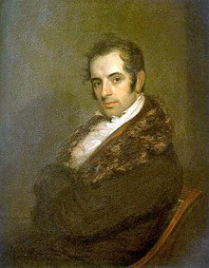
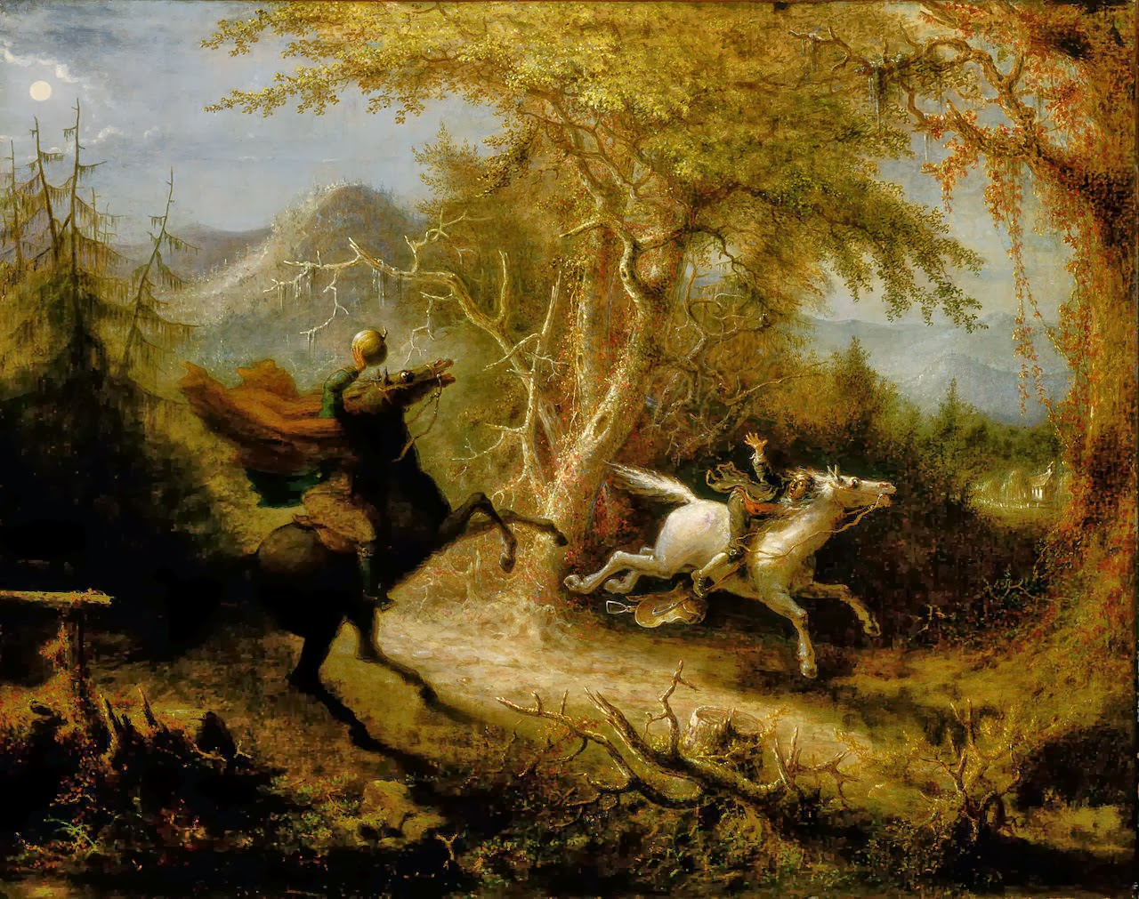
Cultural Aspirations
Nationalism
*American schoolbooks
*American culture was encouraged
Noah Webster
*American Spelling Book (1783)
*Standardized the English language
Washington Irving
*Satirical short story writer
*mainly wrote about American legends
*The Legend of Sleepy Hollow
*Rip Van Winkle

Slide 5
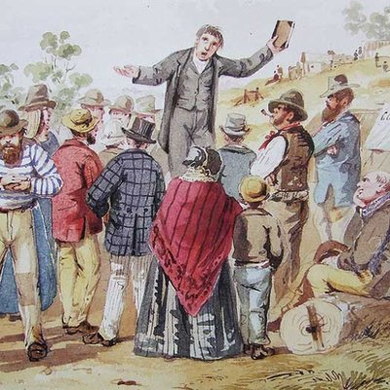
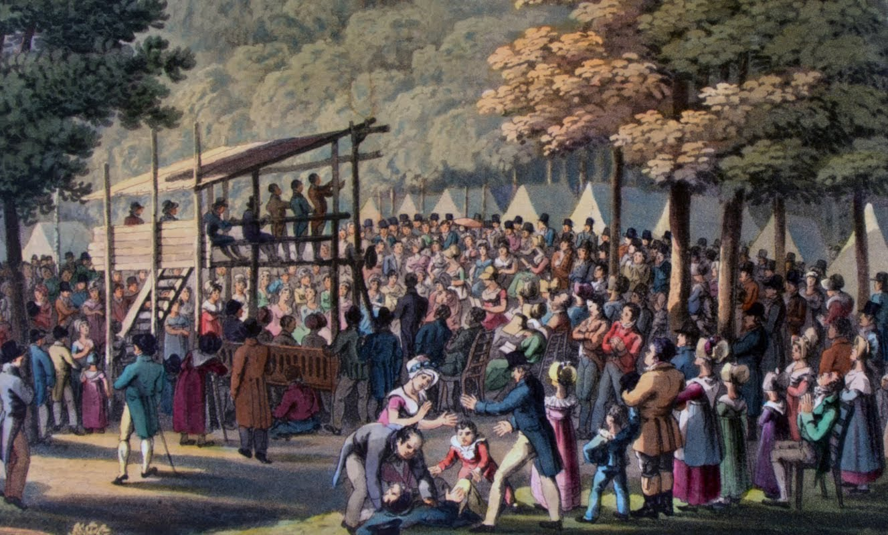
Religion
Deism
*separation of church and state caused many to abandon organized religion
*many believed (Jefferson, Franklin) in deism
*belief in God but not in organized religion (churches)
The Second Great Awakening
*only 10% of Americans part of a formal church
*recommitment to God in daily life
*must embrace active piety
*rejection of skeptical beliefs
*Cane Ridge, KY (1801) 25k people show up
Effects
*more women involved
*a reorganizing of religion in America
*new denominations (Presbyterians, Methodists, Baptists)
*inspired reform movements in 1830s and 40s
*(abolitionism)

Slide 6
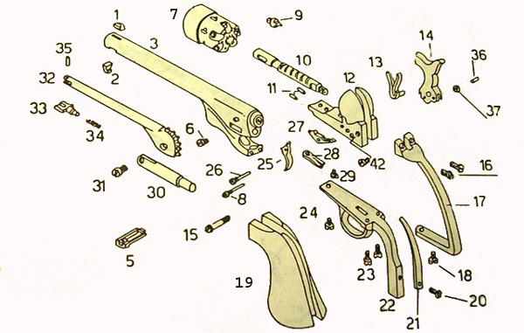
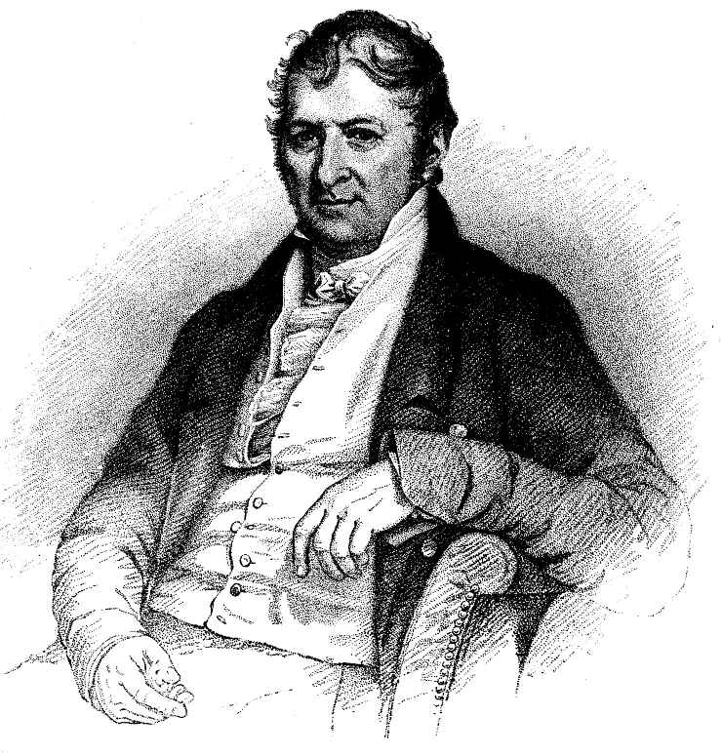
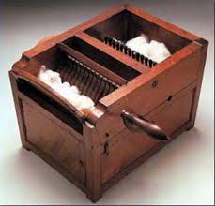
Industrialism
Eli Whitney
Technology
Sam Slater
-spinning mill
-father of the factory system
Oliver Evans
-automated flour mill
-card-making machine
Eli Whitney
*Cotton Engine “Gin”
-separated seed from cotton
-1-3 pounds a day vs. 50 pounds an hour
-led to explosion of cotton production and slavery
-massive textile industry in the North
-women workers increased
-immigrant workers
*devised a new way to make guns with interchangeable parts
-applied to other industries
*“cookie cutter”

Slide 7
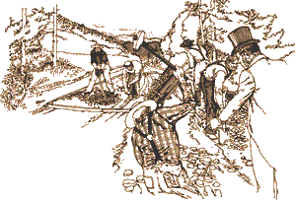
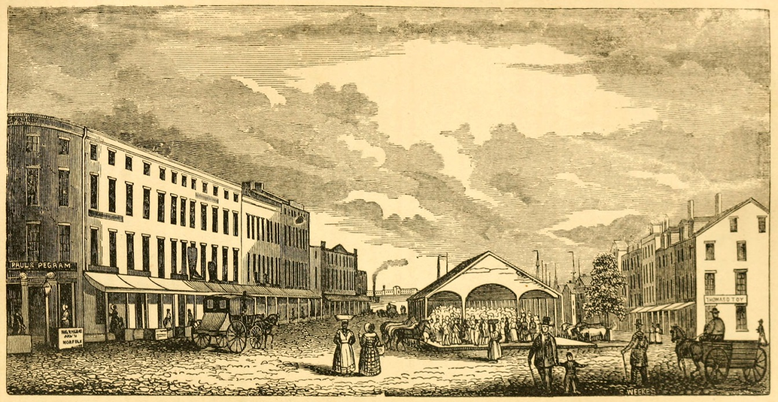
Transportation
Steam Boats
*Robert Fulton
*his steamboat sailed up the Hudson in 1807
*could go up and down rivers instead of only down
Turnpikes
*toll roads made money for corporations
*Lancaster turnpike
*60 miles from Philadelphia to Lancaster
*resulted in growth of other turnpikes
*federal and state governments support building of roads
*brought trade to sparsely populated areas
Cities
*cities were growing due to increased trade
*America still predominantly rural

Slide 8
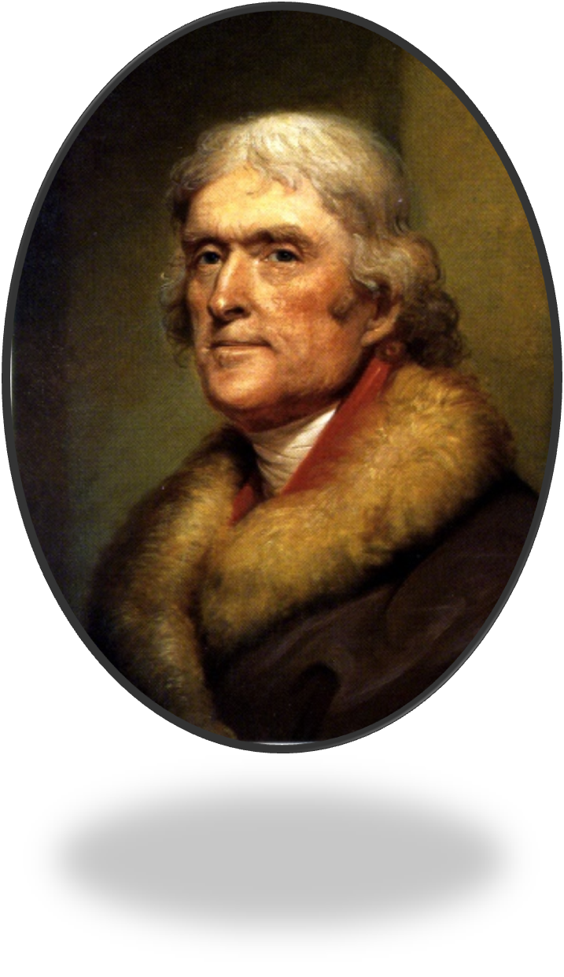
Mr. Jefferson
agriculturalist
inventor
anthropologist
architect
lawyer
astronomer
lexicographer
linguist
bibliophile
mathematician
botanist
meteorologist
classicist
musician
diplomat
naturalist
educator
numismatist
ethnologist
paleontologist
farmer
philosopher
geographer
politician
gourmet
scientist
horseman
statesman
horticulturist
writer
Notes:
Jefferson
Talents, accomplishments and hobbies
*one of the most talented presidents to ever hold office
*Thomas Jefferson has been described as a(n): agriculturalist, anthropologist, architect, astronomer, bibliophile (Jefferson was a deist which meant he believed in a creator but was not a Christian. Wrote his own bible), botanist, classicist, diplomat, educator, ethnologist, farmer, geographer, gourmet, horseman, horticulturist, inventor (plow, dumbwaiter, macaroni machine, polygraph), lawyer, lexicographer (someone who studies the history of words), linguist, mathematician, meteorologist, musician (played the violin), naturalist, numismatist (someone who studies or collects currency), paleontologist, philosopher, political philosopher, scientist, statesman, writer
*fascinated by architecture and was the person who designed many of Washington’s buildings
*could speak several languages (Greek, Latin, Spanish, Italian, French German and several Indian languages)
*despised formal ceremonies and often times answered the door to the Whitehouse in slippers and a fur jacket
*was not good at giving speeches and refrained from doing so during his presidency
*loved having dinner parties and could get his policy across by inviting important guests over and having one-on-one conversations with them
*extremely modest and never sought to gain anything from the executive office
*wanted to unite the nation and weaken the power of the government
*saw his presidency as a second revolution which he felt was necessary every 20 or so years in order to guarantee the survival of the nation
Controversies
*also one of the most controversial and hypocritical founding fathers of this nation
*wrote the Declaration of Independence which stated that “all men were created equal” yet he was a slave-owner
*allegedly had an affair with one of his slaves, Sally Hemming, who was the half sister of his wife (5 children with her)
*wanted to decrease the power of the Executive branch yet pushed the powers to the limit (single handedly doubled the size of the US)
*was an alcoholic (his liquor bill while president was like $198,000 dollars)
*did not want his presidency advertised on his tombstone
*just wanted to spend his time at Monticello (Italian for “Little Mountain”)
*when he died he was completely broke
*lost his slaves and land and had to sell all his books to pay off debtors (first books that made up the Library of Congress)
8

Slide 9
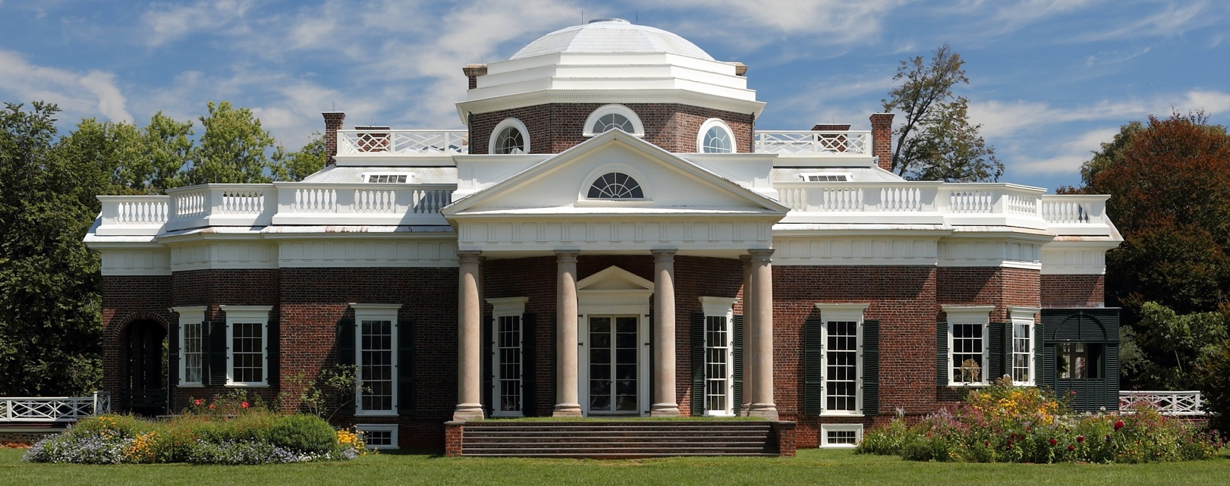
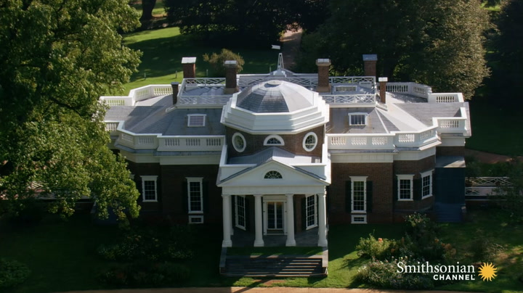
Monticello

Slide 10
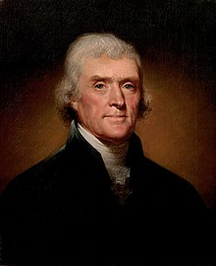
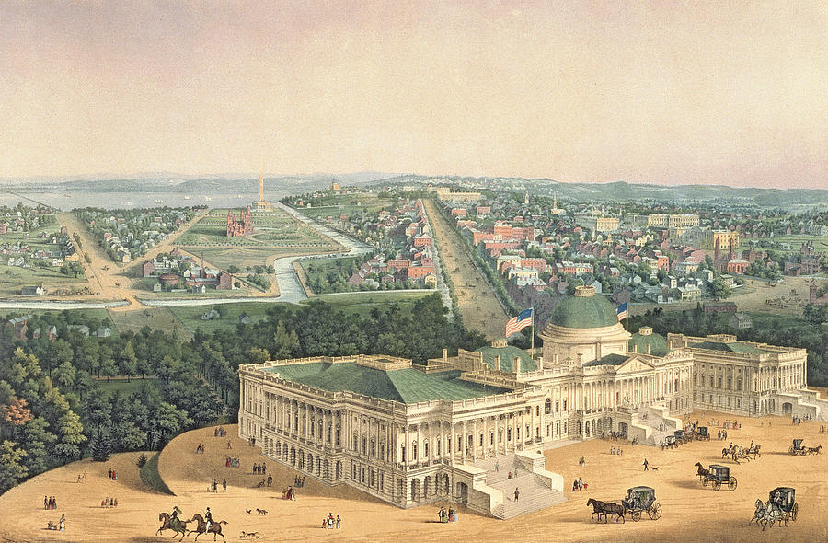
President Jefferson, 1801-1809
“We are all Republicans, We are all Federalists”
*Jefferson attempted to bring the parties together
*mostly succeeded in this
*no political “revolution” took place
*most Federalist policies remained intact
The Village of Washington
*remained fairly small (3,200 people)
*Jefferson downplayed the presidency
*often answered door in his slippers
*widower who threw informal parties
Jefferson the Politician
*was shrewd, supported patronage
*Republicans controlled both houses
*wanted to reduce the size of government
-got rid of internal taxes (Whiskey Tax)
-relied on customs duties and land sales
-reduced deficit by half
-reduced military by half
∙Army: 4,000 -> 2.500
∙only 7 ships in the navy!

Slide 11
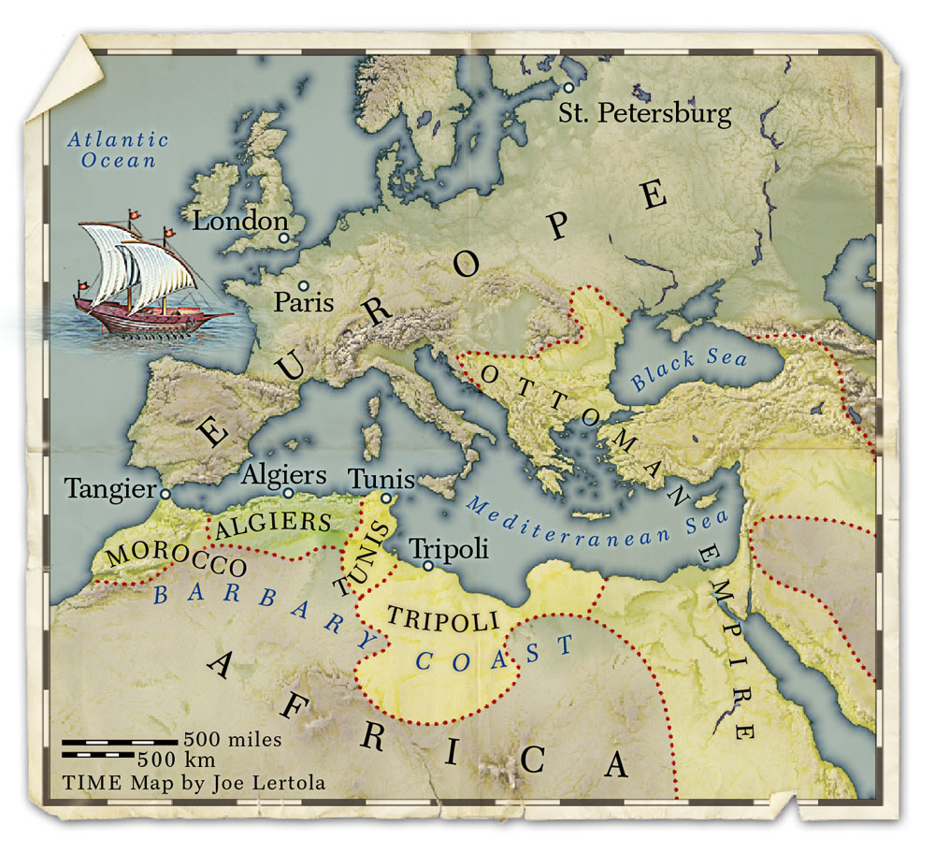
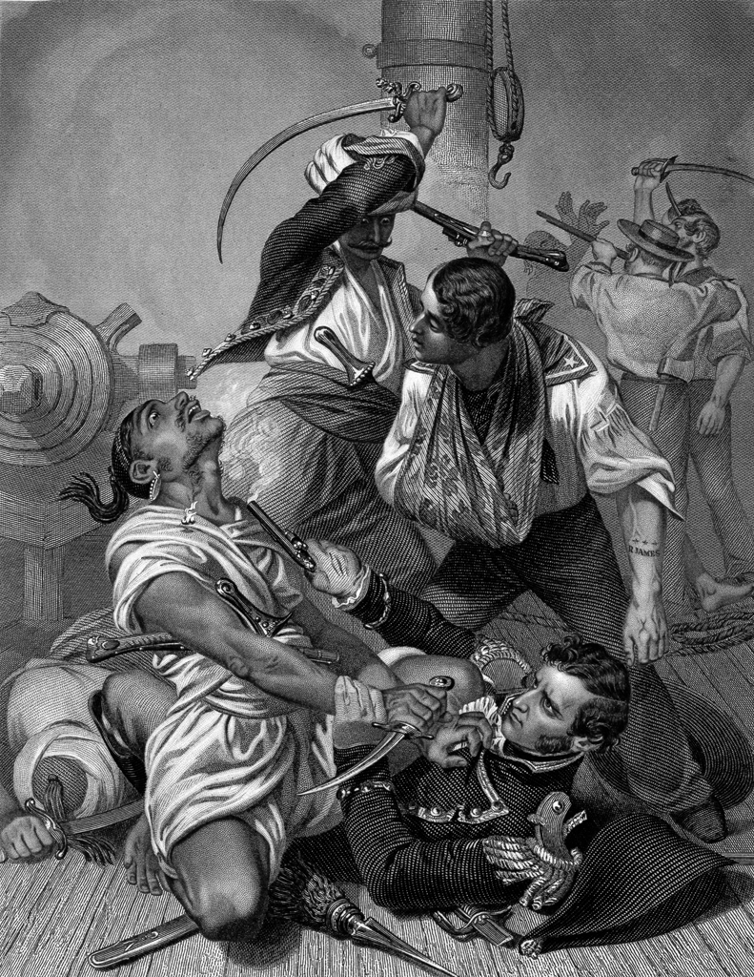
Foreign Issues:
The Barbary Pirates vs. the Marines, 1801
Notes:
11
Barbary pirates
*Jefferson was forced to deal with an issue that would make him think twice about reducing the navy
*for centuries along the Barbary Coast of north Africa (Morocco, Algiers, Tunis and Tripoli) certain kingdoms had practiced piracy and extortion
*after the American Revolution the United States began to increase trade within the Mediterranean region
*American ships were being attacked by pirates in the region
*Jefferson responded by declaring war on the Barbary pirates and blockading Tripoli
*at one point U.S. sailors were captured and there was a mission to save them
*where the famous words from the Marine hymn come from, “to the shores of Tripoli”
*where Marines got their nickname leathernecks from

Slide 12
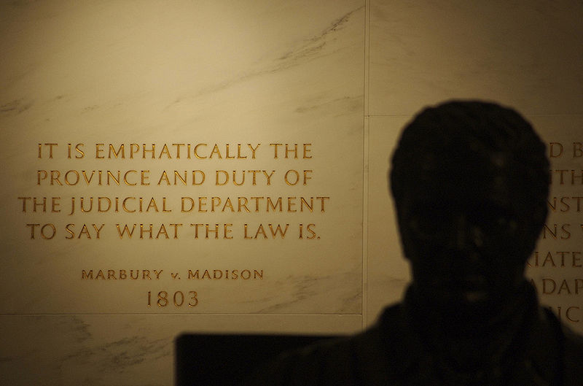
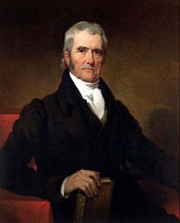
Jefferson and the Judiciary
Marbury Vs. Madison, 1803
*established judicial review
John Marshall
*Chief Justice of SCOTUS
*Federalist who secured the power of the court
*prevented Federalist judges from being impeached
Notes:
Jefferson and the Judiciary
*when John Adams left the presidency he was extremely ungrateful
*tradition holds that the old president welcome in the new one but instead Adams left town and did not welcome his former friend
*not only that but he had made a series of “Midnight Appointments” before he left office
*John Adams’ most controversial appointment was John Marshal, a Supreme Court Justice who was a Federalist
*he also appointed a number of people (mostly Federalists) to jobs
*on top of all this he also got the Judiciary Act of 1801 passed which created several new judge positions which he then filled with fellow Federalists
*Jefferson’s Secretary of State, James Madison, responded by refusing to allow some of the judges to take their jobs
*one of them, William Marbury, decided to take Madison to court
*the case ended up in the Supreme Court
*the court ruled that they had no jurisdiction to rule in the matter allowing Madison to prevent Marbury from getting his job
*this was the first time that the Supreme Court had used its power of Judicial review to rule something unconstitutional or not

Slide 13
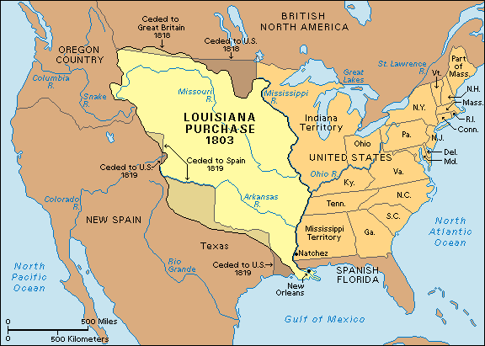
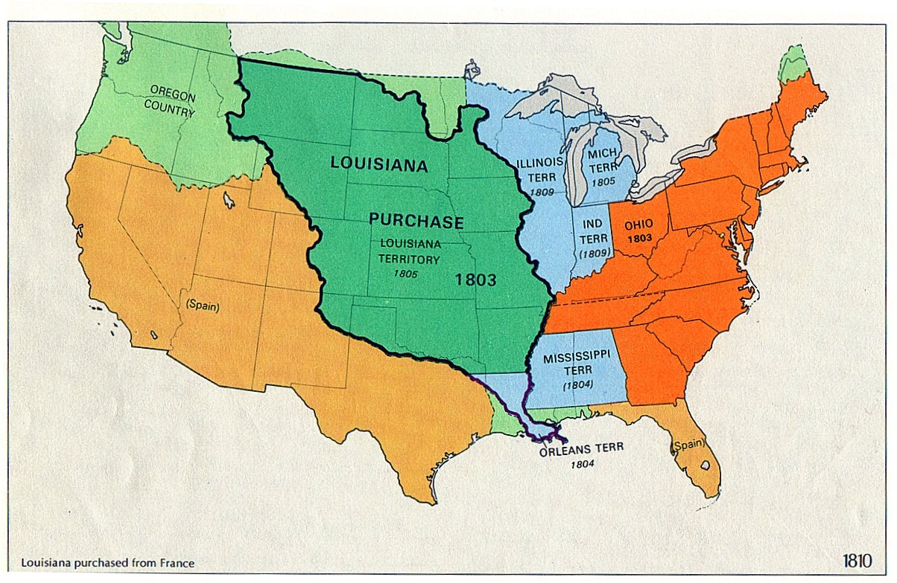
Doubling the National Domain
Napoleon gains power in France, 1800
Treaty of San Ildefonso, 1800
*France regains possession of Louisiana from Spain
*wants to recolonize the area west of the Mississippi
*send troops to Haiti to prepare for recolonization
New Orleans
*Spanish governor refuses American shipping
*Jefferson proposes buying New Orleans
*sends delegation to France to negotiate
The Louisiana Purchase
*slave insurrection and revolt wipes out French troops in Haiti
*Napoleon decides to sell it all for $15m
Was the purchase constitutional?
*according to Jefferson, no
*argued that president had treaty making power
*Jefferson contradicts himself
*Federalists angry and were against this
-feared Jeffersonian farmers moving into new land
-feared they would limit Federalist powers
Notes:
Louisiana Purchase
*after the French and Indian War Spain received the territory west of the Mississippi
*in 1801 Napoleon, the emperor of France, made a secret deal to purchase the land from Spain
*Napoleon had previously sent tens of thousands of troops to Haiti to put down a slave rebellion
*he wanted to use the troops to then colonize Louisiana when they were done
*at the same time threatened to close the port of New Orleans
*this made Americans fearful because New Orleans had become extremely important to American farmers in the West for trade
*Jefferson was afraid that cutting off the port of New Orleans and French colonization would result in War between the US and France
*he also feared that the war between Britain and France in Europe would spill over to North America
*Jefferson decided to send James Monroe to France to negotiate a deal to purchase the region
*negotiations dragged on for two years
*he finally sold the territory to the United States for $15 million (3 cents and acre) it so he could fund his war in Europe and because 30,000 of his troops stationed in Haiti perished from disease
*was one of the crowning achievements of Jefferson’s presidency and doubled the size of the United States
*made a lot of Americans including Jefferson wonder if what he had done was Constitutional or not

Slide 14
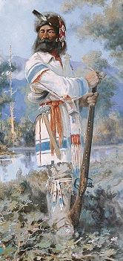
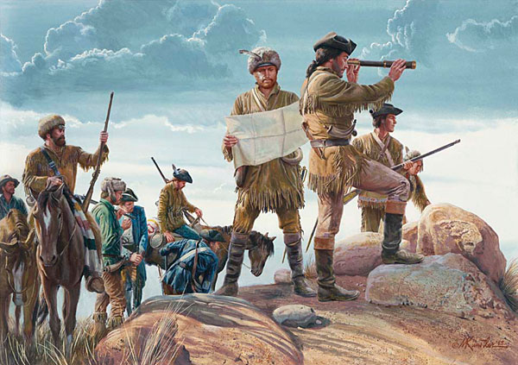
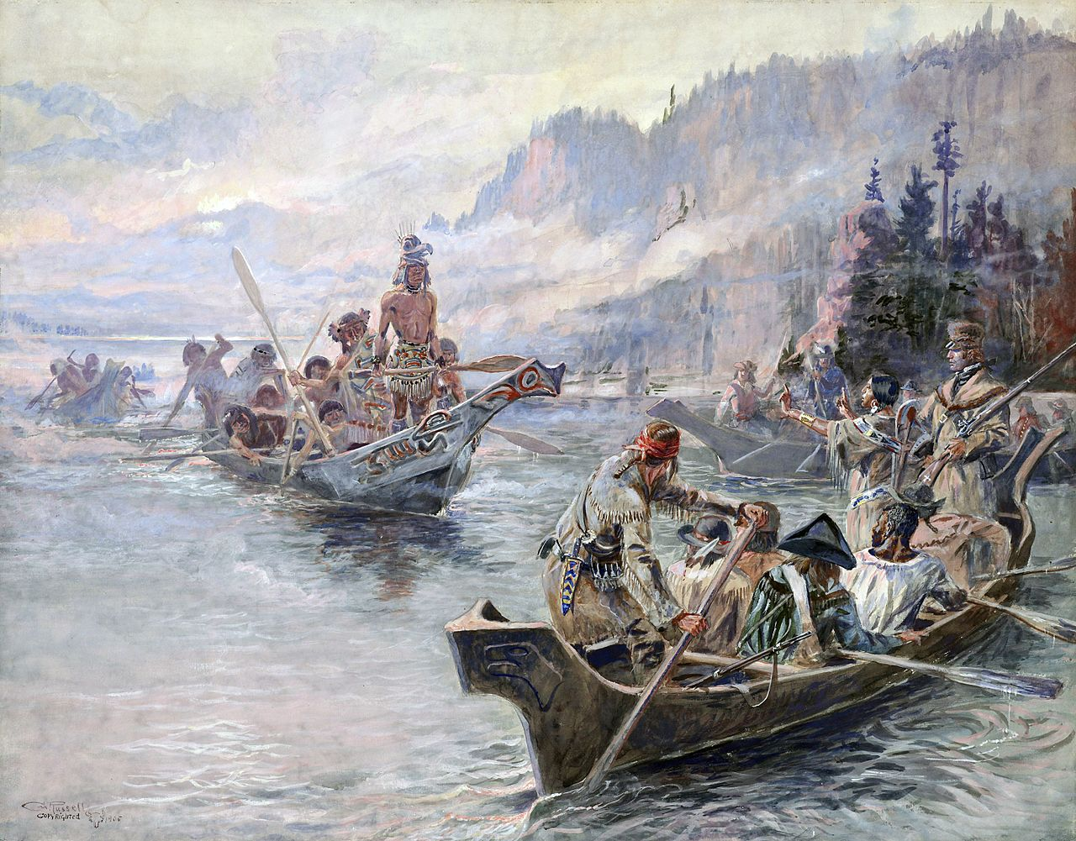
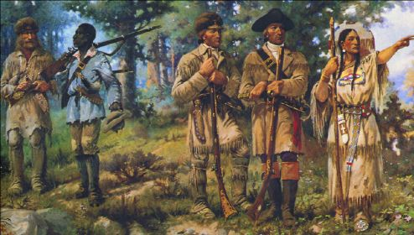
Louis and Clark Expedition, 1804-1806
Corps of Discovery
*52 men who set out from St. Louis
*Meriwether Lewis and William Clark leaders
*experienced Indian fighters and frontiersmen
*commissioned by Jefferson to explore territory
*Shoshone woman Sacajawea, guided them
*made it all the way to the Pacific Ocean and back
Flora & Fauna
*detailed diary of the land and its biology
*accounts were published to promote western settlement
Zebulon Pike
*explored southern part of LP, 1805-1807
*discovered Pikes Peak in Colorado

Slide 16
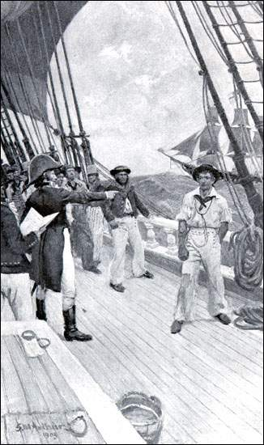
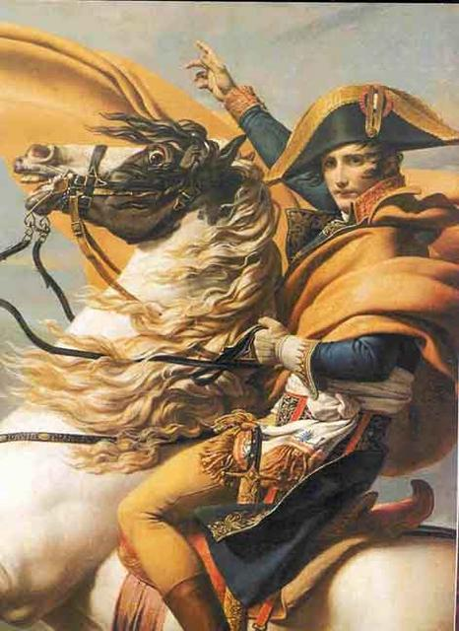
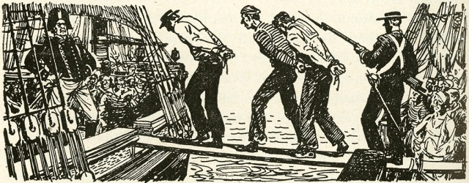
The Napoleonic Wars, 1803-1815
How did they effect America?
*Problems of neutrality
-Berlin Decree forbade trade with England
-Orders in Council forbade trade with France
*Impressment
*Chesapeake-Leopard incident
-British ship attacks American ship
-British kill 3 and impress the survivors
-sours the Anglo American relationship
Notes:
War in Europe
*in 1803 Britain and France went to war on land and sea
*throughout the world the two sides began to restrict trade to prevent the other side from gaining an advantage
*initially, Americans made a lot of money by trading with both sides
*however, as Napoleon started winning more and more battles, the British began to confiscate American vessels and impress or kidnap American sailors
*nearly 9,000 Americans were forced to work on British ships from 1803-1812
*at one point three Americans were killed by the British navy in 1807
*this event almost resulted in war between the U.S. and Britain

Slide 17
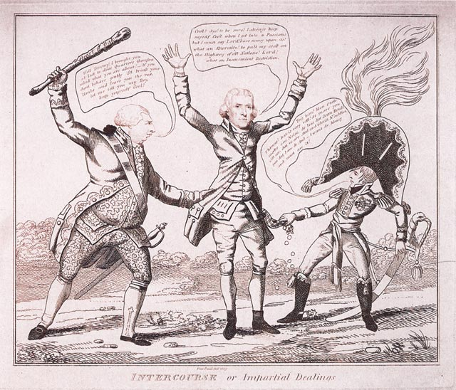
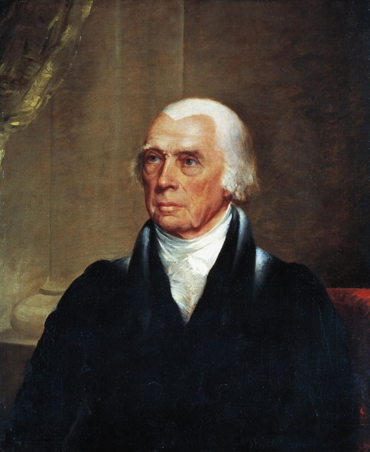
America’s Response
Embargo Act, 1807
*embargo on all foreign trade
*“Like slitting your throat to stop a nosebleed”
*huge disaster
Election of 1808
*Jefferson glad to be done with presidency
*James Madison wins election
*another Virginian
*another Sec. of State
*inherits unresolved problems
Non-Intercourse Act, 1809
*opened trade to everyone but France and Britain
*still a disaster
Macon's Bill #2, 1810
*ends embargo with nations that respect America’s rights
*France agrees but not Britain
Notes:
Election of 1808
*controversy over Jefferson’s final years as president was even more reason for him to not run again in 1808
*his friend and Secretary of State James Madison would win the election in 1808
*his presidency was highlighted by one of the most turbulent times in American history
*was also the beginning of a trend of making the office of the Secretary of State the heir to the throne in a way
*led to a series of secretaries of state gaining the presidential office

Slide 18
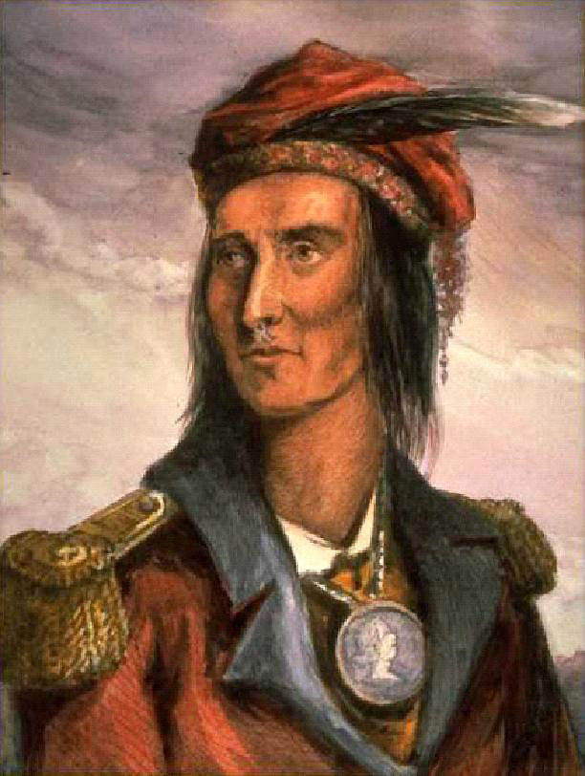
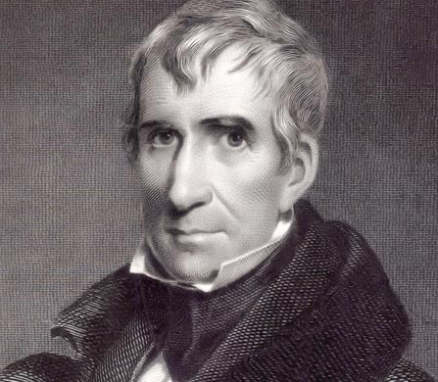
Indian Problems
General William Henry Harrison
*Gov. of Indiana territory
*forcing natives off land to encourage white settlement
Tecumseh
*wanted to unite natives in the region
*claimed that western land belonged to all the tribes
*encouraged by British to attack American settlements
Battle of Tippecanoe, 1811
*Harrison’s Army attacked Indian town
*drove Natives off and claimed land
*more whites moved into Indiana territory

Slide 19
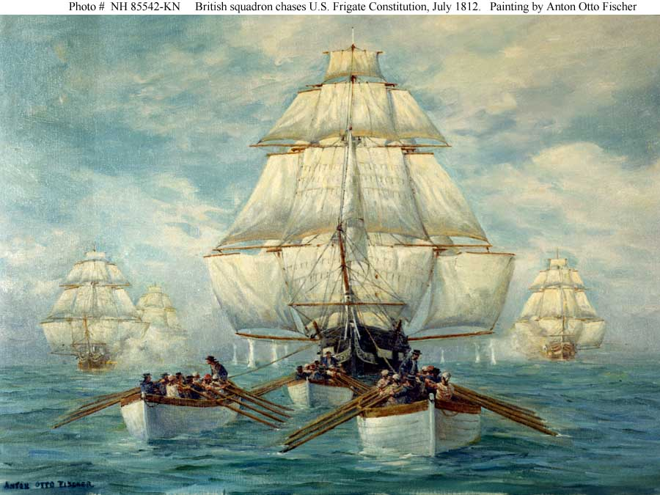
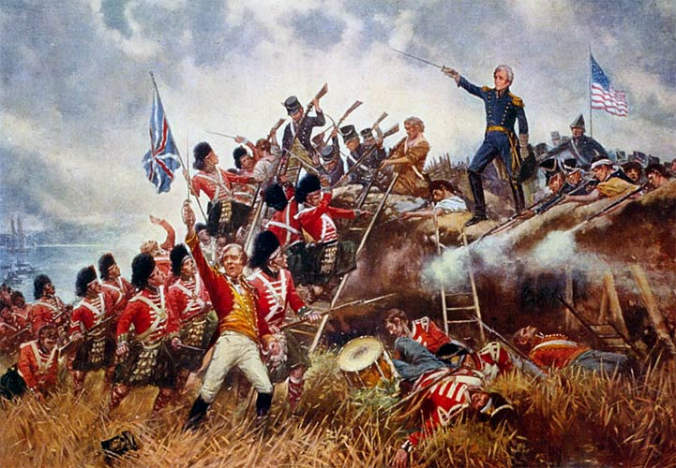
The War of 1812, (1812-1815)
Causes
*Expansion
*Pride
-impressment
-British actions before the war
*chance to prove ourselves as a nation
*War Hawks
-young generation of leaders that wanted war
-mostly from south and west
-Henry Clay, John C. Calhoun, Andrew Jackson
-thought we could catch Britain off guard
US Preparedness
*the Navy
*the Army
Notes:
Causes of the war
*Americans were furious about the British seizing American ships and kidnapping their sailors
*many American citizens and leaders felt that this was a violation of neutral rights and an act of war against the United States
*the relationship between America and Britain went horribly sour
*a group of political leaders known as War Hawks in Congress were beginning to gain support for declaring war on Britain
*men like John C. Calhoun of South Carolina and Henry Clay of Kentucky argued that the United States had been embarrassed by the British
*wanted to go to war to protect America’s national honor
*several Americans saw a war between the United States and Britain as an opportunity to gain more land
*they wanted to get rid of the British presence in Canada and the Spanish presence in Florida
Congress declares war on June 8, 1812
*growing support against Britain led Congress to declare war in June of 1812
*the goal was to put enough pressure on British colonies in Canada that the British would seek a quick end to the war and agree to allow American ships to continue business unabated
U.S. preparations for war
*U.S. military was in a pitiful state
*American leaders refused to raise taxes to pay for a standing army
*thought they could rely on militias to do the fighting
*since the revolution, the army had been reduced to only 3,000 men
*most were stationed along the frontier
*were poorly trained and equipped and were led by inexperienced officers
*the navy had only 18 ships (compared to the British 600 ships)
*they were however very well trained from fighting the Barbary Pirates in the Mediterranean
*the nation itself was split over the support for the war
*New Englanders were hurt badly because they could no longer trade with Britain
*thing got worse in 1813 when the British Navy blockaded the East coast
*New Englanders threatened to secede from the United States so they could open up trade with the British

Slide 20
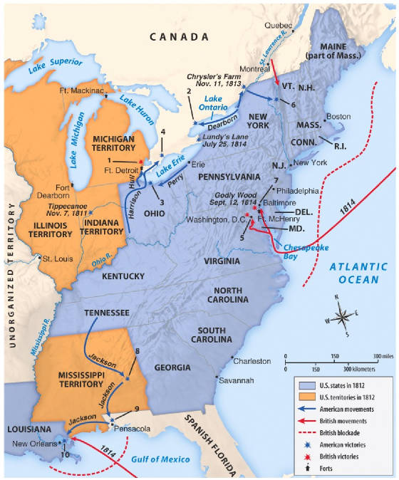
The War of 1812
First Phase, 1812-1814
Second Phase, 1814-1815
*threefold plan
-secure Canada
-blockade and invade east coast
-New England in revolt
-invade the south
-New Orleans
Notes:
First Phase of the War: 1812-1814
*this first phase was highlighted by the U.S. trying to take the offensive while the British were occupied with fighting Napoleon in Europe
*America planed on attacking the British in Montreal, along the Niagara into Canada and into Canada north of Detroit
*the plan was to attack swiftly enough to end the war while the main forces of the British Empire were preoccupied with Napoleon
*the plan was a complete failure mostly because inexperienced American militias were terrible soldiers and refused to invade Canada
*as a result the British were able to hold out long enough to defeat Napoleon and send experienced troops to North America
Second Phase of the War: 1814-1815
British Three pronged attack
*April of 1814 Napoleon had been defeated
*British leadership decided to implement a three pronged attack
1. involved an invasion from Canada (never resulted in any major victories mostly do to the experienced American navy along northern waterways)
2. a blockade of the U.S. East coast
3. an invasion of New Orleans and the south by British troops stationed in the Caribbean

Slide 21
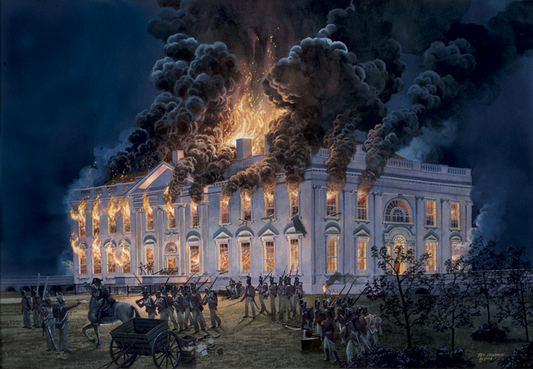
Invasion of Washington, D.C. (Aug. 24, 1814)
Notes:
21
East coast blockade
*was devastating to the Americans
*completely put the economy to a halt
*Northerners were devastated and threatened secession
Invasion of Washington D.C. Aug. 24, 1814
*most humiliating event of the entire war was when Washington was invaded and burned to the ground by the British
*one story tells that the Madison and his staff had to leave so quickly that they left dinner sitting on the table and several British officers ate dinner in the Whitehouse
*Madison then led an artillery unit outside of Washington and was forced to retreat
*luckily his wife Dolly Madison saved the portrait of George Washington
*the British also burned down the Library of Congress
*Thomas Jefferson donated all 6,400 of his personal books to the Library

Slide 22
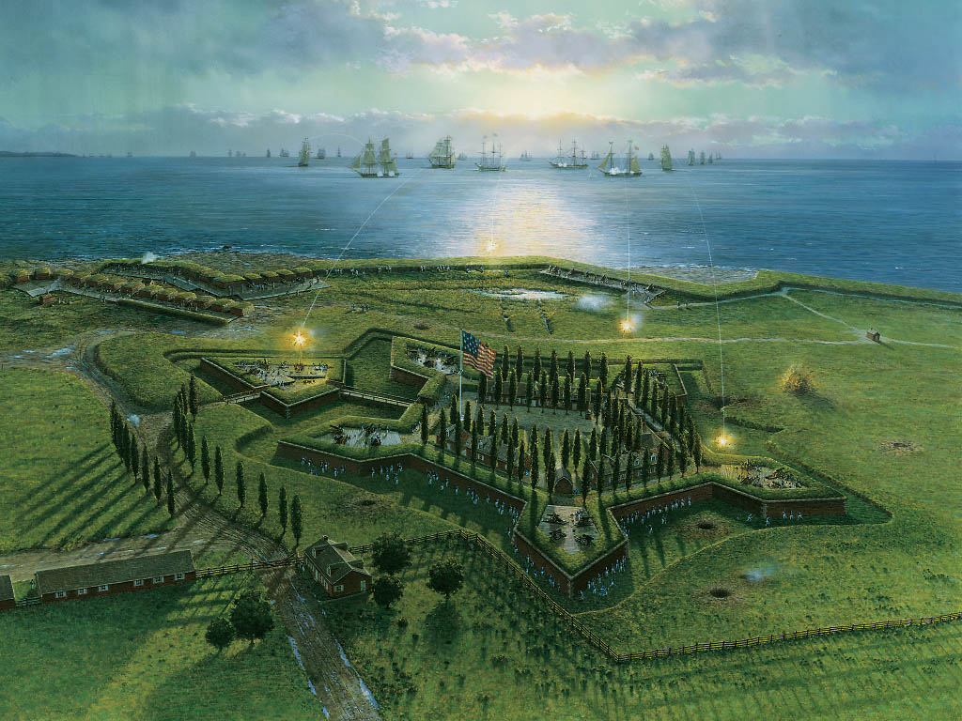
Fort McHenry (Sept. 13, 1814)
Notes:
Fort McHenry Sept. 13, 1814
*after Washington the British moved on to Baltimore which was protected by Ft. McHenry
*on Sept. 13 the British began a 25 hour long bombardment of the fort
*the Americans held out and prevented the British from taking the fort
*the battle is famous because a lawyer by the name of Francis Scott Key, who was on a British ship negotiating prisoner exchange
*when the battle was going on, actually wrote the “Star spangled banner”, America’s National Anthem
*supposedly the tune for the song was based on an English drinking song that the officers sang while at dinner
22

Slide 23
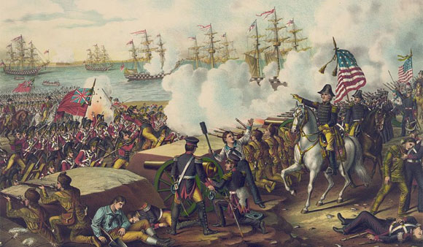
Battle of New Orleans: January 8, 1815
Notes:
Battle of New Orleans: January 8, 1815
*in the South the British hoped to land an invasion force of nearly 11,000 to take and occupy New Orleans
*Andrew Jackson was sent with 4,000 men to hold the city
*the British led a headlong attack right into the defenses of the Americans and were decimated
*it was the biggest victory of the war for the Americans and it was fought two weeks after the war ended
23

Slide 24
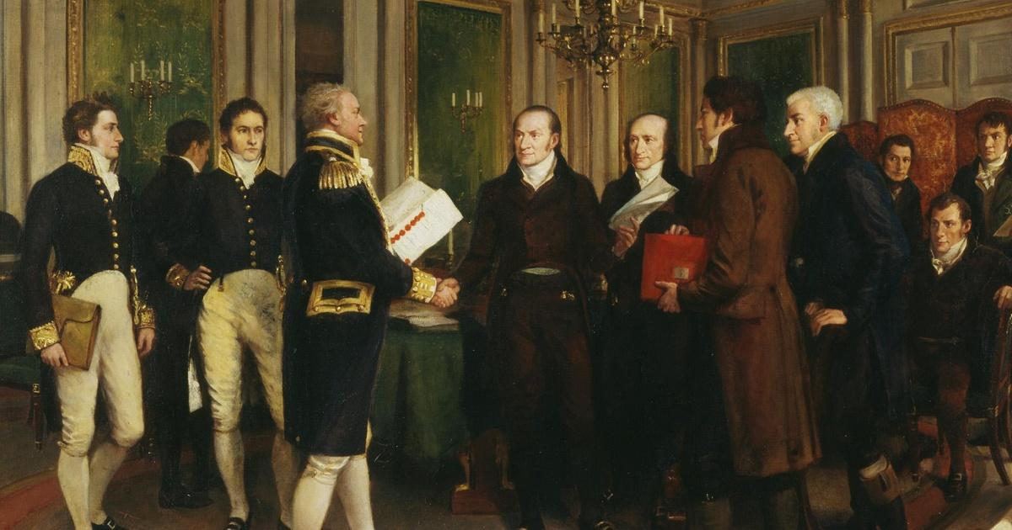
Peace Settlement
Treaty of Ghent, Dec. 24, 1814
*Neither side gains anything
*British agree to leave American frontier
Rush-Bagot Agreement, 1817
*agreement to disarm the Great Lakes
Aftermath of the war (lots of “isms”)
*patriotism
*nationalism
*capitalism
*isolationism
Notes:
Treaty of Ghent: December 24, 1814
*ended the war
*produced no clear winner
*neither side gained any territory and the trade disputes that started the war were left unresolved
*each side had to go back to original boundaries
*in fact most Americans were dumbfounded as to why the United States even initiated or fought the war in the first place
Aftermath of the War
*war had more of a psychological effect on the American people than anything else
*inspired a number of “isms” as a result
1. patriotism: Americans felt that they had some identity now that they had taken on the British Empire once again and had won (in their eyes)
*for the first time, celebrating Independence Day every July 4th became a huge celebration
2. nationalism: many Americans felt like the war was enough of a victory to legitimize the United States as a nation
3. capitalism: the war encouraged the growth of manufacturers and increased the economy
4. isolationism: American’s became more cautious and fearful of getting involved with European affairs and decided to avoid them altogether

Slide 25
Crash Course US History Ep. 10 & 11: Thomas Jefferson/War of 1812
Ep 10
https://youtu.be/_3Ox6vGteek?list=PL8dPuuaLjXtMwmepBjTSG593eG7ObzO7s
Ep. 11 https://youtu.be/qMXqg2PKJZU?list=PL8dPuuaLjXtMwmepBjTSG593eG7ObzO7s

