Slide 1
Ch. 8: Varieties of American Nationalism
Focus Questions:
What were the main elements of the market revolution?
How did the market revolution spark social change and encourage growth in the United States?
What were some of the major changes in transportation that became available during the market revolution?
Explain some of the types of westward expansion.
Identify Monroe’s presidency. (i.e. foreign and domestic issues).
Explain the Monroe Doctrine.
Describe John Quincy Adams’ presidency and its problems.
Explain the Election of 1828.
Notes:
The purpose of the focus questions is to help students find larger themes and structures to bring the historical evidence, events, and examples together for a connected thematic purpose.
As we go through each portion of this lecture, you may want to keep in mind how the information relates to this larger thematic question. Here are some suggestions: write the focus question in the left or right margin on your notes and as we go through, either mark areas of your notes for you to come back to later and think about the connection OR as you review your notes later (to fill in anything else you remember from the lecture or your thoughts during the lecture or additional information from the readings), write small phrases from the lecture and readings that connect that information to each focus question AND/OR are examples that work together to answer the focus question.

Slide 2
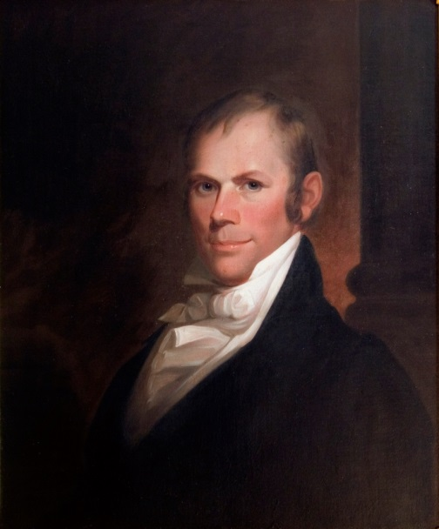
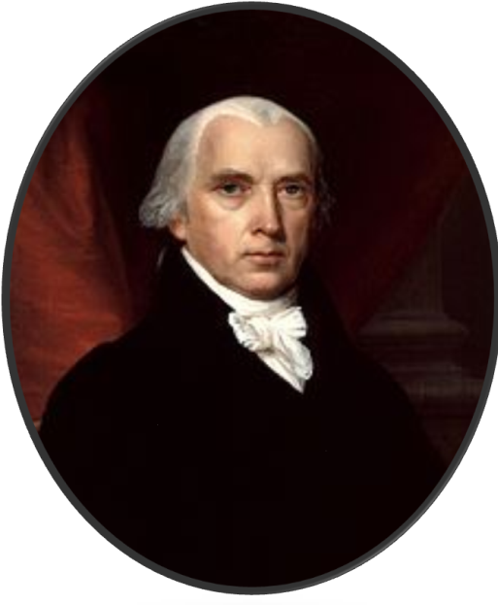
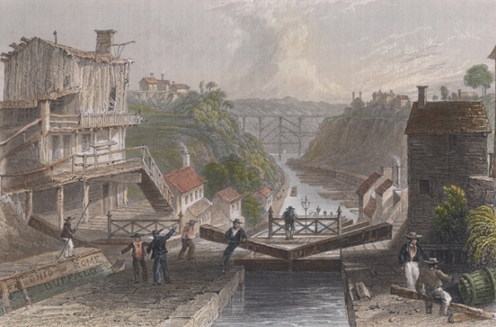
Building a National Market: The “American System”
Banking, Currency and Protection
*1st Bank of U.S, (BUS) expired 1811
-state banks fill the void
-instability created by state banks
*2nd BUS created in 1816 with 20yr charter
-stabilized currency
-had power over state banks
-helped grow factories by giving out loans
-provided capital for internal improvements
Growth of Textile Industry
*Lowell Mill, Boston
-1st spinning and weaving mill
-Francis Cabot Lowell stole English ideas
Postwar economic problems
*British goods flood the market
*hurt U.S. economy
Tariff of 1816
*protected American industries
*prevented flood of cheap foreign goods
*allowed American factories to grow
Henry Clay
Notes:
The Market Revolution
*was an economic movement in the United States that has its origins during and after the War of 1812
*was a way to better sell American goods throughout the nation by improving transportation and communication
*was also a movement to create factories, mostly in the northeast, so the U.S. could industrialize
Post-War America
*1824 Marquis De Lafayette toured the United States
*U.S. population had tripled since he last visited in 1784 (40 Years!!)
*12 million people lived all over the nation which had more than doubled in size since his last visit
*13 states had turned into 24 states
Regional differences North/South/West
*in the South cotton agriculture was taking hold of Georgia, Alabama Mississippi, Louisiana and Texas
*slavery itself was becoming more and more entangled within the southern culture
*North was starting to shift towards industrialization
*the West was growing in population and was becoming more reliant on a mixture of industry and agriculture
*signs of division were beginning to show between the three regions
Economic Prosperity
*differences in economies was causing the regions to become very unique from one another
*North was expanding its ability to trade and was increasing industrially as well
*in the West pioneers took advantage of the abundance of raw materials as well as internal waterways
*Southern agriculture (cotton, tobacco, rice) accounted for 2/3 of American exports
Madison’s proposals
*Madison sought to heed Washington’s warnings and protect the new nation after the war by improving roads, building canals and fortifications as well as increasing the army and navy
*wanted to create a tariff to stimulate internal growth and prevent foreign goods from entering the nation
*by improving roads and canals he would increase trade and production throughout the nation
National Bank 1816
*the charter for the first national bank expired in 1811
*created a new debate throughout the nation as to whether or not to renew the charter
*state banks had flooded the market with different types of currency with uncertain values
*as a result Congress decided to renew the charter for the national bank for another 20 years in 1816
*sparked and old debate over the constitutionality of the national bank
*nonetheless, the bank would help fund the new improvements being introduced to the nation
*none of what we are about to discuss would have ever happened had the government not helped pay for many of the improvements
Protective Tariff
*created in 1816 the tariff was supposed to provide and generate economic growth within the U.S.
*collectively, this all was called the “American System” of economics
*because it provided a home market for American industrial and agricultural goods
The growth of Industry
*while the South and West were being transformed into major agricultural regions the North was becoming an industrial giant
*it could not sustain the growth of large amounts of agriculture
*its abundance of river systems however made it ideal for industrial growth
*it could also provide the much needed labor that industrial areas needed as a result of the constant flow of immigrants migrating to large cities
Industry and growth of cities
North
*in the early 19th century most manufacturing had to be done at home
*Americans made a number of items by hand: mostly clothes, shoes and household tools
*when the steam engine was invented in 1705 in Britain the first industrial revolution began
*for decades the British kept their industrialization practices a secret so they could maintain a monopoly on manufactured goods
*this began to change after the Revolution when British immigrants began to make their way to the states after the War of 1812
*they mostly settled in the north where they could have access to rivers and laborers and they brought with them their ideas of industrial technology
*as factories began to popup in the Northeast, laborers began building homes near the factories to cut down on transportation costs
*after a while these areas turned into cities and urban sprawls
West
*the west also experienced a great deal of industrialization as a result of its reliance on agriculture
*factories producing farm products were developing all over the west as well as gristmills, slaughterhouses, and tanneries
*distilleries were also producing vast quantities of alcohol which aided western farmers who provided the grain needed to make spirits
*many German immigrants especially began to help boost the growth of western farms by developing the beer industry in the west (St. Louis, Milwaukee, Colorado)
Southern mistrust of industry
*as industry spread throughout the north and west it floundered in the south
*the dominance of southern planters resulted in the mistrust of industry in the south

Slide 3
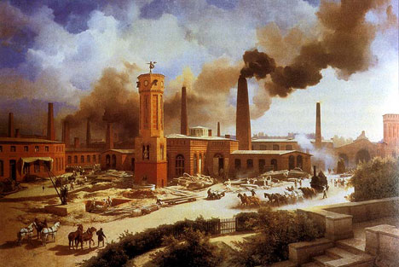
Notes:
3
The growth of Industry
*while the South and West were being transformed into major agricultural regions the North was becoming an industrial giant
*it could not sustain the growth of large amounts of agriculture
*its abundance of river systems however made it ideal for industrial growth
*it could also provide the much needed labor that industrial areas needed as a result of the constant flow of immigrants migrating to large cities
Industry and growth of cities
North
*in the early 19th century most manufacturing had to be done at home
*Americans made a number of items by hand: mostly clothes, shoes and household tools
*when the steam engine was invented in 1705 in Britain the first industrial revolution began
*for decades the British kept their industrialization practices a secret so they could maintain a monopoly on manufactured goods
*this began to change after the Revolution when British immigrants began to make their way to the states after the War of 1812
*they mostly settled in the north where they could have access to rivers and laborers and they brought with them their ideas of industrial technology
*as factories began to popup in the Northeast, laborers began building homes near the factories to cut down on transportation costs
*after a while these areas turned into cities and urban sprawls
West
*the west also experienced a great deal of industrialization as a result of its reliance on agriculture
*factories producing farm products were developing all over the west as well as gristmills, slaughterhouses, and tanneries
*distilleries were also producing vast quantities of alcohol which aided western farmers who provided the grain needed to make spirits
*many German immigrants especially began to help boost the growth of western farms by developing the beer industry in the west (St. Louis, Milwaukee, Colorado)
Southern mistrust of industry
*as industry spread throughout the north and west it floundered in the south
*the dominance of southern planters resulted in the mistrust of industry in the south

Slide 4
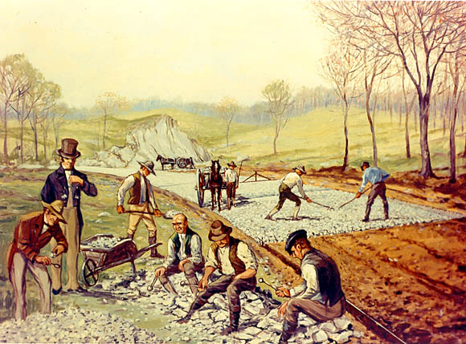
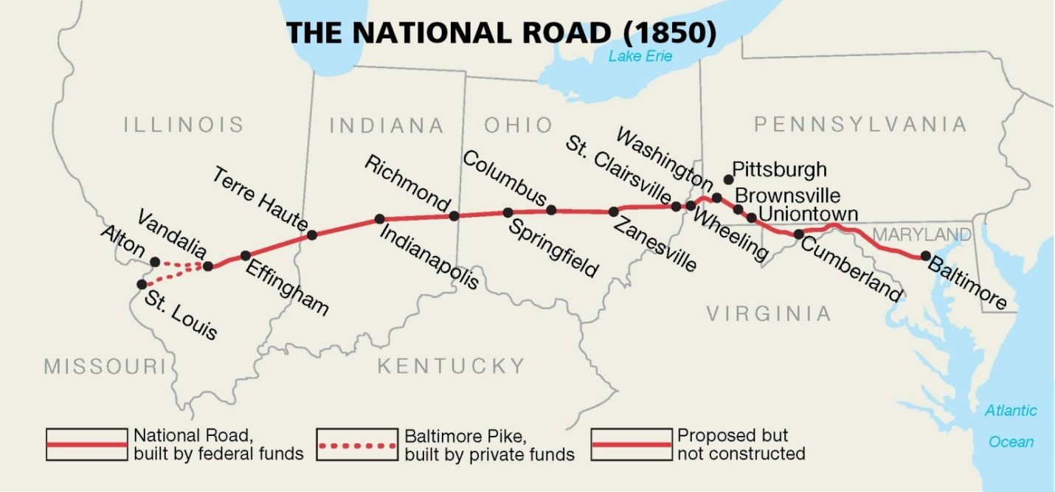
Internal Improvements
Transportation
*most pressing need
*government funded roads
-National Road
*Cumberland, Maryland – Wheeling, VA.
*would eventually expand further
*generated revenue through tolls
*steamboats
-made river travel much faster
*canals
-Erie Canal, 1825 (Buffalo-Hudson River)
-360 miles
-connected Great Lakes with New York
Controversies
*who should pay for it
-Federal Government?
-States?
*Calhoun’s Bill
-wanted US gov. to finance
-vetoed by Madison
Notes:
Improvements in transportation and communication
*in order to improve the national market a new transportation network had to be developed
*government sanctioned the construction of the National Road
*went from Cumberland, Maryland to Wheeling, Virginia (now West Virginia)
*was extended several times
Opening new roads
*most roads were not roads but simply muddy, rutted out, pot holed trails which made travel difficult, slow and dangerous
*most New England cities had paved roads to make it easier to bring in raw materials from the south and the west
*however, the south and the west lagged far behind in road quality
*this began to slow down growth and as a result the government began lending money to states to improve travel
*the purpose was to make it cheaper and easier to move goods from one state to another
*since most of the new roads were owned by the states it became very expensive to travel from one region to another
*collecting tolls became a popular way to pay for the building of roads
*it cost just as much to transport goods 30 miles by horse and cart as it did to send goods 3,000 miles overseas
*this meant that other, cheaper forms of transportation were needed

Slide 5
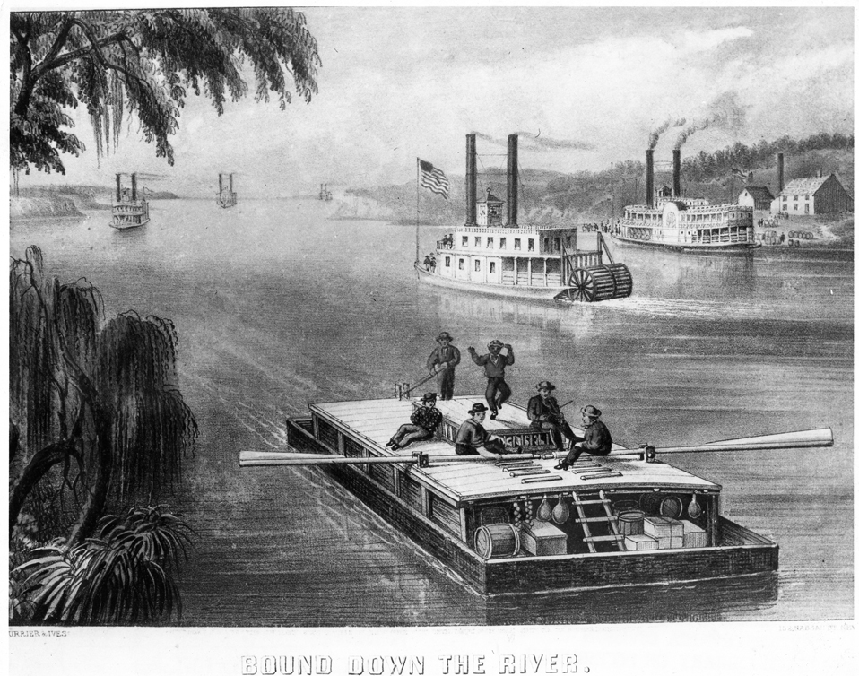
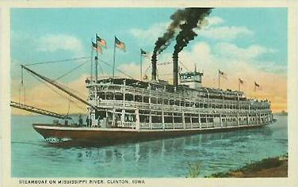
River Transportation
Notes:
River transportation
*one of the main reasons for the successful economic growth in the U.S. was because of the abundance of its river systems
*water was also a much more efficient way to travel because it was cheaper and faster than traveling by road
Flatboats
*were in fact the first form of river transportation and the most efficient way to transport goods throughout the nation
*large flat boats could be loaded down with thousands of pounds of goods
*flatboats would then float down river to a major city where farmers could sell their goods
*only problem was that they only traveled one direction
*merchants would then break their boats down and sell the material and hitch hike or walk back to their homes
*as a result of river transport, cities such as St. Louis and New Orleans became extremely important for the exportation of goods
Steamboats
*appeared in 1807 along the Hudson river in Albany, New York
*they began to revolutionize travel throughout the nation
*made travel much faster
*traveling from Pittsburg to New Orleans by flatboat took 6 weeks and flatboats could only travel one way
*steamboats could travel from New Orleans to Pittsburg in 25 days

Slide 6
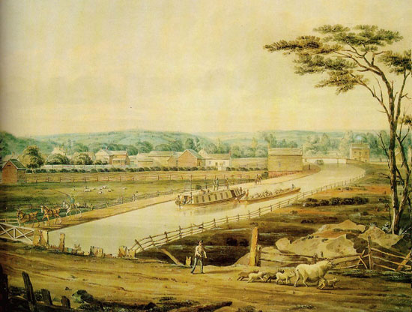
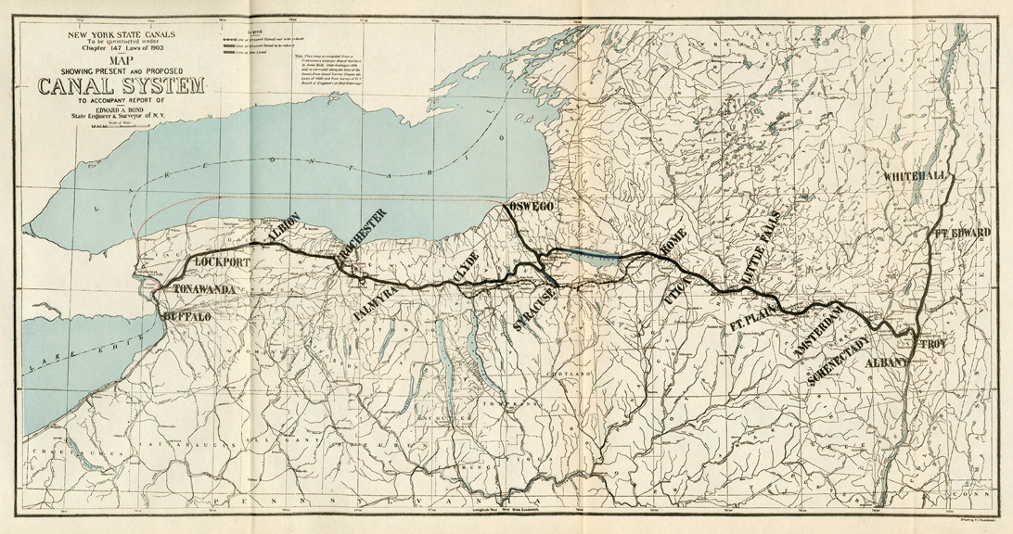
Erie Canal
Notes:
Erie Canal
*river transportation proved to have one major problem
*it was still difficult for western farmers to get their goods to the eastern seaboard
*they had to travel all the way down the Mississippi to New Orleans adding time and money to the transport of their goods to the East
*politicians and merchants sought a solution to this problem by building a canal that would connect the great lakes to the Hudson river
*it started in 1817 and finished in 1825 stretching 360 miles from Buffalo to Albany
*when it was finished it was the longest canal in the World and one of the most spectacular engineering achievements in the World
*it opened the entire great lakes market to the east coast and took only 6 days to travel from Buffalo to New York City as opposed to 20 by road
*it was also a commercial success as it reduced shipping costs greatly and made New York City the commercial capital of the nation
*also provided thousands of jobs to poor Irish immigrants
*there was only one drawback; the canal completely isolated the south from the rest of the nation
6

Slide 7
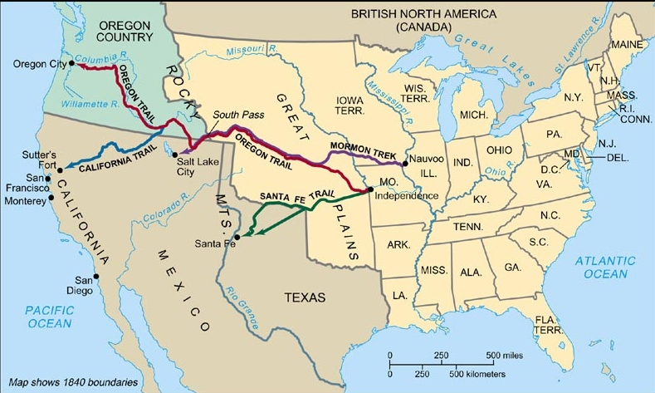
Expanding Westward
The Great Migrations
*mostly white males
*Native American threats diminished
*need for new land as cotton production exploded
*Mexican independence = increased trade with Mexico
*fur trade increased
Population Boom
*1800 = 5.3m
*1820 = 9.6m
*mostly caused by immigration
*cities/west absorbed most of the growth
*new states added
-Indiana, 1816
-Mississippi, 1817
-Illinois, 1818
-Alabama, 1819

Slide 8
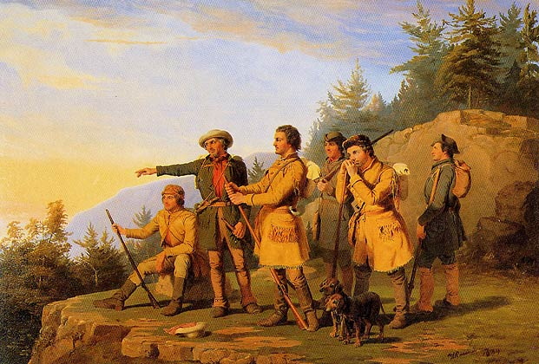
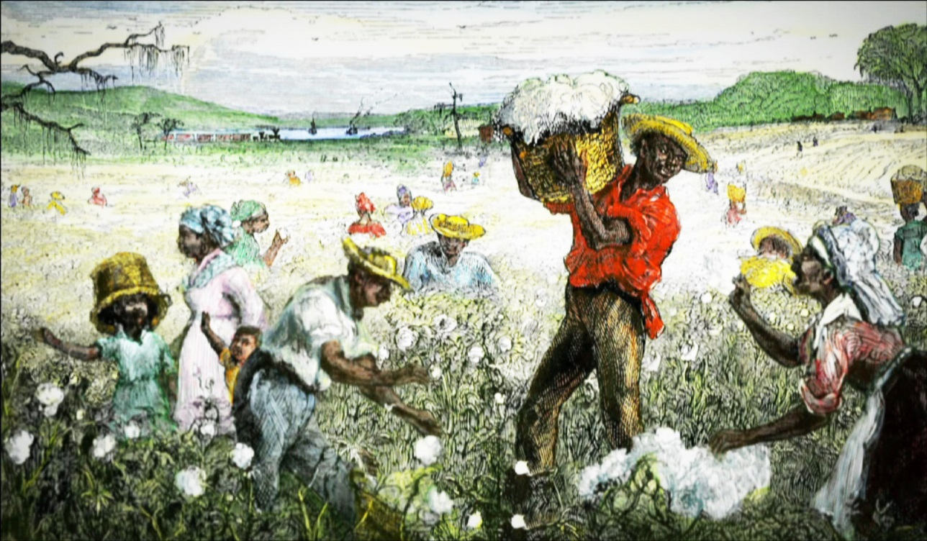
Expanding Westward
Plantation system of the South
*new lands were great for growing cotton
*cotton plantations replaced small farms
*new southern elite developed
*slavery increased
Trade and Trapping in the Far West
*Mexican Independence, 1821
-Santa Fe Trail opened up trade with Mexico
*Jacob Astor: Astoria, Oregon
-Northwestern Fur Company
-est. extensive fur trade from Great Lakes to the Rockies
*Andrew Henry and William Ashley
-Rocky Mountain Fur Company
*fur trappers first to settle new land
*often isolated
*married native women
Eastern Images of West
*dangerous and untamed
*some saw it as a “Great American Desert”

Slide 9
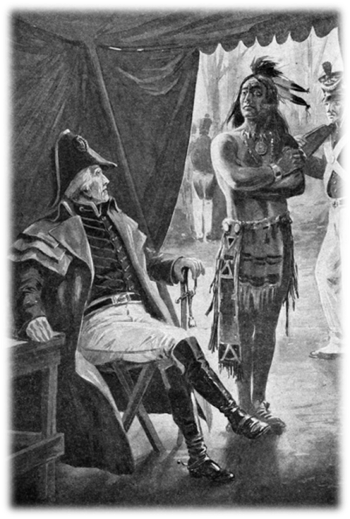
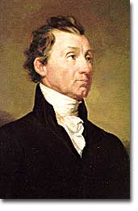
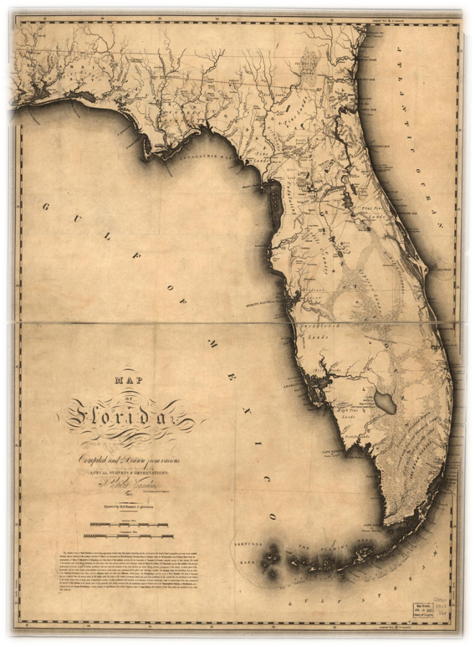
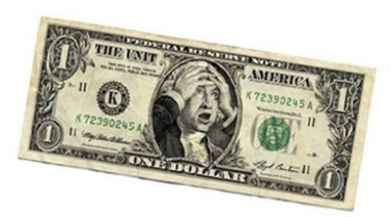
The Era of Good Feelings, 1816-1819
End of the First Party System
*James Monroe, 1817-1825
*Virginia dynasty
*oversaw period of peace both domestically and overseas
*Federalist party disappears
Monroe’s Presidency
*Florida
-problems
-Andrew Jackson: Seminole War
-Sec. of State: John Quincy Adams
-Adams-Onis Treaty of 1819
*Spain cedes Florida and claim to Pacific NW *US gives up claim to Texas
*Panic of 1819
-rising land prices
-rising crop prices
-financial panic
-banks foreclosed
-6 year depression hit
-National Bank was blamed for not preventing crisis

Slide 10
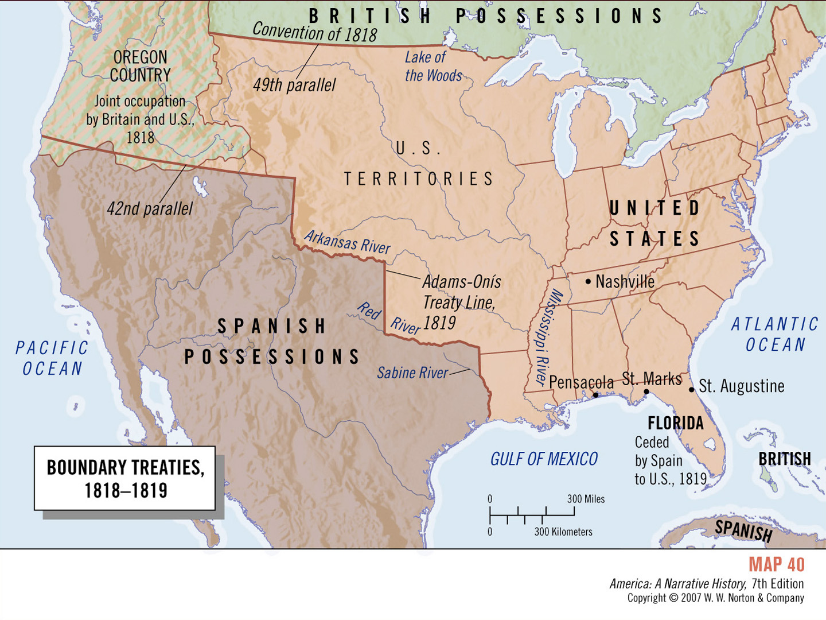
Notes:
10
The Anglo American Convention in 1818
*it was also important to permanently establish the border between the U.S. and Canada
*this was accomplished at the Anglo American Convention in 1818 which set the border between the two nations at the 49th Parallel and an agreement to share the Oregon Territory
Negotiating Russia out of Oregon
*in 1819 Spain gave up its claim to Oregon territory however Russia, which owned Alaska Territory, laid claim to the region as well
*Britain and the U.S. decided to negotiate Russia out of its claims to the territory
*the issue however made many American leaders realize that something had to be done to protect America’s borders from foreign influence

Slide 11
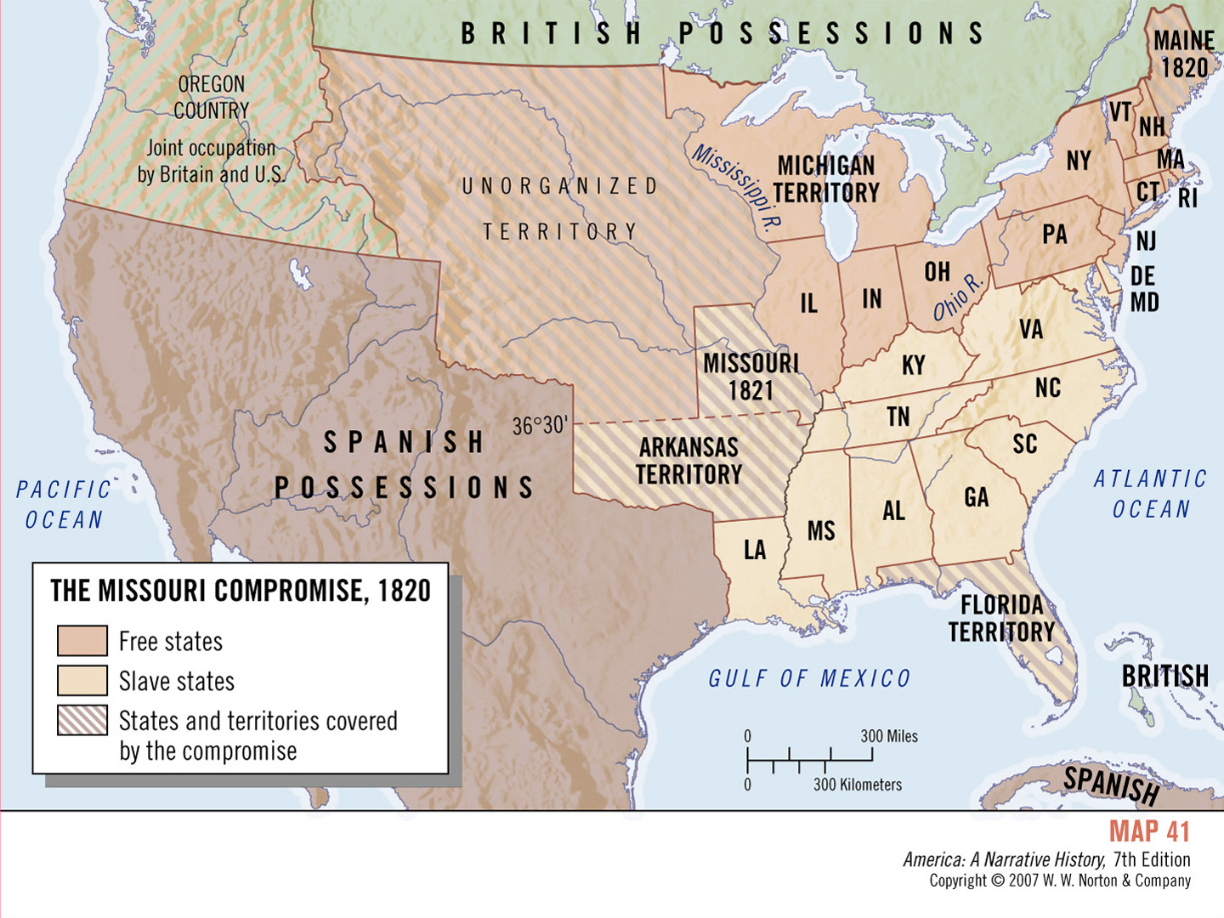
Sectionalism and Nationalism
The Missouri Compromise
*Missouri applies for statehood, 1817
*wants to be a slave state
*debate over free and slave states
*Missouri enters as a slave state
*Maine enters as a free state
*36’30’’ parallel
*temporary solution
*slavery biggest problem
*increased sectionalism
Notes:
Missouri Compromise
*just as the financial crisis was beginning another crisis emerged when Missouri applies for statehood in 1817
*this was a problem because there were 2-3,000 slaves in the area and the issue of whether Missouri would become a free or slave state arose
*because the north was growing much more rapidly than the south, southerners wanted the Missouri to become a slave state
*Northerners were bitter about the 3/5th Compromise and the fact that the Presidency had been dominated by Southerners and wanted Missouri to become a free states
*others feared what would happen if the balance of free and slaves states was upset and how would the nation go about adding new states to maintain that balance
*a great debate erupted within Congress over the issue
Terms of the Compromise
*finally the issue was settled when Maine, part of Massachusetts at the time, petitioned for statehood
*Congress saw the opportunity to fix the issue by adding Missouri as a slave state and Maine as a free state
*the other part of the compromise called for any new states added above Missouri’s 36’30” southern border to be added as a free state and any states added south of the line to become slave states
*the compromise became standard for several decades but controversy over the issue of admitting free/slave states would eventually split the nation in two

Slide 12
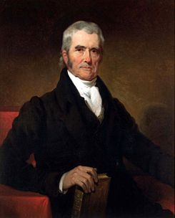
Marshall and the Court
John Marshall
*4th Chief Justice
*during his tenure the nat. gov. became more powerful
*strengthened the Judicial Branch
*promoted commerce
*exerted federal power over the states
Dartmouth College v. Woodward
*NH tried to make the private college a state college
*restricted states from controlling corporations
Cohens v. Virginia
*SCOTUS can review state court decisions
*more federal power over the states
McCullough v. Maryland
*Maryland hated BUS and wanted to tax it
*SCOTUS ruled that states couldn’t tax federal agencies
Gibbons v. Ogden
*only Congress could regulate interstate trade
Worcester v. Georgia
*Georgia could not interfere with native land
*natives forced out anyways by Andrew Jackson

Slide 13
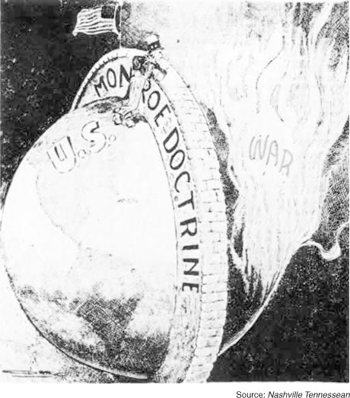
Nationalist diplomacy
●The Monroe Doctrine
1. Europeans were not to settle the American continent
2. Europeans were not to impress their politics in the Americas
3. U.S. would not interfere in Europe’s colonies
4. U.S. would keep out of European affairs
Short term: No effect
Long term: US dominate Western Hemisphere
Notes:
Nationalist Diplomacy
The Monroe Doctrine
Impact of the Napoleonic Wars
*one of the issues Monroe had to deal with was to respond to the revolts going on in Latin America as a result of the Napoleonic Wars
*in 1811 France had occupied Spain leading to a series of rebellions throughout Latin America that left Spain without most of its Empire by 1821 (only Cuba and Puerto Rico remained)
*the United States used this opportunity to build an economic relationship with the newly independent nations
*in 1823 rumors began to surface that France wanted to restore Spanish rule over its former colonies
*U.S. leaders panicked at the idea of this because they saw it as a threat to U.S. security and felt that the presence of smaller, weaker, independent nations in Latin America was an opportunity to expand its borders
The Monroe Doctrine asserted
*in order to prevent Spanish intervention in Latin America Monroe was urged to announce a new policy to deal with foreign influence in the Western Hemisphere
*Europeans would no longer settle the American continent
*Europeans would not impress their political styles in the Western Hemisphere
*U.S. would not interfere in Europe’s colonies
*U.S. would keep out of European wars
Reactions to the Doctrine
*drew little attention from the public or European powers and wasn’t even called the Monroe Doctrine until 30 years later
*became the cornerstone of US diplomacy throughout most of the 19th century and even into the 20th century
13

Slide 14
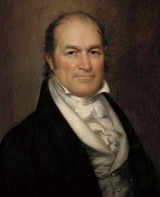
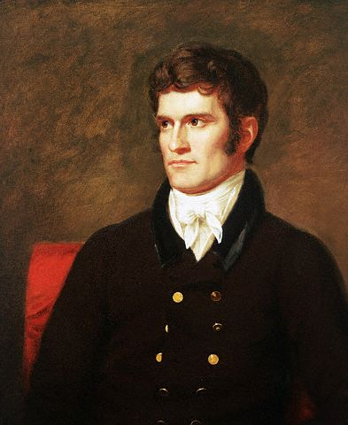
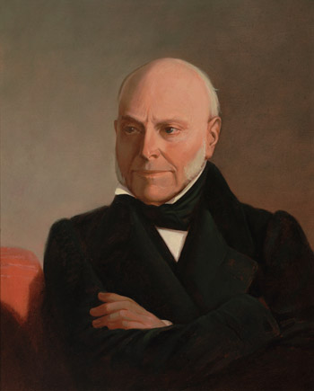
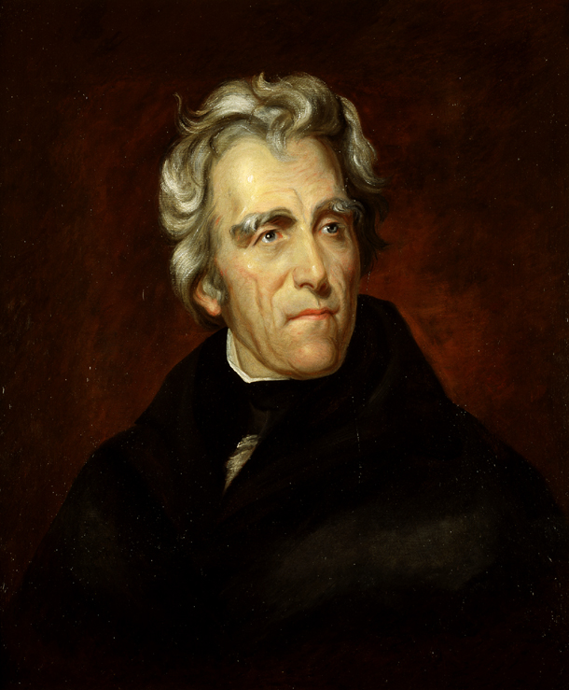
Election of 1824
William Crawford
John C. Calhoun, SC
Henry Clay, KY
John Quincy Adams, MA
Andrew Jackson, TN
Notes:
14
One party politics in 1824
*immediately after Monroe was elected to his second term, Democratic-Republicans began to bicker over who would succeed him
The Candidates
*five men were in the running
*Sec. of Treasury William H. Crawford
*Secretary of War John C. Calhoun
*Sec. of State John Quincy Adams
*Speaker of the house Henry Clay
*General Andrew Jackson
Outcome of the race
*was highly controversial and highly indecisive
*came down to two candidates: Jackson and Adams
*the vote ended up in the House of Representatives where the former candidate, Henry Clay, used his influence to help get Adams elected
*consequently Clay was awarded the appointment of Secretary of State which was seen as an open door to the presidency
Charges of “Corrupt Bargain”
*after the election Jackson was furious
*he argued that Adams had been given the election in exchange for the appointment of Sec. of State and other appointments to other officials
*immediately Jackson began campaigning for the election of 1828
*Jackson also decided to drop the “Republican” part of the party name and create the Democratic party
*(donkey became the mascot because the press often labeled Jackson a “jackass” and he liked the name)

Slide 15
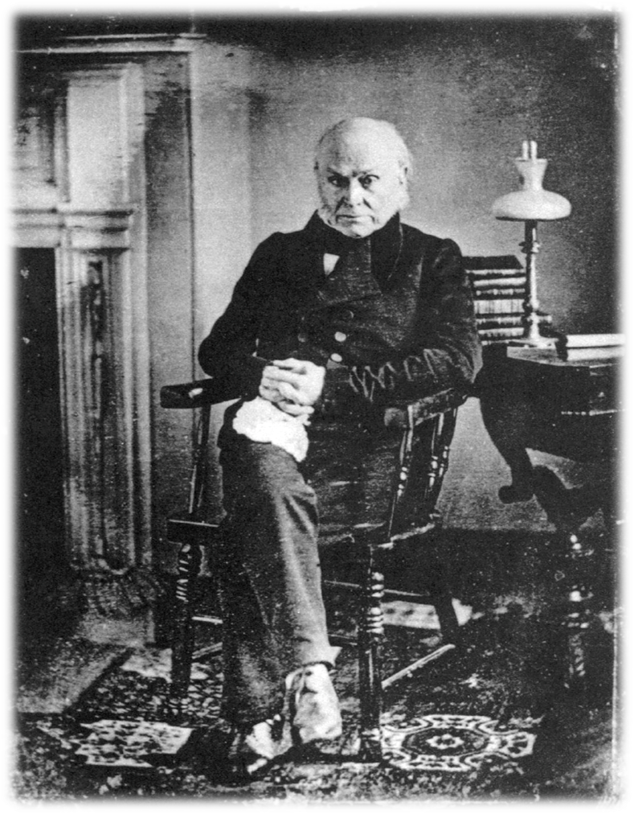
The Revival of Opposition
The “Corrupt Bargain”
*JQA promises to make Clay Sec. of State
*Clay promises to help JQA win
*Jackson furious
*claims corrupt bargain
*vows to destroy Adams
Second President Adams
*supported American System
*attempted removal of Creek and Cherokee Indians
*Tariff of Abominations, 1828
-raises tariff significantly
-loved in north
-hated in south
First ever photo of a president

Slide 16
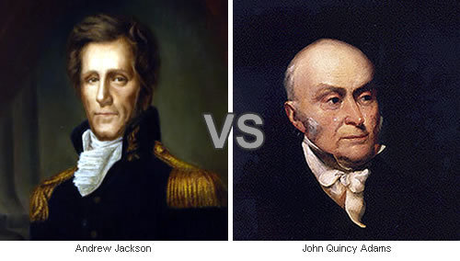
Jackson Triumphant
Election of 1828
*Jackson v. Adams: Round 2
*ugly personal attacks by both sides
-Jackson camp critical of Adams
-Adams personal attacks towards Jackson
*Jackson destroys Adams 178-83
The “Age of Jackson”
*the “Common Man”
Make sure you write down the personal attack made by both…
Notes:
Election of 1828
*Adams’ failed presidency had set the stage for Jackson’s triumphant return to politics in 1828
*the election itself got extremely nasty as both men began making merciless personal attacks on each other
Opposition to Jackson
*biggest opposition came in the form of John Quincy Adams who began to bring up Jackson’s violent past and call him a barbarian
*he had massacred Indians before and during the War of 1812
*he liked to duel…a lot! (see next slide for Jackson’s dueling history)
*the Adams camp also brought up that Jackson had courted and married his wife Rachel before she was divorced from her first husband
*they called her a whore and Jackson spent the rest of his life defending his wife’s honor
Opposition to Adams
*some say he was too much like his father
*Jackson retaliated by claiming Adams had purchased the presidency in the election of 1824 and that he was corrupt
*some said that he had pimped for the Tsar of Russia
*made accusations that he had provided two young girls for Russian dignitaries to have sexual relations with
Jackson’s appeal
*Jackson was extremely popular and appealed to several different groups in the US
*he was a military hero from the War of 1812
*the son of the West
*an Indian fighter, a farmer
*a lawyer and a slave owner who was not part of the aristocracy and came from humble beginnings
*more importantly, Jackson championed himself as a man of the people and that he would bring his own style of democracy to the presidency
*one thing Jackson sought to do was increase suffrage throughout the nation
*this was happening in the west and was beginning to make its way east
*Jackson also started the trend of throwing huge public rallies and parades on election day to encourage voter turnout
*Jackson wanted to extend democracy to make it more in line with the will of the people
*he emerged as a new type of politician
Outcome of the election
*Jackson won by a 2 to 1 margin and he began a new era in American Politics
*sadly, Jackson’s wife died two weeks after the election making him extremely bitter towards his enemies

Slide 17
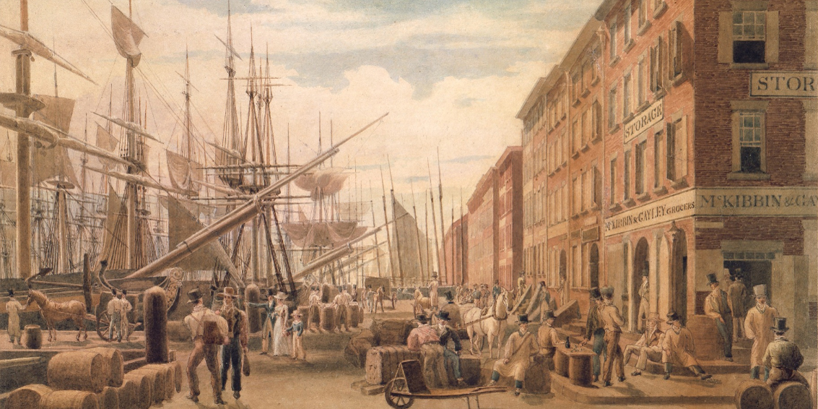
Crash Course Ep. 12: Market Revolution

Slide 18
Ch. 8: Varieties of American Nationalism
Focus Questions:
What were the main elements of the market revolution?
How did the market revolution spark social change and encourage growth in the United States?
What were some of the major changes in transportation that became available during the market revolution?
Explain some of the types of westward expansion.
Identify Monroe’s presidency. (i.e. foreign and domestic issues).
Explain the Monroe Doctrine.
Describe John Quincy Adams’ presidency and its problems.
Explain the Election of 1828.
Notes:
The purpose of the focus questions is to help students find larger themes and structures to bring the historical evidence, events, and examples together for a connected thematic purpose.
As we go through each portion of this lecture, you may want to keep in mind how the information relates to this larger thematic question. Here are some suggestions: write the focus question in the left or right margin on your notes and as we go through, either mark areas of your notes for you to come back to later and think about the connection OR as you review your notes later (to fill in anything else you remember from the lecture or your thoughts during the lecture or additional information from the readings), write small phrases from the lecture and readings that connect that information to each focus question AND/OR are examples that work together to answer the focus question.

