Slide 1
Grab a stack of papers and help me pass them out to people…
Take a little time to get your binders in order.

Slide 2
Ch. 9: Jacksonian America
Focus Questions:
What was the impact of the election of 1828 and describe Jackson as a person?
Explain Jacksonian Democracy.
Identify problems within Jackson’s Cabinet (i.e. the Eaton Affair).
Explain the Nullification Crisis.
Describe Jackson’s Indian policy.
Explain the Bank War and its effect on the economy.
Describe the two major parties at the time and their stance on certain policies.
Discuss Van Buren’s presidency.
Discuss Tyler’s presidency.
Notes:
2
The purpose of the focus questions is to help students find larger themes and structures to bring the historical evidence, events, and examples together for a connected thematic purpose.
As we go through each portion of this lecture, you may want to keep in mind how the information relates to this larger thematic question. Here are some suggestions: write the focus question in the left or right margin on your notes and as we go through, either mark areas of your notes for you to come back to later and think about the connection OR as you review your notes later (to fill in anything else you remember from the lecture or your thoughts during the lecture or additional information from the readings), write small phrases from the lecture and readings that connect that information to each focus question AND/OR are examples that work together to answer the focus question.

Slide 3
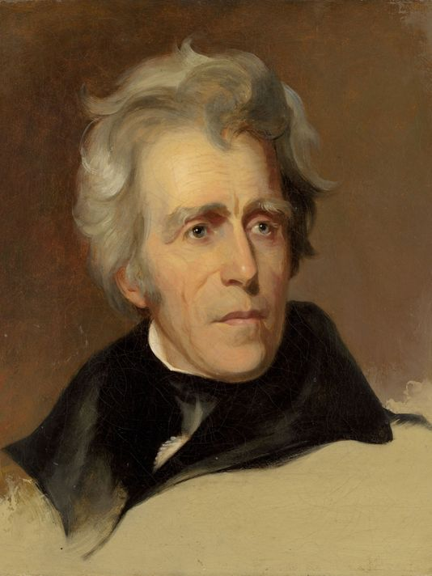
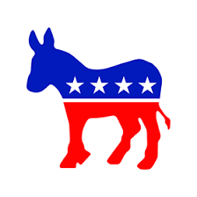
The Rise of Mass Politics
“Old Hickory”
*born in SC to Irish immigrants
*the Revolution
*became a lawyer in Tenn.
*Congressman in 1796
*Senator in 1797
*Judge from 1797-1804
*successful planter in Tenn.
-300+ slaves
*General in 1801
*Indian Wars
*War of 1812
*helped found the Democratic Party
*1st Democrat President
Notes:
His Background
*one of the most bad-ass American presidents ever
*if you’re wondering how he got such a lame nickname, its because he carried around a hickory cane to beat people with because he was a fucking lunatic
*historians attribute his character to his upbringing
*his father died before he was born
* was raised by his mother until she died along with his brother on a prison ship during the Revolution
*during the Revolution, Jackson, who was 13, volunteered to fight for the South Carolina militia
*he was captured by the British and forced to work for a British officer who scarred him with his sword for refusing to shine the officers boots
*actually he gained the nickname, “Old Hickory” by his soldiers for his toughness (because they were all afraid of him)
*his ruthlessness on the battlefield translated to his ruthlessness as a politician
*immediately began to attack his enemies and didn’t stop until they were completely destroyed
Duels
*fought a lot of duels in his life
*total of 13 confirmed but some historians argue that the number is probably closer to 100
*the guy had a death wish and was full of lead
*some say he rattled around like a tin can
*shot and killed a man in a duel once
*Charles Dickinson challenged Jackson to a duel over a bet
*Jackson knew the guy would be a bad shot so he let him shoot first
*Dickinson shot him directly in the chest, Jackson shook it off and shot him back
*he shot Dickinson directly in the face
*in another duel Jackson was shot in his arm
*in both cases the bullets remained in Jackson’s body
Politics
*historians also credit Jackson for creating the “spoils system” of American politics
*this was giving out government jobs to political supporters
*the spoils system gets it name because, as Jackson put it, to the victor goes the spoils
Assassination attempt
*in 1835 there was an assassination attempt on Jackson by a disgruntled painter
*while Jackson was visiting Martha Washington’s grave the man burst out of a bush
*he pulled out a pistol, aimed it at, Jackson and pulled the trigger but the pistol misfired
*he then pulled out a second pistol and it misfired as well
*when Jackson realized that his entire entourage had fled in fear he proceeded to beat the man with his cane
*the guy was later found innocent for reasons of insanity
Andrew Jackson’s funeral (Died: June 8, 1845 [78 years old])
*supposedly there is a story of Jackson’s pet parrot attending his funeral
*apparently the bird had to be removed for cussing
*Jackson enjoyed teaching the bird how to cuss
Favorite Jackson Quote
"I have only two regrets: I didn't shoot Henry Clay and I didn't hang John C. Calhoun.“
*it should be noted that John C. Calhoun was Jackson’s vice president…
The nation in 1828
*was growing at alarming rate
*there were 24 states in the Union
*the US had a population of 13 million and was growing thanks to an increase in immigration after the War of 1812
*the foreign demand for cotton caused the economy to grow at an alarming rate
*textile mills began to spread all over the north
Jacksonian Democracy
*as president Jackson sought to, and did, change the political spectrum in America
*Jackson wanted to make politics more democratic by including a larger portion of the white population in politics
*most historians argued that this never happened
*even though Jackson championed himself as a president for the “Common Man” he never really lived up to his reputation as large portions of the population were never able to vote under his presidency
*nonetheless, Jackson became popular for his political toughness and his intensity as a political leader
*he became famous for attempting, annually, to pass a bill to get rid of the electoral college
*this was his attempt at making the democratic process of electing presidents more democratic
*it was during his second term in office (1835) that the national debt was completely paid off
*however, by 1838 it had risen above $3 million and has never been paid off since

Slide 4
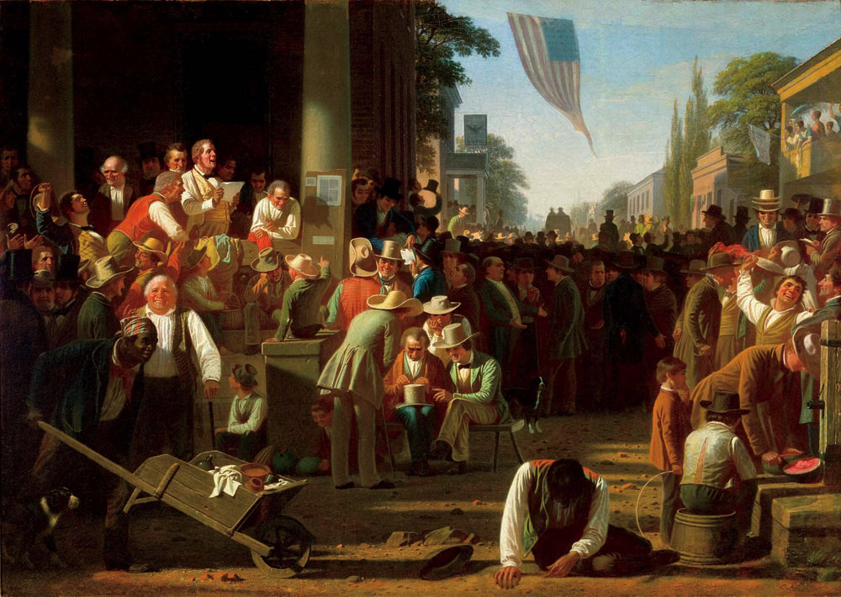
The “Age of Jackson”
Jacksonian Democracy
*Jackson championed himself the president of the “common man”
*more Americans (white males) involved in politics
*property requirements disappearing
*western states becoming more prominent
*presidential electors
-traditionally chosen by state legislatures
-1828: popular election
*Election Trends
-1824: 27% white males voted
-1828: 58% white males voted
-1840: 80% white males voted
Voting in America
*became a big thing
*people often got the day off to vote
*huge parades, cook out and parties

Slide 5
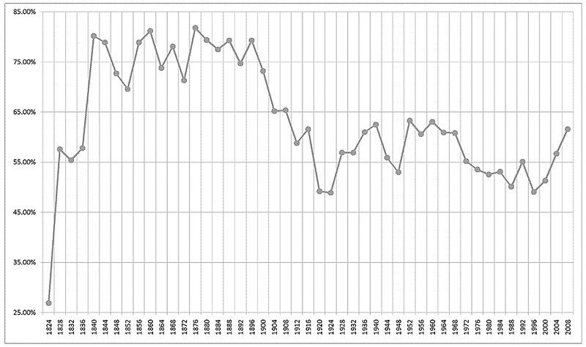

Slide 6
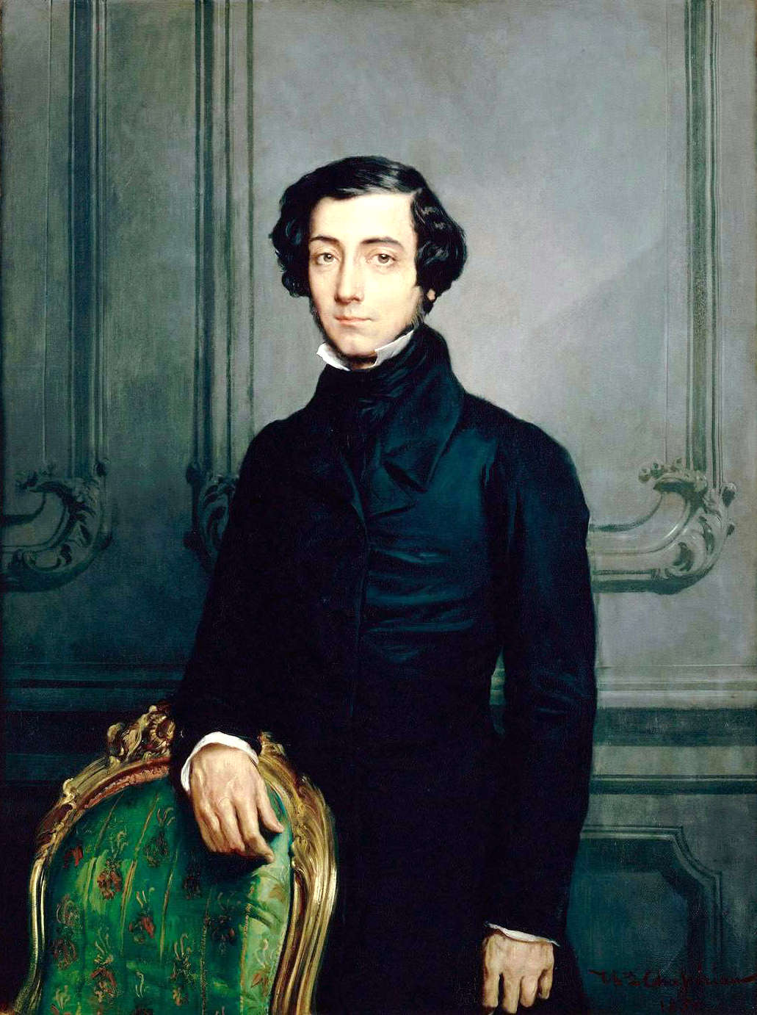
Tocqueville and, Democracy in America
Alexis de Tocqueville
*French aristocrat
*came to US in 1830’s
*supposed to look at American prisons
*instead wrote about American democracy
Tocqueville’s 5 Values
*Egalitarianism
*Populism
*Individual rights
*Liberty
*Laissez-Faire
Democracy in America
*America lacked typical aristocracies
*people from any class could rise and fall
*book helped spread American ideas to Europe

Slide 7
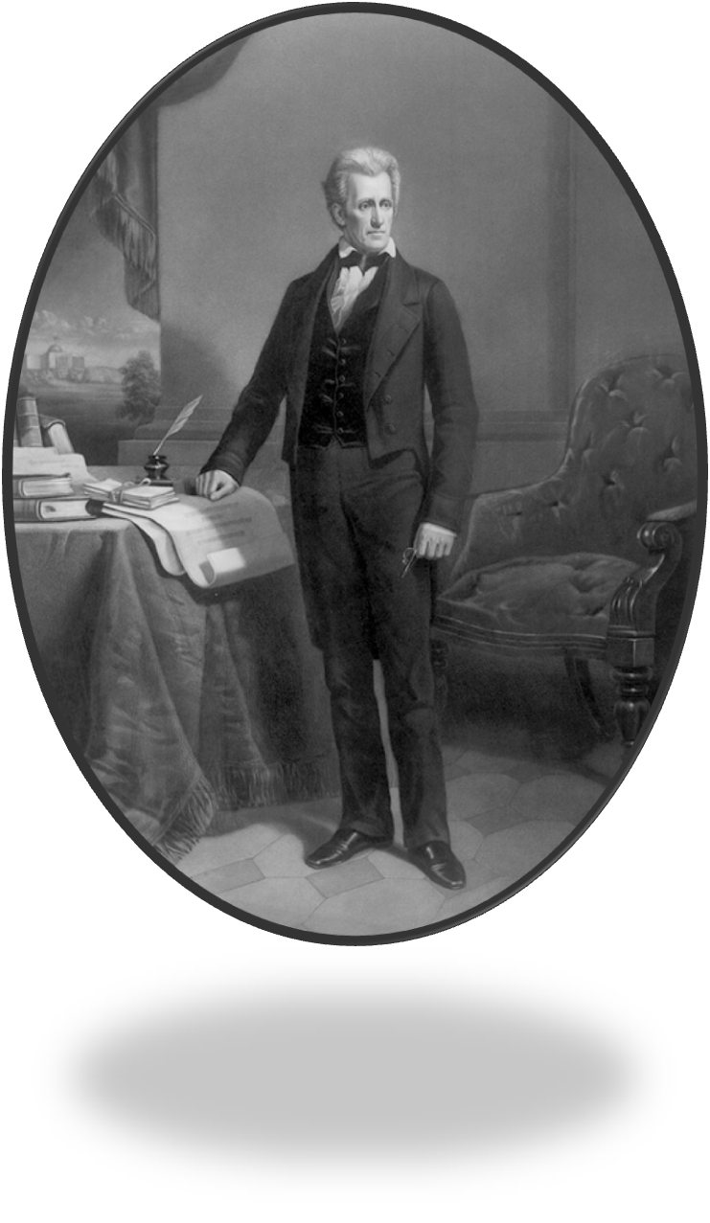
The Legitimization of Party
The Second Party System
*parties essential to democracy
*party loyalty more important than ideology
*The Spoils System, “To the victor goes the spoils”
-patronage
-rewards for loyalty
National Parties
*Democrats (Jackson)
*Whigs (Clay)
President of the “Common Man”
*1st western president
*anti-govt./wealthy establishment (Bank of US)
-wanted to reduce functions of fed. govt.
-too much concentration of power in Washington
-at the same time wanted a strong president
-must preserve the Union
*more power for the people
-replacement of Congressional Caucuses
-electors elected
-equality for all white males

Slide 8
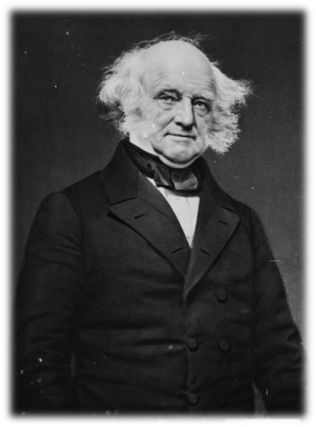
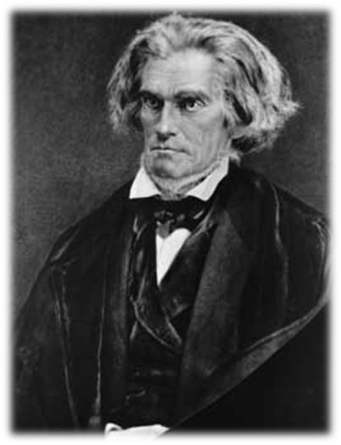
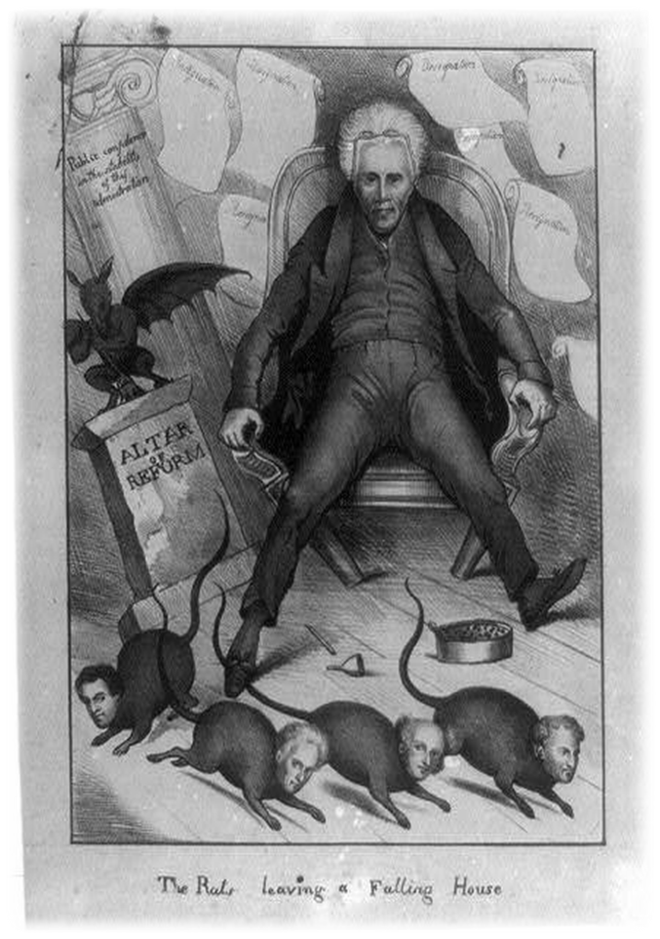
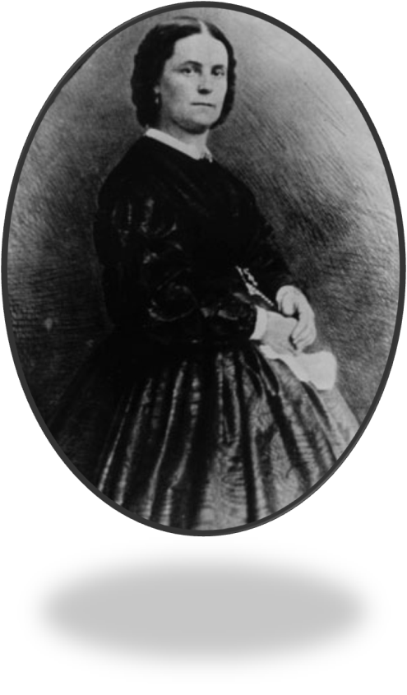
The Eaton Affair, 1830
Martin Van Buren (Sec. of State)
A house divided
*Calhoun v. Van Buren
*did not get along
*regions saw things differently
-land prices
-internal improvements
-tariffs
Peggy Eaton
The “Kitchen Cabinet”
Vs.
John C. Calhoun (Vice President)
Peggy Eaton
Notes:
Conflicts and rivalries
*from the moment Jackson took office a sectional crisis was in the making
*American politicians in the North, South and West were split over the issues of public land sales, national improvements and tariffs
*famous political rivalry during this time between Sec. of State Martin Van Buren and Vice president John C. Calhoun
*both men were sought to defend the interests of their respective regions as well as seek Jackson’s approval in order to succeed him
Land and Internal improvements
*most of the sectional differences throughout the nation were over the sale of newly acquired land
*Northern politicians wanted to keep land prices high to prevent laborers from heading west to buy land
*Westerners wanted to keep land prices low so they could promote western settlement and gain more representation in Congress
*the issue over internal improvements also began to pull the nation apart
*business owners in the North and West supported government spending to improve roads and canals and boost their economies
*good roads and canals would bring food and raw materials to the north and much needed manufactured goods to the west
*Southerners opposed federal spending because it meant an increase in tariffs
*this made southerners bitter towards northerners for determining national policy
Peggy Eaton Affair and Cabinet resignations in 1830
*almost immediately after Jackson gained the presidency his relationship with his vice president began to fall apart
Peggy Eaton
*much of the controversy was over the wife of one of his cabinet members
*Peggy Eaton was the daughter of a Washington tavern owner and the wife of Secretary of War John Eaton
*rumors had begun that Peggy Eaton had met her current husband while still married to her former husband who was out at sea
*her first husband had committed suicide and the rumor mill began to turn with claims that she had an affair while still married to her first husband
*as a result of the rumors several of the other wives of Jackson’s first cabinet refused to socialize with Peggy Eaton
*this caused Jackson to go into a rage because it brought back memories of the way his wife was treated before she died
*Jackson approached his cabinet with the issue and only received support from Van Buren
*the minor crises eventually led to the resignation of Jackson’s entire cabinet
*this gave Jackson the opportunity to appoint an entirely new cabinet of his supporters
*though Van Buren resigned as well he was rewarded for his support of Jackson over the issue and eventually gained enough of Jackson’s favor to become Jackson’s successor to the presidency

Slide 9
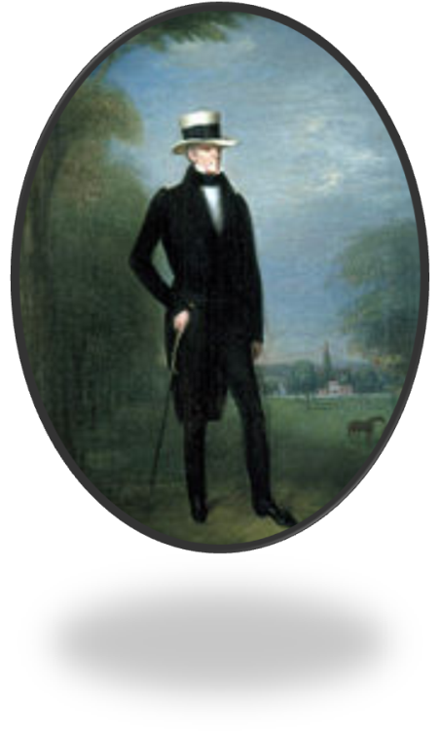
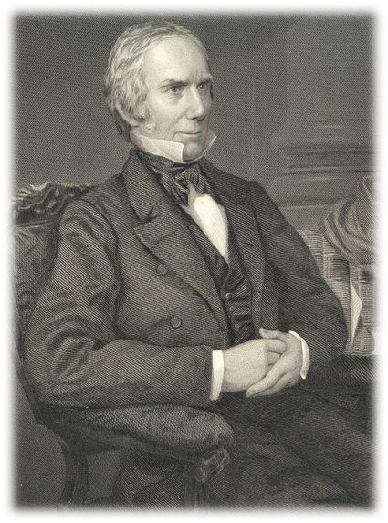
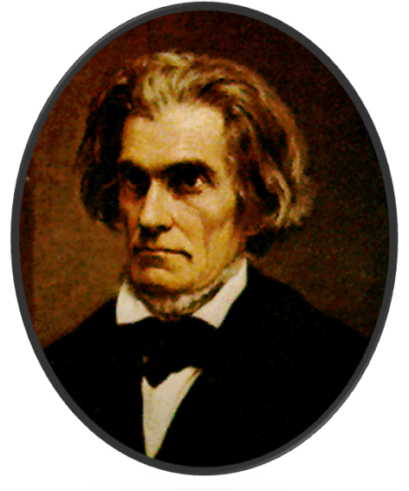
“Our Federal Union”
Calhoun and Nullification
*South Carolina hit hard by Tariff of Abominations
*John C. Calhoun (Vice President) angry about this
*threatens to nullify the tariff
Webster-Hayne Debate
*States Rights (Hayne) vs. National Power (Webster)
*Hayne supports nullification
*Webster supports federal power over states
*Jefferson Banquet
-“Our Federal Union-It must be preserved”-Jackson
- “The Union, next to our liberty most dear”-Calhoun
The Nullification Crisis, 1832-1833
*Calhoun becomes Senator
*SC nullifies tariffs
*Jackson cries treason
*SC threatens secession
*Jackson wants to lead army into SC to hang Calhoun
*Clays Compromise, 1833
Jackson
*Clay’s Compromise 1833
Henry Clay
Calhoun
Notes:
Nullification Controversy 1828-32
*the resignations caused a huge rift between Jackson and Calhoun and things would get worse
*long before Jackson became president the issue over the tariff was causing a major stir in South Carolina which was hit the worst by the tax
*the tax caused an economic slump in South Carolina
*led to thousands of people to migrate out of the state which weakened the state politically
*to add fuel to the fire South Carolinians were angry that northerners were speaking out against the institution of slavery
*it was during this time that abolitionism was becoming a big movement in the north
*at one point the state threatened to secede but Calhoun proposed an old idea that had never been used
Calhoun’s theory
*Calhoun argued that a state had the right to nullify, or reject, any federal law that it considered unconstitutional
*since the tariff only benefitted one part of the country it was viewed as unconstitutional southerners therefore did not have to abide by it
*this sparked a huge debate throughout the nation
Jackson Vs Calhoun
*up until 1830 Jackson had yet to express his view of the issue going on in South Carolina but that would soon change
*in April of 1830 Jackson and Calhoun both attended a dinner to honor the birthday of Thomas Jefferson
*both men were to give a toast and both men used the opportunity to try and sway people over to their perspective
*both men gave speeches
*Jackson spoke out against nullification and preserving the Union
*Calhoun spoke out against the increasing power of the federal government
Tariff reductions in 1832
*in 1832 Congress passed a new tariff that slightly lowed the tax
*Jackson figured this would be enough to change the minds of South Carolinians
*it wasn’t and South Carolina not only threatened to nullify the new tariff but also threatened to secede from the Union as well
*in order to gain support for nullification Calhoun was elected as a Senator in South Carolina and tried to get political support in Congress
*the other states refused to support nullification and South Carolina set out on its own with nullification
Jackson’s Reaction
*Jackson once again asked Congress to reduce the tariff but became infuriated when South Carolina threatened to raise an army to protect itself
*Jackson responded by raising his own army and threatening to march into South Carolina and hang Calhoun from the first tree he saw
Clay’s Compromise 1833
*Jackson instead called upon an old political rival, Henry Clay, to fix the issue in order to prevent a Civil War
*Clay produced a bill that would gradually lower the tariff over a ten year period
*the bill was a success and South Carolina backed down on the nullification issue

Slide 10
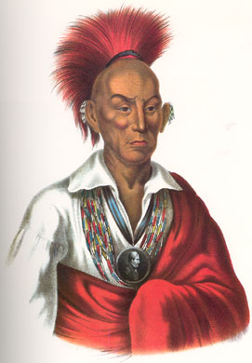
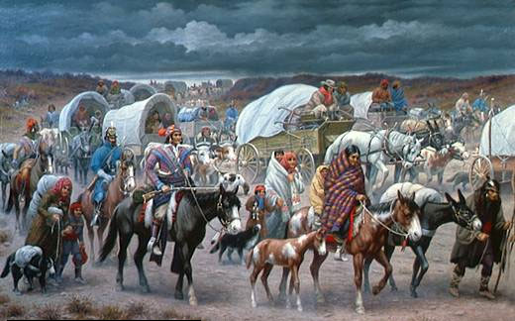
The Removal of the Indians
Jackson wants to move all tribes west of Mississippi
*Jackson felt they were savages
*Western whites wanted them gone
Black Hawk War, 1832
*Sauk and Fox defeated
*whites slaughtered retreating natives
5 Civilized Tribes (Cherokee, Creek, Seminole, Chickasaw, Choctaw)
*tribes that had adopted agricultural lifestyles in GA, AL, FL, MS
*education, written language, mostly peaceful
Indian Removal Act, 1830
*gold found on native lands in Georgia
*forced all natives west of the Mississippi Rv.
Worcester v. Georgia
*Cherokee sue US
*SCOTUS rules in favor of Cherokee
*Jackson sends military to force them out
Trail of Tears
*800 mile forced march to Oklahoma territory
*16,000 natives
*4,000 died from neglect, disease and starvation
“John Marshal has made his decision. Now let him enforce it” – Andrew Jackson
Notes:
Jackson’s Indian Policy
*Indian policy was another issue that came to highlight Jackson’s presidency
*at one time millions of natives had lived west of the Mississippi River
*by Jackson’s presidency there were only about 100,000
*some whites thought natives could live cohesively with them but most whites were extremely racist towards the natives
*some wanted to remove the Indians from the region some wanted to protect them and make them citizens
Jackson’s attitude
*being from the west, Jackson’s stance was simple…he wanted the Indians removed
*he felt they were savages who were preventing America from progressing
*one of the reasons Jackson had received votes from Western and Southern states was because he promised to rid these areas of natives
Indian Removal act
*once gold was discovered in southern states like Georgia, states began to pass laws allowing whites to take over naïve lands
*Jackson decided to take it one step further by calling for the complete removal of Indians from lands east of the Mississippi
*in 1830 Congress approved a law that gave the Indians Federal lands west of the Mississippi (present day Oklahoma)
*the land was seen as useless anyways
*thousands of Indians lost their land and homes and were forced into the Federal territory
Cherokee’s Trail of Tears
*one group of Natives that had established themselves in Georgia were the Cherokee
*when they were told to leave they decided not to protest violently but instead take the case to court to keep their land
*the Supreme Court actually ruled in favor of the Cherokee saying they could keep there land
*Jackson ignored the decision and sent troops into Georgia to forcibly remove the Cherokee by sending them on an 800 mile journey west *became known as the trail of tears because ¼ of the Cherokee out of 16,000 died along the way

Slide 11
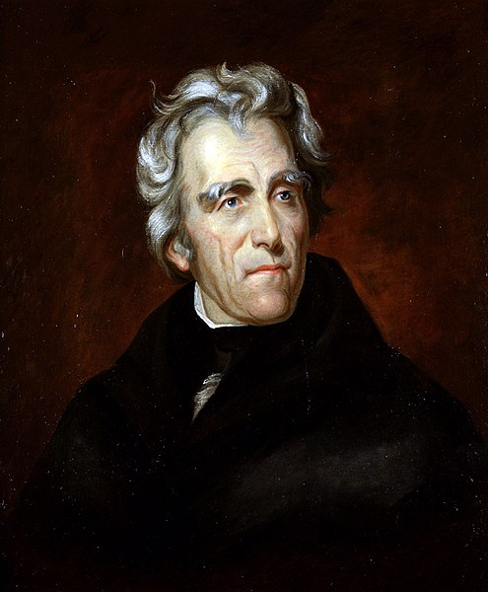
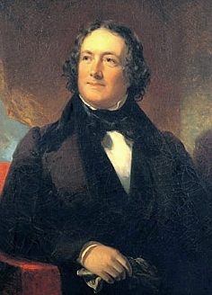
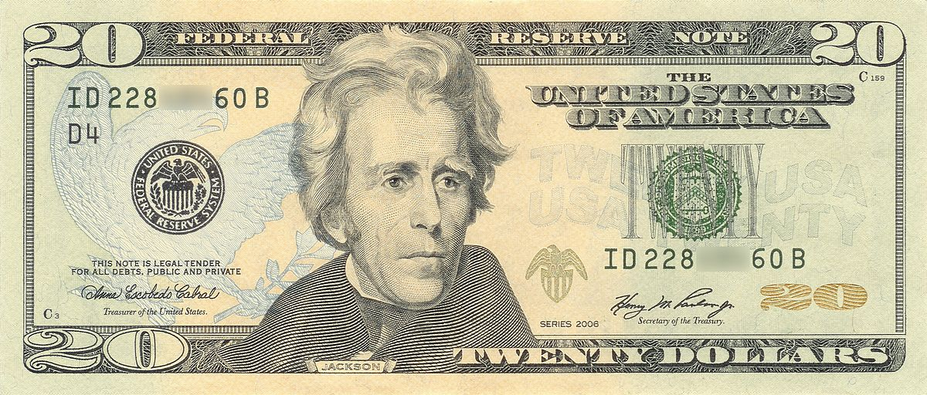
Jackson and the Bank War
Nicholas Biddle
Jackson’s opposition to the Bank
*too much power
*unconstitutional
*served the rich
*too much influence over politics
*goal was to get rid of it
Biddle’s Institution
*Nicholas Biddle (President of BUS)
*had made bank powerful
*used his influence to gain powerful supporters
Hard Money Advocates
*favored gold and silver coinage
*wealthy would favor
Soft Money Advocates
*favored paper money
*poor would favor, lead to inflation
Vs.
Notes:
The Bank Controversy
Jackson’s reasoning against the Bank
*for years Jackson had mistrusted the national bank
*he felt, like Jefferson, that it was unconstitutional
*it concentrated the nation's financial strength in a single institution
*it exposed the government to control by foreign interests
*it served mainly to make the rich richer
*it exercised too much control over members of Congress
*it favored northeastern states over southern and western states
*banks are controlled by a few select families
*he was completely ignorant to the fact that the bank actually stabilized the national currency
*nonetheless Jackson decided upon winning his second term in office in1832 he would prevent the charter from being renewed in 1836
*not only that but Jackson wanted to try and kill the thing before 1836 rolled around
Nicolas Biddle
*the man in charge of the national bank was Nicolas Biddle
*in order to get Jackson to support the re-chartering of the bank Biddle appointed several of Jackson’s friends to Branch offices across the nation
*Jackson didn’t fall for the ruse and even became more angry and more determined to destroy the entity
*he began to take government funds out of the bank and put them into state banks that became known as Jackson’s “pet banks”
*Congressmen who supported the bank grew scared that Jackson would in fact succeed in not getting the charter passed
*so they decided to get the charter passed in 1832 while Jackson was busy with his presidential campaign
Jackson’s Veto
*when the charter passed through both houses Jackson vetoed the bill and then campaigned for public support against the charter
*he called the bank evil
*claimed that it would kill him or I will kill it
*he gained enough support that Congress failed to overturn his veto and the charter failed
*the economy would suffer greatly as a result
Bursting the bubble
*for a time the economy grew after the failure of the bank to get re-chartered however it was only temporary
*however inflation took hold of the nation by 1836 and the bank was not there to fix the issues
*in 1836 the nation gained a new president who would inherit the problems created by Jackson

Slide 12
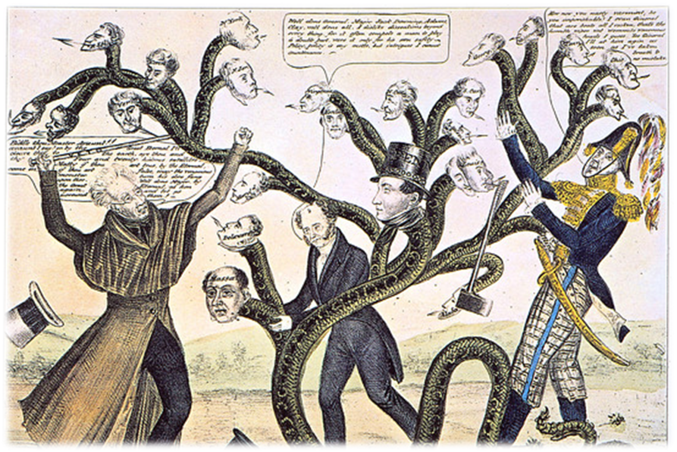
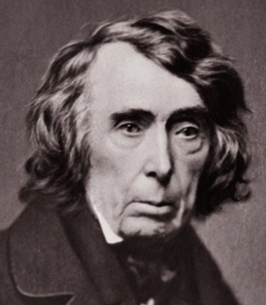
The Bank War (Cont.)
Jackson’s Veto
*Henry Clay tries to push through re-charter in 1832
*Jackson vetoes the bill
*Clay runs against Jackson’s re-election
*gets demolished
The “Monster” Destroyed
*removal of bank deposits
*Jackson places govt. funds in “pet banks”
*Biddle tried to raise interest rates
*caused a recession
*Biddle and BUS lost support
*BUS was killed off in 1836
*left unstable banking system for nearly a century
“The bank is trying to kill me, but I will kill it.” – Andrew Jackson

Slide 13
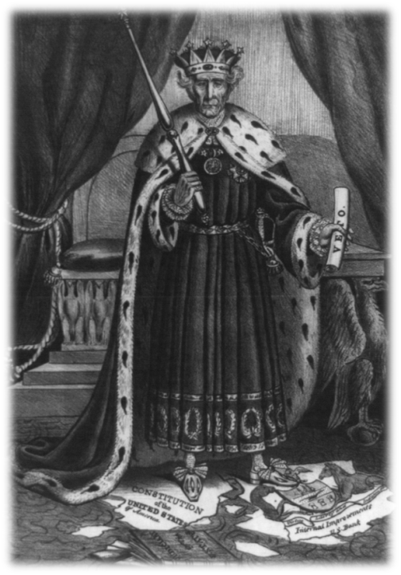
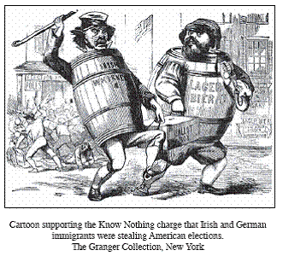
The Changing Face of American Politics
Whigs
*formed to combat “King Andrew I”
*strong central govt.
*promoted industry and internal improvements
*were afraid of rapid western growth
*supported federal institutions like BUS
Democrats
*limited government
*make democracy more democratic
*wanted territorial growth
*limit power of federal institutions
Call to action
*both parties look for new constituents (voters)
*Democrats
-Irish, German and other Catholic voters
-people who supported Jackson
*Whigs
-people who supported; Clay and Calhoun
-people who supported the “American System”

Slide 14
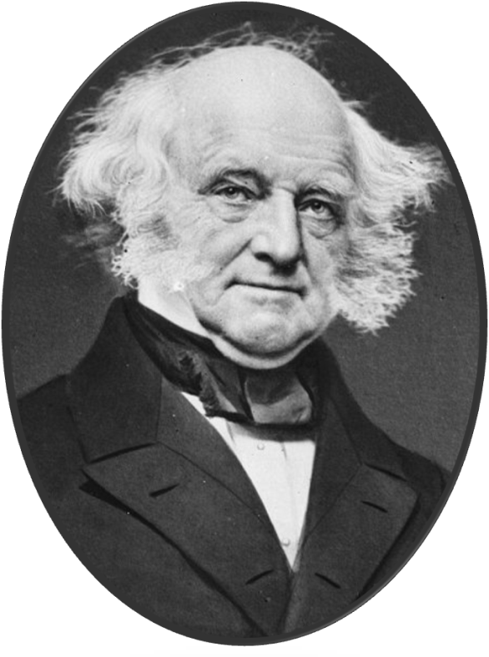
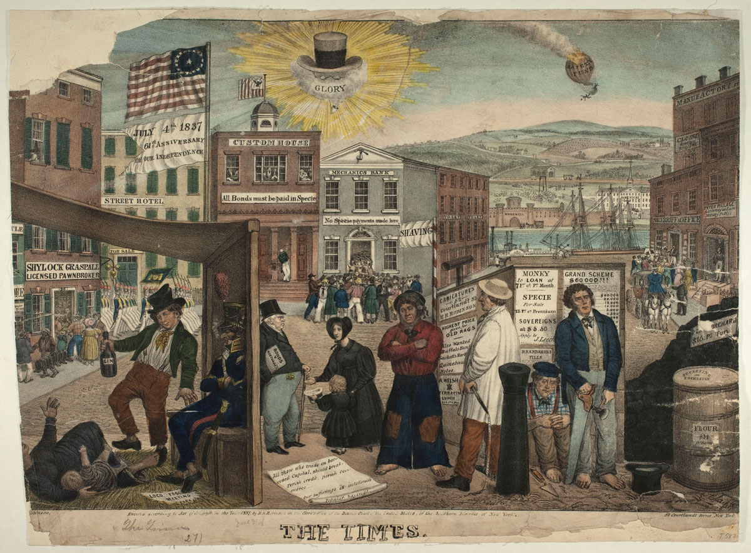
The Election of 1836
Martin Van “Ruin”
Van Buren’s Victory
*won because of economic boom of 1836
*mostly due to boom in land sales
*first and only time in US history we were debt free
*surplus of money provided internal improvements
*led to speculation
Specie Circular, 1836
*land payments must be done in gold or silver
*contributed directly to….
Panic of 1837
CAUSES
*over-speculation on land prices
*crop failures
*panic in Europe
EFFECTS
*drop in land prices created financial panic
*banks, businesses failed and unemployment soared
*railroad and canal projects failed
*worst depression at that point
*lasted 5 years
*ruined Van Buren’s re-election bid

Slide 15
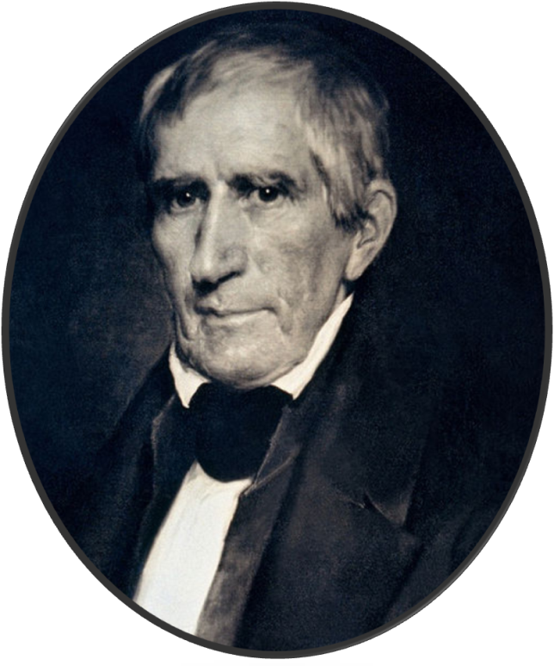
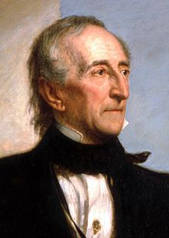
The Election of 1840
William Henry Harrison
*”Tippecanoe and Tyler Too”
*Harrison wins
*dies 30 days later of pneumonia
John Tyler
*former Democrat turned Whig
*hated Jackson but also hated the BUS
*Whigs tried to push through a new re-charter bill
*Tyler vetoes it
*Whigs break from Tyler and his entire cabinet resigns
Problems with Britain
*Webster-Ashburton Treaty, 1842
-settled dispute between lumberjacks
-set boarder between Maine and Canada
*Treaty of Wang Hya
-US receives trading rights with China

Slide 16
Crash Course US: Ep. 14: Age of Jackson

Slide 17
Ch. 9: Jacksonian America
Focus Questions:
What was the impact of the election of 1828 and describe Jackson as a person?
Explain Jacksonian Democracy.
Identify problems within Jackson’s Cabinet (i.e. the Eaton Affair).
Explain the Nullification Crisis.
Describe Jackson’s Indian policy.
Explain the Bank War and its effect on the economy.
Describe the two major parties at the time and their stance on certain policies.
Discuss Van Buren’s presidency.
Discuss Tyler’s presidency.
Notes:
17
The purpose of the focus questions is to help students find larger themes and structures to bring the historical evidence, events, and examples together for a connected thematic purpose.
As we go through each portion of this lecture, you may want to keep in mind how the information relates to this larger thematic question. Here are some suggestions: write the focus question in the left or right margin on your notes and as we go through, either mark areas of your notes for you to come back to later and think about the connection OR as you review your notes later (to fill in anything else you remember from the lecture or your thoughts during the lecture or additional information from the readings), write small phrases from the lecture and readings that connect that information to each focus question AND/OR are examples that work together to answer the focus question.

Slide 18
Review for your test on Thursday
Be able to explain all of the following in as much detail as possible:
Make sure you know Jefferson’s presidency
Important elements of Madison’s presidency
Important elements of Monroe’s presidency
Important elements of John Q. Adams’ presidency
Important elements of Jackson’s presidency
Important elements of Martin Van Buren and John Tyler’s presidencies
Louisiana Purchase
Missouri Compromise
Monroe doctrine
War of 1812 and its impact
The “American System”
Internal improvements and technologies (cotton gin)
Nullification Crisis
Indian policy
The controversy surrounding the national bank
Identify: Henry Clay, John C. Calhoun
Supreme Court Decisions
Have a sheet of paper ready to go…

