Slide 1
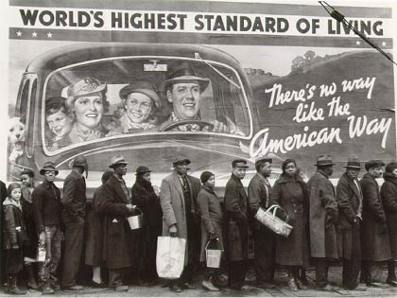
Warm Up: Tuesday, Dec. 5, 2017 1. What's ironic about the photo above?
Notes:
1

Slide 2
Great Depression Picture Analysis 1. Answer the questions to the following photos in complete sentences. 2. You will submit this at the end of the period.

Slide 3
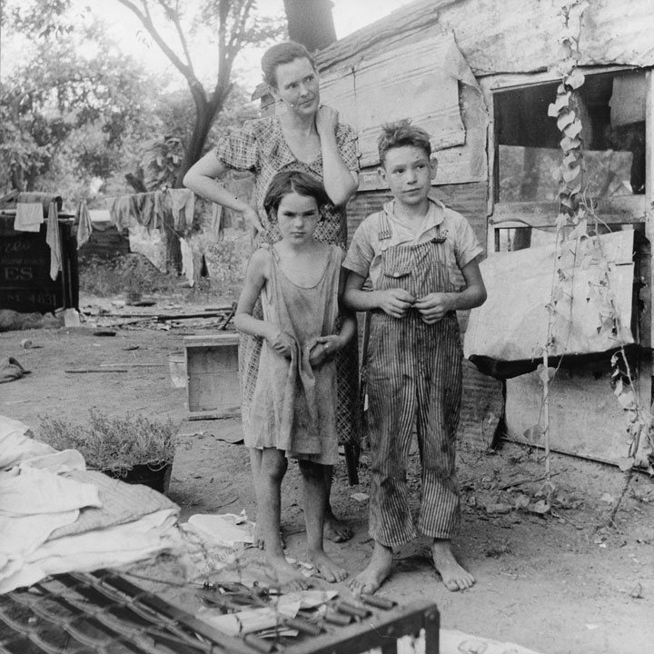
Photo 1: Imagine what you would feel like if you suddenly found out that all your family’s savings and investments were gone, and that your parents’ jobs were gone as well- a situation that many found themselves in during the Great Depression. How would you react? If you were a parent in this predicament, what explanation would you give your children?

Slide 4
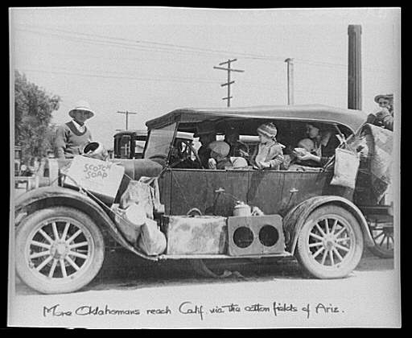
Photo 2: Rich or poor, most Americans have homes and possessions, and take for granted the hundreds of big and little conveniences having a home gives us. Imagine NOT having a home, and being limited in your possessions to what you could carry with you. Make a list of things you would take with you if you have to migrate on a daily basis, in a car with your family.

Slide 5
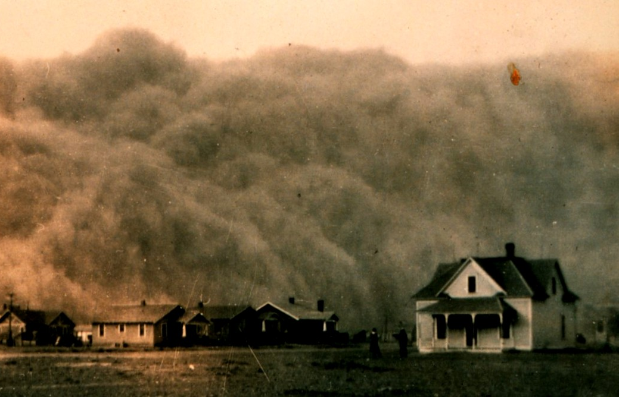
Photo 3: Have you ever been in a severe storm? A blizzard? A hurricane? A dust storm? What are your thoughts at such a time? Imagine living for a decade with the constant threat of blinding dust storms that came up suddenly and lasted for hours. Would you be afraid your home would not be secure? What if you were living in a car or a tar paper shack?

Slide 6
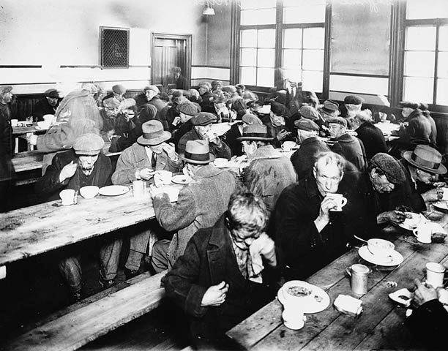
Photo 4: Although the U.S. no longer is in the midst of the Great Depression, not everyone in our society has a comfortable living standard or enough to eat. In big cities and in small towns, it is unfortunately possible to find many people whose only meals come from soup kitchens or other charities. Have you ever encountered a scene such as the one in this picture? If so, what has been your reaction? If not, can you imagine your reaction?

Slide 7
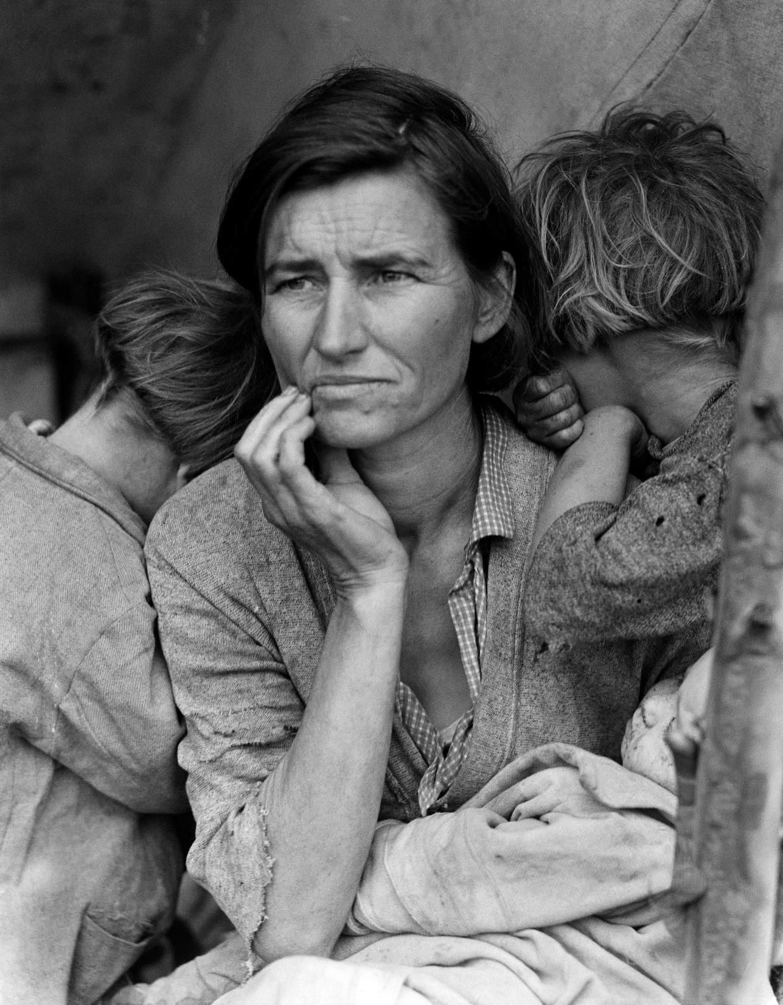
Photo 5: Why do you think the photographer, Dorothea Lange, chose to photograph this particular woman and her children? Write down as many reasons (at least 5) as you can think of.

Slide 8
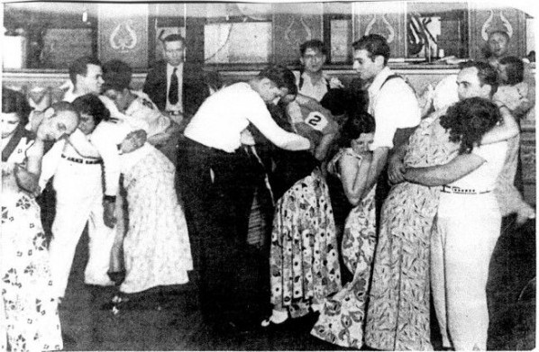
Photo 6: Dance marathons were popular in the 1920’s and into the 30’s for people looking to make money by winning. Some people thought that activities such as this dance marathon were acceptable efforts to provide money for some participants who needed it, and entertainment or amusement for others in the audience. Do you agree? Why or why not?

Slide 9
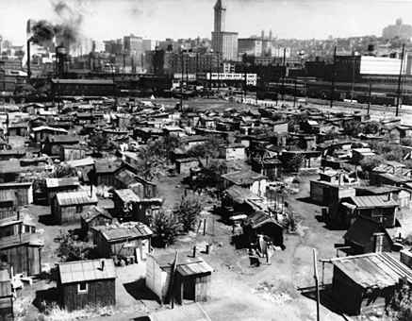
Photo 7: While the economic situation in the U.S. is far from as bleak as it was during the 1930’s, there are still many people in our society who suffer from homelessness and unemployment. However, “Hoovervilles” became a symbol of President Hoover’s term as president. Imagine you are a 16 year old whose mother and father are unemployed and you, along with your 3 younger brothers and sisters, are all living in one of these “Hoovervilles.” Write a short journal entry describing a day in your life living there.

Slide 10
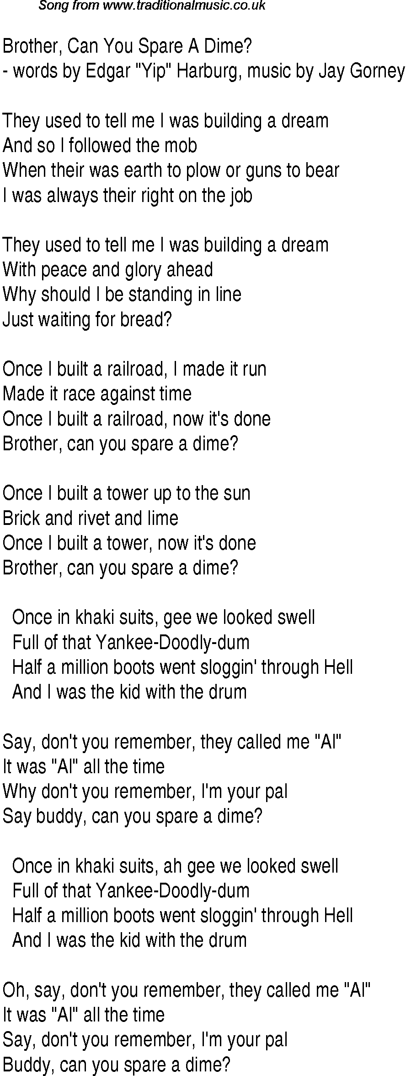
Photo 8:
This is a popular song that was written during the Great Depression. Read the lyrics and identify as many units/time periods that we’ve covered in class as you can (*hint- there’s 3). Who is the singer talking to when he asks “Brother, can you spare a dime?”

Slide 11
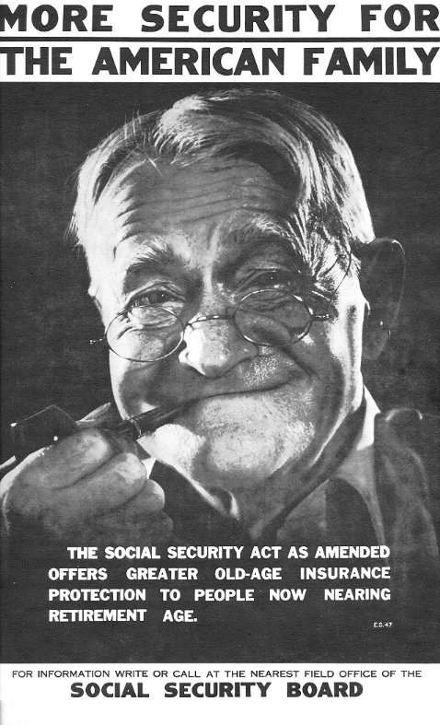
Photo 9: The Social Security Act (SSA) was probably the most important measure of the New Deal. It provided workers with unemployment insurance, old age pensions, and insurance if they died early. Workers and their employers each paid new contributions to fund these benefits. How did this poster promote the SSA? Social Security benefits are still available today. Do you think this is good for Americans? Why or why not?

Slide 12
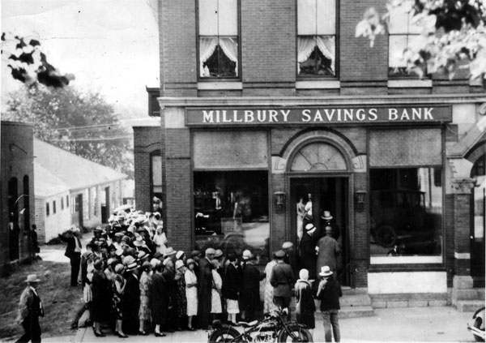
Photo 10: The people in the photo are waiting in line to withdraw their money from the bank. However, in the 1930’s banks failed due to bad investments and the banks did not have any money to give back to the people. Today, we have the Federal Deposit Insurance Corporation (FDIC), which insures our bank deposits. How do you think this type of reform changed American’s views towards banks? Explain your answer.

