Slide 1
CREATE THIS GRAPHIC ORGANIZER IN YOUR NOTES & USE PG 38-41 TO FILL IT IN Describe the life and achievements of each. When you’re done, we’ll check your work together.
Patriots of the American Revolution
Jonathan Trumbull, Sr.
John Peter Muhlenberg
John Hancock
Charles Carroll
John Witherspoon
Dr. Benjamin Rush

Slide 2
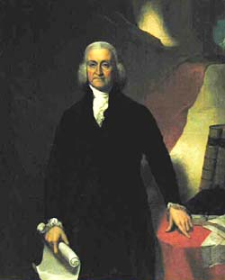
Jonathan Trumbull, Sr.
Governor of Connecticut
Only colonial governor to side with the colonists
Spoke against English abuses
During the Revolutionary War he supplied Washington’s Army with supplies and food

Slide 3
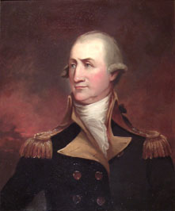
John Peter Muhlenberg
A Protestant minister in Pennsylvania
Helped to enlist more than 100 men into the Continental Army
Part of the “Black Regiment”- ministers who recruited large numbers of volunteers for the Revolution
A General during the war, later became a Senator and Congressman

Slide 4
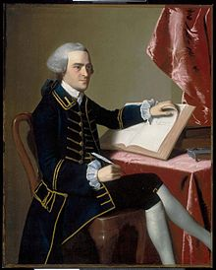
John Hancock
A prosperous merchant from Boston
President of the Continental Congress
Made his signature very large so King George could clearly see it
His signature became a symbol of freedom in the colonies

Slide 5
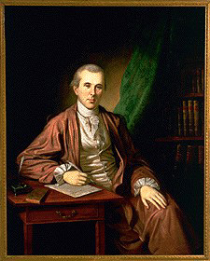
Benjamin Rush
A physician, educator and humanitarian
The “Father of American Medicine”
Established a national public university
Favored the education of women & established the oldest African-American church

Slide 6
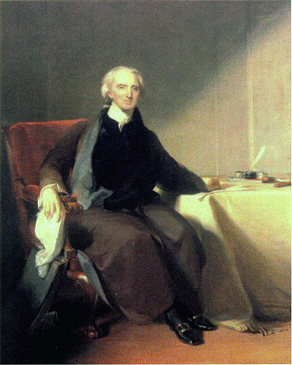
Charles Carroll
Very wealthy- helped finance the Revolution
Argued for armed resistance against the British
Was Catholic and did not have political rights bc of it
Fought for acceptance of Catholics

Slide 7
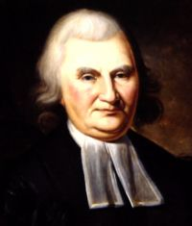
John Witherspoon
Member of the Continental Congress
A Presbyterian clergyman
After signing the Declaration he said the colonies “were not only ripe for independence, but in danger of rotting for the want of it.”
Became the president of Princeton University

