Slide 1
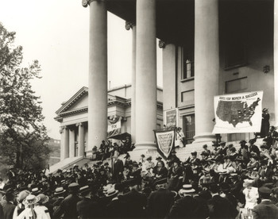
Warm Up Write down and answer on your worksheet somewhere.
What 2 problems was the Progressive Movement concerned with improving?
Name one political party from the Progressive Era other than the Democrats and Republicans.
Name 2 reformers from the Progressive Era.
Give an example of something the government does today to help people.

Slide 2
Progress Reform Scenarios Activity

Slide 3
Daily Grade: Read each scenario and decide the correct vocabulary that fits the situation. Use your Progressive Era vocabulary to help.
Direct Primary Recall
Initiative Referendum
19th Amendment Secret Ballot
Pendleton Act 17th Amendment
18th Amendment
16th Amendment

Slide 4
Progressive Vocabulary Review
Direct Primary- Ensures voters select candidates to run for office, rather than party bosses.
16th Amendment- income tax
17th Amendment-provided for the direct election of senators
18th Amendment- made alcohol illegal in the U.S.
19th Amendment- Provided for women’s suffrage (right to vote)
Initiative- Allows people to propose new laws as bills rather than lawmakers
Referendum- Allows voters to put a bill on the ballot so voters can vote on it
Recall- Allows voters to remove an elected official from office
Secret Ballot- Gave voters privacy at the ballot box; they were less subject to pressure and intimidation
Pendleton Act- Created the Civil Service Commission. It required exams and specific criteria to get government jobs.

Slide 5
Scenario 1
The people of the state of Texas repeatedly explain to their representatives that they would like to create a new law raising the state’s minimum wage. Representatives refuse to listen and do not even propose a bill to do this. Which progressive political reform would address this issue?

Slide 6
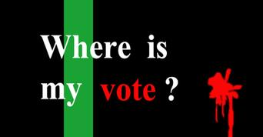
Scenario 2
After receiving enough signatures on a petition, the Texas state legislature is REQUIRED BY LAW to vote on raising the minimum wage. They repeatedly vote “no” despite the fact that the majority of Texas Citizens would like to raise the minimum wage. What Progressive Era Reform would address this issue?

Slide 7
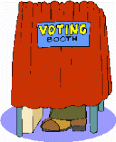
Scenario 3
The principal of a high school has a friend running for mayor. He tells all the teachers in the school to vote for his friend and says that there “will be consequences” if they do not. He has the assistant principals observe at all voting locations to make sure that the teachers vote for the right candidate. Which Progressive Era Reform would fix this?

Slide 8
Scenario 4
After becoming the Mayor of Houston, Frank Frankston makes racial remarks and has been accused of inappropriate activities. While none of his actions are technically illegal, the people are quite convinced that they do not want him to be their mayor any more. The problem is, he is not up for re-election for four more years. What Progressive era reform could address this?

Slide 9
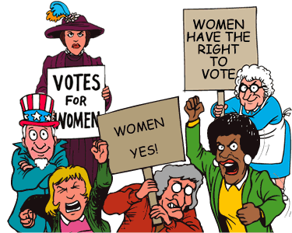
Scenario 5
The city of Pflugerville strangely has 75% of its population as female. Unfortunately, it is the year 1890 and as such, 75% of the population cannot vote. The women of this town would very much like their perspective to be heard since they are the majority of the population.

Slide 10
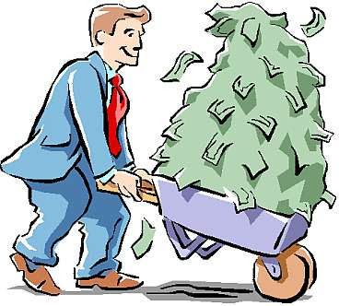
Scenario 6
Republicans in the state of Texas are upset because the only person representing their party in the election for Governor is a radical. He has been given the chance to represent the Republican party because he has donated a lot of money to the Republican Party. The people wish they could vote for a different Republican candidate, but there are no other options. What Progressive Era Reform could address this?
Political Boss
Graft

Slide 11
Scenario 7
Frank Frankston becomes Mayor of Houston and then immediately appoints his friend Rob Robertson to be the city Tax Collector not because he is qualified, but because he is his friend. What Progressive Era Reform could keep this from happening?

Slide 12
Scenario 8
Until the early 1900’s the Senators representing each state in Washington D.C. were chosen by state legislators. Unfortunately this meant that often times they could bribe their way into selection. What Progressive Era Political Reform could address this issue?

Slide 13
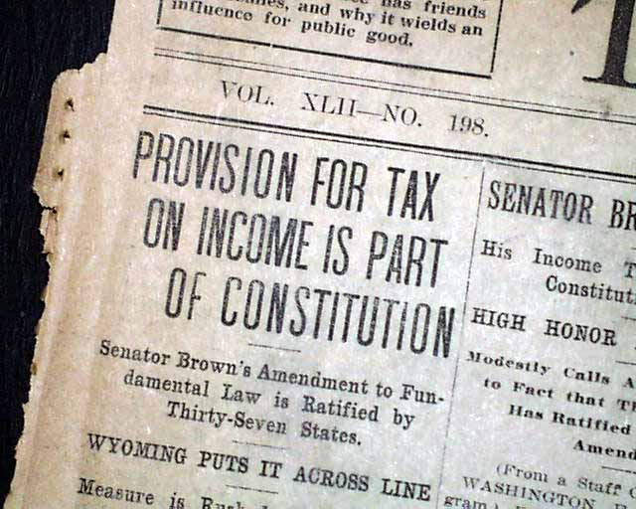
Scenario 9
Congress has decided to lower the Tariff (Tax on imported goods) in order to bring more competition into the United States. However, this causes them to make less revenue through taxes so they create a law that will tax people’s income.

Slide 14
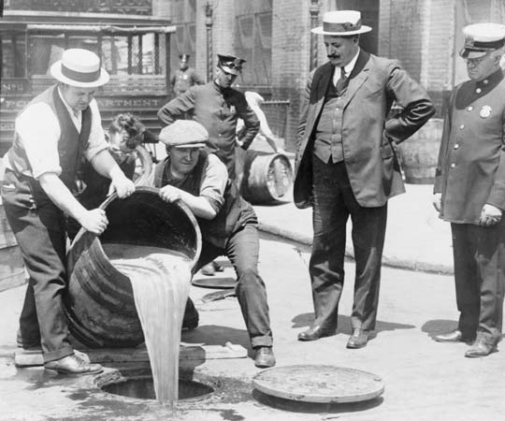
Scenario 10
Alcohol has been linked with corruption in government, domestic violence and unsafe working conditions. The government decides to make alcohol illegal in the United States.

Slide 15
Answers…
Scenario 1 Initiative
Scenario 2 Referendum
Scenario 3 Secret Ballot
Scenario 4 Recall
Scenario 5 Nineteenth Amendment
Scenario 6 Direct Primary
Scenario 7 Pendleton Act
Scenario 8 Seventeenth Amendment
Scenario 9 Sixteenth Amendment
Scenario 10 Eighteenth Amendment

Slide 16
Progressive Era Graphic Organizers
Go ahead and get out your graphic organizers.
This is due by the end of class tomorrow.
You can use your guided notes, the Jarrett book, the Blue textbook or any assignment we’ve done up until this point to complete these.
Use complete sentences when necessary.
You may work with a partner or individually.
When you get done, you can organize your notebook by attaching the worksheets I passed back to the inside.

