Slide 1
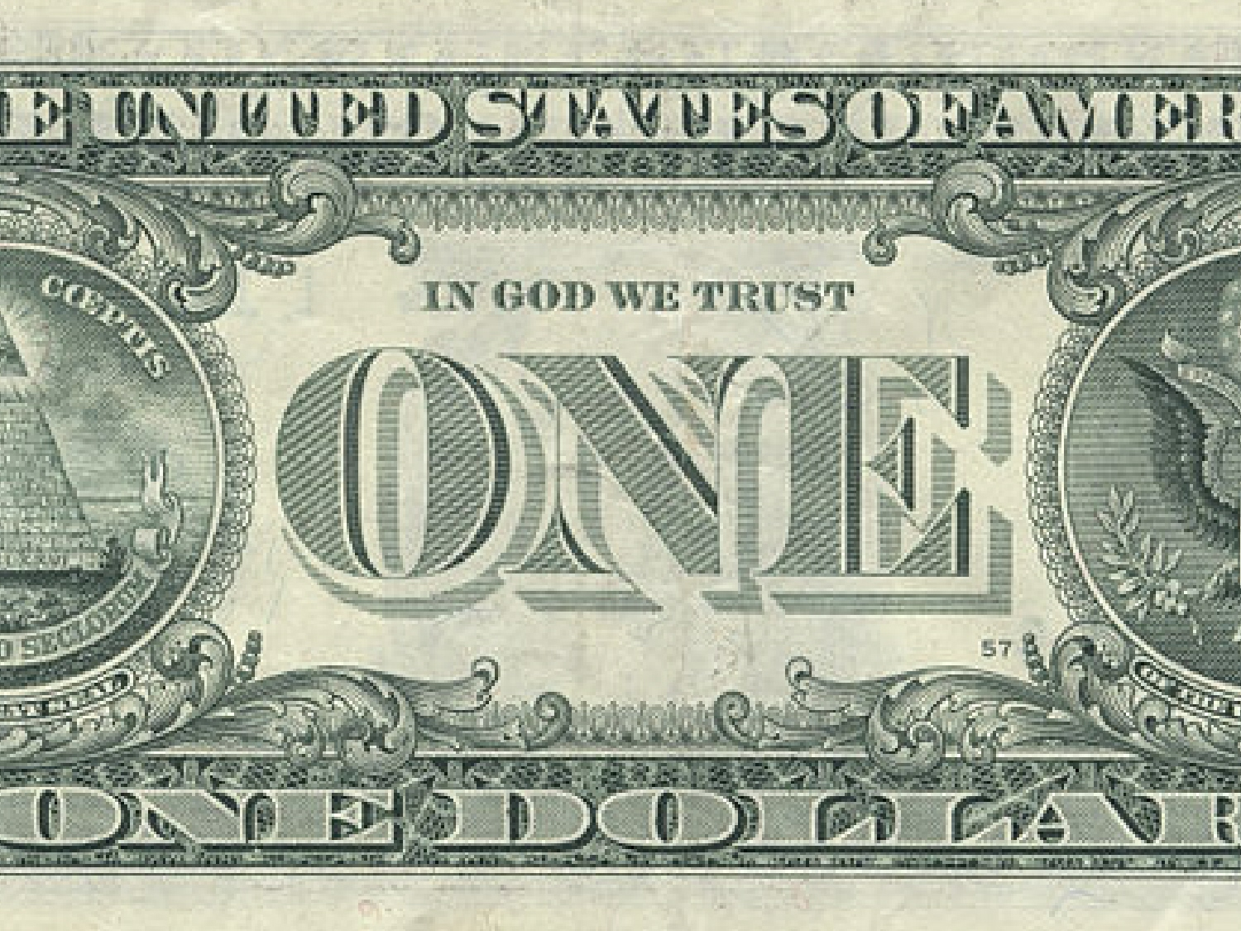
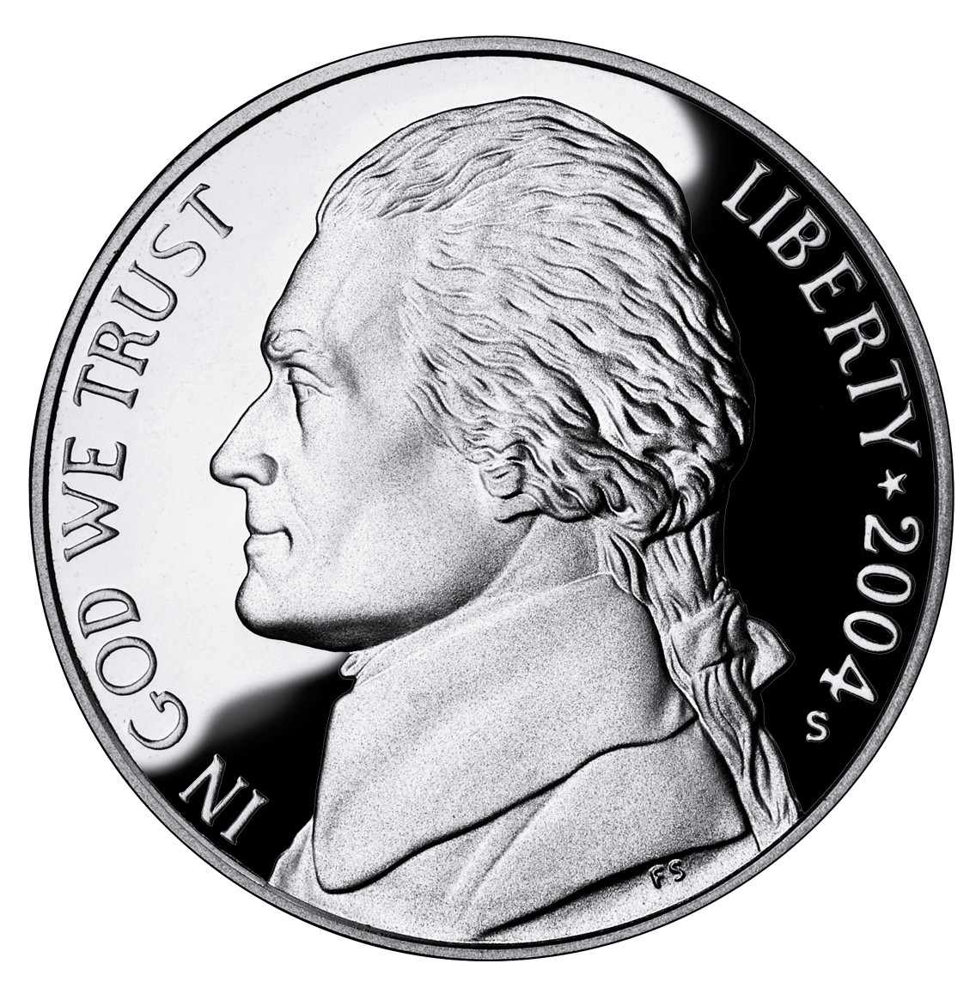
Warm Up:
Write down & answer in your notebook- Why is “In God We Trust” allowed here?:

Slide 2
Warm Up
Question (1st & 4th pds only): Why is the Bill of Rights an important document? Choose which Amendment is most important to you. Would you add an Amendment and if so what would you add?
Question (6th & 7th pds only): In your opinion, was the DoI an idealistic or selfish document? Both? Explain your answer…

Slide 3
Tocqueville’s 5 Values Foldable 1. Choose a piece of colored paper. 2. Fold it in half like a hamburger NOT a hotdog. 3. Cut it in half. 4. Fold those pieces in half then tape/staple the edge. 5. Use this like a flipbook to write the 5 values one per page.

Slide 4
Tocqueville’s 5 Values (write this on the cover page):
Egalitarianism (Equality)
Populism (Popular Sovereignty)
Individualism
Liberty
Laissez-Faire

Slide 5
Alexis de Tocqueville
(Write this on the back of the cover page)
Sent to America in 1824 by the French govt to study prisons to help France fix their own
Wrote Democracy in America
A guide to measure how America has changed since its beginning
Wanted to know how democracy had survived in America

Slide 6
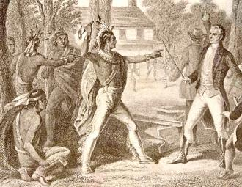
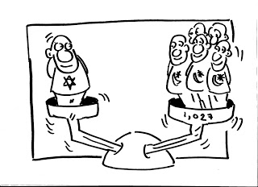
1. Egalitarianism (Equality)
A society made up of socially equal people
The availability of free land promoted equality
3 exceptions he saw: slavery, women & treatment of Native Americans

Slide 7
2. Populism (Popular Sovereignty)
The participation of the common people in political life
Everyone had the same right to participate since they were all equal
Goal was peace and prosperity

Slide 8
3. Individualism
Individuals believed they were free to rise in society
Individuals organized themselves into their own private, voluntary associations, such as charities

Slide 9
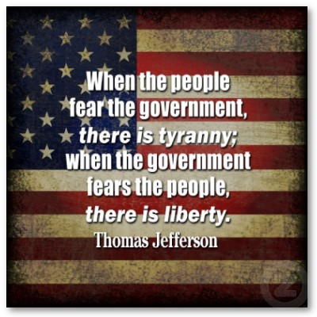
4. Liberty
Protection against tyrannical govt.
America’s federal system helped prevent the rise of an over-powerful govt.

Slide 10
5. Laissez-Faire
Govt. takes a “hands off” approach to the economy.
Each person is the best judge of his own interests, not the govt.
Americans should not allow govt. to become too involved.

Slide 11
Before you Leave: 1. I will be handing back some worksheets to you. 2. They need to be pasted or taped into your notebook at the end of your Freedom Week notes. (Trim them up so they don’t stick out of the sides.) 3. Get this done before you leave today.

