Slide 1
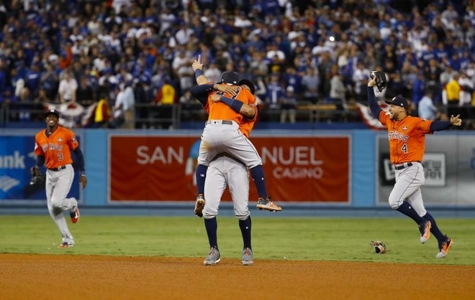

Slide 2
Instructions for today (pay close attention)
The WWI packet you picked up will be a major grade.
Follow the instructions to complete the packet.
You will use several different sources of information to complete this (i.e. your notes, the Jarrett book, the internet (for the flags only).
This will be due next week.
If I see students are working hard and if, and only if, the sub says you were good tomorrow, I will be showing “Flyboys” next week.
The “Flyboys” worksheet will be worth 2 daily grade.
Folks, this is a great opportunity for some of you to pull your grades up in this class.

Slide 3
A New Kind of Warfare: On the image of the trench, write the word and draw the arrow for each object.
Barbed Wire
Artillery
Machine gun nests
Reserve
Dugout
No Man’s Land
(Up to 1 mile)
Support
Front Line
Enemy

