Slide 1
Warm Up: On a separate piece of paper answer the following: 1. Describe what urbanization is. 2. Explain what happened in the activity from yesterday. 3. Analyze how urbanization affected life in America during industrialization. Pass the paper forward when you’re done!

Slide 2
Urbanization & Immigration

Slide 3
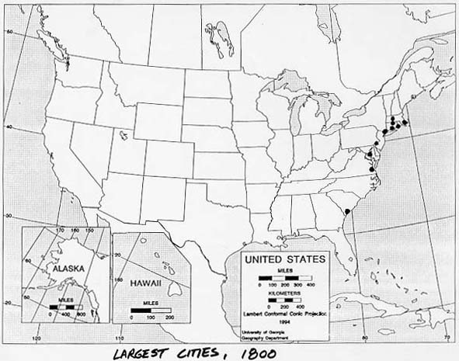
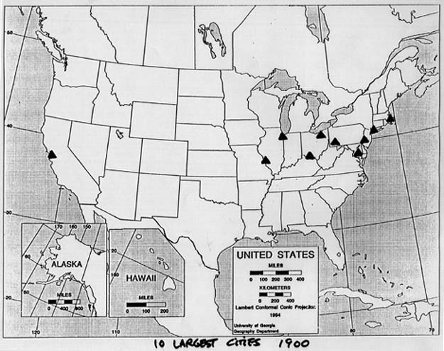
Urbanization
The movement of people from the countryside to towns and cities
1865- only NYC & Philadelphia had over 500,000 people
1900- 6 over 500,000, NYC/Philly/Chicago over 1 million, 40% of population in cities

Slide 4
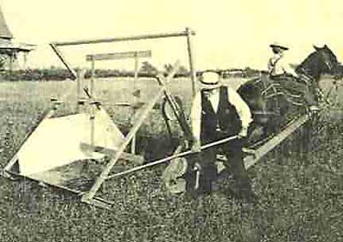
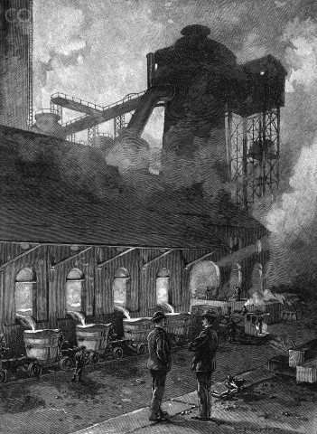
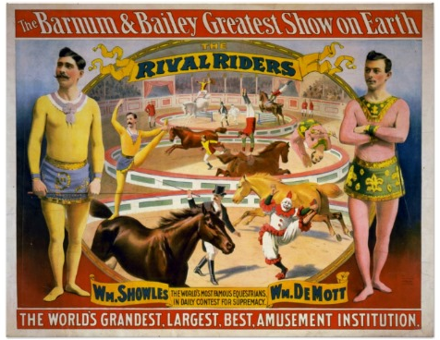
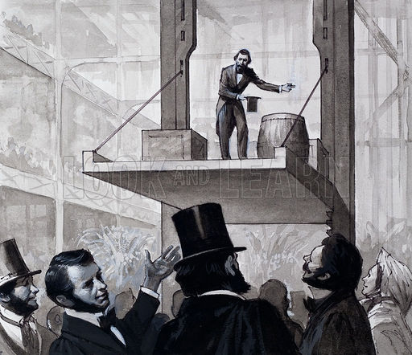
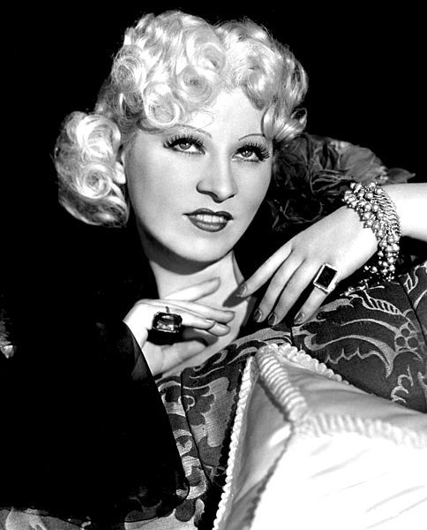
4 reasons for Urbanization
1. New Technologies:
-Cyrus McCormick’s reaper reduced the number of farm jobs
-Elevators allowed buildings to take on more people
-electricity and lightbulbs made life easier and exciting
2. New jobs in industry- workers needed in factories
3. Cultural opportunities- more entertainment
4. immigration- Millions of immigrants poured into cities

Slide 5
(DRAW THIS INTO YOUR NOTES)
Problems Created by Growing Cities
Inadequate Public Services
- Cities couldn’t deliver public services: hospitals, police, schools, garbage collection
Transportation
-Pollution from horse-drawn coaches led to building trolleys and the subway system
Overcrowding
-Families were packed into tenements: small apt buildings
Social Tensions
-Rich and poor lived next to each other, which increased tension and crime

Slide 6
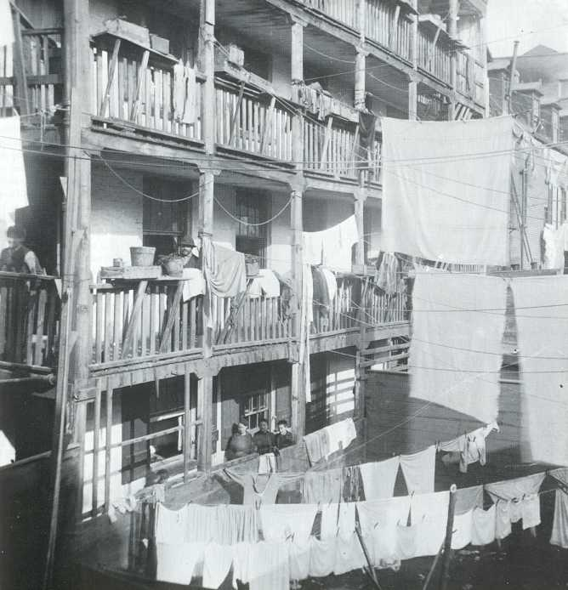
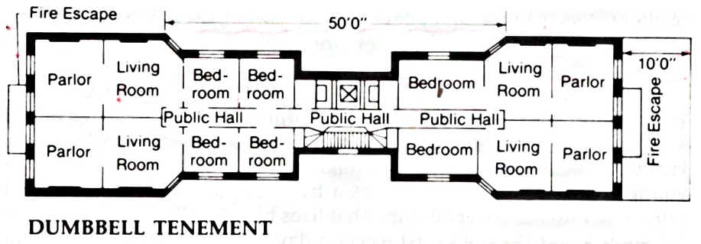
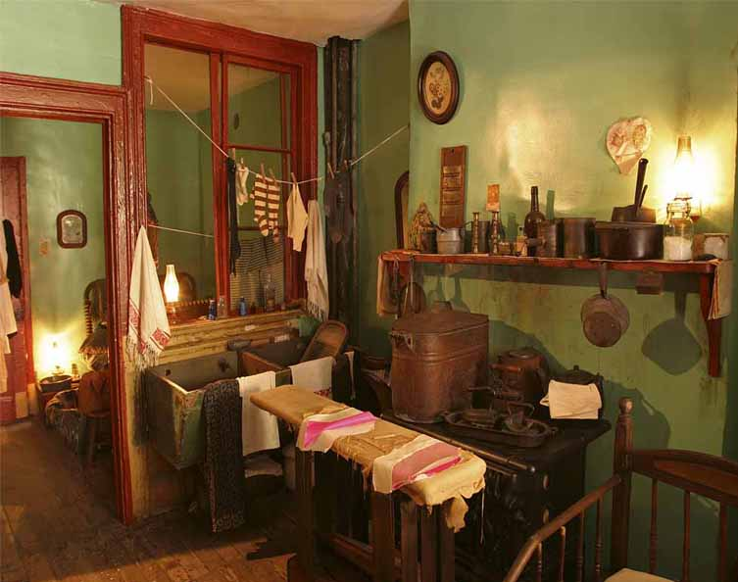
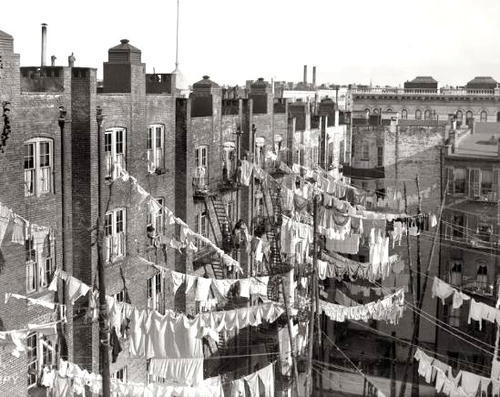
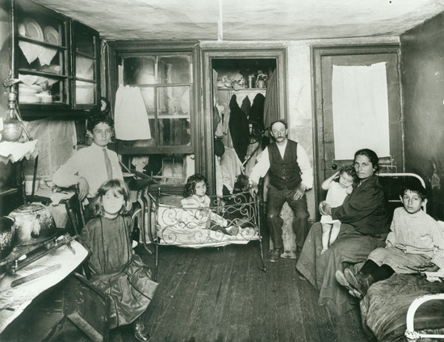
Tenements: Packed, filthy, disease ridden, Crime ridden

Slide 7
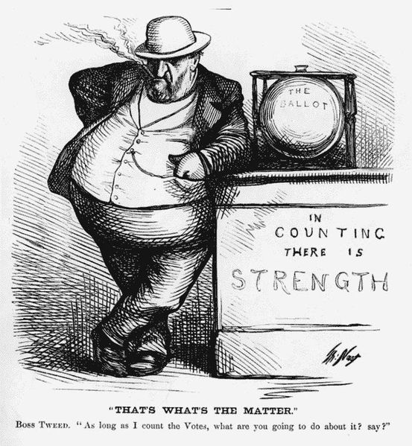
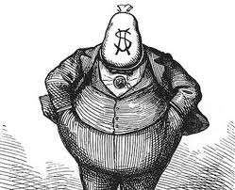
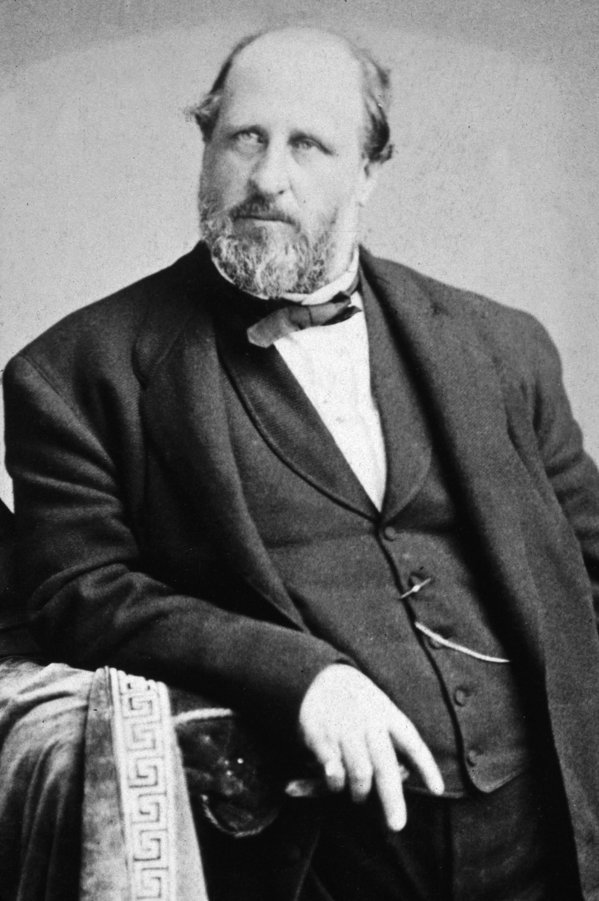
Political Machines (Crash course US history: Gilded Age)
Corrupt city govts run by Political Bosses
Lots of scandals in politics during the Gilded Age
Gave jobs to immigrants and poor in exchange for their votes
Boss Tweed of Tammany Hall
Controlled workers & services in NYC
Bribed lawmakers & overpaid himself

Slide 8
Push & Pull Factors of immigration: Reasons why immigrants came to the United States (Make Sure you draw this into your notebook.
Push Factors
-Oppression
-Poverty
-War
-Religious Persecution
-Population Growth
-Disease
-Famine
Pull Factors
-Freedom of religion
-Economic Opportunity
-Cultural ties
-Free/Cheap land
-Jobs

Slide 9
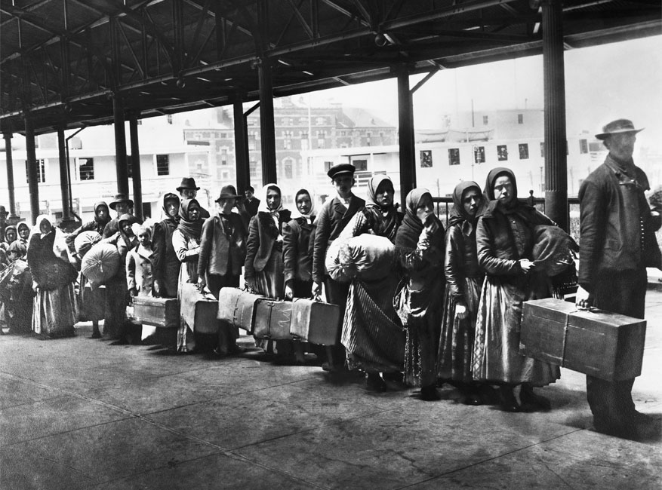
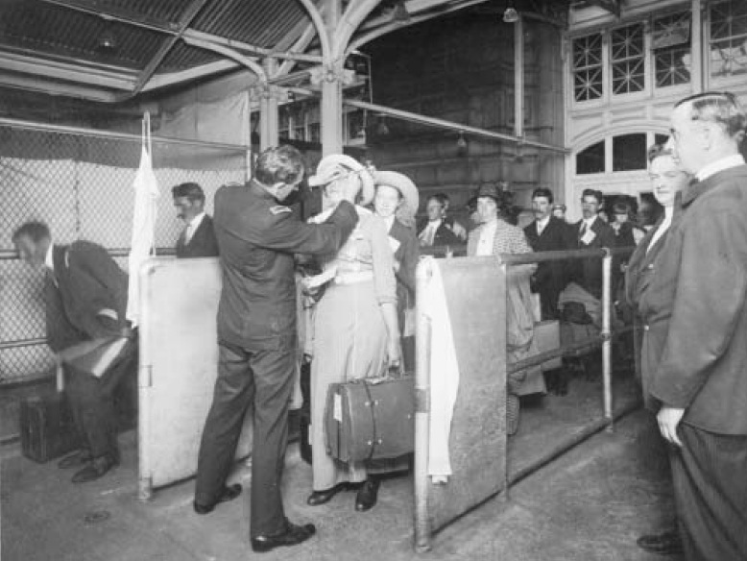
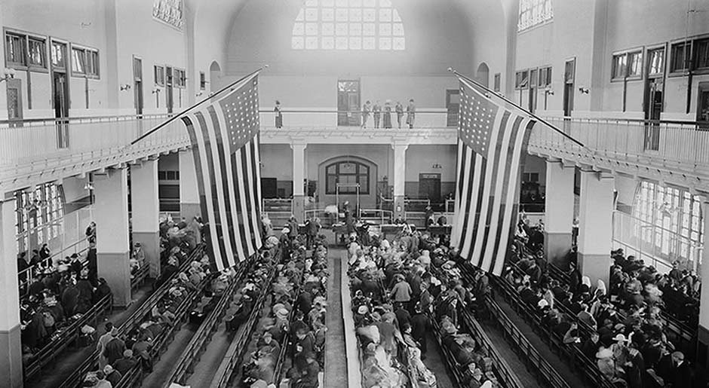
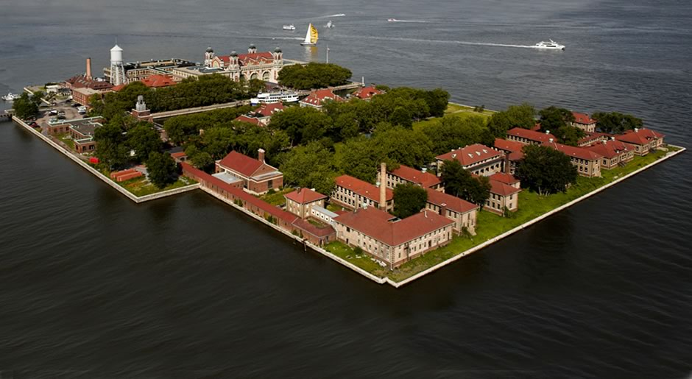
The Immigrant Experience
Traveled for 3 weeks in steerage- an open room below the deck of the boat
Arrived at Ellis Island
Some given new names
Screened for diseases
Sent back to Europe if diseases were found

Slide 10
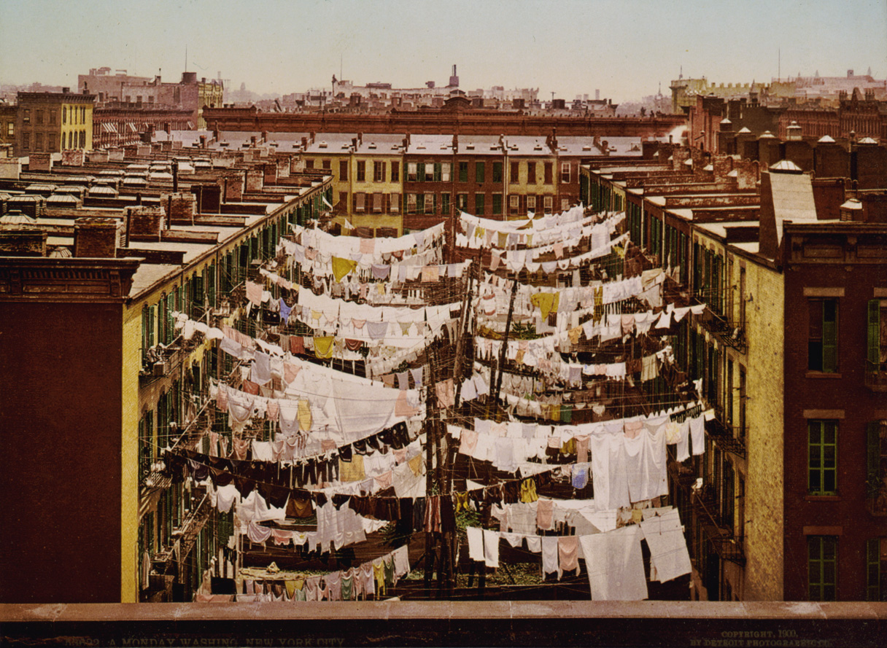
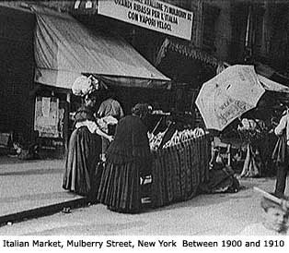
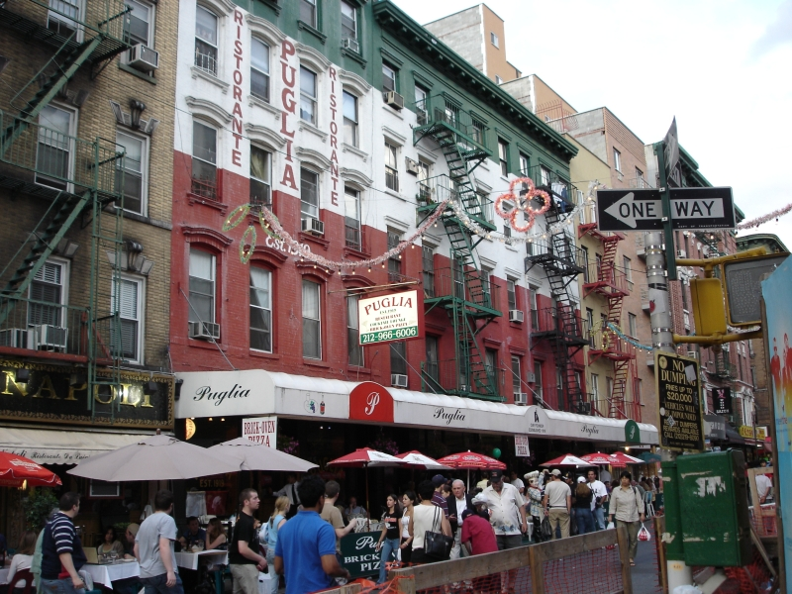
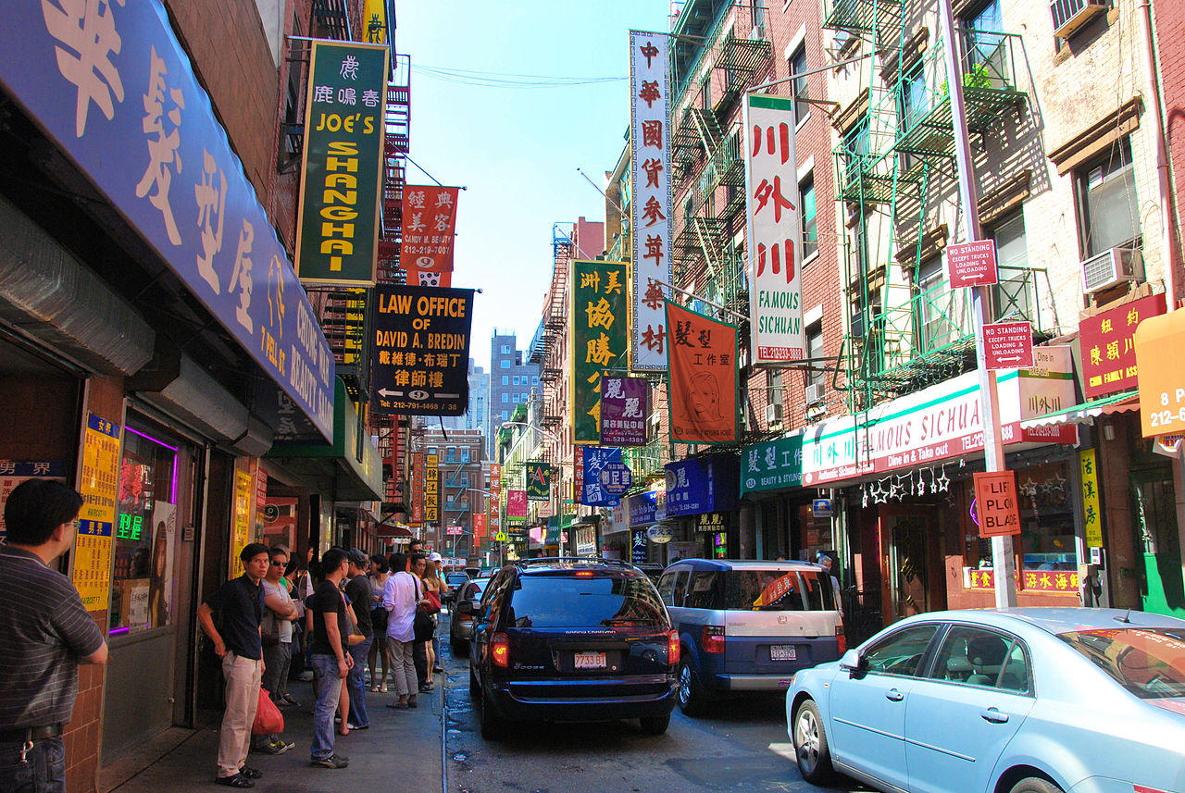
Ethnic Ghettos
Place where immigrants settled with others of the same nationality and ethnicity Immigrant neighborhoods
Felt more comfortable speaking the same language & following customs

Slide 11
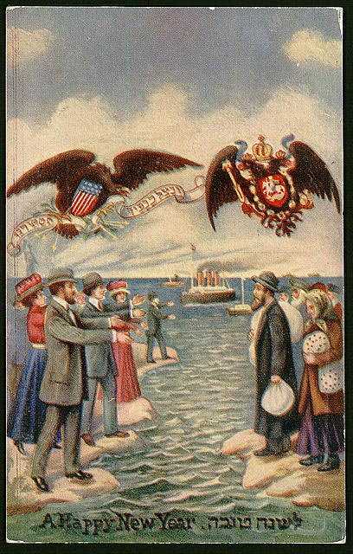
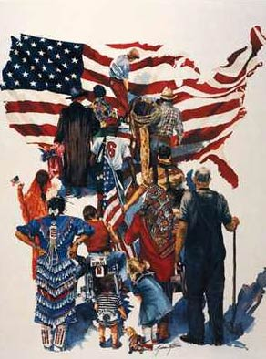
Americanization
Learning to dress, speak, and act like other Americans
Assimilation
Immigrant children became more like other Americans
America was seen as a “Melting Pot”
Reshaping of immigrant Culture

Slide 12
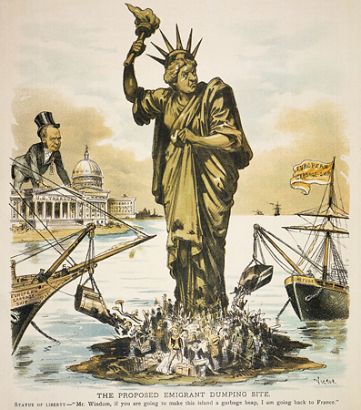
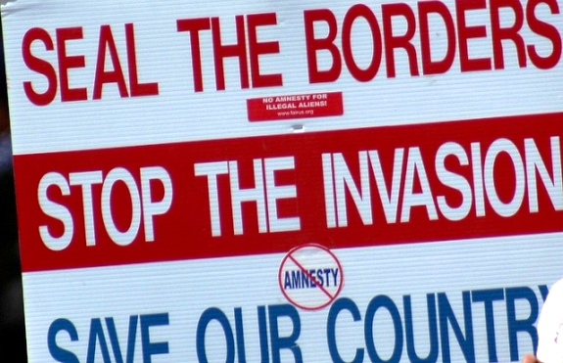
Nativists
People born or native to the U.S.
Believed people of other races, religions, and nationalities were inferior
Wanted to restrict immigration

Slide 13
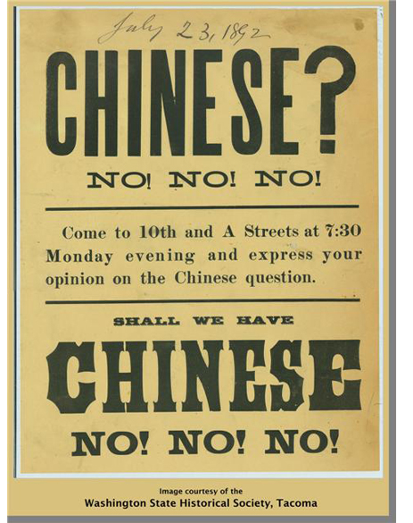
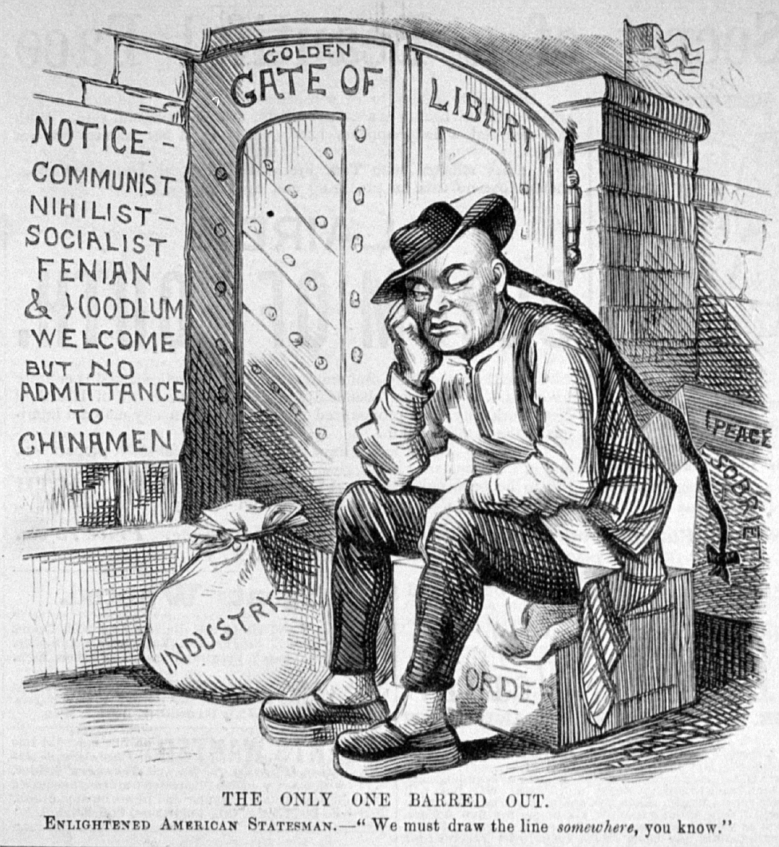
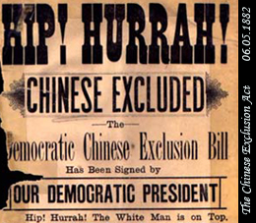
Restrictions on Immigration
Chinese Exclusion Act (1882)
Temporarily banned the immigration of Chinese workers and placed restrictions on Chinese already in the U.S.
Reflected American prejudice at the time against Asians

Slide 14
Warm Up: (In your notebooks) 1. Describe the conditions of tenements. 2. What were some of the dangers of living in a tenement? 3. Why do you think immigrants lived in certain neighborhoods?

