Slide 1
WARM UP: 1. Happy Veteran's Day! 2. On your guided notes somewhere (NOT ON THE BACK), write down what major event occurred on this day in 1918.

Slide 2
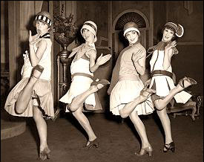
Unit VI: The 1920’s and The Jazz Age
Essential Questions:
What factors sparked the prosperity of the 1920s?
How do social trends and innovation shape popular culture?
How do social, economic, and religious tensions divide Americans?
Vocabulary:
Isolationism Red Scare
Prohibition Speakeasies
Flapper Jazz
Installment Plan Return to Normalcy
Harlem Renaissance
Teapot Dome Scandal
Quota System
Scopes Trial
Fundamentalism
Great Migration

Slide 3
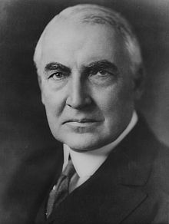
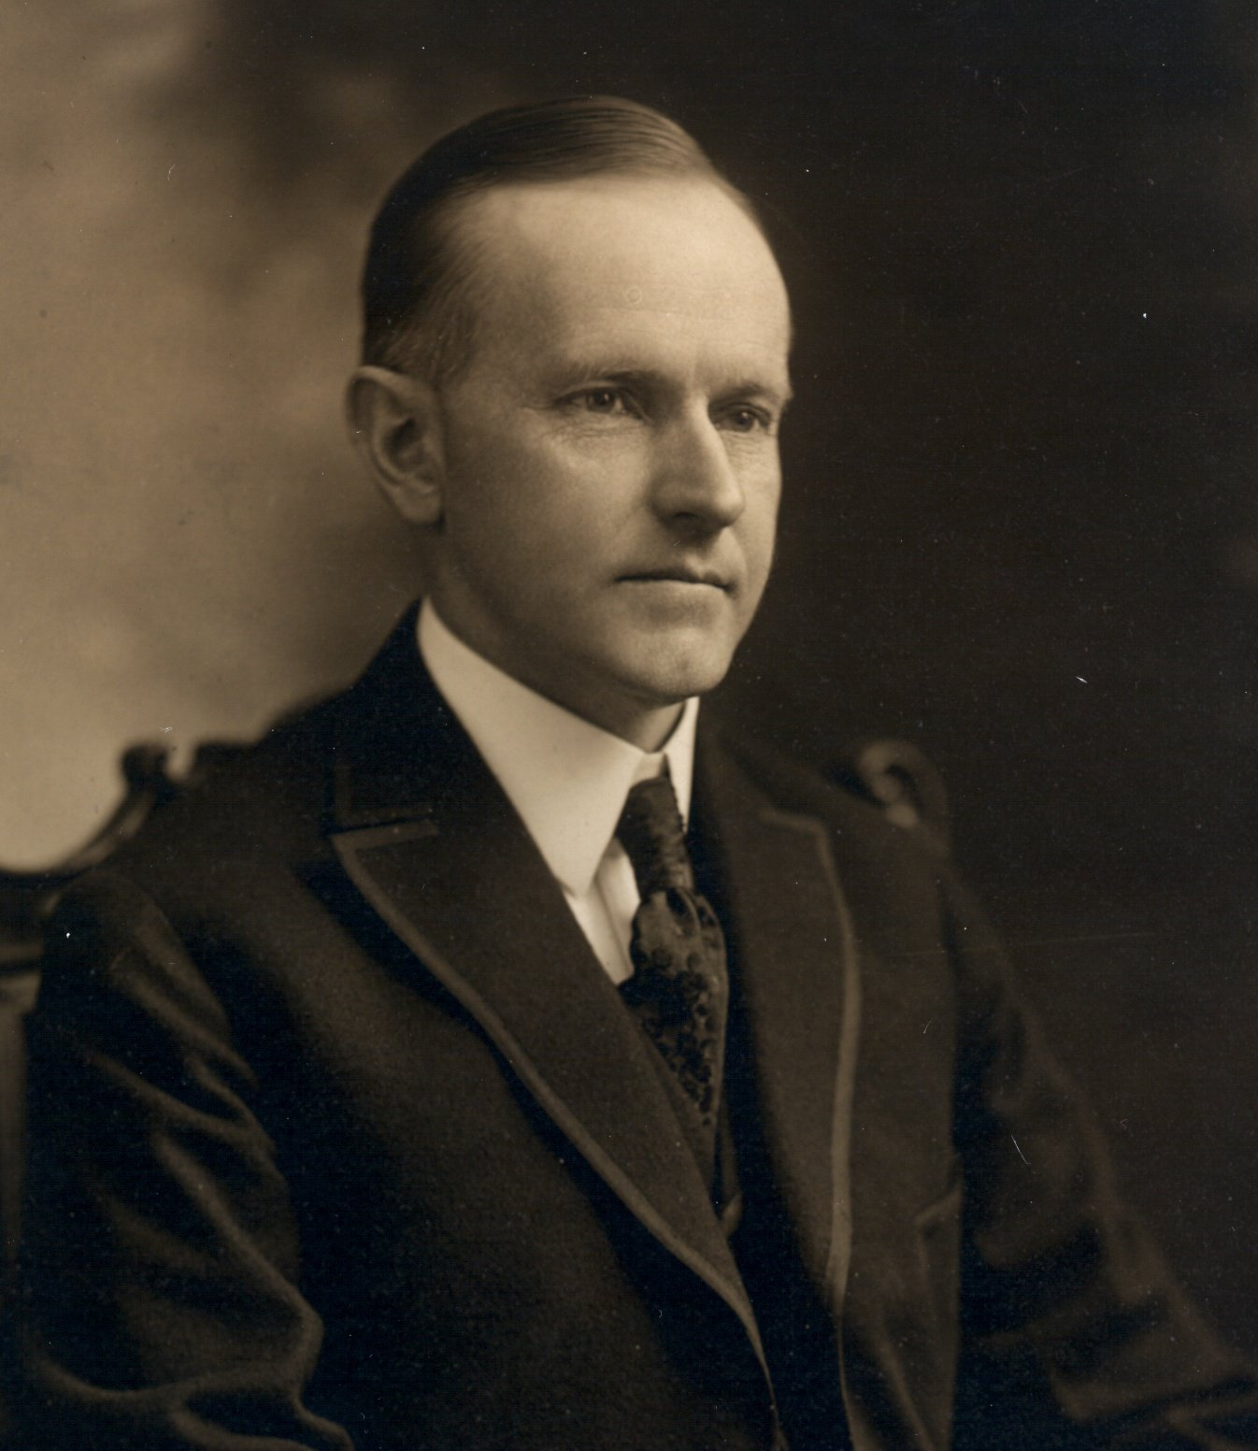
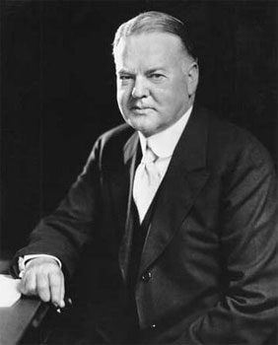
The Presidents of the 1920’s
The presidents of the 1920s were all Republicans.
All favored laissez-faire economics and isolationism from world affairs.
1921-1923: Warren G. Harding
1923-1929: Calvin Coolidge
1929-1933: Herbert Hoover

Slide 4
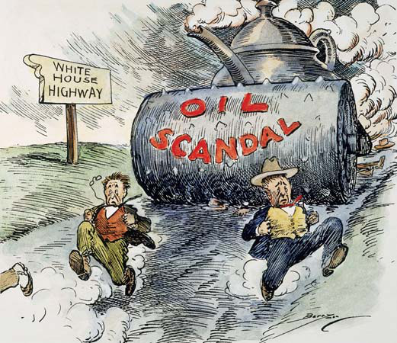
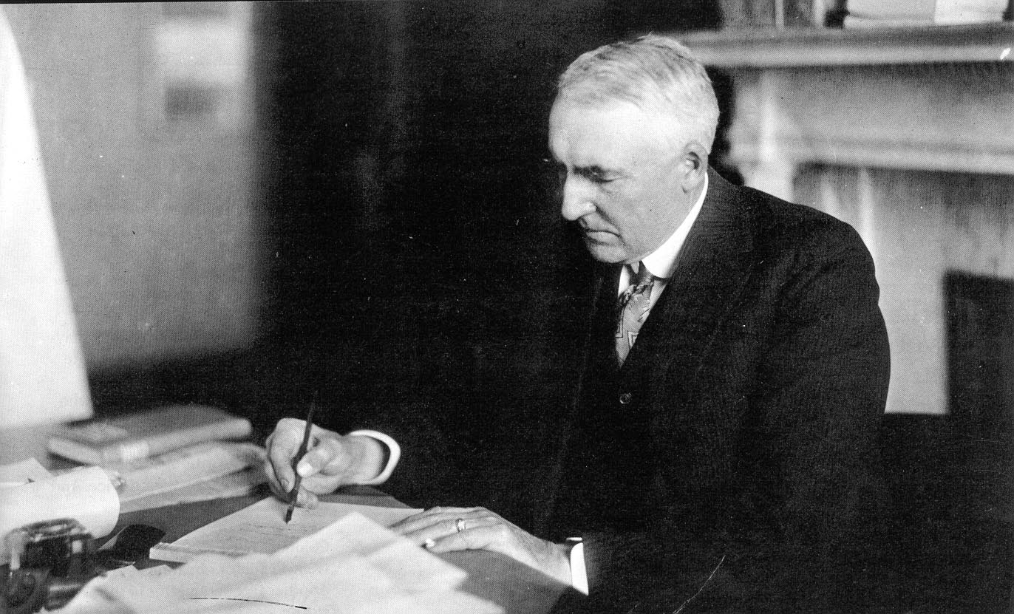
Warren G. Harding
Promised a, “Return to Normalcy”
Wanted to help big business
Presidency was racked with scandal.
The Teapot Dome Scandal:
U.S. officials were illegally leasing out government oil reserves to private companies in exchange for bribes.
•Nan Britain: Woman whom Harding allegedly had an illegitimate child with.
•Harding died in 1923 while on a visit to the west. Some think his wife had something to do with it.

Slide 5
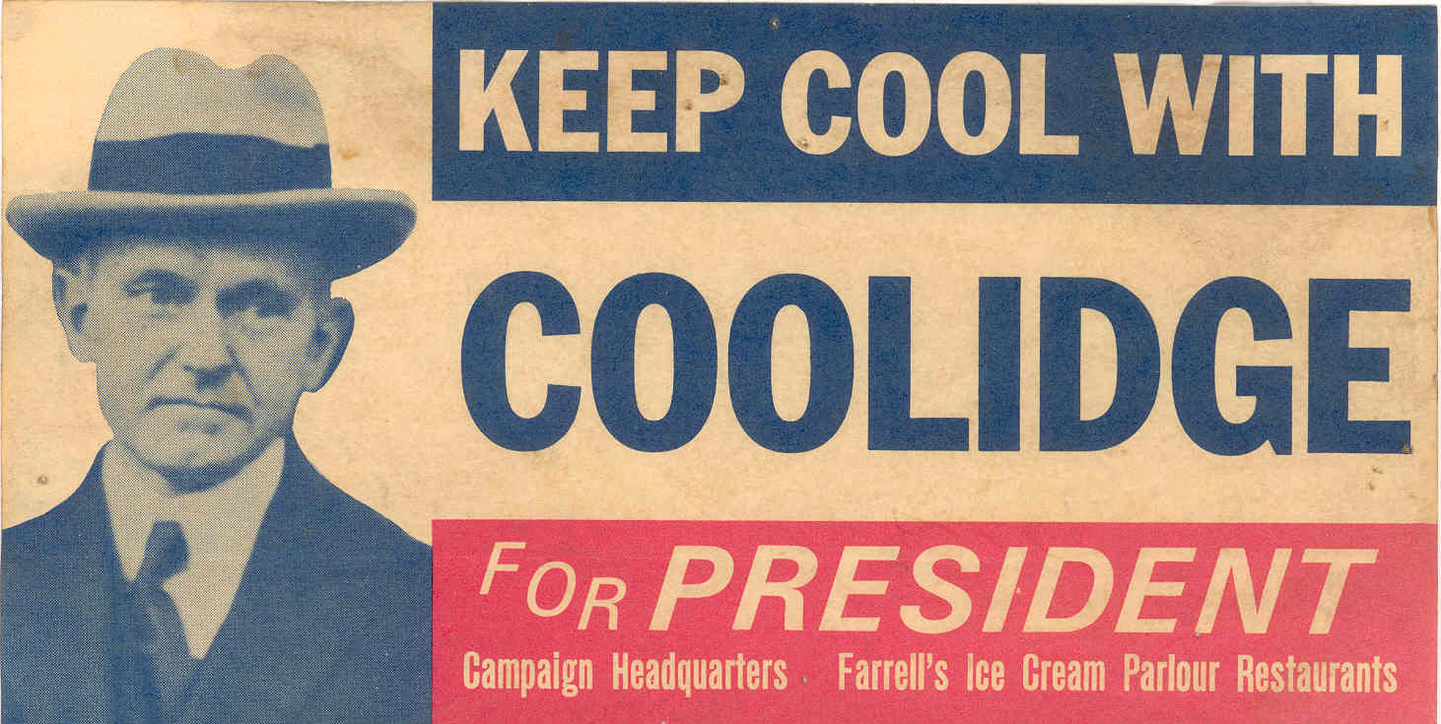
Calvin Coolidge
Sought to clean up politics in the wake of Harding’s scandals.
Was nicknamed, “Silent Cal” because he didn’t like public speaking.
Favored supporting American business
Helped American business by raising the Tariff.
Oversaw one of the most prosperous times in American history.
“The business
of
America
is business.”

Slide 6
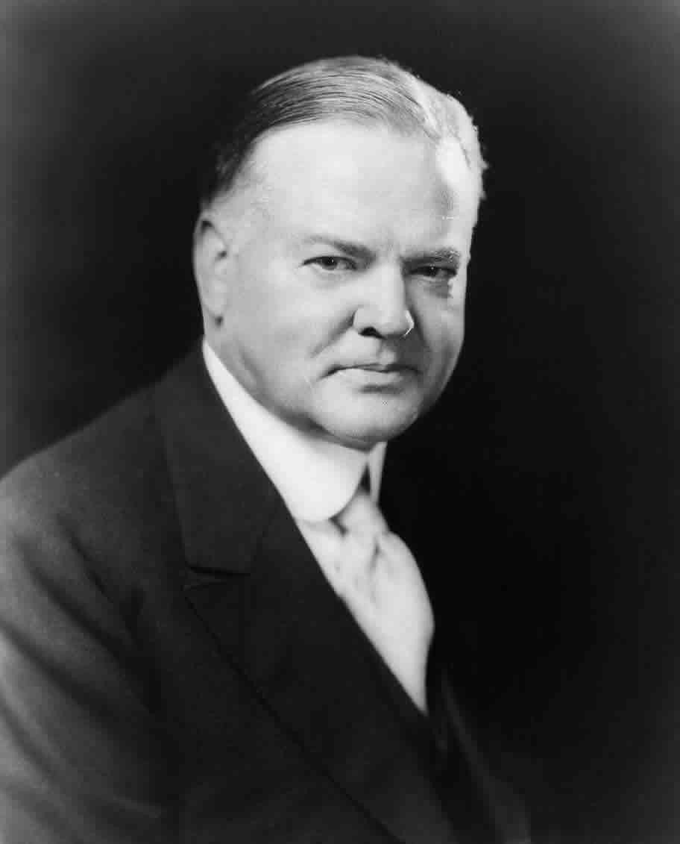
Herbert Hoover
Self-made millionaire and very capable economist
Became president when the economy was growing rapidly
1929: The same year he became president the stock market crashed
Millions lost their jobs and livelihood
Hoover did not help the situation because he thought doing nothing would fix the problem
His idea of “Rugged Individualism” did not work. The idea that businesses would voluntarily lower prices on products while keeping wages high was a disaster.

Slide 7
Section review
On the back of your notes, match the policy to the president:
Warren Harding A. Pro-business policies
Calvin Coolidge B. Rugged Individualism
Herbert Hoover C. Return to Normalcy

Slide 8
3 Republican Presidents Organizers
Directions: Use pgs 176-178 in the Jarrett book to fill in your organizer. You should have one for each president!
1. Important Policies
1.
Name
Years in Office
4.
2.
2. Campaign Platform (How did he become president?)
4. Greatest Success
Picture
Leave Space, we’ll get one later
3.
3. Weaknesses as President

Slide 9
The Ultimate Guide to the presidents
While the video plays make sure you’re answering the questions and finishing the 1920’s presidents graphic organizer from yesterday.
You can use the video to help find information for the organizer if you want.
This video questions are due at the end of the video.

Slide 10
Adjusting to Peace

Slide 11
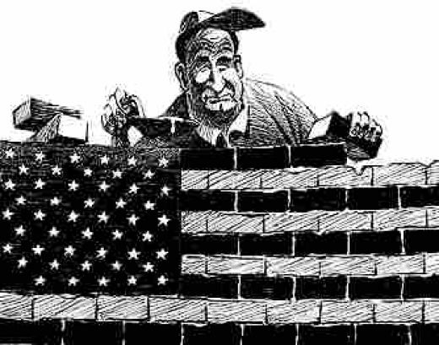
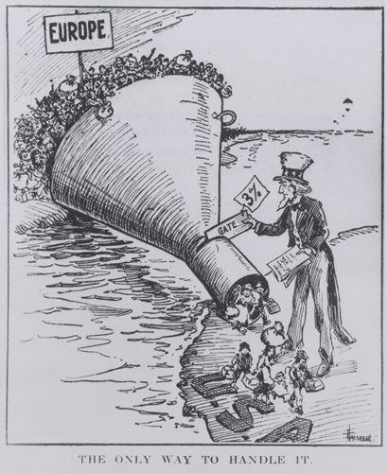
Isolationism
Americans refused to become involved in other nations’ disputes or problems
Factories closed to convert from military to civilian production
Led to an economic recession (downturn)

Slide 12
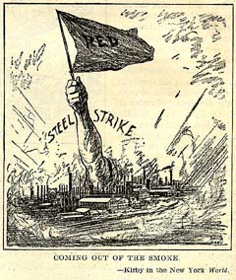
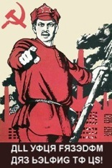
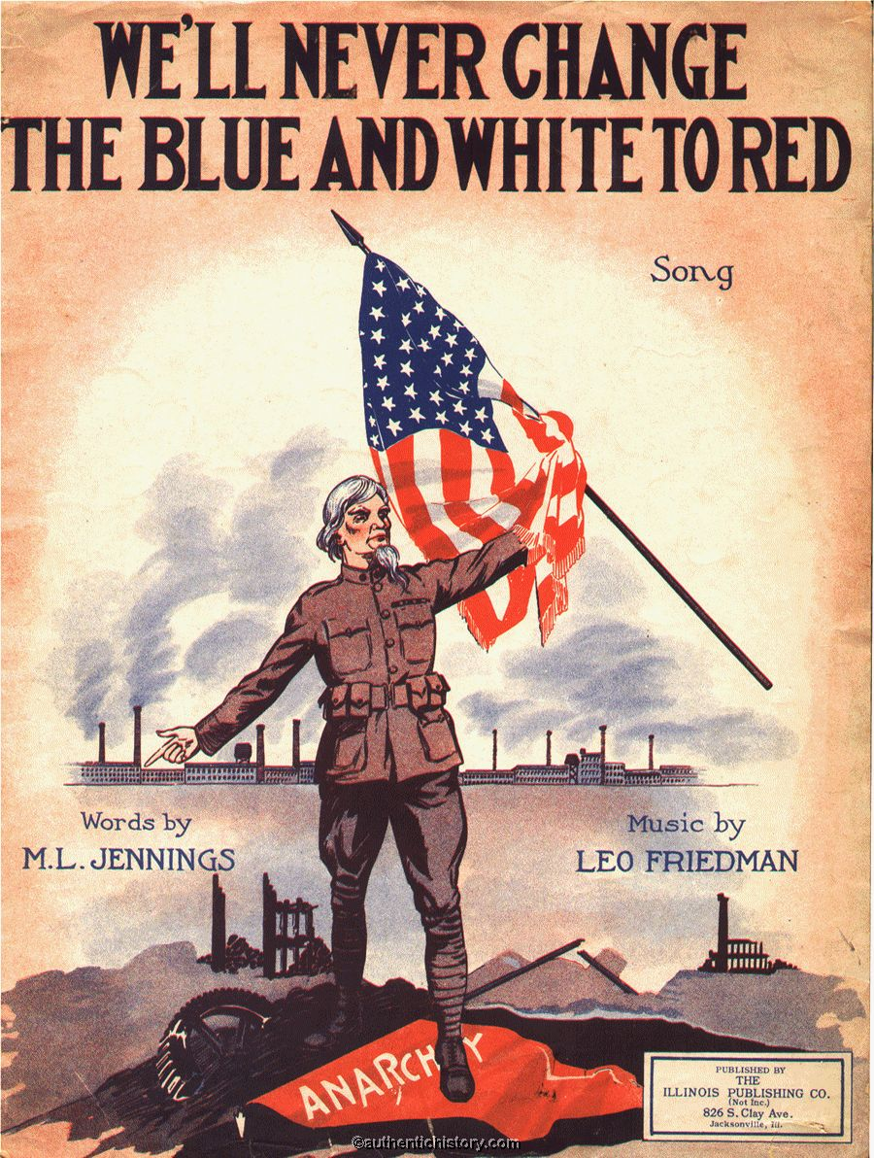
The Red Scare
Many Americans feared Communists, anarchists, and immigrants after WWI bc of Russia’s communist revolution
Thought it would happen in the US

Slide 13
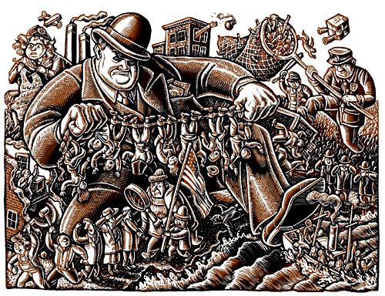
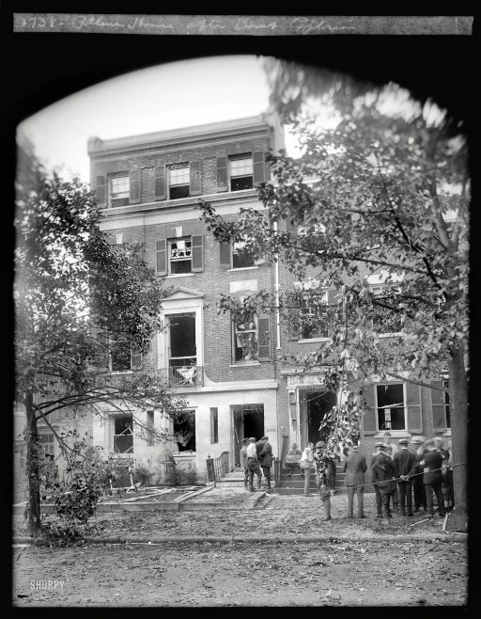
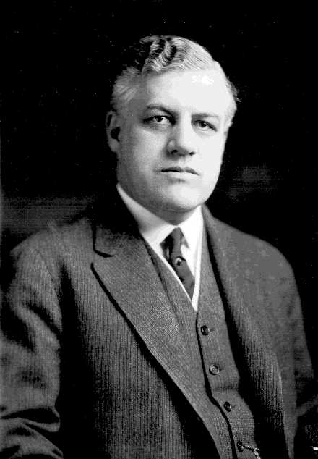
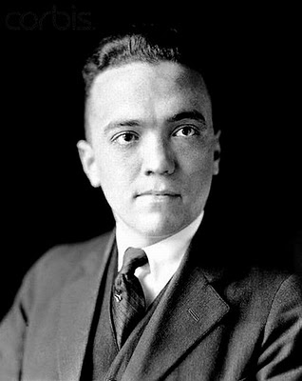
Palmer Raids
Jan 1919- Italian anarchist set off a bomb outside the home of Attorney General Mitchell Palmer
Was one of many attacks that day
Many though it was the overthrowing of the government
Jan 1920- Palmer ordered round-up of 4,000 suspects, 600 were deported
J. Edgar Hoover- assistant who directed raids

Slide 14
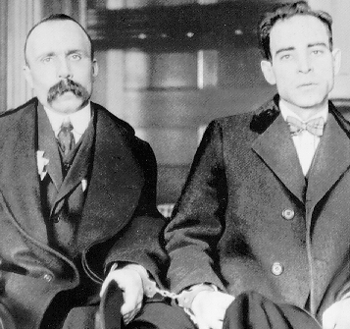
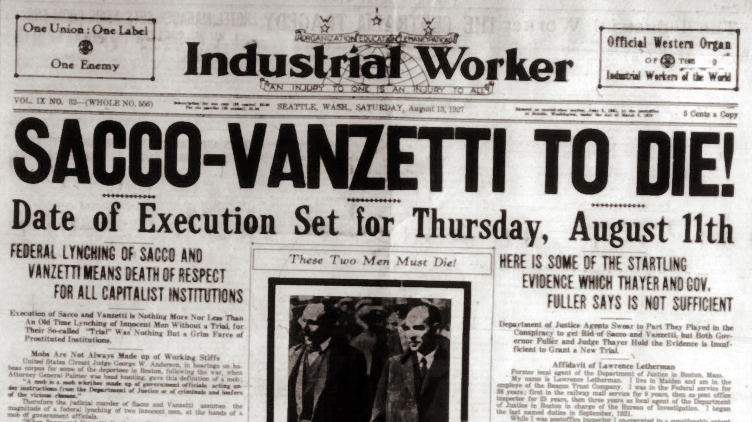
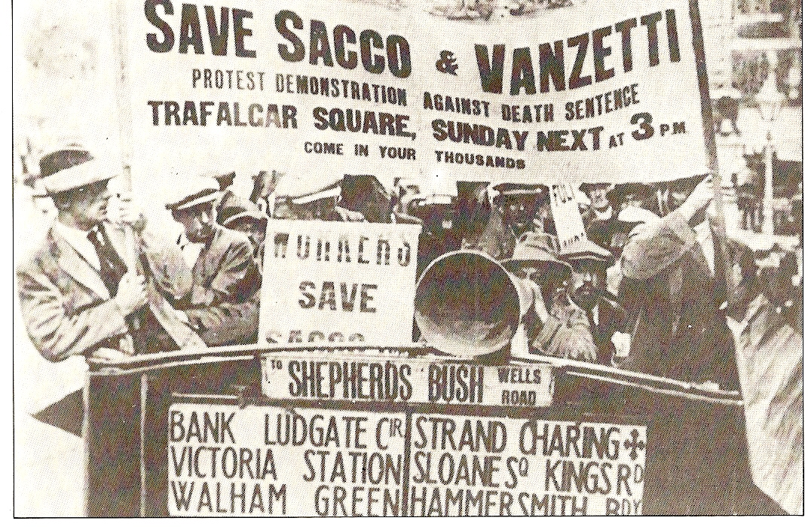
The Sacco and Vanzetti Case
Two Italian immigrants were convicted of committing murder during a robbery
Supposedly wanted money for an anarchist revolution
Americans did not want to look weak by letting them go
Executed in 1927
Millions protested their innocence
Almost no evidence proving they committed the crime

Slide 15
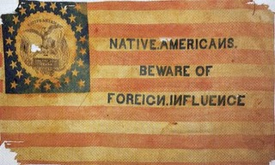
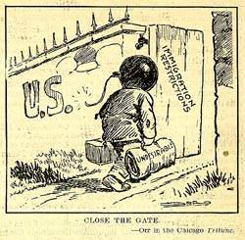
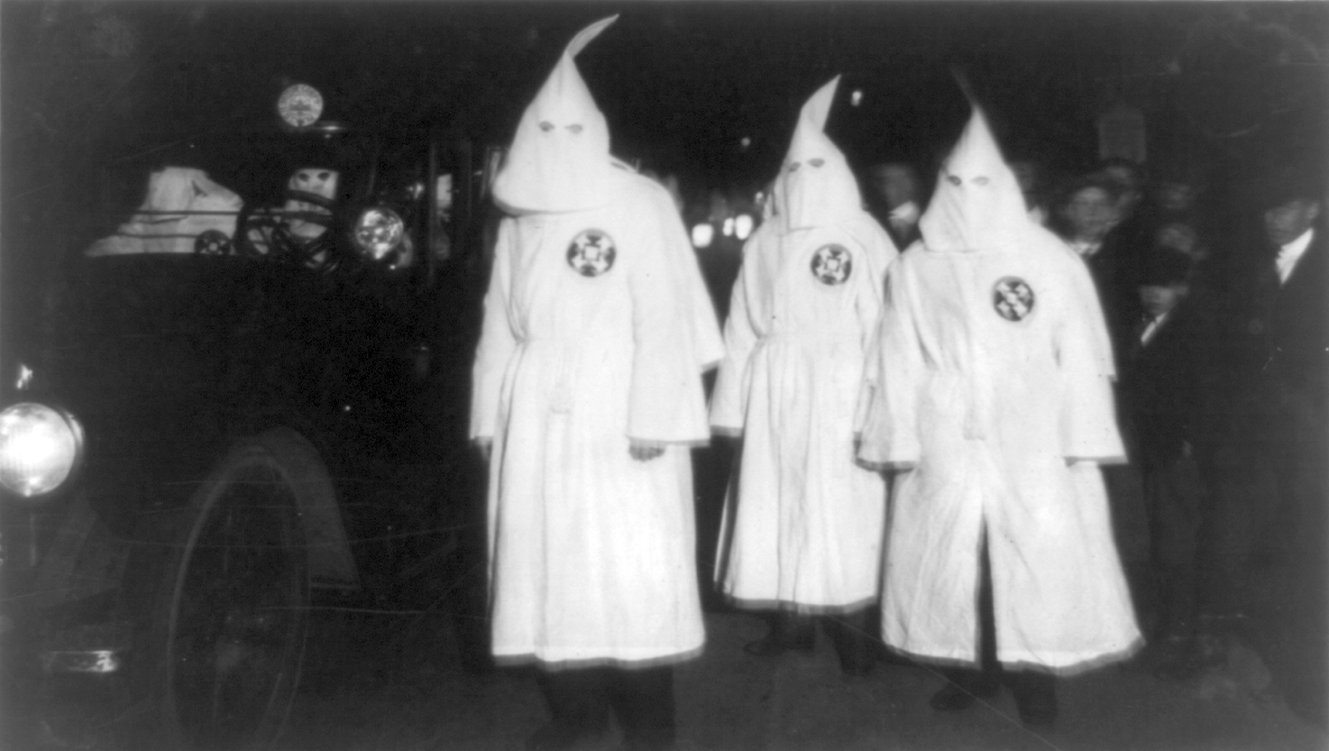
Rise of Nativism & Racism
Nativism- a dislike of foreigners
Led to restrictions/quotas on immigration
Migration of African Americans from south to north increased racial tension
KKK became popular again- led to race riots

Slide 16
Thinking Critically (On the back of your notes.)
How did US diplomacy shift to after WWI?
Why did nativism witness a resurgence after WWI?

Slide 17
The Scopes “Monkey Trial” of 1925

Slide 18
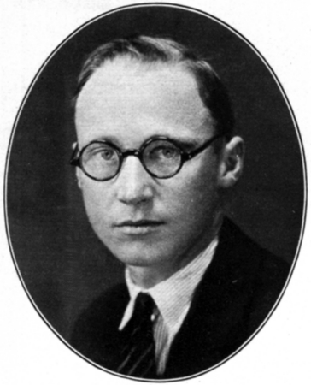
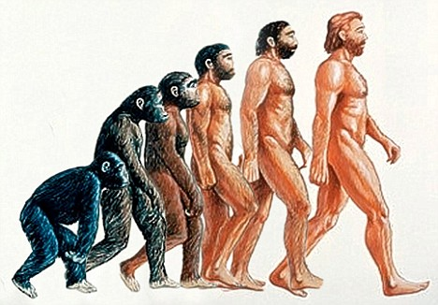
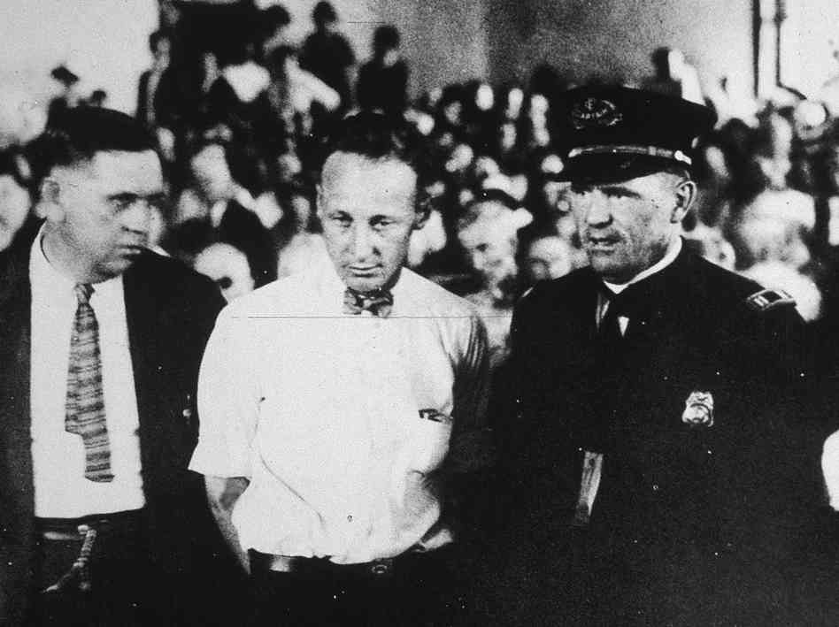
Case Background
Tennessee was the first state to pass a law against teaching evolution
Darwin had contradicted the Biblical account of Creation
John Scopes
Biology teacher
Arrested and put on trial for teaching evolution

Slide 19
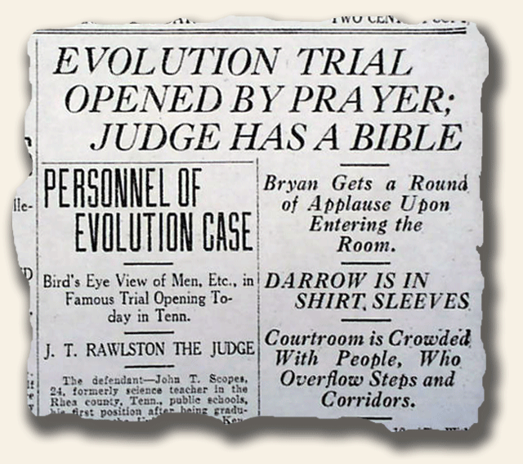
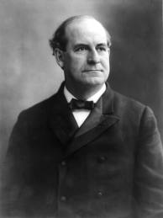
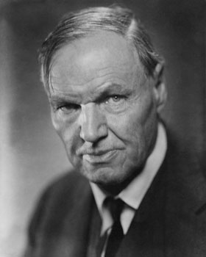
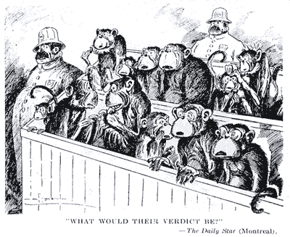
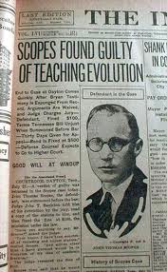
Outcome of the Trial
Trial drew nationwide attention- older religious beliefs vs. new scientific theories
1st trial to be broadcast over the radio
William Jennings Bryan defended the state
Clarence Darrow defended Scopes
Scopes was convicted for teaching evolution, but his $100 fine was waived

Slide 20
Thinking critically
Write down and answer on the back of your notes:
Why was the Sacco and Vanzetti case significant?
Why was the Scopes Monkey Trial significant?

Slide 21
Prosperity of the 1920’s

Slide 22
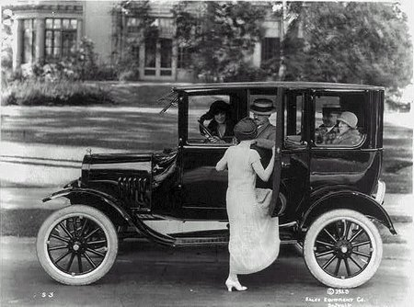
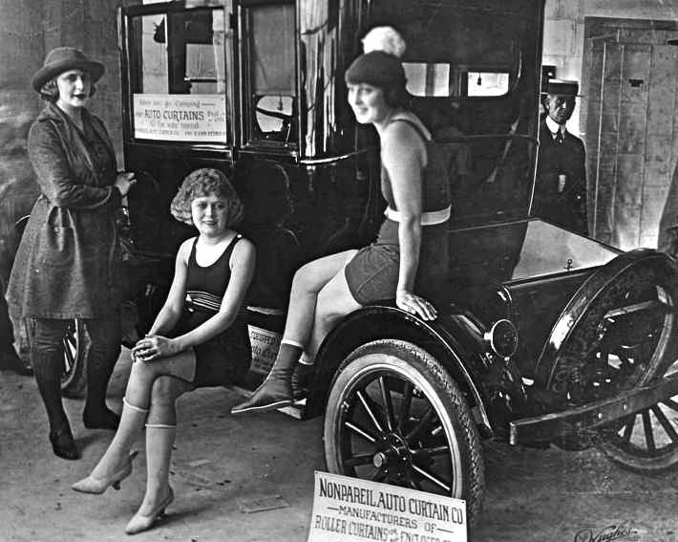
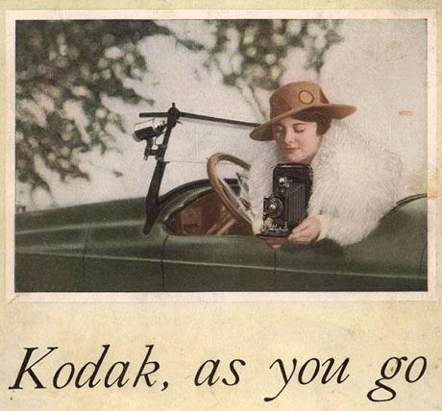
Rise of the Automobile
Stimulated steel, glass, and rubber industries = a lot of jobs
More mobility:
Families took vacations
Growth of suburbs
School buses allowed students to go to school regularly

Slide 23
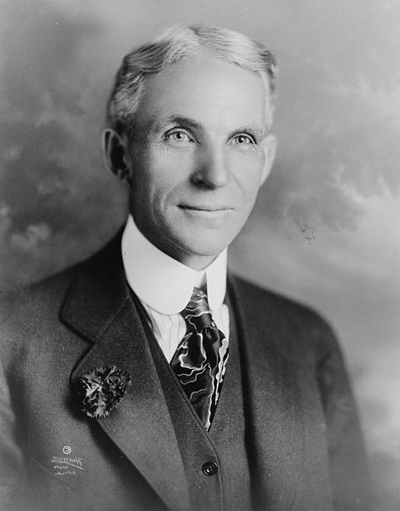
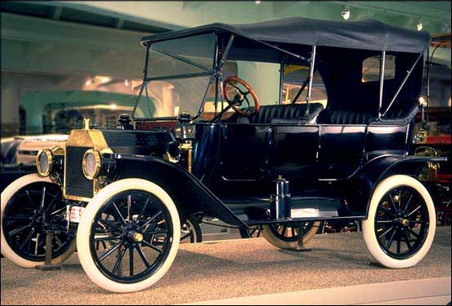
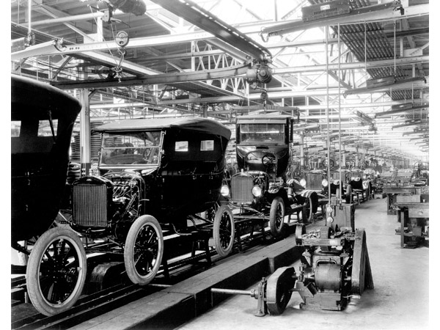
Henry Ford
Built the Model T (1905)
First car many Americans could afford
Introduced the assembly line and increased production
Cost $300
Millions of cars produced during the 20’s

Slide 24
Warm Up:
Get out your guided notes and be ready to finish.

Slide 25
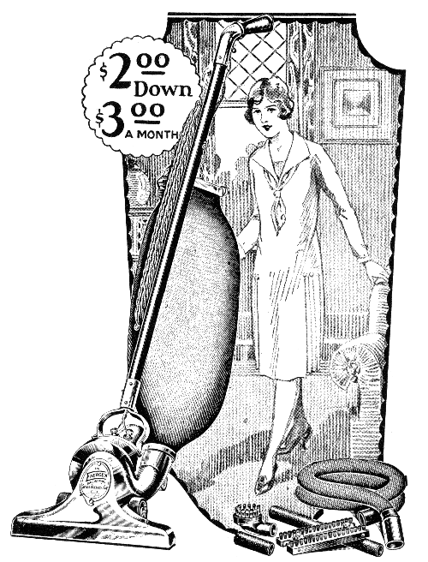
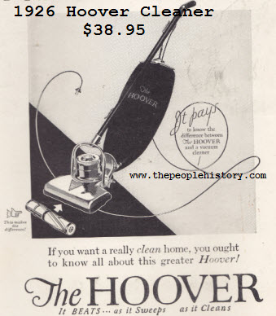
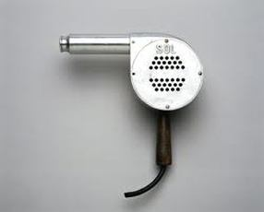
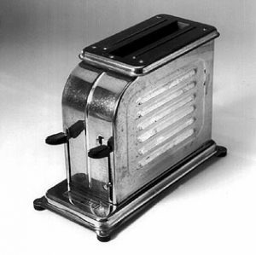
Materialism
Many new items Americans just HAD to have: vacuum cleaners, electric fans, toasters, washing machines and many other luxury items were now available
Women had more leisure time to spend with friends

Slide 26
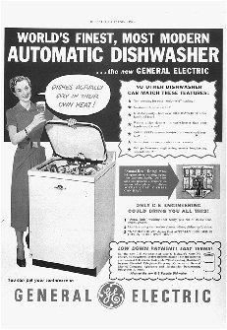
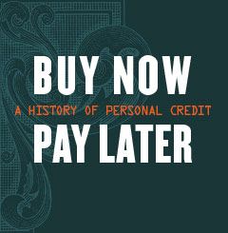
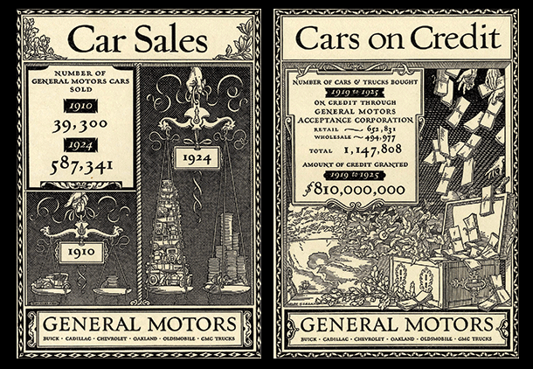
Mass Consumption
Advertisement increased demand, workers had higher wages and more leisure time
Buying on Credit became popular
Ppl bought what they couldn’t afford = debt, no savings
Shares in the Stock Market grew
Farmers and railroad workers were still poor (bc of WWI effects)

Slide 27
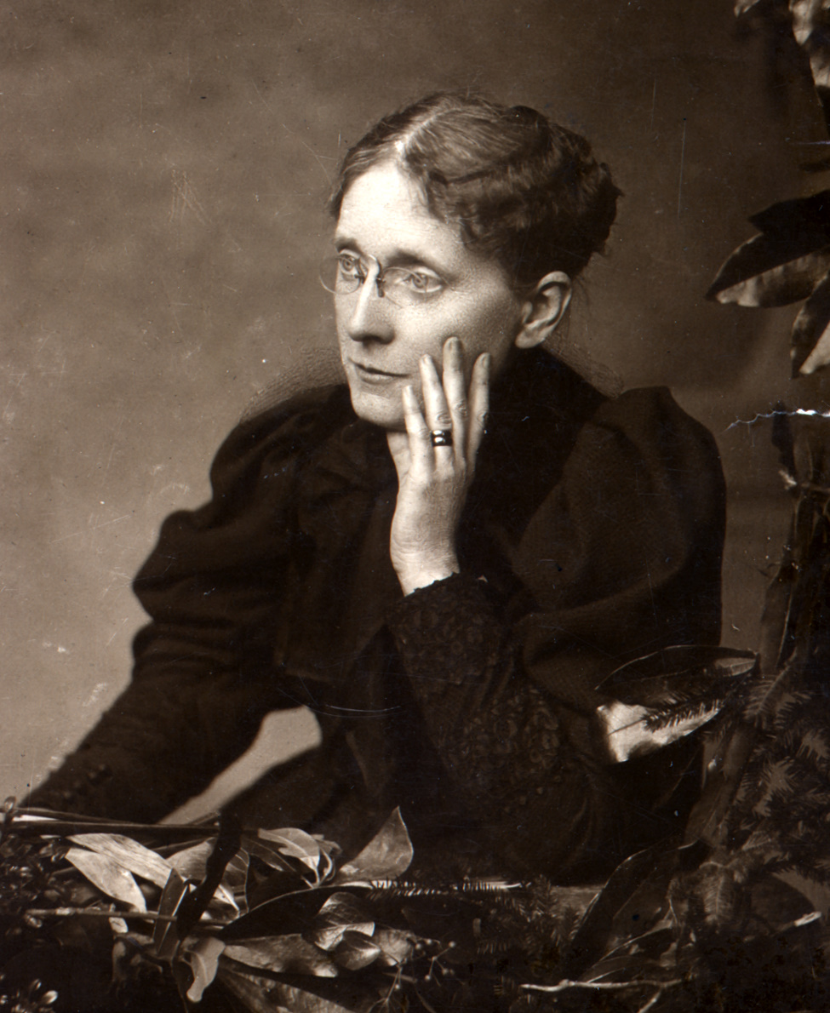
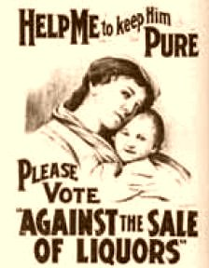
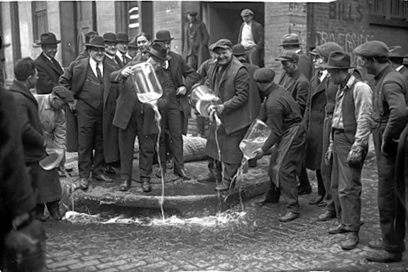
Prohibition
Would protect families from the effects of alcohol abuse
Frances Willard
President of the National Women’s Temperance Union
Created enough pressure to persuade states to ratify the 18th Amendment (1919)- banned the sale of alcohol
Opposition- it forced beliefs on others, ppl lost jobs, crime increased
21st Amendment- repealed prohibition

Slide 28
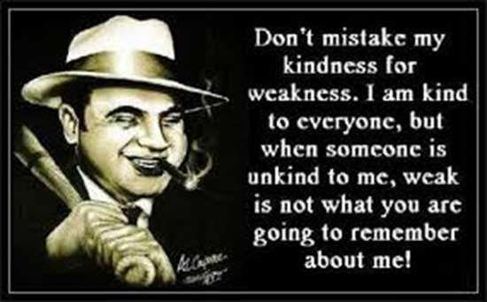
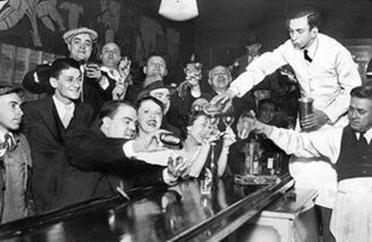
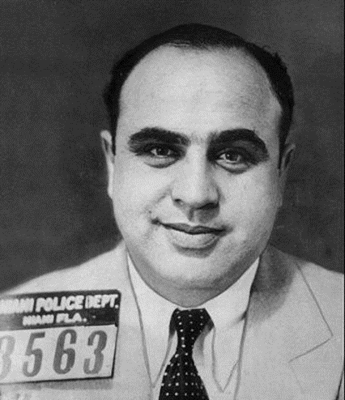
Organized Crime
Prohibition led to the growth of organized crime and speakeasies, which supplied illegal alcohol to willing consumers.
Al Capone (Scarface) led a crime syndicate in Chicago. Despite his occupation, Capone became a public figure. He donated to charity using the money he made from his crimes.
Despite being linked to several murders, Capone was eventually arrested for tax evasion. He spent time at Alcatraz before eventually succumbing to syphilis.

Slide 29
EUGENICS
Belief that the human race could be improved by breeding- light skin, blonde hair, blue eyes
Charles Davenport- prevent the mentally ill from having children & mental illness will decrease

Slide 30
New American Values
Flappers
More women went to college & worked = became more independent
Changed manners and morals
Tin Pan Alley
Area in NYC where jazz became US pop music

Slide 31
The Harlem Renaissance
The Jazz Age- new Af. Am. music and culture
Langston Hughes
One of America’s best poets
Expressed new mood of determination to overcome racial prejudice
Marcus Garvey
“Back to Africa Movement”- return to Africa, especially Liberia, bc of racism in US

Slide 32
Warm Up:
Get your movie questions ready to go.

Slide 33
Crash Course:
http://www.youtube.com/watch?v=VfOR1XCMf7A&list=PL8dPuuaLjXtMwmepBjTSG593eG7ObzO7s&index=34
Give me 10 facts about the 1920’s

Slide 34
Warm Up:
Which factor played the largest role in fueling the economic boom of the 1920s?
Government subsidies paid to farmers
Tariff reductions on imported European goods
The increasing ownership of automobiles by families
Construction by the Tennessee Valley Authority (TVA)
Which event represented an expression of nativism during the 1920s?
Trial of John Scopes for teaching evolution
Adoption of a quota system to limit immigration
Charles Lindbergh’s solo transatlantic flight
The rise in popularity of spectator sports

Slide 35
Warm Up:
Pick up your 1920’s Station Activity packet and get your movie questions out and ready to go.
We will finish the movie questions and turn them in.
In the meantime; would you like to help an Angel?
I have picked up two Angels from the Angel tree.
Last year my students raised over $100 so they could have a wonderful Christmas!
If you would like to donate, I’ll take the money and put it in a donation cup.
You have until December 5th to donate money.

Slide 36
1920’s Station Activity: 1. Grab a packet and get started filling it out. 2. There are 8 stations. 3. Write the underlined part of the notes and answer the questions (you do not have to write the questions). 4. Contrary to what it says, this is not a major grade. You will be getting two daily grades for this. 5. This is due tomorrow by the end of class!!!!!

Slide 37
1920’s Newspaper Cover Page Project
The Newspaper Title
This main article should be about one of the topics from the stations you visited and should take up this whole space.
1st Edition Date in 1920’s Cost
Each article should have a picture and your paper should be neat and organized. It’ll be part of your grade!
MAIN ARTICLE HEADLINE HERE
Main Article Picture
This third article should be about a person from the time period. Use pgs 175-190 in the book. Your options:
A. Mitchell Palmer John Scopes
Sacco & Vanzetti Frances Willard
Warren Harding F. Scott Fitzgerald
Calvin Coolidge Langston Hughes
Herbert Hoover Marcus Garvey
Glenn Curtiss Charles Lindbergh
Henry Ford Al Capone
Babe Ruth Charles Davenport
The 2nd article should either support the main article OR it can be about another topic from one of your stations.
2nd Article Title Here
3rd Article Title Here
2nd Pic
3rd Pic

Slide 38
Warm Up:
Finish the 1920’s station activity.
When you’re done, grab a book discovery and get started.
Use the Jarrett book. (The brown one under your desk, Natalie.)
These will be due tomorrow.

Slide 39
Warm Up:
Get out or grab your book discoveries.
Use the Jarrett book (brown book under your desk) to complete this assignment.
It is due by the end of class.

