Slide 1
Urbanization Activity
Everyone needs:
A large blank piece of paper
A pencil
A good eraser
Also, I need a timekeeper.

Slide 2
Urbanization Activity
You have until I finish reading the prompt to draw the following:
River going East to west Across your paper (About 1 inch wide)
Wooden bridge across river
4 roads coming from each direction and connecting in the middle
Two farms
Trees (as many as you can draw)

Slide 3
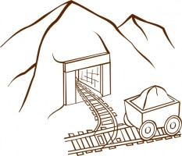
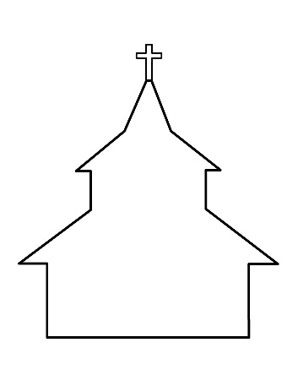
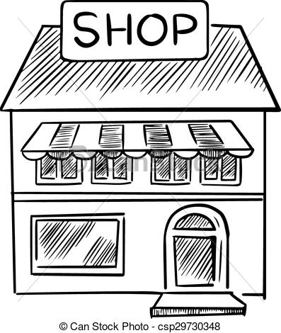
Urbanization Activity
Round 0 (5 mins)
10 houses
1 church
1 cemetery
1 store
1 pub
1 coalmine
*Attention: All buildings must be along a road, river, or railroad.

Slide 4
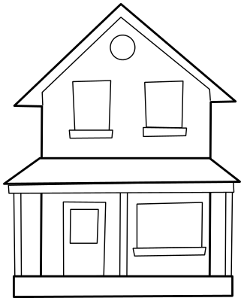
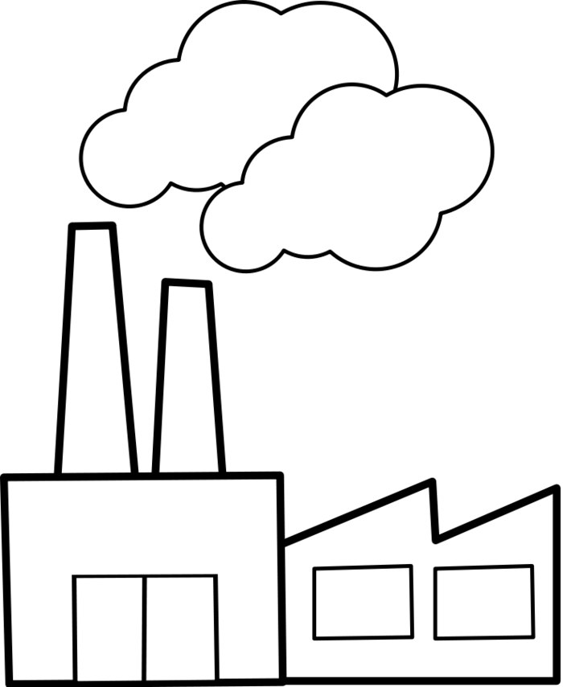
Urbanization Activity
Round 1 (45 seconds)
1 Factory
1 Nice House

Slide 5
Urbanization Activity
Round 2 (45 seconds)
5 houses

Slide 6
Urbanization Activity
Round 3 (45 seconds)
5 tenements (apartments)

Slide 7
Urbanization Activity
Round 4 (2:05 mins)
1 railroad line
5 more factories

Slide 8
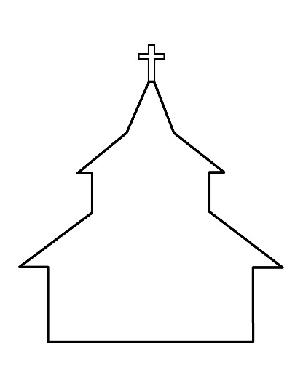
Urbanization Activity
Round 5 (2:05 mins)
1 store
1 pub
1 church
1 school

Slide 9
Urbanization Activity
Round 6 (2:00 mins)
2 pubs

Slide 10
Urbanization Activity
Round 7 (1:55 mins)
2 nice homes

Slide 11
Urbanization Activity
Round 8 (1:40 min)
1 cemetery

Slide 12
Urbanization Activity
Round 9 (1:30 min)
1 jail
2 pubs

Slide 13
Urbanization Activity
Round 10 (1:25 min)
20 street lamps

Slide 14
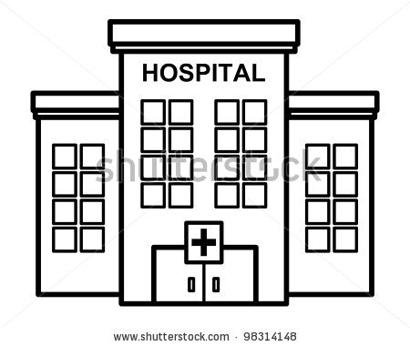
Urbanization Activity
Round 11(1:20 min)
2 Hospitals
1 cemetery

Slide 15
Urbanization Activity
Round 12 (1:15 min)
1 railroad line

Slide 16
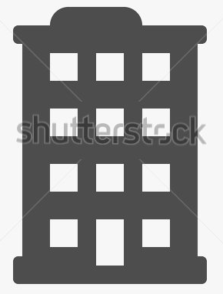
Urbanization Activity
Round 13 (1:10 min)
20 houses
5 tenements (apartments)
2 stores
1 church
5 factories
1 pub
1 nice house

Slide 17
Urbanization Activity
Round 14 (1:05 min)
2 theatres
2 schools

Slide 18
Urbanization Activity
Round 15 (1:00min)
1 cemetery
1 jail
1 hospital

Slide 19
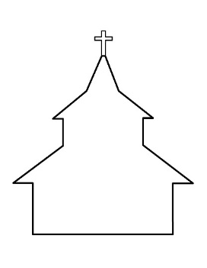
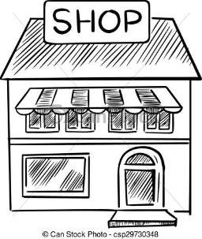
How’d you do?
You should have the following
Houses - 35
Nice homes – 3
Churches – 3
Cemeteries – 4
Stores – 4
Pubs – 7
Coal Mine – 1
Factories – 11
Tenements – 10
Railroad lines – 2
Roads – 4
Schools – 3
Hospitals – 3
Jails – 2
Theatres – 2
Lamp posts - 20

Slide 20
When You’re Done
On the back of your map answer the following questions:
How did you feel during the activity?
How organized is your city? Explain.
Would you do it differently if given the chance? Explain.

