Slide 1
Warm Up:
Create a new section in your notebook & label it “The 1970’s and 1980’s”

Slide 2
Unit 13: The 1970’s and 1980’s
Essential Questions:
How does a public figure lose or restore a nation's trust?
How did American foreign policy influence international events?
What were the effects of the conservative resurgence in America?
Picture Ideas:
Oil
Middle East
Women’s Rights
Environment
Money (Gold Standard)
Scandal or lies
Stopping Arms Race
Communism
Key Vocabulary Terms:
New Federalism OPEC
Conservativism Watergate
EPA Detente
Energy Crisis Stagflation
Camp David Accords
Moral Majority
Reagonomics
Iran-Contra Affair
Deregulation
Strategic Defense Initiative

Slide 3
Write the following titles on 2 separate pages in your notebooks, skip a line between each of them:
Defining Moments of the 1980s:
10. Yuppies
9. Cable TV
8. HIV/AIDS
7. Space Program
6. War on Drugs
5. Relations in Iran
4. Reaganomics
3. Electronics
2. Pollution
1. End of Cold War
Defining Moments of the 1970s:
10. Disco
9. Civil Rights & Sports
8. Star Wars
7. Earth Day
6. Pentagon Papers & Saigon
5. Computers
4. Roe v. Wade
3. Energy Crisis
2. Open Door to China
1. Watergate

Slide 4
The Nixon Presidency
1969-1974

Slide 5
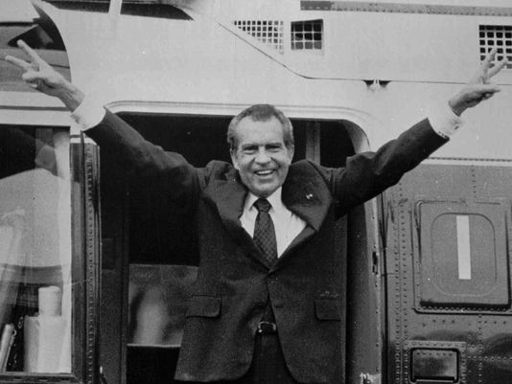
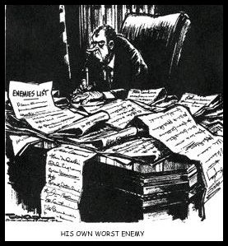
The Imperial Presidency
Idea that the President’s power was growing:
  Radio and TV increased appeal
  Relied on their own advisors instead of approved Cabinet members
Reached its peak under Nixon
  Used public funds to remodel private homes
  Used CIA/FBI to get political enemy info
  Refused to spend funds approved by Congress

Slide 6
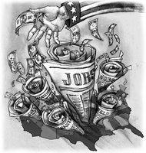
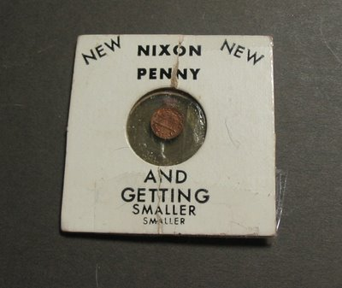
Domestic Policy
Was a conservative
Believed in revenue sharing- giving federal funds to state and local govts so they could decide how to spend them
Was unsuccessful with inflation
  Cut spending on social programs & took US off the gold standard- didn’t work

Slide 7
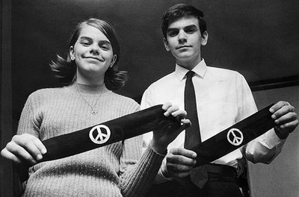
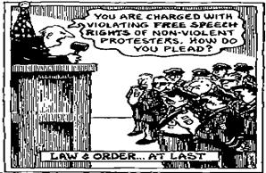

1st Amendment rights under Nixon:
  Tinker v. Des Moines (1969)
    Tinker was suspended from school for wearing black armbands to protest the Vietnam War
    SC ruled it a 1st Am. Rights violation & said students can wear arm bands
  Wisconsin v. Yoder (1972)
    SC struck down a Wisconsin state law that required Amish children to attend school beyond 8th grade
    Violated freedom of religion

Slide 8


The Environmental Protection Agency (EPA)
Sets air and water pollution standards for cities and monitors and enforces them
Endangered Species Act (1973)
  Law that requires the Fish and Wildlife Service to list species of plants and animals that are threatened with extinction & protect them

Slide 9
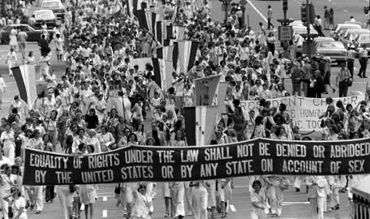
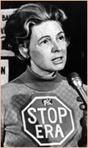
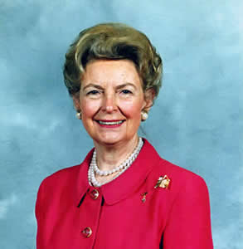
The Equal Rights Amendment (ERA)
Equal rights not denied on account of sex
1972- amendment approved by Congress, never ratified by the states
Phyllis Schlafly
  Against the ERA
  Believed it would reduce the rights of wives & harm family life
    Led to unisex restrooms & required combat roles

Slide 10
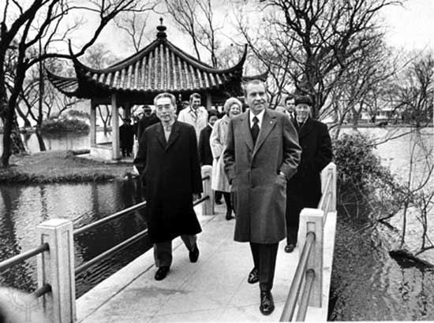
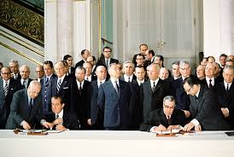
Foreign Policy
Two great successes:
  Opening diplomatic relations with Communist China
  Beginning a détente with the Soviet Union
    A relaxing of tensions
    SALT (Strategic Arms Limitation Talks)- agreement to limit the development of defensive missile systems

Slide 11
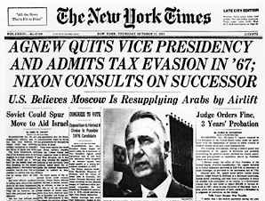
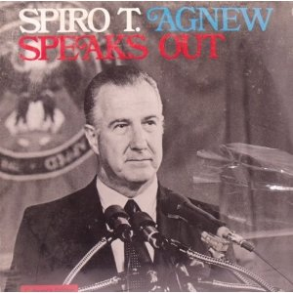
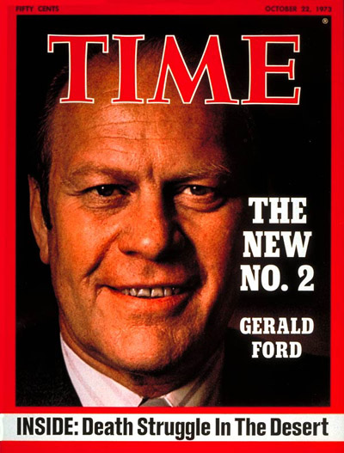
Problems with the Vice Pres.
VP Spiro Agnew
  Resigned after it was revealed that he took bribes while serving as Gov. of Maryland
Under the 25th Amendment, Nixon appointed Gerald Ford- Michigan Congressman- as new VP

Slide 12
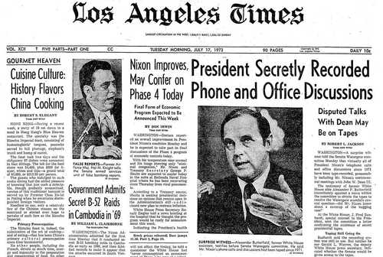
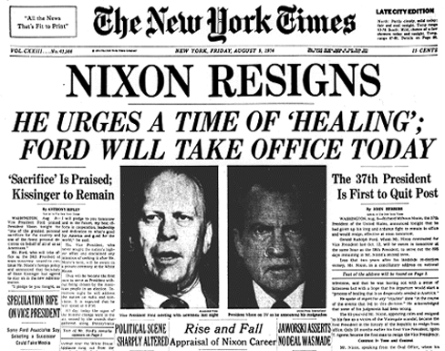
Nixon’s Resignation:
The Watergate Scandal:
A group of former CIA agents working to re-elect Nixon were caught breaking into the Democratic Party Headquarters.
The press found out and connected it to Nixon.
Nixon denied any connection and refused to hand over tapes of his conversations in the Oval Office claiming “executive privilege”.
In US v. Nixon the court ruled that no one is above the law and Nixon resigned to avoid impeachment

Slide 13
Warm Up:
Answer in your notes:
  Why was President Nixon’s visit to Communist China in 1972 so important?

Slide 14
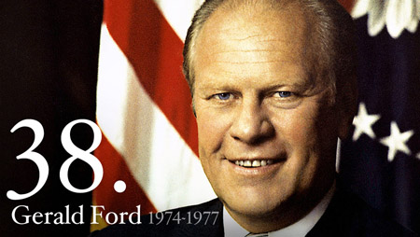
The Ford Administration:
1974-1977

Slide 15
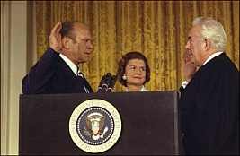
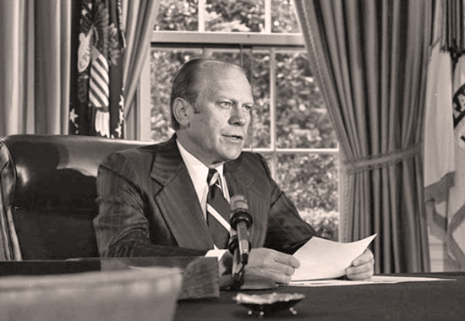
Ford Pardons Nixon:
Upon taking office, Ford pardoned Nixon from all charges.
Many people criticized him, but he said “forgiveness is one of the roots of American tradition…It was the state of the country’s health at home and around the world that worried me.”

Slide 16
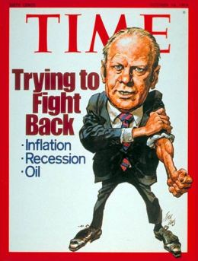
Continuing Stagflation:
Inflation = rising prices.
Economists thought it was good for economic growth because jobs = pay raises = high prices.
But now, Americans suffered from stagflation- high unemployment combined with inflation.

Slide 17
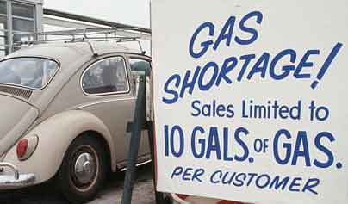
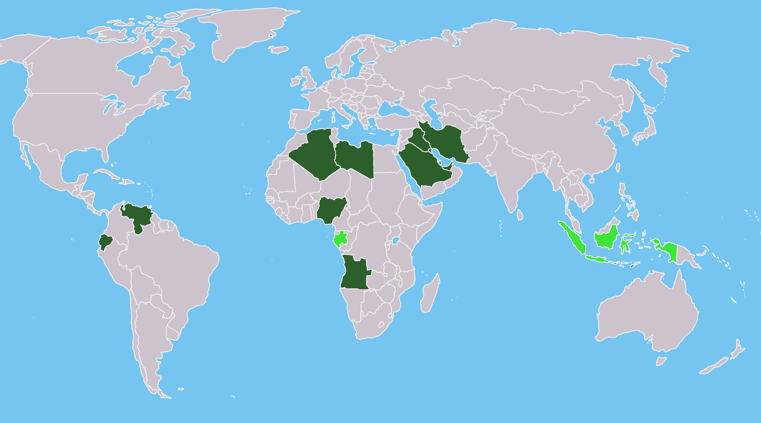
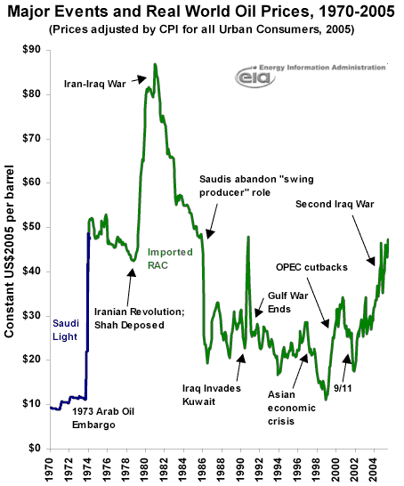
OPEC
Organization of Petroleum Exporting Countries
Formed by oil-producing countries in 1960.
In 1973, Arab nations of OPEC used oil as a political weapon with an oil embargo on the US and Western Europe for supporting Israel.
Prices shot up and heavily impacted Americans who used oil for gas, heat, food and electricity.

Slide 18
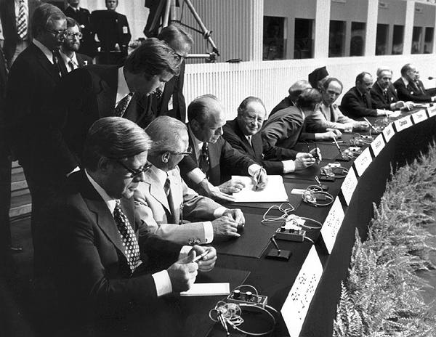
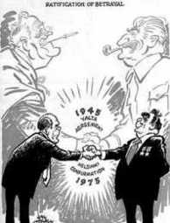
Helsinki Accords:
Ford continued the détente with the Soviet Union.
In 1975, the US and other nations signed this agreement recognizing borders and promising human rights.

Slide 19
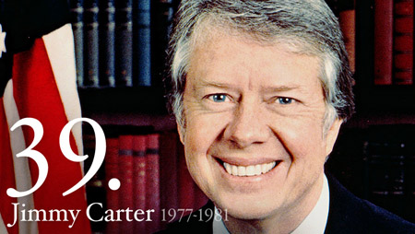
The Carter Administration
1977-1981

Slide 20
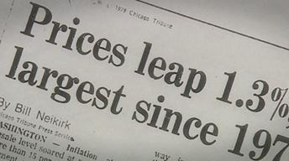
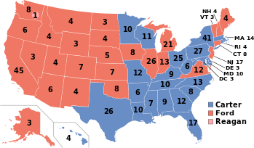
Carter Becomes President
Carter was a democrat from Georgia and was elected as an “outsider” who promised to “clean up” Washington.
The biggest problem was the economy.
  Prices were 10% higher every year
  Interest rates had risen to 20%
  Unemployment remained high

Slide 21
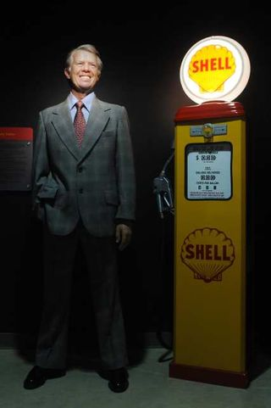
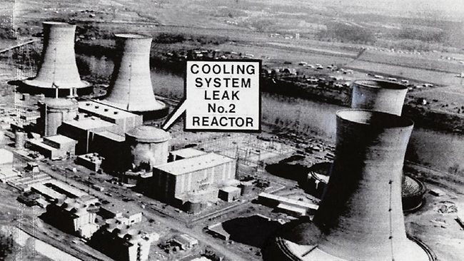
Carter’s Domestic Program
Department of Energy
  Increased “Strategic Petroleum Reserve”
He was denied a tax on large cars and rationing gas
Environment
  Clean up toxic dump sites
  Three Mile Island nuclear reactor accident
Nuclear Regulatory Commission for peaceful energy

Slide 22
Warm Up:
Answer in your notes:
What event most likely caused the most rapid and deepest decline in public trust in government?

Slide 23
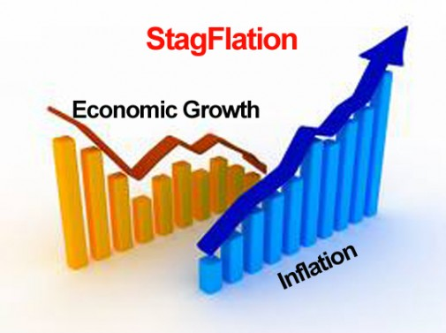
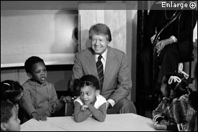
Carter’s Domestic Program Cont.
Stagflation
  Cut federal spending, but it did not help until Reagan was in office
Diversity
  Women and minorities in public office
  ESL programs

Slide 24


Community Reinvestment Act
Required banks to lend credit to poor communities trying to stop the decay of low-income neighborhoods in inner cities.

Slide 25
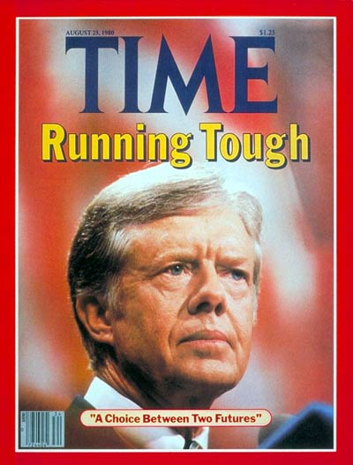
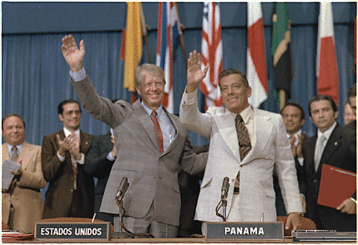
Foreign Policy
Panama Canal Treaty 1977
  Returned control of all of the Canal Zone, except for the canal itself, to Panama
  US agreed to turn over the canal by the end of the century

Slide 26
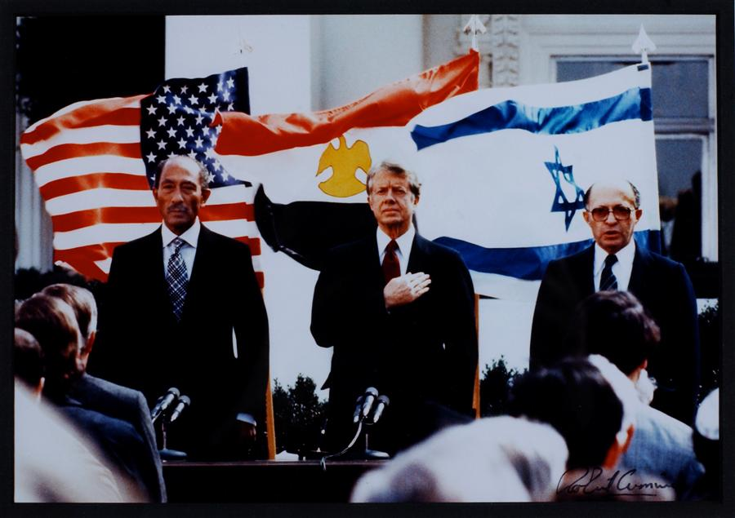
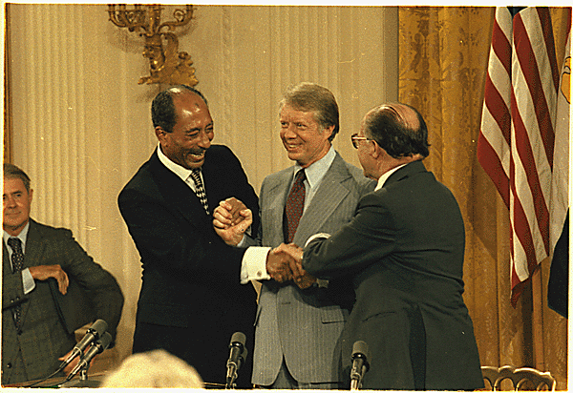
Camp David Accords, 1977
The US had been supporting Israel since its creation after WWII
Egypt and Israel had been fighting a series of wars since 1948
Carter held a meeting at Camp David to negotiate a peace treaty between Anwar Sadat (Egypt) and Menachem Begin (Israel) ending years of war
Palestinians in Israel were ignored in the treaty, but Sadat and Begin won the Nobel Peace Prize

Slide 27

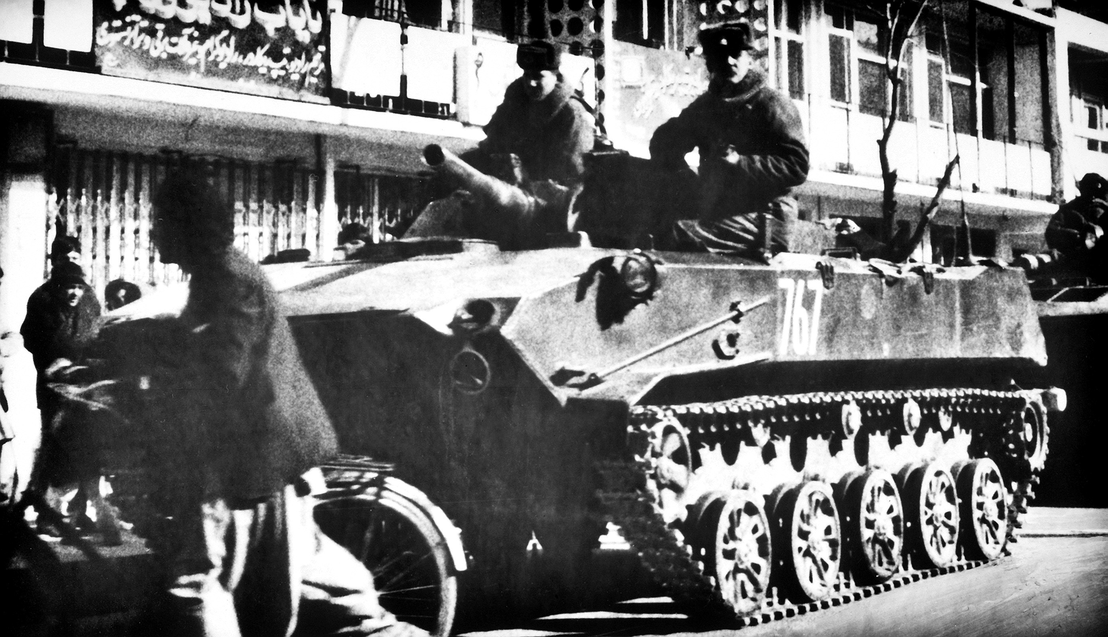
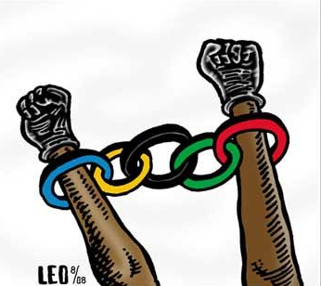
US-Soviet Relations
Carter continued the détente
1979 Soviet Union invaded Afghanistan, temporarily ending the détente
Carter boycotted the Olympics held in Moscow in 1980
A new arms control agreement- SALT II -was called off

Slide 28
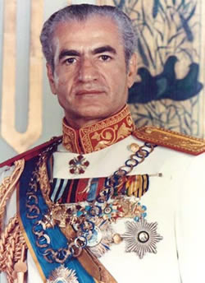
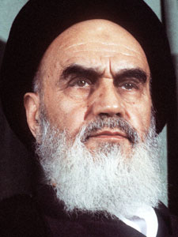
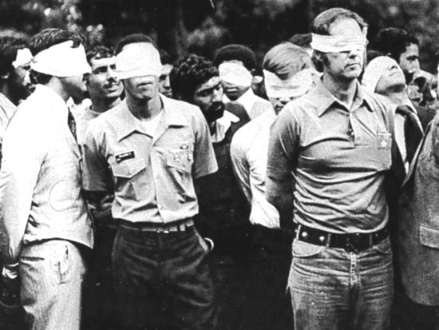
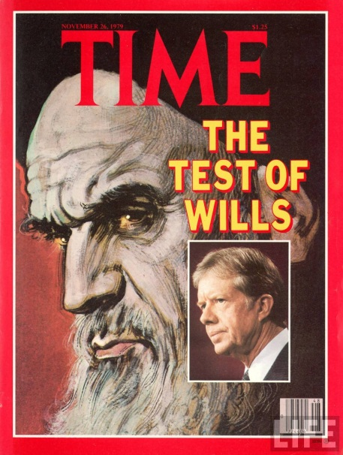
Iran Hostage Crisis
Shah Pahlavi- dictator of Iran
  Ally of US
  Promised his ppl freedoms but didn’t follow through
  Fled the country bc violence broke out
Ayatollah Khomeini took control- hostile to US
Shah came to US for medical aid so angry Iranians seized the staff of the US embassy
Held hostage for a year
Pahlavi
Khomeini

Slide 29
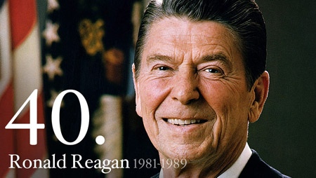
The Reagan Presidency
1981-1989
https://www.youtube.com/watch?v=551SIWucydQ

Slide 30
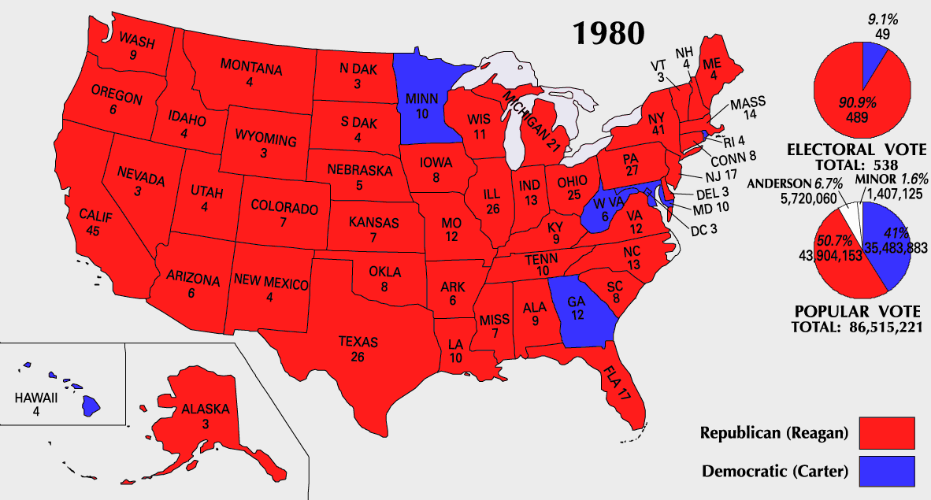
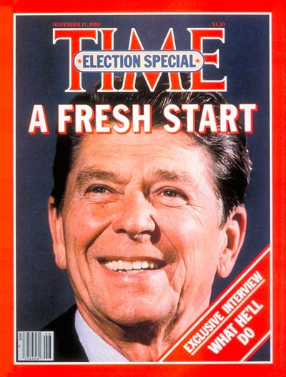
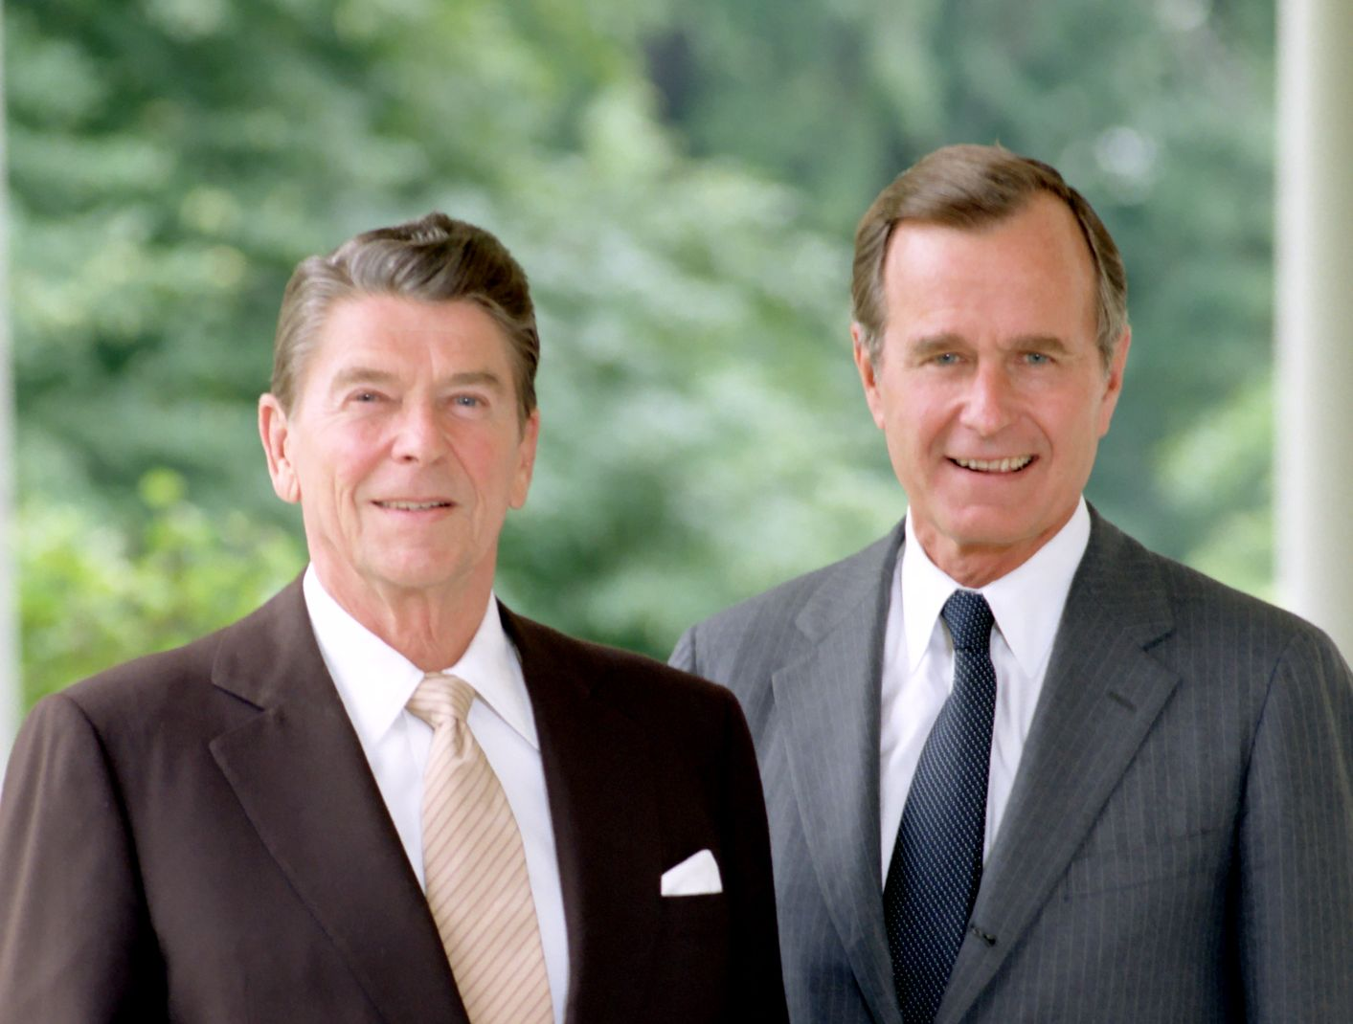
Shift to Conservatism
Originally a Democrat, but grew more conservative
Picked George HW Bush as his running mate for 1980 election

Slide 31

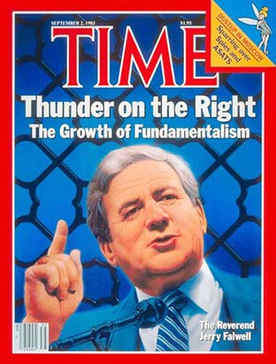
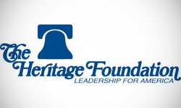
New Conservatism
National Rifle Association
  Became a conservative political group after the Gun Control Act of 1968
  1st Pres endorsed was Reagan
The Moral Majority
  Fundamentalist Christian group led by Rev. Jerry Falwell to help get Reagan elected
Heritage Foundation
  Conservative group that tries to influence legislators on various bills

Slide 32
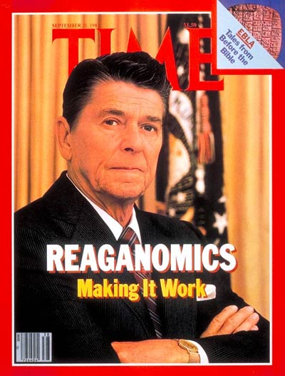
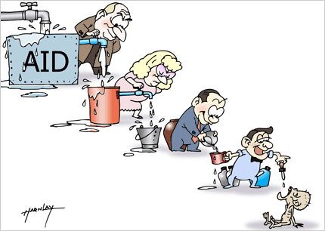
Reaganomics
Reagan’s main problem was stagflation
Solution = “supply-side economics”
  Reduced taxes and business regulations = easier to produce goods = more goods would drive down prices & stop inflation
  1983- economy began to come out of recession
Tax cuts, deregulation on industry, military spending, & oil from Alaska helped

Slide 33

Federal Deficit
$ that the govt spends beyond what it collects in taxes
Military spending doubled the national debt
Trade Imbalance
  Americans bought more than sold overseas
  Led to job losses, closing of steel mills and auto plants & decrease in disposable income

Slide 34


Immigration Policy
Mazzoli-Simpson Act (1986)
  Legalized illegal aliens who had lived continuously in the US since 1981

Slide 35


Sandra Day O’Connor
1981- 1st female Justice on the Supreme Court
Nominated by Reagan

Slide 36



The Reagan Doctrine
US would not limit itself to the containment of Communist, but attempt to “roll-back” by aiding anti-Communists
Peace through Strength policy
  Best way to prevent war was to make US enemies think US would stop aggression with war
  Star Wars- the Strategic Defense Initiative for an anti-ballistic defense system

Slide 37


War on Terrorism
1982- Israeli forces invaded Lebanon
  Lebanon requested US Marines to restore order
1983- a suicide bomber attacked the American barracks in Lebanon, 241 killed
Reagan withdrew forces bc he would not negotiate with terrorists

Slide 38


The Iran-Contra Affair
Reagan officials secretly sold weapons to Iran for the release of American hostages in Lebanon
Profits from the sale of weapons supported anti-Comm. “Contra” rebels fighting the Comm. govt of Nicaragua
  Support prohibited by Congress
Shocked Americans bc Iran was a supporter of terrorism

Slide 39


End of the Cold War
Mikhail Gorbachev came into power & introduce reforms to the USSR
Reagan & Gorbachev signed an agreement dismantling thousands of nuclear missiles

